Slide 1
Moebius DW Fermions
&
Ward-Takahashi identities*
Richard C. Brower
Brookhaven Nat’l Lab. Ides of March, 2007
*RCB, Hartmut Neff and Kostas Orginos
hep-lat/0409118 & hep-lat/0703XXX
Notes:
Lectures:
Ancient Lore
Before QCD
String theory was discovered before QCD Why?
Field theory appeared to fail 3 out 4 time:
Maybe Hadronic and Gravity needs a new approach
Nuclear Democracy and search for small parameter
Regge and Dolan-Horn-Schmid Duality
The Pion amplitude and Chiral L
After QCD
1/N is string theory: weak and strong coupling
Super strings & Failure of the QCD string.
String/Gauge Duality
AdS/CFT Maldacena conjecture
Dbranes and the strong coupling (gravity) limit
Breaking Conformal and SUSY
Deconfinement and Confinement
Hard vs Soft Scattering
Regge/Large Angles/DIS
Non-perturbative Physics in the 5th dimension
Finite T
Instantons/
Quarks/Baryons
Friossart Bound.
QCD String Spectrum vs. Lattice Data
Glueball Spectra:
M theory Spectra at strong coupling
Comparison with Bag and Lattice Spectra
Stretched String
Luscher term and corrections
Seeing the 5th dimension
Lattice sees the QCD string

Slide 2
Need to implement Overlap Operator
(aka Ginsparg Wilson Relation)
Two steps
Algorithm: Choose Rational approx:
ε_{L}[x] ' x/|x|
Physics: Choose 4-d “kernel”:
H ´ γ₅ D(M₅)

Slide 3
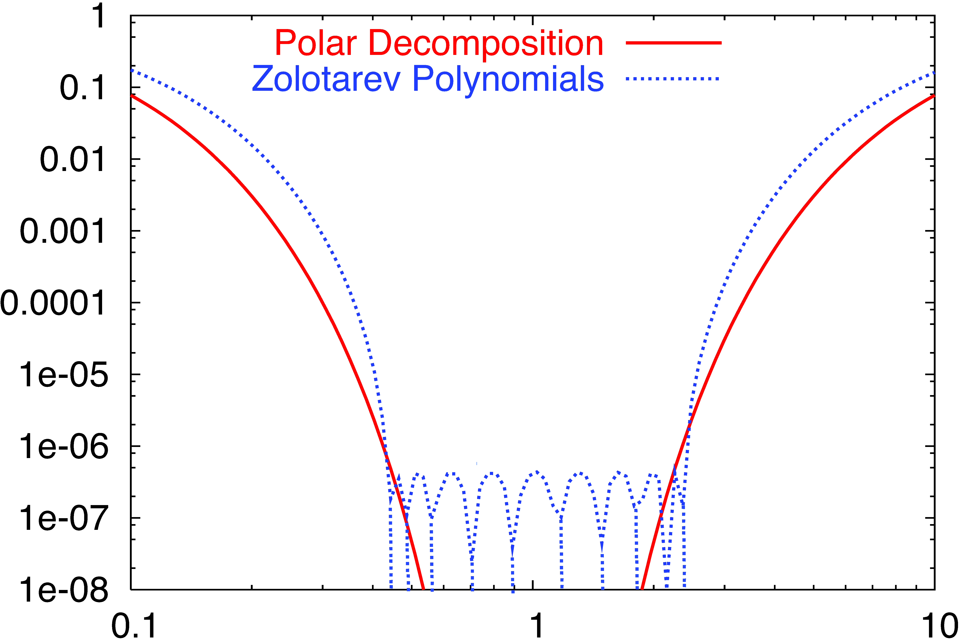
|1− ε_{L}[x]| at L_{s} = 16 (polar) vs 8 (Zolotarev)

Slide 4
Mobius generalization of Shamir/Borici
s = 1
s = 2
s = 3
s = L_s
x + μ
D₊
D₋
D₋
x
x - μ
Shamir: b₅ = a₅, c₅ = 0
Borici: b₅ = c₅ = a₅

Slide 5
Modified Even/Odd ➔4-d Checkerboard
s = 1
s = 2
s = 3
s = L_s
x + μ
a₅
b₅
b₅
x
1-γ₅
1+γ₅
x - μ

Slide 6
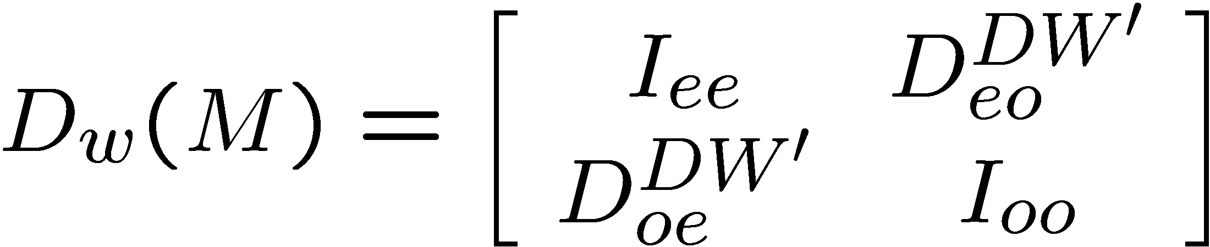
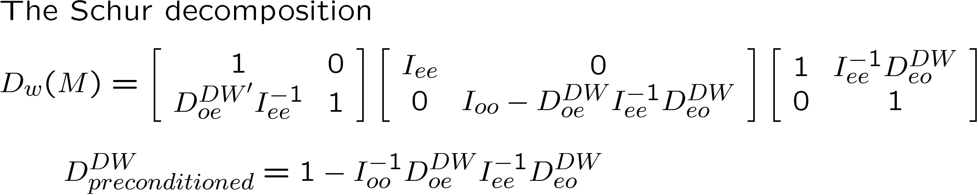
Even/Odd Partition of Matrix
I_{ee} and I_{oo} SHOULD be simple to invert
On 16³ x 32, β = 6.0 lattice
For Shamir: Both 4-d & 5-d Even/Odd give » 2.7 speed up.
For Borici/Moebius: Even/Odd gives » 2.7 speed up

Slide 7
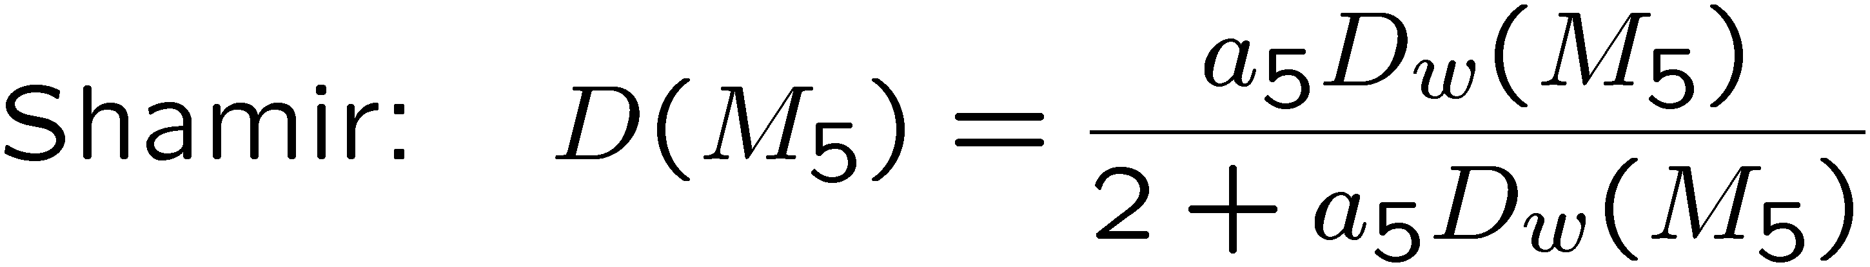
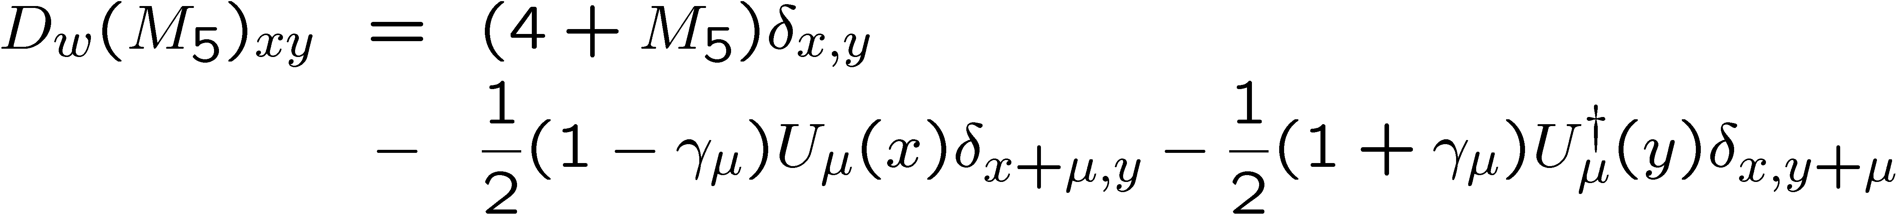
DW Construction: Shamir vs Borici

Slide 8
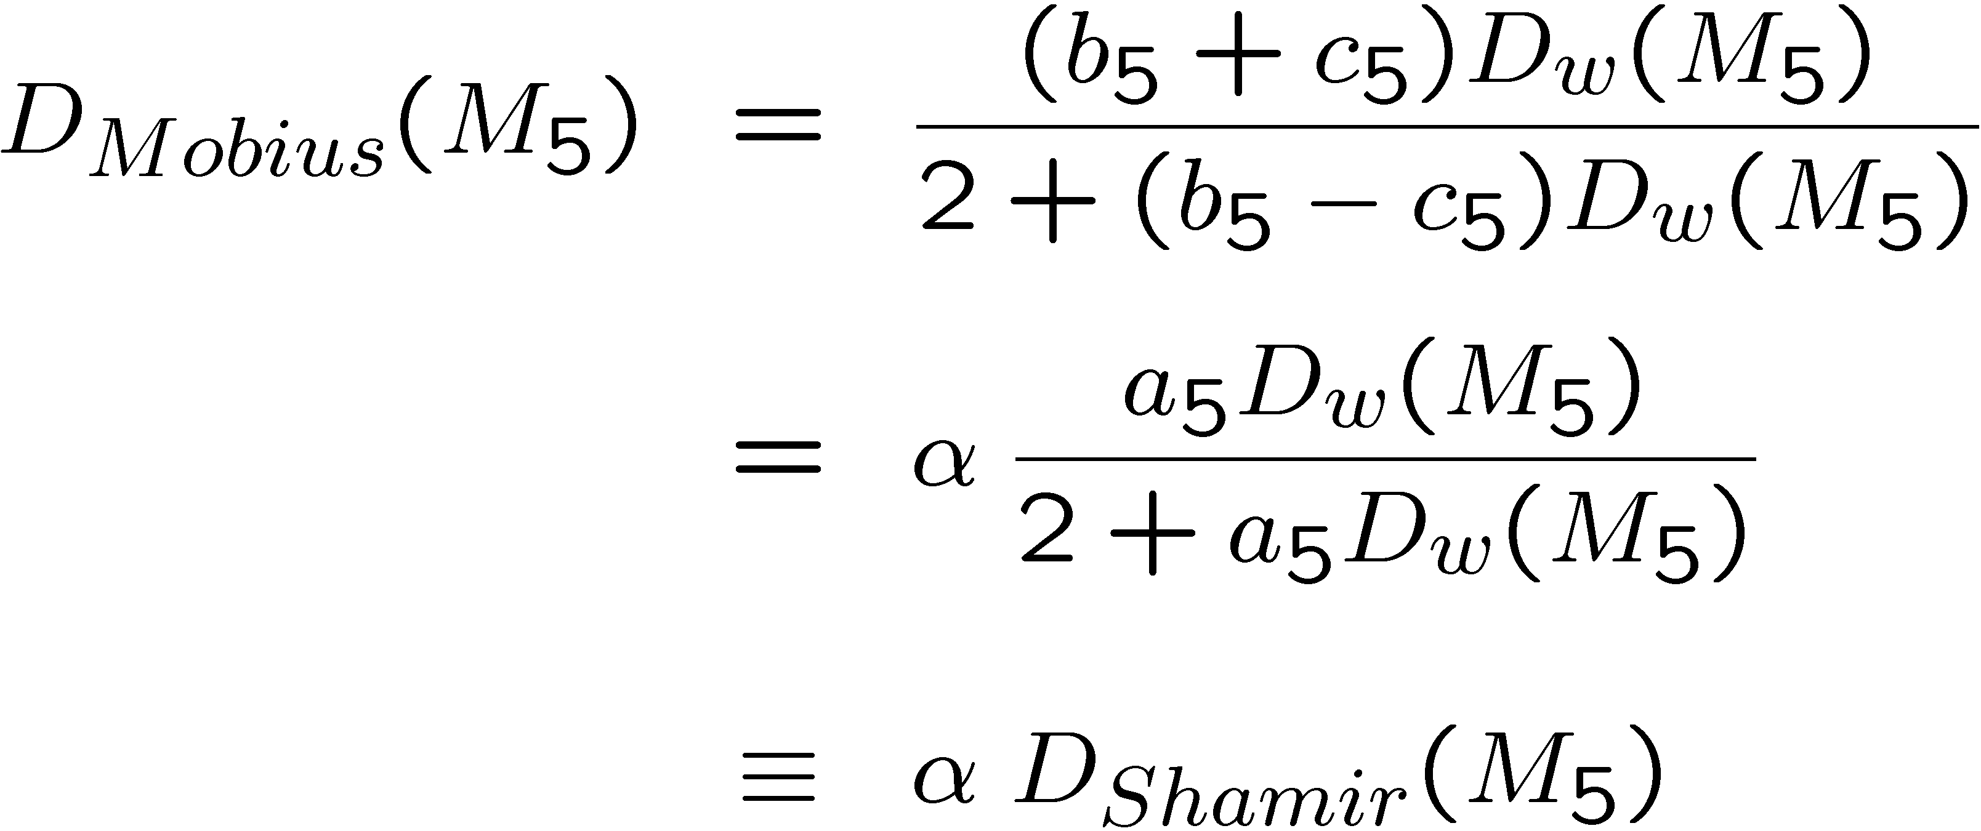
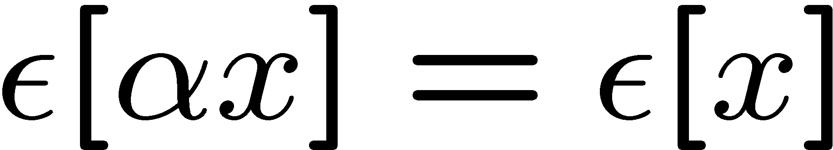
Moebius Generalization
Since
Moebius is an new (scaled) polar algorithm
Parameters: M₅ , a₅ = b₅ – c₅ and scale: a = b₅ + c₅

Slide 9
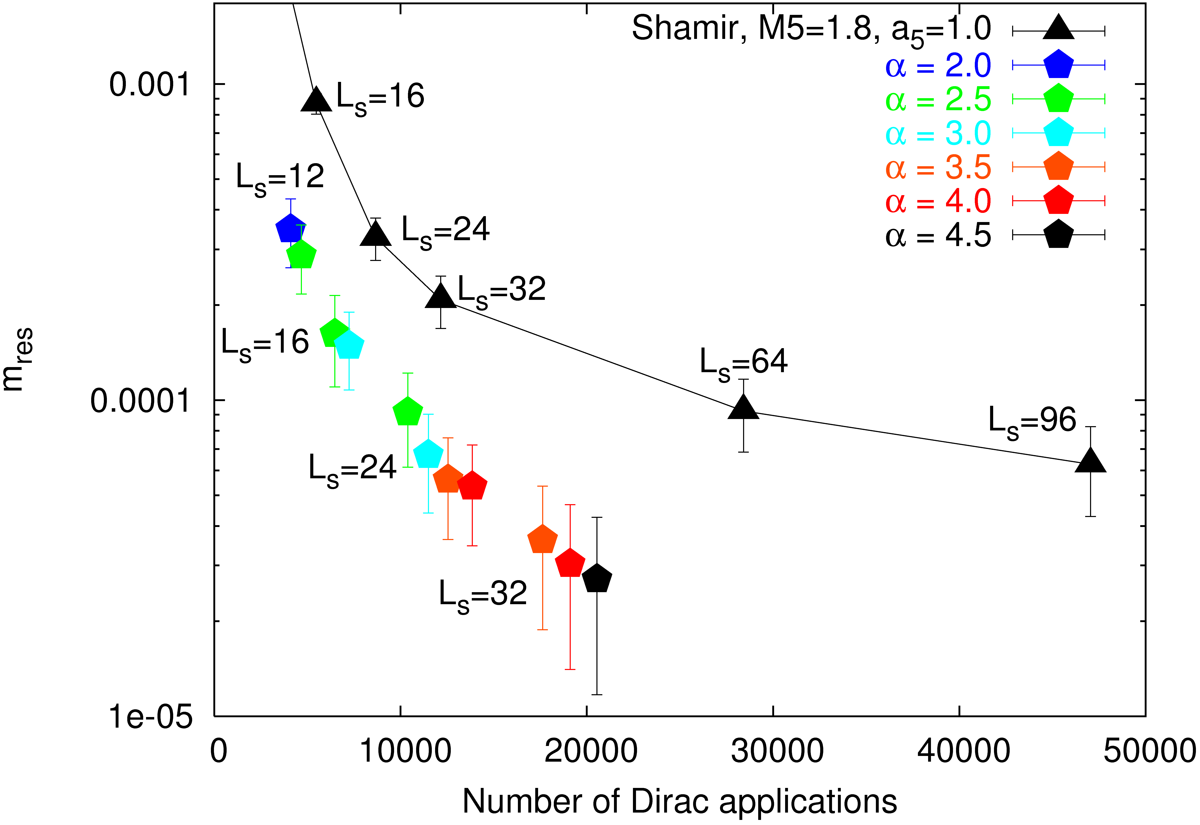
16³ x 32 Gauge Lattice @ β = 6 & m_{π} = 0.44

Slide 10
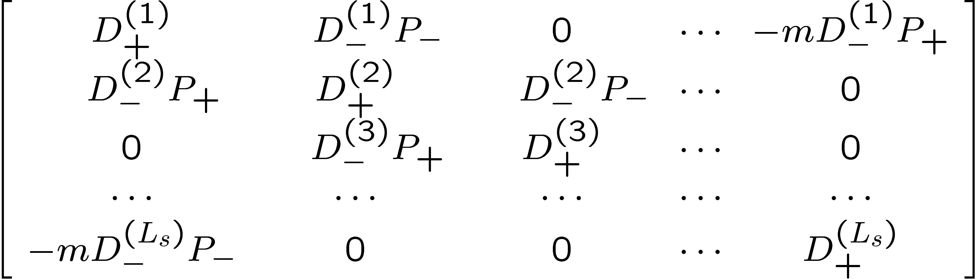
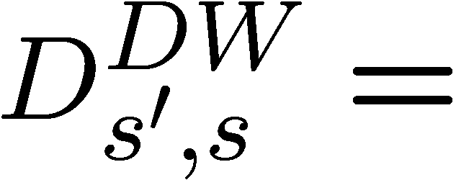
Domain Wall Implementation
L_{s} £ L_{s} DW Matrix:
( need s dependence for Chiu’s Zolotarev:
b₅(s) + c₅(s) = ω(s), b₅(s) – c₅(s) = a₅)

Slide 11
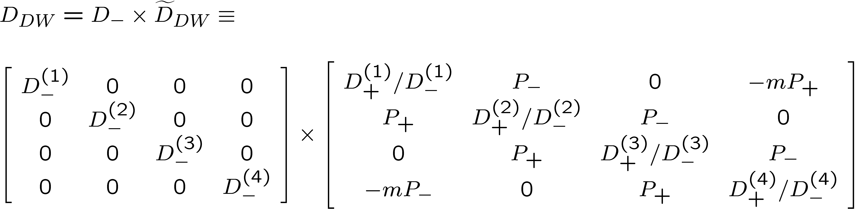
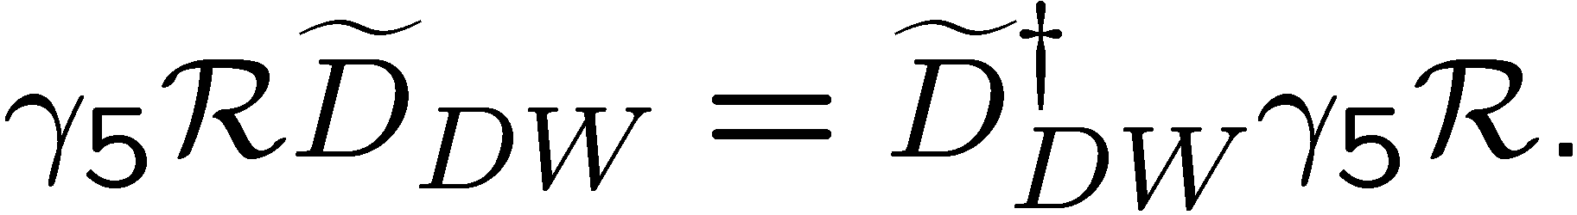
Generalized γ₅ Hermiticity and All That
To get all the nice identities for Borici, Chiu and Mobius

Slide 12
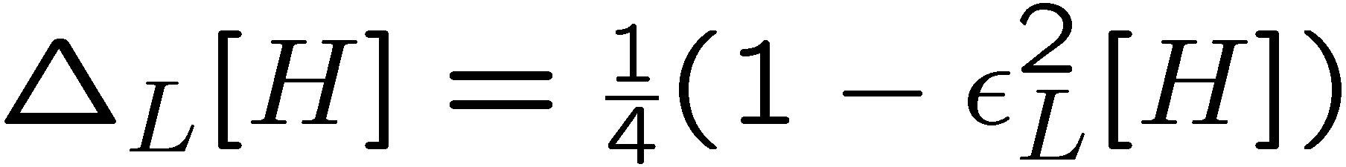
G-W error operator:
Chiral violation for Overlap Action (Kikukawa & Noguchi hep-lat/9902022)

Slide 13
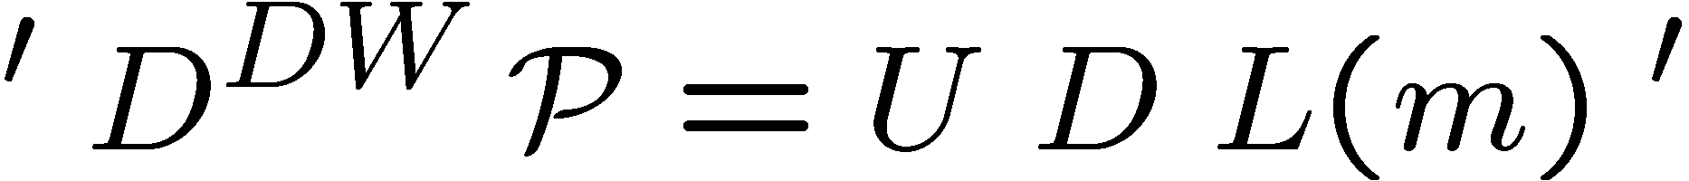
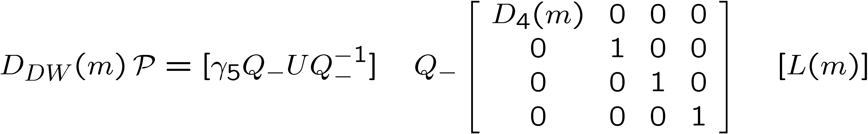
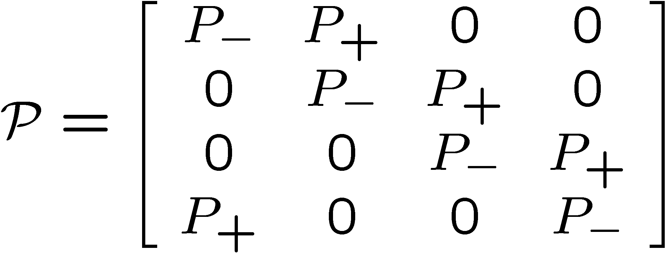
Edwards & Heller use “Standard” UDL decomposition
Step #1: Prepare the Pivots by Permute Columns

Slide 14
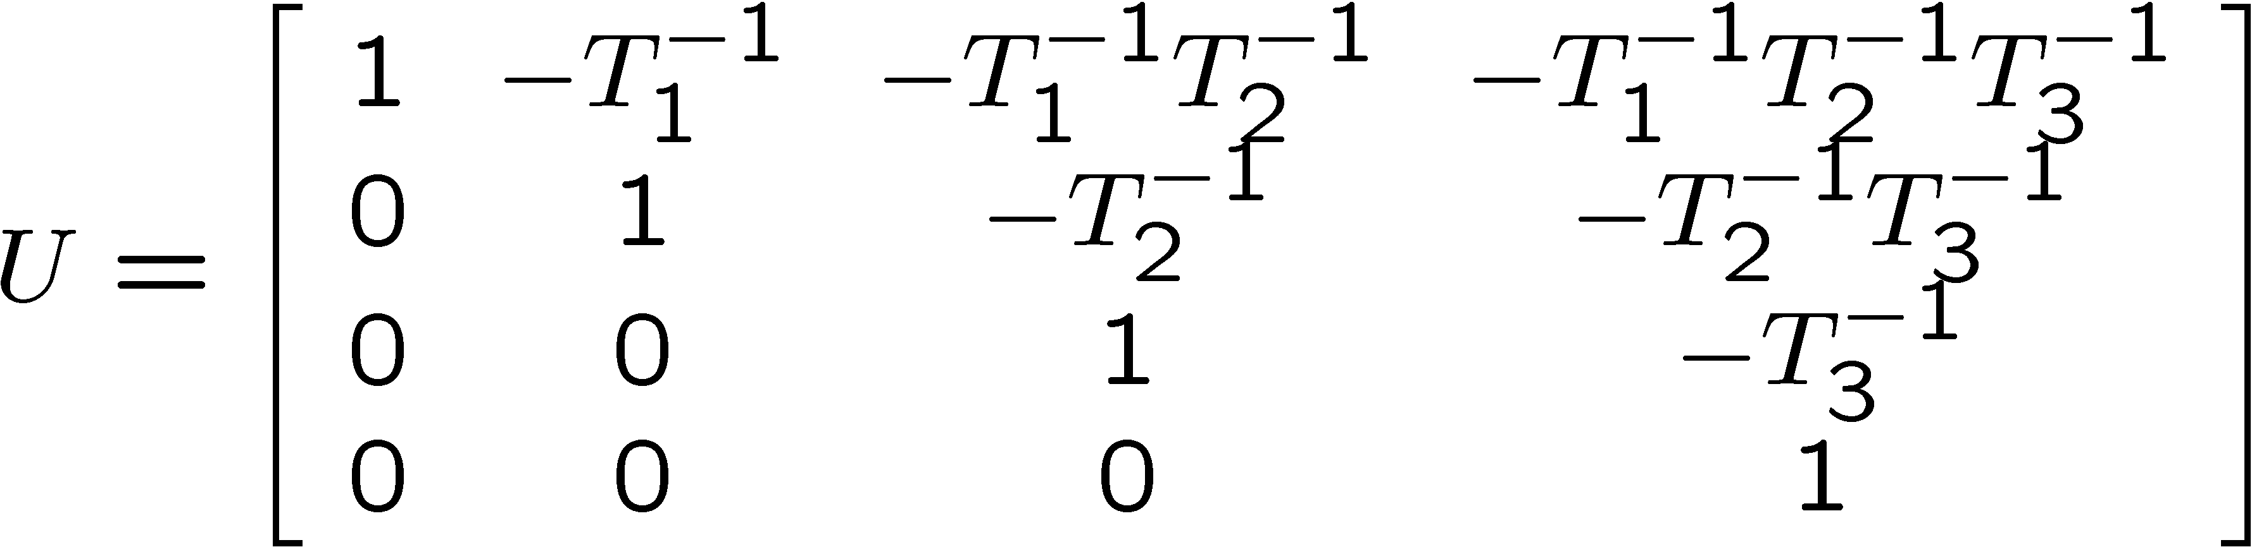
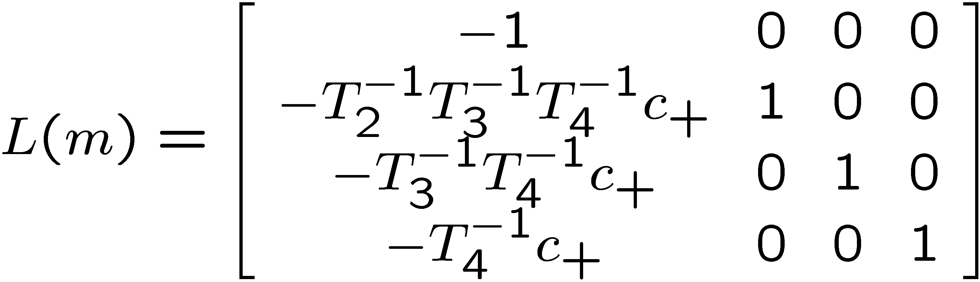
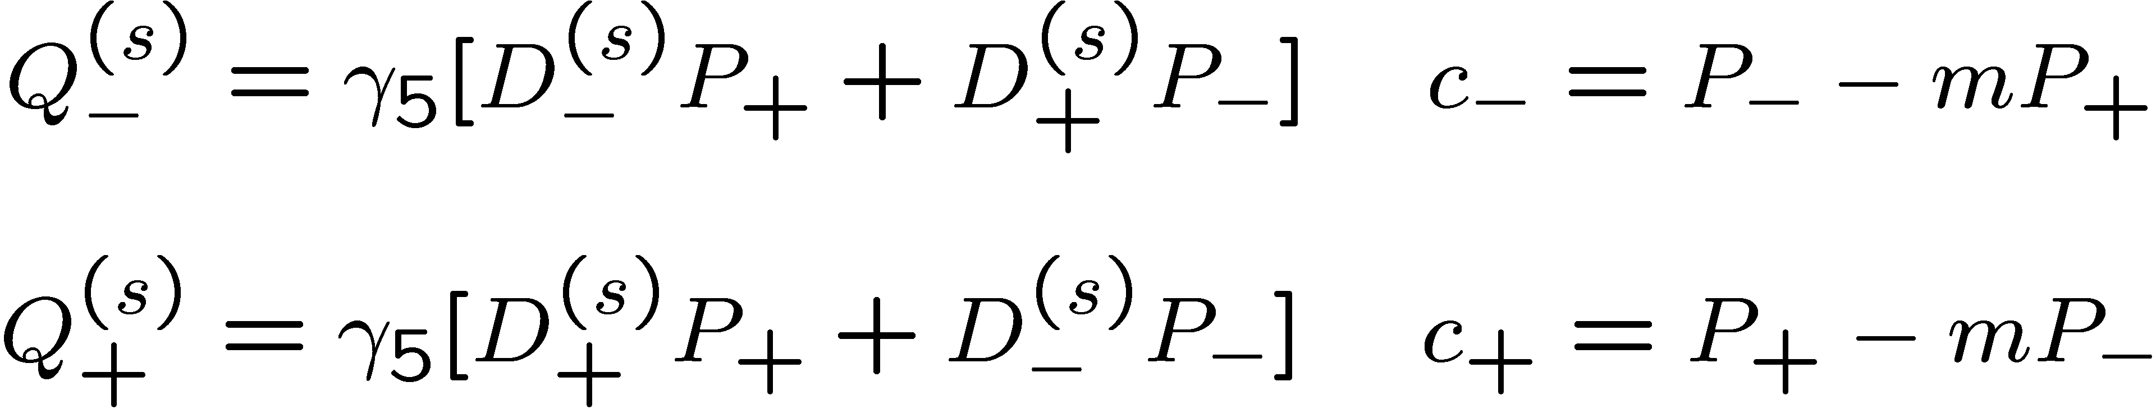
Step #2: Do Gaussian Elimination to get U matrix
Step #3 Back substitution to get L matrix
where

Slide 15
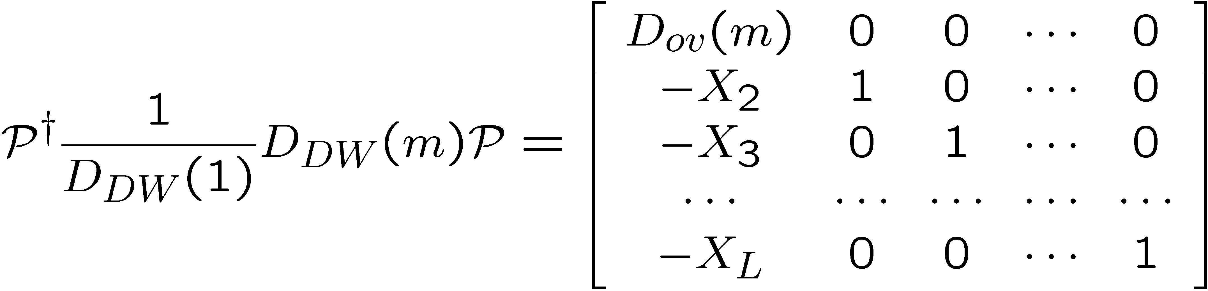
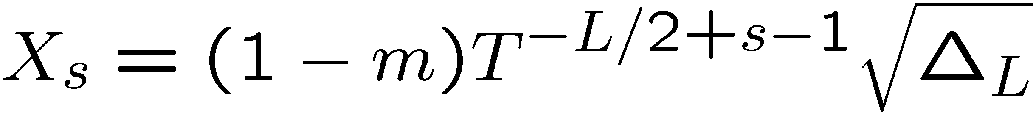
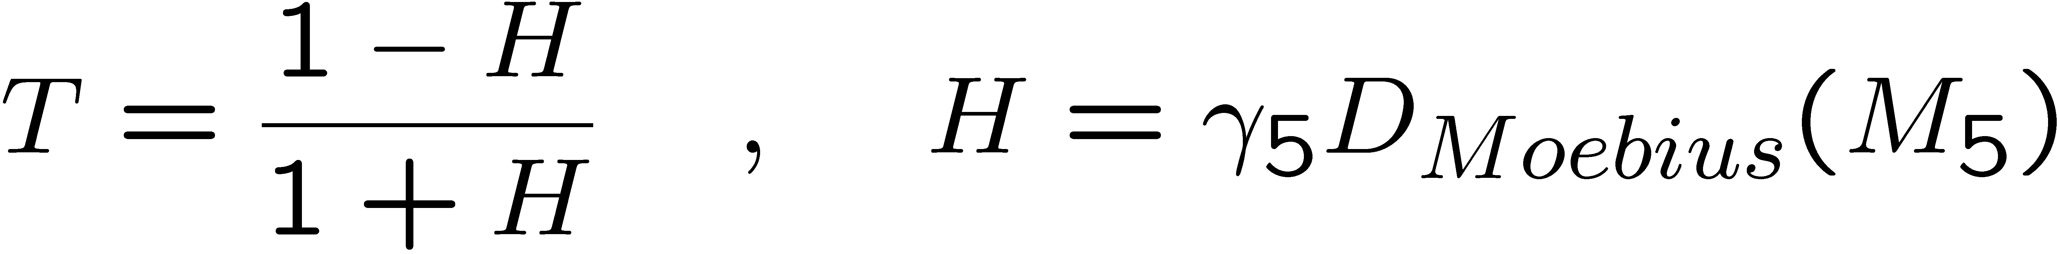
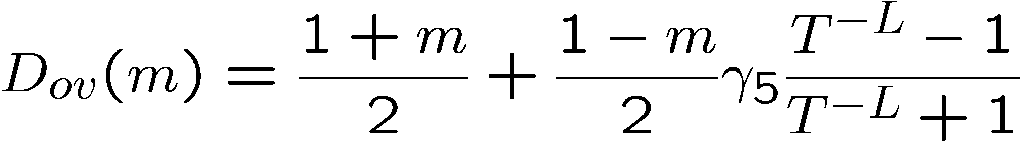
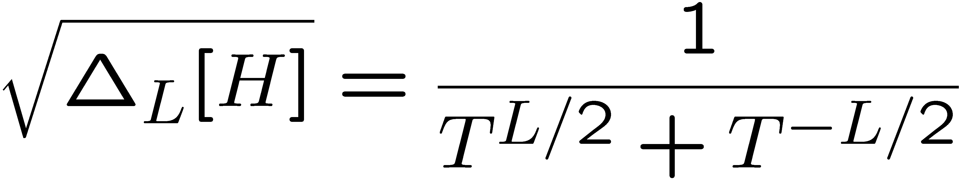
LUD =>

Slide 16
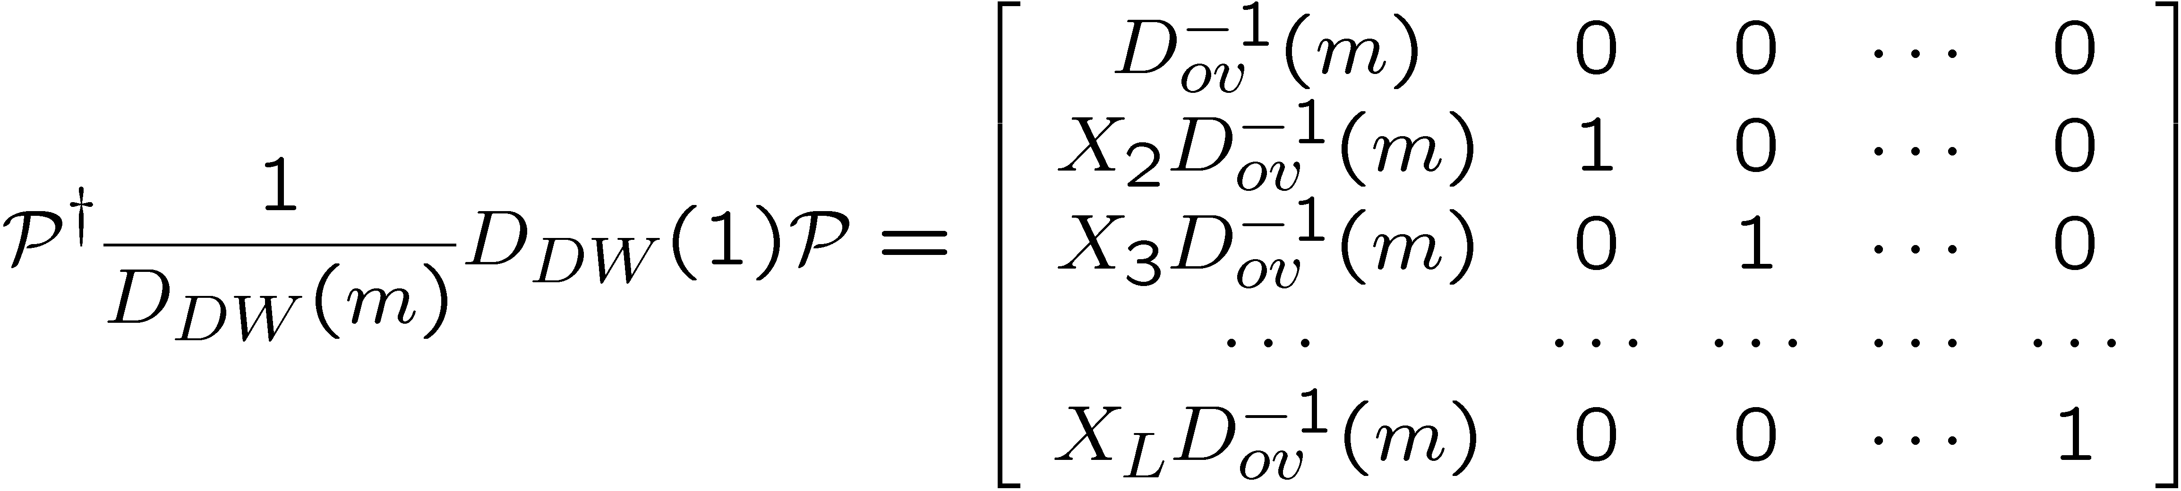
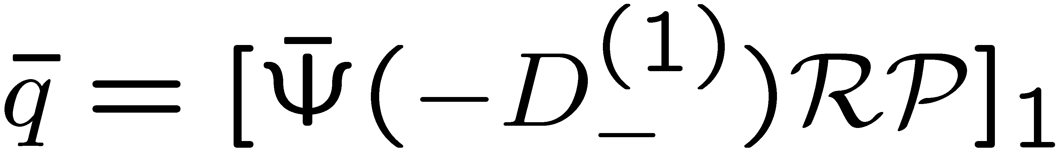
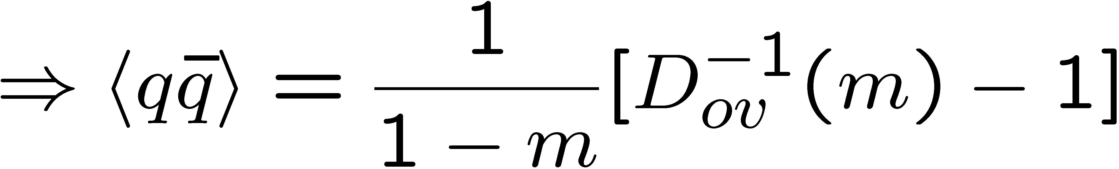
DW/Overlap Equivalence:
where
note: Standard approach

Slide 17
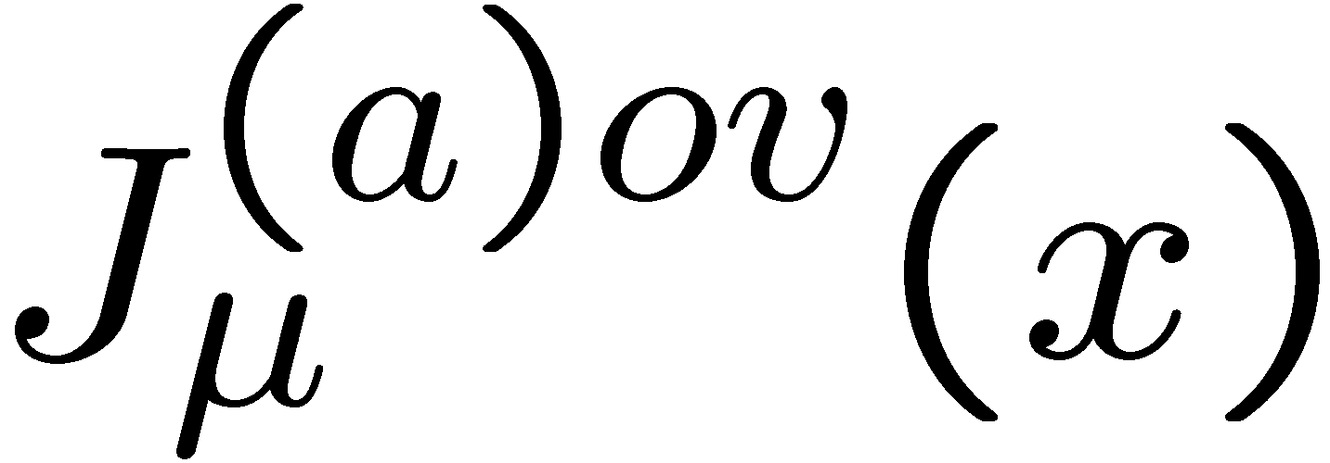
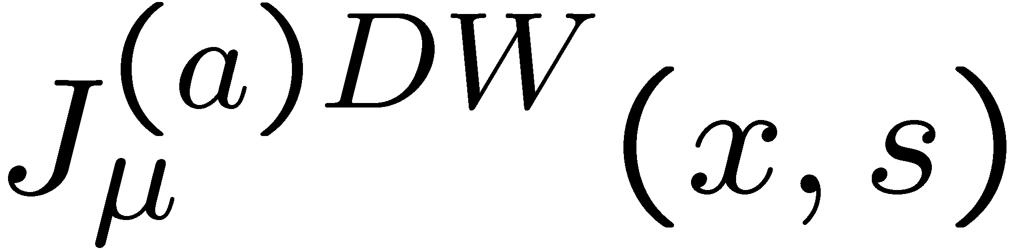
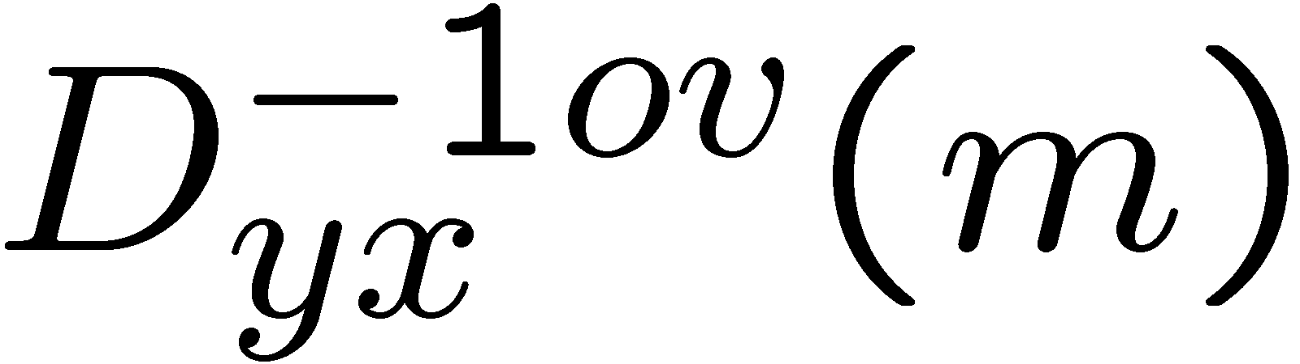
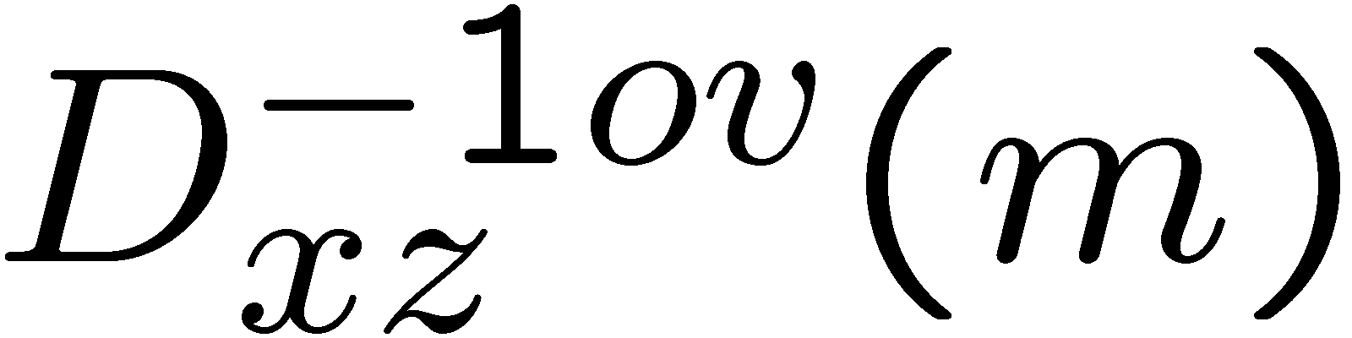
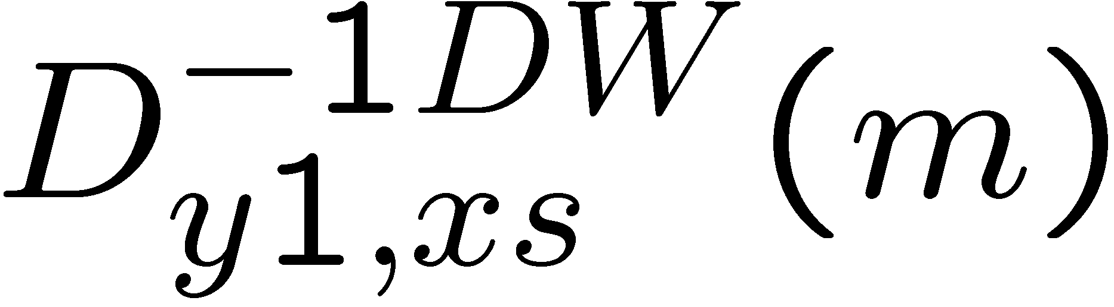
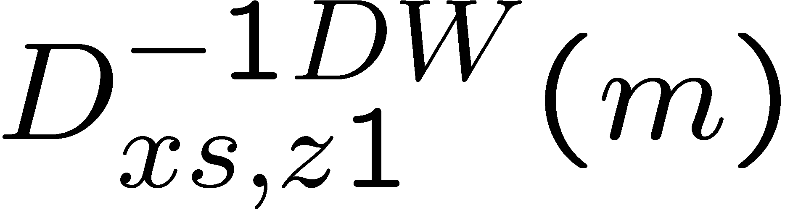

Application of DW/overlap equ to currents
y
z
y,1
z,1

Slide 18
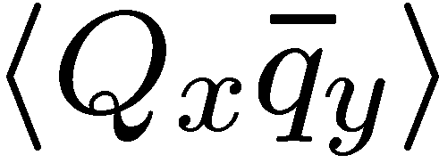
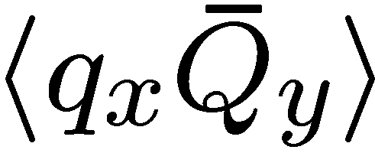
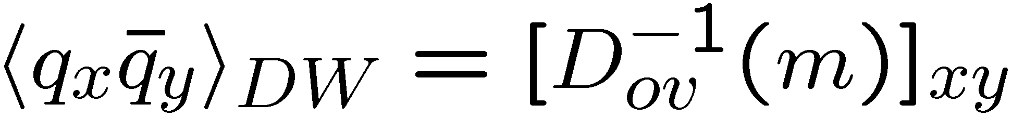
Split Screen Correlators: 5-d Vector => 4-d Axial
s = 1
s = 2
s = M
s = L_s
q_{L}
Q_{R}
Q_{L}
q_{R}
LEFT
RIGHT
q_{R}
q_{L}
Q_{R}
Q_{L}

Slide 19
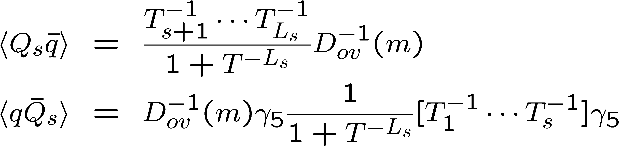
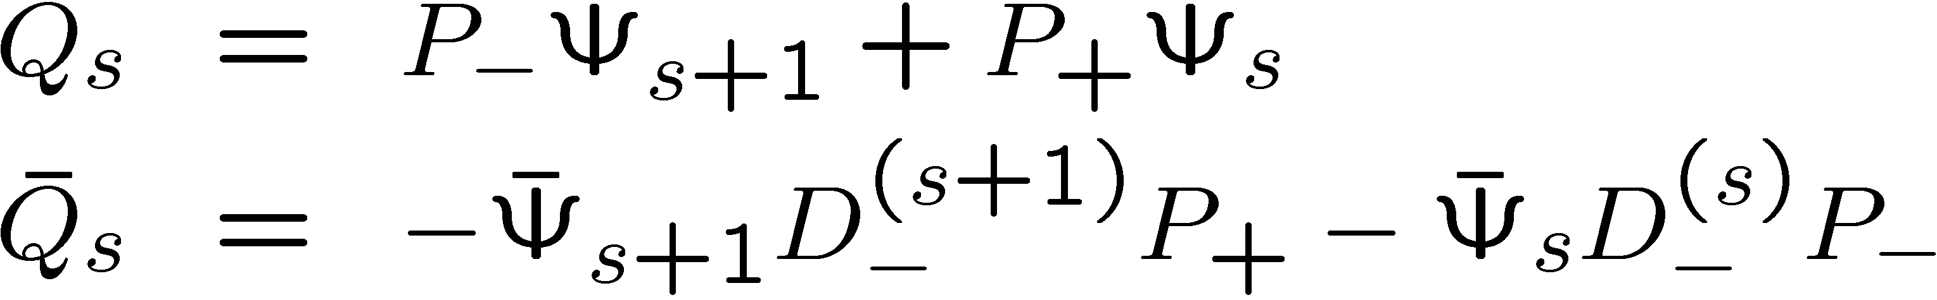
Bulk to Boundary Propagators
y
where s = M plane
y
(See Kikukawa and Noguchi, hep-lat/99902022)

Slide 20
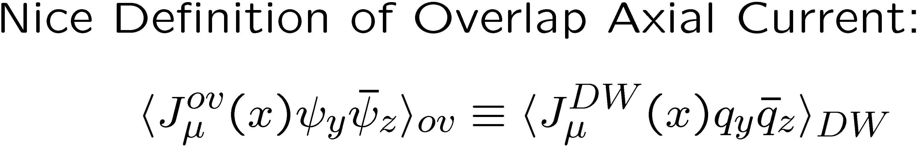
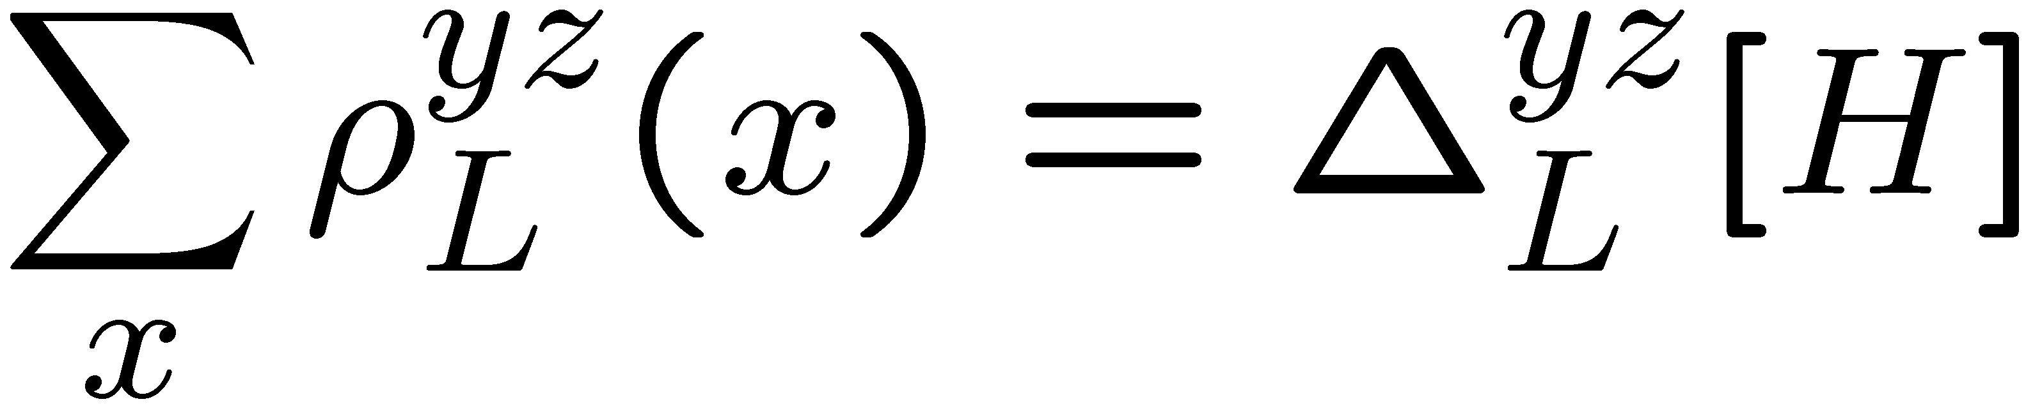
Ward Takashi: DW => Overlap^{y}
implies
where
( ^{y} For single current disconnected diagram gives anomaly)

Slide 21
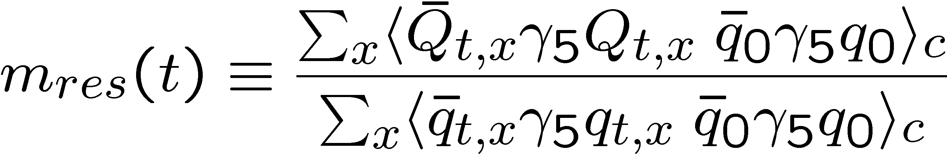
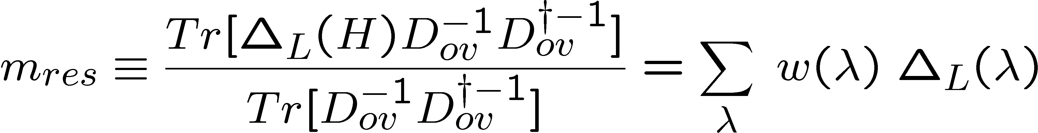
Measuring the Operator Δ_{Ls}
(use Plateau region away from sources)
Sum over t ➔ Measure Matrix element of Δ_{L} operator
|λ > in the Eigen basis of H = γ₅ D(-M)

Slide 22
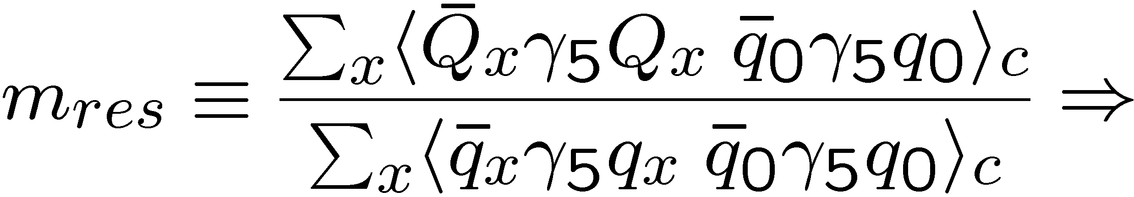
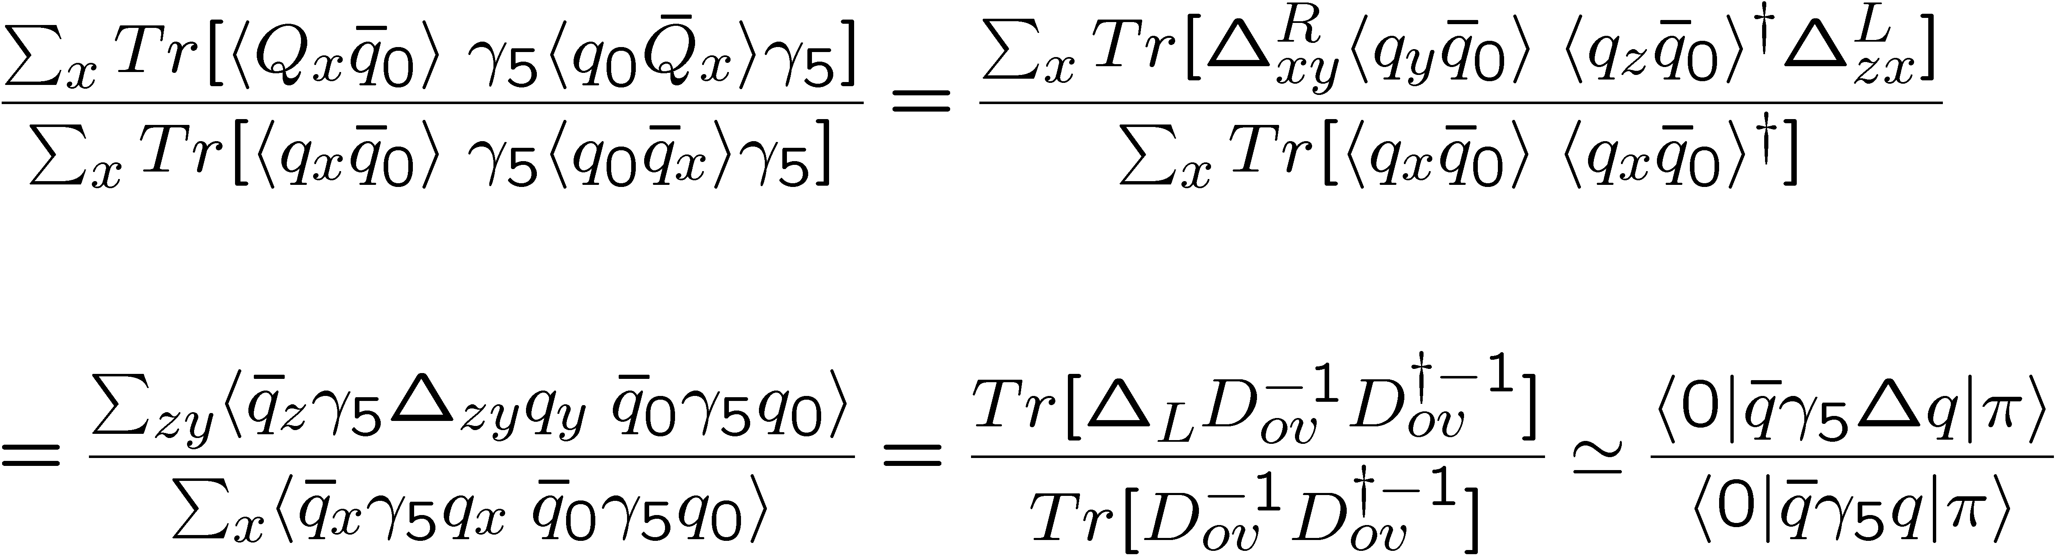
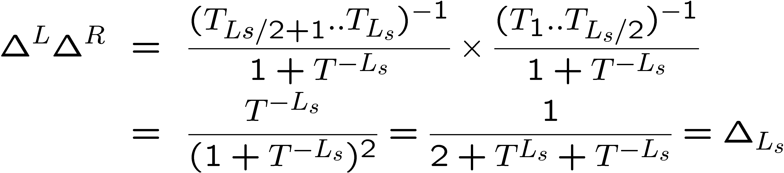
Derivation:
where

Slide 23
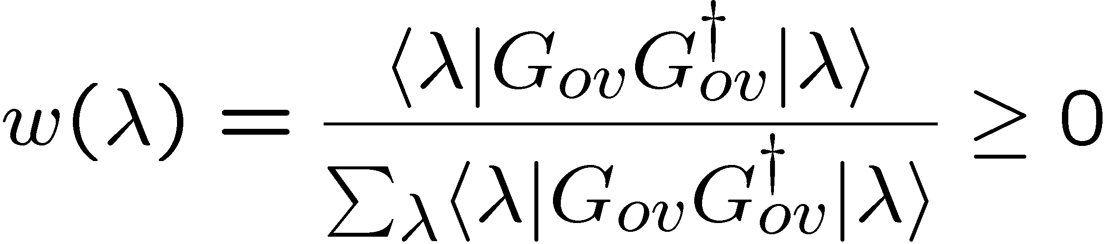
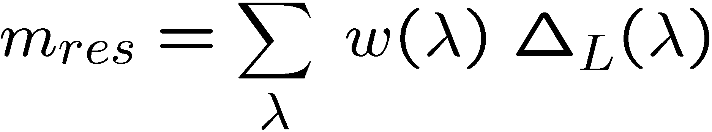
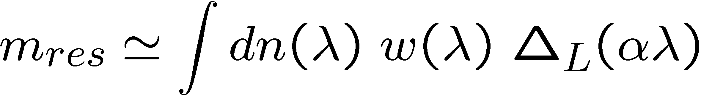
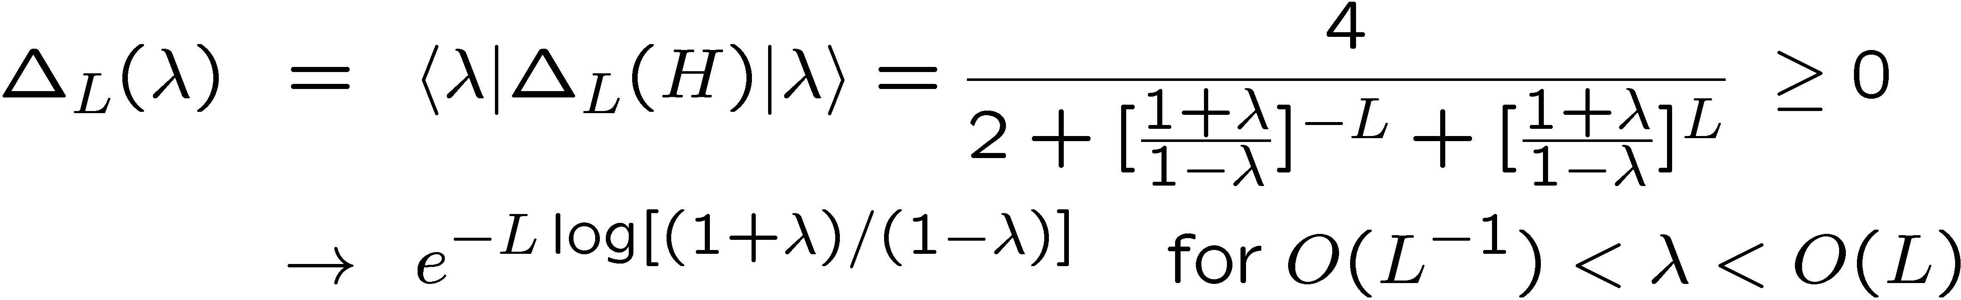
Model for m_{res} dependence on α & L_{s}
ω(λ) has negligible dependence on α and L_{s}
(Parameterize and fit m_{res} data)

