Slide 1
Precise Orbit Determination for the GEOSAT Follow‑On Spacecraft
Frank G. Lemoine
Space Geodesy Branch, Code 926, NASA GSFC
Nikita P. Zelensky
Raytheon ITSS Corp., Greenbelt, MD
GFO CalVal Meeting
NOAA
Washington DC June 12, 2001

Slide 2
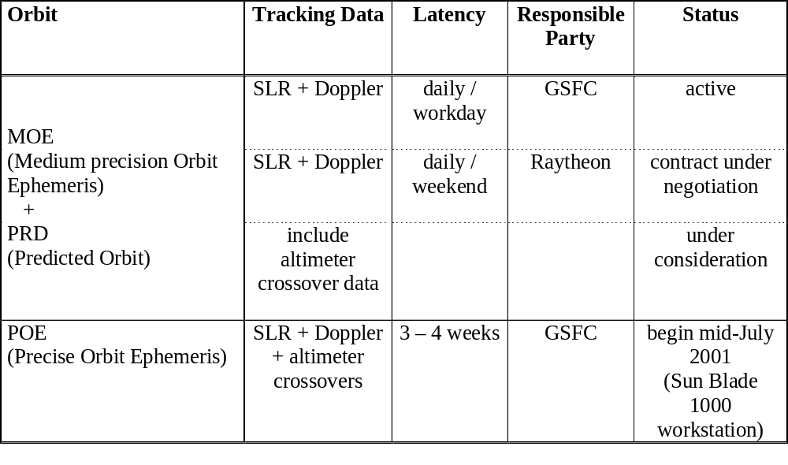
Status SLR-based Orbit Production

Slide 3
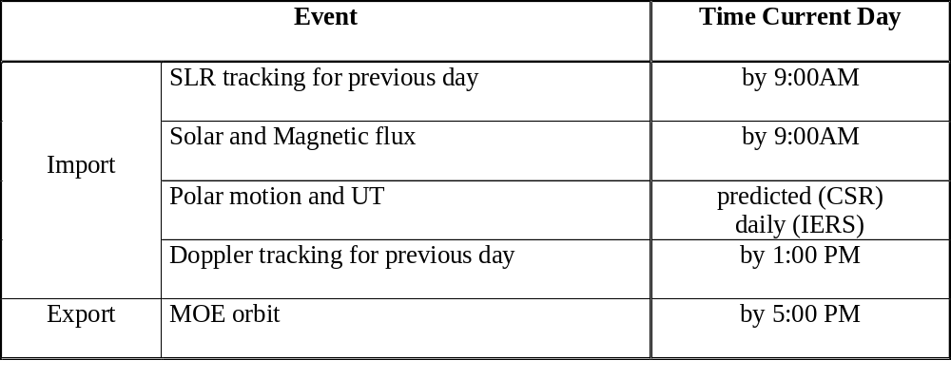
MOE Daily Schedule

Slide 4
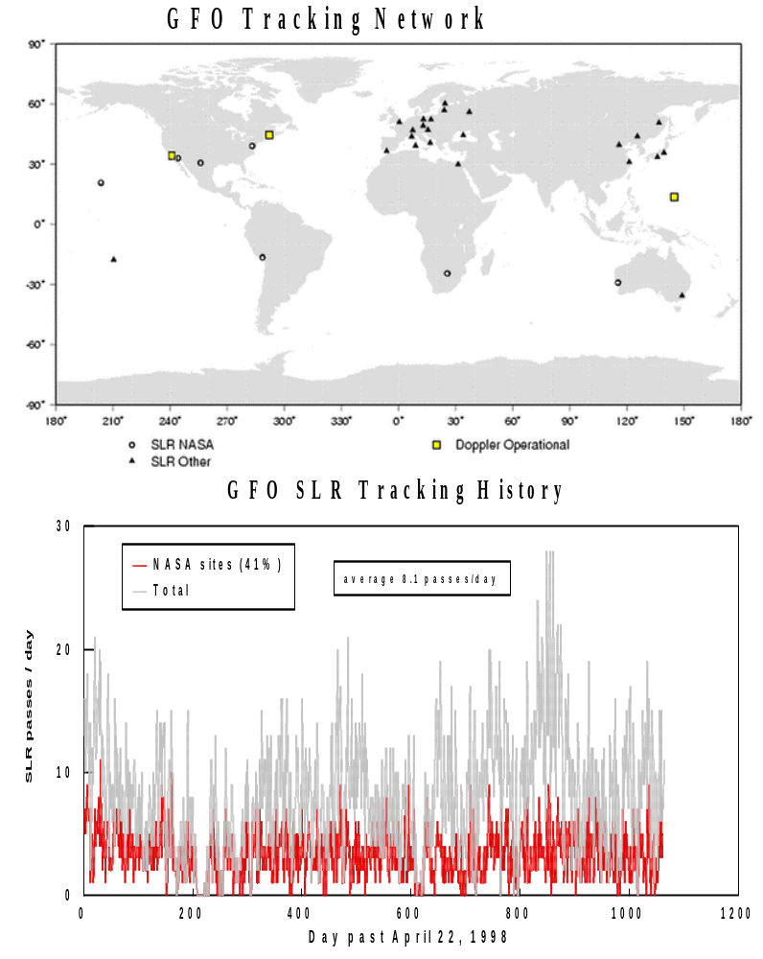

Slide 5
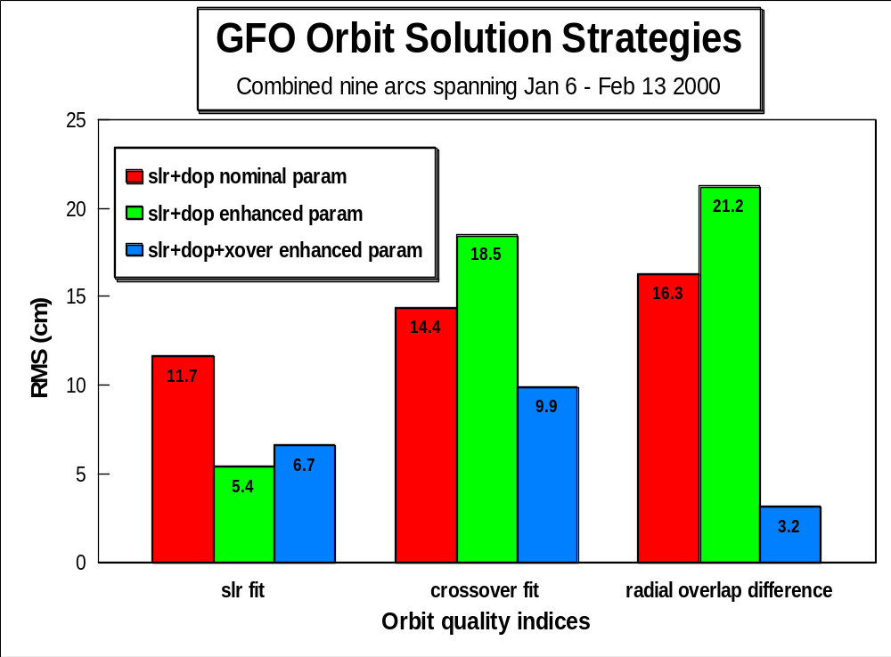
nominal: 1drag/day, 1cpr/5day; enhanced: 3drag/day, 1cpr/1day

Slide 6
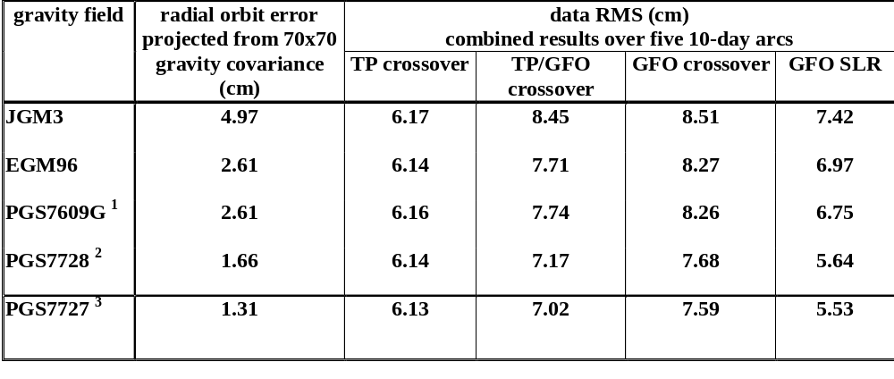
Gravity Field Tests
1. PGS7609G = EGM96 + TDRSS tracking of GRO, XTE, TRMM, ERBS
2. PGS7728 = PGS7609G + GFO SLR/Doppler, GFO/GFO crossover
3. PGS7727 = PGS7609G + GFO SLR/Doppler, GFO/GFO crossover, TOPEX/GFO crossover

Slide 7
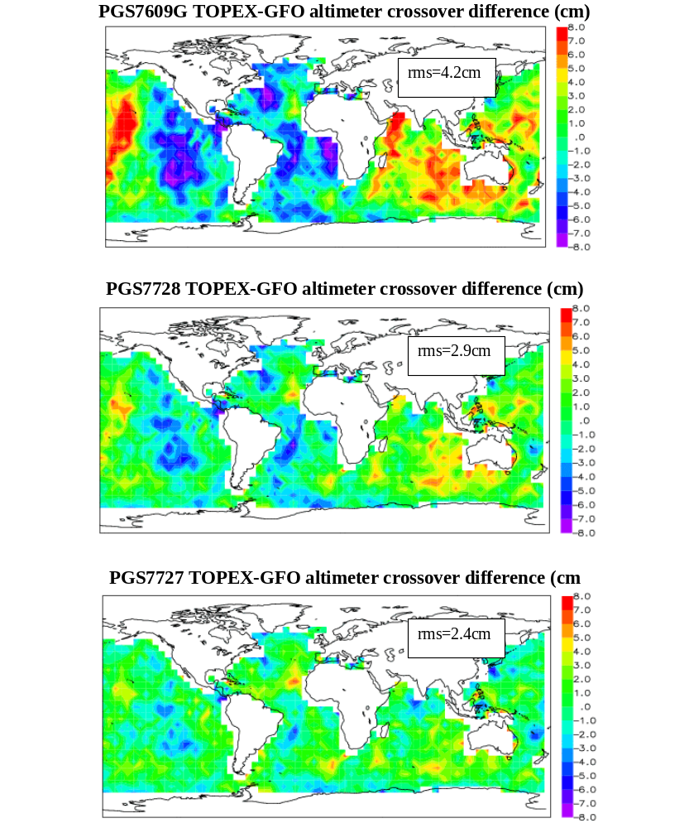
GFO geographically correlated orbit error

Slide 8
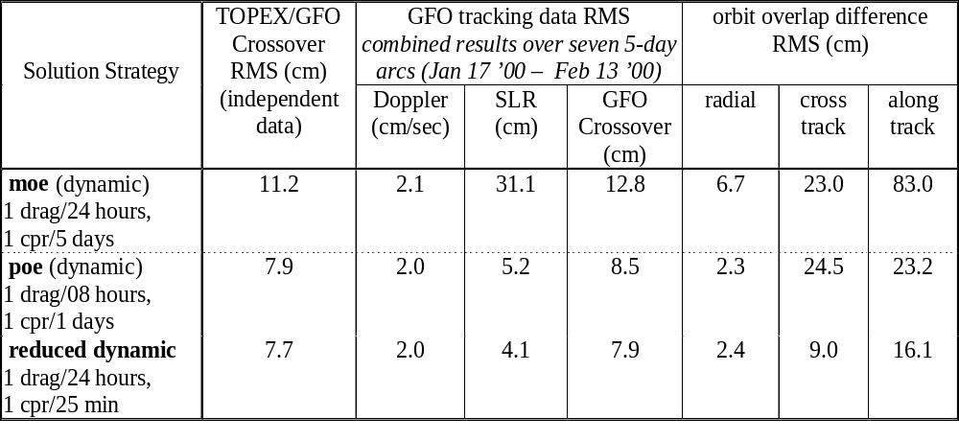
GFO Orbit Solution Strategy

Slide 9
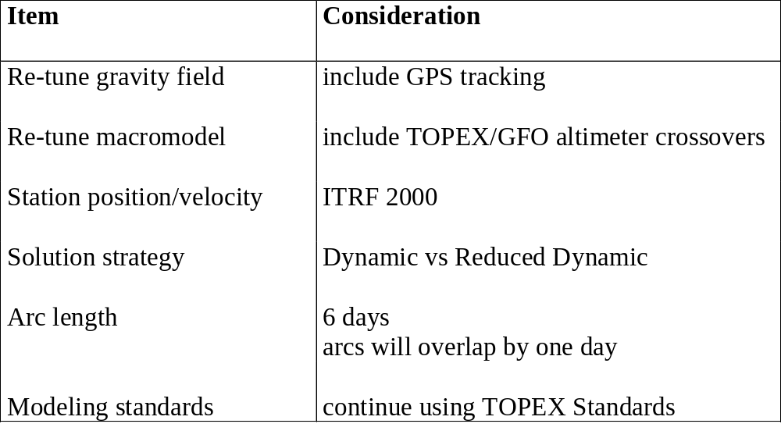
POE Definition Considerations

Slide 10
Orbit Quality Indices
Tracking Data Density and Fits
    SLR
    Doppler
    GFO/GFO altimeter crossover (MOE under consideration)
Orbit Overlap Difference
    MOE 4-day overlap
    POE 1-day overlap
Use of TOPEX/Jason Altimeter Range Data (consider POE only)
Satellite Events Information

Slide 11
Spacecraft Laser Retroreflector Array (LRA) Offset
Satellite Center of Mass (CoM)
Satellite
Coordinate
Origin
CoM Offset
(propellant use dependant)
CoM – LRA Offset
(SLR tracking sensitive)
LRA Offset
LRA Phase Center

Slide 12
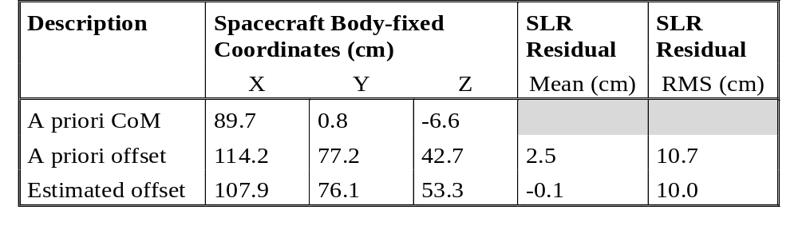
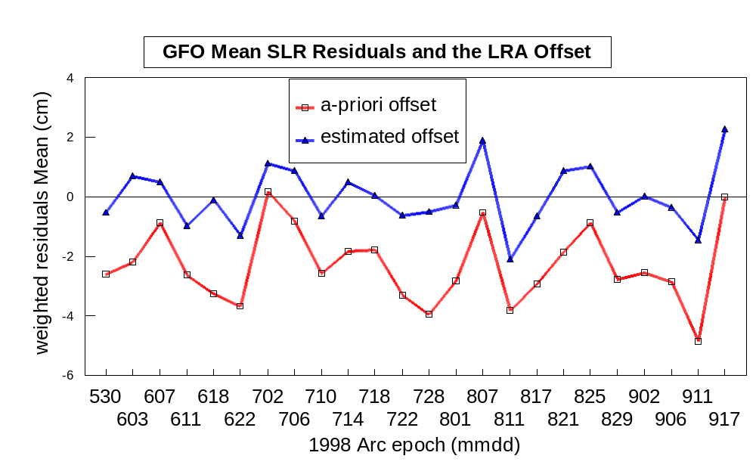
Laser Retroreflector Array Offset to Spacecraft Center of Mass Vector
LRA Offset Estimated using June ’98 SLR Data

Slide 13
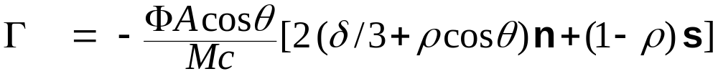
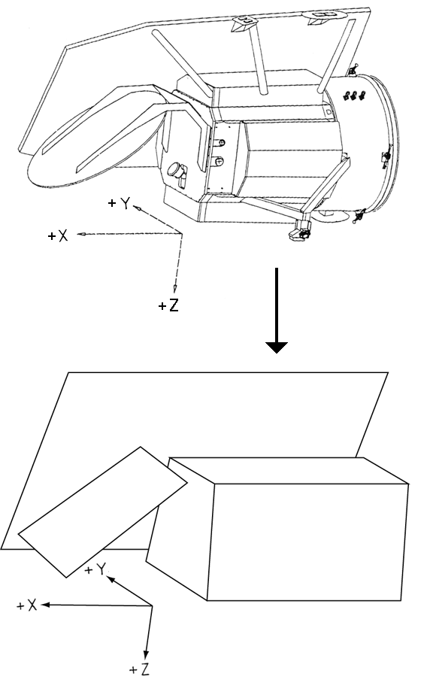
GFO Macro Model Approximation
Anticipate 80-90% pre-tune accuracy
Acceleration due to radiation pressure on a flat plate:
where
Γ = acceleration (m/s²)
Φ = radiation flux from source
Α = surface area of flat plate (m²) *
θ = incidence angle (surface normal to source)
Μ = satellite mass (m)
c = speed of light (m/s)
δ = diffuse reflectivity *
ρ = specular reflectivity *
n = surface normal unit vector
s = source incidence unit vector
* are the adjustable macro model parameters

Slide 14
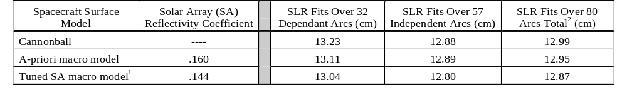
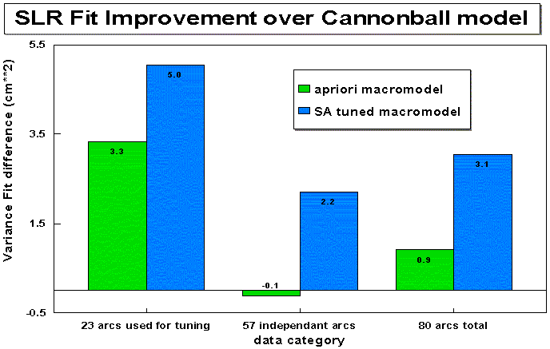
GFO Macro model Tuning
¹ Tuned using 23 SLR+Doppler and 8 SLR+Dopple+Crossover arcs spanning 980522-000206
² 80 consecutive arcs spanning 980422-990603

Slide 15
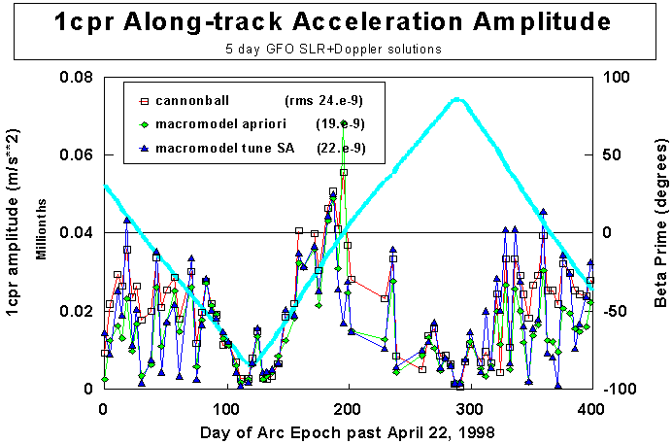
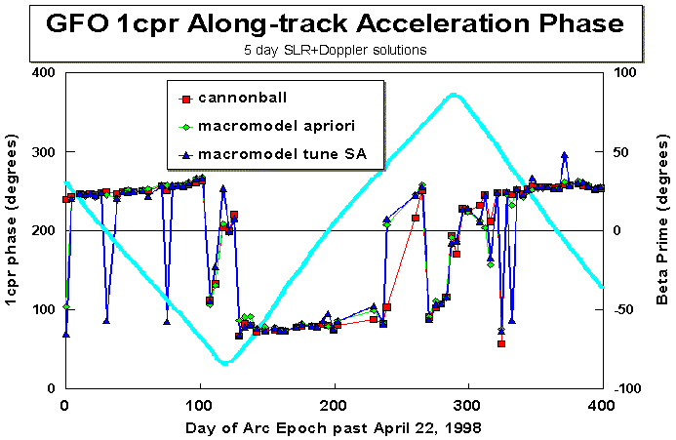
Empirical Acceleration Amplitude and Phase retain strong Beta’ signal

Slide 16
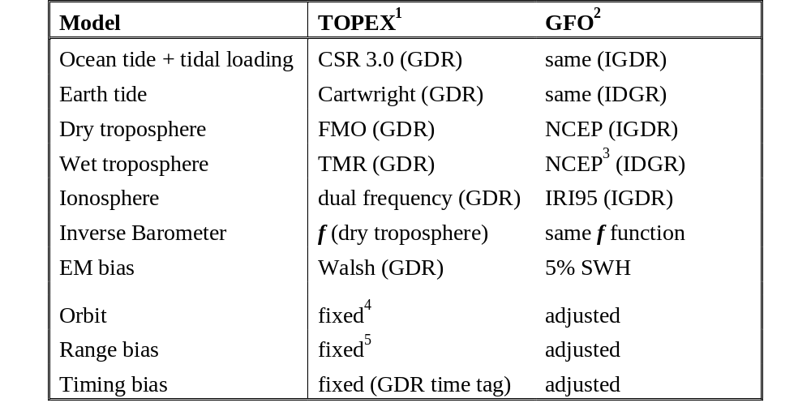
Altimeter Range Modeling for TOPEX-GFO Crossover Processing in GEODYN
¹ TOPEX GDR
² GFO IGDR from NOAA
³ TMR value also available
⁴ POE has 2-3 cm radial accuracy
⁵ routinely computed per cycle by PODPS based on the POE orbit

Slide 17
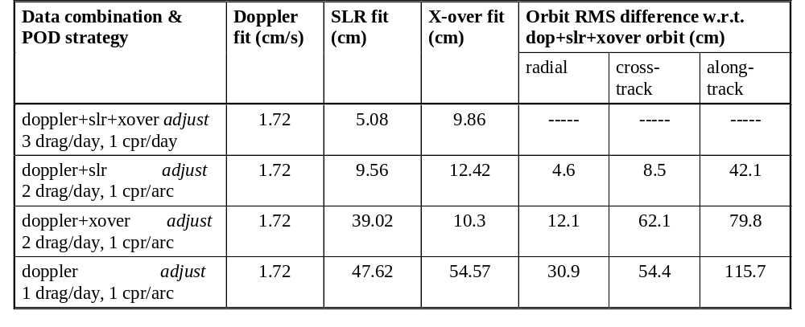
GFO POD Strategies for Tracking Data Combinations
Combined 2 arcs spanning May 5 – May 17, 2000

