Slide 1
ESOC
IGS Reprocessing
T. Springer, F. Dilssner, E. Schoenemann,
I. Romero, J. Tegedor, F. Pereira, J. Dow

Slide 2
IGS Reprocessing at ESOC
Features of New GNSS software at ESOC, Napeos:
  Very fast!
    30 minutes for a full final solution from scratch using 100 stations
    60 minutes when using 150 stations
  Product quality excellent (see our posters)
  Ideally suited for IGS reprocessing
    But also for IGS real time!
Reprocessing is the ideal tool for testing new models
  Future improvements will come from small model changes which need significant amounts of days (if not months) to be reanalysed.
    Being able to do that fast and efficient is key for all future progress!
ESOC wants to play a significant role in the IGS reprocessing

Slide 3
Current Status of Reprocessing
Reprocessed 2007 four times since November 2007
  First time as software test for IGS operations
  Second and third time for IGS reprocessing and Albedo study
    Once without Earth Albedo and Infra-red radiation modelling (OFF)
    Once with Earth Albedo and Infra-red radiation modelling (ON, ES1)
  Fourth time after resolving issue with the CMC correction (see poster)
Results have been analysed in some details
  Orbit overlaps, orbit comparisons, ERP comparisons
  SLR validations
  Outstanding checks are:
    Clock comparisons
    Coordinate comparisons
After completion of the validation the full reprocessing will start!

Slide 4
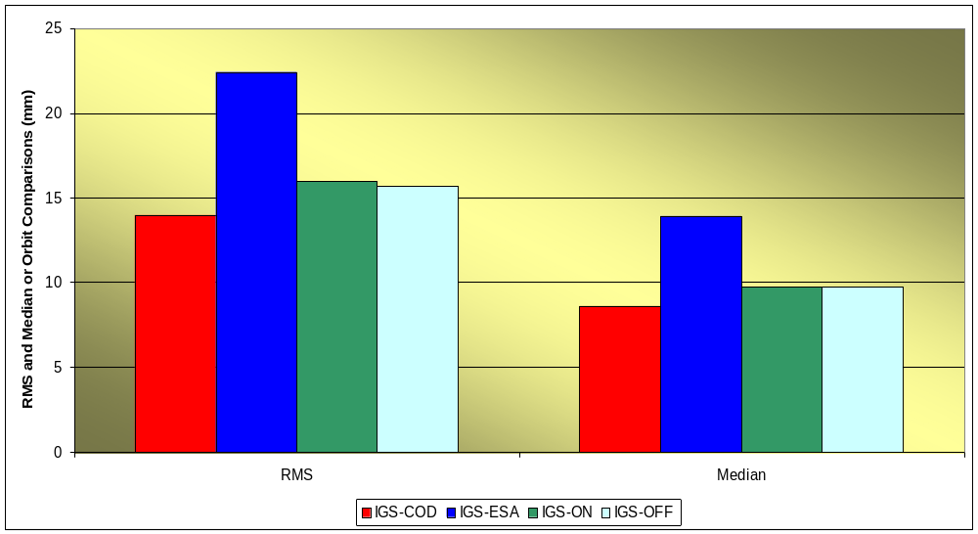
Comparison of ESOC Reprocessed Orbits

Slide 5
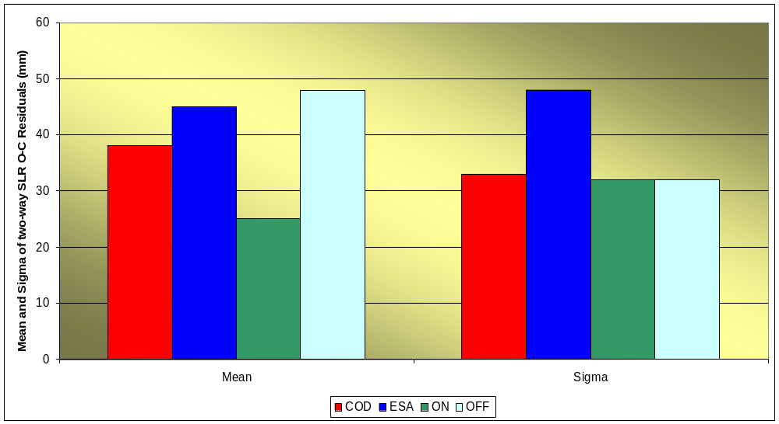
SLR Validation of ESOC Reprocessed Orbits

Slide 6
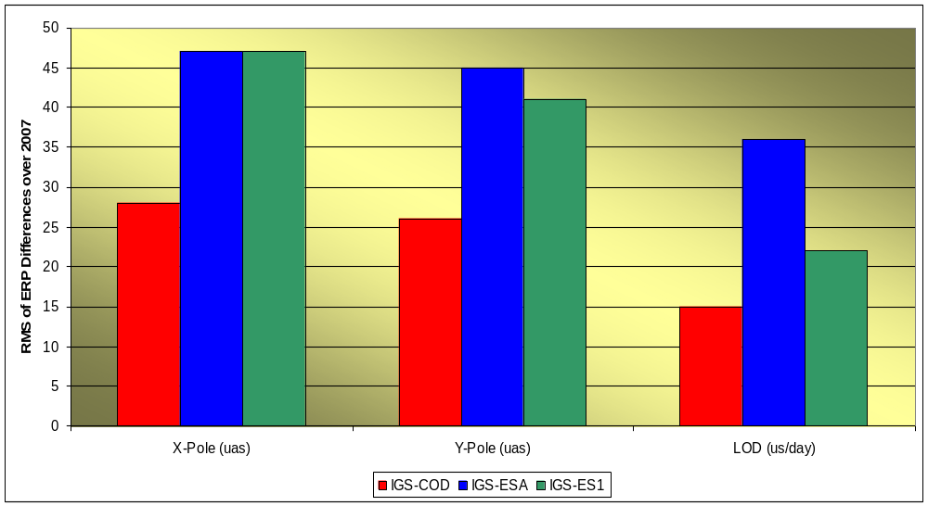
Comparison of ESOC Reprocessed ERP Estimates

Slide 7
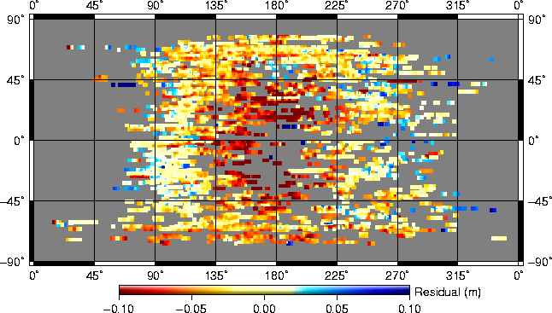
SLR Residuals
(As function of Satellite Latitude and Elevation of the Sun above the orbital plane)

Slide 8
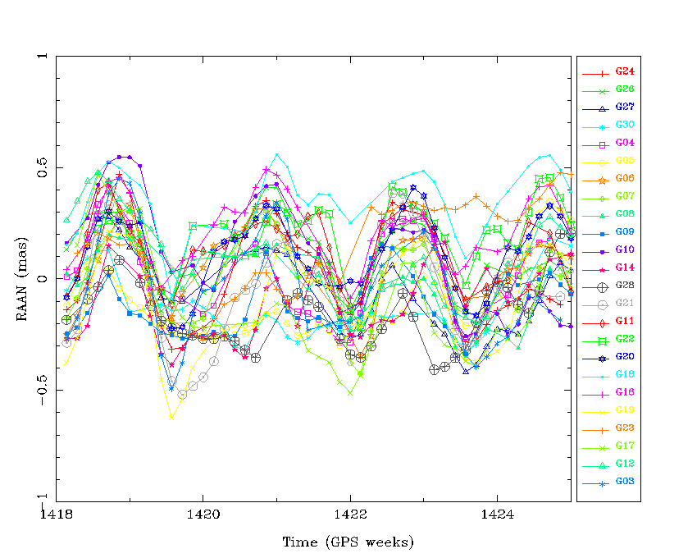
Periodic Signal in Orbit Overlap!

Slide 9
Conclusions
ESOC Reprocessed solutions have very high quality!
  Completely independent 24 hour solutions
    No smoothing and no day boundary constraints!
  Small issue with CMC correction detected and fixed
    Corrected reprocessed series available
Several comparisons show 14-day periods, e.g.,
  Orbit Z-rotations, X-, Y-pole and LOD time series, orbit overlaps
  Most significant effect found in overlap of Right-Ascension of the Ascending Node
    14-day period in RAAN overlap dominating the overlap statistics
    Explanation missing (see also our poster)
      IERS Sub-daily Polar Motion model too simple?
SLR validation of the orbits confirms the high quality
  Difference between SLR observations and GPS orbits remains
  Earth Albedo and Infra-red radiation may give the explanation
    However, the Napeos model is too simple
ESOC ready to reprocess all IGS data since 1994

Slide 10
Thank You!

