Slide 1
Overview of the TDT 2004 Evaluation and Results
Jonathan Fiscus
Barbara Wheatley
National Institute of Standards and Technology
Gaithersburg, Maryland
December 2-3, 2004

Slide 2
Outline
TDT Evaluation Overview
Changes in 2004
2004 TDT Evaluation Result Summaries
  New Event Detection
  Link Detection
  Topic Tracking
  Experimental Tasks:
    Supervised Adaptive Topic Tracking
    Hierarchical Topic Detection

Slide 3




Topic Detection and Tracking
“Applications for organizing text”
Terabytes of Unorganized data
5 TDT Applications
  Story Segmentation*
  Topic Tracking
  Topic Detection
  First Story Detection
  Link Detection
* Not evaluated in 2004

Slide 4
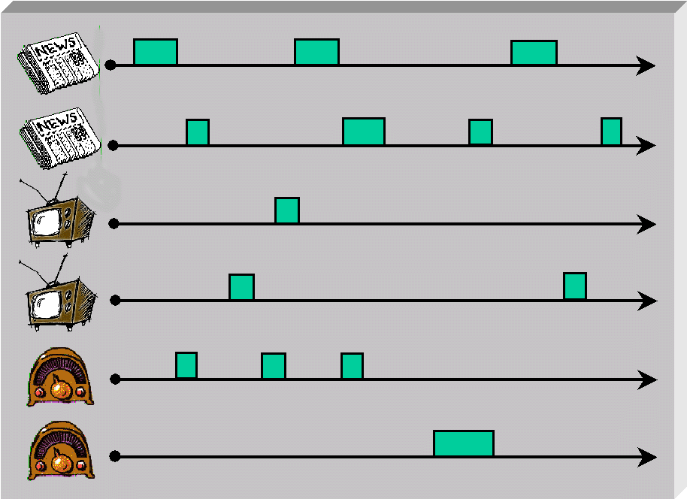
TDT’s Research Domain
Technology challenge
  Develop applications that organize and locate relevant stories from a continuous feed of news stories
Research driven by evaluation tasks
Composite applications built from
  Document Retrieval
  Speech-to-Text (STT) – not included this year
  Story Segmentation – not included this year

Slide 5
Definitions
An event is …
  A specific thing that happens at a specific time and place along with all necessary preconditions and unavoidable consequences.
A topic is …
  an event or activity, along with all directly related events and activities
A broadcast news story is …
  a section of transcribed text with substantive information content and a unified topical focus

Slide 6
Evaluation Corpus
 | TDT4 (Last year’s corpus) | TDT5 (This year’s corpus)
Collection Dates | October 1, 2000 to January 31, 2001 | April 1, 2003 to September 31, 2003
Newswire Sources | 3 Arabic 2 English 2 Mandarin | 6 Arabic 7 English 4 Mandarin
Broadcast News Sources | 2 Arabic 5 English 5 Mandarin | NONE
Story Counts | 90735 news, 7513 non-news stories | 407503 news, 0 non-news
Annotated topics | 80 | 250
Average topic size | 79 stories | 40 stories
Same languages as last year
Summary of differences
  New time period
  No broadcast news
    No non-news stories
  4.5 times more stories
  3.1 times more topics
  Topics have ½ as many on-topic stories

Slide 7
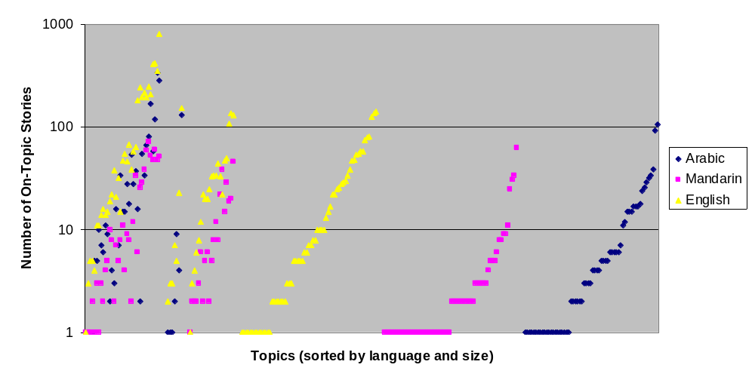
Topic Size Distribution
35 Arb+Eng+Man
7 Arb+Eng
21 Eng+Man
63 Eng
62 Man
62 Arb

Slide 8
Mutlilingual Topic overlap
Single Overlap Topics
Multiply Overlap Topics
Common Stories
Topic ID
107: Casablanca bombs
105
Unique Stories
126
12
283
583
106
118
72
89
532
105
20
380
3
2
215
107
1110
6
154
9
92
1
451
29
125
140
25
1
63
60
227
70
93
1
9
42
151
189
90
71
2
171
22
2
5
6
80
69
145
78
427
1
3
186
193
Topics on Terrorism
71: Demonstrations in Casablanca
31
1
104

Slide 9
Topic labels
Single Overlap Topics
Multiply Overlap Topics
72 Court indicts Liberian President
89 Liberian former president arrives in exile
29 Swedish Foreign Minister killed
125 Sweden rejects the Euro
151 Egyptian delegation in Gaza
189 Palestinian public uprising suspended for three months
69 Earthquake in Algeria
145 Visit of Morocco Minister of Foreign Affairs to Algeria
186 Press conference between Lebanon and US foreign ministers
193 Colin Powell Plans to visit Middle East and Europe
105 UN official killed in attack
126 British soldiers attacked in Basra
215 Jerusalem: Bus suicide bombing
227 Bin Laden Videotape
171 Morocco: death sentences for bombing suspects
107 Casablanca bombs
71 Demonstrations in Casablanca
106 Bombing in Riyadh, Saudi Arabia
118 World Economic Forum in Jordan
154 Saudi suicide bomber dies in shootout
60 Saudi King has eye surgery
80 Spanish Elections

Slide 10
Participation by Task:
Showing the Number of Submitted System Runs
Sites |  |  | New Event Detection | Hierarchical Topic Detection | Topic Tracking |  | Link Detection
 |  |  |  |  | Traditional | Supervised Adaptation
 | CMU | Carnegie Mellon Univ. | 1 |  | 6 | 8 | 10
 | IBM | International Business Machines | 4
 | SHAI | Stottler Henke Associates, Inc. | 5
 | UIowa | Univ. of Iowa |  |  |  |  | 4
 | UMd | Univ. of Maryland |  |  | 1 | 2
 | UMass | Univ. Massachusetts | 4 | 6 | 5 | 7 | 4
 | CUHK | Chinese Univ. of Hong Kong |  | 1
 | ICT | Institute of Computing Technology Chinese Academy of Sciences |  | 11 | 1
 | NEU | Northeastern University in China |  |  | 2 |  | 2
 | TNO | The Netherlands Organisation for Applied Scientific Research |  | 8
Domestic
Foreign

Slide 11
New Event Detection Task
System Goal:
  To detect the first story that discusses each topic
First Stories on two topics
= Topic 1
= Topic 2
Not First Stories

Slide 12
TDT Evaluation Methodology
Tasks are modeled as detection tasks
  Systems are presented with many trials and must answer the question: “Is this example a target trial?”
  Systems respond:
    YES this is a target, or NO this is not
    Each decision includes a likelihood score indicating the system’s confidence in the decision
System performance measured by linearly combining the system’s missed detection rate and false alarm rate

Slide 13
Detection Evaluation Methodology
Performance is measured in terms of Detection Cost
  C_{Det} = C_{Miss} * P_{Miss} * P_{target} + C_{FA} * P_{FA} * (1- P_{target})
  Constants:
    C_{Miss} = 1 and C_{FA} = 0.1 are preset costs
    P_{target} = 0.02 is the a priori probability of a target
  System performance estimates
    P_{Miss} and P_{FA}
  Normalized Detection Cost generally lies between 0 and 1:
    (C_{Det})_{Norm} = C_{Det}/min{C_{Miss}*P_{target}, C_{FA} * (1-P_{target})}
Detection Error Tradeoff (DET) curves graphically depict the performance tradeoff between P_{Miss} and P_{FA}
  Makes use of likelihood scores attached to the YES/NO decisions
Two important scores per system
  Actual Normalized Detection Cost
    Based on the YES/NO decision threshold
  Minimum Normalized DET point
    Based on the DET curve: Minimum score with proper threshold

Slide 14
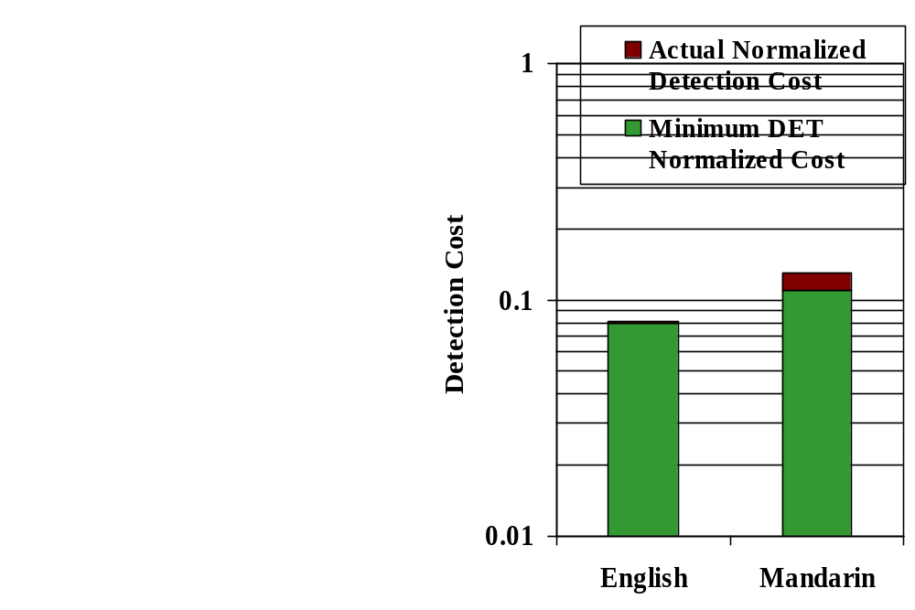
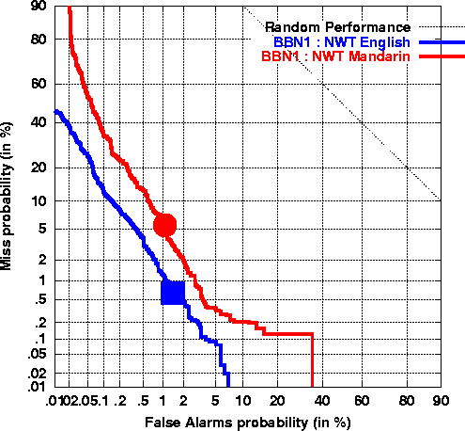
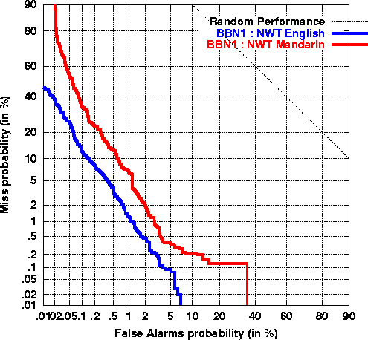
Performance Measures Example
Bar Chart
DET Curve
>
P(miss) = 5.5%
P(fa)=1.1%
Min DET Norm Cost = 0.11
Bottom left is better
>
P(miss) = 0.7%
P(fa)=1.5%
Min DET Norm Cost = 0.08

Slide 15
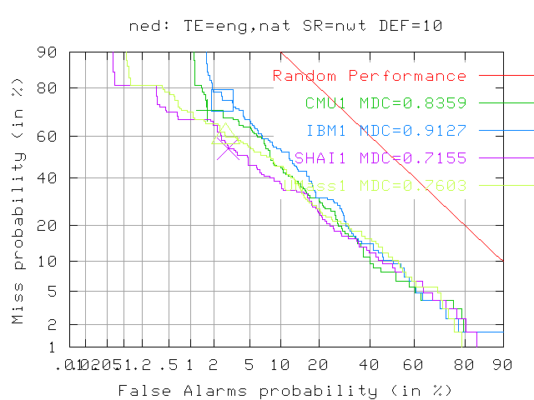
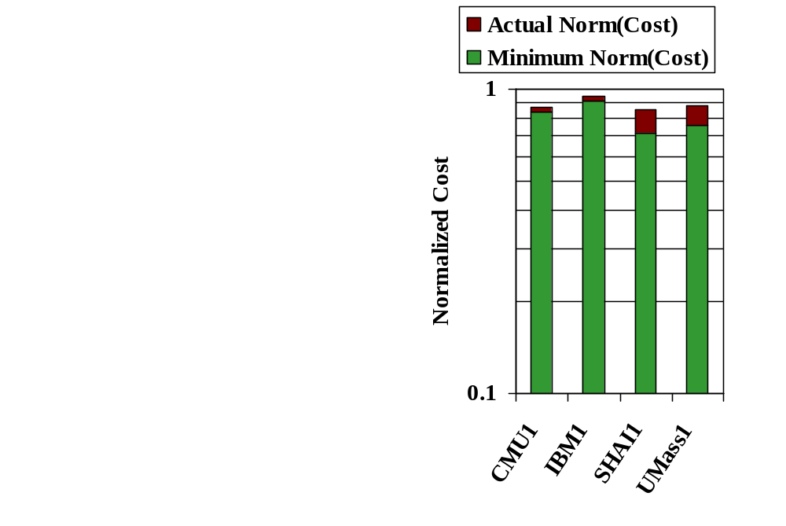
Primary New Event Detection Results
Newswire, English Texts
Last year’s best score

Slide 16
New Event Detection
Performance History
year | condition | site | score
1999 | SR=nwt+bnasr TE=eng,nat boundary DEF=10 | UMass1 | .8110
2000 | SR=nwt+bnasr TE=eng,nat noboundary DEF=10 | UMass1 | .7581
2001 | “ “ | UMass1 | .7729
2002 | SR=nwt+bnasr TE=eng,nat boundary DEF=10 | CMU1 | .4449
2003 | “” | CMU1 | .5971*
2004 | SR=nwt TE=eng,nat DEF=10 | UMass2 | .8387
* 0.4283 on 2002 Topics

Slide 17

TDT Link Detection Task
System Goal:
  To detect whether a pair of stories discuss the same topic.
    (Can be thought of as a “primitive operator” to build a variety of applications)
?

Slide 18
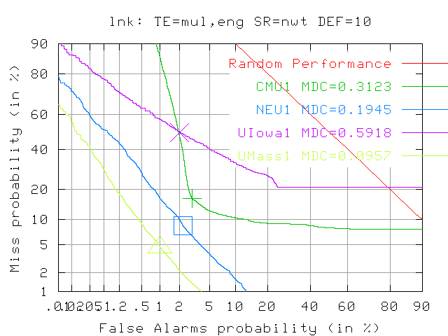
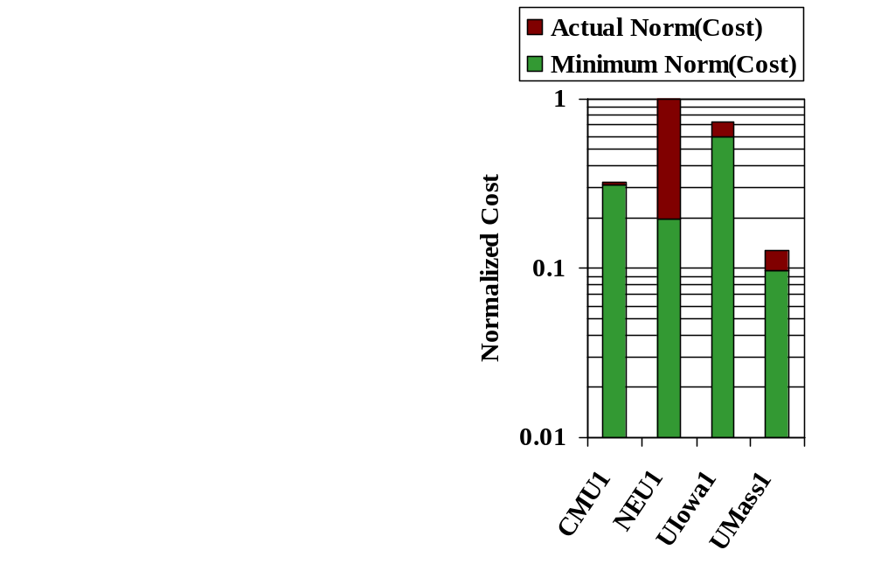
Primary Link Detection Results
Newswire, Multilingual links, 10-file deferral period
Scores are better than last year!

Slide 19
Link Detection
Performance History
year | condition | site | score
1999 | SR=nwt+bnasr TE=eng,nat DEF=10 | CMU1 | 1.0943
2000 | SR=nwt+bnasr TE=eng+man,eng boundary DEF=10 | UMass1 | .3134
2001 | “ “ | CMU1 | .2421
2002 | SR=nwt+bnasr TE=eng+man+arb, eng boundary DEF=10 | PARC1 | .1947
2003 | SR=nwt+bnasr TE=eng+man+arb, eng boundary DEF=10 | UMass01 | .1839*
2004 | SR=NWT TE=eng+man+arb DEF=10 | CMU6 | 0.1047
* 0.1798 on 2002 Topics

Slide 20
Topic Tracking Task
System Goal:
  To detect stories that discuss the target topic, in multiple source streams
    Supervised Training
      Given N_{t} samples stories that discuss a given target topic
    Testing
      Find all subsequent stories that discuss the target topic
on-topic
unknown
unknown
training data
test data

Slide 21
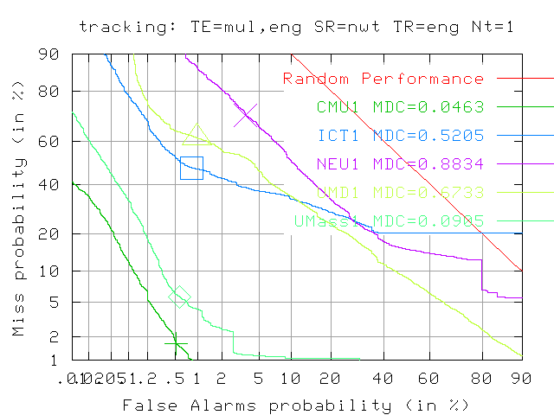
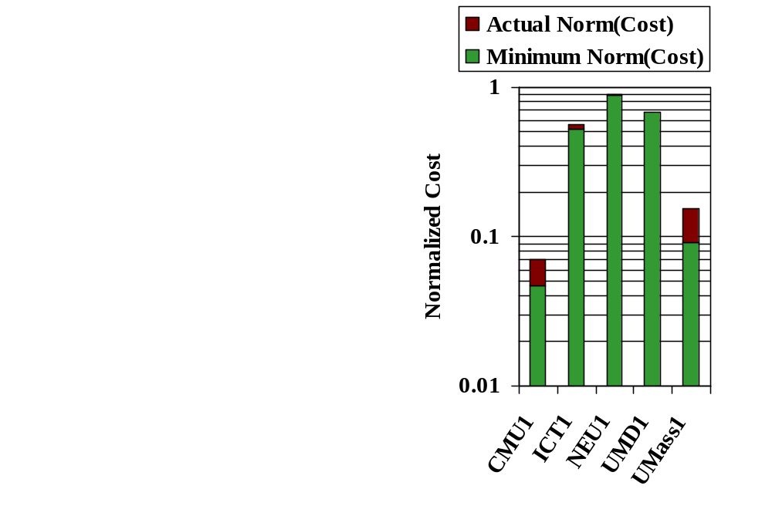
Primary Tracking Results
Newswire, Multilingual Texts, 1 English Training Story
Last year’s best score

Slide 22
Tracking Performance History
year | condition | site | score
1999 | SR=nwt+bnasr TR=eng TE=eng+man,eng boundary NT=4 | BBN1 | .0922
2000 | SR=nwt+bnman TR=eng TE=eng+man,eng boundary NT=1_Nn=0 | IBM1 | .1248
2001 | “ “ | LIMSI1 | .1213
2002 | SR=nwt+bnman TR=eng TE=eng+man+arb, eng boundary Nt=1 Nn=0 | UMass1 | .1647
2003 | SR=nwt+bnman TR=eng TE=eng+man+arb, eng boundary Nt=1 Nn=0 | UMass1 | .1949*
2004 | SR=nwt TR=eng TE=eng+man+arb Nt=1 | CMU2 | .0599
* 0.1618 on 2002 Topics

Slide 23
Supervised Adaptive Tracking Task
Variation of Topic Tracking system goal:
  To detect stories that discuss the target topic when
  a human provides feedback to the system
    System receives human judgment (on or off-topic)
    for every retrieved story
  Same task as TREC 2002 Adaptive Filtering
on-topic
unknown
un-retrieved
retrieved on-topic
retrieved off-topic
training data
test data

Slide 24
Supervised Adaptive Tracking Metrics
Normalized Detection Cost
  Same measure as for basic Tracking task
Linear Utility Measure
  As defined for TREC 2002 Filtering Track
  (Robertson & Soboroff)
  Measures value of the stories sent to the user:
    Credit for relevant stories, debit for non-relevant stories
    Equivalent to thresholding based on estimated probability
    of relevance
  No penalty for missing relevant stories
  (i.e. all precision, no recall)
  Implication: Challenge is to beat the “do-nothing” baseline
  (i.e. a system that rejects all stories)

Slide 25
Supervised Adaptive Tracking Metrics
Linear Utility Measure Computation:
  Basic formula: U = W_{rel} × R - NR
    R = number of relevant stories retrieved
    NR = number of non-relevant stories retrieved
    W_{rel} = relative weight of relevant vs non-relevant
    (set to 10, by analogy with C_{Miss} vs. C_{FA} weights for C_{Det})
  Normalization across topics:
    Divide by maximum possible utility score for each topic
  Scaling across topics:
    Define arbitrary minimum possible score, to avoid having average dominated by a few topics with huge NR counts
    Corresponds to application scenario in which user stops looking at stories when system exceeds some tolerable false alarm rate
  Scaled, normalized value:
    U_{scale} = [ max(U_{norm}, U_{min}) ] / [ 1 - U_{min} ]

Slide 26
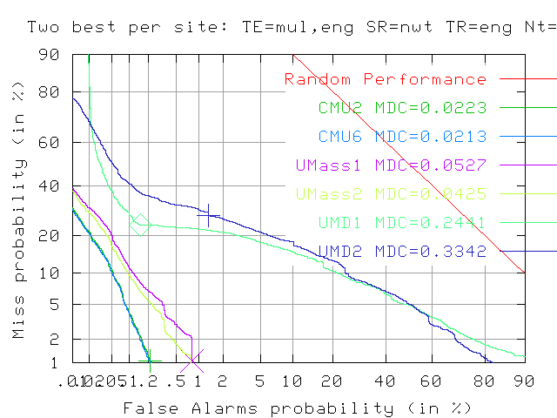
Supervised Adaptive Tracking
Best Two Submissions per Site
Newswire, Multilingual Texts, 1 English Training Story
Best 2004 standard tracking result!

Slide 27
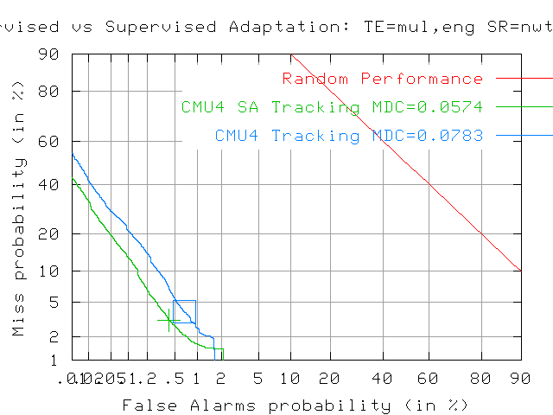
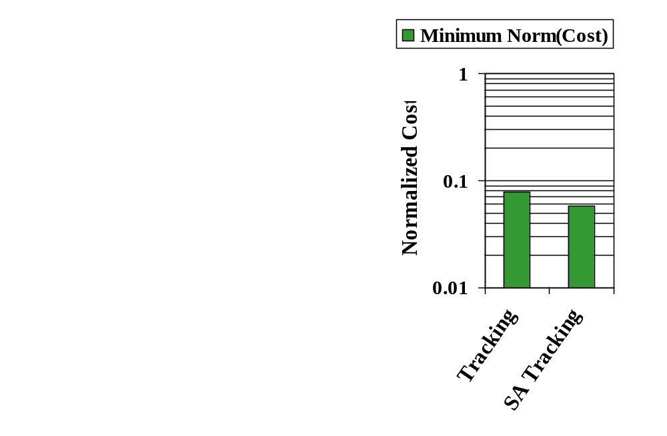
Effect of Supervised Adaptation
CMU4 is a simple cosine similarity tracker
  Contrastive run submitted without supervised adaptation

Slide 28
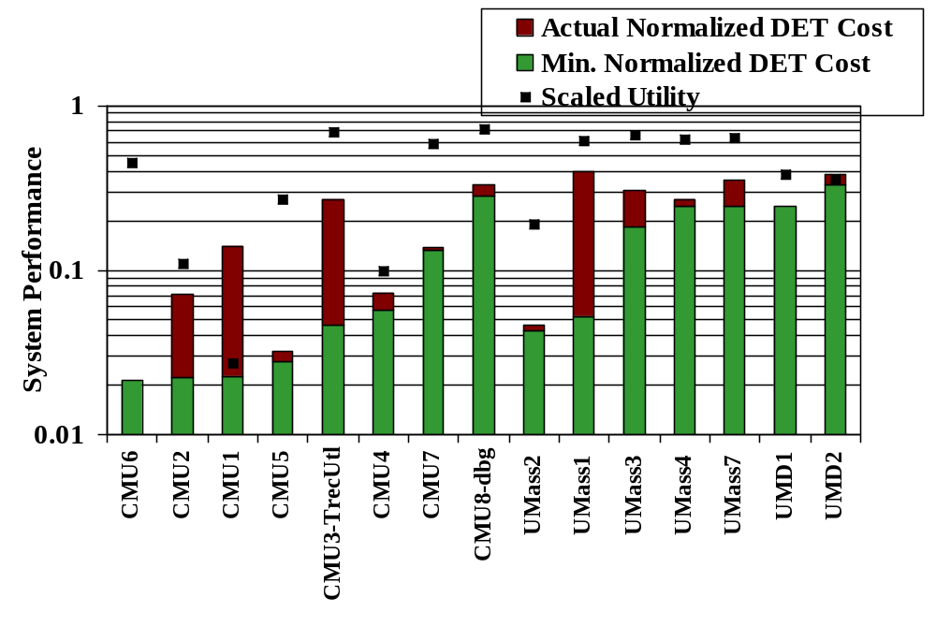
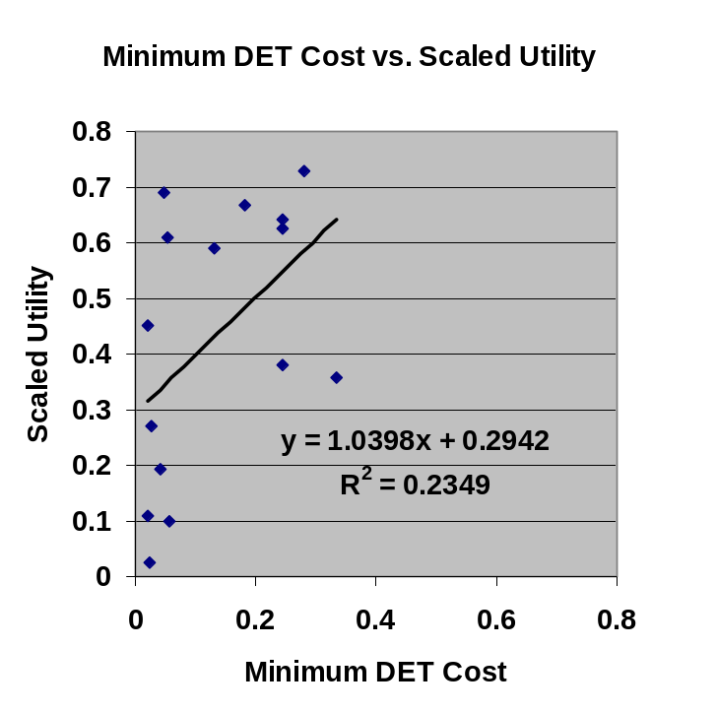
Supervised Adaptive Tracking
Utility vs. Detection cost
Performance on Utility measure:
  2/3 of systems surpassed baseline scaled utility score (0.33)
  Most systems optimized for detection cost, not utility
Detection Cost and Utility are uncorrelated: R² of 0.23
  Even for CMU3 which was tuned for utility

Slide 29
Hierarchical Topic Detection
System goal:
  To detect topics in terms of the (clusters of) stories
  that discuss them
Problems with past Topic Detection evaluations:
  Topics are at different levels of granularity,
  yet systems had to choose single operating point
  for creating a new cluster
  Stories may pertain to multiple topics,
  yet systems had to assign each to only one cluster

Slide 30
Topic Hierarchy Solves Problems
System operation:
  Unsupervised topic training -
  no topic instances as input
  Assign each story to one or more clusters
  Clusters may overlap or include other clusters
  Clusters must be organized as directed acyclic graph (DAG) with single root
  Treated as retrospective search
Semantics of topic hierarchy:
  Root = entire collection
  Leaf nodes = the most specific topics
  Intermediate nodes represent different levels of granularity
Performance assessment:
  Given a topic, find matching cluster
  with lowest cost
a
Vertex
Edge
Story IDs
a
b
c
s1
s4
s3
s2
d
e
f
g
s5
s10
s9
s6
h
i
j
s7
s13
s15
s8
s11
s12
s14
s16

Slide 31
Hierarchical Topic Detection Metric: Minimal Cost
Weighted combination of Detection Cost and Travel Cost:
  WDET × (Cdet(topic, bestVertex))_{Norm} + (1 - WDET) × Ctravel(topic, bestVertex))_{Norm}
  Detection Cost: same as for other tasks
  Travel Cost: function of the hierarchy
  Detection Cost weighted 2× Travel Cost (WDET = 0.66)
Minimal Cost metric selected based on study at U Mass (Allan et al.):
  Effectively eliminates power set solution
  Favors balance of cluster purity vs. number of clusters
  Computationally tractable
  Good behavior in U Mass experiments
Analytic use model:
  Find best-matching cluster by traversing DAG, starting from root
  Corresponds to analytic task of exploring an unknown collection
Drawbacks:
  Does not model analytic task of finding other stories on same or neighboring topics
  Not obvious how to normalize travel cost

Slide 32
Hierarchical Topic Detection Metric: Travel Cost
Travel Cost computation:
  Ctravel(topic, vertex) = Ctravel(topic, parentOf(vertex)) +
    CBRANCH × NumChildren(parentOf(vertex)) + CTITLE
  CBRANCH = cost per branch, for each vertex on path to best match
  CTITLE = cost of examining each vertex
  Relative values of CBRANCH and CTITLE determine preference
  for shallow, bushy hierarchy vs. deep, less bushy hierarchy
  Evaluation values chosen to favor branching factor of 3
Travel Cost normalization:
  Absolute travel cost depends on size of corpus, diversity of topics
  Must be normalized to combine with Detection Cost
  Normalization scheme for trial evaluation chosen to yield Ctravel_{Norm} = 1 for “ignorant” hierarchy (by analogy with use of prior probability for Cdet_{Norm}):
    Ctravel_{Norm} = Ctravel / (CBRANCH * MAXVTS * NSTORIES / AVESPT) + CTITLE
    MAXVTS = 3 (maximum number of vertices per story, controls overlap)
    AVESPT = 88 (average stories per topic, computed from TDT4 multilingual data)

Slide 33
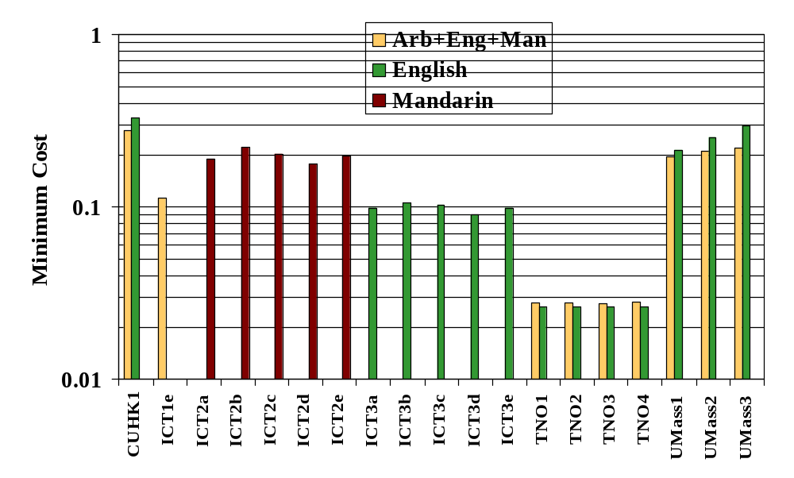
Hierarchical Topic Detection

Slide 34
Hierarchical Topic Detection Observations
All systems structured hierarchy as a tree –
each vertex has one parent
Travel cost has very little effect on finding the best cluster
  Setting WDET to 1.0 has little effect on topic mapping
Cost parameters favor false alarms
  Average mapped cluster sizes are between
  1262 and 7757 stories
  Average topic size is 40 stories

Slide 35
Summary
Eleven research groups participated in five evaluation tasks
Error rates increased for new event detection
  Why?
Error rates decreased for tracking
Error rates decreased for link detection
Dry run of hierarchical topic detection completed
  Solves previous problems with topic detection task, but raises new issues
  Questions to consider:
    Is the specified hierarchical structure (single-root DAG) appropriate?
    Is the minimal cost metric appropriate?
    If so, is the normalization right?
Dry run of supervised adaptive tracking completed
  Promising results for including relevance feedback
  Questions to consider:
    Should we continue the task?
    If so, should we continue using both metrics?

