Slide 1
DES Calibrations Plan
Douglas L. Tucker & Darren L. DePoy
DES Collaboration Meeting
9 November 2008

Slide 2
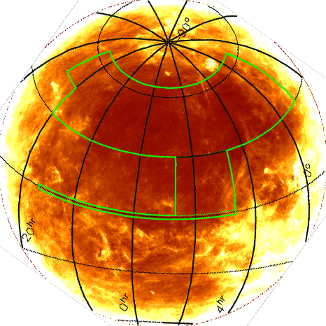
Review: Basic DES Observing Strategy
Survey Area
Overlap with
South Pole
Telescope
Survey
(4000 sq deg)
Observing Strategy
100 sec exposures (nominally)
2 filters per pointing (typically)
  gr in dark time
  iz in bright time
  Y filter in bright time
Multiple tilings/overlaps to optimize photometric calibrations
2 survey tilings/filter/year
All-sky photometric accuracy
  Requirement: 2%
  Goal: 1%
Connector
region
(800 sq deg)
J. Annis
Overlap with SDSS equatorial
Stripe 82 for calibration (200 sq deg)
Total Area: 5000 sq deg

Slide 3
Baseline Calibrations Plan
(Tucker et al. 2007; DES-doc-528)
Use a 10μm All-Sky Cloud Camera to monitor sky conditions throughout the night.
Observe standard star fields with DECam during evening and morning twilight and possibly once in the middle of the night (nightly or intermediate calibrations).
  Half hour per standard star session, or 1-1.5 hours per night
  Current Survey Strategy does not use twilight for science observations, so effectively only 0-0.5 hours per night are “lost” to calibration
  Can also observe standard stars when sky is photometric but seeing is too poor for science imaging (seeing > 1.1 arcsec)
Use the extensive overlaps between exposures over multiple tilings to tie together the DES photometry onto an internally consistent system across the entire DES footprint (global relative calibrations).
Use DECam observations of White Dwarf standards in combination with measurements of the full DECam system response (via, e.g., a tuneable laser flat-field system) to tie the DES photometry onto an AB magnitude system (global absolute calibrations).
  Special observations will be necessary for those White Dwarf standards brighter than r~16, since they will saturate in normal 100-sec DES science observations.
  b. These special observations could be performed under photometric-but-poor-seeing conditions.

Slide 4
Baseline Calibrations Plan: Tasks
The Cloud Camera and the System Response Engine belong to DECam, and progress is being made on these two systems.
  Cloud Camera effort could use some help.
The software for the nightly, global relative, and global absolute calibrations belong to DESDM and are being tested in the Data Challenges.
The following tasks of the Baseline Calibrations Plan have been identified as needing help in order to be ready for the start of DES operations:
  Measurement of transformation relations from SDSS ugriz/u’g’r’i’z’ to DES griz (Effort: 2 FTE months, Costs: travel for CTIO-1m observing runs)
  Establishment of DES Y-band standard stars (Effort: 2 FTE months, Costs: travel for CTIO-1m observing runs)
  Establishment of White Dwarf absolute standards (Effort: 12 FTE months, Costs: travel for observing runs)
  Prepare code to calculate and apply AB offsets from White Dwarf observed by DECam (Effort: 2 FTE months)

Slide 5
SMARTS 1m Telescope @ CTIO
+ DECam 2k x 2k CCD
April 2008 (7 nights)
  First on-sky tests of DECam CCD
  SDSS ugriz filter set + 945nm narrow band filter
  CCD QE and griz sky brightness measurements
  945nm water absorption band variability tests (for final specs of DES z and Y filters)
  Astrometry tests (for effects of “bright edges”)
October 2008 (7 nights)
  Gunn griz filter set (SDSS ugriz not available for the October 2008 run!)
  Measurements of DECam CCD characteristics (e.g., gain, dark current, noise & pedestal stability, fringing, astrometry; see Estrada; DES-doc-db#2245)
  Measurements of sky brightness
Future
  Measure HST white dwarf spectrophotometric standards in DES grizY
  Determine transformation relations between SDSS griz/g’r’i’z’ and DES griz filter systems
  Calibrate of DES z- and Y-band standard star fields
  SISPI guider tests
  Recommend at least three more week-long observing runs scheduled when the DES footprint is visible before the start of DES operations
  Need DES grizY 4-in filters!
Costs: Travel to CTIO for 2 observers for 3+ runs plus ~$10k for filters; 4 FTE mths effort
Part of DECam Project?

Slide 6
Other Initiatives:
PreCam and the Extinction Monitor
We are investigating possible uses of one or more of the small telescopes at CTIO to support DES.
Goals:
  Improve DES efficiency by 10% or more to save funds and increase contingency
    0.10 x 525 nights = 52.5 nights
    52.5 nights x $10K/night = $525K
  Improve scientific quality of DES data
Not part of DECam Project
  Post-CD3b, the budget for DECam Project is already fixed
  Funding must come from non-DECam sources
Two ideas show particular potential:
  “PreCam” Survey: a quick, bright survey of the DES footprint using a small mosaic of DECam 2kx2k CCDs (or possibly DECam 2kx4k CCDs) mounted on the University of Michigan Curtis-Schmidt Telescope at CTIO. Observations would take place in December 2009/January 2010 and/or December 2010/January 2011.
  Extinction Monitor: use one of the 1m-class SMARTS telescopes at CTIO as a nightly extinction and sky brightness monitor during DES operations.

Slide 7
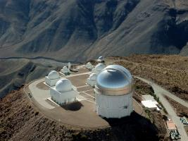
Telescopes at Tololo
UM Curtis-Schmidt
SMARTS 1m
SMARTS 0.9m
SMARTS 1.5m
Blanco 4m
Courtesy: NOAO/AURA/NSF

Slide 8
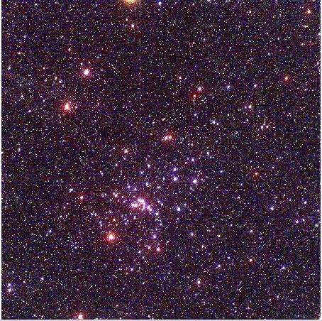
PreCam: Description
Baseline instrument:
2x2 mosaic of DECam 2k x 2k CCDs
Possible upgrades:
  2x3 mosaic
  DECam 2k x 4k CCDs
    If yield is high enough
For baseline instrument:
  FOV of 1.6º x 1.6º (2.69 sq deg) for baseline instrument at a pixel scale of 1.4 arcsec/pixel
  1860 fields to cover 5000 sq deg
  At 600 sec per field (see Table), it would take 372 hours, or about 47 nights, to perform a single-pass PreCam Survey in all 5 DES filters
M48 on UM Curtis-Schmidt + Tek2k#5
FOV: 1.3 deg (2.3 arcsec/pixel)
30 sec each in g, r, i
Baseline PreCam Survey Magnitude Limits
Credit: J. Allyn Smith; see Rider et al. (2004)
Courtesy: NOAO/AURA/NSF

Slide 9
PreCam: Benefits to DES (I)
The baseline PreCam Survey -- a single-pass survey of the full DES footprint in all 5 DES filters down to i≈18 -- would yield a catalog of several million bright stars calibrated in the DES grizY photometric system (typically hundreds per DECam CCD).
If the PreCam Survey can achieve:
  5% global relative calibrations (easy), the PreCam star catalog would be useful for “quick look” diagnostics of the DECam data.
  2% global relative calibrations (do-able), the PreCam star catalog could:
    Start to be used as extinction standards, supplementing the SDSS Stripe 82 standards and the Smith et al. Southern u’g’r’i’z’ standards (could reduce the amount of time needed for observing standard stars during twilight and/or during middle of night)
    Be used for a robust determination of the transformation relations between the SDSS and DES photometric systems
    Be used as initial Y-band standards (see 1b(i))
  <1% global relative calibrations (very challenging), the PreCam star catalog could be used as local standards over the entire DES footprint, obviating the need for observing standard stars during twilight or during the middle of the night
    All DES twlight observations could be reserved for z- and Y-band science observations
    This would effectively increase the amount of time for science observations by 1 hour per night, thus increasing DES observing efficiency by about 10%.
Courtesy: NOAO/AURA/NSF

Slide 10
PreCam: Benefits to DES (II)
In combination with SkyMapper Survey u-band data, candidate DA white dwarfs can be identified over the full DES footprint, which could help in the final absolute calibration of the DES.
The PreCam Survey would serve as an intensive, pre-DES-operations “real-life” test of
  a DECam CCD mosaic camera
  DES survey strategy observing software
  potential DES observers
  DES flat field screen/system response measuring engine
The PreCam Survey would enable grizY bright-object science within the DES footprint
  Stars brighter than r~16 will saturate in the DES 100-second science exposures
  Red giant branch photometry will typically be saturated in most known Galactic star clusters in the DES 100-second science exposures.
  Galactic Archaeology Study Group take note!
Courtesy: NOAO/AURA/NSF

Slide 11
PreCam: Current Status
Negotiations have taken place with Pat Seitzer of the University of Michigan’s Department of Astronomy regarding the possibility of using the Curtis-Schmidt. Use for the PreCam Survey is possible if there is no interference with the NASA project that is currently running on the Curtis-Schmidt through January 2010 (and that will likely be extended beyond then). Darren DePoy has drafted text for a Memorandum of Understanding for DES use of the Curtis-Schmidt telescope that seems satisfactory to Pat Seitzer. Discussion is proceeding as to who on the DES side is empowered to sign this MOU.
Argonne: At the 24 October 2008 PreCam telecon, Steve Kuhlman reported that his group has received $30K of R&D fudning from Argonne for FY2009 for parts and engineering of the cryostat. He (and Darren) have talked with Juan Estrada about the 4- and 6-CCD configurations. The Argonne group has already built two vacuum vessels for about $2K each. The 4-CCD PreCam could easily fit into their current vacuum vessel and could be ready by early 2009. A 6-CCD version would not be hard to do. Joe Bernstein travelled to CTIO the week of October 26-November 1 to observe for a couple nights on the Curtis-Schmidt with Pat Seitzer.
Michigan: At the 24 October 2008 PreCam telecon, the DES Michigan group reported that they are willing and eager to contribute to the planning of PreCam, and assuming PreCam goes forward, could contribute the hardware and personnel (e.g., a grad student). They would be interested in generating and testing the filters. They could also serve as a natural point-of-contact with Pat Seitzer.
Courtesy: NOAO/AURA/NSF

Slide 12
PreCam: Tasks (I)

Slide 13
PreCam: Tasks (II)

Slide 14
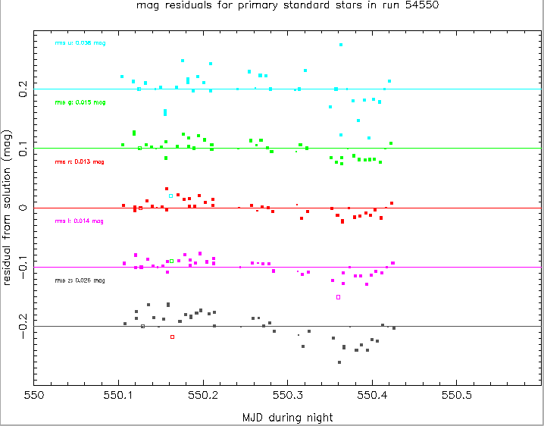
Extinction Monitor: Description
Use one of the 1m-class SMARTS telescopes at CTIO as a nightly extinction and sky brightness monitor during DES operations
The Extinction Monitor telescope would run throughout the night on every night of DES operations (525 nights).
SDSS 0.5m Photometric Telescope
Courtesy: NOAO/AURA/NSF

Slide 15
Extinction Monitor: Benefits to DES
No need for Blanco to observe multiple standard star fields per night.
Still may need to observe one standard field once per night (probably during twilight) to measure photometric zeropoints (“a” terms) and instrumental color (“b”) terms.
Yields an extra hour every night for the Blanco to do something else, assuming about half an hour between 12º and 18º twilight in the evening and the morning, plus some more time in the middle of the night
  Observe Z- and Y-band science fields during twilight (this is what LSST plans to do)
  1 hour per night ~ 10% of observing time ~ 52.5 nights x $10K/night = $525,000.
Set first-order extinction (“k”) coefficients for night in the Photometric Standards Module as measured by small telescope.
  More robust measure of nightly extinction than could be done with the limited time available for standard star observations on Blanco; could even measure a time variable extinction (dk/dt)
  This is even done by SDSS Uebercal (using k and dk/dt as measured by the SDSS Photometric Telescope)
  Not suggesting that we use the small telescope to do “Secondary Patches” a la the SDSS standard calibration.
Courtesy: NOAO/AURA/NSF
Courtesy: NOAO/AURA/NSF

Slide 16
Extinction Monitor: Current Status
Discussions with Charles Bailyn (lead of SMARTS Consortium, which runs the 1m-class telescopes on the Tololo summit) and with Terry Oswalt (lead of SARA Consortium, which runs the Lowell 0.6m telescope, which is located about 1 km from the Tololo summit).
Talks with the SARA Consortium fell through -- DES would need too large a fraction of the Lowell 0.6m time, which is already shared by several institutions.
Talks with the SMARTS consortium fared better. Charles Bailyn of SMARTS suggested two possibilities:
  Build a new (1.3m?) telescope on the Tololo summit and share operations with SMARTS:
    Sep-Mar for DES (South Galactic Cap); Apr-Aug for SMARTS (Galactic Center; most oversubscribed period for SMARTS).
    Problem: Resource intensive; no significant SMARTS contribution to construction possible
  Build a new imaging spectrograph for the SMARTS 1.5m.
    Estimated cost: $500K
    Providing a new SMARTS instrument yields 6% of SMARTS time = 65 service nights per year (@1.5K/night) or $97.5K worth of service observing per yield. $500K cost recouped in 5 years
    Additional time requires $1.5K/night support
    PREST proposal?
Not much progress since the July 21 DES Calibrations Workshop in Ann Arbor.
Courtesy: NOAO/AURA/NSF

Slide 17
Extinction Monitor: Tasks
Instrumentation /
New Telescope Option
  Telescope: $1-2M?
  Single 2k x 2k DECam CCD + dewar: ~$10K?
  DES grizY (+H₂0 band?) filters: ~$10K
  2 years to build & commission?
Instrumentation /
Imaging Spectrograph Option
  Imaging Spectrograph: $500K for equipment
  DES grizY (+ H₂0 band?) filters: ~$10K
  1 year to build & commission?
Mountaintop operations
  SMARTS buy-in costs are $1K/night if we provide our own observers, or 1.5K/night if we use service observers. Providing a telescope or an instrument would significantly reduce or eliminate these costs, depending on which option we follow.
  If we provide our own observers, we need to factor in travel costs.
Software and Analysis
  Software development: 4 FTE months
  Data processing: 1 FTE hour per day for 525 days = 525 hours = 3.2 FTE months over 5 years
Courtesy: NOAO/AURA/NSF

Slide 18
Filter Status
Relaxation of filter specifications
  Inhomogeneity across bandpass
  Allow a “slope” that can vary across filter
  Minimal impact on photometric performance, photo-z’s, etc.
  See Huan Lin’s description of docdb
New Request for Information generated
Sending to multiple filter vendors
May be additional positive responses (in addition to SESO)
  Asahi
  OCLI
May not mean lower cost
  Should know within 1-2 months

Slide 19
In closing…
There is a DES calibration mailing list:
  http://listserv.fnal.gov/archives/des-calib.html.
Please sign up!

Slide 20
Extra Slides

Slide 21
Calibrations Working Group
Observing
Strategy
(connects with
Survey Strategy)
Auxiliary Equipment
Cloud Camera
(with SISPI)
System Response
Measuring
Engine
DRAFT
Flux Standards
PreCam
Extinction
Monitor
White Dwarfs
(Absolute
Calibration)
Standard Stars
(Nightly
Calibration)
“Tiger Team”
(R&D/
liaisons with LSST)
Before Commissioning/During Commissioning/During Operations?
Make explicit connections with DECam, DESDM, CFIP, SWGs?

Slide 22
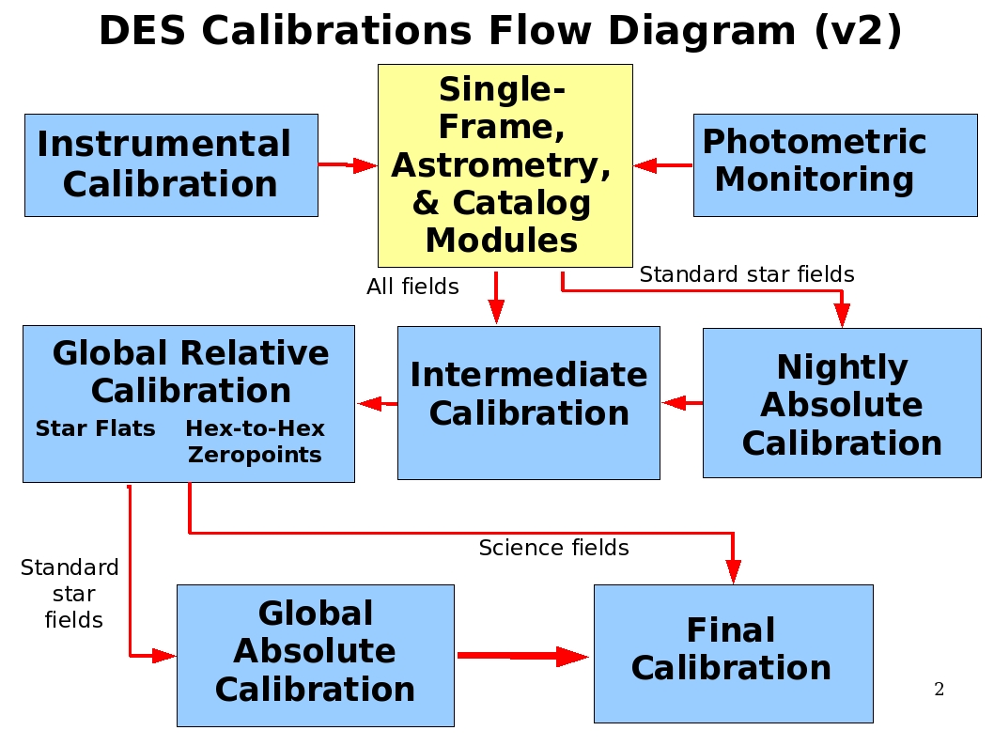
Spectro-
photometric
standard
stars
Co-add

Slide 23
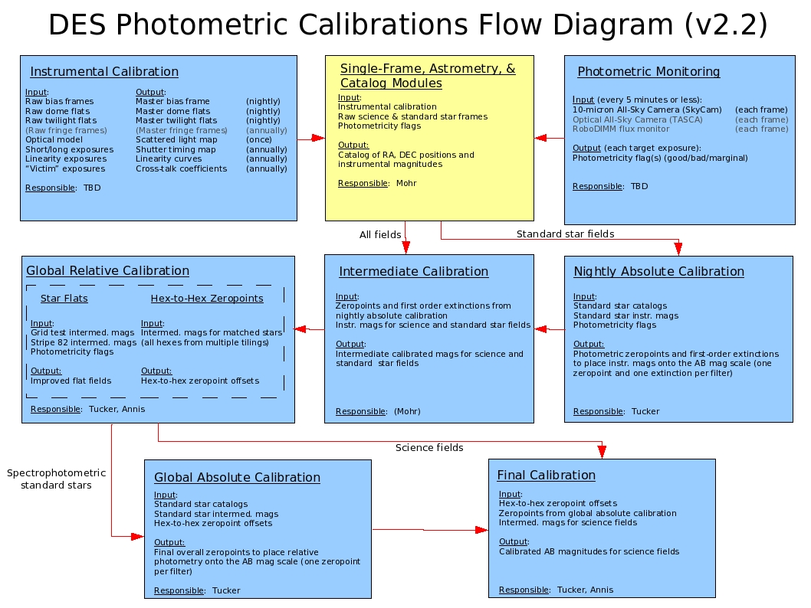

Slide 24
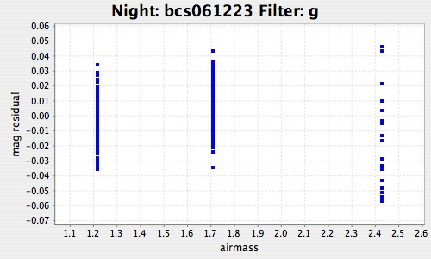
Current DES Strategy for
Standard Star Observations
Observe 3 standard star fields, each at a different airmass (X=1-2), between nautical (12°) and astronomical (18°) twilight (evening and morning).
Observe up to 3 more standard fields (at various airmasses) throughout the night
Also can observe standard star fields when sky is photometric but seeing is too poor for science imaging (seeing > 1.1 arcsec)
Use fields with multiple standard stars (to cover focal plane and to cover a wide range of colors)
Keep an eye on the photometricity monitors
Result: not a very good sampling of
extinction in the time domain

