Slide 1
Overview of Trilinos Preconditioners
(in AztecOO, IFPACK and ML)
…and how to get started using them
Alan Williams, org 1543
william@sandia.gov
with material and input from
Mike Heroux, Marzio Sala, and others
Review&Approval: SAND 2005-7145P

Slide 2
Trilinos – lots of packages, what do I need?
To decipher all the greek package-names, check
http://software.sandia.gov/Trilinos/capabilities.html
Many packages build by default.
  Type ‘configure –help’ in main Trilinos directory
To get started with solving and preconditioning linear systems:
  AztecOO – Krylov subspace iterative methods
  IFPACK – Incomplete factorization package (preconditioners)
  ML – Multilevel solvers/preconditioners
  Amesos direct solvers (more power for IFPACK, ML)
Use –prefix=<dir> option with configure, then gmake, gmake install

Slide 3
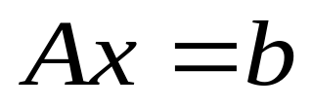
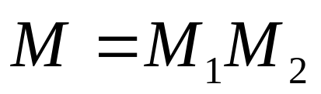
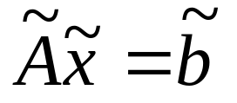
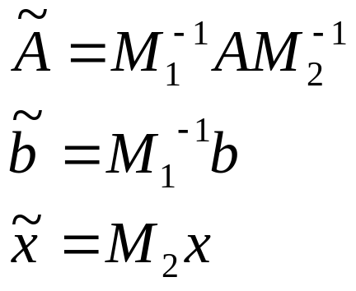



Preconditioning: (Just to make sure we’re on the same page…)
    Denote the linear system (user’s problem):
    Preconditioning: given M such that:
    Solve the preconditioned system:
    Where:
    is close to identity, or nice properties
    The art of preconditioning:
    can be inverted efficiently

Slide 4
More basic stuff…
In practice, usually M1 or M2 is identity, leaving right or left preconditioning, and preconditioner is often referred to as simply “M” or “P”.
Trilinos Krylov methods:
  Aztec/AztecOO
    Preconditioning performed by Krylov implementations, user not concerned with left vs right, etc.
    (Aztec applies preconditioners on the right…)
  Other Krylov methods in Trilinos…
    Belos allows user to specify left or right preconditioning

Slide 5
AztecOO
Krylov subspace solvers: CG, GMRES, Bi-CGSTAB,…
Incomplete factorization preconditioners
Aztec is the workhorse solver at Sandia:
  Extracted from the MPSalsa reacting flow code.
  Installed in dozens of Sandia apps.
  1900+ external licenses.
AztecOO improves on Aztec by:
  Using Epetra objects for defining matrix and RHS.
  Providing more preconditioners/scalings.
  Using C++ class design to enable more sophisticated use.
AztecOO interfaces allows:
  Continued use of Aztec for functionality.
  Introduction of new solver capabilities outside of Aztec.
Developers:
Mike Heroux, Alan Williams, Ray Tuminaro

Slide 6
Preconditioners and Aztec
“old-fashioned” Aztec…
Original Aztec interfaces allow selection of internal preconditioners by setting the contents of the options and params arrays.
Options[AZ_precond]: AZ_none
AZ_Jacobi
AZ_Neumann
AZ_ls
AZ_sym_GS
AZ_dom_decomp
If AZ_dom_decomp, also set options[AZ_subdomain_solve]:
AZ_lu (serial)
AZ_ilut
AZ_ilu
AZ_rilu
AZ_bilu
AZ_icc

Slide 7
A Simple Epetra/AztecOO Program
// Header files omitted…
int main(int argc, char *argv[]) {
MPI_Init(&argc,&argv); // Initialize MPI, MpiComm
Epetra_MpiComm Comm( MPI_COMM_WORLD );
// ***** Create x and b vectors *****
Epetra_Vector x(Map);
Epetra_Vector b(Map);
b.Random(); // Fill RHS with random #s
// ***** Map puts same number of equations on each pe *****
int NumMyElements = 1000 ;
Epetra_Map Map(-1, NumMyElements, 0, Comm);
int NumGlobalElements = Map.NumGlobalElements();
// ***** Create Linear Problem *****
Epetra_LinearProblem problem(&A, &x, &b);
// ***** Create/define AztecOO instance, solve *****
AztecOO solver(problem);
solver.SetAztecOption(AZ_precond, AZ_Jacobi);
solver.Iterate(1000, 1.0E-8);
// ***** Create an Epetra_Matrix tridiag(-1,2,-1) *****
Epetra_CrsMatrix A(Copy, Map, 3);
double negOne = -1.0; double posTwo = 2.0;
for (int i=0; i<NumMyElements; i++) {
int GlobalRow = A.GRID(i);
int RowLess1 = GlobalRow - 1;
int RowPlus1 = GlobalRow + 1;
if (RowLess1!=-1)
A.InsertGlobalValues(GlobalRow, 1, &negOne, &RowLess1);
if (RowPlus1!=NumGlobalElements)
A.InsertGlobalValues(GlobalRow, 1, &negOne, &RowPlus1);
A.InsertGlobalValues(GlobalRow, 1, &posTwo, &GlobalRow);
}
A.FillComplete(); // Transform from GIDs to LIDs
// ***** Report results, finish ***********************
cout << "Solver performed " << solver.NumIters()
<< " iterations." << endl
<< "Norm of true residual = "
<< solver.TrueResidual()
<< endl;
MPI_Finalize() ;
return 0;
}

Slide 8
Preconditioning AztecOO
Epetra_Crsmatrix* A; //or Epetra_VbrMatrix
Epetra_MultiVector *x, *b;
AztecOO azoo(A, x, b);
…
Epetra_Operator* M = // (define preconditioner here…)
azoo.SetPrecOperator(M);
azoo.Iterate(max_iters, tolerance);

Slide 9
IFPACK: Algebraic Preconditioners
Overlapping Schwarz preconditioners with incomplete factorizations, block relaxations, block direct solves.
Accept user matrix via abstract matrix interface (Epetra versions).
Uses Epetra for basic matrix/vector calculations.
Supports simple perturbation stabilizations and condition estimation.
Separates graph construction from factorization, improves performance substantially.
Compatible with AztecOO, ML, Amesos. Can be used by NOX and ML.
Developers:
Marzio Sala, Mike Heroux

Slide 10
IFPACK preconditioners
Class Ifpack_AdditiveSchwarz<T> defines the IFPACK preconditioner
Overlap is specified (on or off) by a parameter
  If overlap > 0, overlapping matrix allocated rows for overlapping region only
This class is templated with the local solver T:
  Defines A_{i}⁻¹
  Must be an Ifpack_Preconditioner derived class
Ifpack_Preconditioner is a base class of Ifpack_AdditiveSchwarz

Slide 11
Available Local Solvers
Effectiveness
Memory
requirements
Simple point relaxation methods:
  Jacobi, Gauss-Seidel, SOR, SSOR
Block relaxation methods:
  Blocks defined by METIS or a simple greedy algorithm
  Blocks of any size, inverse of each block applied using LAPACK
  or any IFPACK preconditioner
  Jacobi, Gauss-Seidel, symmetric Gauss-Seidel
Incomplete factorizations:
  Dropping based on graph
  Dropping based on value
Any Amesos LU factorization
  Replaces Y12M
Local solvers (e.g., Ifpack_ILUT, Ifpack_Amesos) are specializations of Ifpack_Preconditioner
Example:
Ifpack_Preconditioner* P = new Ifpack_AdditiveSchwarz<Ifpack_ILUT>(…);
−
+

Slide 12
IFPACK Example
packages/ifpack/example/Ifpack_ex_Factory.cpp
Ifpack Factory;
std::string PrecType(“ILUT”);
int OverlapLevel = 1;
Ifpack_Preconditioner* P = Factory.create(PrecType, A, OverlapLevel);
Teuchos::ParameterList List;
List.set(“fact: drop tolerance”, 1.e-9);
List.set(“fact: level-of-fill”, 1);
P.SetParameters(List);
P.Initialize();
P.Compute();
Azoo.SetPrecOperator(P);

Slide 13
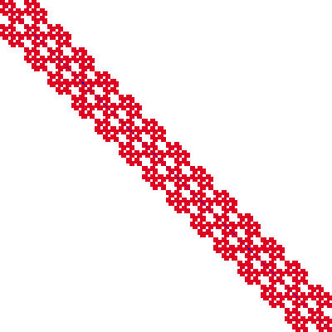
Ifpack Parameters - OverlapLevel
OverlapLevel == 0, no overlap
OverlapLevel > 0, overlap
No Overlap
Overlap
P0
P1
P2

Slide 14
More Ifpack Parameters…
Choice of local solver: PrecType
  “point relaxation”, “block relaxation”
  “IC”, “ICT”, “ILU”, “ILUT”
  “Amesos” (requires Trilinos be configured with –enable-amesos)
Relaxation parameters, examples:
  List.set(“relaxation: type”, “Jacobi”);
  List.set(“relaxation: sweeps”, 3);
  List.set(“relaxation: damping factor”, 1.0);
Factorization parameters, examples:
  List.set(“fact: level-of-fill”, 5);
  List.set(“fact: drop tolerance”, 1.e-6);

Slide 15
ML: Multi-level Preconditioners
Smoothed aggregation, multigrid and domain decomposition preconditioning package
Critical technology for scalable performance of some key apps.
ML compatible with other Trilinos packages:
  Accepts user data as Epetra_RowMatrix object (abstract interface). Any implementation of Epetra_RowMatrix works.
  Implements the Epetra_Operator interface. Allows ML preconditioners to be used with AztecOO and TSF.
Can also be used completely independent of other Trilinos packages.
Developers:
Ray Tuminaro, Jonathan Hu, Marzio Sala

Slide 16
ML parameters, options
Useful defaults:
  ML_Epetra::SetDefaults(“SA”, MLList);
Screen output level
  MLList.set(“output”, 1);
  Value of 0 turns off screen output, higher value gives more output
Third-party libraries for reordering, load-balancing, etc.
  Configure options include –with-ml_metis, –with-ml_parmetis3x, –with-ml_zoltan, etc.
  Covered in User Manual
Consult documentation, and/or ML developers
Jonathan Hu, Ray Tuminaro

Slide 17
ML with Epetra: Example of use
Trilinos_Util_CrsMatrixGallery Gallery(“laplace_3d", Comm);
Gallery.Set("problem_size", 100*100*100);
// linear system matrix & linear problem
Epetra_RowMatrix * A = Gallery.GetMatrix();
Epetra_LinearProblem * Problem = Gallery.GetLinearProblem();
// Construct outer solver object
AztecOO solver(*Problem);
solver.SetAztecOption(AZ_solver, AZ_cg);
// Set up multilevel precond. with smoothed aggr. defaults
ParameterList MLList; // parameter list for ML options
ML_Epetra::SetDefaults(“SA”,MLList);
MLList.set(“aggregation: type”, “METIS”);
// create preconditioner
ML_Epetra::MultiLevelPreconditioner * MLPrec = new
ML_Epetra::MultiLevelPreconditioner(*A, MLList, true);
solver.SetPrecOperator(MLPrec); // set preconditioner
solver.Iterate(500, 1e-12); // iterate at most 500 times
delete MLPrec;
Triutils
AztecOO
ML
AztecOO
Trilinos/packages/ml/examples/ml_example_MultiLevelPreconditioner.cpp

Slide 18
Documentation
Start with Trilinos web site, information about all packages:
  http://software.sandia.gov/Trilinos
AztecOO User’s Manual:
http://software.sandia.gov/Trilinos/packages/aztecoo/AztecOOUserGuide.pdf
ML User’s Guides etc.
  http://software.sandia.gov/Trilinos/packages/ml/documentation.html
Example programs:
  packages/ml/examples
  packages/ifpack/example
Other Preconditioners, interfaces coming in the future
  Claps
  Meros
  Thyra

