Slide 1

GFESuite Plans
Mark Mathewson

Slide 2
Short-Term Plans (through April 03)
Text Generation – Local Formatters
  Phrase Builder
  Discrete Data Types in GFE
OCONUS Work
ISC Enhancements for Snow/QPF/PoP

Slide 3
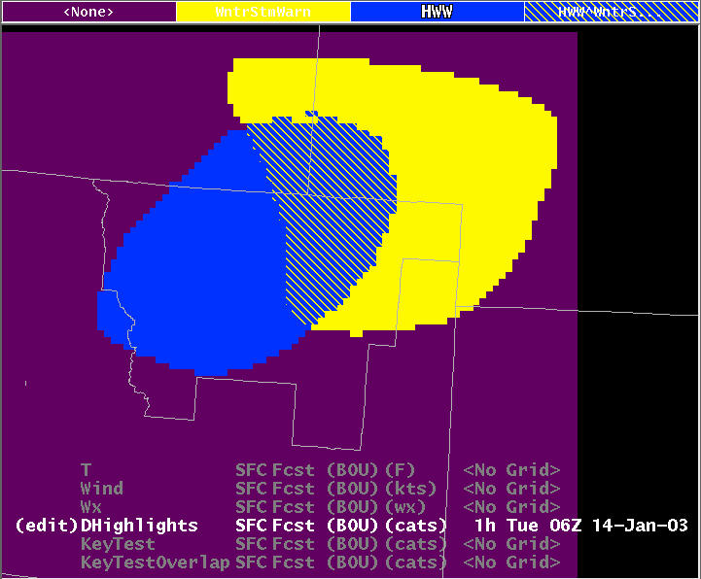
Discrete – Data Type
Similar to Wx, but configurable
Plan to use for Headlines in GFE Formatters
Overlap
Non-Overlap

Slide 4
Mid-Term Plans (through IOC)
PX boxes for servers
Smart Tool libraries
Text Generation how-to documents
User Interface Enhancements
  From Nov 2002 RPP workshop
Beginnings of Gridded DFC

Slide 5
Long-Term (after IOC)
Budget-dependent
Improve smart tool / smart init frameworks
Aviation – 3d
Other Improvements???
  Climate grids…

Slide 6
RPP Style of Development
Switching to focus groups, rather than broad coverage
S/W will be available to all
Focus Groups – 2 at a time at most
  Text Formatting
  ISC Tools/Capabilities
  Smart Tools/Smart Init
  Gridded DFC

