Slide 1

Report on the
FFG Consistency Meeting at LMRFC May 5-6, 2004
Dave Reed
HIC Meeting
July 13-15, 2004

Slide 2
Meeting Overview
Outgrowth of
  FFGIT Findings
  SR RFC Tech Transfer Meeting in December 2003
Goals
  Minimize inconsistency in FFG across RFC boundaries
  Eliminate holes in FFG and overlap at RFC boundaries

Slide 3
Procedure
Reviewed FFGUID User Control Parameters from RFCs
  Set suggested limits on parameters
Reviewed gridded threshhold runoff utilizing ArcView
  Suggested changes in values along boundaries
Decision on making changes up to RFCs

Slide 4
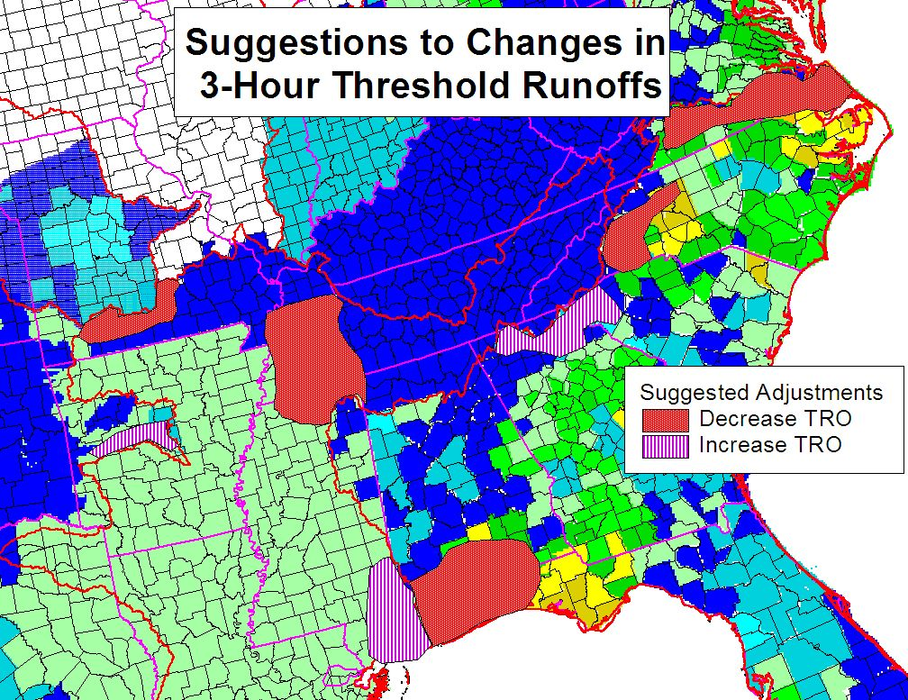
Suggested Changes

Slide 5
Additional Recommendations
Clip gridded FFG at RFC boundaries to eliminate overlap
Utilize ArcInfo to address holes at boundaries of RFCs and basins
Share model parameters for basins near RFC boundaries
Hold quarterly conference calls to discuss/address discrepancies

