Slide 1
Type II SN spectroscopic modeling
Luc Dessart¹ & D. John Hillier²
(¹University of Arizona; ²University of Pittsburgh)
Goal and Method:
Use detailed non-LTE radiative transfer code CMFGEN and high-quality photospheric-phase Type II SN spectra to constrain core-collapse SN explosions, massive star evolution, and distances in the Universe
References: Dessart & Hillier (2005ab, 2006ab); Brown et al. (2007);
Dessart et al. (2007ab, in prep.)

Slide 2
Radiative Transfer Issues
Fast expansion => line-overlap (HHeCNOZ)
Low-density => Scattering + non-LTE
t_{recombination} ~ t_{expansion} => D/Dt effects
⁵⁶Ni production => non-thermal excitation
=> A Challenging Radiative Transfer Problem

Slide 3
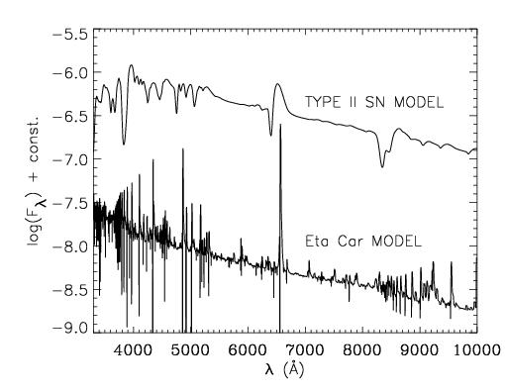
Ambiguity due to line broadening and overlap
Spectral features stem from multiple lines and multiple species => Line identification difficult

Slide 4
Salient Features of the non-LTE CMFGEN code
Hillier & Millier (1998); Dessart & Hillier (2005a)
Solves the radiative transfer equation in the CMF under constraints of Stat. and Radiative Equilibrium
Steady-state (but see end of talk)
1D; homogeneous monotonically-expanding ejecta
Adaptive grid (~50-80 pts; 5 pts per tau decade)
Key asset: metal line-blanketing
All rates included explicitly (radiative + collisional)
All continuum and line opacity sources included explicitly (no opacity sampling)
Large model atom (up to 25 species x [1-12] ionization states; ~1000 levels; ~10000 transitions); use of super-levels
Fine frequency grid, with ~100000 frequency points
Synthetic spectrum covers from ~100A to ~5μm
Recently added: relativistic effects, ⁵⁶Ni energy deposition, chemical stratification included, DJ/Dt, Dn/Dt
Method: Input GLOBAL quantities (L₀, R₀, v₀, X_{i}, etc)

Slide 5
Case Studies with CMFGEN:
Photospheric-Phase Evolution of SN1999em, SN2005cs, and SN2006bp
Multi-epoch Multi-wavelength Observations from Swift, Lick, Keck, NTT, HST, WHT, VLT, HET, Mount Whipple, in the UV, optical, and near-IR.
Sources: Hamuy, Leonard, Filippenko, Baron, Pastorello, CfA, Quimby, Brown, Immler, Milne …), covering from 3-7 days to ~45 days after discovery
See Dessart & Hillier (2006a; 2007 in prep)

Slide 6
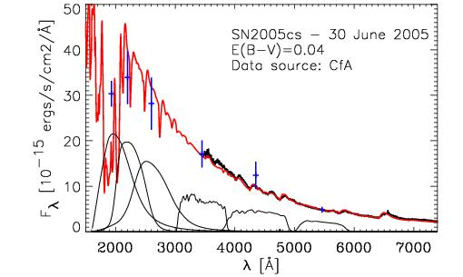
Blue crosses: Swift fluxes
Black curve: Observed spectrum (CfA, Pastorello et al. 2006)
Red curve: reddened CMFGEN synthetic spectrum
Case Study: SN2005cs
Weak optical lines: ρ ~ r⁻²⁰ ; fossil of breakout?

Slide 7
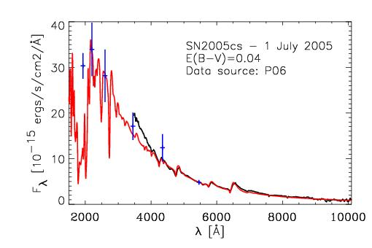
UV line blanketing due to FeIII
Isolated lines AlIII1900, MgII2800A
Optical lines of HI, HeI, NII, and OII

Slide 8
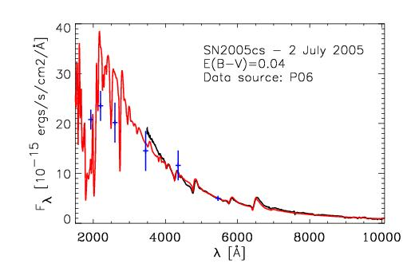
UV flux fading
Optical lines strengthening: ρ ~ r⁻¹²

Slide 9
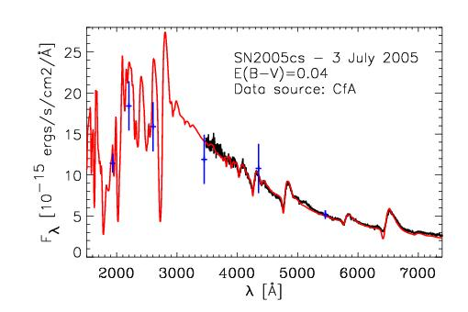
Stronger line blanketing in UV; FeII kicking-in, MgII
HI & HeI strengthening; NII/OII weakening
ρ ~ r⁻¹⁰ ; Flattening density distribution

Slide 10
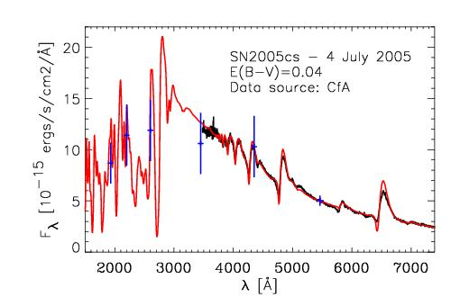
Stronger line blanketing in UV; FeII strengthening, MgII
HI & HeI strengthening; FeII emerging in optical

Slide 11
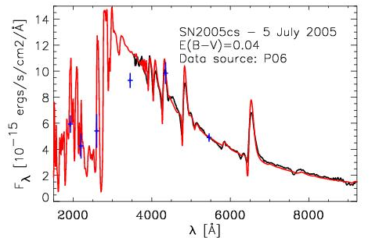
UV flux weak (blanketing + cooling)
HeI weak; FeII, SiII, OI emerging in optical

Slide 12
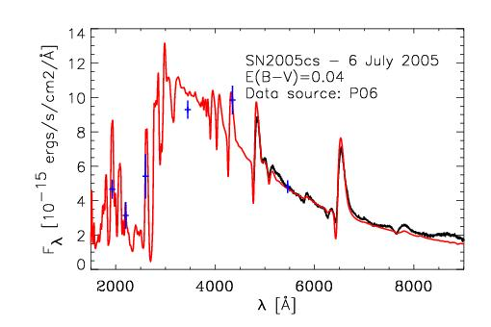

Slide 13
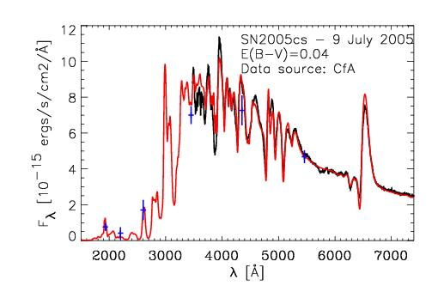
Negligible UV flux (ejecta recombined)
Strong blanketing in optical

Slide 14
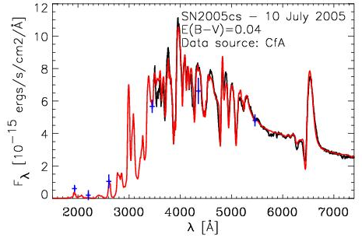
Strong blanketing in optical (FeII, TiII) and HI, SiII; Strong CaII3800A

Slide 15
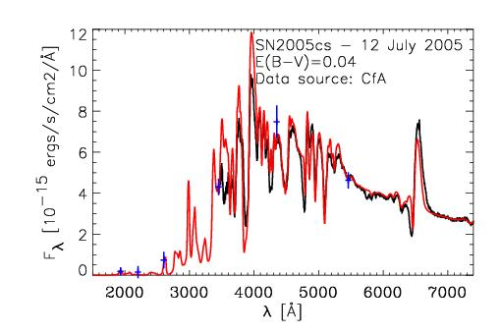
The same + FeII in Hα trough

Slide 16
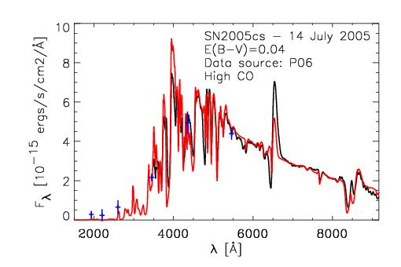
The same + CaII8500A + NaID, strong TiII/FeII at 4200A
Hα underestimated

Slide 17
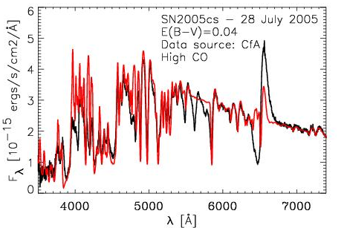
FeII ubiquitous
Hα strongly underestimated
V_{phot} ~ 2200km/s (down from 7000km/s on day 1)

Slide 18
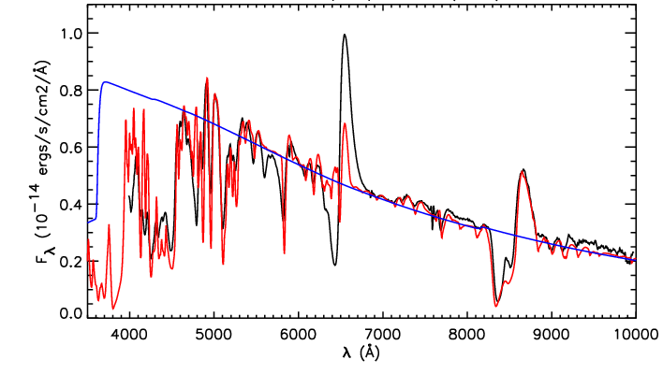
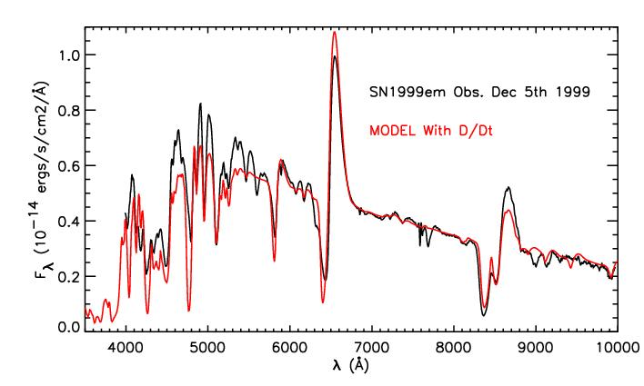
Outstanding Problems: HI lines at Recombination epoch (99br, 99em, 05cs, 06bp etc…)
99em at 45 days
D/Dt: Yes
D/Dt: No
Expansion & recombination times comparable (R/V ~ 1/αN_{e})
Dn/Dt ≠ 0 & energy from changes in ionization/excitation (see also: Utrobin & Chugai 2005; Utrobin talk)
Effects: frozen ionization, τ_{line} modified => HI lines , NaI5895A, HeI10830A (DH06b) Barium abundance in 87A (UC05)

Slide 19
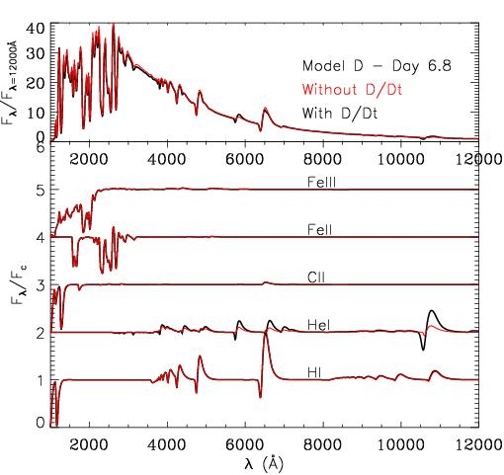
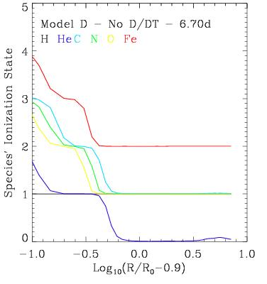
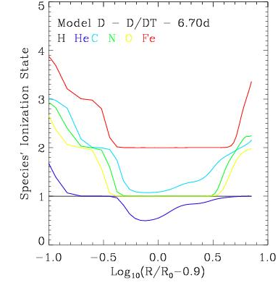
But D/Dt effects present even at early times
D/Dt: No
D/Dt: Yes
All species are affected
H fully ionized => Effect Not tied to recombination energy
HeI lines strongly affected (Not an ⁵⁶Ni effect!). X_{He}
Dn/Dt effects likely important in all SN ejecta

Slide 20
Results
Spectral evolution reflects the ejecta cooling (key to have multi-wavelength observations: Swift, optical, and near-IR).
Key role played by line-blanketing (CNO and metals)
BSG/RSG composition, He/N enhanced first, C and O enhanced later, Z throughout
Steep density gradient (n~20 flattening to 10); break-out?
Time-dependence effects at all times, strong at 1-2 months
At present, little constraint on stellar evolution; later times…
Forthcoming: Full star simulations from shock break-out to nebular phase, with DJ/Dt and Dn/Dt

Slide 21
Use of Type II SN as distance indicators:
Method:
1) Assume homologous expansion, i.e. R ~ V t
2) Minimize the scatter, between epochs, of the distance modulus μ_{S}(t ,t_{exp}) = m(t) - M_{S}(t,t_{exp}) - A_{S}, S={B,V,I}, for a set of guesses on the explosion time t_{exp}, or improved EPM
SN1999em: 11.5 Mpc (DH06a), 12.5Mpc (SEAM), 11.7Mpc (Cepheid)
SN2005cs: 8.9Mpc (Dessart et al. 2007), 7.6 Mpc (PNLF, SBF), 9.6Mpc (HII regions; Sandage & Tamman 1974); 7.1Mpc (Takats &Vinko 2006, with EPM, SCM)
SN2006bp: 17Mpc (Dessart et al. 2007), 17Mpc (Tully 1988)
Accurate to 5-10%
Alternate distance indicator
Independent check on Hubble constant
use out to z~1-5 with JWST

Slide 22
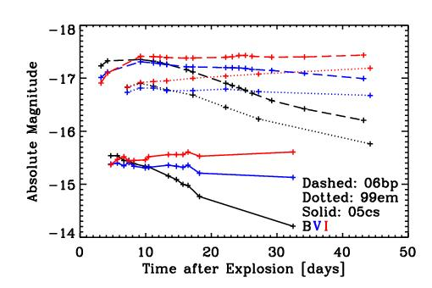
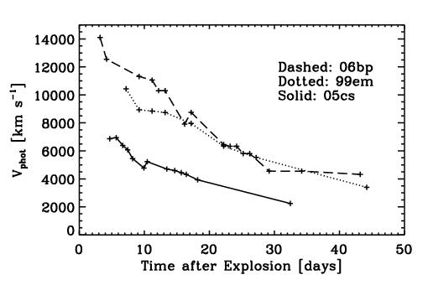
Core-Collapse SN Properties (with our inferred distance)
Range of energetics
Kinetic energy <=> Bolometric Luminosity

Slide 23
Conclusions
Many insights permitted by non-LTE calculations (line identifications, abundances)
Common photospheric origin for UV + optical in 05cs.
Importance of multi-wavelength observations (reddening, ionization); Swift + monitoring from the ground
Time dependence plays a critical role (ionization, line strengths)
Time dependence is likely to play a role in all SN ejecta.
Type II SN reliable distance indicators

