Slide 1
Homelessness and Mental Health Services: Data Collection and Analysis for
Performance & Outcome Measures
Michael Shank
Virginia DMHMRSAS
Learning Community Workgroup Meeting of the U.S. Departments of Health and Human Services, Housing and Urban Development,
Veterans Affairs, and Labor
Houston, Texas December, 2006
Expanded and revised version

Slide 2
Chronic Homelessness and Mental Illness
in Richmond, Virginia
On any given night, 229 individuals are chronically homeless in Greater Richmond (2006 Point-in-Time Count)
  Approximately 60% of these individuals have a mental illness or co-occurring substance abuse disorder (Leslie,2004)

Slide 3
Chronic Homelessness and Hospital Care Data Analysis: What is the overlap?
Richmond Homeless
Services
Clients
2003-2004
Local Hospital
Psych
Inpatients
2003-2005
Homeless Management
Information System
(HMIS)
Virginia Health
Information System
(VHI)

Slide 4
Initial Study of Richmond Area HMIS Data Homelessness and Psychiatric Inpatient Care
HMIS data on 2,948 adults who sought homeless services during 2003 and 2004 were merged with VHI data on the utilization of psychiatric inpatient care in local hospitals from 2002 through 2004.
Findings:
  541(18%) of these homeless adults were found to have a total of 2,190 psychiatric admissions during this period at an estimated cost in excess of $8 million (and over $3.5 million in 2004 alone).
  On average, roughly $9,000 was spent for each of these homeless adults to spend 15 days per year in psychiatric units of local hospitals.
  For a subset (29%) that had three or more admissions in a year’s time, that average cost rises to $21,000.

Slide 5
Chronic Homelessness and Hospital Care Local Data Analysis: What is the overlap?
One Public
General
Hospital
2002-2004
Richmond Homeless
Services
2003-2005
Homeless Management
Information System
(HMIS)
Virginia Commonwealth University Health System
(VCU/MCV Hospital)

Slide 6
Richmond HMIS and VCU/MCV Local Public Hospital Data Analysis
Homeward HelpNet (HMIS) Database
  Identifies 5,660 adults enrolled in homeless services
    2003 (n=801), 2004 (n=2,147), and 2005 (n=2,712).
  Records the date of enrollment as documentation of an episode of homelessness.
VCU/MCV Local Public Hospital Database
  Data on patients and episodes of hospital care.
  Matches with HelpNet individuals identified.
  Dates of care compared to HelpNet enrollment date for the 2004 cohort.

Slide 7
Richmond HMIS and VCU/MCV Local Public Hospital Data Analysis
Findings:
  45% of Richmond-area homeless adults were patients of VCU/MCV hospital
      in the calendar year in which they enrolled in the HelpNet (HMIS) database.
  For those enrolled during calendar year (CY) 2004, 56% were treated at VCU/MCV hospital
      during the period 12 months before to 12 months after HelpNet enrollment date.

Slide 8
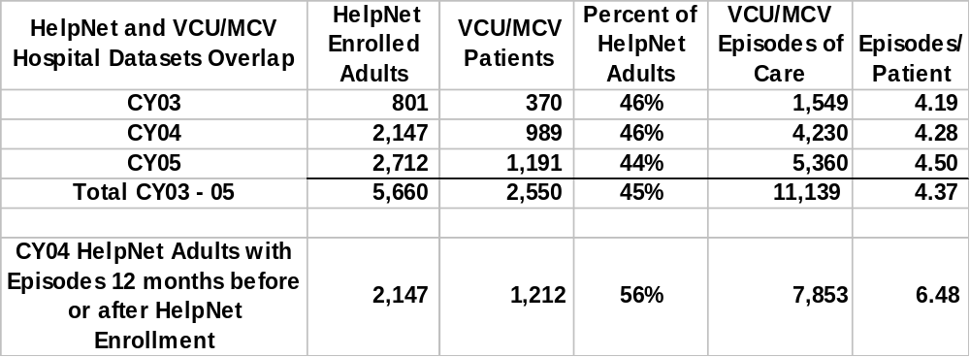
Richmond HMIS and VCU/MCV Hospital Data Analysis: Frequent Use of MCV Hospital Care
Each had episodes of hospital care an average of 4 times per year.
Over a two-year period, the average was 6.5 times.

Slide 9
Policy Issue: Do hospitals discharge into homelessness?
Data Analysis: Emergency hospital episodes before and after HMIS enrollment
Hospital episodes peak around the month of homeless services enrollment, but occur both before and after episodes of homelessness.
VCU-MCV Hospital Emergency Episodes of Care (n=3,889)
in the Emergency, Psychiatry, and General Medicine Departments
by Number of Months Before and After Richmond Area Adults (n=1,089) Enroll in Homeless Services
450
400
350
300
221
250
257
200
150
144
156
110
89
98
108
100
118
100
101
100
88
111
93
89
87
97
85
78
85
78
77
92
50
27
18
22
23
17
15
39
28
26
38
47
87
164
80
84
64
70
65
56
41
50
59
55
52
0
-12
-11
-10
-9
-8
-7
-6
-5
-4
-3
-2
-1
0
1
2
3
4
5
6
7
8
9
10
11
Number of Months Before and After Homeless Service Enrollment
Pre-Episodes Only
Post-Episodes Only
Pre- and Post-Episodes

Slide 10
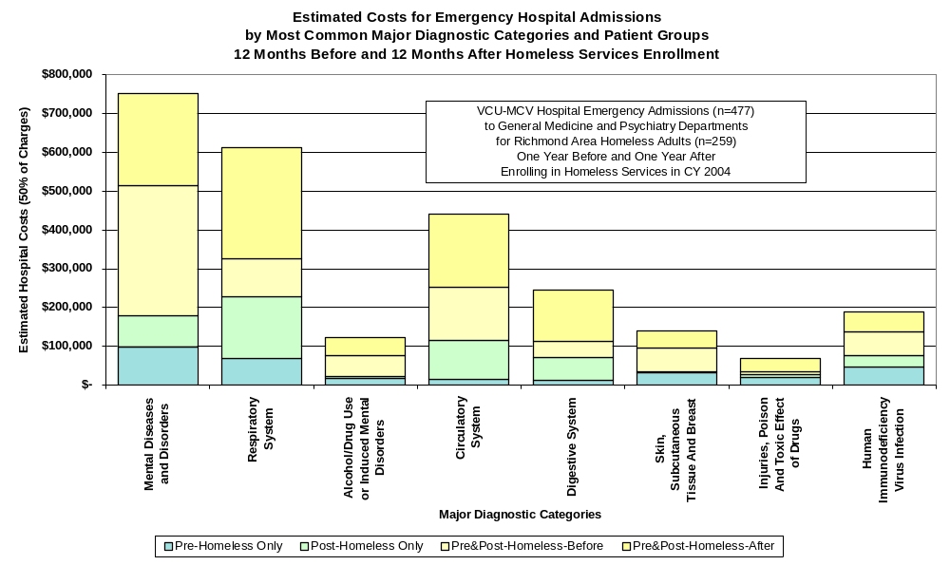
Estimated hospital costs for these homeless patients
Are highest for admissions to treat psychiatric disorders, followed by respiratory and circulatory disorders. These might be avoided by providing more comprehensive community care

Slide 11
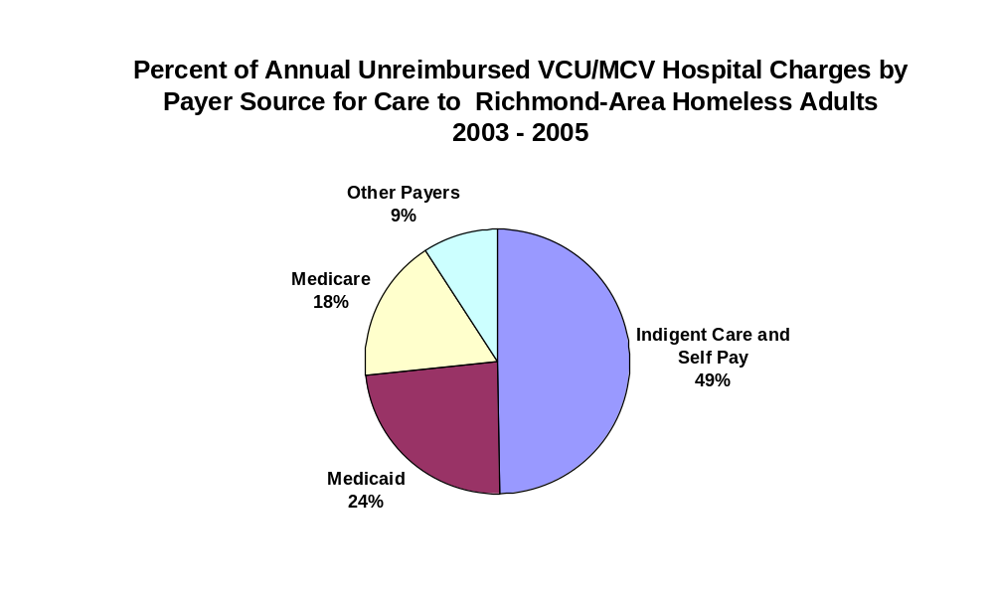
Policy Issue: Can Homeless Housing Save Hospitals $ ?
Data Analysis: A significant proportion of hospital charges go un-reimbursed
Suggesting that the VCU/MCV hospital might benefit by investing in less expensive community-based options that lead to reduced admission rates among the homeless.

Slide 12
Chronic Homelessness and Mental Health Care
What is the overlap?
CSB
(Community MH)
Services
through 6/30/05
Local Hospital
Psych
Inpatients
7/1/02 – 6/30/05
Community Services
Boards (CSBs) /
DMHMRSAS
Database
Homeless
Services
2003-2005
Virginia Health
Information System
(VHI)
Homeless Management
Information System
(HMIS)

Slide 13
Richmond HMIS, CSBs, and VHI: MH Systems Data Analysis
4,355 adults enrolled in the HelpNet (HMIS)
  homeless services database (greater Richmond area)
20,274 adults in DMHMRSAS/CSB database
  as CSB consumers in Planning District 15 (greater Richmond area)
13,225 adults in Va Health Info (VHI) database
  of local hospital psych inpatients in Planning District 15
  1,001 records matched HMIS to CCS
    4.9% of CCS and 23% of HelpNet
  722 records matched HMIS to VHI
    5.5% of VHI and 16% of HelpNet
Notes:
Records are matched based on a hashed social security number, which is estimated to be about 90% accurate.

Slide 14
Richmond-Area Homeless Adults and
Adult MH Consumers FY 03 - 05
CSB
Services
Local Psych
Hospital
4,033
20,274
13,225
438
1,001
722
Homeless
Services
4,355
Notes:
23% of HelpNet Clients in CSB services
16% of HelpNet Clients in local inpatient
4.9% of CSB clients experience homelessness (during 2-year period)
5.5% of local hospital inpatients experience homelessness (during 2-year period)

Slide 15
Average Richmond-Area CSB Adult Consumer’s
Local Psychiatric Hospital Use FY 03 – 05
The average homeless CSB consumer, as compared to the average housed CSB consumer, had four times the number of admissions, three times the number of bed days, and three times the total estimated cost for local psychiatric inpatient care.
Housed (n=19,273)
  Hospital Use Per Client
    Admissions = 0.57
        FY03 = .16
        FY04 = .24
        FY05 = .17
    Bed Days = 4.46
        FY03 = 1.23
        FY04 = 1.85
        FY05 = 1.38
    Est. Cost = $2,795
        FY03 = $706
        FY04 = $1,165
        FY05 = $924
Homeless (n=1,001)
  Hospital Use Per Client
    Admissions = 2.24
        FY03 = .63
        FY04 = .87
        FY05 = .74
    Bed Days = 14.51
        FY03 = 4.24
        FY04 = 5.77
        FY05 = 4.51
    Est. Cost = $8,846
        FY03 = $2,289
        FY04 = $3,557
        FY05 = $2,999
Notes:
23% of HelpNet Clients in CSB services
16% of HelpNet Clients in local inpatient
4.9% of CSB clients experience homelessness (during 2-year period)
5.5% of local hospital inpatients experience homelessness (during 2-year period)

Slide 16
CSB Homeless Consumer’s Low vs. High
Local Psychiatric Hospital Use FY 03 – 05
About 20% of homeless CSB consumers had three or more admissions in a year, accounting for most of the hospital use differences between the homeless and housed groups. Annual costs for this high inpatient user group accounted for 79% of the total.
Low Users (n=242) 24%
Cost $639,000/yr 21%
  Admissions = 2.03
      FY03 = .48
      FY04 = .90
      FY05 = .66
  Bed Days = 3.93
      FY03 = 2.69
      FY04 = 6.11
      FY05 = 4.27
  Est. Cost = $7,921
      FY03 = $1,487
      FY04 = $3,589
      FY05 = $2,845
High Users (n=196) 20%
Cost $2,312,600/yr 79%
  Admissions = 8.92
      FY03 = 2.63
      FY04 = 3.35
      FY05 = 2.94
  Bed Days = 57.99
      FY03 = 18.32
      FY04 = 21.91
      FY05 = 17.76
  Est. Cost = $35,397
      FY03 = $9,854
      FY04 = $13,738
      FY05 = $11,805
Notes:
23% of HelpNet Clients in CSB services
16% of HelpNet Clients in local inpatient
4.9% of CSB clients experience homelessness (during 2-year period)
5.5% of local hospital inpatients experience homelessness (during 2-year period)

Slide 17
Psychiatric Hospital Inpatient Cost for Shared Homeless Consumers
CSB
Services
Local Psych
Hospital
2%
3%
9%
Estimated
Psych Hospital Cost
$2.9 Million per Year
(~$2,600 - $35,000/person)
Homeless
Services
Notes:
A subset (29% - 30%) have three or more admissions during the year. Their average annual inpatient hospital costs are estimated at $21,000.

Slide 18
Policy Implications:
Psychiatric Hospital Inpatient Cost Offsets
On average, roughly $6,700 is spent each year for a homeless adult with psychiatric disabilities in the Richmond area to spend a total of 11 days “housed” in local hospitals.
For roughly 20% of this group, (i.e., those with 3 or more admissions per year), this one service costs $35,000.
What does housing with supports cost?
Who is willing to pay for it?
Notes:
The largest funding sources for these hospital costs are
Medicaid and Medicare
Self-Pay (probably means losses to the hospital)
State and Local Government
Managed Care Companies
Jails
Charities

Slide 19
Data Analysis: Are homeless MH clients different?
Richmond-Area CSB Adult Consumers
Housed vs. Homeless Comparison
Housed (n=19,273)
Average Age = 39.5
Male= 53.3%
African American = 41.2%
Richmond Resident= 29.3%
Bipolar/Mood Disorder Related 19.4%
Schizophrenia Related 11.6%
Alcohol Related 15.9%
Any Cocaine Diagnosis 10.5%
Homeless (n=1,001)
Average Age = 40.1
Male= 50.9%
African American = 68.6%
Richmond Resident= 61.7%
Bipolar/Mood Disorder Related 18.8%
Schizophrenia Related 18.1%
Alcohol Related 20.2%
Any Cocaine Diagnosis 30.5%
Notes:
Using such datasets could help us decide where to target what kind of services for what kinds of populations before they become homeless.

Slide 20
Richmond-Area CSB Adult Consumers
Housed vs. Homeless Comparison
Housed (n=19,273)
Residence at Admission
  Private Residence 71.9%
  Local Jail/Corrections 9.9%
  Homeless/Shelter 0.8%
Employment at Admission
  Employed Full Time 14.7%
  NILF-Disabled 14.6%
  Unemployed 11.9%
Education at Admission
  High School/Voc Ed. 26.5%
  Some HS/Voc Ed. 20.4%
  Some College 12.0%
Homeless (n=1,001)
Residence at Admission
  Private Residence 54.6%
  Local Jail/Corrections 13.1%
  Homeless/Shelter 12.5%
Employment at Admission
  Employed Full Time 7.3%
  NILF-Disabled 22.2%
  Unemployed 21.3%
Education at Admission
  High School/Voc Ed. 27.1%
  Some HS/Voc Ed. 25.7%
  Some College 17.3%

Slide 21
Richmond-Area CSB Adult Consumers
Housed vs. Homeless Comparison
Housed % (n=19,273)
Admitted to Hospital
  FY 2003 7.9%
  FY 2004 13.4%
  FY 2005 9.5%
High Annual Admissions (3+)
  FY 2003 1.7%
  FY 2004 2.3%
  FY 2005 1.7%
Homeless % (n=1,001)
Admitted to Hospital
  FY 2003 22.5%
  FY 2004 33.6%
  FY 2005 27.4%
High Annual Admissions (3+)
  FY 2003 8.6%
  FY 2004 10.7%
  FY 2005 10.3%
Odds Ratio - Homelessness : High Psych Hospital Admits > 6:1
Notes:
Two and one half to three times as many homeless CSB consumers experience local psych hospital admissions as compared to the “non-homeless” CSB consumers
They have 3.5 to 4 times the total number of admissions
And five to six times as many homeless CSB consumers experience three or more local psych hospital admissions per year as compared to the “non-homeless” CSB consumers

Slide 22

Measuring MH Service Solutions
Housing, Hospitals, & Other Outcomes
Virginia
Programs
of
Assertive
Community
Treatment
PACT

Slide 23
PACT Outcomes in FY2004
n = 1,151
74% of PACT consumers had no hospital admissions,
  and another 9% had only one or two stays of ten or less days each on average = 83% “no or low” hospitalizations.
84% of PACT consumers had stable housing
  (two or fewer placements and no homelessness).
72% lived in private households.
94% had no arrests.
18% had some employment experience.

Slide 24
Other PACT Performance
and Outcome Monitoring
Information about PACT staff is also collected, such as:
  FTE level, educational degrees, professional license, position, and dates of tenure.
PACT Staff “Fidelity to the Model” can therefore be measured and compared to Consumer Outcomes.

Slide 25
Fidelity to PACT Staff the Model
(100% of required staff 100% of the time = 100% Score)
Virginia PACT Teams should include:
a team leader,
three nurses,
five or more clinicians (half of whom hold a master’s degree), including a vocational specialist and a substance abuse specialist,
a peer counselor,
plus psychiatry and administrative support

Slide 26
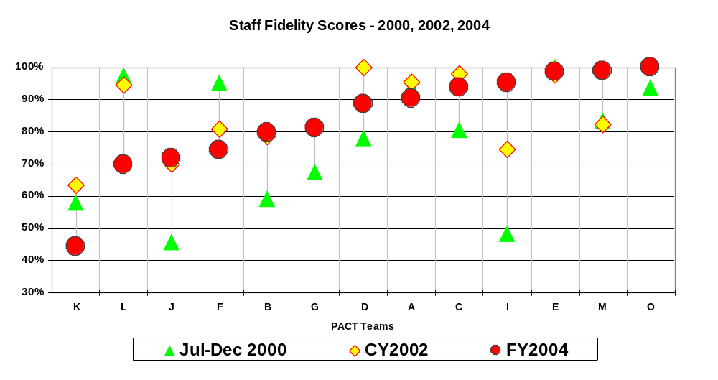
PACT Staff Fidelity Scores

Slide 27
PACT Staff Fidelity Scores
High >90%
Low <90%

Slide 28
PACT- State Hospital Readmission Rates by Team Fidelity Score
2.0
1.5
1.0
.5
High Team Fidelity
Low
95% CI POSTADM
0.0
.00
High
0.68
0.35
-.5
1.00
N =
83
64
68
85
84
46
71
64
76
45
71
83
71
.44194
.69752
.71852
.74379
.79808
.81174
.88558
.90306
.93585
.95238
.98630
.98904
1.00000
n= 911 p=.0001
TFIDELITY

Slide 29
PACT - % with Low or No Local Hospitalizations by Team Fidelity Score
1.1
1.0
.9
.8
High Team Fidelity
Low
95% CI LONOHOSP
.7
.00
High
80%
86%
.6
1.00
N =
92
75
84
93
88
95
80
84
83
108
88
103
78
.44194
.69752
.71852
.74379
.79808
.81174
.88558
.90306
.93585
.95238
.98630
.98904
1.00000
n=1,151 p=.019
TFIDELITY

Slide 30
PACT- Housing Placement Rate by Team Fidelity Score
Higher number of placements means lower housing stability
3.5
3.0
2.5
High Team Fidelity
2.0
1.5
Low
95% CI HOUSED
.00
1.0
1.36
1.55
High
.5
1.00
N =
92
75
83
86
87
90
80
84
83
108
87
103
78
.44194
.69752
.71852
.74379
.79808
.81174
.88558
.90306
.93585
.95238
.98630
.98904
1.00000
n=1,136 p=.014
TFIDELITY
Stable housing means two or fewer places lived during the year and no episodes homeless

Slide 31
PACT Combined Success Rates by Fidelity Score
Living in stable housing with few or no hospital admissions
(Stable housing means 2 or fewer places lived and no episodes homeless)
1.0
.9
.8
High Team Fidelity
.7
95% CI SUCCES_1
Low
.6
.00
.5
72%
78%
High
.4
1.00
N =
92
75
84
93
88
95
80
84
83
108
88
103
78
.44194
.69752
.71852
.74379
.79808
.81174
.88558
.90306
.93585
.95238
.98630
.98904
1.00000
p=.008
TFIDELITY

Slide 32
PACT - % with No Arrests by Team Fidelity Score
1.1
1.0
.9
High Team Fidelity
Low
95% CI NOARREST
.8
.00
High
92%
96%
.7
1.00
N =
92
75
84
93
88
95
80
84
83
108
88
103
78
.44194
.69752
.71852
.74379
.79808
.81174
.88558
.90306
.93585
.95238
.98630
.98904
1.00000
n=1,151 p=.019
TFIDELITY

Slide 33
Example of Analyzing Outcomes by Other Factors
PACT - Number of Consumers Arrested By Race and Team Fidelity Score
Note outliers – low number majority White/Caucasian, high number majority African American
11
race
10
Asian or Pacific Islander
Black/African American
Other
9
White/Caucasian
6
Pies show counts
# arrested
5
3
2
0
0.44194
0.71852
0.79808
0.88558
0.93585
0.98630
1.00000
0.69752
0.74379
0.81174
0.90306
0.95238
0.98904
TFIDELITY

Slide 34
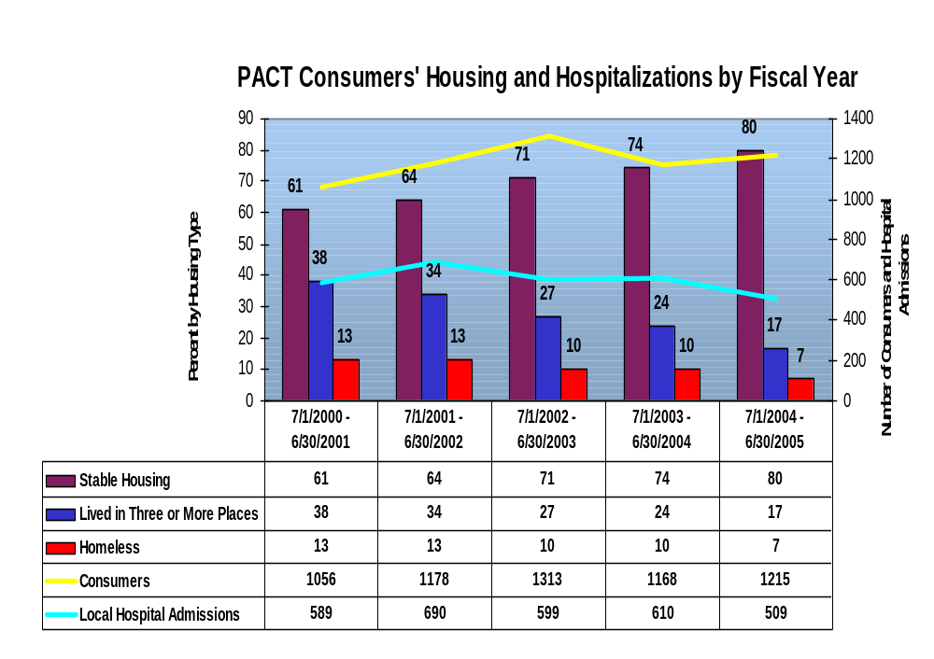
Policy Conclusion: PACT reduces hospital use and increases housing stability
Notes:
Stable housing in this case is defined as living in only one or two places during the year and not experiencing homelessness or incarceration that results in a loss of housing (but the data is not very clear on that last point… PACT teams may be over-reporting by including jail stays even when the client’s apartment is maintained for them.)
Fairfax PACT’s numbers are similar in regards to stable housing, rising from 47% in 2001 to 78% in 2005 and “lived in 3 or more places” fell from 50% in 2001 to 13% in 2005. The percentage of homeless clients, however, is much higher than the state average, with 33% in 2001 and 20% in 2005. This is in part by design – the Fairfax PACT does a good job of outreaching to homeless consumers.

Slide 35
Performance and Outcome
Measurements in Human Services
What gets measured gets done.
  If you measure it, you can manage it
Measure what matters.
  Keep staff invested in the reported outcomes
Keep it simple.
  To understand and track
Feed it Back.
  Use reports to focus discussions, decision making

