Slide 1
Genomics and Population Studies
Debbie Nickerson
Department of Genome Sciences
University of Washington
debnick@u.washington.edu

Slide 2

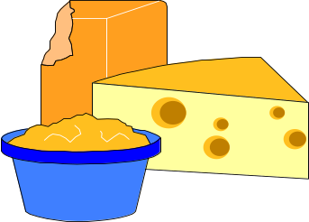
The Next Challenge
Understanding the link between -
DNA sequence Biology/Disease
(Genotype) (Phenotype)
Environment
ATTCGCATGGACC
C
A

Slide 3
Genomics - Lesson Learned
Large-scale projects - Drives technology development
  and feasibility
Collaborative projects - Many groups contributing
to efforts
Data Sharing - Benefits to all - database mining of
new information
New analysis tools and insights - Genes, Variation, Function
Genome Sequences (basic code), HapMap and Structural Variation (differences),
Encode (functional analysis) Opportunities for all scientists -
Biology/Translation to Medicine

Slide 4
Overview of Genomics and Population Studies
Genetic Analysis Strategies
What do we know about sequence variation in humans and status
The HapMap and its impact on variation analysis
Implementation - Lots of new associations - The Big Wave is true!
How will identify valid associations? Replication, Replication, Replication - databases key
Translational impact - diagnostics/prediction versus treatment
Identifying functional variation and new forms of variation
Whole genome sequencing coming

Slide 5
Human Genetic Analysis
Families
Linkage Studies
Populations
Association Studies
C
/
C
C
/
T
C
/
C
C
/
T
C
/
C
C
/
T
C
/
C
C
/
C
4
0
%
T
,
6
0
%
C
1
5
%
T
,
8
5
%
C
C
/
T
C
/
C
C
/
T
C
/
T
C
/
C
C
/
C
C
a
s
e
s
C
o
n
t
r
o
l
s
Simple Inheritance (Segregate)
Complex Inheritance (Aggregate)
Single Gene with Major Effect
Multiple Genes with Small Contributions
and Environmental Contexts
Variant Rare in the Population
Variant(s) Common in the Population
~600 Short Tandem Repeat Markers
Polymorphic Markers > 500,000 -1,000,000
Single Nucleotide Polymorphisms (SNPs)

Slide 6
Total sequence variation in humans
Population size: 6x10⁹ (diploid)
Mutation rate: 2x10^{–8} per bp per generation
Expected “hits”: 240 for each bp
∴Every variant compatible with life exists in the population
BUT: Most are vanishingly rare
Compare 2 haploid genomes: 1 SNP per 1331 bp*
*The International SNP Map Working Group, Nature 409:928 - 933 (2001)

Slide 7
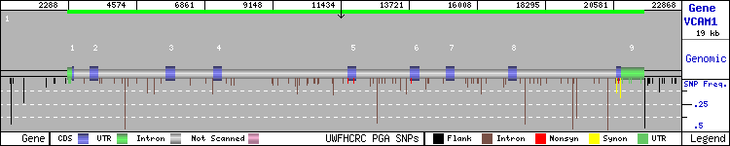
SNPs in the Average Gene
Average Gene Size -19 kb ~ Compare 2 haploid - 1 in 1,000 bp
~100 SNPs (200 bp) - 15,000,000 SNPs
~ 40 SNPs > 0.05 MAF (600 bp) - 6,000,000 SNPs
~ 5 coding SNPs (half change the amino acid sequence)
Crawford et al Ann Rev Genomics Hum Genet 2005;6:287-312

Slide 8
Finding SNPs: Sequence-based SNP Mining
Genomic
mRNA
BAC
Library
RRS
Library
Random
Shotgun
cDNA
Library
DNA
SEQUENCING
BAC
Overlap
Shotgun
Overlap
Align to
Reference
EST
Overlap
RANDOM Sequence Overlap - SNP Discovery
G
Validated - 5..6 MILLON SNPS
GTTACGCCAATACAGGATCCAGGAGATTACC
GTTACGCCAATACAGCATCCAGGAGATTACC
> 11 Million SNPs
C
Notes:
In order to answer this question we have to back up and revisit the approach used to find these SNPs. HapMap Random Shotgun reads key point heer is that these are random process and the key is that by doing this these really only sample from a very small fraction inviduals or actually chromostomes and in actuality many of these SNPs are coming from the comparison obviously a minimum of two chromosoems.. - so what really does that mean for SNP disocvery.???? And

Slide 9
SNP discovery is dependent on your sample population size
{
GTTACGCCAATACAGGATCCAGGAGATTACC
GTTACGCCAATACAGCATCCAGGAGATTACC
2 chromosomes
1.0
8
8
Fraction of SNPs Discovered
0.5
2
0.0
0.0
0.1
0.2
0.3
0.4
0.5
Minor Allele Frequency (MAF)
Notes:
When we draw from two chromosomes, we can develop theoretical preductions of about what the fraction of SNPs you can discover using this method. When using 2 chromosomes we actually can never discovery more than 50% of ao the most common SNPs - those occuring at 50% allele frequency. But in truthfullness they were discovered in a few more chromosome than that but probably not much more than 8 chromosomes. At that level you are able to ascertain nearly all of the very frequent polymorphisms (50% allele frequency), but a much lower percentage of the rare SNPs - in this case about 50% of the SNPs occurring at 10% frequency in the popualtion and this basically makes sense. In order to overcome the probability of seeing a rare SNps you would need to sample from more people. BOTTOM LINE: is that by using these large scale random approaches it isn’t possible to fully disover the entire spectrum of common and rare SNPs.

Slide 10
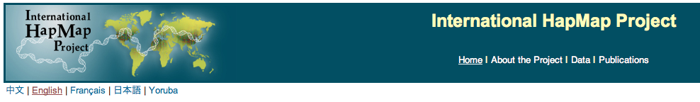
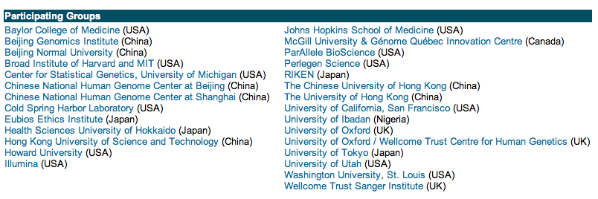
HapMap Project: Genotype validated SNPs in the dbSNP
To produce a genome-wide map of common variation
Genotype 6 Million SNPs in Four populations in Two Phases:
  CEPH (CEU) (Europe - n = 90, trios)
  Yoruban (YRI) (Africa - n = 90, trios)
  Japanese (JPT) (Asian - n = 45)
  Chinese (HCB) (Asian - n =45)
Nature 437: 1299-320, 2005
www.hapmap.org
Notes:
The second objective of the hapMap project was to characterize SNP by genotyping in major representatative population from around the world. The goal for this was to develop 600,000 SNPs genome-wide where they would have genotype each individual from four populations - Say something about trios - hapolotypes - you’ll be hearing more about that in the following talk from Dr. Crawford.

Slide 11
Correlations among SNP
genotypes
can simplify site selection
for genotyping

Slide 12
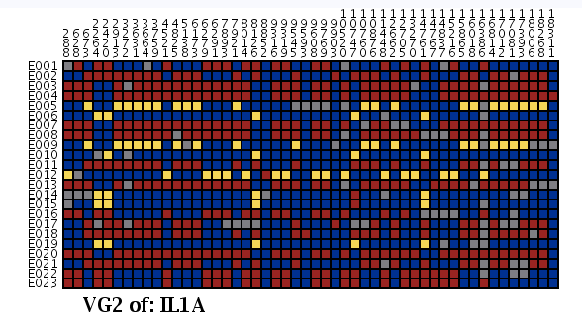
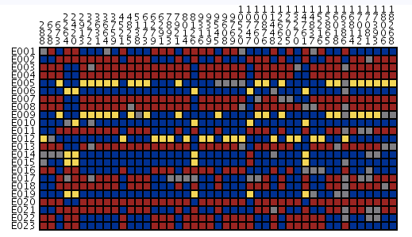
Variation in the Human IL1A Gene
IL1A in Europeans
  18.5 kb
  50 SNPs
  46 common
  SNPs
  (> 10%MAF)
Homozygote common
Heterozygote
Homozygote alternative allele
Missing Data
Carlson et al. (2004)
Am J Hum Genet. 74: 106-120.

Slide 13
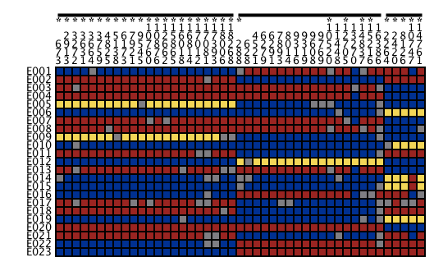
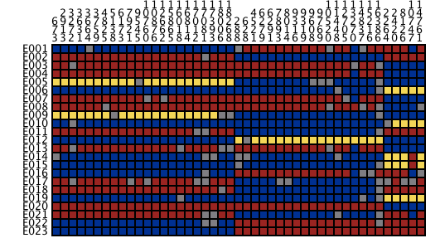
New approaches for site selection -
LDSelect
Threshold LD: r²
  Bin 1: 22 sites
  Bin 2: 18 sites
  Bin 3: 5 sites
Genotype 1 SNP from each bin
- TagSNP, chosen for biological intuition or ease of assay design

Slide 14
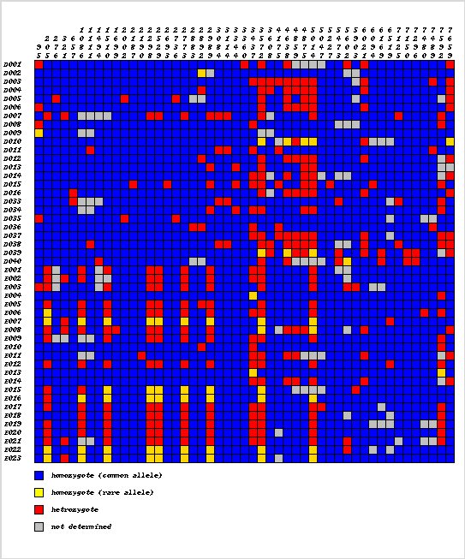
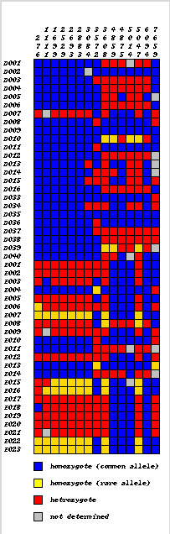
Common Variants - LD (Association) Patterns
All SNPs
SNPs > 10% MAF
African-
American
European-
American

Slide 15
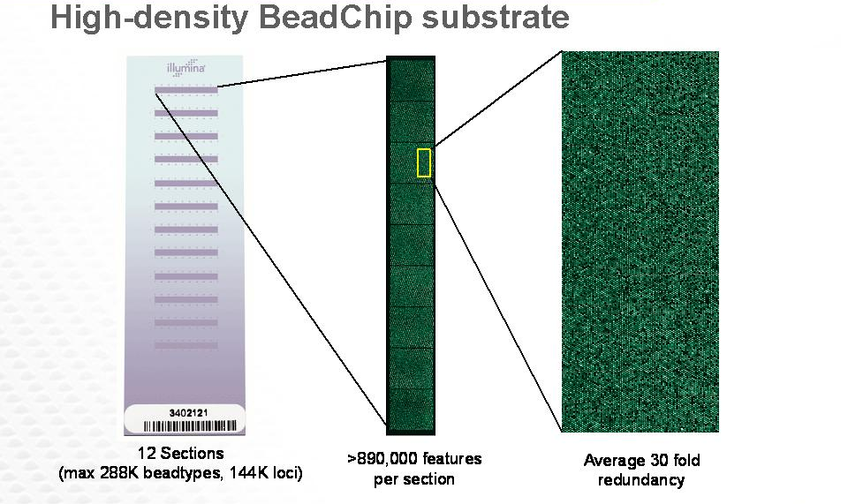
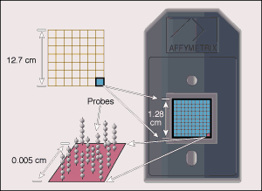
Genotyping Systems
Affymetrix
Illumina
100,000 or 500,000 Quasi-Random SNPs
100,000, 317,000, 550,000, 650,000Y SNPs
1 Million Products are here and on the way!
A significant proportion of common SNPs can be captured

Slide 16
Applying Genome Variation - Will it work? YES!!
Hits:
Macular Degeneration, Obesity, Cardiac Repolarization,
Inflammatory Bowel Disease, Diabetes T1 and T2, Coronary Artery Disease.Rheumatoid Arthritis, Breast Cancer, Colon Cancer, ……
There are misses as well unclear why - Phenotype, Coverage, Environmental Contexts?
    Example of a miss - Hypertension
-There are lots more hits in these data sets - sample size, low proxy coverage with other SNPs …..
Analysis of associations between phenotype(s) and even individual sites is daunting and this will just be the first stage,
and this does even consider multi-site interactions.

Slide 17
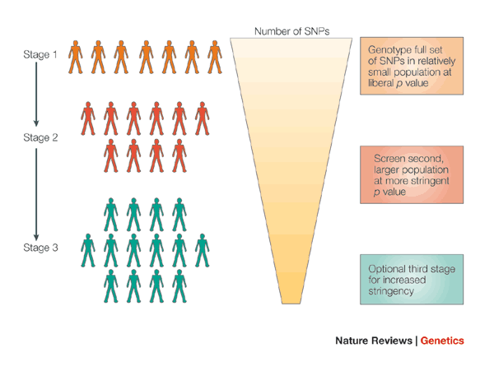
Replication A Must
Replication
Replication
Replication
Hirschhorn & Daly Nat. Genet. Rev. 6: 95, 2005
NCI-NHGRI Working Group on Replication Nature 447: 655, 2007

Slide 18
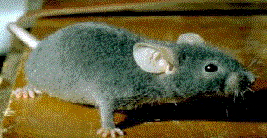
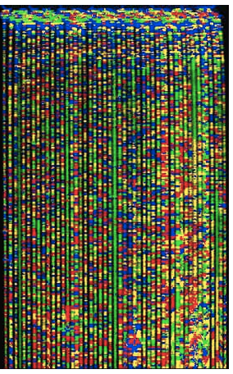
Genetic Studies
Families
LINKAGE
Controls Cases
ASSOCIATION
MODEL ORGANISMS
….. Candidate Gene 1 2 3 4 5 ……

Slide 19
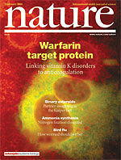
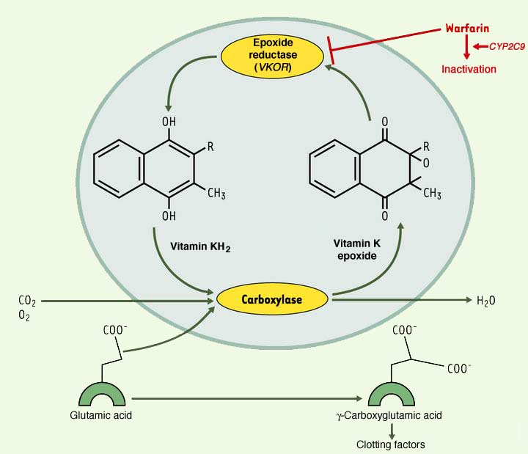
New Target Protein for Warfarin
Epoxide
Reductase
(VKORC1)
γ -Carboxylase
(GGCX)
Clotting Factors
(FII, FVII, FIX, FX, Protein C/S/Z)
Rost et al. & Li, et al., Nature (2004)
Notes:
And encoded for the gene now named VKORC1. In this work by Rost et al that should the overt warfarin resistance was due to non-synonymous mutation in VKORC1 - that is patients needing doses at 25-50 mg/d had clear predisposing mutations. Interestingly, NO nonsynomymous mutations were found in control chromosomes.

Slide 20
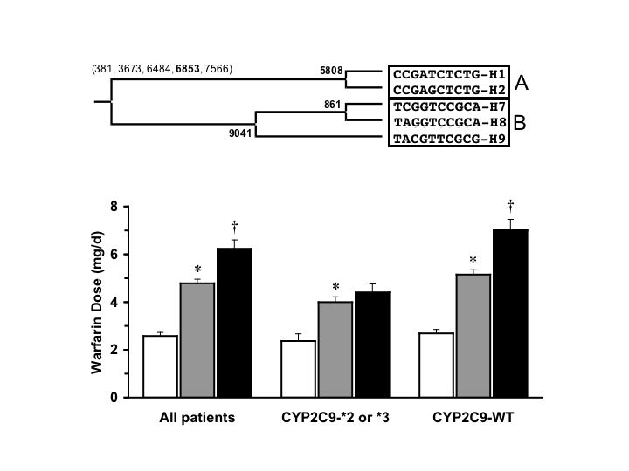
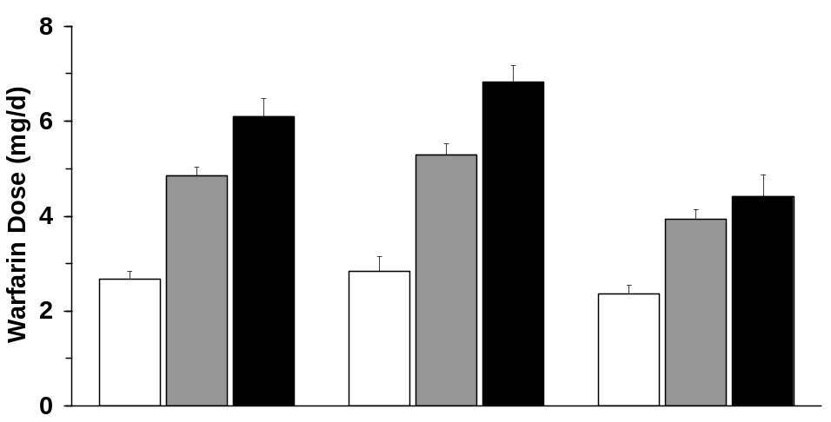
VKORC1 SNPs and haplotypes show a strong association with warfarin dose
Low
High
†
A/A
†
A/B
*
B/B
*
*
AA
AB
BB
AA
AB
BB
AA
AB
BB
All patients
2C9 WT patients
2C9 VAR patients
(n = 181)
(n = 124)
(n = 57)
Rieder et al N Engl J Med 352: 2285-93, 2005

Slide 21
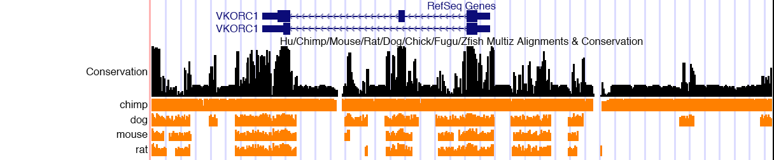
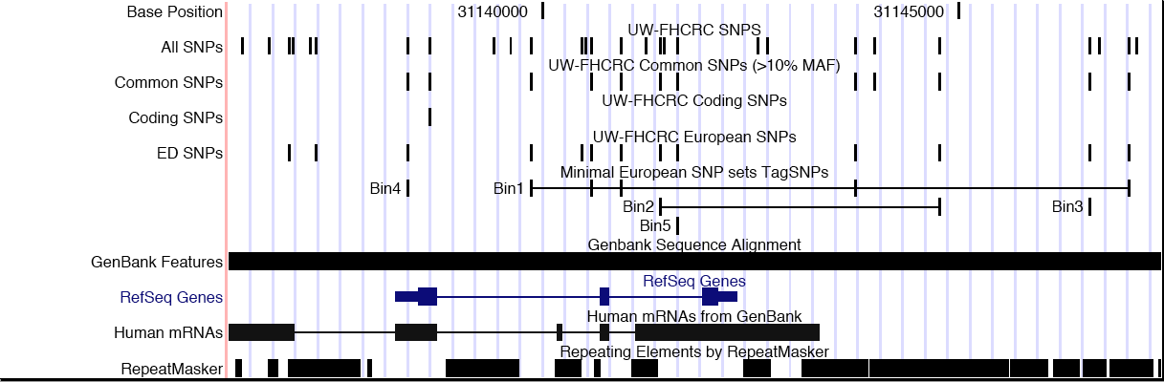
SNP Function: VKORC1 Expression
mechanism
All SNPs non-coding but are present in evolutionarily conserved non-coding regions - mRNA expression is associated with warfarin dosing

Slide 22
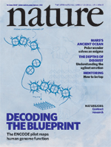
Associated SNPs can be diagnostic/predictive but finding functional SNPs to understand mechanism will take time but offers the promise of new therapies
ENCODE PROJECT - Identify the functional elements in the Human Genome - 1% now and soon all
Nature 447: 799, 2007
Transcriptional Regulatory Elements
Expressed Sequences
Chromatin Structure
Replication
Multi-species Conservation
…….

Slide 23
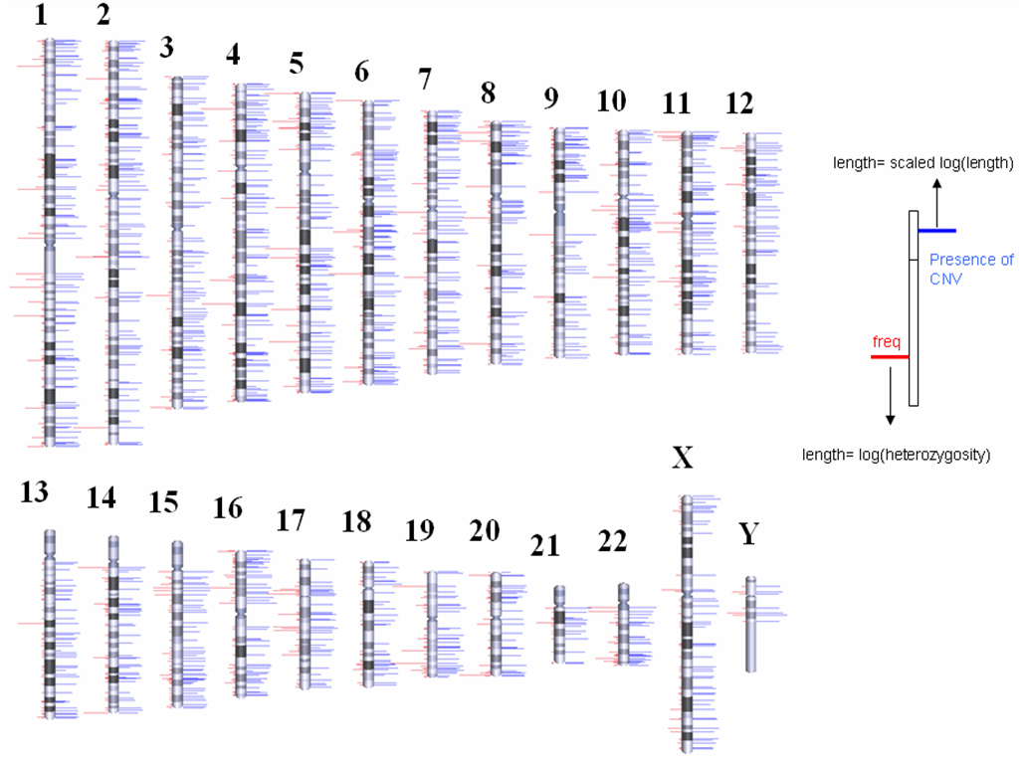
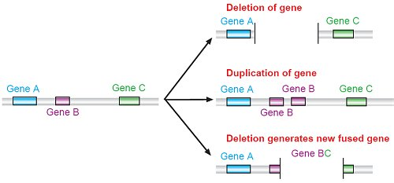
Structural Variation Project
Types of Structural Variants
Insertions/Deletions
Inversions
Duplications
Translocations
Size:
Large-scale (>100 kb)
intermediate-scale (500 bp–100 kb)
Fine-scale (1–500 bp)
More than 10% of the genome sequence
Nature 447: 161-165, 2007

Slide 24
Genetic Strategy - New Insights
STRONG
LINKAGE
effect
size
ASSOCIATION
Common Disease
Many Rare Variants
??
WEAK
LOW
allele frequency
HIGH
Ardlie, Kruglyak & Seielstad (2002) Nat. Genet. Rev. 3: 299-309
Zondervan & Cardon (2004) Nat. Genet. Rev. 5: 89-100

Slide 25
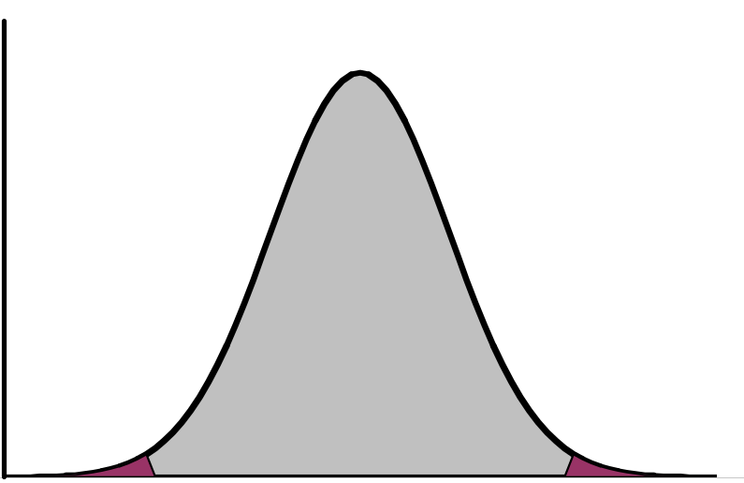
Sequencing Known Candidate Genes for Functional Variation
From Individuals at the Tails of the Trait Distribution
Individuals
Low HDL
High HDL
High Density Lipoprotein (HDL)

Slide 26
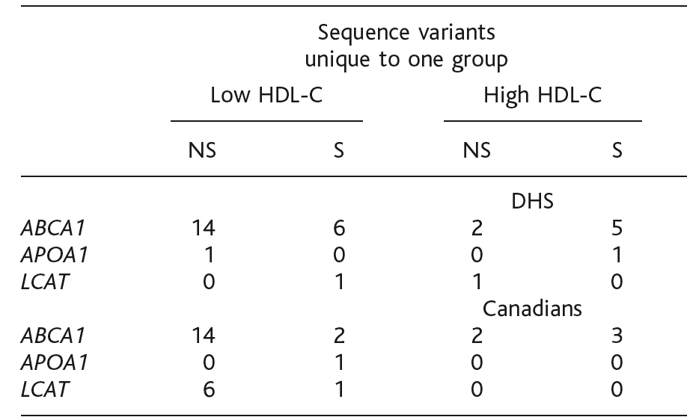
ABCA1 and HDL-C
  Cohen et al, Science
  305, 869-872, 2004
  Many examples emerging
  Common Disease
  Rare Variants
Observed excess of rare, nonsynonymous variants in low HDL-C samples at ABCA1
Demonstrated functional relevance in cell culture

Slide 27
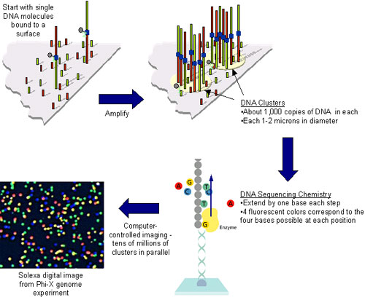
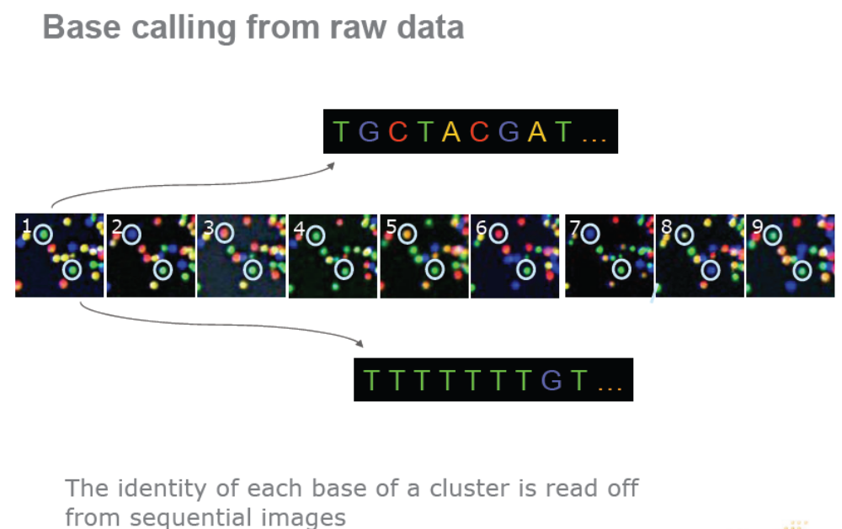
Personalized Human Genome Sequencing
Solexa - an example

Slide 28
Genomics - Summary
New Insights in Variation - Types and Patterns
Structural Variation and Regions under Selection
- Environmental Response and Immune Genes
New Insights into function - ENCODE
New Technologies - Genotyping and Sequencing
Common and Rare Variation
Common Interactive Projects that Share Data, Analysis Teams and Findings before Publication Worldwide

