Slide 1
Neutrino Scattering Physics with
the Fermilab Proton Driver
Conveners:
Jorge G. Morfín (Fermilab)
Ron Ransome (Rutgers)
Rex Tayloe (Indiana)

Slide 2
Outline
What motivates further study of neutrino scattering physics?
  EPP needs
  NP needs
What will we know by the start of a Fermilab proton Driver (FPD)?
  Snapshot of expected experimental results at FPD start-up
What can best/only be done with the FPD?
  Is there anything left to do and reason to do it?
What tools do we need to do it?
  “Designer” beams
  Specialized detectors

Slide 3
Neutrino Scattering Physics at FPD Brings Together Several Communities
EPP - motivated by increased understanding of physics relevant to neutrino oscillation experiments, properties of the neutrino and structure of nucleon
NP - motivated by understanding of physics complementary to the Jlab program (form factors, structure of nucleon)
Neutrinos from 8 GeV Protons
Limited scope of physics topics
Minimize backgrounds from
higher energies
Specialized study of very
low-energy phenomena
Neutrinos from 120 GeV Protons
Extended scope of physics topics
to cover quasi-elastic to DIS
Must understand/study “backgrounds”
Neutrino energies similar to JLab

Slide 4
Motivation: Conclusions- Neutrino Oscillation: Requirements
D. Harris - Proton Driver Workshop
ν_{e} appearance needs:
  Coherent pion cross sections
    Robust predictions from CC process to NC process
  High y ν_{μ} cross sections
  If signal is seen, we really need QE and Resonance cross sections much better than we have now
  Control neutrino/anti-neutrino systematics at 1 percent level for mass hierarchy and CP studies
High Statistics ν_{μ} disappearance needs:
  Measurements of Nuclear effects in neutrinos
  “neutrino energy calibration”
  Ratio of Quasi-elastic to non-Quasi-elastic cross sections

Slide 5
Motivation: Nuclear Physics Interest - Ron Ransome
Significant overlap with JLab physics for 1-10 GeV neutrinos
Four major topics:
Nucleon Form Factors
Duality
Parton Distribution Functions - overlap with EPP
Generalized Parton Distributions - overlap with EPP

Slide 6
State of our Knowledge at start of FPD - Time Snapshot
Assume following experiments complete…
K2K - 12 GeV protons
MiniBooNE - 8 GeV protons
MINERνA (Running parasitically to MINOS) - 120 GeV protons
Associated experiments to help flux determination - HARP, BNL E910, MIPP (E907)
Jlab High precision elastic scattering to help QE analysis
T2K-I (no input as to scattering physics expectations)
FINeSSE

Slide 7
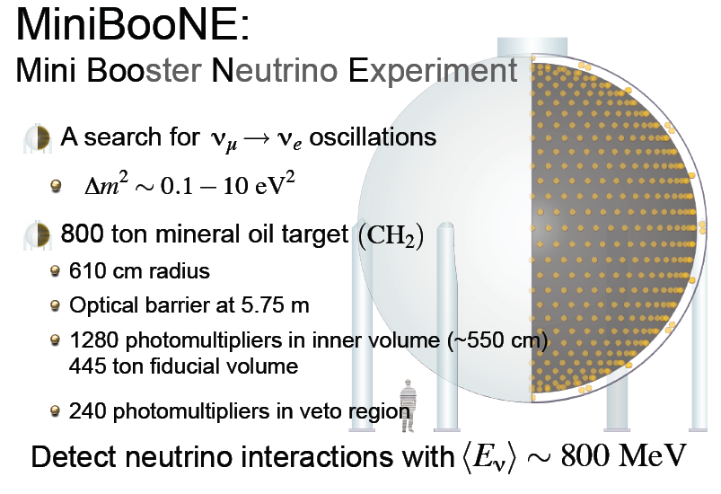
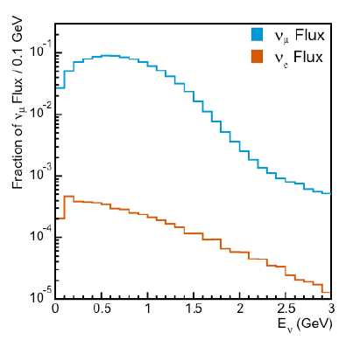
MiniBooNE
8 GeV Protons
Review current experiments to assess scope of physics and
potential of detector techniques at FPD
Main physics channels quasi-elastic, resonant and coherent 1-π production

Slide 8
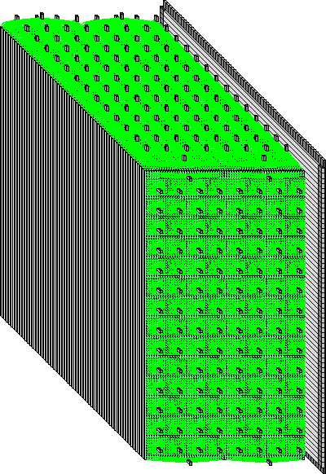
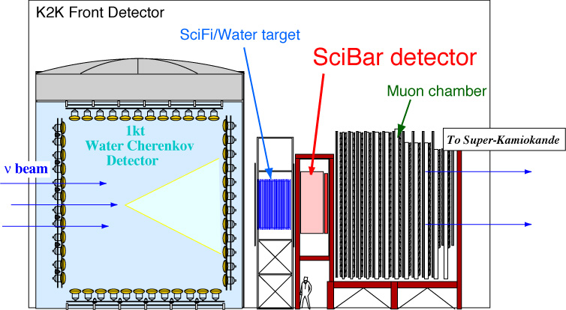
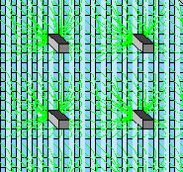
K2K Near Detectors
12 GeV Protons
Extruded
scintillator
(15t)
3m
ν
Multi-anode
PMT (64ch)
3m
1.7m
Wave-length
shifting fiber
Main physics channels quasi-elastic,
Resonant and coherent 1-π production
and low-W, multi- π channels
E_{ν} (GeV)
SciBar
T2K: 40 - 50 GeV Protons

Slide 9
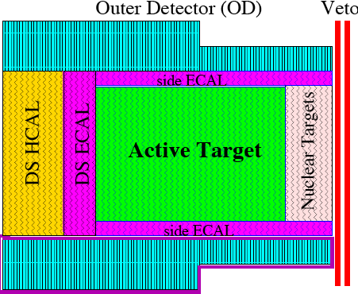
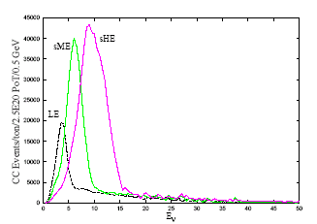
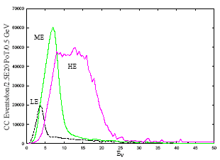
MINERνA
MI 120 GeV Protons
Move target only
C, Fe and Pb
Nuclear targets
ν
Move target and
Second horn
Active target of scintillator bars
  6t total, 3 - 5 t fiducial
Surrounded by calorimeters
  upstream calorimeters are Pb, Fe targets (~1t each)
  magnetized side and downstream tracker/calorimeter
Notes:
here’s what results from that exercise. surrounding active; calorimeters, OD and MR magnetized

Slide 10
MINERνA will have the statistics to cover a wide variety of important ν physics topics
Assume 9x10²⁰ POT: MINOS chooses 7.0x10²⁰ in LE ν beam, 1.2x10²⁰ in sME and 0.8x10²⁰ in sHE
ν_{μ} Event Rates per fiducial ton
Process CC NC
Quasi-elastic 103 K 42 K
Resonance 196 K 70 K
Transition 210 K 65 K
DIS 420 K 125 K
Coherent 8.4 K 4.2 K
TOTAL 940 K 305 K
Typical Fiducial Volume =
3-5 tons CH, 0.6 ton C, ≈ 1 ton Fe
and ≈ 1 ton Pb
3 - 4.5 M events in CH
0.5 M events in C
1 M events in Fe
1 M events in Pb
Main Physics Topics with Expected Produced Statistics
Quasi-elastic 300 K events off 3 tons CH
Resonance Production 600 K total, 450 K 1π
Coherent Pion Production 25 K CC / 12.5 K NC
Nuclear Effects C:0.6M, Fe: 1M and Pb: 1 M
DIS and Structure Functions 2.8 M total /1.2 M DIS event
Strange and Charm Particle Production > 60 K fully reconstructed events
Generalized Parton Distributions few K events

Slide 11
Neutrino Scattering Topics
What will we know and not know at time snapshot?
Quasi-elastic
Resonance Production - 1pi
Resonance Production - npi, transition region - resonance to DIS
Deep-Inelastic Scattering
Coherent Pion Production
Strange and Charm Particle Production 
Nuclear Effects
σ_{T} and Structure Functions
  s(x) and c(x)
  High-x parton distribution functions
Spin-dependent parton distribution functions
Generalized Parton Distributions

Slide 12
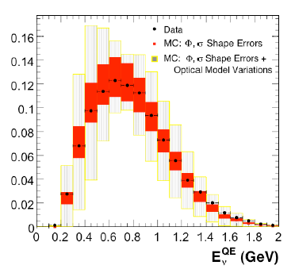
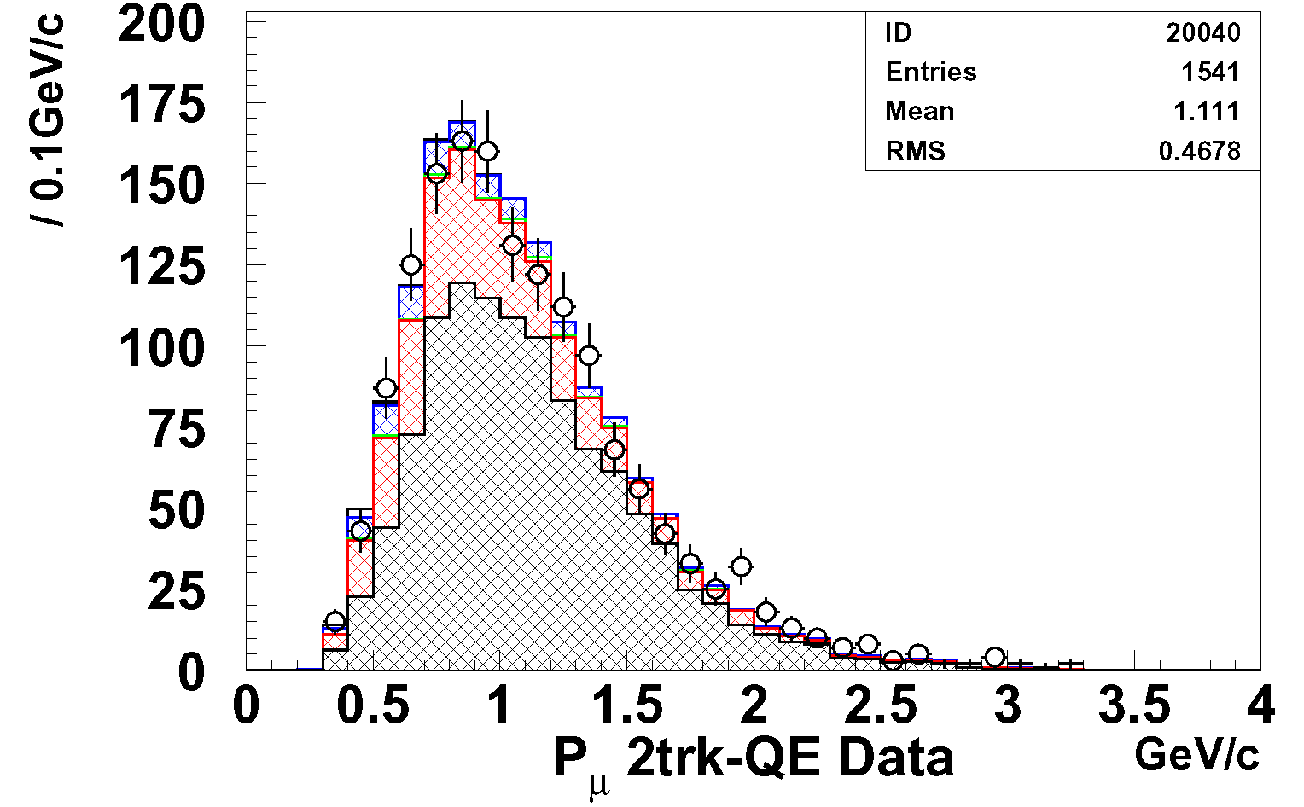
(Quasi)-elastic Scattering
Dominant reaction up to ~1 GeV energy
Essential for E_{ν} measurement in K2K/T2K
The “well-measured” reaction
  Uncertain to “only” 20% or so for neutrinos
  Worse in important threshold region and for anti-neutrinos
Axial form-factor not accessible to electron scattering
  Essential to modeling q² distribution
Recoil proton reconstruction requires fine-grained design - impractical for oscillation detectors
Recent work focuses on non-dipole form-factors, non-zero G_{n}^{E} measurements
(88% purity)
MiniBooNE
K2K SciBar
(80% purity)

Slide 13
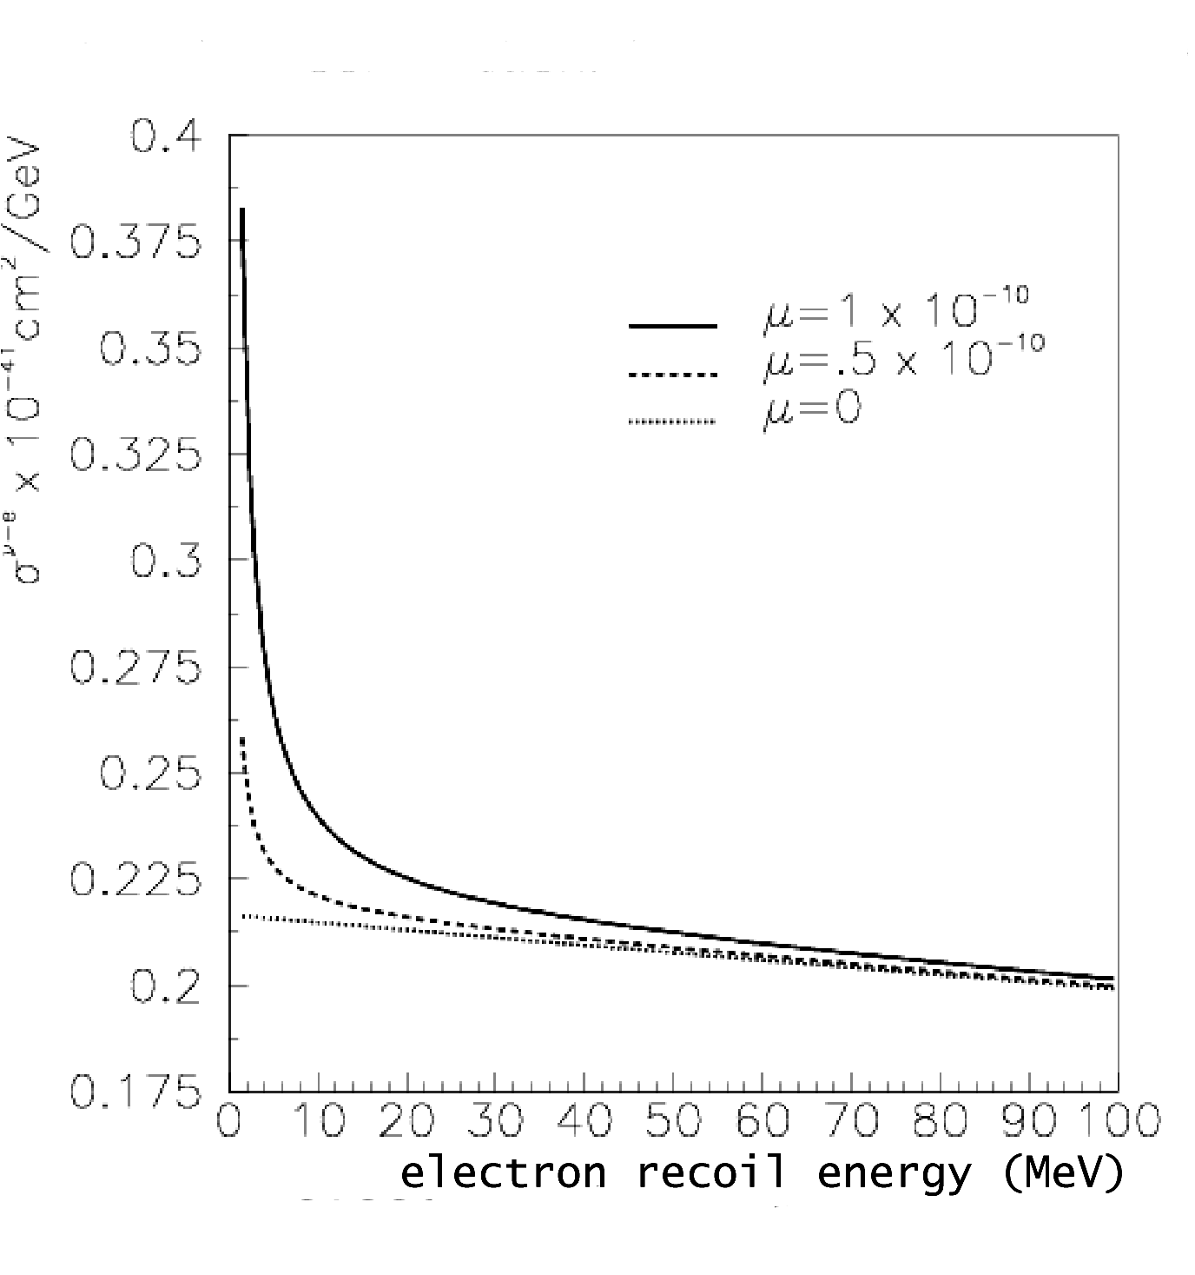
Neutrino Scattering: 8 GeV Proton Driver - Rex Tayloe
- NC elastic scattering
- A measurement of NC elastic scattering is sensitive to axial, isoscalar component of proton (strange quark contribution to proton spin, Δs)
- Ratio of NC/CC reduces systematics
- proton driver would enable this measurement with ν
- and perhaps (with high intensity) measurement on nucleon targets (H/D) allowing elimination of nuclear structure errors.
- ν e elastic scattering
- sensitive to ν magnetic moment => new physics
- measured by low-E e recoil energy behavior
- rates are low! Require highest-intensity beam.
FINeSSE could give us a first look at these topics

Slide 14
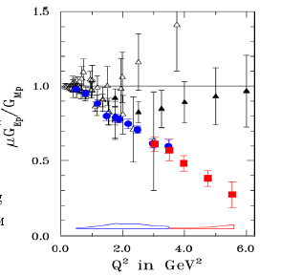
Nucleon Form Factors - NP Interest
JLab experiments have shown unexpected difference between Q² dependence of electric and magnetic form factors
The behavior of the axial form factor is almost completely unknown. Precision measurement on hydrogen needed.

Slide 15
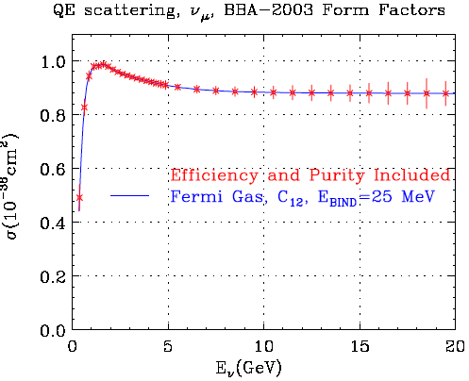
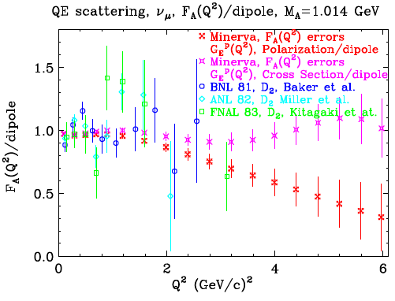
MINERνA CC Quasi-Elastic Measurements
Fully simulated analysis, including realistic detector simulation and reconstruction
Average: eff. = 74 % and purity = 77%
We will understand ν - nucleus elastic scattering by the time of FPD.
We will NOT have elastic ν -nucleus nor ν / ν - nucleon as well

Slide 16
Coherent Pion Production
Characterized by a small energy transfer to the nucleus, forward going π. NC (π⁰ production) significant background for ν_{μ} --> .ν_{e} oscillation search
Data has not been precise enough to discriminate between several very different models.
K2K, with their SciBar detector, and MiniBooNE will attempt to explicitly measure this channel - important low E_{ν} measurement
Expect 25K events and roughly (30-40)% detection efficiency with MINERνA.
Can also study A-dependence with MINERνA
ν
ν
π⁰
Z
P
N
N

Slide 17
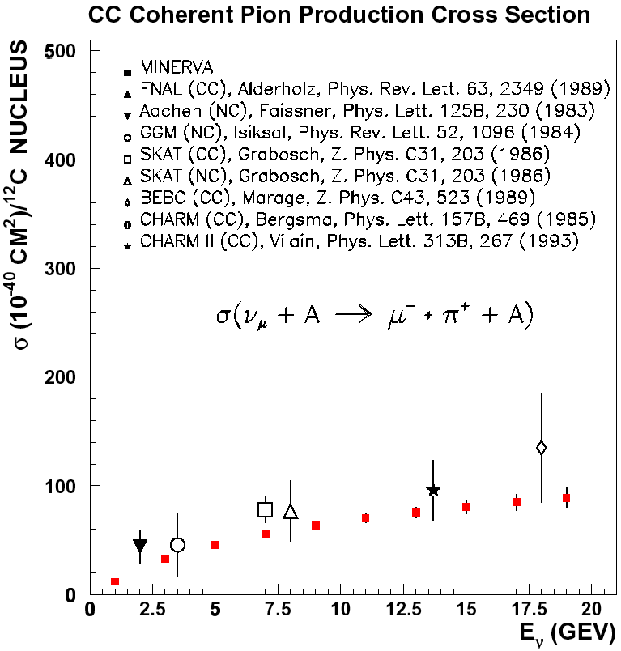
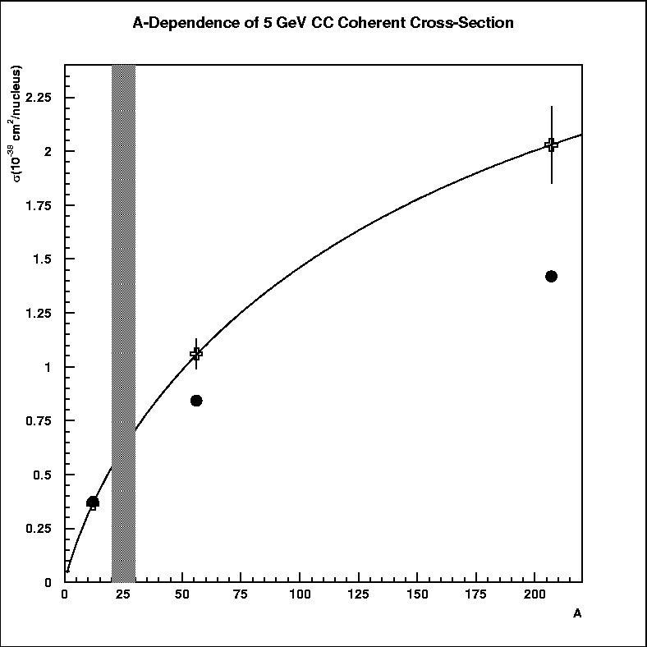
MINERνA: Coherent Pion Production
25 K CC / 12.5 K NC events off C - 8.3 K CC/ 4.2 K NC off Fe and Pb
Rein-Seghal
Paschos-
Kartavtsev
We will understand ν coherent
scattering well by the time of FPD.
We will NOT have measured
ν - coherent scattering well
MINERνA
Expected MiniBooNE
and K2K measurements

Slide 18
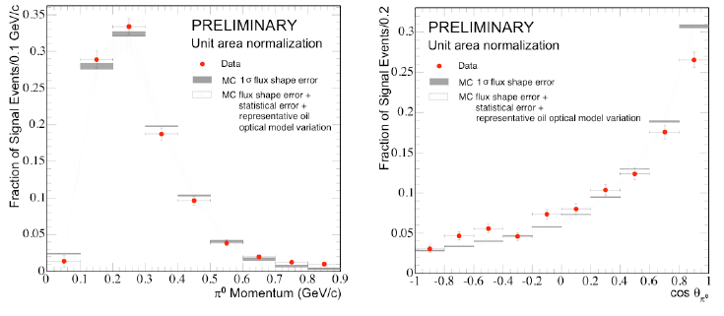
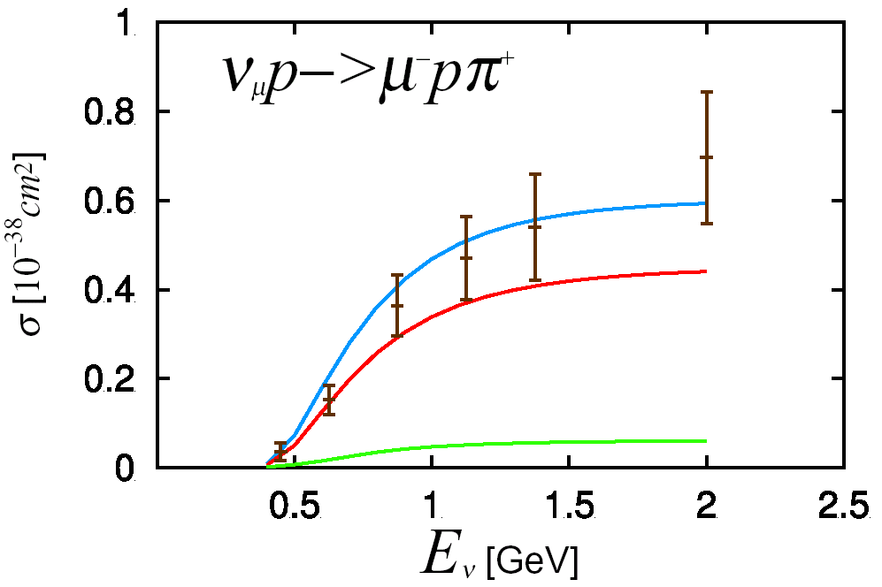
CC Resonant Single-Pion Production
Existing data inconsistent (factor 2 variations)
Treatment of nuclear effects unclear
Renewed theoretical interest
  Rein - Sehgal used for decades
Sato-Uno-Lee model gives a better fit to (poor) data
Very comprehensive Paschos -Lalakulich model just released
K2K S. Nakayama
M. Hasegawa
π⁰
π⁰
MiniBooNE H. Tanaka:

Slide 19
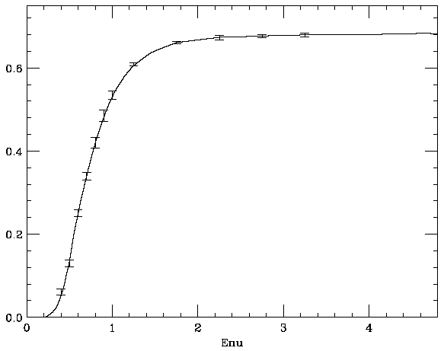
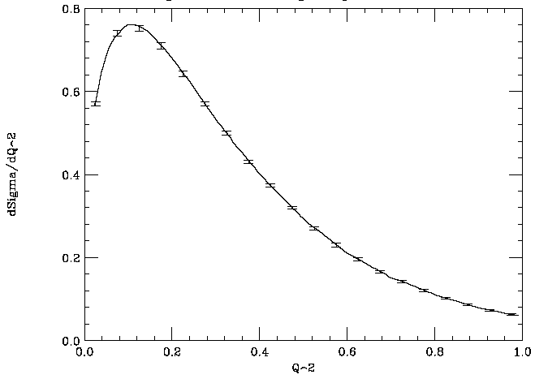
MINERνA Resonance Production - Δ
Total Cross-section and dσ/dQ² for the Δ⁺⁺ assuming 50% detection efficiency
DO NOT FORGET RADIATIVE DECAYS AS BACKGROUND TO ν_{μ} --> ν_{e}
Errors are statistical only
σ_{T}
produced 1-π and 2- π states will be well measured by time of FPD
ν resonant π production NOT well measured

Slide 20
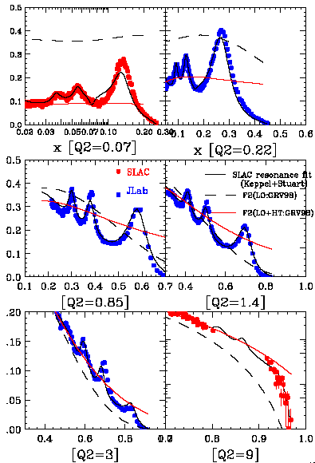
Resonant Multi-pion Production and transition to DIS Quark/Hadron Duality
Recent JLAB data have revived interest in quark/hadron duality
Bodek and Yang have shown that DIS cross-sections can be extended into the resonance regime, and match the “average” of the resonant cross-section
We need more than just the “average” knowledge of the transition region - hills and valleys
Beyond kinematic range of K2K and MiniBooNE.
MINERνA - 600K events
Bodek and Yang

Slide 21
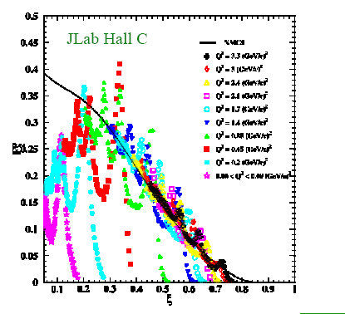
Duality - NP Interest
JLab experiments have shown strong correlation of structure functions measured in resonance region with DIS.
Origins of duality still unknown. Flavor dependence of duality should give insight into this phenomenon.
Need precision measurements on hydrogen targets
ξ (approx. x) dependence of F₂ in DIS (black line) and resonance (colors) region

Slide 22
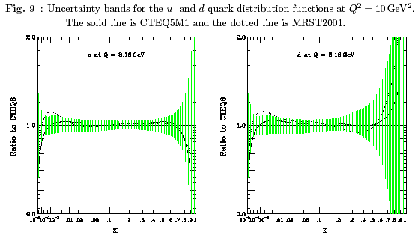
Parton Distribution Functions
CTEQ uncertainties in u and d quark fits

Slide 23





DIS: Parton Distribution Functions
Ability to taste different quarks allows isolation of flavors
ν/ ν - Proton Scattering
At high x
No messy nuclear corrections!
F₂^{νp} - xF₃^{νp} = 4xu
F₂^{νp} + xF₃^{νp} = 4xu
EPP and NP interest in PDFs
Need ν and p/n target

Slide 24
Generalized Parton Distribution Functions - NP Interest
One of the most exciting theoretical developments – gives the opportunity to determine complete 3-D picture of the nucleon. Gives transverse distribution as function of momentum fraction of parton.
Difficult experimentally – requires exclusive measurements (e.g. νn → μγp )
Best done with nucleon (hydrogen or deuterium) targets.
Cross section is small – need high intensity neutrino and anti-neutrino beams.

Slide 25
Nuclear Effects - modified interaction probabilities
Fermi motion
S. Kumano
1.2
EMC
NMC
1.1
E139
E665
valence-quark
1
0.9
0.8
original
EMC finding
antiquark
shadowing
0.7
0.001
0.01
x
0.1
1
sea quark
valence quark
EXPECTED to be different for ν!!

Slide 26
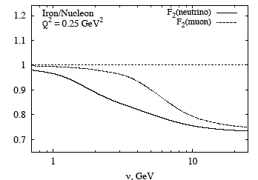
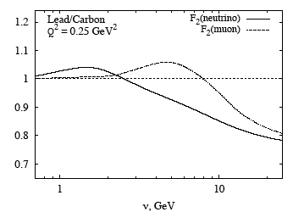
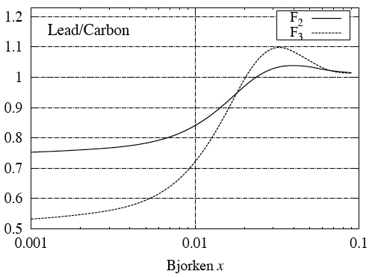
Difference between ν−Α and μ−Α nuclear effects
Sergey Kulagin
Need significant ν statistics to
fully understand nuclear effects
with the weak current

Slide 27
What will we need beyond MiniBooNE, K2K and MINERνA for neutrino scattering at FPD?
HIGH-STATISTICS ANTINEUTRINO EXPOSURE
  Need to improve purity of ν beam?
HYDROGEN AND DEUTERIUM TARGET FOR ν and ν
  Need reasonable event rates at E ≈ 1 GEV
NARROW BAND BEAM FOR DETAILED LOOK AT NC
  Is off-axis beam sufficiently narrow?
IMPROVED DETECTOR TECHNIQUES
  Particularly good neutron detection for ν
  Need a fully-active detector for H₂ and D₂ exposures

Slide 28
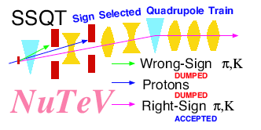
Need a Very Efficient ν Beam - B. Bernstein
Low energy NuMI ‘ν”””’ beam yields around
1.1 ν events
for every ν event!
Resulting beam is almost pure ν beam:
in ν mode = 4 x 10⁻³
Loose factor five in intensity compared to NuMI + factor 3.5 compared to ν

Slide 29
Need a large H₂/D₂ target
An efficient fully-active CCD coupled tracking detector
Bubble Chamber
A Chicago - Fermilab collaboration developing
Contemporary large BC design/construction/operation
Techniques including CCD readout
BC Placed in the upstream
part of MINERνA
H_2/D_2

Slide 30
Summary
At the completion of MiniBooNE, K2K and the MINERνA parasitic run we will have reasonable results for neutrino-nucleus interactions including exclusive cross-sections, form factors and nuclear effects.
We will need the FPD, with both an 8 GeV (proton) and 120 GeV (proton) neutrino program, to have similarly reasonable results for:
  ν -nucleus cross-sections,
  ν and ν - proton and neutron (D₂) cross-sections,
  ν / ν - e elastic scattering
  high-statistics narrow-band studies of NC (and CC) channels.

Slide 31
After initial (parasitic to MINOS) run - could add a Liquid H₂/D₂(/O/Ar) Target
NOT APPROVED FOR THIS
Fid. vol:
r = 80 cm. l = 150 cm.
350 K CC events in LH₂
800 K CC events in LD₂
per year he-ν running. Few events with E ≈ 1 GeV.
H_2/D_2
MINOS Near
Technically easy/inexpensive to build and operate.
Meeting safety specifications the major effort.
Planes of C, Fe, Pb
For part of run

Slide 32
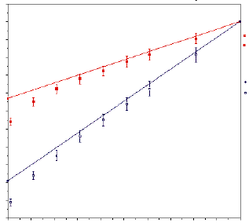
Measuring Six Structure Functions for Maximal Information on PDF’s
R = R_{whitlow}
Neutrino
1 year he-beam
Anti-Neutrino
2 years he-beam
+ y² F_{L}
X = 0.1 - 0.125
Q² = 2 - 4 GeV²
Kinematic cuts in (1-y)
not shown
(1-y)²

Slide 33
Presentations and Discussions:
Neutrino Scattering Physics at the Fermilab Proton Driver (FPD)
Summary of APS Neutrino Study, Neutrino Scattering Physics Bonnie Fleming
Summary of NuFact'04 Neutrino Scattering Group Jorge G. Morfin
Neutrino Probes of Hadronic Structure Wally Melnitchouk
Deeply Virtual Neutrino Scattering Ales Psakar
C C Neutrino Induced Nuclear Reactions at Intermediate Energies Manuel Valverde
Neutrino-nucleon Elastic Scattering with the Proton Driver Chuck Horowitz
A High Intensity Neutrino Beam Using 8 GeV Protons Geoff Mills
Neutrino Scattering Measurements: What do Oscillation
Experiments Really Need Debbie Harris
Status of Neutrino Cross-Sections Sam Zeller
General Discussion: What experimenters need from theorists
and vice versa
Overview of Neutrino Beams Bob Bernstein
COUPP, Using Contemporary Techniques to Develop a
WIMP-sensitive Bubble Chamber at FNAL Juan Collar
A LAr TPC Near Detector Adam Para

Slide 34
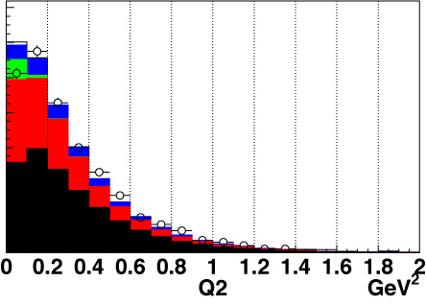
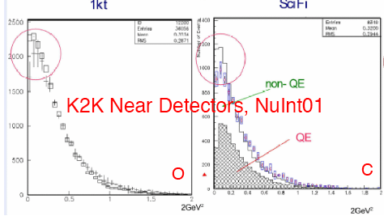
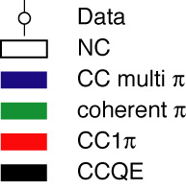
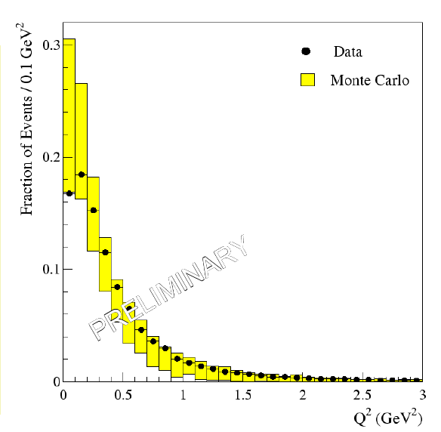
Nuclear Effects - Low ν, low Q² shadowing
Q2 distribution for SciBar detector
Problem has existed
for over two years
Larger than expected rollover at low Q²
All “known” nuclear effects taken into account:
  Pauli suppression, Fermi Motion, Final State Interactions
They have not included low-ν shadowing that is only
allowed with axial-vector (Boris Kopeliovich at NuInt04)
L_{c} = 2ν / (m_{π}² + Q²) ≥ R_{A} (not m_{Α}²)
L_{c} 100 times shorter with m_{π} allowing low ν-low Q² shadowing
ONLY MEASURABLE VIA NEUTRINO - NUCLEUS
INTERACTIONS! MINERνA WILL MEASURE THIS
ACROSS A WIDE ν AND Q² RANGE WITH C : Fe : Pb
MiniBooNE
From J. Raaf
(NOON04)

