Slide 1
Enhanced SCIT
Briefing for the TAC
Arthur Witt, NSSL

Slide 2
Current WSR-88D SCIT
Identifies 3D “storms” by vertically-associating 2D “components” at adjacent elevation angles based on spatial proximity
Merges 3D storms if there is no vertical overlap and the vertical gap is < 4 km

Slide 3
Current WSR-88D SCIT
Is good at identifying individual cells
For multicell storms, including supercells, there are often multiple 3D detections
In larger storms, the main core is often “fragmented” into 2 or more 3D detections

Slide 4
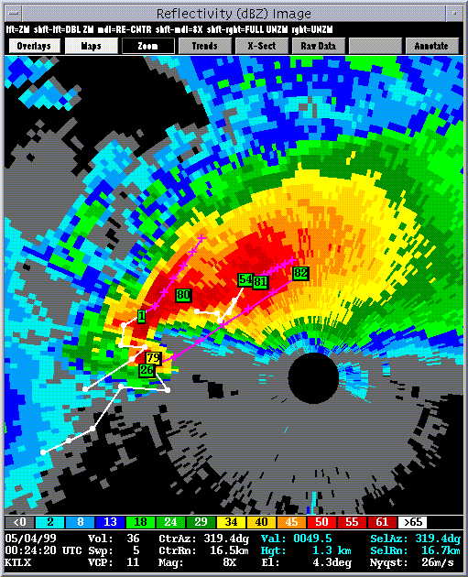
Example of storm “fragmentation”

Slide 5
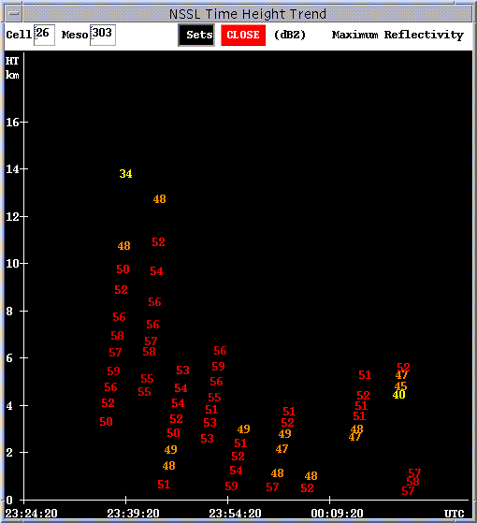
Poor trends due to storm “fragmentation”

Slide 6
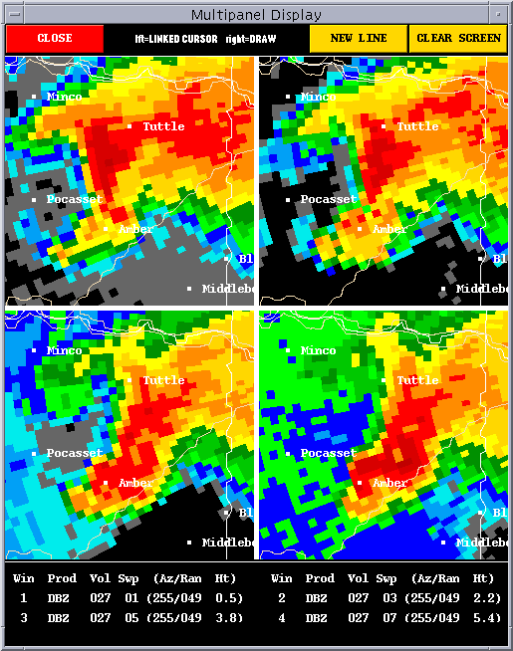
KTLX 3 May 1999 - Storm A

Slide 7
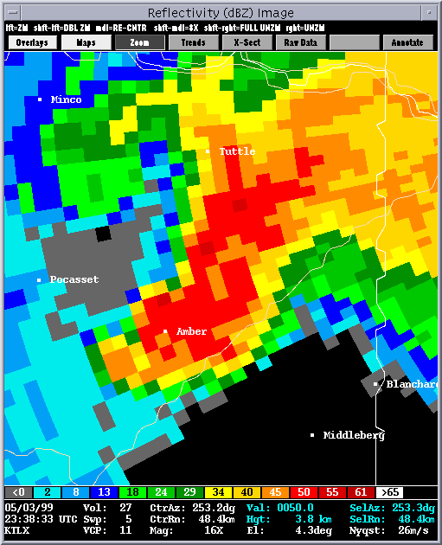
KTLX 3 May 1999 - Storm A

Slide 8
KTLX 3 May 1999 - Storm A
Elev 3D #1 3D #2 Common
0.5 55
1.5 55
2.4 50
3.3 50 45 40
4.3 50 50 45
5.3 50 50 45
6.2 50 50 45
7.5 50
8.7 55
10 50
12 50
14 45

Slide 9
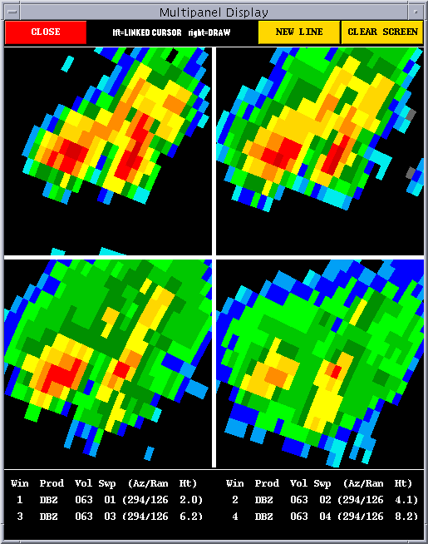
KIWA 14 Aug 1996 - Distinct cells

Slide 10
KIWA 14 Aug 1996 - Distinct cells
Elev Cell #1 Cell #2 Common
0.5 50 50 35
1.5 45 45 35
2.4 40 40
3.3 40 40
4.3 30

Slide 11
Enhanced SCIT
Allows merging of 3D detections to occur without a vertical gap
Includes safeguards so that distinct cells in close proximity are not merged

Slide 12
New vertical-merge technique
First, merge 3D detections that have a vertical gap
Then, attempt to merge 3D detections that overlap vertically
Determine the reflectivity level that 2D components at the same elevation angle have in common

Slide 13
New vertical-merge technique
Calculate the difference between the common dBZ level and the stronger 2D component
If the reflectivity difference is ≤ 10 dbZ for 40% or more of the overlapping elevation angles, then merge the 3D detections
New 3D detection retains the stronger of the two 2D components at the same elevation angle

Slide 14
Test cases
Warm-season/supercell: 3 May 1999 KTLX
Squall-line: 15 April 1994 KLSX
Southwest-monsoon: 14 August 1996 KIWA
Warm-season/MCS: 22 June 1996 KDTX
Hurricane Opal: 4 October 1995 KEVX

Slide 15
Vertical-association failures
Case Volumes Baseline New-merge
(#, rate) (#, rate)
KTLX 5/3/99 76 20, 26% 8, 11%
KIWA 8/15/96 196 48, 24% 41, 21%
KLSX 04/15/94 199 33, 17% 25, 13%
KDTX 6/22/96 115 45, 39% 33, 29%
KEVX 10/4/95 83 14, 17% 10, 12%
Totals 669 160, 24% 117, 17%
Average failure rate (per case) 25% 17%

Slide 16
Tracking errors
Case # Storms, Baseline New-merge
Volumes (#, rate) (#, rate)
KTLX 5/3/99 4, 70 14, 20% 5, 7%
KIWA 8/15/96 27, 158 28, 18% 16, 10%
KLSX 4/15/94 30, 154 40, 26% 23, 15%
KDTX 6/22/96 10, 105 21, 20% 8, 8%
KEVX 10/4/95 13, 68 44, 65% 23, 34%
Totals 84, 555 147, 26% 75, 14%
Average error rate (per case) 30% 15%

Slide 17
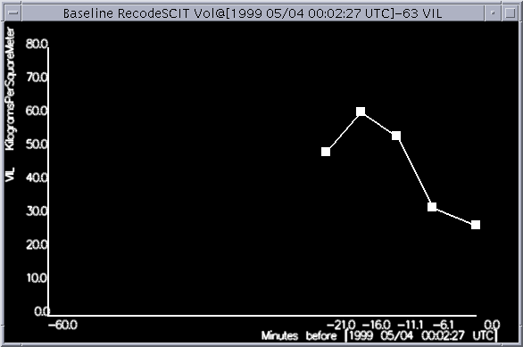
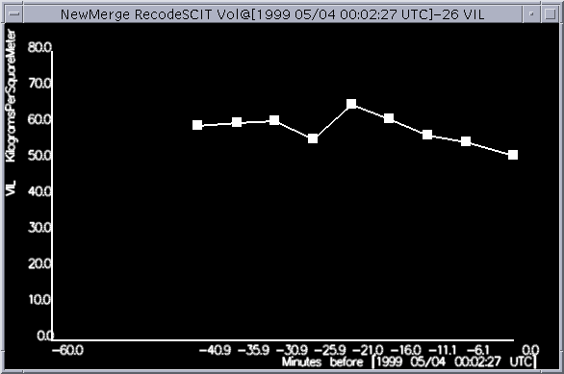
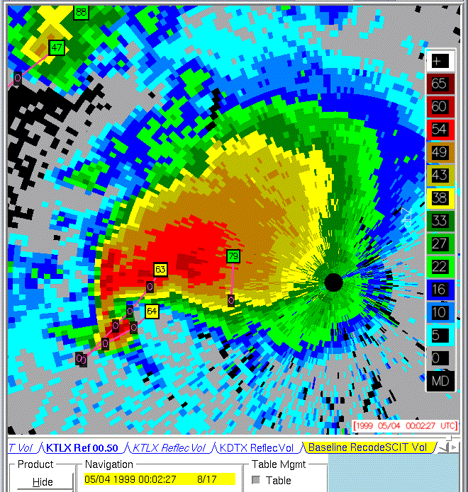
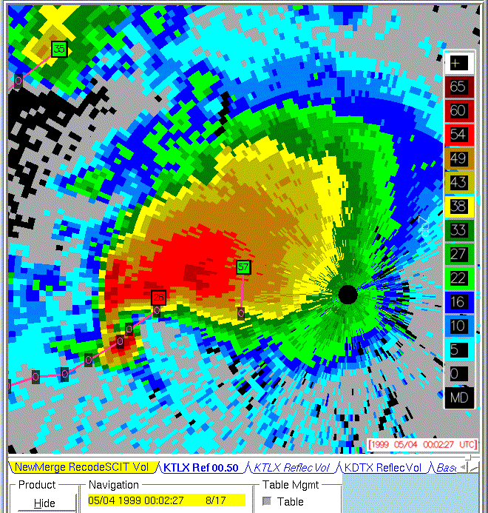

Slide 18
Status of the enhanced SCIT
Integrated into an off-line version of ORPG
Source code delivered to the ROC

