Slide 1



GriPhyN, iVDGL and LHC Computing
Paul Avery
University of Florida
http://www.phys.ufl.edu/~avery/
avery@phys.ufl.edu
DOE/NSF Computing Review of LHC Computing
Lawrence Berkeley Laboratory
Jan. 14-17 2003

Slide 2
GriPhyN/iVDGL Summary
Both funded through NSF ITR program
  GriPhyN: $11.9M (NSF) + $1.6M (matching) (2000 – 2005)
  iVDGL: $13.7M (NSF) + $2M (matching) (2001 – 2006)
Basic composition
  GriPhyN: 12 funded universities, SDSC, 3 labs (~80 people)
  iVDGL: 16 funded institutions, SDSC, 3 labs (~70 people)
  Expts: US-CMS, US-ATLAS, LIGO, SDSS/NVO
  Large overlap of people, institutions, management
Grid research vs Grid deployment
  GriPhyN: 2/3 “CS” + 1/3 “physics” ( 0% H/W)
  iVDGL: 1/3 “CS” + 2/3 “physics” (20% H/W)
  iVDGL: $2.5M Tier2 hardware ($1.4M LHC)
  Physics experiments provide frontier challenges
  Virtual Data Toolkit (VDT) in common

Slide 3
GriPhyN Institutions
  U Florida
  U Chicago
  Boston U
  Caltech
  U Wisconsin, Madison
  USC/ISI
  Harvard
  Indiana
  Johns Hopkins
  Northwestern
  Stanford
  U Illinois at Chicago
  U Penn
  U Texas, Brownsville
  U Wisconsin, Milwaukee
  UC Berkeley
  UC San Diego
  San Diego Supercomputer Center
  Lawrence Berkeley Lab
  Argonne
  Fermilab
  Brookhaven

Slide 4
iVDGL Institutions
  U Florida CMS
  Caltech CMS, LIGO
  UC San Diego CMS, CS
  Indiana U ATLAS, iGOC
  Boston U ATLAS
  U Wisconsin, Milwaukee LIGO
  Penn State LIGO
  Johns Hopkins SDSS, NVO
  U Chicago CS
  U Southern California CS
  U Wisconsin, Madison CS
  Salish Kootenai Outreach, LIGO
  Hampton U Outreach, ATLAS
  U Texas, Brownsville Outreach, LIGO
  Fermilab CMS, SDSS, NVO
  Brookhaven ATLAS
  Argonne Lab ATLAS, CS
T2 / Software
CS support
T3 / Outreach
T1 / Labs
(not funded)

Slide 5
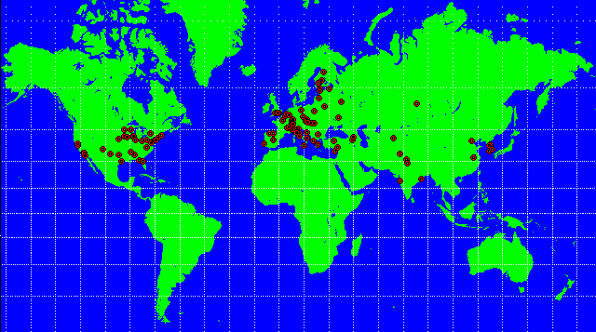
Driven by LHC Computing Challenges
Complexity: Millions of detector channels, complex events
Scale: PetaOps (CPU), Petabytes (Data)
Distribution: Global distribution of people & resources
1800 Physicists
150 Institutes
32 Countries

Slide 6
Goals: PetaScale Virtual-Data Grids
Production Team
Single Investigator
Workgroups
Interactive User Tools
Request Planning &
Scheduling Tools
Request Execution &
Management Tools
Virtual Data Tools
Resource
Management
Services
Security and
Policy
Services
Other Grid
Services
Petaflops
Petabytes
Performance
Transforms
Distributed resources
(code, storage, CPUs,
networks)
Raw data
source

Slide 7
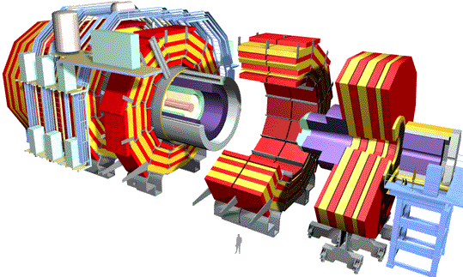

Global LHC Data Grid
Experiment (e.g., CMS)
Tier0/(Σ Tier1)/(Σ Tier2) ~ 1:1:1
Online System
100-200 MBytes/s
Tier 0
CERN Computer Center > 20 TIPS
2.5-10 Gbps
Tier 1
Korea
UK
Russia
USA
2.5-10 Gbps
Tier 2
Tier2 Center
Tier2 Center
Tier2 Center
Tier2 Center
~0.6 Gbps
Tier 3
Institute
Institute
Institute
Institute
> 1 Gbps
Physics cache
Tier 4
PCs, other portals

Slide 8

Coordinating U.S. Grid Projects: Trillium
Trillium: GriPhyN + iVDGL + PPDG
  Large overlap in project leadership & participants
  Large overlap in experiments, particularly LHC
  Joint projects (monitoring, etc.)
  Common packaging, use of VDT & other GriPhyN software
Organization from the “bottom up”
  With encouragement from funding agencies NSF & DOE
DOE (OS) & NSF (MPS/CISE) working together
  Complementarity: DOE (labs), NSF (universities)
  Collaboration of computer science/physics/astronomy encouraged
  Collaboration strengthens outreach efforts
See Ruth Pordes talk

Slide 9
iVDGL: Goals and Context
International Virtual-Data Grid Laboratory
  A global Grid laboratory (US, EU, Asia, South America, …)
  A place to conduct Data Grid tests “at scale”
  A mechanism to create common Grid infrastructure
  A laboratory for other disciplines to perform Data Grid tests
  A focus of outreach efforts to small institutions
Context of iVDGL in US-LHC computing program
  Mechanism for NSF to fund proto-Tier2 centers
  Learn how to do Grid operations (GOC)
International participation
  DataTag
  UK e-Science programme: support 6 CS Fellows per year in U.S.
  None hired yet. Improve publicity?
☹

Slide 10
iVDGL: Management and Coordination
U.S. Piece
US Project
Directors
International Piece
US External
Advisory Committee
Collaborating Grid Projects
US Project
Steering Group
DataTAG
TeraGrid
EDG
LCG?
Asia
BTEV
ALICE
Bio
Geo
?
Facilities Team
Core Software Team
D0
PDC
CMS HI
?
Operations Team
Project Coordination Group
Applications Team
GLUE Interoperability Team
Outreach Team

Slide 11
iVDGL: Work Teams
Facilities Team
  Hardware (Tier1, Tier2, Tier3)
Core Software Team
  Grid middleware, toolkits
Laboratory Operations Team (GOC)
  Coordination, software support, performance monitoring
Applications Team
  High energy physics, gravity waves, digital astronomy
  New groups: Nuc. physics? Bioinformatics? Quantum Chemistry?
Education and Outreach Team
  Web tools, curriculum development, involvement of students
  Integrated with GriPhyN, connections to other projects
  Want to develop further international connections

Slide 12
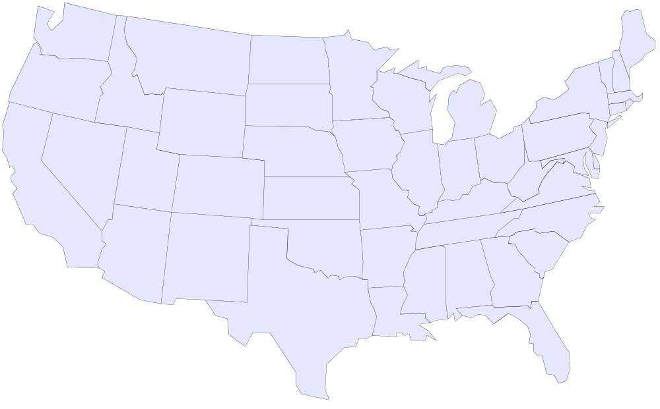
US-iVDGL Sites (Sep. 2001)
SKC
Boston U
Wisconsin
PSU
Fermilab
Argonne
BNL
J. Hopkins
Indiana
Caltech
Hampton
UCSD/SDSC
UF
Tier1
Brownsville
Tier2
Tier3

Slide 13
New iVDGL Collaborators
New experiments in iVDGL/WorldGrid
  BTEV, D0, ALICE
New US institutions to join iVDGL/WorldGrid
  Many new ones pending
Participation of new countries (different stages)
  Korea, Japan, Brazil, Romania, …

Slide 14
US-iVDGL Sites (Spring 2003)
SKC
Boston U
Wisconsin
Michigan
PSU
LBL
Fermilab
Argonne
BNL
NCSA
J. Hopkins
Indiana
Hampton
Caltech
Oklahoma
Vanderbilt
Partners?
EU
CERN
Brazil
Korea
Japan
UCSD/SDSC
FSU
Arlington
UF
Tier1
Tier2
FIU
Brownsville
Tier3

Slide 15






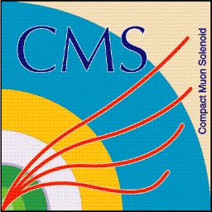

An Inter-Regional Center for High Energy Physics Research and Educational Outreach (CHEPREO) at Florida International University
E/O Center in Miami area
iVDGL Grid Activities
CMS Research
AMPATH network
Int’l Activities (Brazil, etc.)
Status:
Proposal submitted Dec. 2002
Presented to NSF review panel
Jan. 7-8, 2003
Looks very positive

Slide 16
US-LHC Testbeds
Significant Grid Testbeds deployed by US-ATLAS & US-CMS
  Testing Grid tools in significant testbeds
  Grid management and operations
  Large productions carried out with Grid tools

Slide 17
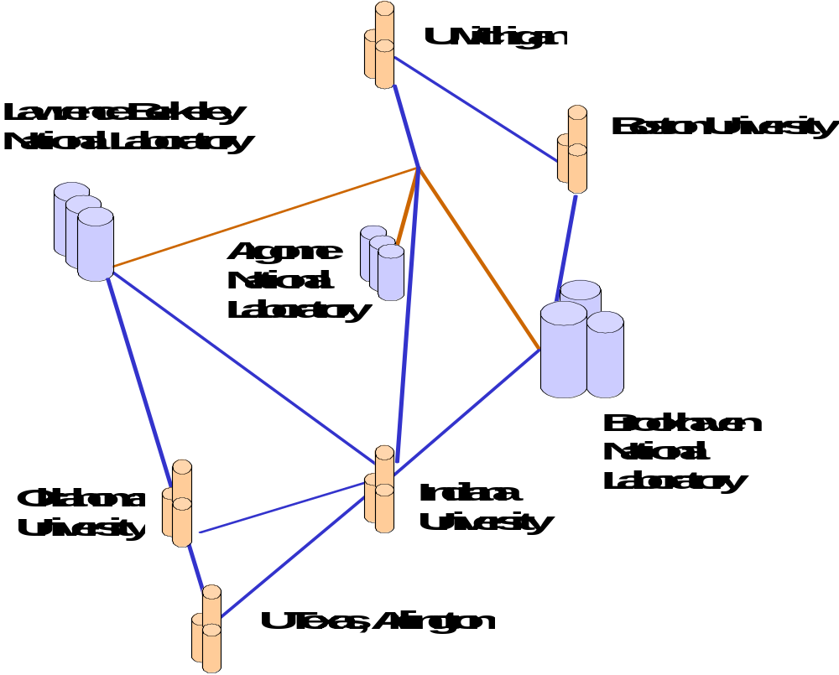
US-ATLAS Grid Testbed
Grappa: Manages overall grid experience
Magda: Distributed data management and replication
Pacman: Defines and installs software environments
DC1 production with grat:
Data challenge ATLAS simulations
Instrumented Athena: Grid monitoring of Atlas analysis apps.
vo-gridmap: Virtual organization management
Gridview: Monitors U.S. Atlas resources

Slide 18
US-CMS Testbed
Korea
Wisconsin
Belgium
Fermilab
CERN
Caltech
UCSD
FSU
Florida
Rice
FIU
Brazil

Slide 19
Commissioning the CMS Grid Testbed
A complete prototype
  CMS Production Scripts
  Globus, Condor-G, GridFTP
Commissioning: Require production quality results!
  Run until the Testbed "breaks"
  Fix Testbed with middleware patches
  Repeat procedure until the entire Production Run finishes!
Discovered/fixed many Globus and Condor-G problems
  Huge success from this point of view alone
  … but very painful
Notes:
OK

Slide 20
CMS Grid Testbed Production
Remote Site 1
Batch
Queue
GridFTP
Master Site
Remote Site 2
IMPALA
mop_submitter
DAGMan
Condor-G
Batch
Queue
GridFTP
GridFTP
Remote Site N
Batch
Queue
GridFTP

Slide 21
Production Success on CMS Testbed
Recent results
  150k events generated: 1.5 weeks continuous running
  1M event run just completed on larger testbed: 8 weeks
MCRunJob
Linker
ScriptGenerator
Configurator
MasterScript
"DAGMaker"
VDL
Requirements
MOP
MOP
Chimera
Self Description
Notes:
Modify MCRunJob?

Slide 22
US-LHC Proto-Tier2 (2001)
“Flat” switching topology
FEth/GEth
Switch
Router
Data Server
20-60 nodes
Dual 0.8-1 GHz, P3
1 TByte RAID
WAN
>1 RAID

Slide 23
US-LHC Proto-Tier2 (2002/2003)
“Hierarchical” switching topology
GEth
Switch
GEth/FEth
Switch
Switch
GEth/FEth
Switch
Router
Data Server
40-100 nodes
Dual 2.5 GHz, P4
2-6 TBytes RAID
WAN
>1 RAID

Slide 24

Creation of WorldGrid
Joint iVDGL/DataTag/EDG effort
  Resources from both sides (15 sites)
  Monitoring tools (Ganglia, MDS, NetSaint, …)
  Visualization tools (Nagios, MapCenter, Ganglia)
Applications: ScienceGrid
  CMS: CMKIN, CMSIM
  ATLAS: ATLSIM
Submit jobs from US or EU
  Jobs can run on any cluster
  Demonstrated at IST2002 (Copenhagen)
  Demonstrated at SC2002 (Baltimore)

Slide 25
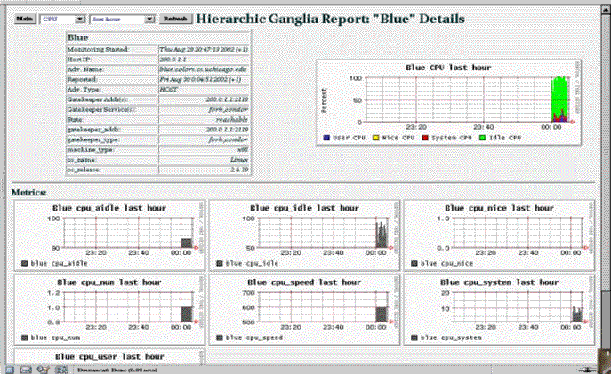
WorldGrid

Slide 26
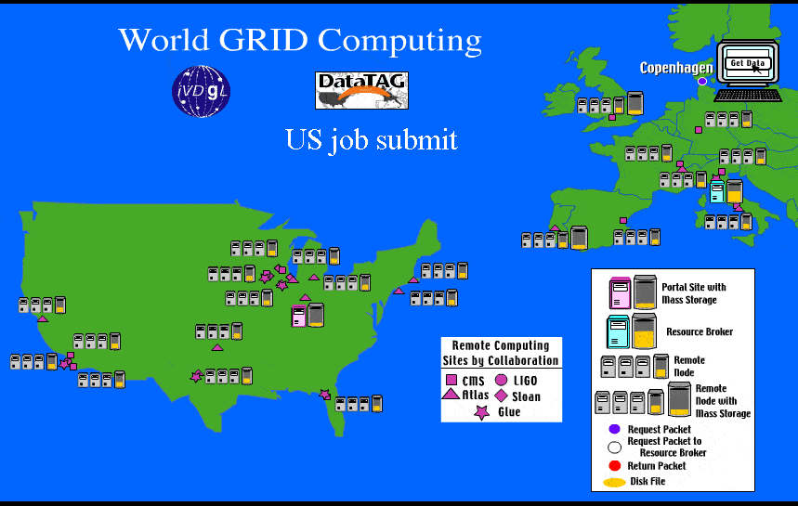
WorldGrid Sites

Slide 27
GriPhyN Progress
CS research
  Invention of DAG as a tool describing workflow
  System to describe, execute workflow: DAGMan
  Much new work on planning, scheduling, execution
Virtual Data Toolkit + Pacman
  Several major releases this year: VDT 1.1.5
  New packaging tool: Pacman
  VDT + Pacman vastly simplify Grid software installation
  Used by US-ATLAS, US-CMS
  LCG will use VDT for core Grid middleware
Chimera Virtual Data System (more later)

Slide 28
Virtual Data Concept
Major facilities, archives
Data request may
  Compute locally/remotely
  Access local/remote data
Scheduling based on
  Local/global policies
  Cost
Regional facilities, caches
Fetch item
Local facilities, caches

Slide 29
Virtual Data: Derivation and Provenance
Most scientific data are not simple “measurements”
  They are computationally corrected/reconstructed
  They can be produced by numerical simulation
Science & eng. projects are more CPU and data intensive
  Programs are significant community resources (transformations)
  So are the executions of those programs (derivations)
Management of dataset transformations important!
  Derivation: Instantiation of a potential data product
  Provenance: Exact history of any existing data product
Programs are valuable, like data. They should be community resources.
We already do this, but manually!

Slide 30
Virtual Data Motivations (1)
“I’ve found some interesting data, but I need to know exactly what corrections were applied before I can trust it.”
“I’ve detected a muon calibration error and want to know which derived data products need to be recomputed.”
Data
product-of
consumed-by/
generated-by
Transformation
Derivation
execution-of
“I want to search a database for 3 muon SUSY events. If a program that does this analysis exists, I won’t have to write one from scratch.”
“I want to apply a forward jet analysis to 100M events. If the results already exist, I’ll save weeks of computation.”

Slide 31
Virtual Data Motivations (2)
Data track-ability and result audit-ability
  Universally sought by scientific applications
Facilitates tool and data sharing and collaboration
  Data can be sent along with its recipe
Repair and correction of data
  Rebuild data products—c.f., “make”
Workflow management
  A new, structured paradigm for organizing, locating, specifying, and requesting data products
Performance optimizations
  Ability to re-create data rather than move it
Needed: Automated, robust system

Slide 32
“Chimera” Virtual Data System
Virtual Data API
  A Java class hierarchy to represent transformations & derivations
Virtual Data Language
  Textual for people & illustrative examples
  XML for machine-to-machine interfaces
Virtual Data Database
  Makes the objects of a virtual data definition persistent
Virtual Data Service (future)
  Provides a service interface (e.g., OGSA) to persistent objects
Version 1.0 available
  To be put into VDT 1.1.6?

Slide 33
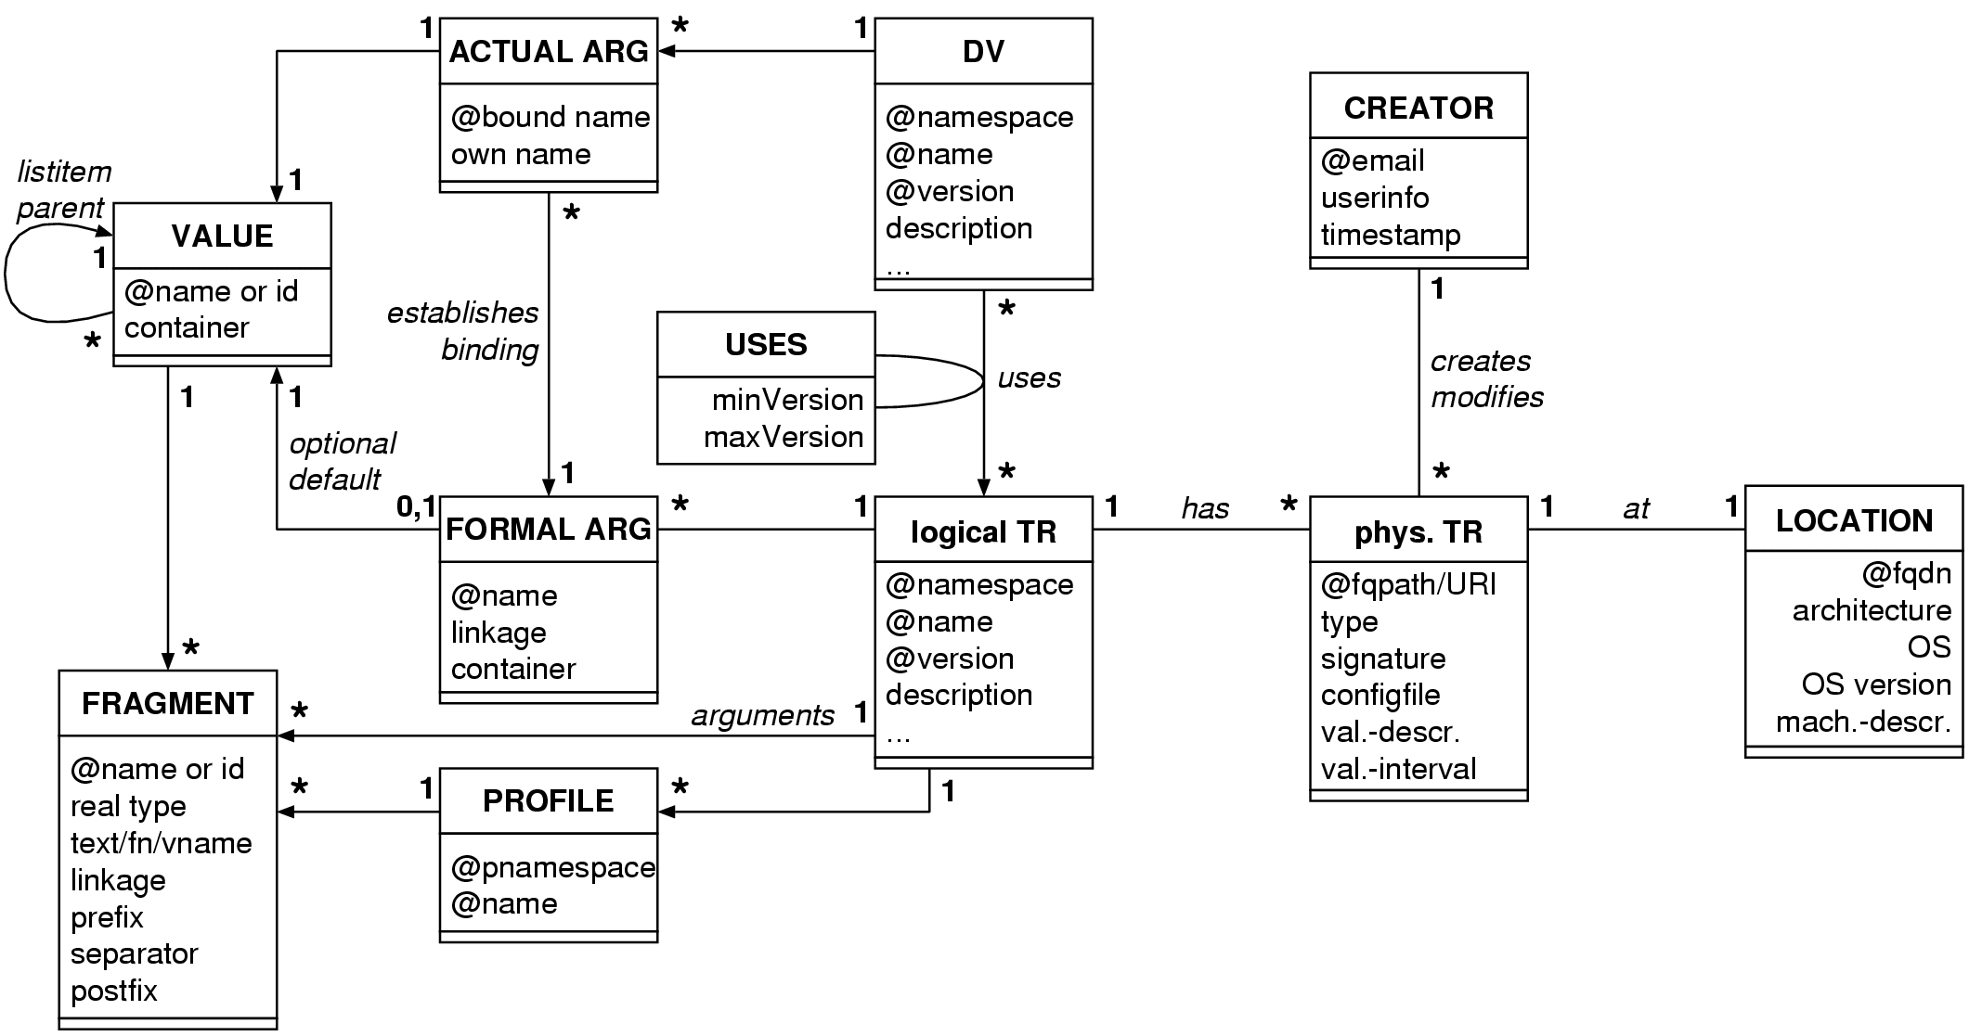
Virtual Data Catalog Object Model
Notes:
Feel free to skip.

Slide 34
Chimera as a Virtual Data System
Virtual Data Language (VDL)
  Describes virtual data products
Virtual Data Catalog (VDC)
  Used to store VDL
Abstract Job Flow Planner
  Creates a logical DAG (dependency graph)
Concrete Job Flow Planner
  Interfaces with a Replica Catalog
  Provides a physical DAG submission file to Condor-G
Generic and flexible
  As a toolkit and/or a framework
  In a Grid environment or locally
VDC
XML
XML
Abstract
Planner
VDL
DAX
Logical
Replica
Catalog
Concrete
Planner
Physical
DAG
DAGMan
Notes:
OK

Slide 35

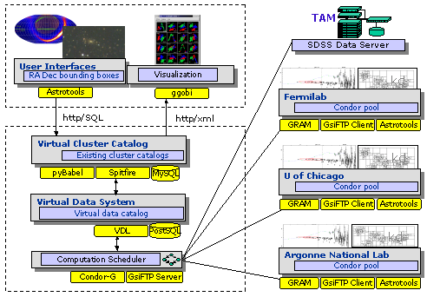
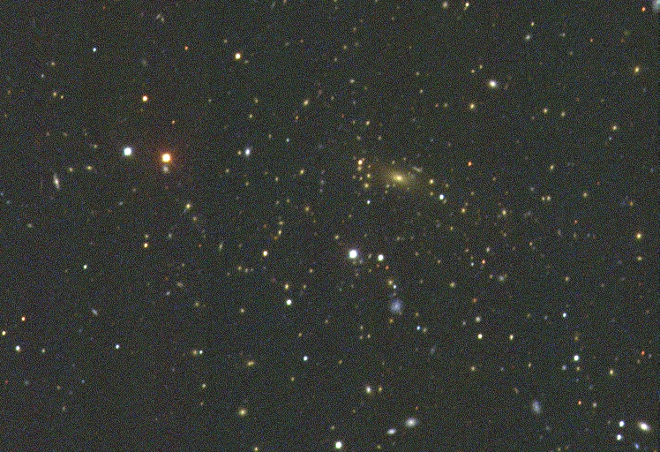
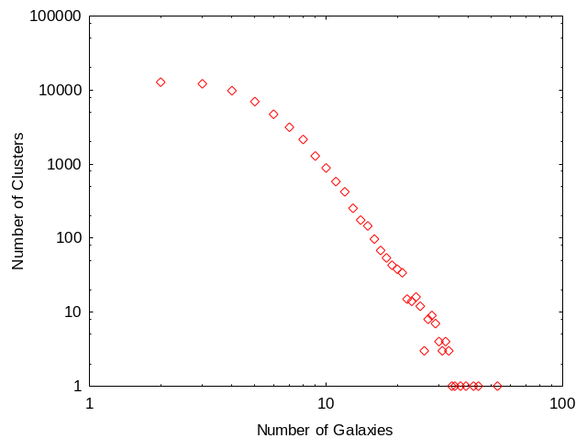
Chimera Application: SDSS Analysis
Size distribution of
galaxy clusters?
Galaxy cluster
size distribution
Chimera Virtual Data System
+ GriPhyN Virtual Data Toolkit
+ iVDGL Data Grid (many CPUs)

Slide 36
Virtual Data and LHC Computing
US-CMS (Rick Cavanaugh talk)
  Chimera prototype tested with CMS MC (~200K test events)
  Currently integrating Chimera into standard CMS production tools
  Integrating virtual data into Grid-enabled analysis tools
US-ATLAS (Rob Gardner talk)
  Integrating Chimera into ATLAS software
HEPCAL document includes first virtual data use cases
  Very basic cases, need elaboration
  Discuss with LHC expts: requirements, scope, technologies
New ITR proposal to NSF ITR program($15M)
  Dynamic Workspaces for Scientific Analysis Communities
Continued progress requires collaboration with CS groups
  Distributed scheduling, workflow optimization, …
  Need collaboration with CS to develop robust tools

Slide 37
Summary
Very good progress on many fronts in GriPhyN/iVDGL
  Packaging: Pacman + VDT
  Testbeds (development and production)
  Major demonstration projects
  Productions based on Grid tools using iVDGL resources
WorldGrid providing excellent experience
  Excellent collaboration with EU partners
Looking to collaborate with more international partners
  Testbeds, monitoring, deploying VDT more widely
New directions
  Virtual data a powerful paradigm for LHC computing
  Emphasis on Grid-enabled analysis
  Extending Chimera virtual data system to analysis

