Slide 1
Update on West Nile Virus
George J. Dawson, Ph.D.
Abbott Laboratories

Slide 2
West Nile Virus Update
  Abbott’s commitment to WNV will continue as needed to aid in understanding evolution of markers associated with infection
  Abbott’s Research WNV IgM assay:
    Cutoff set based on human population studies, experimental infection studies in primates
    Repeatably reactive specimens were characterized with other serologic assays to confirm reactivity
    Supplemental tests from various sources have been utilized to aid in setting cutoff for Abbott’s test

Slide 3
West Nile Virus Update
Recent observations indicate:
  Considerable overlap of WNV RNA detection and IgM detection in the early stage of infection
  Low level viremics may be negative by minipool NAT and reactive by WNV IgM
  Infectivity studies may be required to determine transmissibility of low level viremic specimens
  More sensitive IgM assays have greater overlap with WNV RNA detection than less sensitive assays
  As WNV IgM tests become more sensitive, there are fewer options for confirmatory tests with appropriate sensitivity

Slide 4
West Nile Virus
Specificity issues with WNV IgM assays for WNV:
1. Cross reactivity
A repeatably reactive test result may be induced
by flaviviruses other than WNV due to relatively
high degree of amino acid homology between proteins of WNV and other flaviviruses
2. Confirmatory testing
Low level reactives may be difficult to confirm Follow-up samples may be required

Slide 5
Amino Acid Sequence Homology
Comparison of percent identity of West Nile Virus vs. Dengue, Yellow Fever, Japanese Encephalitis and St. Louis Encephalitis Viruses
Region | Dengue* | YFV | TBEV | MV | JEV | SLE
Core | 41.4 | 27.1 | ~21.9 | 65.9 | 61.8 | 60.3
PreM/M | 37.6 | 38.6 | 30.2 | 77.2 | 74.2 | 65.9
ENV | 50.1 | 45.2 | 44.1 | 79.3 | 78.8 | 73.3
NS1 | 52.3 | 43.4 | 43.1 | 76.1 | 77.8 | 65.2
NS2A | 28.5 | 27.9 | 21.3 | 64.8 | 65.6 | 49.8
NS2B | 33.1 | 28.5 | 25.2 | 74.0 | 67.9 | 52.7
NS3 | 63.6 | 52.1 | 46.7 | 80.5 | 81.7 | 72.9
NS4A | 40.4 | 35.6 | 34.2 | 77.2 | 77.8 | 63.1
NS4B | 40.7 | 32.0 | 27.1 | 64.6 | 65.5 | 56.9
NS5 | 66.5 | 60.9 | 60.1 | 82.6 | 81.2 | 75.3b
* Average of Dengue type 1 through 4: analyses performed at Abbott Laboratories

Slide 6
ELISA Cross-reactivities of WNV IgM Test
(S/N values as reported by CDC)
Serum
SLE
JE
WN
DEN2
YF
POW
1
4.96
7.75
16.74
2.45
1.82
1.56
2
4.8
13.77
16.68
4.13
2.14
1.75
3
5.45
9.67
16.08
4.09
1.61
1.44
4
4.76
10.07
17.19
3.32
1.62
1.3
Positive
6.5
8.2
6.34
7.45
3.96
4.5
Control
* 1:400 screening dilution of WNV patient serum

Slide 7

Two-Step IgM Capture EIA
Antigen Added
Diluent
Red
Serum Added
Diluent
Anti-IgM Coated Solid Phase
Conjugate Added
Diluent
Blue
Timing: 1 hr/37ºC/Static 2 hr/37ºC/Static

Slide 8
West Nile Virus
Studies
Volunteer blood donors from 2002
  Based on previous population studies the cut-off was provisionally set at S/N = 5.0
Experimentally infected rhesus monkeys*
  Daily bleeds for 2 wks
  Natural history of WNV
*In collaboration with Dr. Tesh and associates at UTMB Galveston, TX and Dr. Marion Ratterree and associates at the Tulane National Primate Research Center, Covington, LA

Slide 9
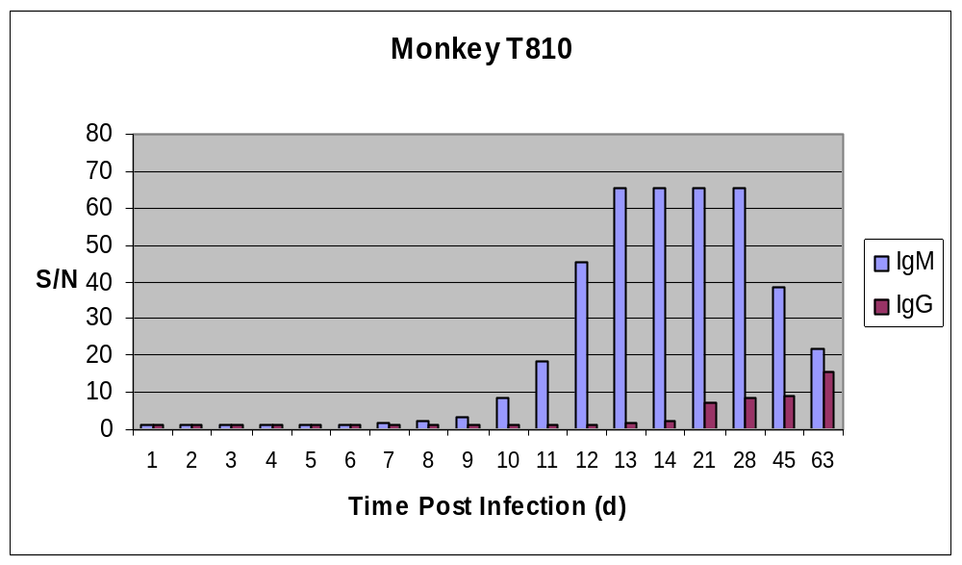
Serologic Profile of WNV Infection in Experimentally Infected Monkeys
+
+
+
+
+
+
+
-
+
+
-
-
-
-
-
-
-
-
Nested RT-PCR
-
+
+
+
+
-
-
-
-
-
-
-
-
-
-
-
-
-
Virus Isolation
*In collaboration with Dr. Tesh and associates at UTMB Galveston, TX and Dr. Marion Ratterree and associates at the Tulane National Primate Research Center, Covington, LA

Slide 10
Serologic Profile of Experimentally Infected Macaque #810
Day # | Virus (log) | RT-PCT | IgM (S/N) | IgG S/N | HI (titer) | CF (titer) | PRNT (titer)
0 | - | - | 1.0 | 1.0 | - | - | -
1 | - | + | 1.0 | 1.0 | - | - | -
2 | 2.0 | + | 1.0 | 1.1 | - | - | -
3 | 1.0 | + | 1.0 | 1.1 | - | - | -
4 | 1.7 | + | 1.0 | 1.2 | - | - | -
5 | 1.7 | + | 1.0 | 1.1 | - | - | -
6 | - | + | 1.3 | 1.0 | - | - | -
7 | - | + | 1.6 | 1.0 | - | - | -
8 | - | - | 2.1 | 1.0 | - | - | -
9 | - | + | 3.3 | 1.0 | - | - | -
10 | - | +/- | 8.3 | 1.1 | - | - | 1:10
11 | - | - | 18.3 | 1.1 | 1:20 | - | 1:20
12 | - | - | 45.2 | 1.3 | 1:160 | - | 1:20
13 | - | - | >65.6 | 1.5 | 1:640 | - | 1:40
14 | - | - | >65.6 | 2.0 | 1:640 | 16 | 1:20
21 | - | - | >65.6 | 7.1 | ND | ND | 1:80
28 | - | - | >65.6 | 8.2 | 1:1280 | 64 | ND
45 63 | - - | - - | 38.7 21.6 | 9.0 15.9 | 1:640 1:1280 | 64 64 | ND 1:512
*In collaboration with Dr. Tesh and associates at UTMB Galveston, TX and Dr. Marion Ratterree and associates at the Tulane National Primate Research Center, Covington, LA

Slide 11
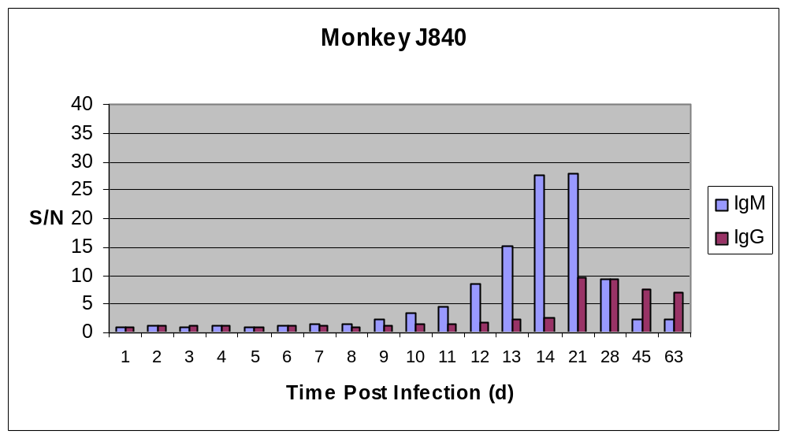
Serologic Profile of WNV Infection in Experimentally Infected Monkeys
+
+
+
+
-
+
-
-
-
-
-
-
-
-
-
-
-
-
Nested RT-PCR
-
+
-
-
-
-
-
-
-
-
-
-
-
-
-
-
-
-
Virus Isolation
*In collaboration with Dr. Tesh and associates at UTMB Galveston, TX and Dr. Marion Ratterree and associates at the Tulane National Primate Research Center, Covington, LA

Slide 12
Serologic Profile of Experimentally Infected Macaque #J840
Day # | Virus | RT-PCT | IgM (S/N) | IgG S/N | HI | CF | PRNT
0 | - | - | 1.0 | 1.0 | - | - | -
1 | - | + | 0.8 | 0.9 | - | - | -
2 | 1.7 | + | 1.1 | 1.0 | - | - | -
3 | - | + | 0.8 | 1.0 | - | - | -
4 | - | + | 1.0 | 1.0 | - | - | -
5 | - | - | 0.9 | 0.9 | - | - | -
6 | - | + | 1.1 | 1.0 | - | - | -
7 | - | - | 1.4 | 1.0 | - | - | -
8 | - | - | 1.5 | 0.9 | - | - | -
9 | - | - | 2.3 | 1.1 | - | - | -
10 | - | - | 3.3 | 1.3 | - | - | -
11 | - | - | 4.4 | 1.4 | - | - | -
12 | - | - | 8.4 | 1.6 | 1:20 | 8 | -
13 | - | - | 15.2 | 2.2 | 1:40 | 32 | 1:10
14 | - | - | 27.6 | 2.6 | 1:80 | 32 | 1:20
21 | - | - | 27.9 | 9.6 | 1:320 | 64 | 1:80
28 | - | - | 9.3 | 9.2 | 1:160 | 64 | ND
45 63 | - - | - - | 2.3 2.3 | 7.7 7.0 | 1:160 1:160 | 16 8 | ND 1:1280
*In collaboration with Dr. Tesh and associates at UTMB Galveston, TX and Dr. Marion Ratterree and associates at the Tulane National Primate Research Center, Covington, LA

Slide 13
Summary of Serologic Profiles of Experimentally Infected Macaques
Median Values
Day # | Virus log PFU’s (pos/total) | RT-PCR (pos/total) | IgM (S/N) | IgG S/N | HI (titer) | CF (titer) | PRNT (titer)
0 | - | - | 1.0 | 1.0 | - | - | -
1 | - | 5/5 + | 0.9 | 1.0 | - | - | -
2 | 1.7 (5/5+) | 5/5 + | 1.1 | 1.0 | - | - | -
3 | 2.0 (3/5+) | 5/5 + | 1.0 | 1.0 | - | - | -
4 | 1.0 (2/5+) | 5/5 + | 1.1 | 1.0 | - | - | -
5 | 1.7 (2/5+) | 3/5+ | 1.1 | 1.0 | - | - | -
6 | - | 3/5 + | 1.3 | 1.0 | - | - | -
7 | - | 1/5+ | 1.5 | 1.0 | - | - | -
8 | - | 0/5 + | 2.1 | 0.9 | - | - | -
9 | - | 1/5 + | 3.3 | 1.0 | - | - | -
10 | - | 1/5 +- | 11.9 | 1.0 | 1:20 | - | 1:10
11 | - | - | 18.3 | 1.1 | 1:40 | - | 1:20
12 | - | - | 30.9 | 1.3 | 1:80 | 8 | 1:20
13 | - | - | 40.2 | 1.5 | 1:160 | 16 | 1:40
14 | - | - | 50.8 | 2.1 | 1:320 | 16 | 1:40
21 | - | - | 46.1 | 7.1 | 1:320 | 32 | 1:80
28 | - | - | 27.0 | 8.2 | 1:160 | 64 | ND
45 | - | - | 11.6 | 9.0 | 1:160 | 16 | 1:640
63 | - | - | 3.4 | 7.0 | 1:160 | 16 | 1:640
*In collaboration with Dr. Tesh and associates at UTMB Galveston, TX and Dr. Marion Ratterree and associates at the Tulane National Primate Research Center, Covington, LA

Slide 14
Experimentally Infected Macaques
A total of 38 of the 41 IgM reactive specimens (S/N>5.0) were confirmed by one or more supplemental assay
  2 of 5 of the first bleed dates were confirmed by one or more supplemental assays
A provisional cutoff was set an S/N greater than 5.0 and utilized for human studies

Slide 15
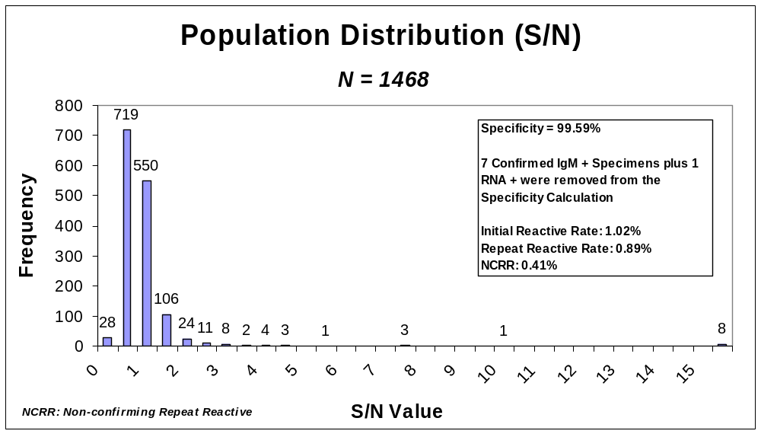
IgM Detection in a Selected Population*
Volunteer blood donations from 2002, from centers considered at “high risk” for WNV
Infection – Dr. L Tobler Blood Centers of the Pacific; Dr. Michael Busch, America’s Blood Centers

Slide 16
Serologic Profile of Repeatably Reactive Human Specimens
Number | IgM (S/N) | IgM (S/N) retest | IgM 2 (S/N) | PRNT Titer | WNV IgG | WNV IgG retest | Supplemental Testing
1 | >155.5 | >111.1 | 48.8 | 640 | 14.5 | 20.1 | Pos
2 | 142.4 | >111.1 | 45.0 | 1280 | 85.2 | 99.8 | Pos
3 | 127.3 | >111.1 | 47.1 | 320 | 8.7 | 8.4 | Pos
4 | 110.7 | 109.2 | 24.7 | 320 | 24.6 | 38.9 | Pos
5 | 103.9 | 108.8 | 32.4 | 160 | 29.1 | 20.1 | Pos
6 | 91.1 | 95.9 | 26.4 | 160 | 63.8 | 57.8 | Pos
7 | 59.9 | 78.3 | 20.4 | 640 | 81.4 | 45.6 | Pos
8 | 31.6 | 32.1 | 18.4 | Neg | 0.8 | ND | Neg*
9 | 10.1 | 9.6 | 4.4 | Neg | 1.3 | ND | Neg*
10 | 7.9 | 8.7 | 5.1 | Neg | 1.1 | ND | Neg*
11 | 7.8 | 5.0 | 4.4 | Neg | 0.5 | ND | Neg*
12 | 7.7 | 12.4 | 5.8 | Neg. | 0.5 | ND | Neg*
13 | 5.5 | 10.4 | 4.4 | Neg | 0.6 | ND | Neg*
Additional supplemental testing is being performed
Volunteer blood donations from 2002, from centers considered at “high risk” for WNV
Infection – Dr. L Tobler Blood Centers of the Pacific; Dr. Michael Busch, America’s Blood Centers

Slide 17
SUMMARY
Assay Format Finalized
  EIA on polystyrene beads
  Capture IgM completed in 3.5 hours at 37° C
Preliminary evaluation of IgM testing indicates:
  In experimentally infected primates, IgM was detected by day 10 post infection
  The provisional cutoff set at S/N 5.0 appears to provide adequate specificity
  Specificity improvements may be made in the future if needed
  Research studies will continue utilizing current provisional cutoff, while evaluating supplemental testing (confirmatory) algorithms

