Slide 1


Scaling of Anisotropic Flow in the Picture of Quark Coalescence
Hot Quarks 2004
Markus D. Oldenburg
for the STAR Collaboration
July 23, 2004

Slide 2
Outline
Introduction
Meson-Baryon Scaling of Elliptic Flow v₂(p_{t})
Scaling of Higher Harmonics of Anisotropic Flow
Summary and Outlook

Slide 3
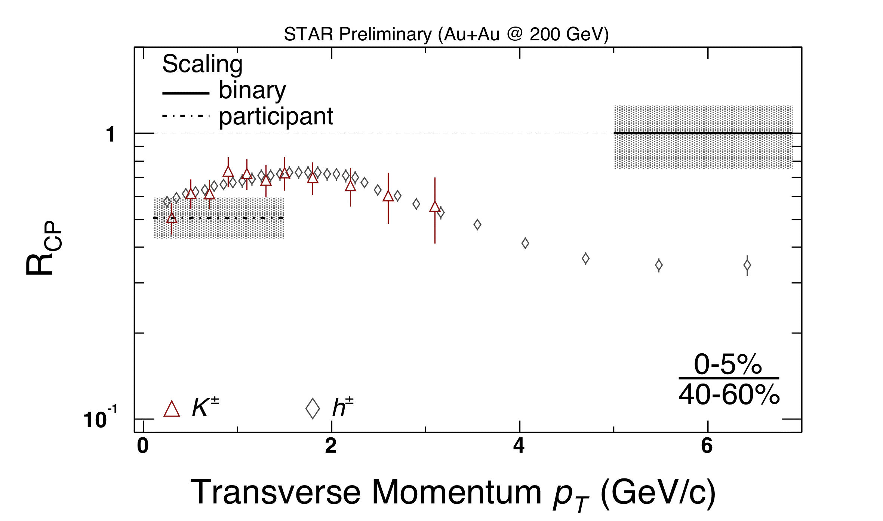
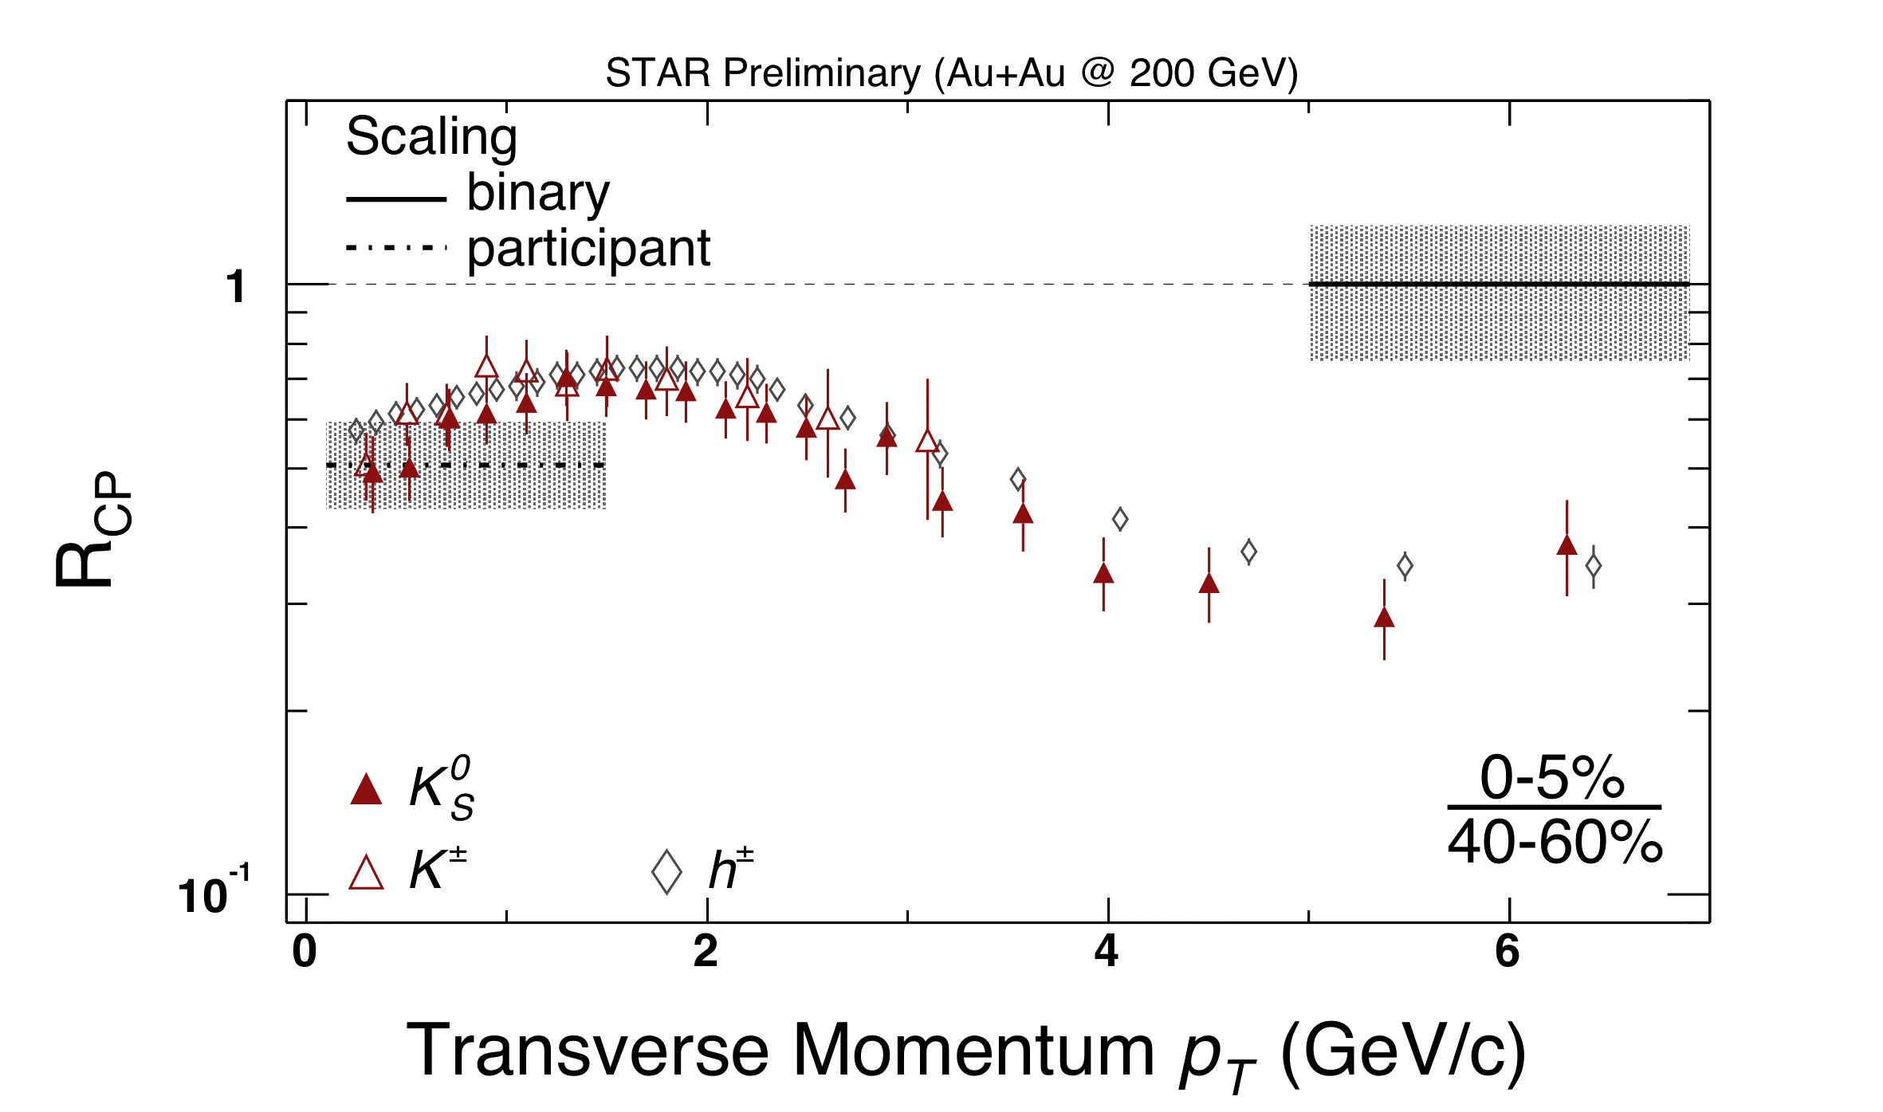
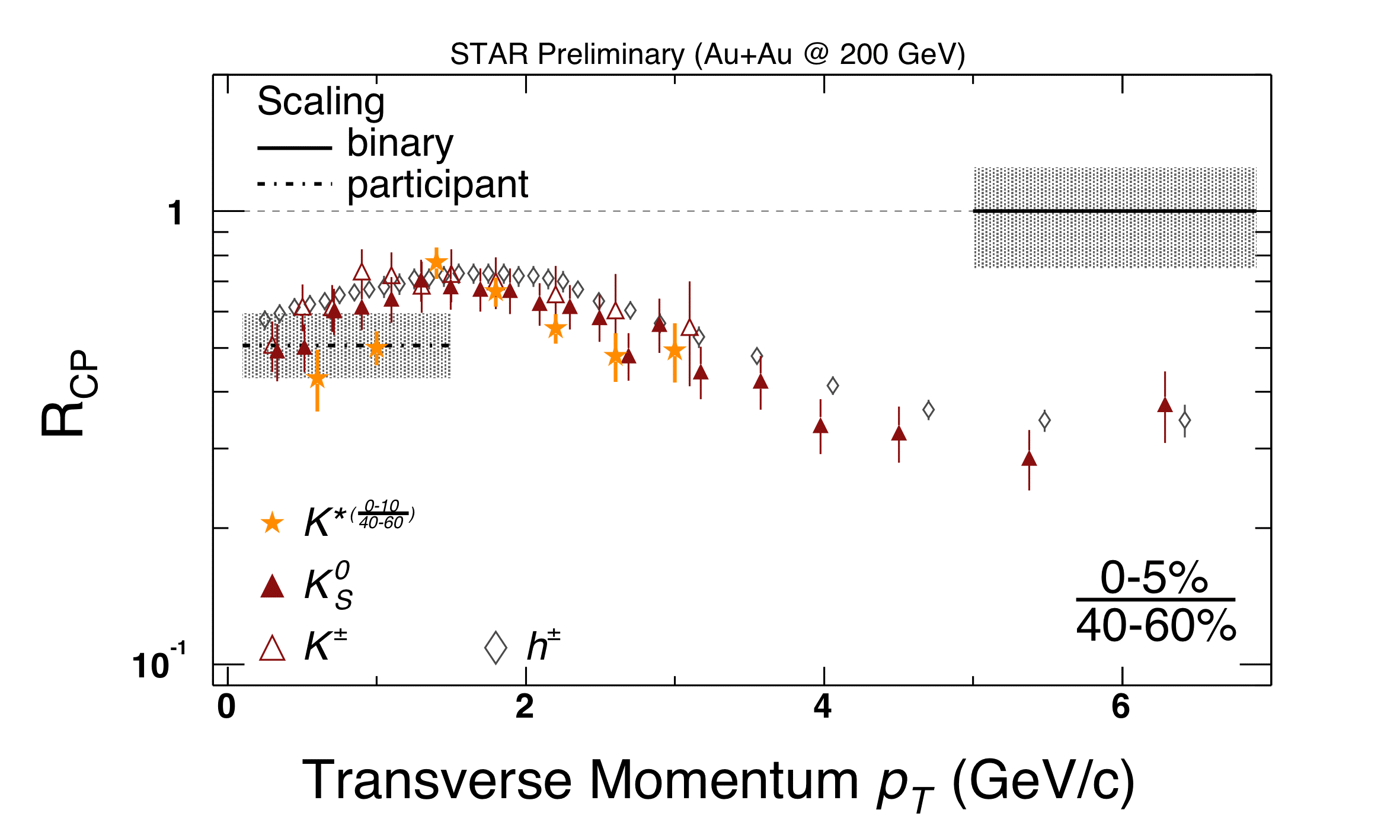
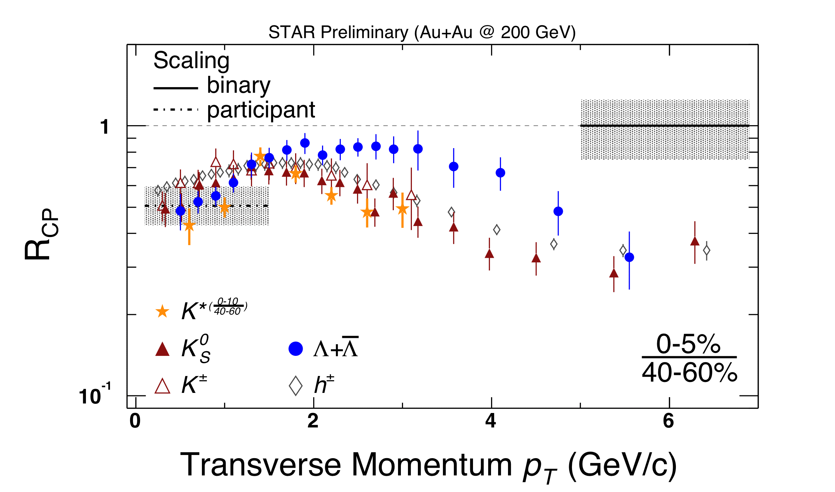
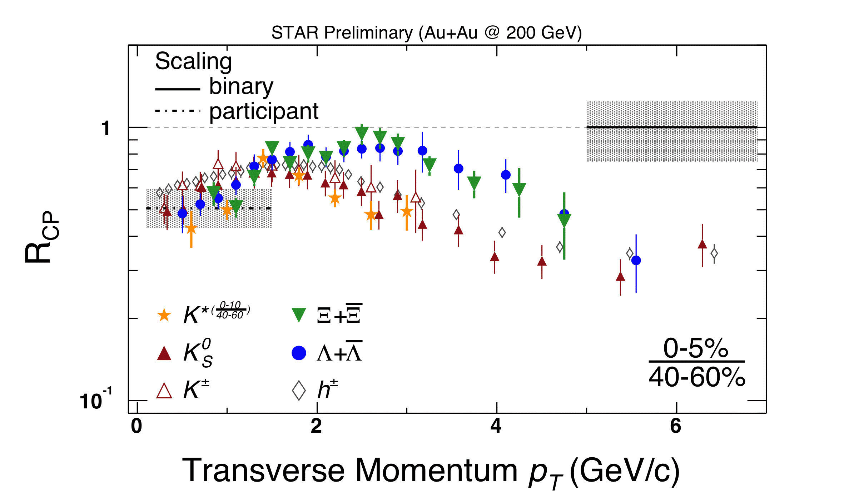
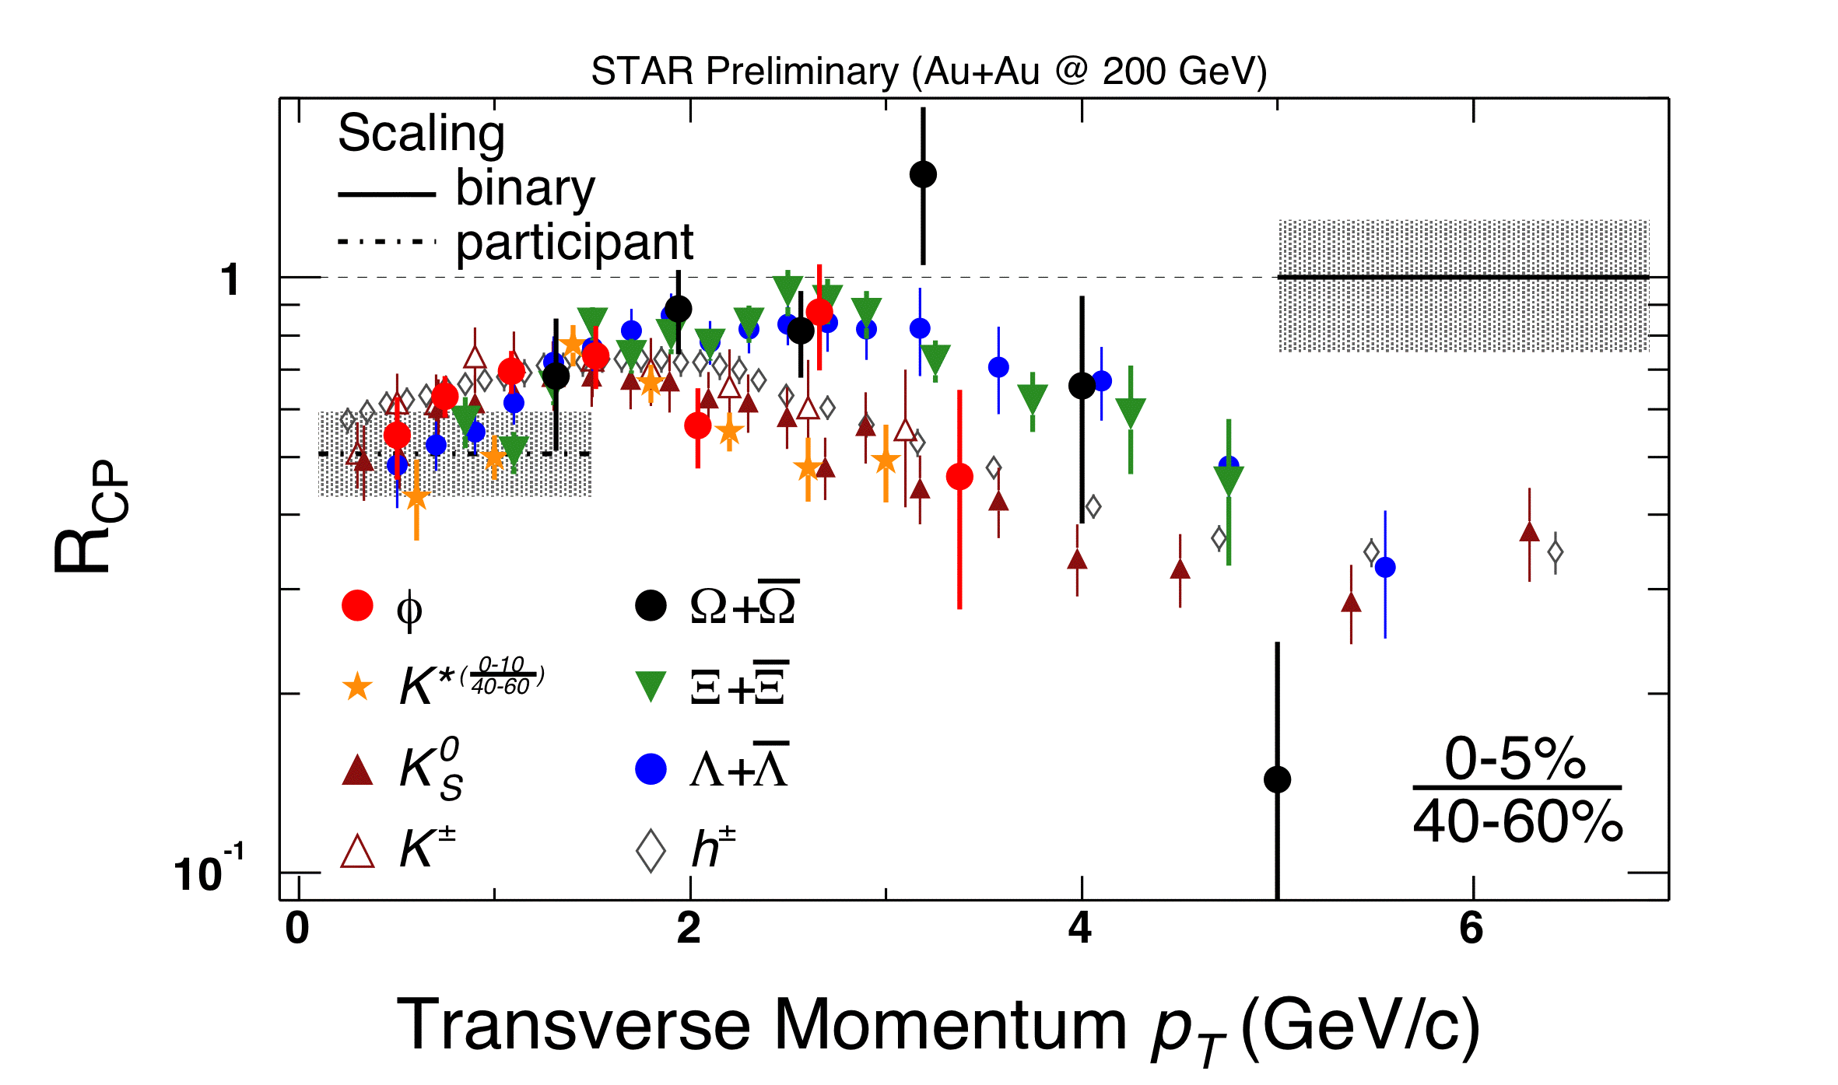
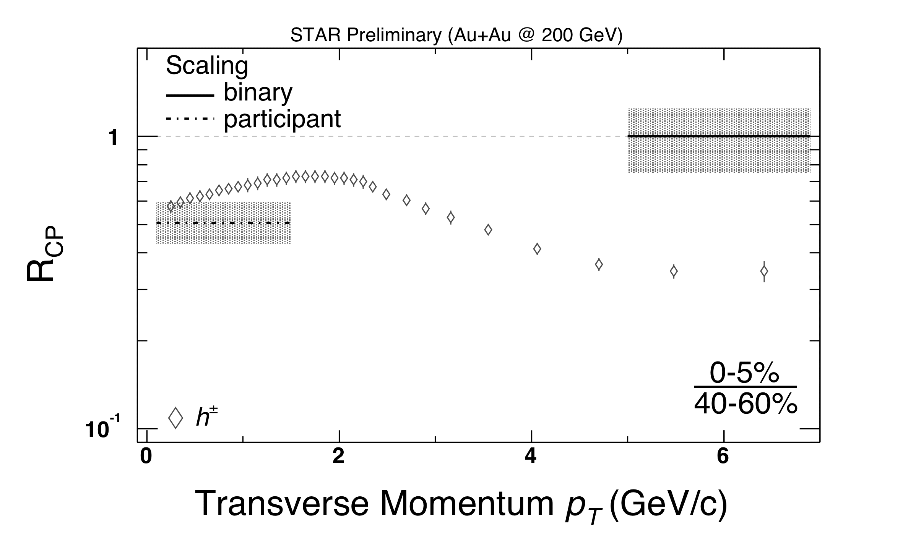
R_{CP} of Strange Hadrons
Two groups (2<p_{t}<6GeV/c):
- K⁰_{s}, K±, K*, φ → mesons
- Λ, Ξ, Ω → baryons
dependence on number of constituent quarks
limited to p_{t} < 6GeV/c?
hadron production from quark coalescence?

Slide 4
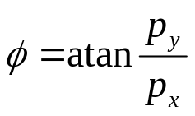

Anisotropic Flow
Look at peripheral collisions
Overlap region is not symmetric in coordinate space
Almond shaped overlap region
  Larger pressure gradient in x-z plane than in y-direction
  Spatial anisotropy → Momentum anisotropy
    Interactions among constituents transform the initial spatial anisotropy into an (observed) momentum anisotropy
    Process quenches itself → sensitive to early times in the evolution of the system
    sensitive to the equation of state
y
z
x
y
p_{y}
Perform a Fourier decomposition of the momentum space particle distributions in the x-y plane
  v_{n} is the n-th harmonic Fourier coefficient of the distribution of particles with respect to the reaction plane
    v₁: “directed flow”
    v₂: “elliptic flow”
x
p_{x}

Slide 5
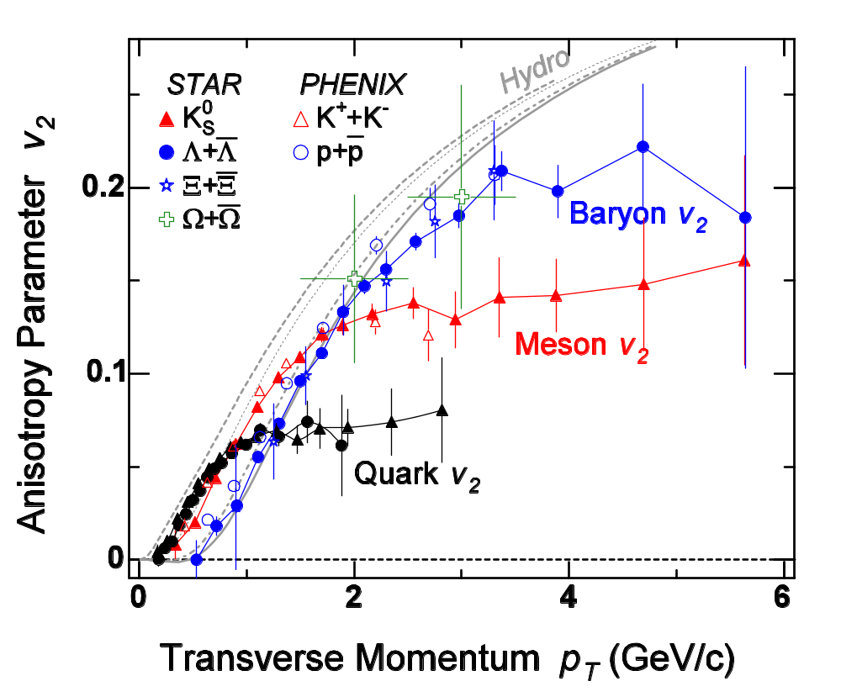
Scaled strange particle v₂(p_{t})
Hadronization via quark coalescence:
v₂ of a hadron at a given p_{t} is the partonic v₂ at p_{t}/n scaled by the # of quarks (n).
Shown to work for K⁰_{s}&Λ
(PRL 92, 052302 (2004))
Works also for other particles
⇒ v₂^{s} ~ v₂^{u,d} ~ 7%
200 GeV
preliminary
D. Molnar, S.A. Voloshin: Phys. Rev. Lett. 91, 092301 (2003)
V. Greco, C.M. Ko, P. Levai: Phys. Rev. C68, 034904 (2003)
R.J. Fries, B. Muller, C. Nonaka, S.A. Bass: Phys. Rev. C68, 044902 (2003)
Z. Lin, C.M. Ko: Phys. Rev. Lett. 89, 202302 (2002)

Slide 6
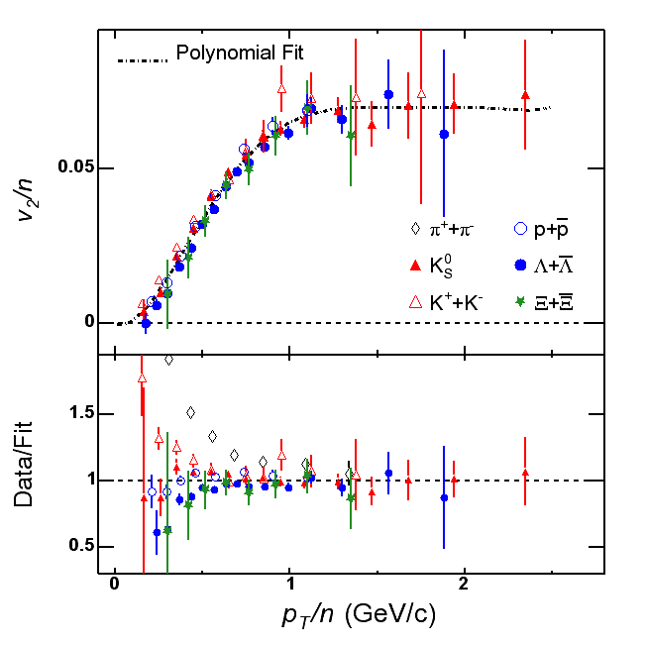
Number of constituent quark scaling of v₂(p_{t})
K_{S} and Lambda from published STAR data (PRL 92, 052302 (2004)).
K± and Cascade are preliminary STAR measurements (K. Schweda, J. Castillo and J. Amonett).
Pion and proton from published PHENIX data (Nucl. Phys. A715, 599 (2003)).
Polynomial fit to all species except pions.
200 GeV
preliminary

Slide 7
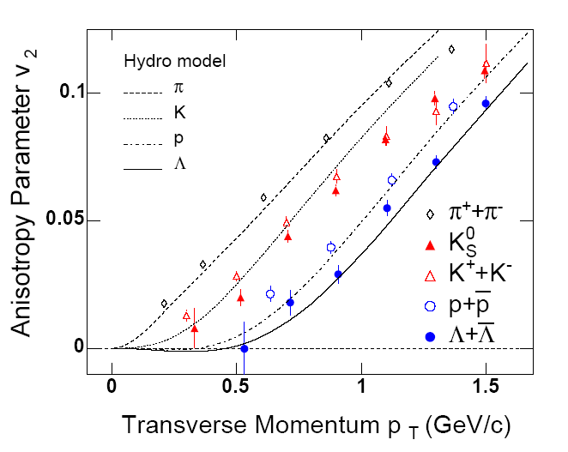
Elliptic Flow v₂(p_{t}) at low p_{t}
200 GeV
preliminary
v₂(p_{t}) and mass dependence is reproduced by hydrodynamical model calculations
Hydro model implicitly assumes local thermal equilibrium and is sensitive to the EOS
Pion, neutral Kaon and Proton data taken from PHENIX:
Nucl. Phys. A715, 599 (2003)
Hydro: P. Huovinen et al., Phys. Lett. B503, 58 (2001)

Slide 8
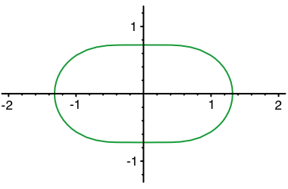
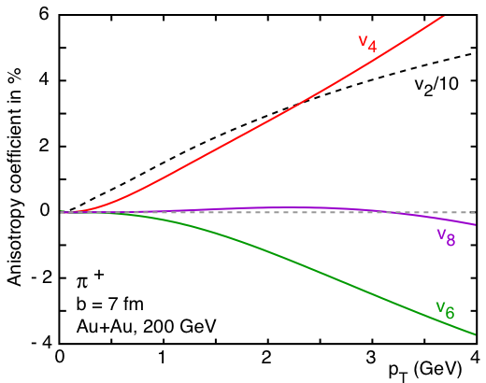
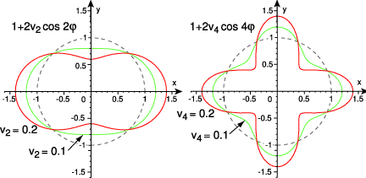
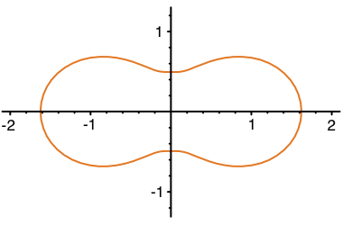
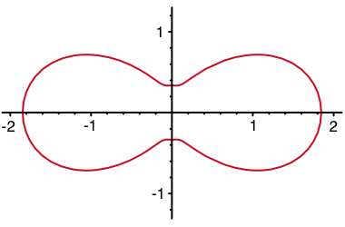
Higher harmonics
strong potential to constrain model calculations
sensitive to the dynamical evolution of the system
initial conditions of hydro influence magnitude and even the sign of v_{n}
v₂
v₄
isotropic
momentum space
P. Kolb

Slide 9

Scaling of higher harmonics
Assuming coalescence of quarks:
quarks
2 for mesons
1/4 + 1/2 (v₄^{q}/(v₂^{q})²)
for mesons
1/3 + 1/3 (v₄^{q}/(v₂^{q})²)
for baryons
Assuming scaling for quarks:
v_{n}^{q} = (v₂^{q})^{(n/2)}
for mesons
1/4 + 1/2 = 3/4
1/3 + 1/3 = 2/3
for baryons
Voloshin, Kolb, Chen, Ko, and Lin

Slide 10
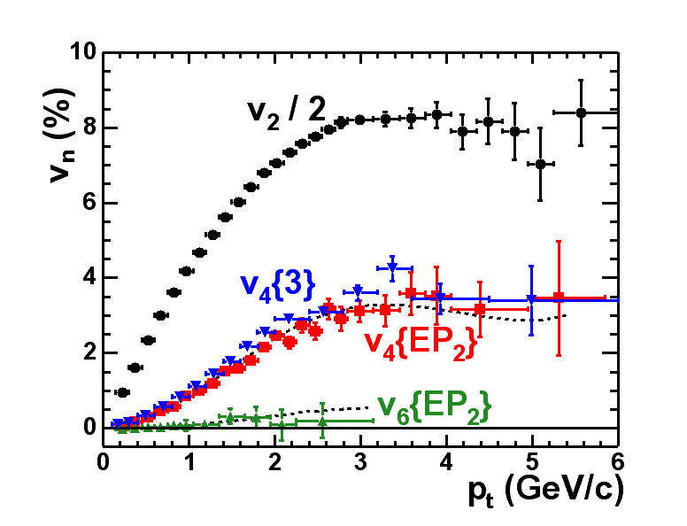

v₄(p_{t}) and v₆(p_{t}) @ 200 GeV
utilizing large elliptic flow to estimate the reaction plane
sizeable v₄
v₆=0 within errors
200 GeV
v_{n}~ v₂^{n/2}
1.2 v₂²
v₄ and v₆ scale like v₂² resp. v₂³
1.2 v₂³
PRL 92, 062301 (2004)

Slide 11
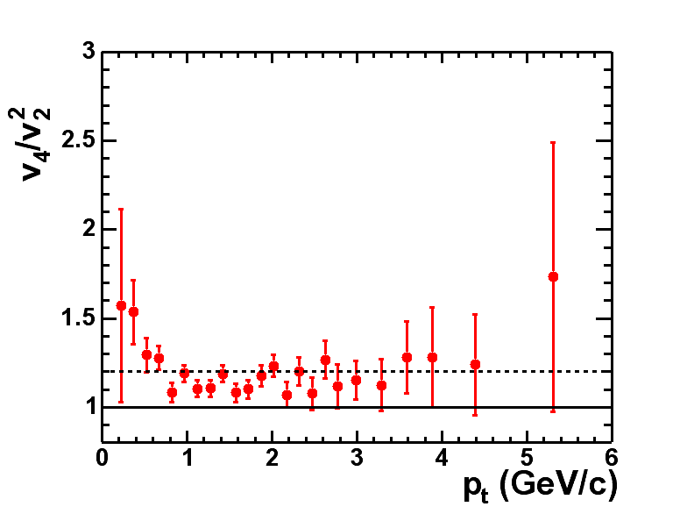
v₄/v₂² scaling
200 GeV
1.2
Mean is definitely larger than 1.

Slide 12
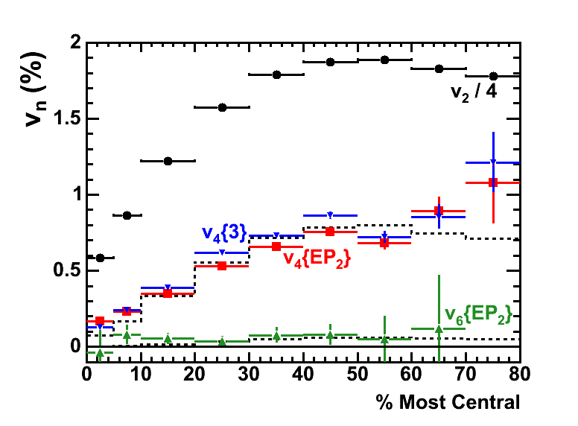
v₄(centrality) @ 200 GeV
200 GeV
1.4 v₂²
1.4 v₂³
PRL 92, 062301 (2004)

Slide 13
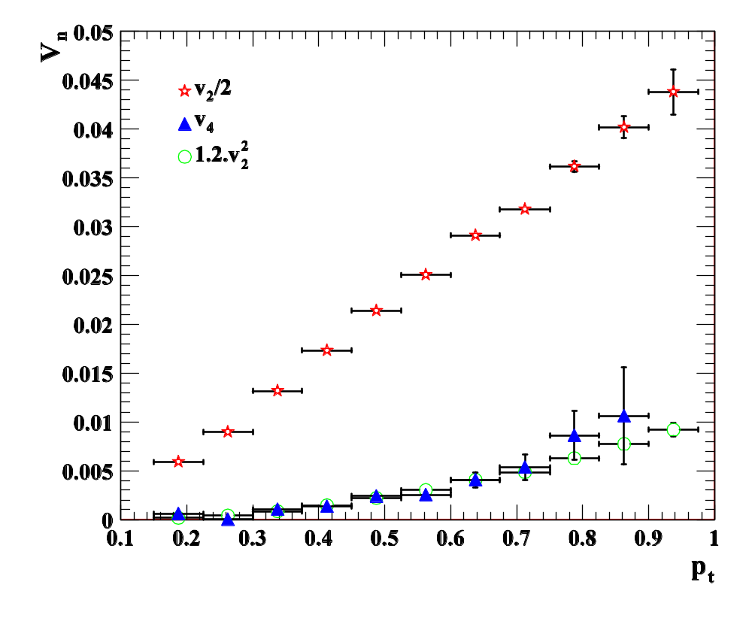
v₄(p_{t}) of pions @ 62.4 GeV
STAR preliminary
62.4 GeV
min.bias: 0 ~ 80%
Analysis done by Yuting Bai
v₄ scales approximately as v₂² as a function of p_{t}

Slide 14
Scaling of higher harmonics
Assuming coalescence of quarks:
quarks
2 for mesons
1/4 + 1/2 (v₄^{q}/(v₂^{q})²)
for mesons
1/3 + 1/3 (v₄^{q}/(v₂^{q})²)
for baryons
Experimental value is 1.2 → v₄^{q} is greater than zero!
Assuming scaling for quarks:
v_{n}^{q} = (v₂^{q})^{(n/2)}
for mesons
3/4
Experimental value is 1.2 → v₄^{q} is even greater than simple parton scaling indicates.
2/3
for baryons

Slide 15
Summary and Outlook
Meson-baryon scaling of v₂ at intermediate pt works (except for pions).
consistent with hadronization via quark coalescence
We seem to see anisotropic flow of partons in this p_{t} region!
v₂(p_{t}) and mass dependence below 1 GeV/c are well reproduced by hydro calculations. (No contradiction to scaling argument at intermediate p_{t}!)
The higher harmonics v₄ and v₆ @ 200 GeV were measured and a scaling with v₂² was observed.
Pions show similar scaling properties of v₄ @ 62.4 GeV.
v₄^{q} is greater than simple coalescence models with scaling for quarks would predict.
Studies @ 62.4 GeV for v₂ and higher harmonics for different particle species are under way.
200 GeV data of run IV will allow detailed studies on anisotropic flow to test coalescence.

