Slide 1
Tuning for MPI Protocols
Aggressive Eager
Rendezvous with sender push
Rendezvous with receiver pull
Rendezvous blocking (push or pull)

Slide 2
Aggressive Eager
Performance problem: extra copies
Possible deadlock for inadequate eager buffering

Slide 3
Tuning for Aggressive Eager
Ensure that receives are posted before sends
MPI_Issend can be used to express “wait until receive is posted”

Slide 4
Rendezvous with Sender Push
Extra latency
Possible delays while waiting for sender to begin

Slide 5
Rendezvous Blocking
What happens once sender and receiver rendezvous?
  Sender (push) or receiver (pull) may complete operation
  May block other operations while completing
Performance tradeoff
  If operation does not block (by checking for other requests), it adds latency or reduces bandwidth.
Can reduce performance if a receiver, having acknowledged a send, must wait for the sender to complete a separate operation that it has started.

Slide 6
Tuning for Rendezvous with Sender Push
Ensure receives posted before sends
  better, ensure receives match sends before computation starts; may be better to do sends before receives
Ensure that sends have time to start transfers
Can use short control messages
Beware of the cost of extra messages

Slide 7
Rendezvous with Receiver Pull
Possible delays while waiting for receiver to begin

Slide 8
Tuning for Rendezvous with Receiver Pull
Place MPI_Isends before receives
Use short control messages to ensure matches
Beware of the cost of extra messages

Slide 9
Experiments with MPI Implementations
Multiparty data exchange
Jacobi iteration in 2 dimensions
  Model for PDEs, Matrix-vector products
  Algorithms with surface/volume behavior
  Issues similar to unstructured grid problems (but harder to illustrate)
Others at http://www.mcs.anl.gov/mpi/tutorials/perf

Slide 10
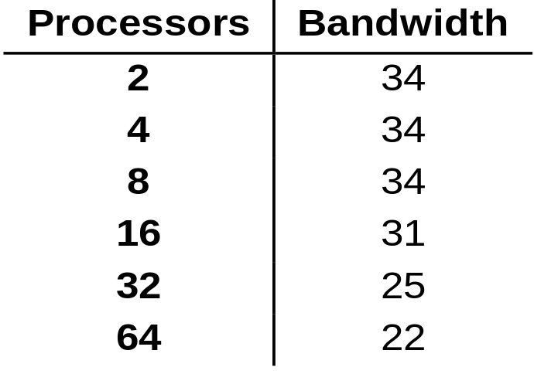
Multiparty Data Exchange
Real programs have many processes exchanging data, often nearly at the same time
Pingpong tests do not measure this communication pattern
Simultaneous pingpong between processes i and i+p/2 on IBM SP2:

Slide 11
Scheduling for Contention
Many programs alternate between communication and computation phases
Contention can reduce effective bandwidth
Consider restructuring program so that some nodes communicate while others compute:
0
Compute
Comm
1
Compute
2
Compute
Comm
3
Compute

Slide 12
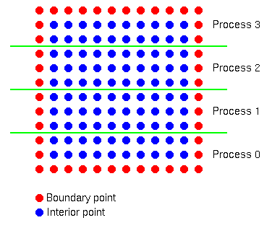
Jacobi Iteration
Simple parallel data structure
Processes exchange rows with neighbors

Slide 13
Background to Tests
Goals
  Identify better performing idioms for the same communication operation
  Understand these by understanding the underlying MPI process
  Provide a starting point for evaluating additional options (there are many ways to write even simple codes)

Slide 14
Different Send/Receive Modes
MPI provides many different ways to perform a send/recv
Choose different ways to manage buffering (avoid copying) and synchronization
Interaction with polling and interrupt modes

Slide 15
Some Send/Receive Approaches
Based on operation hypothesis. Most of these are for polling mode. Each of the following is a hypothesis that the experiments test
  Better to start receives first
  Ensure recvs posted before sends
  Ordered (no overlap)
  Nonblocking operations, overlap effective
  Use of Ssend, Rsend versions (EPCC/T3D can prefer Ssend over Send; uses Send for buffered send)
  Manually advance automaton
Persistent operations
Notes:
Need some for interrupt mode

Slide 16
Scheduling Communications
Is it better to use MPI_Waitall or to schedule/order the requests?
  Does the implementation complete a Waitall in any order or does it prefer requests as ordered in the array of requests?
In principle, it should always be best to let MPI schedule the operations. In practice, it may be better to order either the short or long messages first, depending on how data is transferred.

Slide 17
Some Example Results
Summarize some different approaches
More details at http://www.mcs.anl.gov/mpi/tutorial/perf/_x000b_ mpiexmpl/src3/runs.html

Slide 18
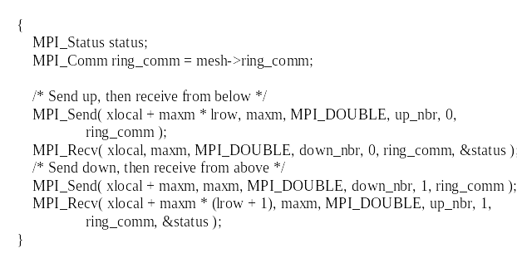
Send and Recv
Simplest use of send and recv
Very poor performance on SP2
  Rendezvous sequentializes sends/receives
OK performance on T3D (implementation tends to buffer operations)

Slide 19
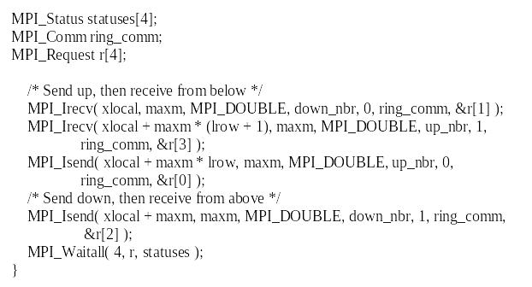
Better to start receives first
Irecv, Isend, Waitall
Ok performance

Slide 20
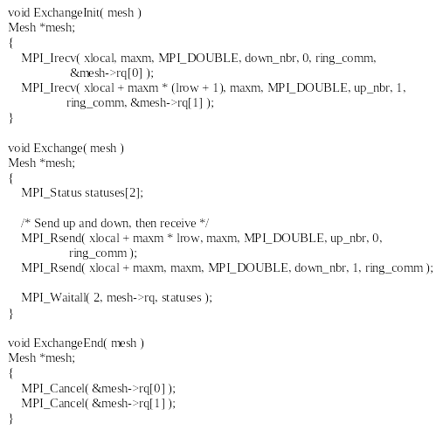
Ensure recvs posted before sends
Irecv, Sendrecv/Barrier, Rsend, Waitall

Slide 21
Receives posted before sends
Best performer on SP2
Fails to run on SGI (needs cancel) and T3D (core dumps)

Slide 22
Ordered (no overlap)
Send, Recv or Recv, Send
MPI_Sendrecv (shift)
MPI_Sendrecv (exchange)

Slide 23
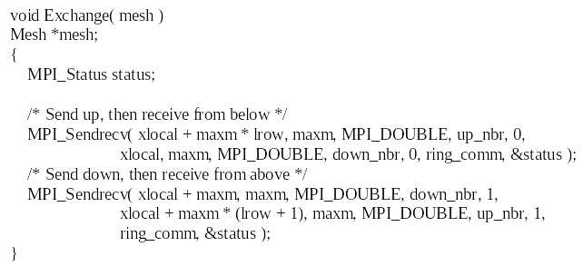
Shift with MPI_Sendrecv
Performs reasonably well; simpler than many other approaches
T3D performance is ok but other approaches are better

Slide 24
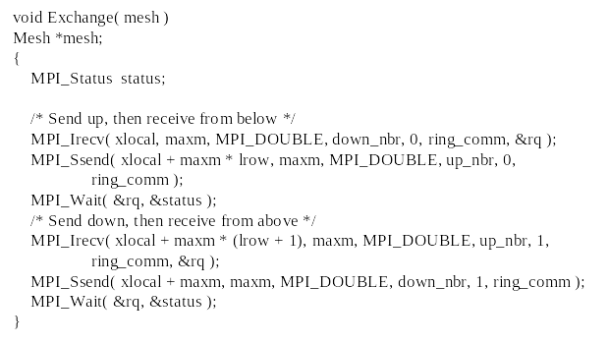
Use of Ssend versions
Ssend allows send to wait until receive ready
  At least one implementation (T3D) gives better performance for Ssend than for Send

Slide 25
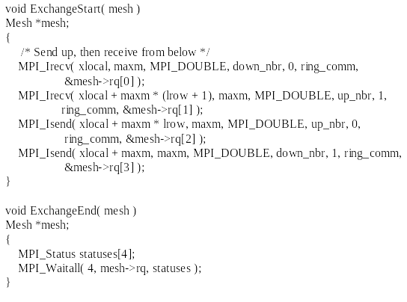
Nonblocking Operations, Overlap Effective
Isend, Irecv, Waitall
A variant uses Waitsome with computation

Slide 26
Persistent Operations
Potential saving
  Allocation of MPI_Request
  Validating and storing arguments
Variations of example
  sendinit, recvinit, startall, waitall
  startall(recvs), sendrecv/barrier, startall(rsends), waitall
Some vendor implementations are buggy
Persistent operations may be slightly slower

Slide 27
Manually Advance Automaton
irecv, isend, iprobe in computation, waitall
To test for messages:
MPI_Iprobe( MPI_ANY_SOURCE, 0,
MPI_COMM_WORLD, &flag, &status )

Slide 28
Summary of Results
Better to start sends before receives
  Most implementations use rendezvous protocols for long messages (Cray, IBM, SGI)
Synchronous sends better on T3D
  otherwise system buffers
MPI_Rsend can offer some performance gain on SP2
  as long as receives can be guaranteed without extra messages

