Slide 1
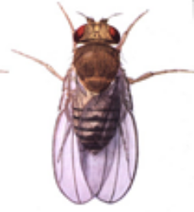
A brief summary of the status of experimental and computational methods for identification of functional DNA elements related to alternative splicing in Drosophila
Steve Mount
D-encode
Dec. 5, 2004
The identification of “all” spliced variants is an acknowledged goal of the encode project.
Notes:
“All” spliced variants is hard to define. Variants that occur stochastically below a certain frequency are probably not of interest. Nor are RNAs that are derived from errors in the splicing process. However, rare spliced variants that result from bona fide regulatory events are certainly of interest.

Slide 2

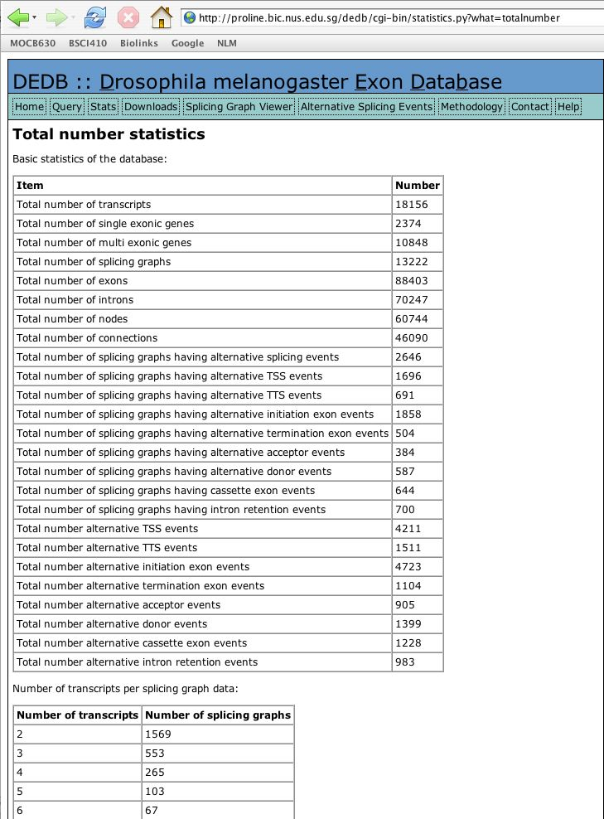
Drosophila is a good model for alternative splicing because it has a lot of alternative splicing
BDGP/flybase data indicates that 20% of Drosophila genes are alternatively spliced (see also Misra et al. 2002, summary of release 3 data)
In fact, the number is probably much higher.
Stolc et al. report that 46% of genes show multiple patterns of exon expression, indicating alternative splicing.

Slide 3
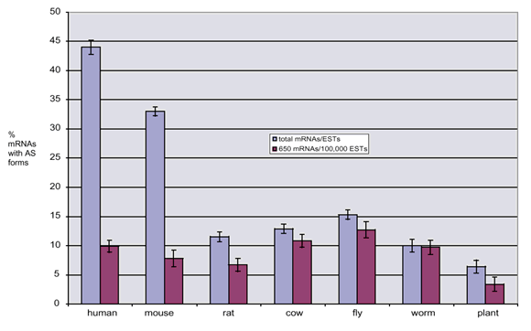
Alternative splicing frequency in various species.
Normalization for size of EST databases indicates that flies may have more alternative splicing than mammals.
Brett et al. 2002. Nature Genetics 30:29-30.
Notes:
Comparison species with respect to the fraction of genes for which there is evidence of alternative splicing at a fixed EST database size (Brett et al. Nature Genetics 2002) suggests that Drosophila has more alternative splicing than any other model organism and more than mammals. Although this could be biased by differences in the frequency distribution of genes sampled (either due to a greater degree of variation in the sources of RNA for EST libraries or fewer genes) it is clear that the extent of alternative splicing is significant and at least comparable to that in humans.

Slide 4
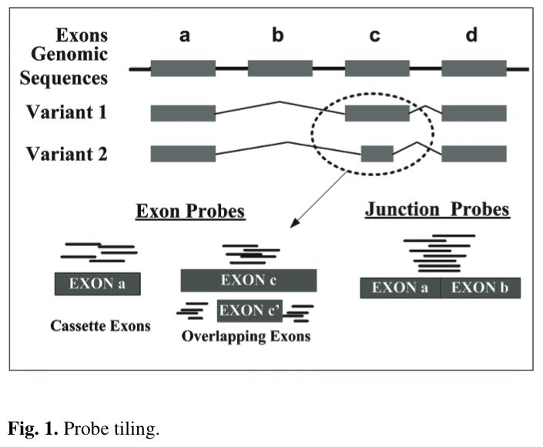
Several groups have demonstrated that high-throughput analysis of alternative splicing on chips is feasible
-- exon probes or tiling probes cannot provide information about pairs of splices and are not well-suited for closely spaced alternative sites.
-- junction probes can only be made against known splice sites
-- junction probes may not be optimal for hybridization
From Wang et al., 2003. Gene structure-based splice variant deconvolution using a microarry platform . Bioinformatics. 19: i315
Notes:
In particular, Clark et al. (2002), http://www.ncbi.nlm.nih.gov/entrez/query.fcgi?cmd=Retrieve&db=pubmed&dopt=Abstract&list_uids=11988574 showed the feasibility of this approach. Wang et al., cited for the figure examined the problem of deconvolution of the signal from junction probes. Stolc et al. (White lab) made use of junction probes in Drosophila.
The fact that junction probes can only be made against known or predicted splice site indicates the value of real experimental (cDNA, RACE or RT-PCR) determination of splice junctions.

Slide 5
There is a need to annotate nonfunctional mRNAs
  -- At least three well-studied cases of alternative splicing in Drosophila (Sxl, tra, su(wª) )involve the regulated production of "mRNAs" that do not encode functional proteins
  -- More than a third of reliably inferred alternative splicing events in humans have been shown to result in mRNAs with premature termination codons.
Notes:
It will be important to distinguish in annotations between presumed nonfunctional spliced isoforms and those forms that encode functional proteins. However, noncoding isoforms derived from protein-coding genes are important products that tell us something about regulation.
Steven Brenner has published several papers on the extent of production of mRNAs with premature termination codons. One is Hillman et al. 2002: http://www.ncbi.nlm.nih.gov/entrez/query.fcgi?cmd=Retrieve&db=pubmed&dopt=Abstract&list_uids=14759258
An important caveat is that NMD in flies may not require the exon junction complex (Gatfield et al., 2003:
http://www.ncbi.nlm.nih.gov/entrez/query.fcgi?cmd=Retrieve&db=pubmed&dopt=Abstract&list_uids=12881430
so the rules for predicting which RNAs are subject to NMD established in mammalian models may not readily apply to flies.
See Valencia-Sanchez and Maquat for a review:
http://www.ncbi.nlm.nih.gov/entrez/query.fcgi?cmd=Retrieve&db=pubmed&dopt=Abstract&list_uids=15519847

Slide 6
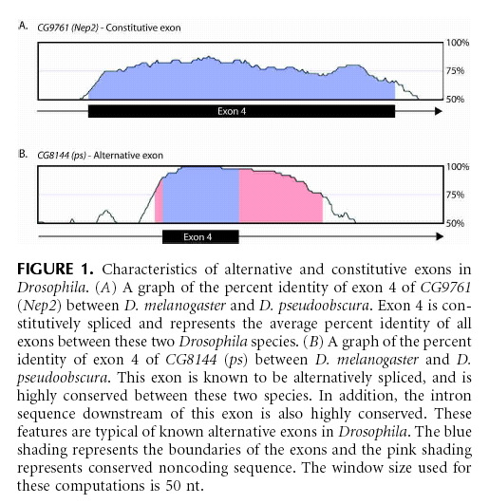
Several groups have made progress on computational prediction of alternative splicing events
Alternatively spliced exons often show a higher level of conservation and conservation that extends into the flanking introns.
Fig. 1 from Philips et al. 2004. A computational and experimental approach toward a priori identification of alternatively spliced exons. RNA
Notes:
The other group is Yeo and Burge. They have not published yet. The original observation that conserved alternative splicing events are flanked by an excess of conservation including intron conservation was made by Sugnet, Kent, Ares and Haussler. 2004.
Transcriptome and genome conservation of alternative splicing events in humans and mice. Pac Symp Biocomput. 2004;:66-77.

Slide 7
Additions to nomenclature?
Notes:
The goal of the encode project is to annotate DNA elements.
We should have good names for these elements!

Slide 8
Improvements in nomenclature?
In particular, there are things that are not exons which are sometimes called exons that perhaps should be given names of their own.

Slide 9
Improvements in nomenclature?
In particular, there are things that are not exons which are sometimes called exons that perhaps should be given names of their own.
1) The region of overlap between an exon and the CDS

Slide 10
The region of overlap between an exon and the CDS (illustrated below as X and Z) is only part of an exon and only part of the CDS. Segments like this are often called exons and this has led to confusion.
X
Y
Z
5' UTR
3' UTR
Notes:
After my talk, Myles Axton told me that he used the term CROE (pronounced as in “crow”) in his own lab.
This stands for “Coding Region Of an Exon”.

Slide 11
Improvements in nomenclature?
In particular, there are things that are not exons which are sometimes called exons that perhaps should be given names of their own.
1) The region of overlap between an exon and the CDS
2) segments that differ between mRNA products from a gene

Slide 12
Different modes of alternative splicing have the same effect on the mRNA in that they create an indel between variants
Exon skipping vs. retention
Alternative 5’ splice sites
Alternative 3’ splice sites
Intron retention
It might be useful to have a name for segments of this sort

Slide 13
Summary:
-- Drosophila is a good model for alternative splicing because it has a lot of alternative splicing
-- Several groups have demonstrated that high-throughput analysis of alternative splicing on chips is feasible. Junction probes would provide more information than exon or tiling probes but are currently available only on custom chips.
-- Several groups have made progress on computational prediction of alternative splicing events. This is strongly supported by comparative (and variation data).
-- There is a need to annotate nonfunctional mRNAs
-- There is a need for improvements in nomenclature

