Slide 1
Photo Red Light Enforcement Program
Update
Public Safety Committee
June 18, 2012
Item #2

Slide 2
Background
July 2006 – Program approval
August 2006 – Redflex agreement
October 2011 – First amendment to Redflex agreement
5 additional years
Terminate at any time at City Council’s discretion
Notes:
Allows up to 8 moves at no cost to the City
$3,850 per month per camera (cameras)
$5,400 per month per camera (6 cameras until 5 years old)

Slide 3
Current Program
30 Cameras at 20 intersections
5 cameras at 3 Caltrans Intersections
1 camera at joint controlled intersection
Moreno Valley/Riverside
Improving Traffic Safety
Reducing red light running
Reducing traffic collisions
Changing Driver’s Behavior
Notes:
Camera locations selected based on:
- Frequency of traffic collisions
- Number of red light runners
- Other risk criteria
- Close proximity to schools, hospitals, etc.

Slide 4
Program Results - Collisions
2006 to 2011 – decrease in collisions at photo enforced intersections
45% decrease in all collisions
46% decrease in broadside collisions
36% decrease in rear-end collisions
Notes:
Cameras are a tool in the Traffic Safety arsenal and are not the sole factor in accident reduction but are believed to play a crucial role

Slide 5
Program Results – Possible Spillover
2006 to 2011 – decrease in collisions at all intersections
44% decrease in all collisions
43% decrease in broadside collisions
45% decrease in rear-end collisions
Notes:
Possible spillover effect of increased driver safety at intersections throughout city
Other possible factors contributing to increased driver safety are the economic downturn, capacity improvements, among other factors
Photo Enforcement Cameras are a traffic safety tool and are part of the City’s traffic safety program. Are not the sole factor to the improvement of safety.

Slide 6
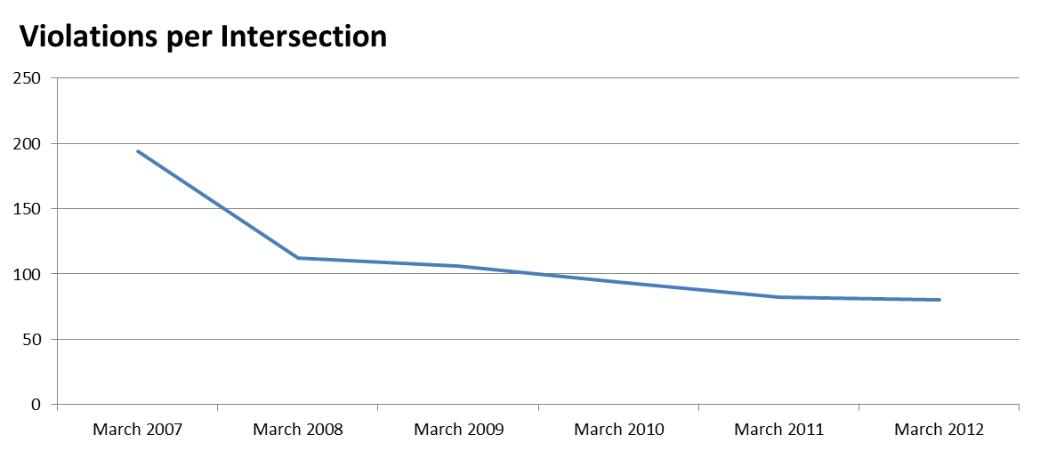
Program Results – Red Light Running
Reduction in red light runners
March 2007 – 4,076 citations issued
194 per camera (21 cameras)
March 2011 – 2,405 citations issued
80 per camera (30 cameras)
59% reduction
Notes:
March 2007 was chosen because it is the first complete month where no warnings were being issued, kinks were working out by this time. First solid month of the program
March continued to be used to compair similar weather and traffic conditions.

Slide 7
Program Changes - Caltrans
5 cameras at 3 intersections
In 2011 issued 14,499 (53% of citations issued)
2009 to 2011
33% reduction in collisions
39% reduction in citations
Caltrans will not renew encroachment permit
3 year construction of High Occupancy Vehicle lane (HOV)
Notes:
Caltrans intersections include
-Tyler and 91 Fwy (1 camera)
-Arlington and Indiana (2 cameras)
-Fourteenth and Mulberry (2 Cameras)

Slide 8
Program Changes – Moreno Valley
1 camera, Day St. & Canyon Springs Pkwy
In 2011 issued 3,046 (11% of citations issued)
63% left turn violations
48% of incidents - light red for 1+ seconds
2010 - Moreno Valley disbanded red light program
Moreno Valley requesting removal of camera from their right-of-way
Notes:
Camera location was requested by 2 Moreno Valley resident complaining of the gridlock and red light running at the intersection
Red light running and collision data was reviewed and it was determined that this intersection would benefit from a camera
Camera monitors EB Canyon Springs Parkway.
Violations technically occur in Riverside City limits but do to the configuration of the intersection the face camera was installed in Moreno Valley.

Slide 9
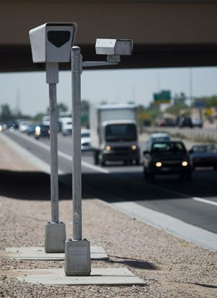
Options
Relocation of cameras
Surveys provide few viable locations
No locations with similar violation rates
Fiscal Impact to General Fund to relocate
Estimated revenue $1,519,000
Estimated expenditures $2,130,000
Necessary subsidy of $611,000
Notes:
Estimated revenue 1,518,750
Estimated expenditures 2,130,190
includes moving of cameras to new locations

Slide 10
Options
Discontinue Program
Provide 60 day notice to Redflex upon Council approval
Stop citation issuance
Resolve outstanding citations
After 60 days citations may be resolved in court
Fiscal Impact to General Fund to discontinue
Estimated revenue $253,000
Estimated expenditures $628,000
Necessary subsidy of $375,000
Notes:
General fund savings of $235,868.33

Slide 11
Fiscal Impact
Relocation Option
Discontinue Program Option
Estimated revenue $1,519,000
Estimated expenditures $2,130,000
Necessary subsidy of $611,000
Estimated revenue $253,000
Estimated expenditures $628,000
Necessary subsidy of $375,000
General Fund savings of $236,000

Slide 12
Alternative
$300,000 credit
$25,000 per month
Allow City to move 5 identified cameras
No cost to City
Fiscal Impact
Net Expenditures $1,830,000
Receivable Fines $1,519,000
GF Subsidy of $311,000
Notes:
5 moves are in addition to the 8 moves allowed by the First Amendment to the Contract
Revenue $1,518,750 includes 5 Caltrans camera moves.
Bob may mention that if we use the 8 moves to relocate the cameras at intersections which no longer meet the safety criteria we could make up that revenue
- we may never find 8 new locations

Slide 13
Recommendation
That the Public Safety Committee recommend that the City Council discontinue the Photo Red Light Enforcement Program
Notes:
Not sure if this is correct

