Slide 1
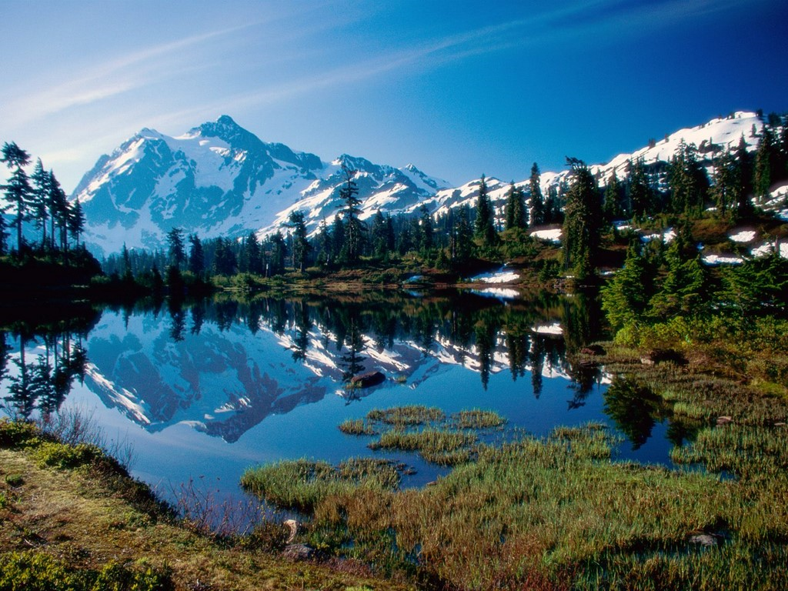
Climate Challenge
North Cascades National Park
Electronic Field Trip
Created by T. Trimpe 2010 http://sciencespot.net/
For use with the North Cascades EFT at http://www.electronicfieldtrip.org/cascades/
Image Source: http://wallpaper-s.org/42__Mount_Shuksan%2C_North_Cascades_National_Park.htm

Slide 2
Part 1: What is climate change?
1. In what state is the North Cascades National Park located? Washington
2. What is the difference between climate and weather? Weather is temporary, while climate change refers to long term changes to earth's climate.
3. What are some causes for climate change? Build up of greenhouse gases
4. How do we know that the climate is changing? Tree rings, corals, lake and ocean sediments, sea levels, and the size of glaciers
5. How will climate change affect the water on Earth? Higher water temperatures, less snow in the winter
6. What are the goals of the national park? To preserve and protect our natural resources
7. Are global warming and climate change the same thing? Why or why not? No, global warming is an important part of climate change, but other factors are also involved, such as the amount of snow and the strength of storms.
8. How does climate change affect the whole world? It is warming the whole world, increasing ocean levels, and moving the ranges of tree species.

Slide 3
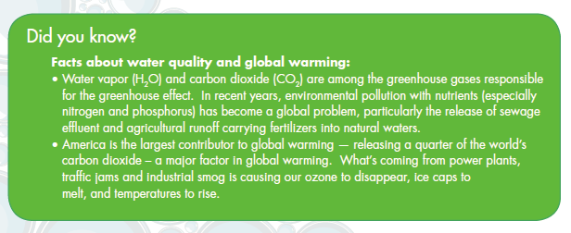
Talk About It #1
What creates greenhouse gases, such as CO2?
What affect will the moving of range of tree species have on animals and plants?

Slide 4
Let’s see what happens …
1. Pour one cup of water into a plastic baggie, seal ¾ of the way, and then squeeze out as much of the air as possible. Repeat this for 2 more bags.
Safety … Wear goggles ,
do not drink the water, and clean up spills immediately!
2. You will need to place ½ tablet into one of the bags, 1 tablet in another, and 2 tablets in the third bag ALL AT THE SAME TIME through the small opening in the bag.
3. Seal the bag quickly and gently shake to make sure the tablet reacts completely. Watch closely. What happens?
Does the CO₂ make the water basic or acidic?
Which bag had the highest amounts of CO₂? How could you tell?
What are some ways CO₂ is produced?
Which of these can we reduce or eliminate?

Slide 5
Part 2: Glaciers
9. What do we call a perennial mass of ice that flows over the land? Glacier
10. How can we tell how well a glacier is doing? By monitoring the amount of growing and shrinking it does from season to season; if more of the glacier melts during the summer than is gained during the winter, the glacier will shrink.
11. How do glaciers move? How fast? They move by sliding on a thin bed of water at a top speed of 6-7" per day.
12. What percentage of the world's fresh water supply is stored in glaciers? 70%
13. What organisms can be found in glaciers? Ice worms and watermelon algae
14. What do we call the scratches or gouges cut into earth and rock by glacier movement? Glacial striations
15. What do we call the soil and rock debris that defines a glacier's path? Glacial moraine
16. How do scientists monitor glaciers? Measure the amount of accumulated snow (depth) in April; use plastic stakes to measure the amount of the glacier that has melted away
17. What do scientist calculate when they subtract summer melt from spring accumulation? Glacier Balance
18. What percentage of our glacier's have we lost in the last century? 50%

Slide 6
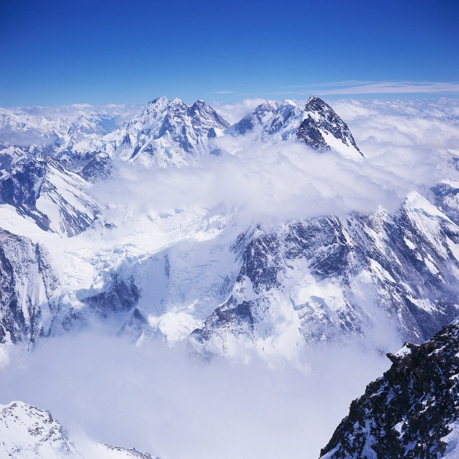
Talk About It #2
How do scientists measure the size of past glaciers?
How much water have we lost?
Are glaciers the same size all around the world?
Can glaciers reform?
How does melting glaciers affect people downstream?
Let’s learn more about glaciers …

Slide 7
Part 3: Living Things
19. What do we call tiny aquatic animals that many fish consume for food? Zooplankton
20. Which side of the mountains get more rain? West side gets 4 times more rain than the east side.
21. What is the number and variety of plant and animal species within a region? Biodiversity
22. How does climate change affect niches? They will move or shift causing animals to lose their homes
23. What effect does climate change have on pikas and marmets? The grasses they need to survive will not grow as well as the area becomes overgrown with trees causing them to live in smaller spaces
24. Give an example of how the loss of glaciers has a negative impact on living things. Loss of habitat for ice worms, loss of food for rosy finches that feed on ice worms, trout need colder glacial melt water, higher costs for electricity
25. What type of species are going to have the hardest time adapting as the climate changes? Specialist species (such as bull trout who like cold water)

Slide 8
Talk About It #3
What might the impact of the redside shiners be on the environment?
How does the amount of rainfall on the west and east sides of the mountains affect its habitats?
How will plant life be affected by climate change?

Slide 9
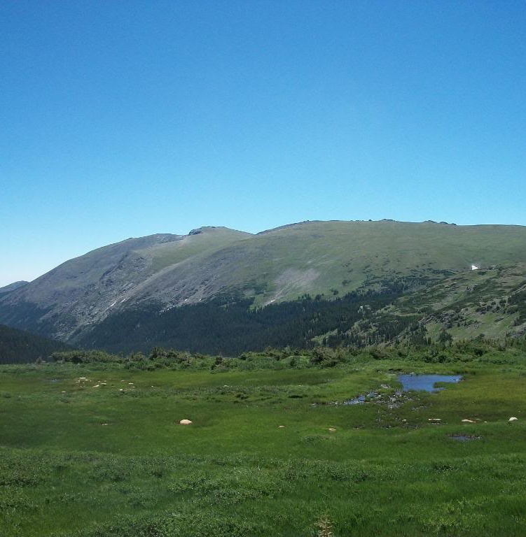
A mountain ecosystem from the top …
Alpine Zone
Elevation: 7,000+ ft or 2,100+ m
Features:
Area above the treeline, meaning there are no trees able to survive in this harsh environment
Coolest temperatures
Most precipitation is snow
Windy
Bare rock or rocky soil
Shortest growing season
Plants & Animals:
Smaller variety of plant life that includes wildflowers, grasses, lichens, and mosses
Animals include mountain goats, Big Horn Sheep, pikas, marmots, birds, and elk
Picture by T. Trimpe 2010

Slide 10
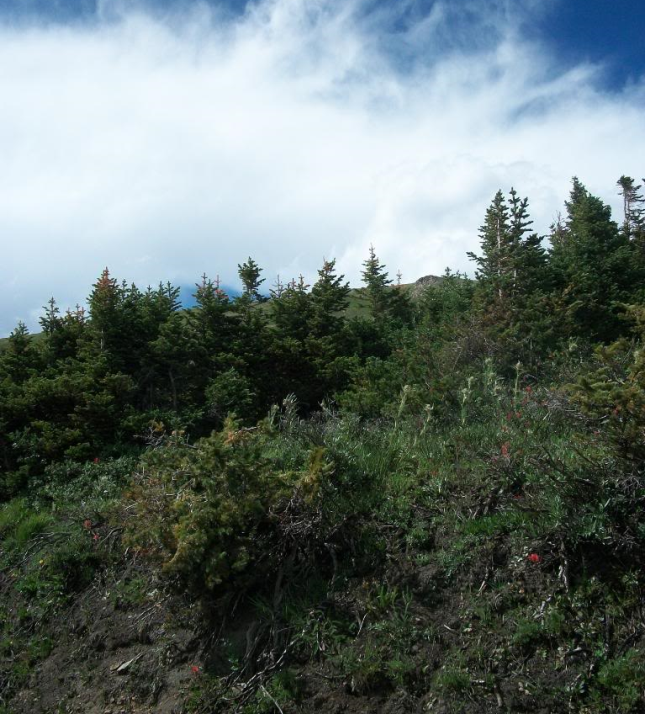
To the next layer – Tree line
Subalpine Zone
Elevation: 4,000-7,000 feet
Features:
High mountain valleys or mountain slopes between the montane and treeline
More precipitation - often snow (which you can see in the summer)
Short growing season
Plants & Animals:
Animals include mountain goats, Big Horn Sheep, pikas, marmots, birds, and elk,
Smaller variety of plant life that includes wildflowers, shrubs, and evergreens
Picture by T. Trimpe 2010

Slide 11
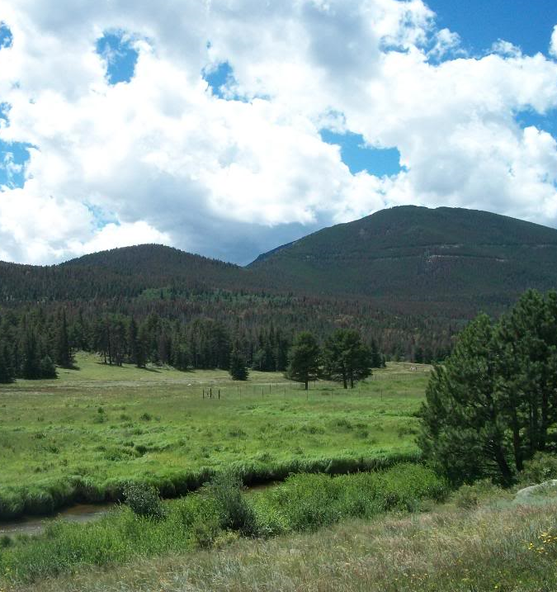
To the lower slopes and valleys …
Montane
Elevation: 2,000-5,550 feet
Features:
Valleys and lower slopes of mountains with forests, grassy meadows, and wetlands
Warmer temperatures
Plentiful food in the form of pants and animals
Used by people, highways, railways
Plants & Animals:
Plant life includes evergreen and deciduous trees, grasses, wildflowers, and shrubs/bushes
Animals include bears, moose, elk, Big Horn Sheep, bears, cougars, chipmunks, pikas, deer, and many types of birds
Picture by T. Trimpe 2010

Slide 12
What’s my habitat?
Organize the plant and animal cards into the areas where they might live. Use the descriptions on the back of the cards to help you find the correct habitat for each.
Alpine | Subalpine | Montane

Slide 13
What am I?
Each person will have an animal attached
to the back of their shirt. No peeking!
Your goal is to guess the identity of the animal by
asking your classmates YES or NO questions.
How many questions do you think you have to ask before you identify your animal?

Slide 14
Part 4: Energy
26. How is energy related to climate change? How the energy is produced and how much we use has an effect on climate change
27. What are some examples of "dirty" or nonrenewable energy sources? Coal, oil, and gasoline
28. What are some examples of clean or renewable energy sources? Wind, water, and solar energy
29. What do we call the power generated by moving water? Hydroelectric
Talk About It #4
How does climate change affect our ability to generate electricity?
What percentage of Seattle's energy is produced by the hydroelectric dams? How will this change in the next few decades?

Slide 15
Energy Hogs
Vocabulary To Know …
Greenhouse Gas – Any of the gases in the atmosphere that create the greenhouse effect, and in excess are leading to climate change.
Emissions – A substance that is discharged into the air. In the case of climate change, emissions are generally greenhouse gases being discharged through the use of fossil fuels.
Watt – the unit that power is measure in.
Power – the rate at which something gains or loses energy.
The majority of electricity that we use to power our homes comes from burning fossil fuels such as coal. This process releases high amounts of carbon dioxide, a greenhouse gas that contributes to climate change. The less energy you use in your home or school, the less carbon dioxide will be emitted into the atmosphere.
Power is the rate at which something gains or loses energy. We measure power in watts, or how many joules of work can be done in a second. Different appliances require different amounts of power to operate.
What uses energy in your home and school? What do you think uses more?

Slide 16
Energy Hogs
Which items use the most energy?
Organize them from the biggest energy hogs to the smallest.
Clothes dryer
Toaster
Refrigerator
Electric oven
Plasma TV
Microwave
Coffee Maker
Desktop Computer
CFL Light
Dishwasher
Incandescent Light
Telephone

Slide 17
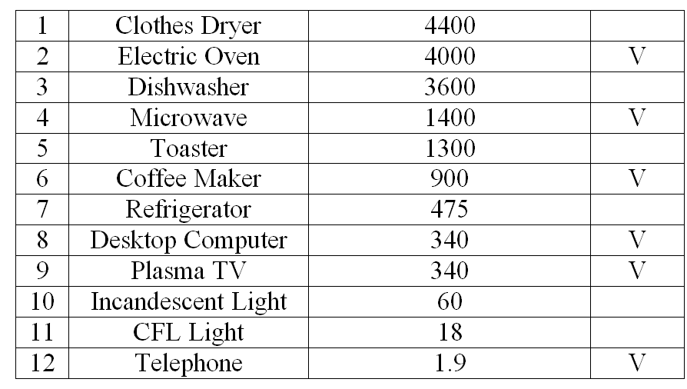
Energy Hogs – Biggest to Smallest
What does the “V” indicate?

Slide 18
Part 5: Sustainability
30. What are choices we make that use resources at a renewable rate? Sustainable
31. Complete these statements about living a sustainable life:
Take only what you need, not what you want, and share with others.
Don't harm the earth, and fix it, it you do.
Leave the world a better place than you found it.
Talk About It #5
What are some sustainable choices you can make?
What is the most important lesson we can learn from this video?

Slide 19
Think About It
What can you do to reduce the impact of human activities on the Earth?
Fill this space with words, pictures, symbols, or other items that communicates at least 3 things you and your family will do to live a more sustainable life.

Slide 20
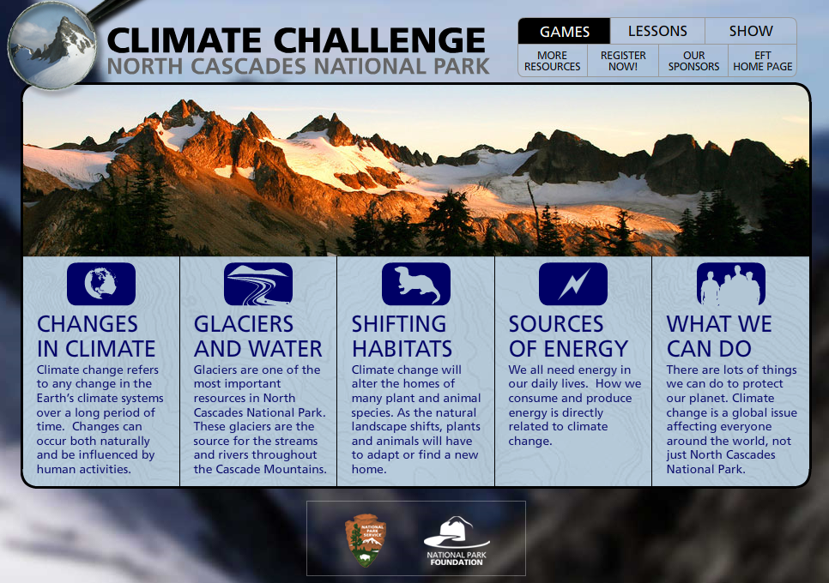
Explore the website at http://www.northcascadeseft.org/cascades/

