Slide 1
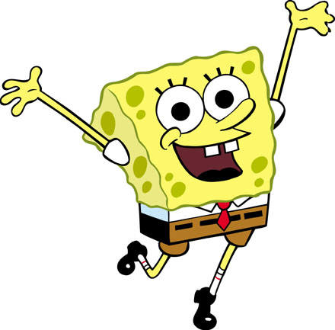
SpongeBob Genetics 1 & 2
To be used with
http://sciencespot.net/Pages/classbio.html#Anchor-genetics
Notes:
PPT created by Liz LaRosa @ www.middleschoolscience.com 2011

Slide 2
Scientists at Bikini Bottoms have been investigating the genetic makeup of the organisms in this community.
Use the information provided and your knowledge of genetics to answer each question.
For each genotype below, indicate whether it is a heterozygous (He) OR homozygous (Ho).
TT _____ Bb _____ DD _____ Ff _____ tt _____ dd _____
Dd _____ ff _____ Tt _____ bb _____ BB _____ FF _____
Which of the genotypes in #1 would be considered purebred?
Which of the genotypes in #1 would be hybrids?

Slide 3
Scientists at Bikini Bottoms have been investigating the genetic makeup of the organisms in this community.
Use the information provided and your knowledge of genetics to answer each question.
For each genotype below, indicate whether it is a heterozygous (He) OR homozygous (Ho).
TT Ho Bb He DD Ho Ff He tt Ho dd Ho
Dd He ff Ho Tt He bb Ho BB Ho FF Ho
Which of the genotypes in #1 would be considered purebred?
TT Ho DD Ho tt Ho dd Ho ff Ho bb Ho BB Ho FF Ho
Which of the genotypes in #1 would be hybrids?
Bb He Ff He Dd He Tt He

Slide 4
2. Determine the phenotype for each genotype using the information provided about SpongeBob.
Yellow body color is dominant to blue.
YY ________________ Yy ________________ yy ________________
Square shape is dominant to round.
SS ________________ Ss ________________ ss ________________

Slide 5
2. Determine the phenotype for each genotype using the information provided about SpongeBob.
Yellow body color is dominant to blue.
YY - Yellow Yy - Yellow yy - blue
Square shape is dominant to round.
SS –square Ss – square ss - round

Slide 6
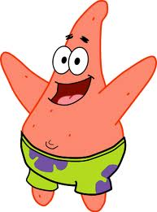
3. For each phenotype, give the genotypes that are possible for Patrick.
A tall head (T) is dominant to short (t).
Tall = _______________ Short = _______________
Pink body color (P) is dominant to yellow (p).
Pink body = _____________ Yellow body = _________________

Slide 7
3. For each phenotype, give the genotypes that are possible for Patrick.
A tall head (T) is dominant to short (t).
Tall = TT, or Tt Short = tt
Pink body color (P) is dominant to yellow (p).
Pink body = PP, or Pp Yellow body = pp

Slide 8
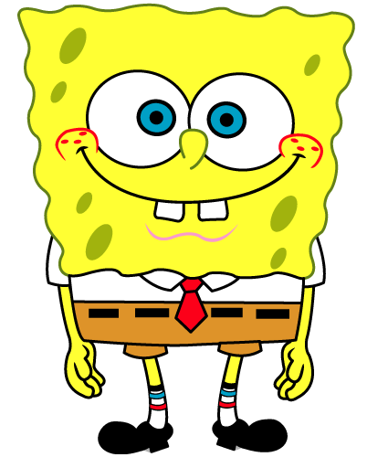
4. SpongeBob SquarePants recently met SpongeSusie Roundpants at a dance. SpongeBob is heterozygous for his square shape, but SpongeSusie is round. Create a Punnett square to show the possibilities that would result if SpongeBob and SpongeSusie had children.
HINT: Read question #2!
List the possible genotypes and phenotypes for their children.
B. What are the chances of a child with a square shape? ____ out of ____ or ____%
C. What are the chances of a child with a round shape? ____ out of ____ or ____%

Slide 9
4. SpongeBob SquarePants recently met SpongeSusie Roundpants at a dance. SpongeBob is heterozygous for his square shape, but SpongeSusie is round. Create a Punnett square to show the possibilities that would result if SpongeBob and SpongeSusie had children.
HINT: Read question #2!
List the possible genotypes and phenotypes for their children. Ss or ss, square, round
B. What are the chances of a child with a square shape? 2 out of 4 or 50 %
C. What are the chances of a child with a round shape? 2 out of 4 or 50 %
SpongeBob
 | S | s
s | Ss | ss
s | Ss | ss
SpongeSusie

Slide 10
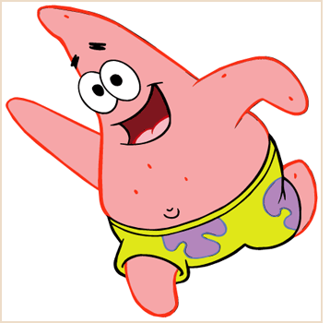
5. Patrick met Patti at the dance. Both of them are heterozygous for their pink body color, which is dominant over a yellow body color. Create a Punnett square to show the possibilities that would result if Patrick and Patti had children. HINT: Read question #3!
List the possible genotypes and phenotypes for their children.
B. What are the chances of a child with a pink body? ____ out of ____ or ____%
C. What are the chances of a child with a yellow body? ____ out of ____ or ____%

Slide 11
5. Patrick met Patti at the dance. Both of them are heterozygous for their pink body color, which is dominant over a yellow body color. Create a Punnett square to show the possibilities that would result if Patrick and Patti had children. HINT: Read question #3!
List the possible genotypes and phenotypes for their children. PP, Pp, pp, pink, yellow
B. What are the chances of a child with a pink body? 3 out of 4 or 75 %
C. What are the chances of a child with a yellow body? 1 out of 4 or 25 %
Patrick
 | P | p
P | PP | Pp
p | Pp | pp
Patti

Slide 12
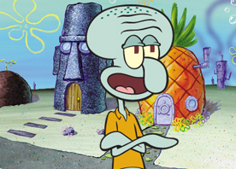
6. Everyone in Squidward’s family has light blue skin, which is the dominant trait for body color in his hometown of Squid Valley. His family brags that they are a “purebred” line. He recently married a nice girl who has light green skin, which is a recessive trait. Create a Punnett square to show the possibilities that would result if Squidward and his new bride had children. Use B to represent the dominant gene and b to represent the recessive gene.
List the possible genotypes and phenotypes for their children.
B. What are the chances of a child with light blue skin? ____%
C. What are the chances of a child with light green skin? ____%
D. Would Squidward’s children still be considered purebreds? Explain!

Slide 13
6. Everyone in Squidward’s family has light blue skin, which is the dominant trait for body color in his hometown of Squid Valley. His family brags that they are a “purebred” line. He recently married a nice girl who has light green skin, which is a recessive trait. Create a Punnett square to show the possibilities that would result if Squidward and his new bride had children. Use B to represent the dominant gene and b to represent the recessive gene.
List the possible genotypes and phenotypes for their children. Bb, blue
B. What are the chances of a child with light blue skin? 100%
C. What are the chances of a child with light green skin? 0%
D. Would Squidward’s children still be considered purebreds? Explain! No, hybrids
Squidward
 | B | B
b | Bb | Bb
b | Bb | Bb
Nice Girl

Slide 14
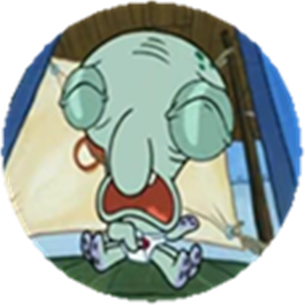
7. Assume that one of Squidward’s sons, who is heterozygous for the light blue body color, married a girl that was also heterozygous. Create a Punnett square to show the possibilities that would result if they had children.
List the possible genotypes and phenotypes for their children.
B. What are the chances of a child with light blue skin? ____%
C. What are the chances of a child with light green skin? ____%

Slide 15
7. Assume that one of Squidward’s sons, who is heterozygous for the light blue body color, married a girl that was also heterozygous. Create a Punnett square to show the possibilities that would result if they had children.
List the possible genotypes and phenotypes for their children. BB, Bb, bb, blue, green
B. What are the chances of a child with light blue skin? 75%
C. What are the chances of a child with light green skin? 25%
Squidward’s son
 | B | b
B | BB | Bb
b | Bb | bb
Nice girl

Slide 16
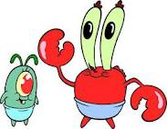
8. Mr. Krabbs and his wife recently had a Lil’ Krabby, but it has not been a happy occasion for them. Mrs. Krabbs has been upset since she first saw her new baby who had short eyeballs. She claims that the hospital goofed and mixed up her baby with someone else’s baby. Mr. Krabbs is homozygous for his tall eyeballs, while his wife is heterozygous for her tall eyeballs. Some members of her family have short eyes, which is the recessive trait. Create a Punnett square using T for the dominant gene and t for the recessive one.
List the possible genotypes and phenotypes for their children.
B. Did the hospital make a mistake? Explain your answer.

Slide 17
8. Mr. Krabbs and his wife recently had a Lil’ Krabby, but it has not been a happy occasion for them. Mrs. Krabbs has been upset since she first saw her new baby who had short eyeballs. She claims that the hospital goofed and mixed up her baby with someone else’s baby. Mr. Krabbs is homozygous for his tall eyeballs, while his wife is heterozygous for her tall eyeballs. Some members of her family have short eyes, which is the recessive trait. Create a Punnett square using T for the dominant gene and t for the recessive one.
List the possible genotypes and phenotypes for their children. TT or Tt
B. Did the hospital make a mistake? Explain your answer. Yes, they can’t have short eyeballed children
Mr. Krabbs
 | T | T
T | TT | TT
t | Tt | Tt
Mrs. Krabbs

Slide 18
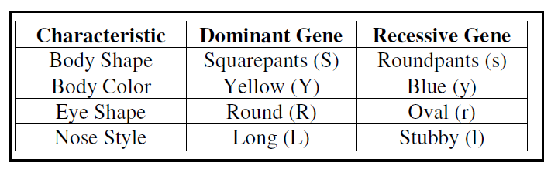
Use the information for SpongeBob’s traits to write the phenotype (physical appearance) for each item.
(a) LL-______________ (e) Rr-_______________
(b) yy-_______________ (f) ll- _______________
(c) Ss-_______________ (g) ss- _______________
(d) RR - _____________ (h) Yy -______________

Slide 19
Use the information for SpongeBob’s traits to write the phenotype (physical appearance) for each item.
(a) LL- long nose (e) Rr- Round Eye
(b) yy- Blue body (f) ll- stubby nose
(c) Ss- squarepants (g) ss- roundpants
(d) RR – round eye (h) Yy - yellow body

Slide 20
2. Use the information in the chart in #1 to write the genotype (or genotypes) for each trait below.
Yellow body - ___________ (e) Stubby nose - ___________
(b) Roundpants - ___________ (f) Round eyes - ____________
(c) Oval eyes - ______________ (g) Squarepants - ___________
(d) Long nose - _____________ (h) Blue body - ____________

Slide 21
2. Use the information in the chart in #1 to write the genotype (or genotypes) for each trait below.
Yellow body – YY, Yy (e) Stubby nose - ll
(b) Roundpants - ss (f) Round eyes - RR, Rr
(c) Oval eyes - rr (g) Squarepants - SS, Ss
(d) Long nose – LL, Ll (h) Blue body - yy

Slide 22
3. Determine the genotypes for each using the information in the chart in #1.
Heterozygous round eyes -_____ (c) Homozygous long nose - ______
(b) Purebred squarepants - ______ (d) Hybrid yellow body - ______

Slide 23
3. Determine the genotypes for each using the information in the chart in #1.
Heterozygous round eyes – Rr (c) Homozygous long nose -LL
(b) Purebred squarepants – SS (d) Hybrid yellow body - Yy

Slide 24
4. One of SpongeBob’s cousins, SpongeBillyBob, recently met a cute squarepants gal, SpongeGerdy, at a local dance and fell in love. Use your knowledge of genetics to answer the questions below.
If SpongeGerdy’s father is a heterozygous
squarepants and her mother is a
roundpants, what is her genotype?
Complete the Punnett square to show the
possible genotypes that would result to help you
determine Gerdy’s genotype. What is Gerdy’s genotype?
(b) SpongeBillyBob is heterozygous for his squarepants shape. What is his genotype?
(c) Complete the Punnett square to show the possibilities that would result if Billy Bob & Gerdy had children.
(d) List the possible genotypes and phenotypes for the kids.
(e) What is the probability of kids with squarepants?
(f) What is the probability of kids with roundpants?

Slide 25
4. One of SpongeBob’s cousins, SpongeBillyBob, recently met a cute squarepants gal, SpongeGerdy, at a local dance and fell in love. Use your knowledge of genetics to answer the questions below.
If SpongeGerdy’s father is a heterozygous
squarepants and her mother is a
roundpants, what is her genotype?
Complete the Punnett square to show the
possible genotypes that would result to help you
determine Gerdy’s genotype. What is Gerdy’s genotype? Ss
(b) SpongeBillyBob is heterozygous for his squarepants shape. What is his genotype? Ss
(c) Complete the Punnett square to show the possibilities that would result if Billy Bob & Gerdy had children.
(d) List the possible genotypes and phenotypes for the kids.
SS, Ss, ss
(e) What is the probability of kids with squarepants? 75%
(f) What is the probability of kids with roundpants? 25%
Father
 | S | s
s | Ss | ss
s | Ss | ss
Mother
BillyBob
 | S | s
S | SS | Ss
s | Ss | ss
Gerdy

Slide 26
5. SpongeBob’s aunt and uncle, SpongeWilma and SpongeWilbur, have the biggest round eyes in the family. Wilma is believed to be heterozygous for her round eye shape, while Wilbur’s family brags that they are a pure line. Complete the Punnett square to show the possibilities that would result if SpongeWilma and SpongeWilbur had children.
Give the genotype for each person.
Wilma – Wilbur -
(b) Complete the Punnett square to show the
possibilities that would result if they had children.
(c) List the possible genotypes and phenotypes for the kids.
(d) What is the probability that the kids would have round eyes?
(e) What is the probability that the kids would be oval eyes?

Slide 27
5. SpongeBob’s aunt and uncle, SpongeWilma and SpongeWilbur, have the biggest round eyes in the family. Wilma is believed to be heterozygous for her round eye shape, while Wilbur’s family brags that they are a pure line. Complete the Punnett square to show the possibilities that would result if SpongeWilma and SpongeWilbur had children.
Give the genotype for each person.
Wilma – Rr Wilbur - RR
(b) Complete the Punnett square to show the
possibilities that would result if they had children.
(c) List the possible genotypes and phenotypes for the kids. RR, Rr
(d) What is the probability that the kids would have round eyes? 100 %
(e) What is the probability that the kids would be oval eyes? 0 %
SpongeWilbur
 | R | R
R | RR | RR
r | Rr | Rr
SpongeWilma

Slide 28
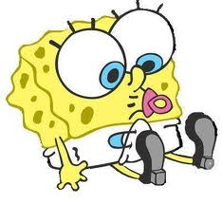
6. SpongeBob’s mother is so proud of her son and his new wife, SpongeSusie, as they are expecting a little sponge.
She knows that they have a 50% chance of having a little roundpants, but is also hoping the new arrival will be blue (a recessive trait) like SpongeSusie and many members of her family.
If SpongeBob is heterozygous for his yellow body color, what are the chances that the baby sponge will be blue?
Create a Punnett square to help you answer this question.

Slide 29
6. SpongeBob’s mother is so proud of her son and his new wife, SpongeSusie, as they are expecting a little sponge.
She knows that they have a 50% chance of having a little roundpants, but is also hoping the new arrival will be blue (a recessive trait) like SpongeSusie and many members of her family.
If SpongeBob is heterozygous for his yellow body color, what are the chances that the baby sponge will be blue? 50%
Create a Punnett square to help you answer this question.
SpongeBob
 | Y | y
y | Yy | yy
y | Yy | yy
SpongeSusie

Slide 30
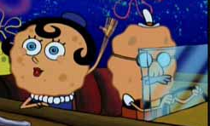
7. SpongeBob’s aunt is famous around town for her itty, bitty stubby nose! She recently met a cute squarepants fellow who also has a stubby nose, which is a recessive trait.
Would it be possible for them to have a child with a regular long nose? Why or why not? Create a Punnett square to help you answer this question.

Slide 31
7. SpongeBob’s aunt is famous around town for her itty, bitty stubby nose! She recently met a cute squarepants fellow who also has a stubby nose, which is a recessive trait.
Would it be possible for them to have a child with a regular long nose? Why or why not? Create a Punnett square to help you answer this question.
No, all will have recessive traits for stubby nose (ll)
Aunt
 | l | l
l | ll | ll
l | ll | ll
Fellow

Slide 32
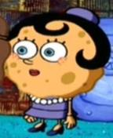
8. If SpongeBob’s aunt described in #7 wanted children with long noses, what type of fellow would she need to marry in order to give her the best chances?
Create a Punnett square to help you answer this question.

Slide 33
8. If SpongeBob’s aunt described in #7 wanted children with long noses, what type of fellow would she need to marry in order to give her the best chances?
Homozygous dominant LL = 100%, Heterozygous = 50% chance
Create a Punnett square to help you answer this question.
Aunt
 | l | l
L | Ll | Ll
L | Ll | Ll
Fellow
Aunt
 | l | l
L | Ll | Ll
l | ll | ll
Fellow

