Slide 1
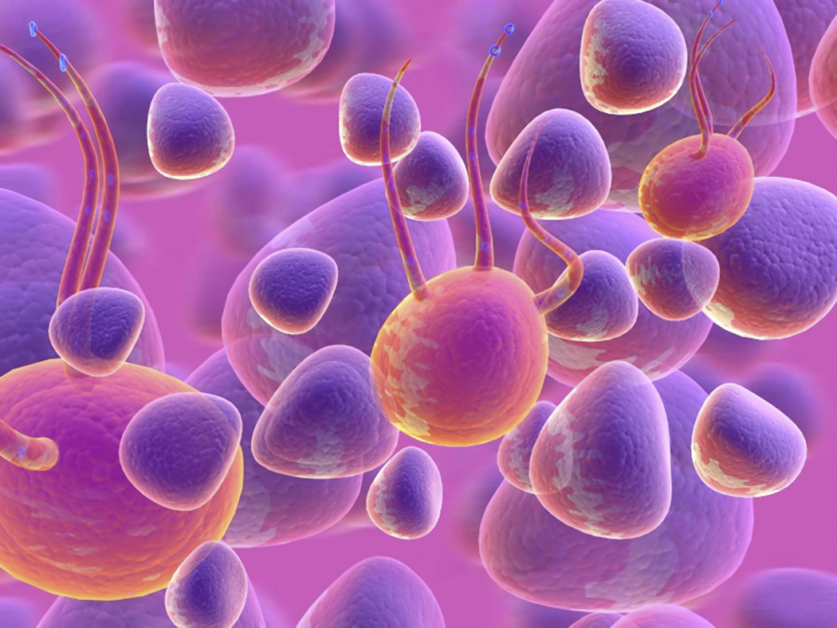
Protein Power
How well can your class make proteins?
Game created by T. Trimpe 2011 http://sciencespot.net/

Slide 2
Part 1: Complete this section using the class notes.
What is created during protein synthesis?
What molecules make up proteins?
Where does protein synthesis take place in a cell?
Where are the instructions for creating proteins?
What does each type of RNA do?
Why is this process important?
Proteins
Amino Acids
Ribosome
Chromatin in the nucleus
mRNA – Goes to the nucleus to get the code for a protein and takes it to a ribosome.
tRNA – Gathers amino acids the ribosomes need to make a protein.
Proteins form parts of cell membranes and organelles. Special types, called enzymes, are necessary for life.

Slide 3
What will you do?
Each of you will play the role of a specific organelle or cell part by performing the required tasks during the game.
You will work together as a class to simulate cell processes and protein synthesis.
You will compete against other classes to determine which "cell" has the lowest time for creating six proteins.
You will be responsible for following the rules and completing the activity worksheet.

Slide 4
7. Identify the items or areas of the room that are used to represent each of these parts of the game.
Cell -
Cell Parts –
Nucleus –
Amino Acids –
Protein –
Cell Membrane –
The classroom
The students
Center table
Lego pieces
Lego structure
Student at the classroom door

Slide 5
Game Rules
(1) Cell parts must perform the correct functions. If you do not, you will be sent to a lysosome and kept out of the game for 30 seconds before you can be "recycled" and return to the game. If you are sent to a lysosome, you must stay with that person until you are "recycled".
(2) Ribsomes can only work on one protein at a time with the help of one mRNA molecule and the tRNA molecules. The tRNA molecules must stay near the table with amino acids unless they are delivering pieces.
(3) Cell parts cannot run around the classroom or shove other cell parts.
(4) You must keep the same role for an entire round and are not allowed to have the same role more than once during the entire game.
(5) There will be a total of 4 rounds during which your cell (class) must make a total of 6 correct proteins. Your best time will be used to determine the most efficient cell (class). Every organelle/part must have done something in order for the score to count.

Slide 6
Cell Part | Game Tasks
Lysosome | "Breaks down" proteins that are not correct (either from the cell membrane or a ribosome) and "recycles" organelles that have not done their job correctly.
mRNA | Get instructions for a protein from the chromatin and tell a ribosome how to make the protein. The tRNA molecules cannot hear or talk to you.
tRNA | Helps a ribosome by gathering the pieces it needs for a specific protein. You will need to stay near the amino acids unless you are delivering pieces.
Ribosome | Gets instructions from the mRNA, tells the tRNA to get the pieces needed, and assembles the protein. Calls for an ER to pick up completed proteins.
ER | Gets a protein from a ribosome and takes it to a golgi body.
Golgi Body | Gets two proteins from two ribosomes and takes the set to the cell membrane. You must have at least two proteins before you can hand them off.
Chromatin | Shows a protein pattern to the mRNA molecule when it enters the nucleus. The ribosomes and other organelles should not be allowed to see the pattern.
Cell Membrane | Check the proteins. If correct, pass through the membrane to the teacher. If not, yell for a lysosome to get it for recycling.

Slide 7
RIBOSOMES
mRNA
mRNA
mRNA
mRNA
AMINO ACIDS
tRNA
tRNA
NUCLEUS
& CHROMATIN
CELL MEMBRANE
ER & GOLGI BODIES – Move around the room as needed, but stay out of the way of the mRNA and tRNA molecules.

Slide 8
Part 3: Complete this section after you have completed the game.
What type of cell did your class represent? Why?
What was the easiest role you had? Explain.
What was the hardest role you had? Explain.
How successful was your class in their role as a cell? Explain.

Slide 9
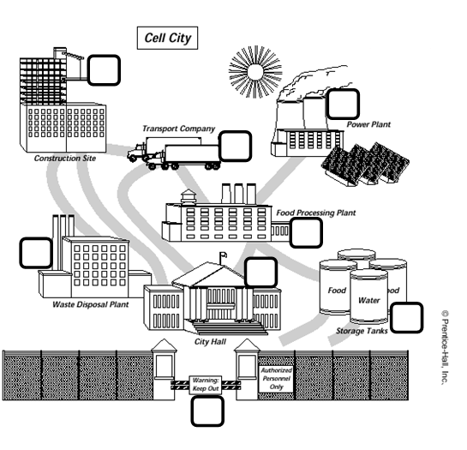
Part 4: Label the “cell city” using what you know about organelles and their functions.
Cell Wall
ER
Golgi Body
Lysosome
Mitochondria
Nucleus
Ribosome
Vacuole
What could be included in the
diagram for each organelle?
Cell membrane
Chloroplasts
Nucleolus
Chromatin
7
5
2
3
4
6
8
1

