Slide 1
Interactive Science Notebooks (ISNs)
T. Trimpe 2012
http://sciencespot.net/

Slide 2
Have you ever heard yourself say ... ?
I can't remember what
we did in class yesterday.
I can't find my . . .
notes, homework, quizzes . . .
I'm sure it’s in . . .
my locker? my book bag? my room?
I was absent last week, did I miss anything?
Source: Gretchen Vikingson at http://vikingson.edublogs.org/files/2011/07/2011-2012-INB-student-version-2afd6sb.ppt

Slide 3

No worries …
Turn those frowns upside down …
Interactive Science Notebooks
are here to save the day!

Slide 4
What Is An Interactive Science Notebook?
An interactive science notebook (ISN) is your own personalized SCIENCE BOOK.
A portfolio of your work in ONE spot that you bring EVERY DAY. This is a great resource for STUDYING for quizzes & tests.
A great ORGANIZATIONAL tool that gives you permission to be COLORFUL and CREATIVE to show me what you know or have learned.
Allows you to be like a REAL SCIENTIST by asking QUESTIONS, RECORDING what you observe, and SHARING it with your classmates!
Source: Gretchen Vikingson at http://vikingson.edublogs.org/files/2011/07/2011-2012-INB-student-version-2afd6sb.ppt

Slide 5


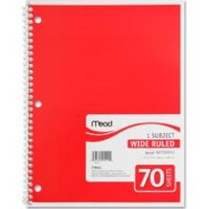
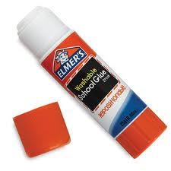
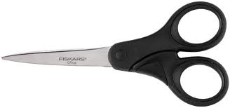
Science Notebook Supplies
Colored Pencils
Pens & Pencils
Spiral Notebook
Scissors
Glue Stick
NO MARKERS!
(except on the covers)

Slide 6
The ISN is divided into TWO sections:
Left Side
Right Side
“LOVES” YOUR work. This is the side that you can use to show me what you learned in a creative and colorful way.
This is the “output” or product side.
Even-numbered pages
“RESTRICTED” to Ms. Trimpe’s input work
Contains info my teacher tells me to “ADD” or “WRITE”
This is the “input” side or info side.
Odd-numbered pages
Source: Gretchen Vikingson at http://vikingson.edublogs.org/files/2011/07/2011-2012-INB-student-version-2afd6sb.ppt

Slide 7
What Goes Where?
Left Side
Student Output
Lots of Color, Diagrams, & Doodles
Concept Maps/Organizers
Drawings
Reflective Writing
Questions
Data Charts and Graphs
Songs, Poems, or Riddles
Data from Experiments
Cartoons or cartoon strips
Right Side
Teacher Input/Content
Blue/Black Ink or Pencil
Information given in class
Lecture Notes
Lab Activities
Video Notes
Summaries
Textbook Notes
Procedures for experiments
Classroom Specific Information
Source: http://www.slideshare.net/arholder/interactive-science-notebook-full-version

Slide 8
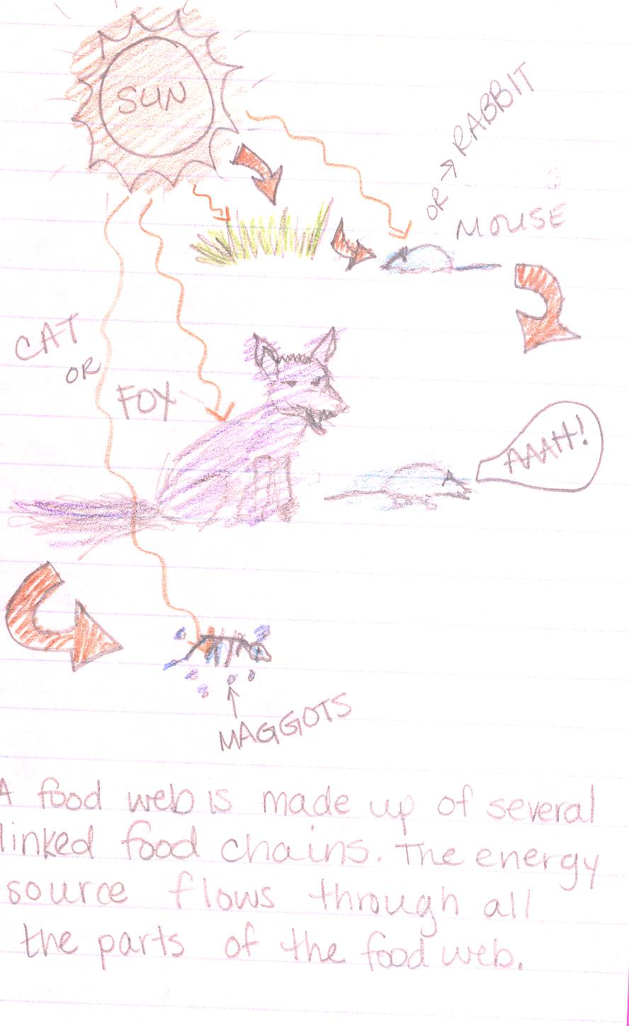
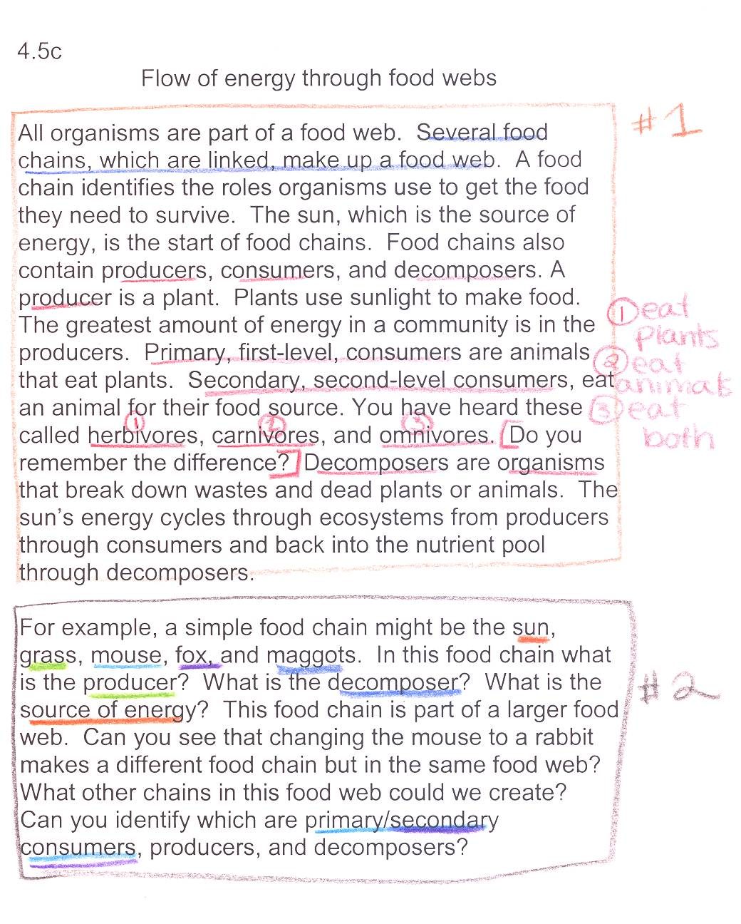
Example page:
OUTPUT (your interpretation)
INPUT (notes from teacher)
Source: http://www.slideshare.net/arholder/interactive-science-notebook-full-version

Slide 9
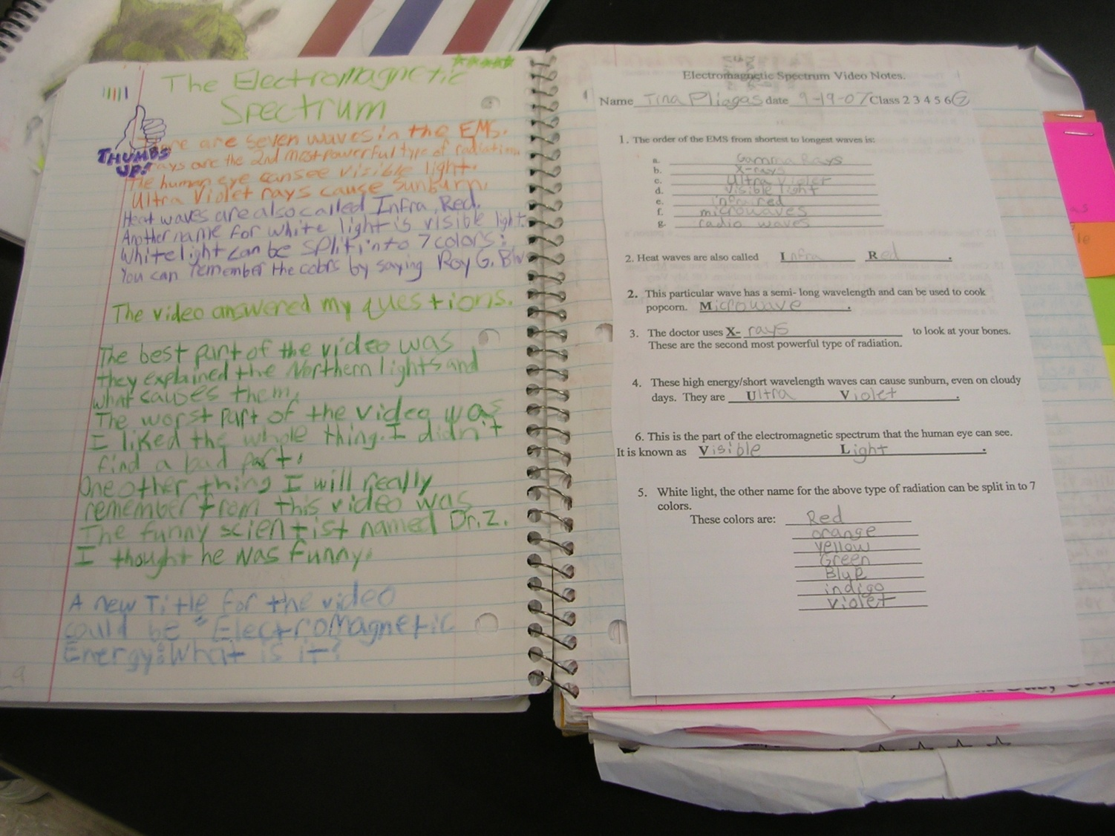
OUTPUT (your interpretation)
INPUT (notes from teacher)
Source: http://www.slideshare.net/arholder/interactive-science-notebook-full-version

Slide 10

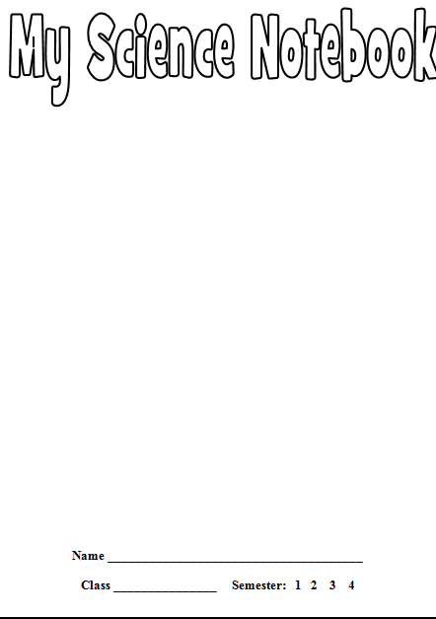
Step 1: Getting Started
1 – Fill out the info slip and glue it in the front of the cover.
2 – Add pictures of your favorite science things. You may draw them or use images you find online.

Slide 11

Step 2: Page Numbers
Add PAGE NUMBERS for the first twenty pages.
Start with 1 in the bottom-right corner of the first page, follow with a 2 on the back of that page and so on.
EVENS
ODDS

Slide 12

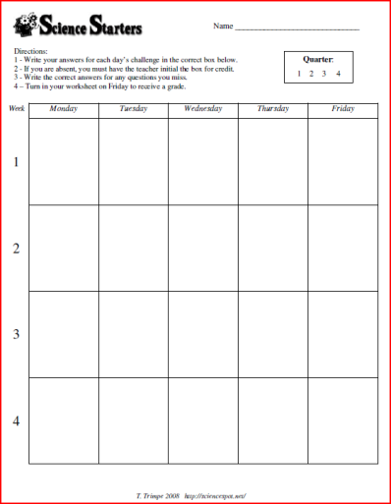
Step 3: Science Starters
Glue your SCIENCE STARTER
worksheet on page one by following your teacher’s directions!
Cut the top and the bottom. Fold the left side back and glue the front.
What goes behind it? Questions!
What questions do you have about the topic? Come up with at least 5 questions and as more as you think of them. Add the answers as you find them.

Slide 13
Notebook Rules
Do not RIP OUT pages or tear corners.
All handouts MUST BE GLUED IN!
Please don’t DOODLE unless it relates to science.
Your ISN should only be used for SCIENCE CLASS and COMES TO CLASS EVERYDAY!
Each page should have the DATE and PAGE#.
BE COLORFUL, CREATIVE, & LOVE YOUR NOTEBOOK!
Source: Gretchen Vikingson at http://vikingson.edublogs.org/files/2011/07/2011-2012-INB-student-version-2afd6sb.ppt

Slide 14
QUESTIONS?

