Slide 1


THE CREATIVE PROCESS OF PROBLEM FINDING MANIFESTED IN OPEN INQUIRY
Frank LaBanca, EdD
Director

Slide 2
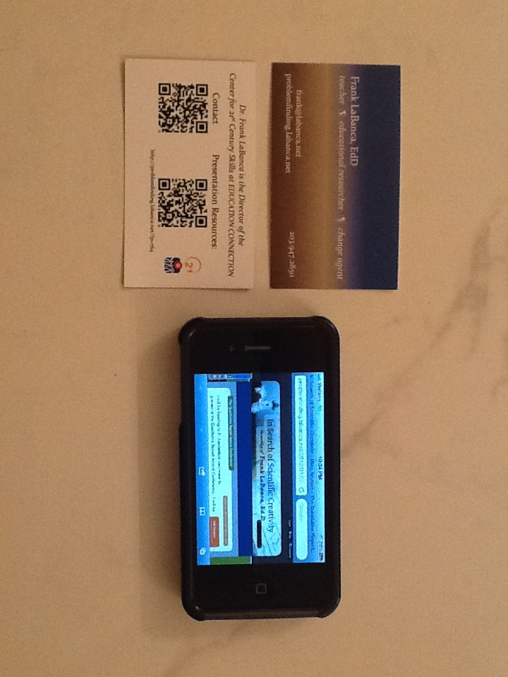
21st-century Approach to Presentation
Resources

Slide 3

2010 Programme for International Student Assessment (PISA)
34 Nations tested
Subject | US Rank
Reading | 14
Science | 17
Math | 25

Slide 4

International Science and Engineering Fair Top Winners 2002-2011
US Citizens | 80%
All other countries | 20%

Slide 5
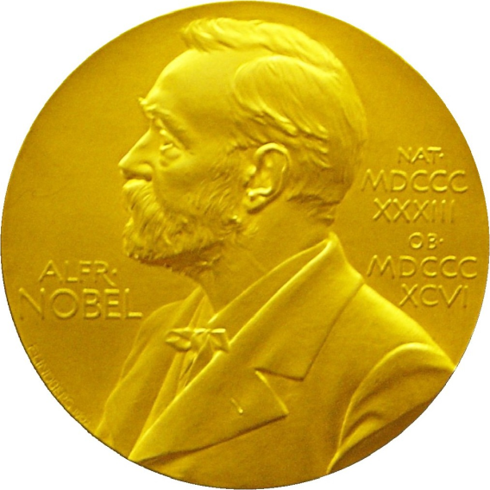
Nobel Prize Recipients 2002-2011
 | Physics | Chemistry | Physiology/Medicine
US affiliations | 67% | 61% | 57%
All other countries | 33% | 39% | 43%

Slide 6
FRAMEWORK
Inquiry & Science Education
Problem solving
Problem finding
↔
Logical/Analytical
Creative
↔

Slide 7



FRAMEWORK
Structured Inquiry | Guided Inquiry | Open Inquiry
STEP-BY-STEP
PROBLEM-POSED
PROBLEM-BASED

Slide 8
RATIONALE
PF not extensively studied in science (Hoover & Feldhusen, 1990&1994; Smilansky 1994; Subotnik, 1988)
PF not extensively examined in learning psychology (Jonassen, 1997; Shymansky, 1990)
PF studies in science primarily in classroom (Roth studies: 1993, 1997, 1998; Prince, 2004)
Science fair studies primarily descriptive – not focused on cognitive structures (Bellipani, 1994; Pyle, 1996)

Slide 9
RESEARCH QUESTIONS
What are the distinguishing problem finding features of externally-evaluated, exemplary, open-inquiry science research projects?
How do parents, teachers, and mentors influence student problem finding?

Slide 10

SAMPLE
12 student presenters
8 student presenters
Grades 11-12
16-18 years of age
Variety of quality,
as determined by judges
Purposeful selection of six mentors and teachers and two fair directors for triangulation

Slide 11
TRIANGULATION STRATEGY
Interviews:
Students
Mentors
Teachers
Fair Directors
Triangulation
of Methods
Surveys:
Documents:
USRT Scale
Popular Press
Demographic Survey
CSF & ISEF Documents

Slide 12
RESULTS
Major themes:
Creative thinking
Entry point characteristics
Reflexive behaviors
Inquiry strategies
Situated learning
Critical thinking
Teaching approach

Slide 13
RESULTS
Major themes:
Creative thinking
Entry point characteristics
Reflexive behaviors
Inquiry strategies
Situated learning
Critical thinking
Teaching approach

Slide 14
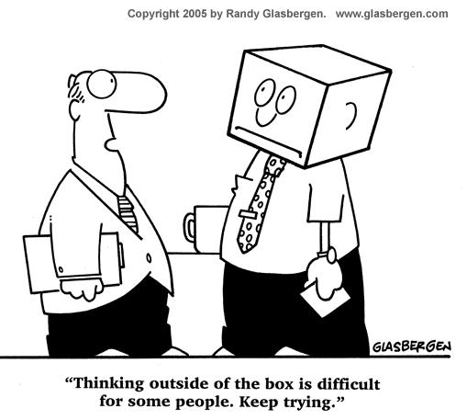
RESULTS
Creative thinking
Definition of creativity by student scientists
Classification of problems and subsequent projects

Slide 15

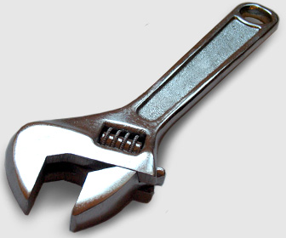

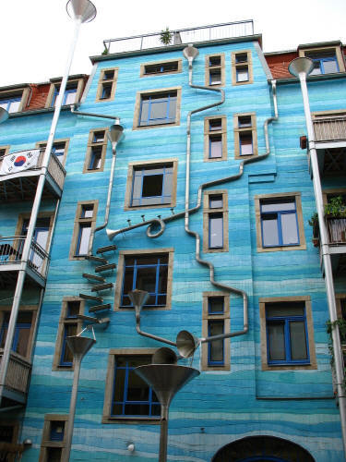
TYPES OF PROJECTS
Literature Review | Technical
Technical with Value | Novel Approach

Slide 16
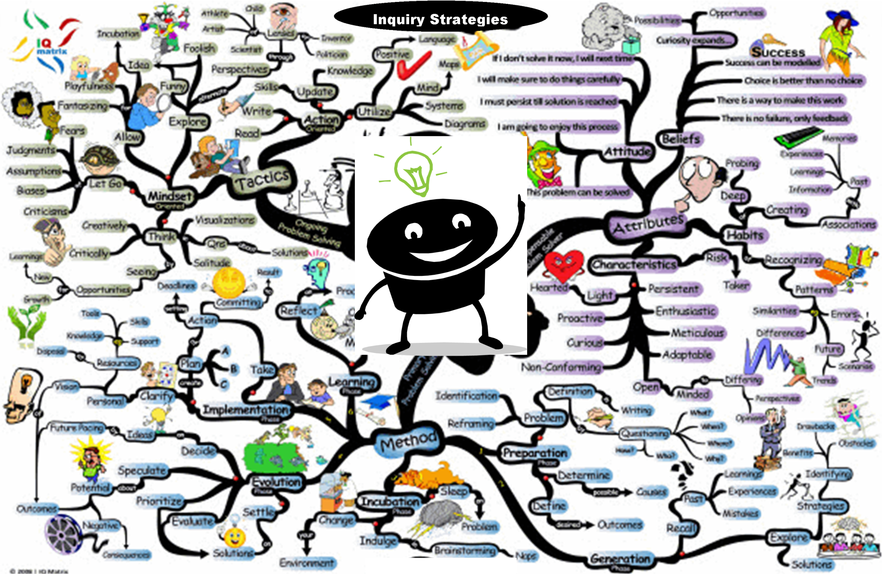
RESULTS
Inquiry strategies

Slide 17
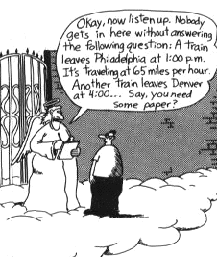
RESULTS
Situated learning
Ability to communicate well
Applying knowledge
Application of the research and relevance to the greater community

Slide 18
CONCLUSIONS
The technical versus the novel problem
Situated project classification
Previous experience
Temperament for science research
Defining inquiry
Inbound and boundary trajectory with the community of practice

Slide 19
LIMITATIONS
Trustworthiness
Purposeful selection
Sample size
Transferability

Slide 20
IMPLICATIONS
Knowledge of external expectation
Treating problem finding as a meaningful process
Student autonomy
Cognitive apprenticeships
Teacher research experience
The idiosyncratic nature of scientific research
Formal structures for communication skills

Slide 21


Slide 22
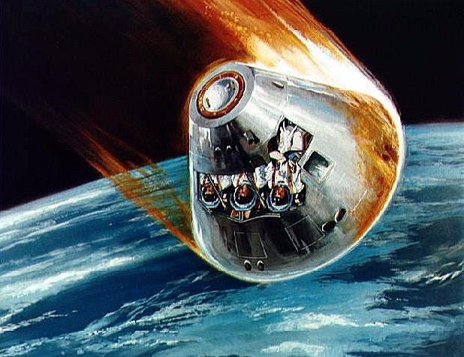
RESULTS
Entry point characteristics
Temperament for science research
Previous experience

Slide 23

RESULTS
Teaching approach
Role of parents
Role of teachers and mentors

Slide 24

RESULTS
Critical thinking
Specialized understanding
Deep understanding
Reverse engineering

Slide 25
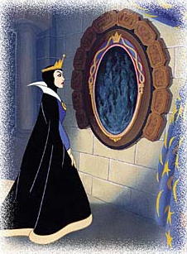
RESULTS
Reflexive behaviors
Motivation
Descriptions of self
Above average ability, creativity, task commitment

