Slide 1


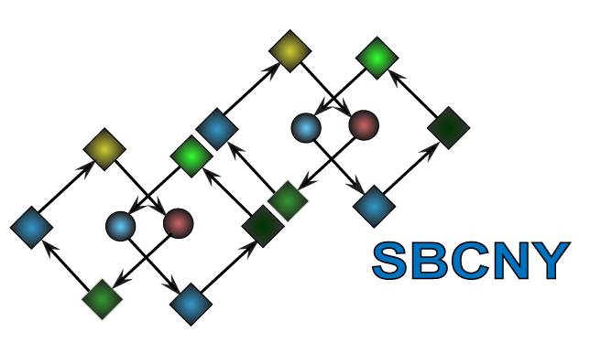
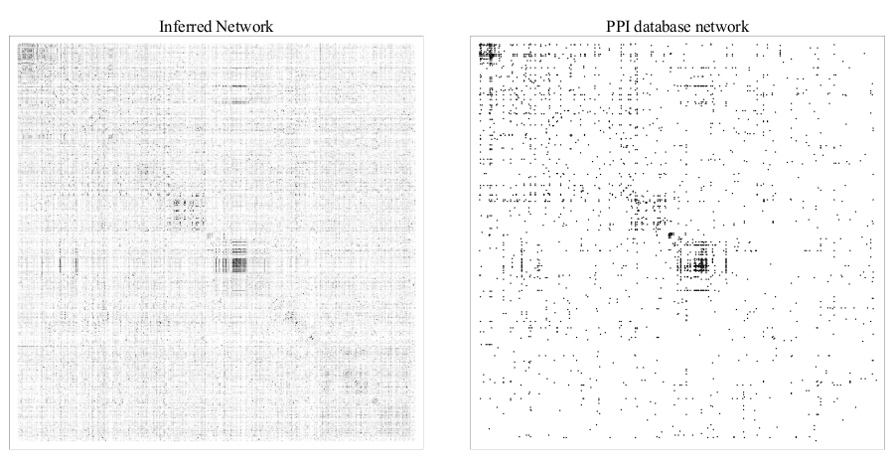
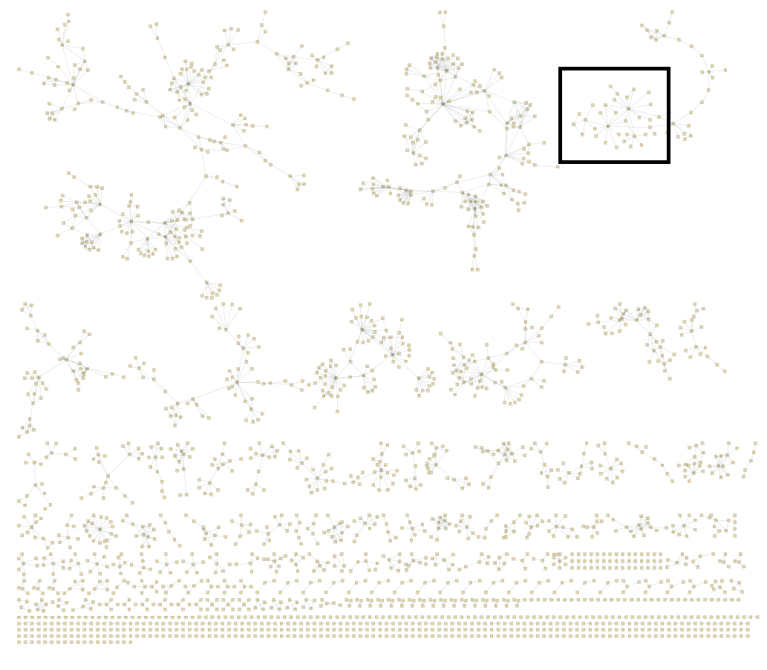
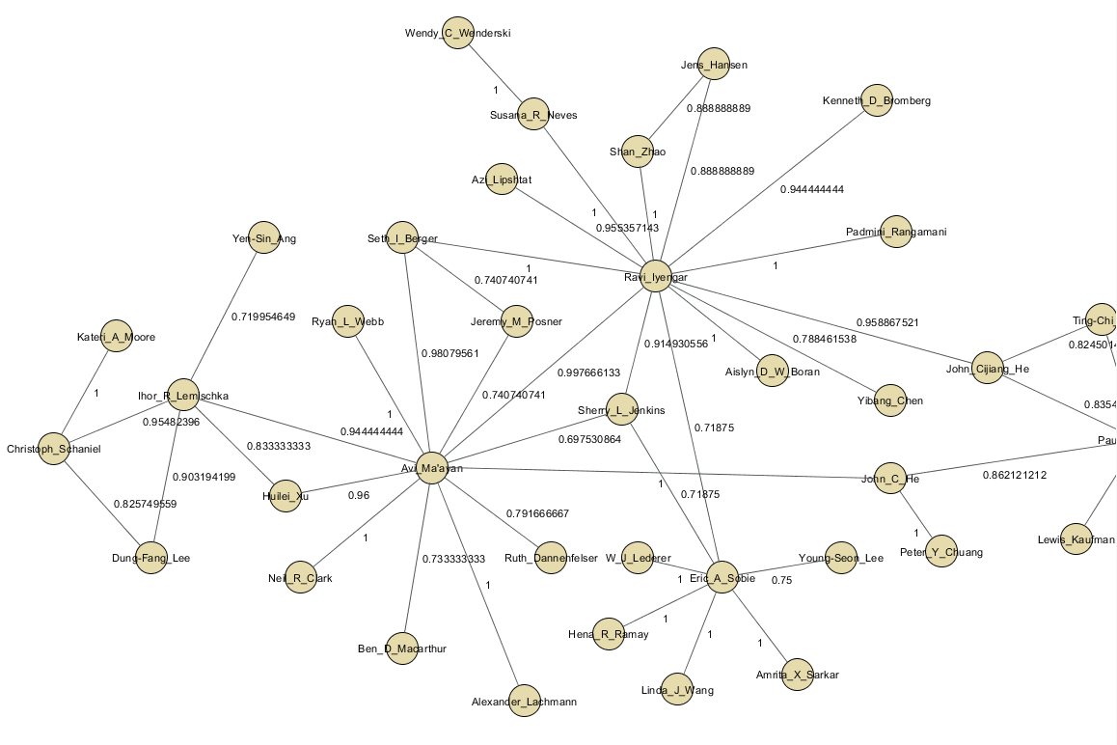
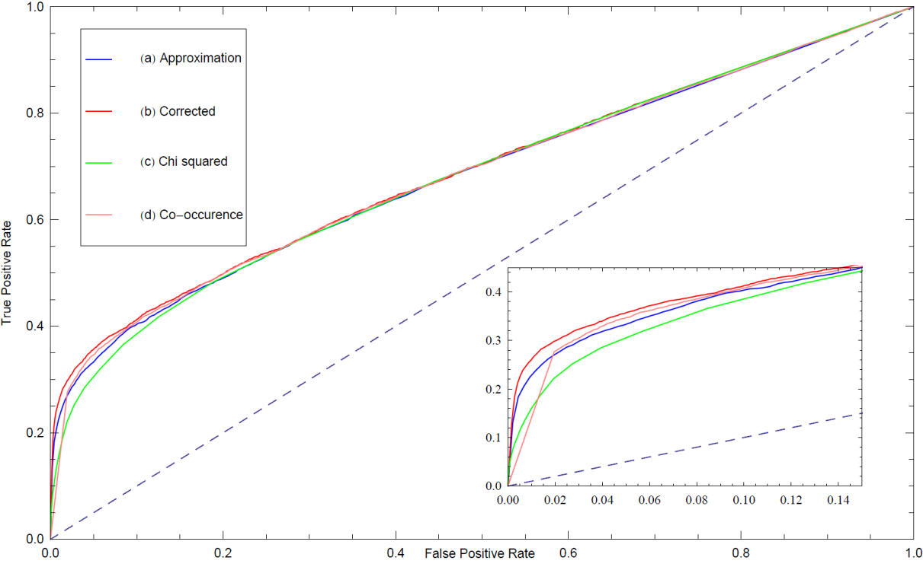
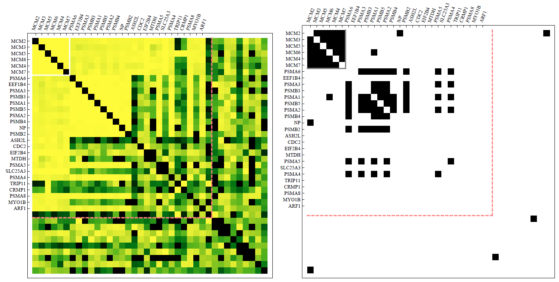
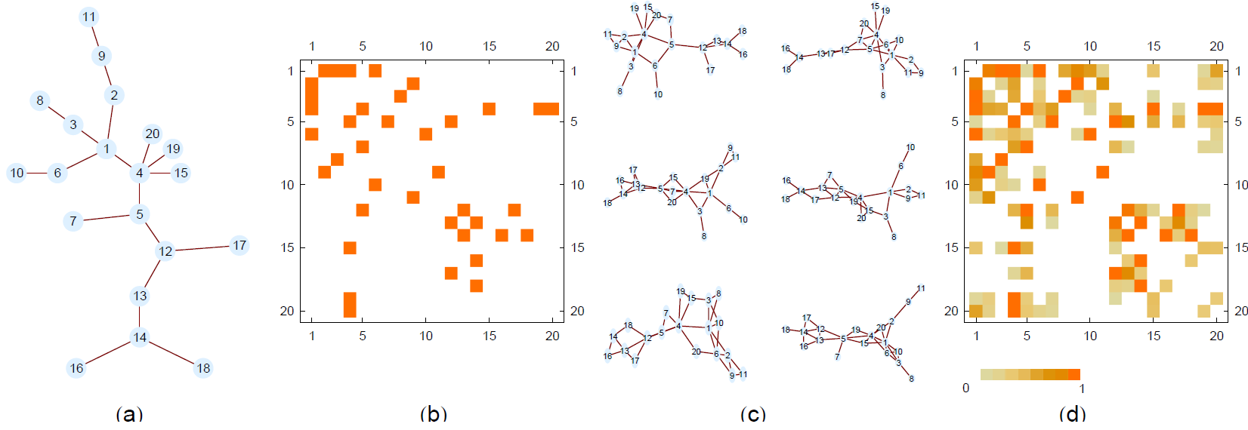
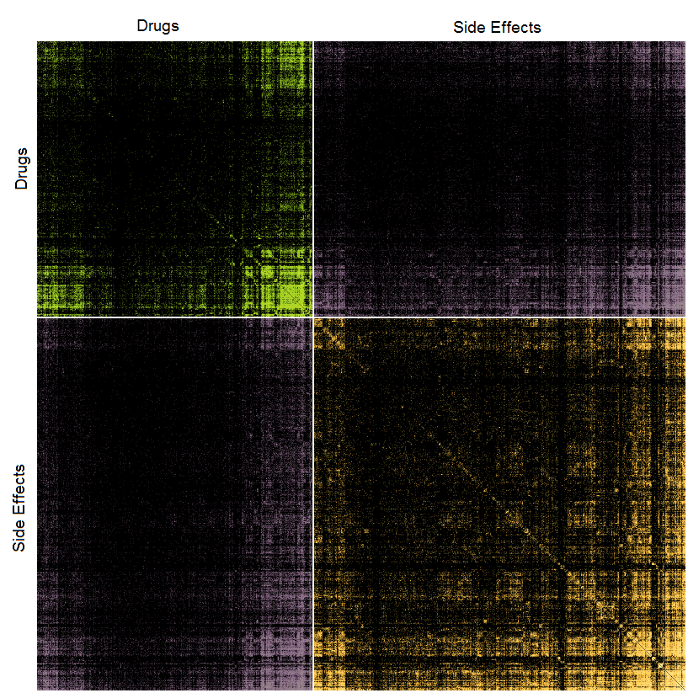
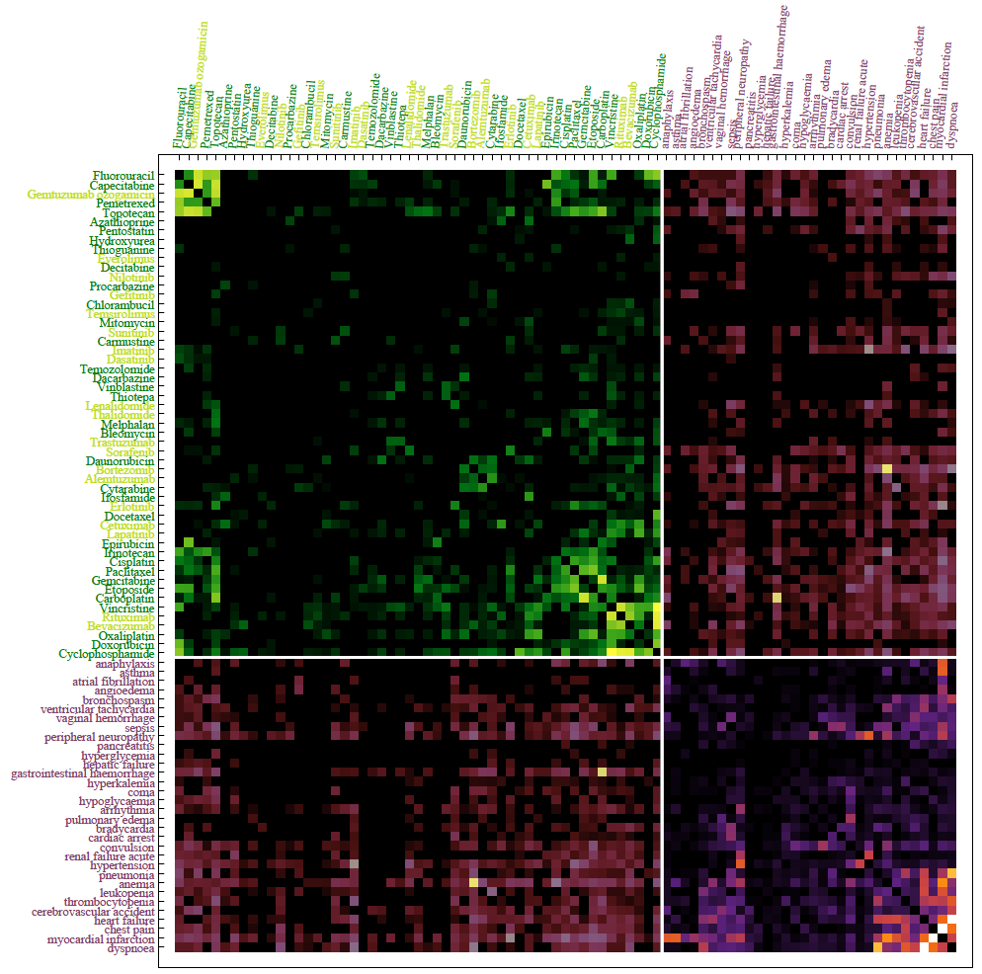
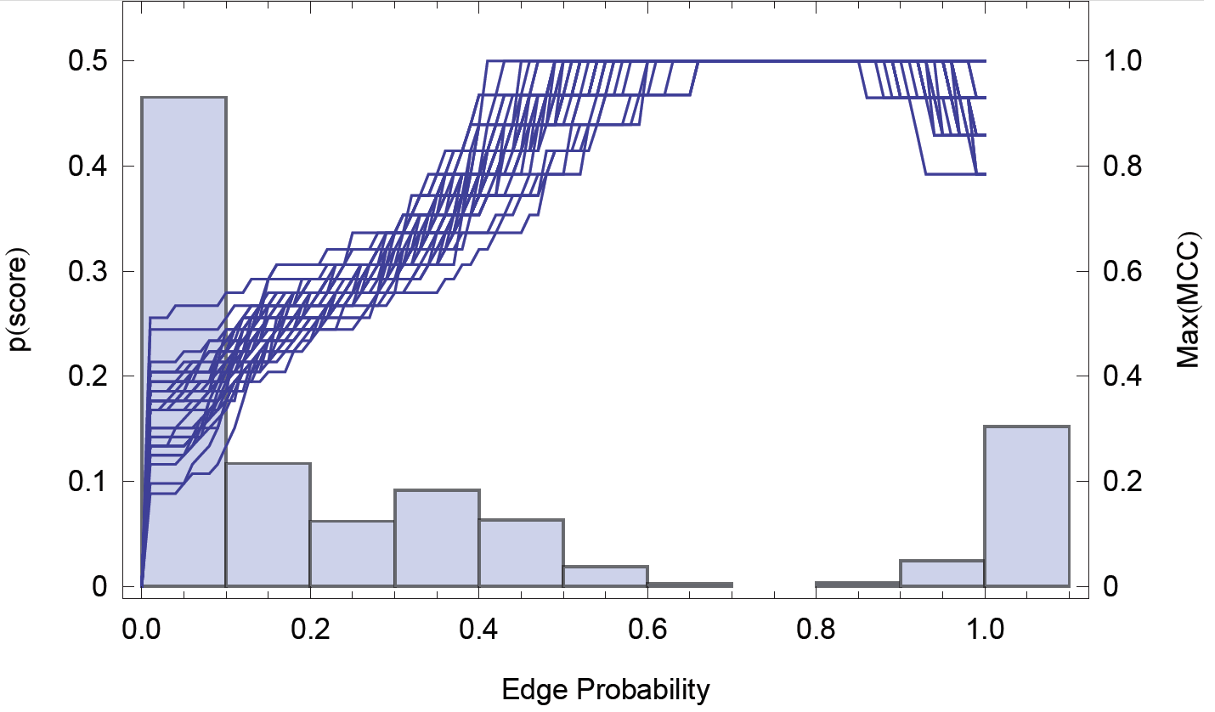
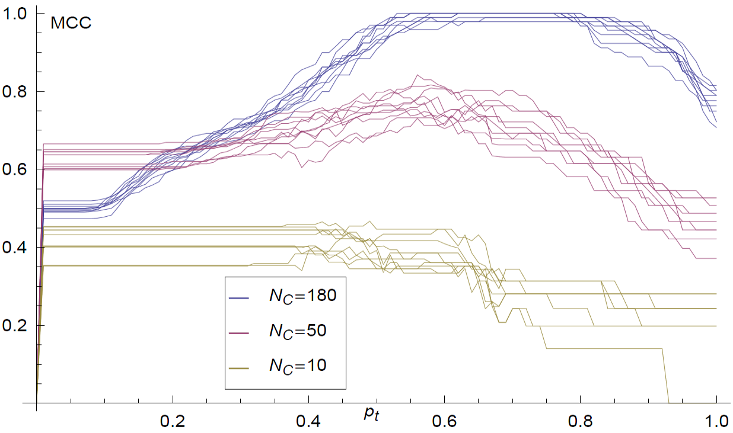

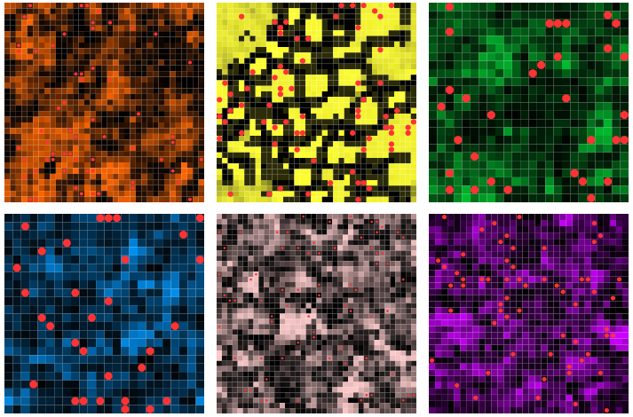
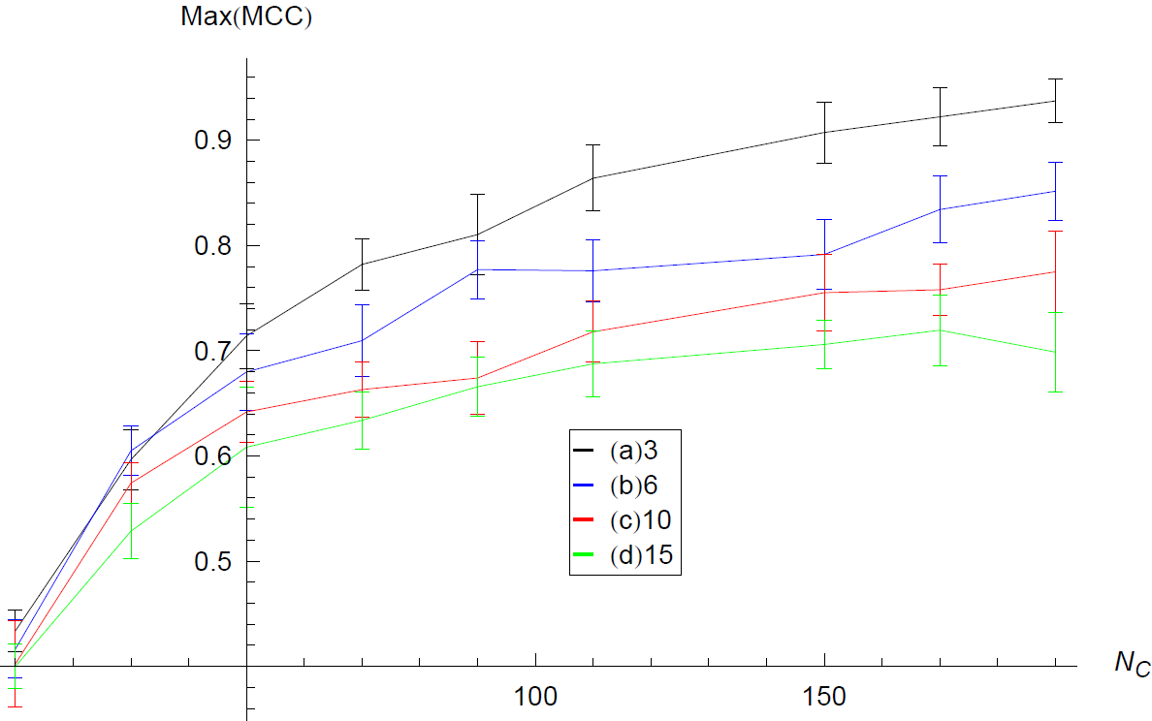
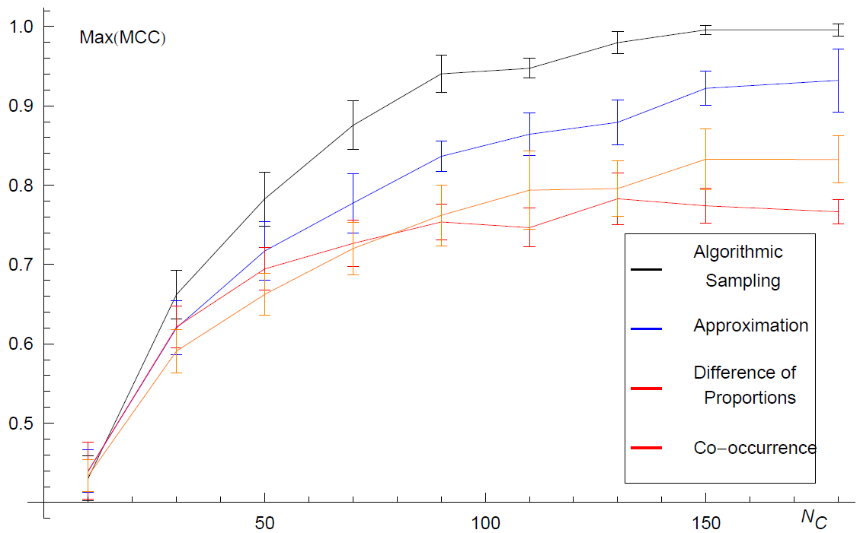
Network inference from repeated observations of sets
Neil R. Clark, Ruth Dannenfelser, Christopher M. Tan, Michael E. Komosinski, and Avi Ma'ayan
Department of Pharmacology and Systems Therapeutics, Systems Biology Center of New York (SBCNY), Mount Sinai School of Medicine, One Gustave L. Levy Place, Box 1215, New York, NY, 10029, USA
Introduction
The skeleton of complex systems can be represented as networks where vertices represent entities, and edges represent the relations between these entities. While many algorithms have been developed to infer networks from quantitative data, less attention has been paid to methods which infer networks from repeated observations of related sets. This type of data is ubiquitous in the field of systems biology.
We developed a general method for network inference from repeated observations of sets of related entities. Given experimental observations of such sets, we infer the underlying network connecting these entities by generating an ensemble of networks consistent with the data. The frequency of occurrence of a given link throughout this ensemble is interpreted as the probability that the link is present in the underlying real network conditioned on the data. Exponential random graphs are used to generate and sample the ensemble of consistent networks, and we take an algorithmic approach to numerically executing the inference method. The effectiveness of the method is demonstrated on synthetic data before employing this inference approach to problems in systems biology and systems pharmacology.
Application to PPI inference
Mount Sinai collaboration network
Network inferred from 3290 IP/MS experiments next to known PPI network made from 20 online PPI databases
Comparing different inference methods
Recovering known complexes listed in CORUM
Inferred network from 5,000 recent (5/2012) publications listed on PubMed from Mount Sinai investigators
Synthetic example
Applications in Systems Pharmacology
Conclusions
As empirical data about sets of related entities accrues, there are more constraints on possible network realizations that can fit the data; in the language of statistical mechanics, the size of the microstate ensemble shrinks, until the underlying network resolves. The network inference method we developed can be applied to resolve different types of networks in current systems biology and systems pharmacology as well as in other fields of research.
Web-site and citation
http://www.maayanlab.net/S2N
Neil R. Clark, Ruth Dannenfelser, Christopher M. Tan, Michael E. Komosinski, and Avi Ma'ayan. Sets2Networks: network inference from repeated observations of sets. BMC Systems Biology. In press
Inferring a connected random network
Distribution of scores vs. quality of inference for different thresholds
Inferred network from ~800,000 AERS records for all drugs and side effects
Cancer drugs and 34 severe side-effects
Quality of inference for various # of lines
Drug-drug networks connected by different types of shared attributes:
ARES, ATC, CMAP-ChEA,
CMAP-KEGG, MACCS, SIDER
Quality of inference for various average line lengths
Comparing different inference methods
Acknowledgements: This work was supported by NIH grants P50GM071558-03, R01DK088541-01A1, RC2LM010994-01, P01DK056492-10, RC4DK090860-01, and KL2RR029885-0109

