Slide 1
What is OSLN?
Dustin A. Pyles, OSLN Director of Operations
Before the Ohio STEM Learning Network (OSLN)
2006; Battelle, OSU, and Knowledgeworks start planning first STEM school in Ohio (Metro Early College HS)
2007; OSU, Battelle, Knowledgeworks open Metro & H.B. 119 allocated $13 million to establish STEM schools and Hubs in Ohio
2008; the OSLN is created through support of Battelle, Ohio Business Roundtable, Governor and state legislature, which was the catalyst for additional support of the Gates Foundation.
Battelle chosen to manage and support OSLN as the state’s public-private STEM education partner (3 schools open; 4 in design; & 9-K-8 Programs of Excellence)

Slide 2
What is OSLN? (con’t)
2009; Ohio Governor & legislature commit $10 million to fund 5 more STEM schools in Ohio
8 STEM schools established; 2 schools in design and 19 K-8 Programs of Excellence funded
OSLN had five (5) regional STEM Hubs established to support the STEM platform schools and regional STEM initiatives, two (2) more were in design (NW and SE)
2010; With seven (7) hubs established, OSLN continues to grow with the addition of two (2) more STEM schools
2011; Evolution of the network to inspire other state networks – Battelle co-manages the TSIN

Slide 3
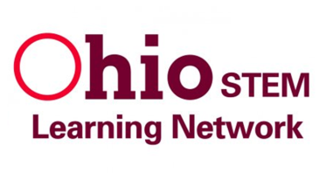

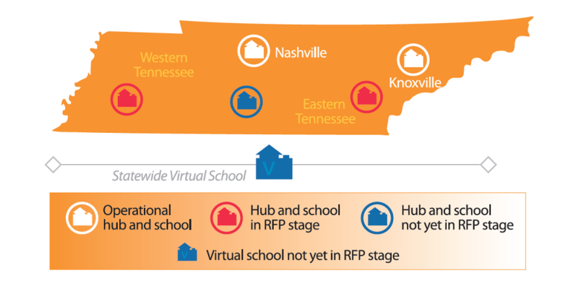
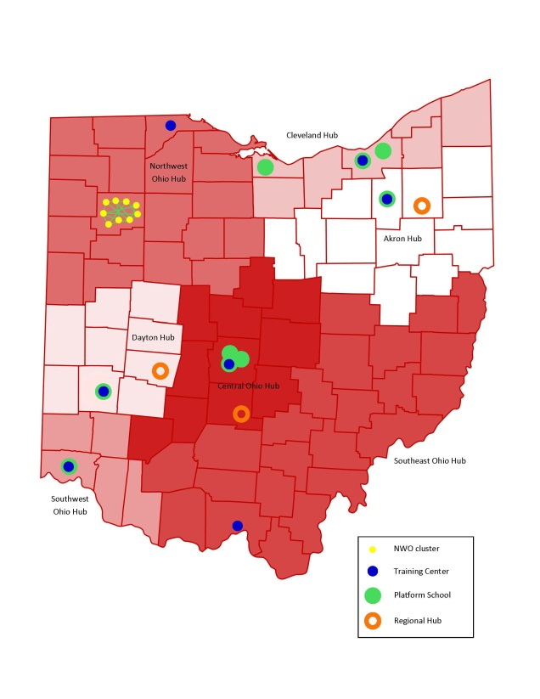
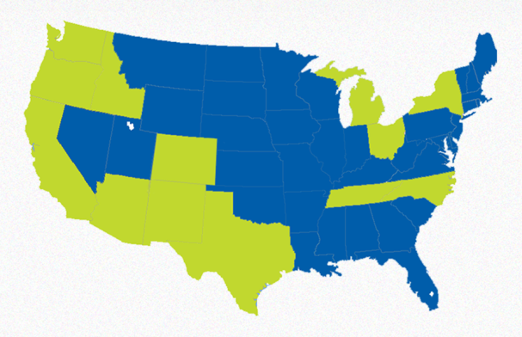

Supporting Excellence in STEM Networks

Slide 4
OSLN Inspires other States
Tennessee STEM Innovation Network
Co-managed by Battelle and TN State Dept. of Education
Rapid creation of hubs and schools
Bill & Melinda Gates Foundation support mobilizing STEM in four (4) additional states:
California, New York, North Carolina and Texas
STEMx (multi-state network)
11 states to 13 states participating

Slide 5
Current OSLN Initiatives – 2012
Race to the Top (RttT) Contract with State of Ohio
8 Regional STEM & ECHS/STEM Training Centers
Supporting STEM in lowest-achieving & innovative schools
Spreading effective STEM instructional practices to pre- and in-service educators
College Ready Tools (CRTs) – Literacy Design Collaborative (LDC) network deployment
OH (Phase 1); TX (Phase 2) NY& NC(Phase 3)
Currently fully implementing in 2 Ohio Schools and training 6 additional schools – 7 fully and 13 training in one year.
Planning to implement in 3 TX schools; with 10 training in one year.

Slide 6
Current OSLN Initiatives – 2012
Supporting TSIN’s growth – hub and STEM school creation
Providing technical assistance and professional development to emerging STEM programs in Ohio
Advocating at state, regional and local levels for policy and partnerships that foster learning environments that allow STEM education and learning to grow

Slide 7
Why does OSLN do it?
OSLN created to support the development and startup of STEM platform schools in Ohio.
Ohio STEM schools created to be demonstration sites.
Ohio Regional Hubs created to support platform schools and regional STEM efforts.
Regional STEM Training Centers created to provide a vehicle for the STEM platform schools and Regional Hubs to spread effective and proven STEM practices to other educators.
OSLN has evolved from a network that primarily assists in the startup and design implementation of STEM schools to a network that spreads effective STEM best practices throughout the state and other states.

