Slide 1

Android
The most exploitable smartphone on the market

Slide 2
Thank You!
This presentation is a compilation of original research done by the following people:
Charlie Miller,
Sergio ‘shadown’ Alvarez,
Jon Oberheide,
Alfredo Ortega,
Nicolas Economou,
Dan Bornstein, and others listed in the appendix!
Notes:
To be clear, this presentation is not really original work of mine, sometimes blatantly so!
I created this presentation for an NYU:Poly course in mobile application development – non-security CS undergrads and a non-security course – to introduce them to mobile device security issues. I knew very little about Android before making it and I have stopped researching it since. There might be mistakes in here but I tried to source the material as much as possible from people who actually do know what they’re talking about.

Slide 3
Outline
What are we talking about?
The OS, the SDK, Dalvik, Dex
SDK Security Architecture
APKs, Permissions, Android Market
Native Apps
Toolchain, Debugging
Exploiting Android
Jailbreaking, Attacking Applications, Exploiting Android, Finding Bugs
Research Opportunities
Notes:
We’re not talking so much about code security issues in the Davlik SDK. SDKs from both Android and iPhone do a good job of taking security out of the hands of developers. Dino is going to talk more about the possible issues you should be aware of as developers. My talk is going to focus more on OS internals and embedded OS design issues.

Slide 4
The Point
The Android OS is the most easily exploitable smartphone on the market today (!)
Typical mobile phones:
Operating system not documented
Firmware delivered via binary
Hardware not commonplace
Application whitelisting / code signing

Slide 5
Android Fail
Many security goals not addressed
Platform well understood by hackers
Infrequent patching of 3rd party libraries
Consists of new, untested C code
Large set of low-level tools available
High-profile device is attracting attention
Notes:
You’ll notice this talk is much more “ad hoc” than Dino’s upcoming talk on the iPhone. This is a reflection of the current implementation of Android. They either haven’t thought about the big mobile device security issues or they haven’t addressed them yet. The iPhone is at v3.0 and Android is at v1.1, so this might change in time, but currently, Android doesn’t have good answers to lots of security questions.
The Android OS is based on Linux which is among the most well documented OS’s from an exploitation perspective. ARMv5.
Android contains dozens of 3rd party OSS libraries whose vulnerabilities aren’t tracked and their patching status is unknown. Finding a vulnerability in the Android OS is as easy as grepping a changelog.
The code that isn’t 3rd party is fresh C development by Google engineers, not to mention, most of the code is publicly available.
Many common tools used for exploit development on Linux can be easily ported over to Android.
Historically, we’ve seen a large amount of interest in hacking this platform because it is easy and high-profile. There were 3 separate talks at a recent security conference re: Android security.

Slide 6
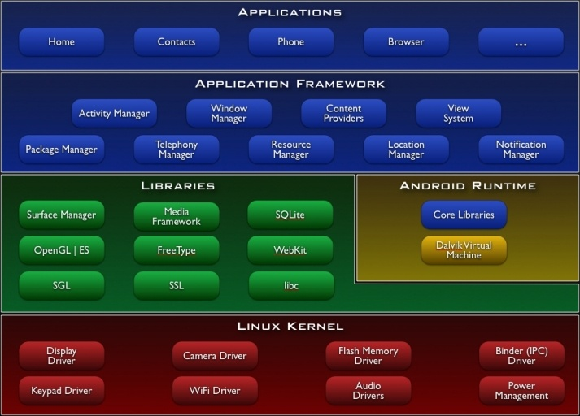
Android Basics
Notes:
- Why are we talking about this? This image partially (mostly) defines the attack surface of the phone. The Android Platform consists of a large number of components at the OS, middleware, and application level.
- At the lowest level, the OS is based on a fairly stock Linux kernel (2.6.25) with binary drivers added to enable functionality in some of the hardware. (save those binary drivers when flashing the phone) (binary keyboard update that caused the root terminal issue)
Google provides a full set of libraries to enable rich media functionality on the phone. They wanted to make it as easy as possible to write complicated and interactive applications so they sourced libraries from all over OSS and even wrote a large amount of their own code implementing things like a multimedia framework for parsing formats like h264 and mp3.
At the application level, most are written in Java and compiled to dex to be run by the Davlik interpreter. These applications run as Linux processes on a 1-1 mapping.

Slide 7
Demystifying Dalvik
Optimizing translator for Java class files to a register-based bytecode format called dex
Collapses shared elements in class files
Filesize savings are in line with gzip’ing a class file
Instruction stream / code units more dense
More code in cache at once
Many optimizations specifically target ARM CPU
Notes:
Bytecode interpreter: while -> switch statement. Speed this up by making an opcode table and indexing to find instruction. Davlik guarantees that interpreter begins at certain address and that each opcode is the same number of bytes (pads it). Aligns on cache-line boundary.

Slide 8
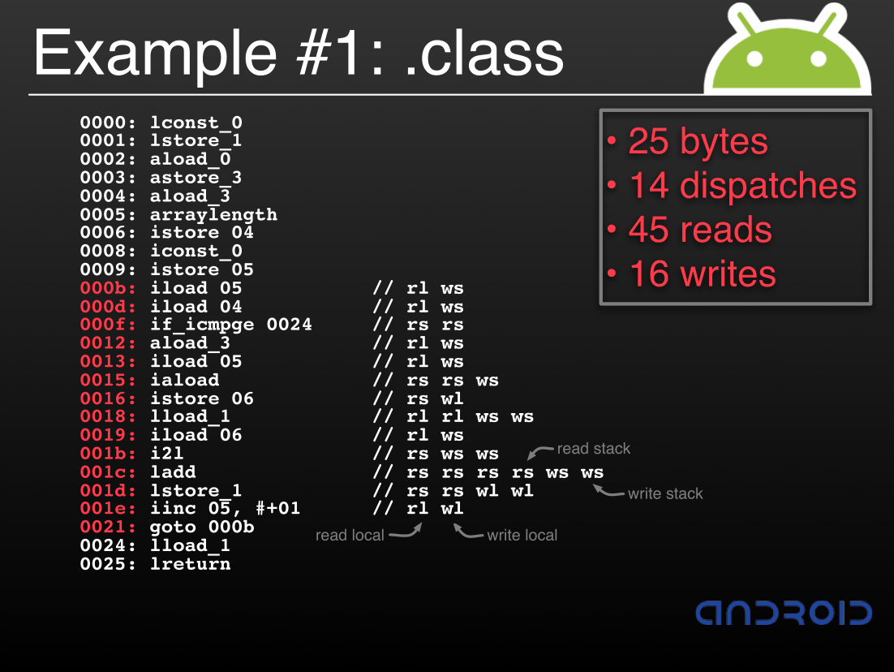
Notes:
From Bornstein’s presentation

Slide 9
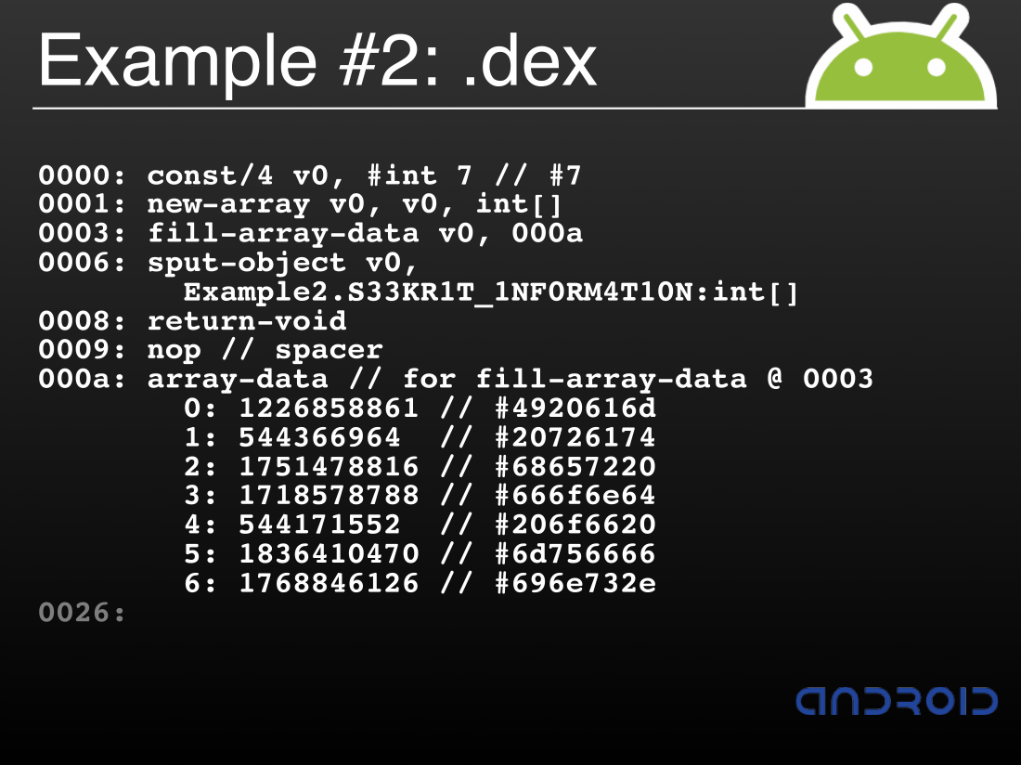
Notes:
From Bornstein’s presentation

Slide 10
Sandboxing
Each app runs in its own Linux process
Each app is given unique user and group IDs
App data stored user readable/writable only
‘sharedUserId’ attribute
MODE_WORLD_READABLE, MODE_WORLD_WRITEABLE

Slide 11
Application Signing
No CA’s, all apps self-signed by developers
Recommended to expire certs after 25 years
This is enforced by the Android Market
Not used for application control a la iPhone
Ad hoc distribution is more than possible
If not control, then what is it used for?
Code/data sharing between applications
Lets apps run in the same process
Facilitate application upgrades

Slide 12
Access Controls
Apps request permissions at install-time
For example, access to location information
User is informed and may accept / reject
“pm list permissions” – show available perms
Perms requested in AndroidManifest.xml
<manifest xmlns:android="http://schemas.android.com/apk/res/android"
package="com.android.app.myapp" >
<uses-permission android:name="android.permission.RECEIVE_SMS" /> </manifest>

Slide 13
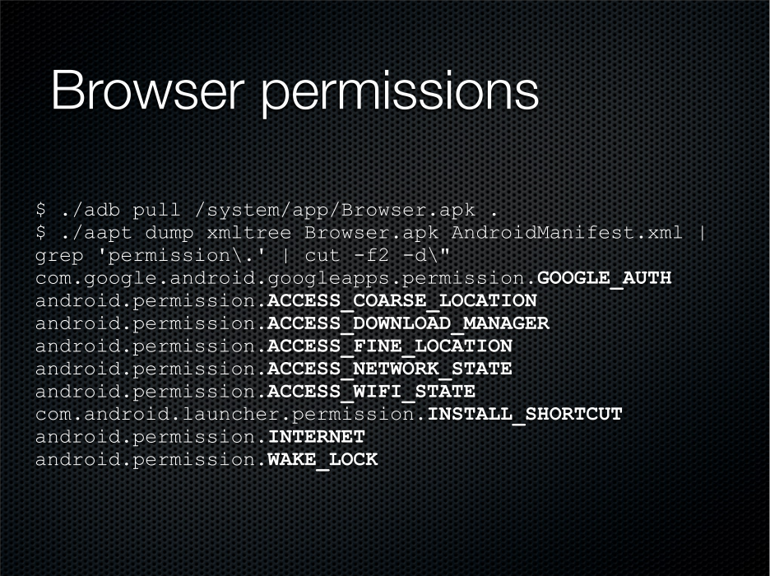
Notes:
From Charlie’s presentation

Slide 14
Granularity
Permissions are very coarse
Users might benefit from finer permissions
Must balance granularity vs permission overload
Example: I install 3rd party Facebook app
Restrict app’s network traffic to facebook.com
Don’t want trojan app dumping my creds somewhere
Restrict app’s traffic to HTTPS
MITM -> malicious update check / javascript injection

Slide 15
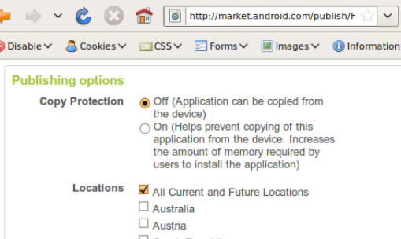
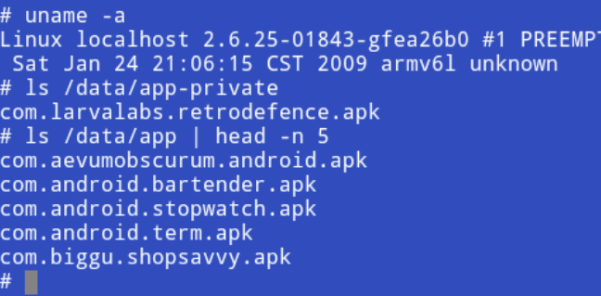
Android Market
Offers opt-in copy protection for apps
Off?
App stored in /data/app
Readable to user
On?
App stored /data/app-private
Unreadable to user
Notes:
Can you see a problem with this? (From Oberheide’s presentation)

Slide 16
Android Market Exploit
Buy app on developer phone (ADP1)
Use root access to copy apk off the device
Post apk online
Ask for refund within 24 hours
Protection is system-level, not app-level
3rd party protections filling the gap
SlideLock
Links with app
Phones home with unique ID of phone

Slide 17
Bypassing the SDK
Static compilation
Use provided gcc ARM cross-compiler with –static
Dynamic linking
Android uses a non-standard libc, bionic
Mostly BSD with Linux threads, processes, and signals
Use ‘agcc’ wrapper to set all the flags you need
Install Debian (!)
Install busybox
Set up mountpoints on /sdcard
Run debootstrap

Slide 18
Debugging
adb, Android Debug Bridge
Push/pull files, forward network ports, poll state
Issue arbitrary shell commands, adb shell
Control/manipulate emulator instances
DDMS, Dalvik Debug Monitor Service
Java debugger, exposed in Eclipse
logcat, collects system debug output
Native: gdb, IDA 5.4 with gdbserver module

Slide 19
Jailbreaking
Grab OTA update files exposed online
android.clients.google.com/updates/
Put RC29 on SD card as update.zip
Reboot with Home+End keys
Alt+S to install firmware
Exploit local privilege escalation vulnerability
Re-flash with developer image

Slide 20
Reality Check
Jailbreak phones: Check
Steal apps from Market: Check
Install arbitrary applications: Check
Steal user data: … wait a few more slides ☺

Slide 21
Threats to Applications
Some things you can screw up…
Passive credential snarfing
Wifi + non-HTTPS web service = 0wned
Active MITM
Wifi + HTTPS login + HTTP data = 0wned
Wifi + non-HTTPS update check = 0wned

Slide 22
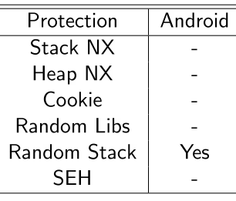
Exploiting Android
All apps are written in Java, aren’t we safe?
VM built on many C/C++ libraries
APIs commonly pass data to C/C++ daemons
Multi-media, image, compression, crypto, doc parsing
Browser HTML, Javascript, XML, WebServices parsers
Source code available!
What about Sandboxing?
User data is exposed after 1 exploit
Root requires 2nd priv escalation
Browser is native code (webkit)
Notes:
From Charlie’s presentation

Slide 23
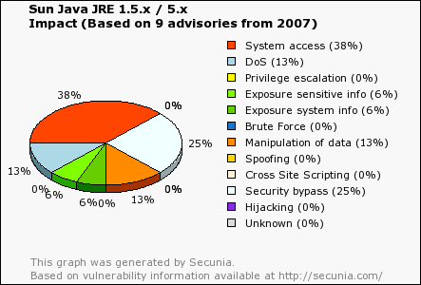
Interpreter Bugs
No one has ever found a bug in a VM before!
Notes:
Just thought I should mention this

Slide 24
Finding More Bugs
“Changelogging”
Find an OSS library Android uses
Find a recent security bug in it
Done.
Fuzzing
logcat catches crash information
adb can launch and control apps from CLI

Slide 25
Research Opportunities
Audit the available source code (Fortify?)
Build a fuzzing harness on top of the emulator
Decompile .dex back to .class or to source
IDA scripts for exploit-development
Trojan Apps
Do they already exist?
How would we make one?

Slide 26

Issues not discussed
Exercises for the reader
How does Android do OTA updates?
How does Android authenticate to the Market?
Can you do it with a regular web browser?
Where does Android store my Google password?
Further, where should my app store its passwords?
How would you write an Android rootkit?
How do you secure a platform where 50,000 Android users install Fartdroid?

Slide 27
Appendix
Pulling a John Connor: Defeating Android
Charlie Miller, ShmooCon 2009
The Smart-Phones Security Nightmare
Sergio ‘shadown’ Alvarez, CanSecWest 2009
Smartphone (in) Security
Ortega & Economou, CanSecWest 2009
Google’s Android Platform
Jon Oberheide, CanSecWest 2009

Slide 28
Appendix
Dalvik Virtual Machine Internals
Dan Bornstein, Google I/O 2008
Debian & Android Together on G1
Jay Freeman, saurik.com/id/10
Updated Dex File Format
Tim Strazzere, strazzere.com/blog/?p=104

