Slide 1
Georgia’s Race to the Top Grant
Teresa MacCartney
Deputy Superintendent for RT3 Implementation

Slide 2
Broad Statewide Impact
26 LEAs represent a very diverse mix of districts ranging from small to very large systems, from urban to rural, with wide representation from across the state:
Atlanta, Ben Hill, Bibb, Burke, Carrolton, Chatham, Cherokee, Clayton, Dade, DeKalb, Dougherty, Gainesville, Gwinnett, Hall, Henry, Meriwether, Muscogee, Peach, Pulaski, Rabun, Richmond, Rockdale, Spalding, Treutlen, Valdosta and White.
Represent 884 schools (39%), 668K students (41%), and 47K teachers (40% of all teachers).
Among the students are over 420K students in poverty (46%), 330K African-American students (53%), and 90K Hispanic students (48%)

Slide 3
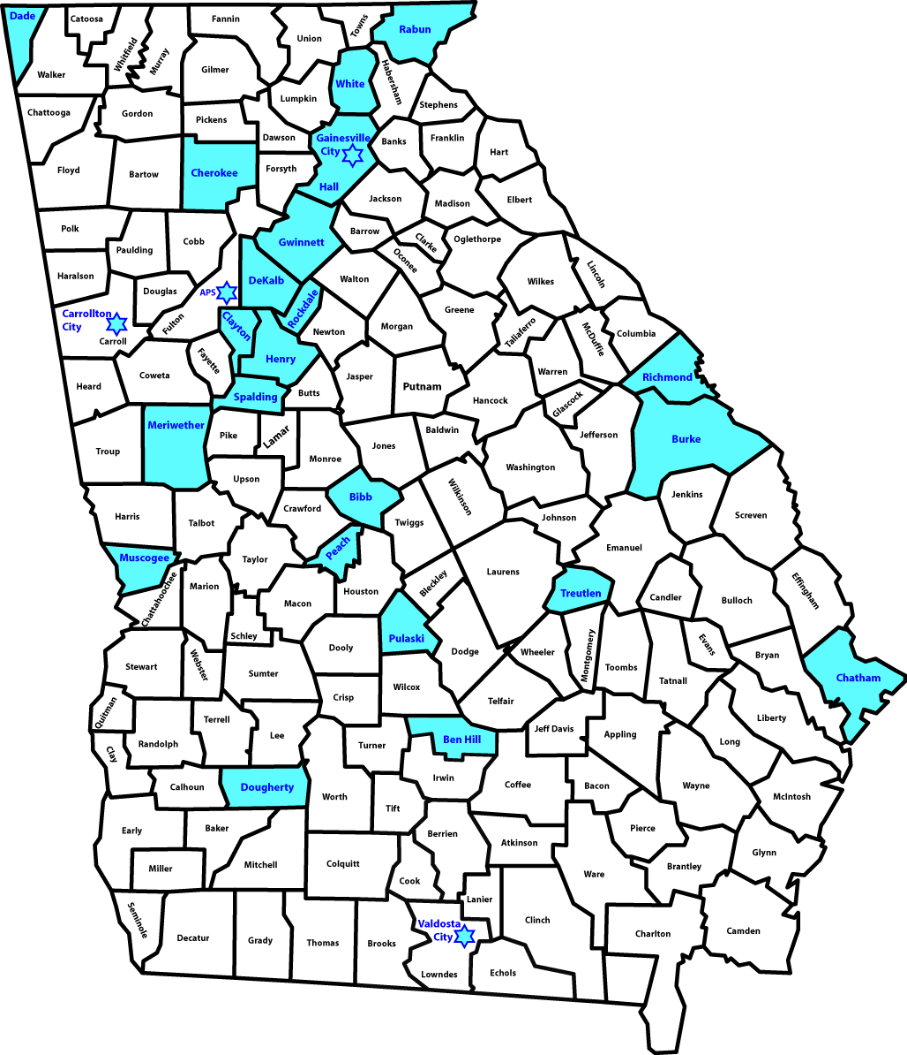
Broad Statewide Impact

Slide 4
4 Education Reform Areas
Recruiting, preparing, rewarding, and retaining effective teachers and principals, especially where they are needed most; and
Adopting standards and assessments that prepare students to succeed in college and the workplace and to compete in the global economy;
Building data systems that measure student growth and success, and inform teachers and principals about how they can improve instruction;
Turning around our lowest-achieving schools.
Notes:
The Common Core State Standards Initiative (CCSS) is a state-led process to develop common standards in English-Language Arts and Mathematics for grades K-12 which are internationally benchmarked and aligned to college and work expectations.
The state will provide face-to-face training to teachers on the CCGPS through regional meetings and will develop new formative and benchmark assessments to provide teachers with critical feedback
Seamless access to robust and comprehensive data on student and teacher performance represents a foundational element of GA’s reform agenda.
Longitudinal data across the P-20 pipeline is critical to ensure that the state has appropriate information available to support core policy decisions and ongoing operational improvement.
Georgia will employ one of the four intervention models below turning around the state’s lowest achieving schools:
Turnaround (replace principal and remove 50% of staff)
Charter/EMO Conversion
School closure
Transformation (combination of aforementioned strategies)

Slide 5
GaDOE RT3 Structure
Martha Reichrath
Standards and Assessments
Teresa MacCartney
Implementation
Sylvia Hooker
Avis King
Great Teachers and Leaders
Lowest Achieving Schools
Superintendent Dr. John Barge
Bob Swiggum
Data Projects

Slide 6
Standards and Assessments
The Common Core State Standards Initiative (CCSS) is a state-led process to develop common standards in English-Language Arts and Mathematics for grades K-12 which are internationally benchmarked and aligned to college and work expectations.
Georgia served as a leader in this work and the State Board of Education adopted the Common Core Georgia Performance Standards (CCGPS) in July.
Through Race to the Top, the state will provide face-to-face training to teachers on the CCGPS through regional meetings.
Training will be provided to all districts.
Notes:
Georgia is a member of the PARRC Consortia to develop a common assessment aligned to the Common Core State Standards (CCSS).
These new assessments will be available to all states in the 2014-2015 school year and will allow the state to measure the “college and career readiness” of Georgia students compared to their peers across the nation and globe.

Slide 7
Standards and Assessments
Georgia is a governing member of the PARRC Consortia to develop a common assessment aligned to the Common Core State Standards (CCSS).
These new assessments will be available to all states in the 2014-2015 school year and will allow the state to measure the “college and career readiness” of Georgia students compared to their peers across the nation and globe.
Notes:
Georgia is a member of the PARRC Consortia to develop a common assessment aligned to the Common Core State Standards (CCSS).
These new assessments will be available to all states in the 2014-2015 school year and will allow the state to measure the “college and career readiness” of Georgia students compared to their peers across the nation and globe.

Slide 8
Standards and Assessments
Create new formative assessment test items
The state will contract, through a competitive bid process, with a vendor to produce additional test items for placement within the state’s Online Assessment System.
Create new benchmark assessment test items
The state will contract, through a competitive bid process, with a vendor to produce benchmark assessments.
Notes:
Also provide every high school student with one free PSAT opportunity.

Slide 9
Data Systems to Improve Instruction
Design, develop and implement a P-20 system to electronically link educational information.
Longitudinal data across the P-20 pipeline is critical to ensure that the state has appropriate information available to support core policy decisions and ongoing operational improvement.

Slide 10
Turning Around Our Lowest Achieving Schools
Georgia will employ one of the four intervention models below, as prescribed through Race to the Top, in turning around the state’s lowest achieving schools:
Turnaround (replace principal and remove 50% of staff)
Education Management Organizations (EMOs) and Charter Management Organizations (CMOs).
School closure
Transformation (combination of aforementioned strategies)

Slide 11
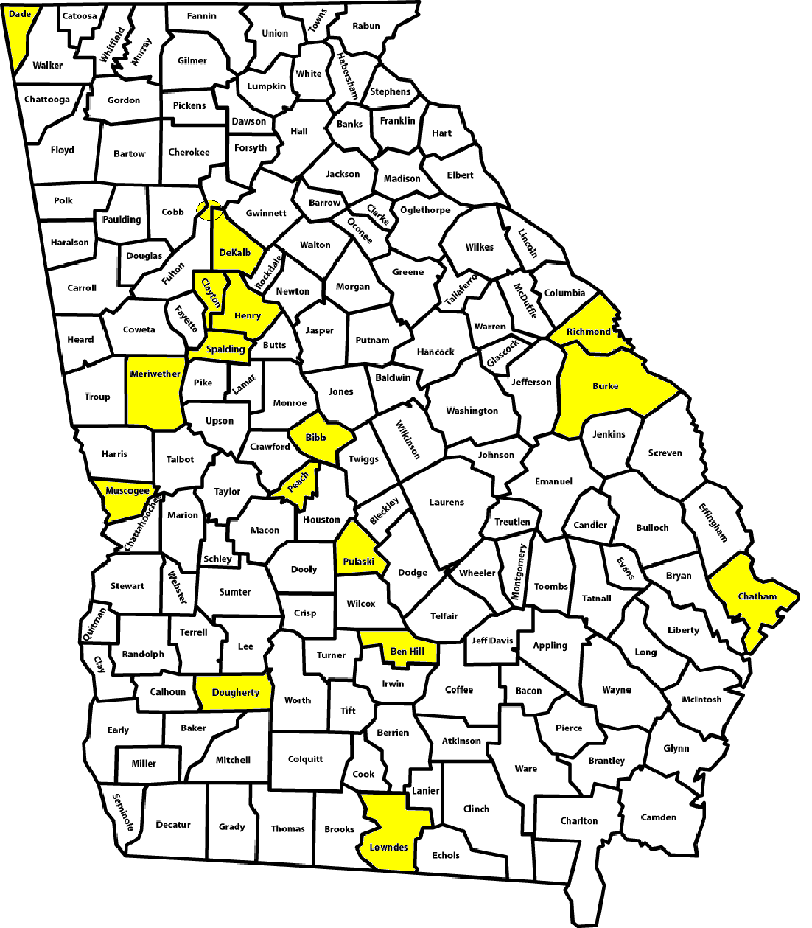
Lowest Achieving Schools

Slide 12
Participating LEAs with schools that have been identified as lowest achieving schools will:
Utilize resources made available through RT3 plan to turn around lowest achieving schools
Agree to review of existing resource allocations in the 1st year of the turnaround plan to ensure that existing resources are being used for maximum impact & financial sustainability of any new programs
Allow for a diagnostic to be performed by a State’s “turnaround experts” to determine the most appropriate of the four turnaround models
Maintain/place a high-performing principal at a low-performing school w/control over staffing/budget
Pursue meaningful partnerships to advance applied learning opportunities
Optimize use of existing time for all students and increase learning time for those students or student subgroups that need additional time
Commit at least one full-time graduation coach at the high school level & one full-time math coach per school
Commit to focus on the feeder schools of the lowest achieving schools.

Slide 13
Great Teachers and Leaders

Slide 14
Effectiveness Measures
To align Georgia’s evaluation system with the state’s primary goal of student learning, Georgia will create a single:
Teacher Effectiveness Measure (TEM),
Leader Effectiveness Measure (LEM) (for school building leaders—principals and assistant principals), and
District Effectiveness Measure (DEM).

Slide 15
System-wide Approach to Effectiveness and Accountability
State
Leader Effectiveness Measure
(LEM)
Teacher Effectiveness Measure
(TEM)
District Effectiveness Measure
(DEM)
Creates and implements polices in collaboration with Partners (standards, assessments, educator certification requirements, AYP, etc.)
Monitors students’ achievement across districts
Provides support in the form of funding, professional development, and other services
Implements state and district polices
Responsible for student achievement across schools
Provides support to school leaders through district’s central office functions (recruiting, hiring, professional development)
Provides instructional leadership and manages school operations
Responsible for school-wide performance
Evaluates teachers and ensures that they have appropriate professional development supports to achieve full potential
Provides instruction to students, teaching to CCGPS and using data to modify instruction
Responsible for student learning and achievement
Notes:
Accountability at each step of the system-wide effectiveness measurement system must be accompanied by appropriate levels of support.

Slide 16
System-wide Approach to Effectiveness and Accountability
State
School Leaders
Teachers
Teacher and Leader Preparation Program Effective Measure
(TPPEM and LPPEM)
Provides funding and appropriate regulations
TPPs and LPPs prepare teacher candidates for the profession of teaching in K-12 classrooms, and prepare building level administrators to lead schools and develop teachers
Graduate teacher candidates who have the content and pedagogy skills to be successful in boosting student learning
Graduate building level administrators who have the leadership and management skills to change culture, motivate staff, increase student learning, and manage schools in fiscally responsible way
May provide support to graduates in various ways (professional development, mentorships, etc.)
Notes:
Accountability at each step of the system-wide effectiveness measurement system must be accompanied by appropriate levels of support.
The state will use TEMs and LEMs to guide broader policy decisions, tying results back to Teacher and Leadership Preparation Programs to ensure the effectiveness of the state’s educator preparation programs.

Slide 17
Four components of TEMs and LEMs:
Class Keys and Leader Keys: Qualitative, rubric‐based evaluation tool with multiple rating categories to give educators constructive feedback as opposed to the current satisfactory v. unsatisfactory rating.
Evaluation not subject to open records (Code Section: 20-2-210)
Notes:
-Started field study in 08-09 school year. (55 systems, 176 schools)
-09-10 expanded to 71 systems and 597 schools
-10-11 up to 85 systems and 756 schools (129 implemented and 627 preparation to implement)
5 RT3 systems have implemented – 10 in preparation to implement
20-2-210 "All personnel employed by local units of administration, including school superintendents, shall have their performance evaluated annually by appropriately trained evaluators. All such performance evaluation records shall be part of the personnel evaluation file and shall be confidential.".

Slide 18
Four components of TEMs and LEMs:
Growth/Value‐added Model
Accommodate students with missing test scores
Use all test data in grades and subjects for each student in the analyses
Not require that test scores be vertically linked
Accommodate different classroom practices such as team-teaching and self-contained classroom
Based on full academic year (FAY) students
Notes:
This meeting is to focus on the value-added component.
Georgia will contract with a value‐added provider to develop a statewide value‐added model (VAM) to calculate value‐added scores at the teacher level. VAMs are a collection of complex statistical techniques that use multiple years of students’ test score data to estimate the effects of individual schools or teachers on student learning. These scores will be calculated based on standardized tests currently available in Georgia, such as Criterion Referenced Competency Tests (CRCTs) in Reading, English‐Language Arts, Mathematics, Social Studies and Science for grades 1‐8 and End of Course Tests (EOCTs) in high school courses.
Only teachers in tested subjects (about 30% of teachers) will have value‐added scores. Georgia does not plan to create new summative tests in non‐core subjects.
The state will develop measures to assess student engagement and achievement.

Slide 19
Four components of TEMs and LEMs:
Reduction in the student achievement gap at the classroom/student roster level for teachers and the school level for principals
Difference in achievement between any student subgroup (n > 15) in a given teacher’s classroom and the highest performing subgroup in the State (based on aggregated performance, by student subgroup, at the State level).

Slide 20
Four components of TEMs and LEMs:
Other quantitative measures, to be developed, tested and evaluated by the state in collaboration with participating LEAs.
Student, parent and peer surveys

Slide 21
Teacher Effectiveness Measure
(TEM)
Qualitative (Rubrics-based) Evaluation
30% Core
60% Non-Core
Class-level Value –Added/Growth Score
50% Core
0% Non-Core
Other Quantitative Measures
10% Core
40% Non-Core
Student Achievement Gap Reduction
10% Core
0% Non-Core
Evaluation tool with multiple rating categories and based on a number of inputs (peer and principal observations, informal walk-throughs, teacher artifacts)
Measure student growth in tested areas school-wide
Measure gap reduction over a year
Student surveys (starting in grade 4)
Parent surveys in grades K-3
Peer surveys/ratings
Other quantitative measures that are rigorous and comparable across classroom

Slide 22
Leader Effectiveness Measure
(LEM)
Qualitative (Rubrics-based) Evaluation
20%
School-wide Value –Added/Growth Score
50%
Governance and Leadership
10%
School-wide Student Achievement Gap Reduction
20%
Evaluation tool with multiple rating categories and based on a number of inputs (e.g., quality of school improvement plan; student, staff and parental feedback)
Measure student growth in tested areas school-wide
Student graduation rate (HS)
Measure student achievement gap reduction over a year
Climate surveys measuring school working conditions
Student attendance (E/M/H)
Retention of effective teachers

Slide 23
Performance ‐Based Talent Management
TEM/LEM will be used to inform all talent management decisions:
Professional development
Compensation
Pilot merit pay in school year 2013-2014 (opt in system for current teachers)
Promotion
Retention
Recertification
Interventions
Dismissals
Notes:
• Salary schedule step increases will be tied to performance for all teachers and leaders
• Georgia will make career ladder opportunities available for all teachers (Master Teachers and Teacher Leaders)‐‐allowing teachers to take on additional responsibilities for additional pay, while remaining in the classroom
• Award individual performance salary increases to all teachers on the basis of TEM and all school leaders on the basis of LEM to recruit, reward and retain Georgia’s most
effective educators
• To attract effective teachers to the state’s lowest performing schools, additional bonuses will be available to core teachers in high needs schools if they reduce the achievement gap
• Georgia will create an Induction Certificate (3‐year, non‐renewable certificate for those who have completed an initial prep program or who have been accepted into a GaTAPP program) and teachers must reach a threshold TEM by the end of his or her third year to advance to a career teacher certificate
• Teachers must achieve a required threshold TEM to be recertified every five years

Slide 24
Performance ‐Based Talent Management
 | Induction Certification Teacher | Career Certification Teacher
Promotion | A teacher who reaches a threshold TEM by the end of his/her third year is eligible for a Career Certificate. | If a Career Teacher’s average TEM (e.g., over the last two years of teaching) is above the threshold, the teacher will be able to renew his/her certification.
Dismissal | A teacher who does not reach a threshold TEM by the end of his/her third year will not be able to advance to the Career Teacher Certification level. | If a Career Teacher’s average TEM is below the threshold, the teacher will become ineligible for recertification and will therefore not be able to continue teaching. If the TEM is “borderline”, the teacher will be placed on a one-year probation and given the opportunity to improve his/her TEM with supports provided by the school and district.
Retention | Tracking teachers’ TEM will allow principals and districts leadership to identify rising stars and invest in the retention of these teachers. | Tracking teachers’ TEM over the course of their careers will allow principals and district leadership to identify teachers who are high performers and invest in the retention of these teachers.

Slide 25
District Effectiveness Measure
(DEM)
District-wide Value-Added/Growth Score
40%
District-wide Student Achievement Gap Reduction
20%
Governance and Leadership
20%
College and Career Readiness Assessment
20%
Measures student growth in tested areas district-wide
Measure gap reduction over a year
Measures the percent of NI schools in the district (out of all schools in the system)
Percentage of the district’s high school graduates that enroll in postsecondary somewhere in the country.
High School graduation rate
Measures district’s success, relative to other districts, in developing effective leaders and teachers
Climate surveys measuring overall environment and working conditions in districts
Accreditation standing
Operational excellence (e.g., audit results)

Slide 26
Teacher Preparation Program Effectiveness Measure
(TPPEM)
Student Achievement
50%
Success Rates of Induction Certificate Teachers
20%
Persistence of Teachers
10%
Content Knowledge
20%
Overall student achievement of graduates, as measured by TEM scores of graduates
(Aggregated by each graduating teacher cohort)
Percentage of teachers who “graduate” from the Induction Certificate to the Career Certificate
Overall GACE scores on content tests
(Aggregated by each graduating teacher cohort)
Retention rate of graduates in the first 3 years of teaching (percentage who are still teaching by end of third year)
(Aggregated by each graduating teacher cohort)

Slide 27
Leader Preparation Program Effectiveness Measure
(LPPEM)
Student Achievement
50%
Talent Development
30%
Persistence of Principals
10%
Content Knowledge
10%
Overall student achievement of graduates, as measured by LEM scores of graduates
(Aggregated by each graduating leader cohort)
Overall TEM scores, aggregated for teachers in the leader’s school
(Aggregated by each graduating leader cohort)
Overall GACE scores on Leadership Assessment
(Aggregated by each graduating leader cohort)
Percentage of graduates who are still in the k-12 system in leadership positions by the end of their third year (at the building or district office level) – not necessarily in the same district
(Aggregated by each graduating leader cohort)

Slide 28
Other RT3 Projects

Slide 29
Innovation Fund
Innovation Fund will provide seed money to:
Support student learning
Increase the teacher and principal pipeline in high needs subjects and geographic areas
Provide quality induction to retain and further develop highly effective teachers and leaders
STEM Charters
ALL districts will be eligible.

Slide 30
Partners
UTeach to strengthen pipeline of math and science teachers from higher education institutions.
Teach for America
New Teacher Project
CEISMC to provide professional development of existing math and science teachers.
Summer Leadership Academy
Quality Plus Leadership Academy
Community in Schools

Slide 31
Department of Education RT3 Contacts
Teresa MacCartney – Deputy Superintendent for RT3 Implementation
tmaccartney@gadoe.org
404-656-7552
Jon Rogers – RT3 Communications Director
jonrogers@gadoe.org
404-357-7661
Kathie Wood – Teacher Lead Advisor
kwood@gadoe.org
404-772-1645

