Slide 1
The CACTVS Chemoinformatics Toolkit: Universal Tcl Scripting for Chemistry
Wolf D. Ihlenfeldt
wdi@xemistry.com
Washington, Aug 2009
Notes:
Company contact information:
Xemistry GmbH
Hainholzweg 11
D-61462 Königstein/Germany
www.xemistry.com

Slide 2
A Simple Everyday Project
Process large structure file
Filter compounds in file
Use canonic tautomer
Compute descriptors
Write out data table
Perform QSAR
… but there shall be some complications requiring a custom solution.
… and yes, this involves scripting in Tcl.
Notes:
This talk is structured as follows:
Define a typical problem with some scaling problems
Introduce the scripting language elements of the Cactvs toolkit which can be used to address the various subtasks inherent in the problem
Wrap up a sample solution in a couple of scripts with increasing levels of sophistication to make effective use of multi-threaded and server-farm CPU resources

Slide 3
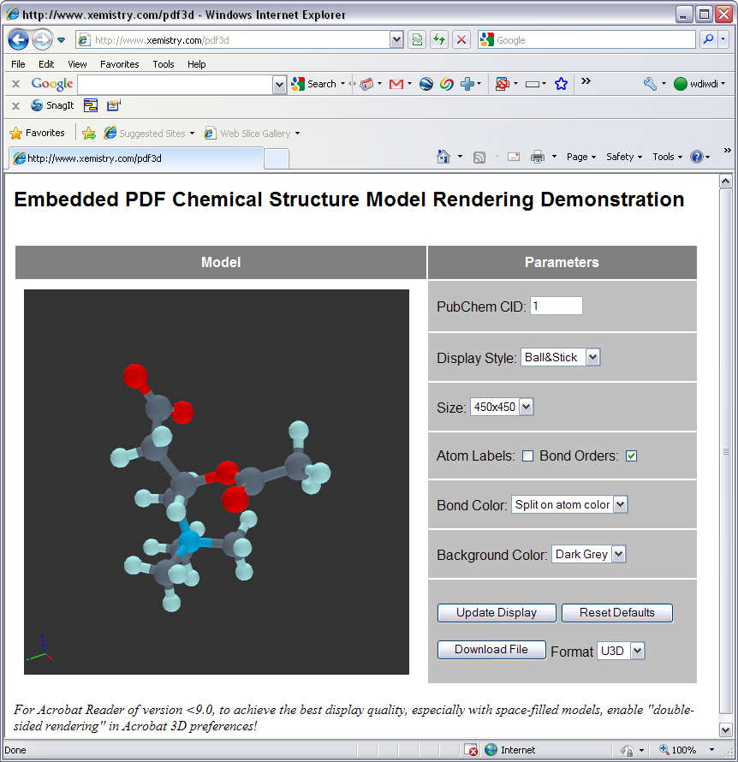
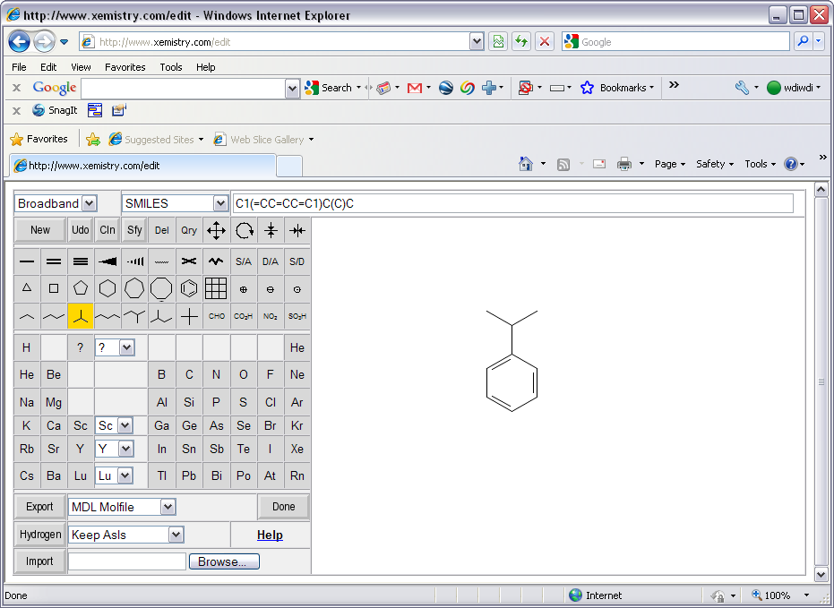
No Pretty Pictures in this Lecture!
Notes:
The Cactvs toolkit can be used to implement graphical tools, both for Web sites (two examples are presented as screen shots, the successor of the PubChem WebSketcher, and a prototype of an interactive 3D PDF structure model image generator ) and for applications with GUI elements, this is not what we will be concentrating on today.
In this talk, we dig deep into the scripting facilities for batch processing, which is a central application area for the toolkit. You will need to parse code. You have been warned.
Still, you should be told that the toolkit indeed does have extensive features designed to facilitate the implementation of Web application, and can use the Tk toolkit for the development of platform-independent GUI tools.

Slide 4
cactvs>ens create
ens0
cactvs>ens create C=C(O)C
ens1
cactvs>ens create 2048
ens2
cactvs>ens create Viagra
ens3
cactvs>reaction create c1ccccc1>>C1CCCCC1
reaction0
cactvs>dataset create [ens list]
dataset1
cactvs>network create
network0
Notes:
These few lines of code show how to create some objects.
The toolkit is centered around chemistry-aware objects. The most important ones are structures (ensembles), reactions, datasets, networks, tables and structure files.
Every major object has a handle, which is the primary method to address an object in a script. Some objects have sub-objects, for example, ensembles have atoms, bonds, rings, molecules, etc., but these cannot exist outside the context of a major object. Other major objects can contain major objects, for example datasets can store an ordered list of ensembles, reactions or tables.
Some object creation methods are quite advanced. For example, ensembles can be created empty, from SMILES/SMARTS string or another linear notation, a packed serialized object representation, a compact database representation (Minimol), a PubChem CID (by contacting PubChem), a compound name (via name lookup at the LMCh Internet service) or a CAS number (ditto).

Slide 5
cactvs>ens create c1ncccc1
ens0
cactvs>ens props ens0
A_TYPE A_LABEL A_ELEMENT A_FORMAL_CHARGE A_IMPLICIT A_RING_COUNT A_FRAMEWORK A_IUPAC_GROUP A_FREE_ELECTRONS A_SHELL_ELECTRONS A_RINGHASH A_PSE_ROW A_POSS_STEREO A_TERMINAL_DISTANCE A_HASH A_RING_SIZE_BITS A_MOL_NUMBER A_HCOUNT A_BRIDGEHEAD A_VERTEX_DEGREE B_TYPE B_ORDER B_LABEL B_POSS_STEREO B_RING_COUNT B_RINGS E_NMOLECULES E_SMILES R_TYPE R_LABEL R_SIZE
cactvs>ens get ens0 A_ELEMENT
6 7 6 6 6 6 1 1 1 1 1
cactvs>ens get ens0 A_LABEL
1 2 3 4 5 6 7 8 9 10 11
cactvs>atom get ens0 2 A_SYMBOL
N
cactvs>ens get ens0 E_WEIGHT
79.1012
cactvs>ens props ens0
A_TYPE A_LABEL A_ELEMENT A_FORMAL_CHARGE A_SYMBOL A_WEIGHT A_IMPLICIT A_RING_COUNT A_FRAMEWORK A_IUPAC_GROUP A_FREE_ELECTRONS A_SHELL_ELECTRONS A_RINGHASH A_PSE_ROW A_POSS_STEREO A_TERMINAL_DISTANCE A_HASH A_RING_SIZE_BITS A_MOL_NUMBER A_HCOUNT A_BRIDGEHEAD A_VERTEX_DEGREE B_TYPE B_ORDER B_LABEL B_POSS_STEREO B_RING_COUNT B_RINGS E_NMOLECULES E_SMILES E_WEIGHT R_TYPE R_LABEL R_SIZE
Notes:
Every object can posses an arbitrary number of properties, both predefined or defined on the fly. The standard distribution comes with several hundred predefined properties.
Computation of properties via a “get” command is performed in a lazy fashion. If the data is already present, it is just returned. Otherwise, an attempt is made to find methods to compute the requested information from what information is already available. This is a recursive process, so when one property is requested, many more may actually be computed. In any case, the user does not need to care about any data preparation for methods, or computational sequences – this is all automatically handled by the system. Property and computation method lookup can be non-local – the search patch can contain centralized or even Internet-repositories.
Sub-objects such as atoms are addressed by a combination of the major object handle, and (in standard cases) a value of the minor object label property (A_LABEL for atoms).
Internally, the object handles are not necessarily strings, or minor object labels integers, though they can be used or provided as such. Using the Tcl object extension mechanism, these are optimized to contain direct references, so that no handle decoding is performed if the identifiers are passed in scripts.

Slide 6

cactvs>ens get ens0 E_NAMESET
Pyridine PYRIDINE-RING 110-86-1 Azabenzene C00747 152758-95-7 163392-20-9 45410-39-7 62301-32-0 6999-00-4 82005-06-9 85404-19-9 85404-20-2 AI3-01240 Azine {CCRIS 2926} {CP 32} {Caswell No. 717} {EINECS 203-809-9} {EPA Pesticide Chemical Code 069202} {FEMA No. 2966} {FEMA Number 2966} {HSDB 118} NCI-C55301 {NSC 406123} {Piridina [Italian]} {Pirydyna [Polish]} {Pyridin [German]} {Pyridine [UN1282] [Flammable liquid]} {RCRA waste no. U196} {RCRA waste number U196} UN1282 ST5214494 NCGC00091476-01 02486_FLUKA 184527_ALDRICH 270407_ALDRICH 270970_ALDRICH 33638_RIEDEL 34945_RIEDEL 360570_SIAL 494410_ALDRICH 676772_SIAL 82702_FLUKA 82704_FLUKA P57506_SIAL W296600_ALDRICH NSC406123 Piridina Pirydyna Pyridin {WLN: T6NJ} CHEBI:16227 py NSC141574 NCI60_006101 NCIOpen2_002809 NCIOpen2_007786 NCIOpen2_007866 NCIOpen2_007986 NCIOpen2_007999 ZINC00895354
cactvs>ens get ens0 E_CAS
110-86-1
cactvs>ens create 110-86-1
ens1
cactvs> prop setparam E_GIF bgcolor black bondcolor white atomcolor white
cactvs>ens get ens1 E_GIF
/tmp/wb000km4yNS.gif
Notes:
The toolkit provides a collection of hook-ups with useful Internet services, as demonstrated here for compound name and CAS number lookups. These implicit lookups are tightly controlled in commercial versions, and disabled by default if using the service would require the sending of a connection table.
Many of the properties defined by the toolkit are computable, for example a broad set of image formats (GIF, PNG, PICT, EMF, WMF, SVG, PDF, SWF, EPS, MIF) on all platforms. Computable properties allow the specification of parameters, and this parameter set is stored as metadata with the actual property data. Parameter sets are thread-specific, so multiple threads can compute different variants of a property in parallel.
The toolkit supports an extensive set of data types for properties, and this set can even be dynamically expanded by loading type handler modules. Besides standard types such as integers, doubles, strings, booleans etc. there are disk files (as for the GIF image), in-memory blobs, vectors of various types, matrices and volumes of various types, keyword/value dictionaries, date and time, colors, variants, enumerated values, Unicode strings, numbers with uncertainty ranges, generic data trees, compound properties with multiple fields of different types, and even recursive properties where fields are of a complex type defined by another property.

Slide 7
cactvs>ens get ens1 E_NHACCEPTORS
1
cactvs>prop get E_NHACCEPTORS functiontype
tclscript
cactvs>prop get E_NHACCEPTORS interpreter
e_nhacceptors
cactvs>interp slaves
e_xlogp2 e_nameset e_inputdate b_delta_pi_charge b_delta_pi_electronegativity e_sort_name m_stereo_tauto_hash e_nhacceptors e_isotope_tauto_hash b_delta_total_charge e_changedate a_nh2_count a_hydrogen_bonding e_sort_formula b_delta_sigma_charge b_delta_sigma_electronegativity m_tauto_hash e_isotope_stereo_tauto_hash
cactvs>ens show ens1 A_HYDROGEN_BONDING
none none none none none basic none none none none none
Notes:
The computation function of a property can implemented in various variants, for example as dynamically loaded shared object/DLL, a network connection to a synchronous or asynchronous compute server, or as embedded Tcl script.
The code of these embedded Tcl scripts is executed in individual slave interpreters which are linked to the main interpreter, but have restricted access rights to the global system. Code running in these slaves cannot clobber any data in the main interpreter or another slave, but they can still easily maintain, for example, persistent per-property information in global variables. Tcl interpreters are lightweight and instantiated automatically when required. It is not unusual to have a dozen slave interpreters in applications without doing anything special. The command set accessible to slave interpreters can be restricted, so that they can be run in a sandbox without, for example, Internet and file system access, which may be useful for testing un-trusted properties and associated methods.
Every main Tcl interpreter thread has an independent set of property function slaves. In the fourth example in this talk, we are, without really noticing, juggling about one hundred interpreters!

Slide 8
NAME E_NHACCEPTORS
AUTHOR "Wolf-D. Ihlenfeldt"
EMAIL wdi@xemistry.com
VERSION 1.0
DATE "Apr 8 01:13:23 1999“
DESCRIPTION "Number of hydrogen bond acceptors"
MENUNAME #HAcceptors
MAGIC -1
DEFAULT 0
DATATYPE P_INT
INVALIDATION INVAL_ATOMCHANGE|INVAL_BONDCHANGE
DEPENDS A_HYDROGEN_BONDING
ATTACHMENT P_ENS
FLAGS TRUSTED|PORTABLE|EXPORT
FUNCTYPE PF_TCLSCRIPT
FUNCNAME CSgetE_NHACCEPTORS 1
proc CSgetE_NHACCEPTORS { ehandle } {
set cnt 0
foreach astatus [ens get $ehandle A_HYDROGEN_BONDING] {
if {$astatus=="acceptor" || $astatus=="basic"} {
incr cnt
}
}
ens set $ehandle E_NHACCEPTORS $cnt
}
LOGMODE DONTCARE
NAMESPACE .xemistry.com
Notes:
This is a short excerpt from the property definition file for property E_NHACCEPTORS which contains an embedded Tcl function.
Note the lines which indicate what the conditions are when the property data becomes invalid. In this example, these are generic atom and bond changes, as well as implicitly any change in the value of property A_HYDROGEN_BONDING. Whenever the structure is modified by, for example, deleting an atom or bond, or changing it, the property is automatically dropped from the ensemble data collection. Also, changing any value of property A_HYDROGEN_BONDING on the ensemble has the same effect. By this maintenance mechanism the data content of objects remains always valid. Script writers do not need to care about information invalidation and cleanup. If during the processing of a script E_NHACCEPTORS is again accessed, it (and potentially A_HYDROGEN_BONDING, and potentially its input data, etc.) is automatically recomputed.
Property definitions are loaded automatically when a property whose name is not yet known to the application. The search path is configurable.
In some instances, when a property definition cannot be located, the system will automatically synthesize a minimal definition. For example, all data fields are always read from an SD file – into standard properties if they can be found, into synthetic properties if not.

Slide 9
cactvs>llength [ens get ens1 E_DESCRIPTORS]
777
cactvs>prop get E_DESCRIPTORS datatype
floatvector
cactvs>lrange [ens get ens1 E_DESCRIPTORS] 200 209
6.204196 6.889908 2.510523 2.46225 1.218234 0.810955 0.477246 0.382773 0.193117 0.144838
cactvs>lrange [prop get E_DESCRIPTORS fields] 200 209
{D201 float} {D202 float} {D203 float} {D204 float} {D205 float} {D206 float} {D207 float} {D208 float} {D209 float} {D210 float}
cactvs>prop get E_DESCRIPTORS literature
J. Chem. Inf. Model., 2008, 48 (7), pp 1337-1344
cactvs>prop get E_DESCRIPTORS comment
These are the original MOLD2 descriptors
Notes:
This slide describes the computation of a topological descriptor set.
The toolkit contains a wrapper for the MOLD2 descriptor computation library. Information about the origin of such methods is part of the property definition. For this property, the implementation is a shared library which directly includes the original code. The rather basic I/O routines of the normal MOLD2 stand-alone executable are bypassed and its internal data structures are directly initialized.
If this kind of approach is not possible, it is still a simple task to link any external executable into the property system by writing a suitable Tcl function which starts the program, sets control parameters, provides suitable input, parses the output and attaches the results as normal object property data. Once such a wrapper has been set up, the property can be used in a completely transparent fashion.
The data type of E_DESCRIPTOR is a rather large floating point vector. Individual elements of this vector can be addressed using the original MOLD2 nomenclature.
This data will later be inserted into a table object. The column data types of the toolkit tables can be of any type the property system supports, including vector types. However, most table file formats do not support vectors. When writing the table, we will perform a flattening operation which will output 777 floating point columns instead of the initial single vector column.

Slide 10
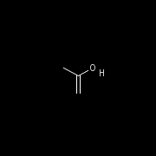

cactvs>ens create C=C(O)C
ens0
cactvs>ens get ens5 E_GIF
/tmp/wb000PnKpZc.gif
cactvs>ens get ens0 E_HASHISY
B70501D3EB42D440
cactvs>ens get ens0 E_TAUTOSET
dataset1
cactvs>dataset ens dataset1
ens3 ens4
cactvs>dataset get dataset1 E_HASHISY
B70501D3EB42D440 360E57580AC41A49
cactvs>dataset get dataset1 E_TAUTOMER_SCORE
1 5
cactvs>ens get ens0 E_CANONIC_TAUTOMER
ens5
cactvs>ens get ens5 E_HASHISY
360E57580AC41A49
Notes:
Transformations of structures are also conveniently implemented as properties. The toolkit fully supports SMIRKS transformations. The generation of tautomers is internally handled by a collection of SMIRKS transforms that are exhaustively applied to the growing result set, until no new structures can be found, or some other limit like the maximum number of operations has been reached.
Structural identify is most conveniently checked by a set of very reliable hashcodes. The E_HASHISY isotope- and stereo-aware ensemble hash code is, for example, the primary key for the PubChem database.
The canonic tautomer is selected by computing a score for the structures in the tautomer set. Ties are broken with the hash code.
This example shows that the data type of a property can be an object, such as a dataset or ensemble. So the canonic tautomer E_CANONIC_TAUTOMER is a structure which is property data of the base structure, and the tautomer set E_TAUTOSET is a dataset object which is property data of the base structure and contains itself a collection of ensemble objects. These embedded objects can be addressed just like base objects and be the subject of property queries or computations. They disappear when the base object is deleted and have some limitations with regard to independent deletion without the base object, transfer into datasets, etc.

Slide 11
cactvs>molfile open Compound_00000001_00025000.asn.gz
molfile0
cactvs>molfile read molfile0
ens0
cactvs>molfile read molfile0
ens1
cactvs>molfile count molfile0
23059
cactvs>ens props ens0 E_*
E_PUBCHEM_COMPOUND_ID E_CHARGE E_PUBCHEM_COMPOUND_CANONICALIZED E_COMPLEXITY E_NHACCEPTORS E_NHDONORS E_NROTBONDS E_SCREEN E_IUPAC_ALLOWED_NAME E_IUPAC_OECAS_NAME E_IUPAC_PREFERRED_NAME E_IUPAC_SYSTEMATIC_NAME E_IUPAC_TRADITIONAL_NAME E_INCHI E_INCHIKEY E_PUBCHEM_XLOGP3 E_EXACT_MASS E_FORMULA E_WEIGHT E_SMILES E_SMILES/2 E_TPSA E_WEIGHT/2 E_HEAVY_ATOM_COUNT E_STEREO_COUNT E_ISOTOPE_COUNT E_TAUTOMER_COUNT E_NMOLECULES E_FILE E_STDBLE
cactvs>molfile close molfile0
1
Notes:
The toolkit features a large set of I/O modules for dozens of structure and reaction data exchange formats.
In this example, we are reading raw PubChem binary ASN data, which is the recommended format for working with PubChem data because the SD files of PubChem are only approximations of the complete data. The toolkit fully supports the PubChem ASN data structure, including complex points like literature references which are impossible to encode as SD.
File formats are automatically identified – by content, not by file name suffix. This even works on non-rewindable data sources such as Internet connection sockets, pipes and standard input. Additionally, standard wrappers like gzip compression, zip archival, or 16-bit-Unicode encodings are automatically detected and suitable decoder mechanisms inserted. This is the explanation why the sample code directly reads the compressed file without decompression or explicit format specification.
The molfile structure I/O objects are generic and not at all limited to handling MDL or Sybyl Molfiles. The toolkit handles multi-record files, in-memory data blobs, and can even open collections of files of the same or different formats as a virtual multi-record file.

Slide 12
cactvs>molfile open <pubchem>
molfile0
cactvs>molfile read molfile0
ens0
cactvs>ens get ens0 E_CID
1
cactvs>ens props ens0 E_*
E_PUBCHEM_COMPOUND_ID E_CHARGE E_PUBCHEM_COMPOUND_CANONICALIZED E_COMPLEXITY E_NHACCEPTORS E_NHDONORS E_NROTBONDS E_SCREEN E_IUPAC_ALLOWED_NAME E_IUPAC_OECAS_NAME E_IUPAC_PREFERRED_NAME E_IUPAC_SYSTEMATIC_NAME E_IUPAC_TRADITIONAL_NAME E_INCHI E_INCHIKEY E_PUBCHEM_XLOGP3 E_EXACT_MASS E_FORMULA E_WEIGHT E_SMILES E_SMILES/2 E_TPSA E_WEIGHT/2 E_HEAVY_ATOM_COUNT E_STEREO_COUNT E_ISOTOPE_COUNT E_TAUTOMER_COUNT E_NMOLECULES E_FILE E_STDBLE
cactvs>molfile scan molfile0 \
{and
{E_CID <-> {1 25000}}
{E_PUBCHEM_AID_COUNT(active) > 0}
} count
3391
Notes:
File I/O modules are interfaced by means of function tables. With a suitable set of functions, the files does not even need to have a local physical existence, as is shown in this example. The magic name <pubchem> is intercepted and handled by the PubChem access module.
Using this module, PubChem can be accessed, in read-only fashion, in a way which is essentially indistinguishable from reading a large local file.
The real power of this interface however lies in its optimized query functions. The toolkit implements a generic query processing system which can match structures and reactions in any file as well as in in-memory datasets. When processing files, the worst case is that every structure or reaction is actually read and then matched in memory locally. However, I/O modules can provide functions which allow for optimizations. For example, the native toolkit query file formats (cbs and bdb) will use data field indices, bitvector screening, direct field data access and other mechanisms to limit the number of full object retrievals as much as possible.
The PubChem interface can do this as well. The example query above is exclusively executed on the Entrez servers. Note that the test for the number of CIDs with an active assay ID count larger than zero cannot even performed locally because this data is not encoded in the ASN file.

Slide 13
set th [table create]
table addcol $th E_CID
table addcol $th E_SMILES
table addcol $th E_TPSA
table addcol $th E_PUBCHEM_XLOGP3
table addcol $th E_DESCRIPTORS
molfile loop $fh eh {
table addens $th $eh
}
table write $th decriptors_v1.sav sav {flatten 1}
Notes:
The toolkit includes a powerful table object. It can store arbitrary data in its columns and associate rows with chemical objects. While it is possible to define classical column data types independent of property definitions, it is often convenient to directly associate table columns with properties as in this example.
Property data columns are especially handy when data from ensembles or reactions needs to be collected. In that case, the automatic property computation mechanism can be triggered on the objects. In this case, it is not necessary to explicitly compute any data on the ensembles – the column definitions will take care of that.
In the later examples, we still perform some explicit computations and data transfers before filling the table. This is done in order to weed out structures for which crucial data cannot be computed. In direct table transfer, this would result in NULL cells.
Tables can be read and written in many formats. In our example, we use the native SPSS statistics format. Using the native format instead of simple tab-separated text output is advantageous because it preserves the encoding of column data types and names as well as proper handling of NULL (missing) data.
Other supported advanced table formats include Excel xls and xlsx (even with embedded structure images or editable OLE objects), HTML report pages, PDF prints, native PubChem ASN assay data files, SAS xpt files, Stata DTA files, Weka ARFF files, JSON tables and SQLITE containers.

Slide 14

Version 1
molfile scan <pubchem> {and {E_CID <-> {1 25000}} {E_PUBCHEM_AID_COUNT(active) > 0}} {array {E_CID actives}}
set th [table create]
table addcol $th E_CID
…
set fh [molfile open Compound_00000001_00025000.asn.gz]
molfile loop $fh eh {
if {![info exists actives([ens get $eh E_CID])]} continue
if {[ens get $eh E_NMOLECULES]>1||[ens get $eh E_CHARGE]!=0} continue
if {![ens scan $eh {formula = C+H*N*O*S*F*Cl*Br*}]} continue
if {[catch {ens get $eh E_CANONIC_TAUTOMER} eh_canonic]} continue
if {[catch {ens get $eh_canonic E_DESCRIPTORS}]} continue
foreach p [list E_TPSA E_PUBCHEM_XLOGP3 E_CID] {
catch {ens set $eh_canonic $p [ens get $eh $p]}
}
table addens $th $eh_canonic
}
table write $th decriptors_v1.sav sav {flatten 1}
Notes:
This is the first implementation of a script to conquer the sample project. A couple of lines have been omitted, by the first solution is less then 20 lines of script code. We like to think this is pretty impressive.
For the PubChem scan, we use a retrieval method which directly constructs an associative Tcl array. Its element names are the CID values, and this makes testing in the file input loop easy.
Other structure filter checks include a global check for the number of fragments (molecules) and the total charge, as well as formula match. The formula requires one or more carbon atoms, and any number of N, O, S, F, Cl or Br, but no other elements. This is another example of the generic structure query functions of the toolkit. Here the query is applied to the in-memory structure object, but the same expression could have been included as another branch in the PubChem query.
We then compute the canonic tautomer, and the MOLD2 descriptors on this structure. Additionally, three properties E_TPSA, E_CID and E_PUBCHEM_XLOG3 are copied from the base structure to the canonic structure. The data is then added to the table as a new row.
The loop construct automatically deletes the processed structure and all attached property data, including the canonic tautomer structure and its data, so no clean-up is required.

Slide 15
Version 2
set dh [dataset create]
dataset set $dh maxsize 50
dataset addthread $dh 1 [dict create %T $th] {
while {1} {
set eh [dataset pop %D]
if {$eh==""} break
if {[catch {ens get $eh E_CANONIC_TAUTOMER} eh_canonic]} {
ens delete $eh; continue
}
if {[catch {ens get $eh_canonic E_DESCRIPTORS}]} {
ens delete $eh; continue
}
foreach p [list E_TPSA E_PUBCHEM_XLOGP3 E_CID] {
catch {ens set $eh_canonic $p [ens get $eh $p]}
}
table addens %T $eh_canonic
ens delete $eh
}
}
Notes:
The first version of the script worked, but it becomes noticeable that tautomer enumeration is not a very fast process. So how could this be accelerated?
One idea is to split the task into two parts: File input and filtering, and computation and table storage. This can be organized as two independent threads.
In order to move objects from processing by one thread to the next, dataset objects are very useful. The standard model is to have feeder threads which put objects into the dataset, and processing threads which consume the objects. In this example, the feeder thread is the main process, and we attach a single processing thread to the dataset.
The processing thread removes incoming items from the dataset. The “dataset pop” operation, when executed in a thread context, will automatically suspend itself if the end-of-data condition has not been met, and re-awaken when new data arrives. If the command returns an empty string, the end-of-data condition has been triggered, and the thread enters a suspended state and can be collected.
The processing thread needs to store the table data into the table object which has been defined outside the thread, in a different Tcl interpreter. In order to access the table, the substitution dictionary is set up to translate the %T token into the table handle. The %D token is automatically expanded into the current dataset.
When working with threads, all toolkit objects will automatically use appropriate mutex locks so that no two threads can wreck havoc by attempting to modify a common object at the same time.

Slide 16
Version 2
while {![catch {molfile read $fh} eh]} {
if {![info exists actives([ens get $eh E_CID])]} continue
if {[ens get $eh E_NMOLECULES]>1 ||
[ens get $eh E_CHARGE]!=0} continue
if {![ens scan $eh {formula = C+H*N*O*S*}]} continue
ens move $eh $dh
}
dataset set $dh eod 1
molfile close $fh
dataset cancelthread $dh all
table write $th decriptors_v2.sav sav {flatten 1}
Notes:
This is the complementary I/O and filtering script section.
It is very similar to the first version. The important changes are again highlighted. In the input loop, the main thread does no longer perform the canonicalization and computation operations. Rather, it just moves the structure into the dataset. This operation will block if the size limit of the dataset has been reached until objects have again been removed from it, so the faster input thread will not exhaust the available memory.
After reading all structures from the file and posting them into the transfer dataset, the end-of-data mark for the dataset is set. This will indicate to the processor thread that no more data will come, and the thread will then break out of the loop and enter a suspended state after fetching the last structure.
The main thread cannot write out the table until the processing thread has completed processing all structures. The cancelthread command waits until this has happened.
The result? Disappointing, a few percent speed gain. The majority of the time is obviously spent in the computation thread. I/O and filtering are not the rate-determining step, to use chemical terminology.

Slide 17
Version 3
set dh [dataset create]
dataset set $dh maxsize 50
dataset addthread $dh 4 [dict create %T $th] {
while {1} {
set eh [dataset pop %D]
if {$eh==""} break
if {[catch {ens get $eh E_CANONIC_TAUTOMER} eh_canonic]} {
ens delete $eh; continue
}
if {[catch {ens get $eh_canonic E_DESCRIPTORS}]} {
ens delete $eh; continue
}
foreach p [list E_TPSA E_PUBCHEM_XLOGP3 E_CID] {
catch {ens set $eh_canonic $p [ens get $eh $p]}
}
table addens %T $eh_canonic
ens delete $eh
}
}
Notes:
Can this be improved? Fortunately, the answer is yes, and it is straightforward.
Workstations today almost always have more than one core, so it could help to have more than a single processing thread. In this example, we do not start a single processing thread, but four. All work in parallel picking up their structures from the same dataset.
The feeder part of the set-up is unchanged.
The result: On a 4-processor Intel quad-core workstation, going from one to four processing threads resulted in a speed-up of about 320%, so parallelism is definitely helping with this task.
That is, until a closer examination of the table content shows that now the entries are no longer in order. This is not surprising, since the time to generate a tautomer set is extremely variable. It is not unusual for a thread to jump ahead with 100 simple structures, while another chews on a complex case. If the sequence of structures needs to be conserved, a sort step is required.

Slide 18
Version 4
set ncomputethreads 4
set dh [dataset create]
dataset set $dh maxsize 50
set dh2 [dataset create]
dataset set $dh2 targeteod $ncomputethreads
prop create E_SEQUENCE_NUMBER datatype int
set n 0
while {![catch {molfile read $fh} eh]} {
if {![info exists actives([ens get $eh E_CID])]} continue
if {[ens get $eh E_NMOLECULES]>1 ||
[ens get $eh E_CHARGE]!=0} continue
if {![ens scan $eh {formula = C+H*N*O*S*F*Cl*Br*}]} continue
ens set $eh E_SEQUENCE_NUMBER [incr n]
ens move $eh $dh
}
dataset set $dh eod 1
dataset cancelthread $dh2 all
table write $th decriptors_v4.sav sav {flatten 1}
Notes:
Adding a sorter is not difficult. In this example, a second dataset is used. The processing threads will not write directly to the table but move the processed structures and their data into the second dataset, where another thread is waiting for the next object in the sequence.
The sequence number is imprinted on the input structures by setting a custom property E_SEQUENCE_NUMBER which is defined in the script.
Signaling the second dataset that no more data will arrive is slightly complicated by the fact that is has multiple feeder threads. If one of these threads is out of data, it does not mean that all the other threads are also finished. The end-of-data threshold is therefore reconfigured. The sort thread cannot assume that all data has been seen until all feeder threads have signaled.
The I/O thread now needs to wait for the sort thread to enter the suspended state until the table can be written.

Slide 19
Version 4
dataset addthread $dh $ncomputethreads [dict create %S $dh2] {
while {1} {
set eh [dataset pop %D]
if {$eh==""} {
dataset append %S eod 1
break
}
if {[catch {ens get $eh E_CANONIC_TAUTOMER} eh_canonic]} {
ens delete $eh; continue
}
if {[catch {ens get $eh_canonic E_DESCRIPTORS}]} {
ens delete $eh; continue
}
foreach p [list E_TPSA E_PUBCHEM_XLOGP3 E_CID E_SEQUENCE_NUMBER] {
catch {ens set $eh_canonic $p [ens get $eh $p]}
}
ens move $eh %S
}
}
Notes:
This is the new version of the processing thread. There are few changes.
Since this thread needs the handle of the second dataset, the substitution dictionary is updated. End-of-data signaling for the second dataset is performed by atomically incrementing the end-of-data counter instead of simply setting it. And finally, the processed structure is not dumped into the table, but moved over to the second dataset where the sort thread is waiting.

Slide 20
Version 4
dataset addthread $dh2 1 [dict create %T $th] {
set n 0
while {1} {
set eh [dataset wait %D "E_SEQUENCE_NUMBER = [incr n]"]
if {$eh==""} break
table addens %T $eh
ens delete $eh
}
}
Notes:
This is the code for the sort thread in the second dataset which waits for the canonic tautomers with the correct sequence number to show up.
The “dataset wait” expression is again a generic query expression which is applied to all items in the dataset until a match is found. If no such item can be found, the thread is temporarily suspended until new items arrive in the dataset. As you can see, one can easily test its own properties in query expressions, such as E_SEQUENCE_NUMBER which we have just defined on the fly.
The size of this dataset fluctuates. Peak sizes of more than 100 structures can be expected. However, since the sort thread has much less work to do than the processing threads, it quickly catches up once the next sequence structure has been received. Setting a maximum dataset size is not safe, since a slow structure which is being waited for could be blocked from transfer by simpler structures later in the file which have already filled the dataset.
Yes, of course it would also have been possible in this example to assemble the table rows in random order without the extra thread and then sort on the E_CID column with a
table sort $th {E_CID ascending}
command, but this is only possible if the table does contain a suitable sort column and is not a generic solution. And thread bucket chains are fun.

Slide 21
Version 5
set dh [dataset create]
dataset set $dh maxsize 10 port 18965
set dh2 [dataset create]
dataset set $dh2 port 18966
prop create E_SEQUENCE_NUMBER datatype int
set n 0
while {![catch {molfile read $fh} eh]} {
if {![info exists actives([ens get $eh E_CID])]} continue
if {[ens get $eh E_NMOLECULES]>1 ||
[ens get $eh E_CHARGE]!=0} continue
if {![ens scan $eh {formula = C+H*N*O*S*F*Cl*Br*}]} continue
ens set $eh E_SEQUENCE_NUMBER [incr n]
dataset set $dh2 targeteod $n
ens move $eh $dh
}
Notes:
OK, four cores are now saturated, but it is still too slow. How about that server farm idling in the basement?
No problem. Toolkit objects cannot just be moved between datasets which are defined in the local application, but also over a network.
Every dataset object can be set up with a listener thread which waits for incoming data on a specific port. This thread is not a script thread but provides hard-coded object transfer support. Remote datasets can be addressed by using the host name and listener port instead of a local handle (plus a passphrase and other security tokens, if required).
In the final example, the processing will be farmed out. Only the I/O and filtering and the sort/table entry tasks remain local. The whole set-up is quite similar to the last threading example, except that the first dataset now has a listener thread, so that remote processes on the farm can pick up objects, and the second dataset also uses a listener thread so that the farm jobs can deposit the processed structures for sorting. The first dataset no longer has a thread, and the thread mechanism of the second dataset is unchanged – listener threads and script threads can be combined.
Since in this model we do not know the number of farm jobs, the end-of-data signaling mechanism is once more updated. We now use as a dynamic threshold the number of filtered structures moved to the first dataset, which are signed off in the sort thread.

Slide 22
Version 5
dataset addthread $dh2 1 [dict create %T $th] {
set n 0
while {1} {
set eh [dataset wait %D "E_SEQUENCE_NUMBER = [incr n]"]
if {$eh==""} break
table addens %T $eh
ens delete $eh
dataset append %D eod 1
}
}
Notes:
The sort thread is almost unchanged. The only modification is the end-of-data condition handling.

Slide 23
Version 5
prop create E_SEQUENCE_NUMBER datatype int
while 1 {
set eh [dataset pop blackbox:18965]
if {$eh==""} break
if {[catch {ens get $eh E_CANONIC_TAUTOMER} eh_canonic]} {
ens delete $eh; continue
}
if {[catch {ens get $eh_canonic E_DESCRIPTORS}]} {
ens delete $eh; continue
}
foreach p [list E_TPSA E_PUBCHEM_XLOGP3 E_CID E_SEQUENCE_NUMBER] {
catch {ens set $eh_canonic $p [ens get $eh $p]}
}
ens move $eh_canonic blackbox:18966
ens delete $eh
}
Notes:
And this is the processing task script which can be run in parallel on an unlimited number of farm servers, and additionally as multiple processes per server if desired.
The structures are popped from the remote dataset on the workstation host (in this example, it is host blackbox) via the well-known port of the first dataset. Processing than proceeds as usual, and the canonic tautomer is sent back to the second dataset. Since this ensemble is a property of the original ensemble, it is actually undeletable and the result of the move command is that a copy is sent, but the local data remains valid. The local base structure then needs to be deleted explicitly.
Currently, there is no property definition exchange between script interpreter instances. This is the reason why the private property definition for the sequence number property needs to be repeated here. If it is not defined, the data associated with this property will get lost in the object transfer, and the sort thread will then fail.

