Slide 1

Enterprise Manager
Cloud control
12C
-- installation --

Slide 2
Topics
Overview
Part 1 - Installation
Requirements
Pre-requisites
Database Installation
OMS, Agent, and Plug-ins Installation
Startup and Shutdown
Part 2 - Agent Deployment
File System files and directories
Interface Overview
Questions
Resources
Overview and Installation of Oracle’s New Cloud Control 12c

Slide 3
Overview
What is Cloud Control?
Key Features and Enhancements
Installer Features

Slide 4
Cloud Control – What is it?
System management software for centralized administration, monitoring and life cycle management
Databases, listeners, asm, clusters, app servers, web apps, and much more
Non-Oracle products such as IBM WebSphere Application Server, Microsoft SQL Server, Juniper Networks NetScreen Firewall, and more
Does not require a private or public “cloud”
12c is a dashboard that enables visibility and management of entire IT infrastructure
Similar in architecture to 11g Grid Control
Agent, OMS, Weblogic, Repository database
Includes plug-ins for monitoring all targets, not just 3rd party
Manadatory plug-ins are Oracle Database, Fusion Middleware, My Oracle Support, and Exadata

Slide 5
Key Features
Software Library
Repository that stores certified software entities such as patches, appliance and reference gold images, and application software.
In addition to storing them, it also enables you to maintain versions, maturity levels, and states of these software entities.
System Monitoring and administration
Everything that 11 did and more
incident manager/rules, expanded performance/health metrics
JVM Diagnostics, Middleware monitoring
Job scheduler, Flashback, Data Guard, Streams, Patching, Backup and recovery
Cloud management
Set up and monitor virtualization targets, such as virtual server pools, servers, and guest VM’s
Manage “assemblies” for deployment of Oracle products
“Self service” provisioning without IT intervention
Chargeback and trending for applying dollar value to metrics

Slide 6
New Features and Enhancements
Customization of layout and data displayed for targets
Select pre-defined view for home page layout
More intuitive layout, less cumbersome to navigate
New console pages, better searching, favorites and history menus
Enhanced diagnostics for agents and OMS
Improved credential model for storing job credentials and deploying across multiple targets and users
Reporting Enhancements and integration with Oracle BI Publisher
Fine-grained privilege control for access to targets, objects and other resources
Blackout enhancements and improved monitoring template integration

Slide 7
New Features – continued
Create single instance or RAC database via Cloud Console
Upgrade database via console
Enhanced Exadata support
Manage clustered ASM resources as a single target
Data Subsetting that maintains referential integrity
Reversible Application Data Masking
Middleware/Weblogics diagnostics advisor
Application replay
Data Comparison in addition to metadata
Out of place patching and patch templates for phased rollout
Real-time change detection for regulatory/audit compliance

Slide 8
Installer Enhancements
Full release – No need to install a base release and then apply patches
Ability to view the running logfile from within the OUI graphical interface
More information about errors in pre-requisite checks and recommendations to fix
Option to “fix” certain requirements and retry without exiting the installer
Software only installation option – for configuration later
Still Graphical or Silent modes – simplified response file

Slide 9
Installer Enhancements (cont)
Single installer for OMS, Agent, Weblogic, and Java as opposed to individual downloads and installations of each component
Agent 12.1.0.1.0 (required version)
WLS 10.3.5 (required version)
JDK 1.6_24
Fewer steps in the installation
 | Cloud Control 12.1 | Grid Control 11.1 | Grid Control 10.2.0.1+10.2.0.5
Installer - Steps | 6 | 13 | 21 (9 + 12)
Installer - Inputs | 12 | 30 | 36 (26 + 10)

Slide 10
Part 1 – Installation
Obtaining software and completing pre-requisites
Installing the software using Oracle Universal Installer

Slide 11
Certification Matrix
Steps to determine compatibility
Go to metalink.oracle.com
Click on Certifications tab
Select “Enterprise Manager Base Platform – OMS” under Product
Select “12.1.0.1” under Release
Click Search

Slide 12
Agent: 12.1.0.1
Repository: 10.2.0.5
Db Target: 9.2.0.8
OS: AIX 5.3
Linux x86 - EL 4, SLES 10
Linux x86-64 – EL 5, SLES 11
Solaris SPARC 64 – 9
Solaris x86-64 – 10u9

Slide 13
Hardware Requirements - OMS
Resource | Small | Medium | Large
 | 1 OMS, < 1000 targets, <100 agents | 2 OMS, < 10,000 targets, <1000 agents | >2 OMS, >10,000 targets, >1000 agents
CPU cores/host | 2 | 4 | 8
RAM | 4 gb | 6 gb | 8 gb
Weblogic and JVM | 512 mb | 1 gb | 2 gb
Hard disk space | 10 gb | 12 gb | 14 gb
Recommend minimum 6gb RAM, + >= 3gb swap, 2 cpus, 20gb storage + stage
Notes:
Recommend minimum 6gb RAM, 2 cpus, 20gb hard drive + stage

Slide 14
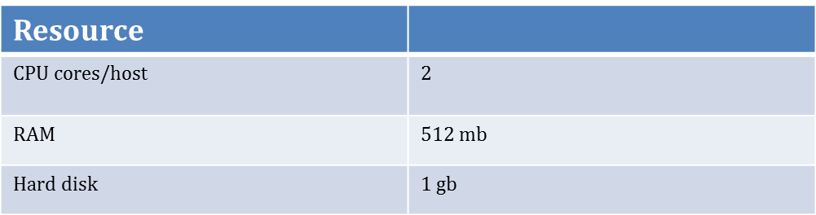
Hardware Requirements - Agent
Recommend minimum 1gb RAM (for agent), 2 cpus, 4gb storage + stage (+ room for logfiles)
Notes:
Recommend 2 cpu, 2gb RAM, 4gb hard drive + stage

Slide 15
Hardware Requirements - Repository
Resource | Small | Medium | Large
CPU | 2 | 4 | 8
RAM | 4 gb | 6 gb | 8 gb
Hard Disk | 50 gb | 200 gb | 400 gb
Recommend minimum 2gb RAM (for db), 2 cpus, 50gb storage + stage (+ logfiles and backups)
Notes:
SQL> exec DBMS_SYSTEM.SET_EV(sid, serial#, 10046, level,’ ’ );

Slide 16
Oracle-Validated Requirements
On Oracle Enterprise Linux 5.x (for package installation) – As user root – This will set and install everything as well as create Oracle user and groups
# yum install oracle-validated
OUI will inform you of missing packages and allow you to fix or ignore

Slide 17
Packages – Cloud Specific
If you have already installed 11g db, these will be present:
# OL 5.x and 6.x make-3*
binutils-2*
gcc-4*
libaio-0*
glibc-common-2*
libstdc++-4*
sysstat-5*
# OL 5.x only
setarch-1*
rng-utils-2*

Slide 18
Packages – Install Manual Method
Consult with Oracle Installation Documentation for complete listing
Packages:
# rpm -qa --queryformat "%{NAME}-%{VERSION}-\ %{RELEASE}(%{ARCH})\n" | grep glibc
From the Linux media
rpm -Uvh binutils-2.*
rpm -Uvh compat-libstdc++-33*
rpm -Uvh compat-libstdc++-33*.i386.rpm
rpm -Uvh elfutils-libelf*
rpm -Uvh gcc-4.*
rpm -Uvh gcc-c++-4.*
rpm -Uvh glibc-2.*
rpm -Uvh glibc-common-2.*
rpm -Uvh glibc-devel-2.*
rpm -Uvh glibc-headers-2.*
rpm -Uvh ksh*
rpm -Uvh libaio-0.*
rpm -Uvh libaio-devel-0.*
rpm -Uvh libgomp-4.*
rpm -Uvh libgcc-4.*
rpm -Uvh libstdc++-4.*
rpm -Uvh libstdc++-devel-4.*
rpm -Uvh make-3.*
rpm -Uvh sysstat-7.*
rpm -Uvh unixODBC-2.*
rpm -Uvh unixODBC-devel-2.*
rpm -Uvh numactl-devel-*

Slide 19
Kernel Params – Manual Config
Check kernel params:
# /sbin/sysctl -a | grep <param-name>
As user root, add the following lines to /etc/sysctl.conf
fs.suid_dumpable = 1
fs.aio-max-nr = 1048576
fs.file-max = 6815744
kernel.shmall = 2097152
kernel.shmmax = 536870912
kernel.shmmni = 4096
kernel.sem = 250 32000 100 128
net.ipv4.ip_local_port_range = 9000 65500
net.core.rmem_default=4194304
net.core.rmem_max=4194304
net.core.wmem_default=262144
net.core.wmem_max=1048586
Execute the following to update current params
# /sbin/sysctl -p

Slide 20
Security Limits – Manual Method
Add the following lines to /etc/security/limits.conf
oracle soft nproc 2047
oracle hard nproc 16384
oracle soft nofile 4096
oracle hard nofile 65536
oracle soft stack 10240

Slide 21
User and Group - Manual Creation
As root user:
# groupadd oinstall
# groupadd dba
# groupadd oper
# groupadd asmadmin
# useradd -g oinstall -G dba,oper,asmadmin oracle
# passwd oracle

Slide 22
Sample User Profile
Oracle install guide recommends NOT having any Oracle related variables set in the environment
For korn shell
# Oracle Settings
TMP=/tmp; export TMP
TMPDIR=$TMP; export TMPDIR
ORACLE_HOSTNAME=localhost.localdomain; export ORACLE_HOSTNAME
ORACLE_UNQNAME=emrep; export ORACLE_UNQNAME
ORACLE_BASE=/u02/app/oracle; export ORACLE_BASE
ORACLE_HOME=$ORACLE_BASE/product/11.2.0/db_1; export ORACLE_HOME
OMS_HOME=$ORACLE_BASE/Middleware/oms; export OMS_HOME
AGENT_HOME=$ORACLE_BASE/Middleware/agent/core/12.1.0.1.0
ORACLE_SID=emrep; export ORACLE_SID
PATH=/usr/sbin:/sbin:$PATH; export PATH
PATH=$ORACLE_HOME/bin:$PATH; export PATH
LD_LIBRARY_PATH=$ORACLE_HOME/lib:/lib:/usr/lib; export LD_LIBRARY_PATH
CLASSPATH=$ORACLE_HOME/jlib:$ORACLE_HOME/rdbms/jlib; export CLASSPATH
EDITOR=vi; export EDITOR
set -o vi

Slide 23
Additional Setup
Edit /etc/selinux/config
SELINUX=disabled
Edit /etc/hosts to include ip and fully qualified host name for grid server
192.168.1.100 gridhost.localdomain gridhost
192.168.1.101 rdbmshost.localdomain.com rdbmshost
Test nslookup, ping for server accessibility
$ nslookup gridhost
$ nslookup rdbmshost

Slide 24
Additional Setup - Continued
Create directories for software and file storage
mkdir -p /u02/app/oracle/product/11.2.0.3/db_1
mkdir –p /u02/app/oracle/stage
mkdir –p /u02/app/oracle/fast_recovery_area
mkdir –p /u02/app/oracle/Middleware
chown -R oracle:oinstall /u02
chmod -R 775 /u02

Slide 25
Download Software - Database
Repository database 11.2.0.3
Must go to metalink.oracle.com
Select “Patches and Updates” tab
Under Patching Quicklinks
Select Latest Patchsets
Oracle Database
Need disks 1 and 2
You will create an empty database with, at minimum, XML, or use an existing database
Any db prior to 11.2.0.2 will require additional patching

Slide 26
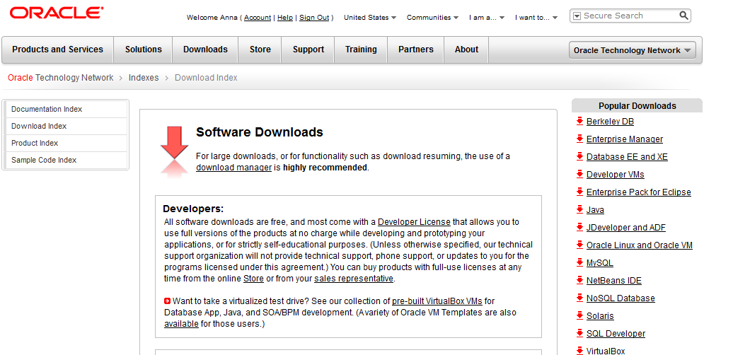
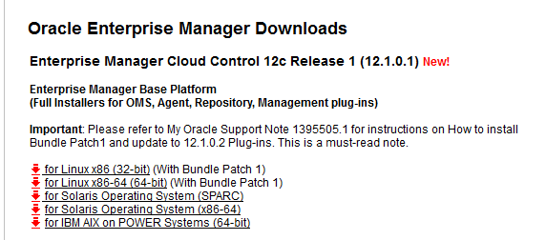
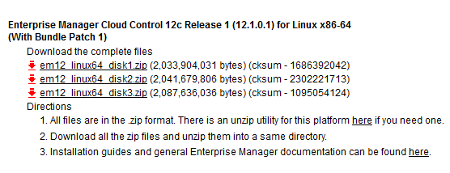
Download Software – Cloud 12.1.0.1 (with BP1)
Enterprise Manager Cloud Control 12c
Go to download.oracle.com
Select “Enterprise Manager” from righthand menu
Select OS, and download disks 1, 2, and 3

Slide 27
Bundle Patch 1
Released Feb 2012
Mandatory
Bug fixes, performance enhancements, and new features
Available for Linux_x86, 32 and 64-bit platforms
Solaris x86/SPARC = Q2
AIX = Q3
HP not planned
3 options to apply BP1
Fresh install using updated, pre-patched base platform 12.1.0.1 full installer – available OTN
Upgrade from 10.2.0.5 or 11.1.0.1 using the updated, pre-patched base platform 12.1.0.1
Requires pre-upgrade console script from OTN
Apply BP1 to OMS and Agent, manually update plug-ins (least straightforward method - not recommended)

Slide 28
Stage Software
3 Disks for EM installation (+2 Disks for rdbms)
Verify binaries against checksum listed at download.oracle.com
$ cksum em12_linux64_disk1.zip
1686392042 2033904031 em12_linux64_disk1.zip
...
Uncompress files:
Will create a list of directories. Unzip in place each of the 3 files.
$ unzip em12_linux64_disk1.zip
$ unzip em12_linux64_disk2.zip
$ unzip em12_linux64_disk3.zip

Slide 29
Prepare Repository
Standard Database installation for the repository – Requires separate downloaded media.
Software Install of RDBMS is not discussed here
Repository db must have listener running and be accessible from the Cloud Control server
Prepare repository db
If dbconsole is configured:
$ . oraenv
<sid>
$ emca -deconfig dbcontrol db -repos drop -SYS_PWD <sys password> -SYSMAN_PWD <sysman password>

Slide 30
Prepare Repository - Continued
Configure instance for the repository
sqlplus / AS SYSDBA
ALTER SYSTEM SET sga_max_size=2g SCOPE=SPFILE;
ALTER SYSTEM SET sga_target=2G SCOPE=SPFILE;
ALTER SYSTEM SET pga_aggregate_target=1G SCOPE=SPFILE;
ALTER SYSTEM SET processes=300 SCOPE=SPFILE;
ALTER SYSTEM SET session_cached_cursors=200 SCOPE=SPFILE;
ALTER SYSTEM SET shared_pool_size=600M SCOPE=SPFILE;
ALTER SYSTEM SET job_queue_processes=20 SCOPE=SPFILE;
--resize or turn on autoextend for UNDO
ALTER DATABASE datafile ‘/u02/app/oracle/oradata/emrep/undotbs1.dbf’ autoextend on maxsize 4g;
-- Restart the instance.
SHUTDOWN IMMEDIATE
STARTUP

Slide 31
Install Software
Launch the Cloud Control 12c installation
as user oracle
$ cd /u02/app/oracle/stage/Linux_Grid12c
$ ./runInstaller

Slide 32
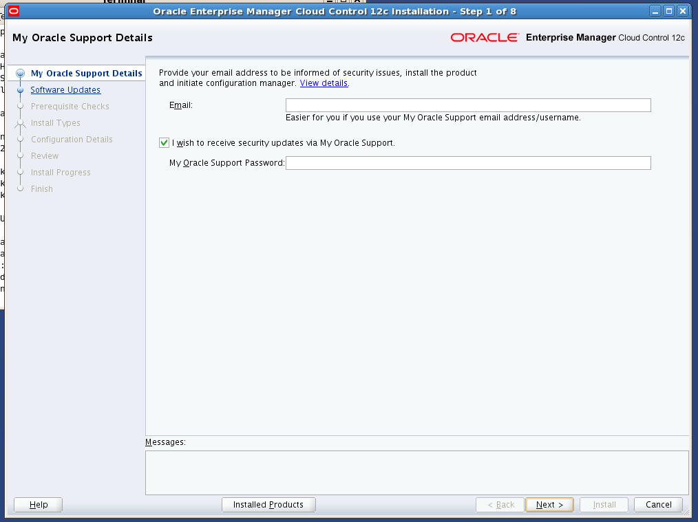
OUI – My Oracle Support

Slide 33
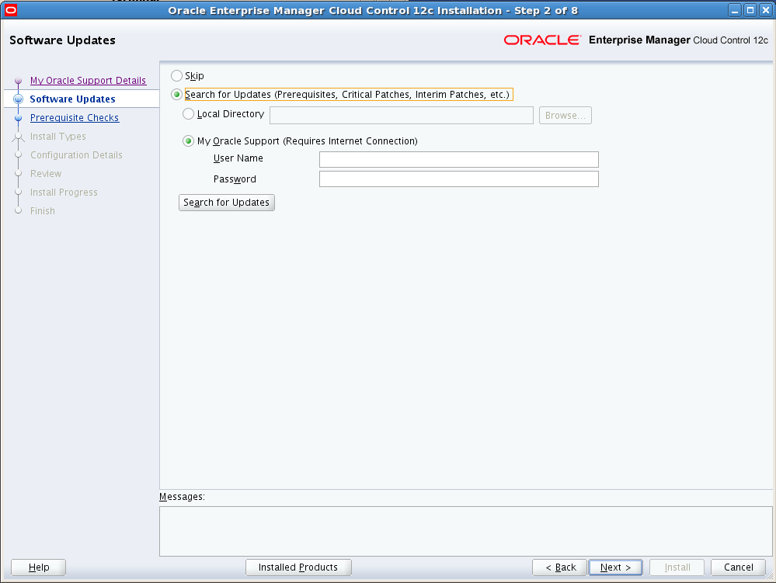
OUI – My Oracle Support - Software

Slide 34
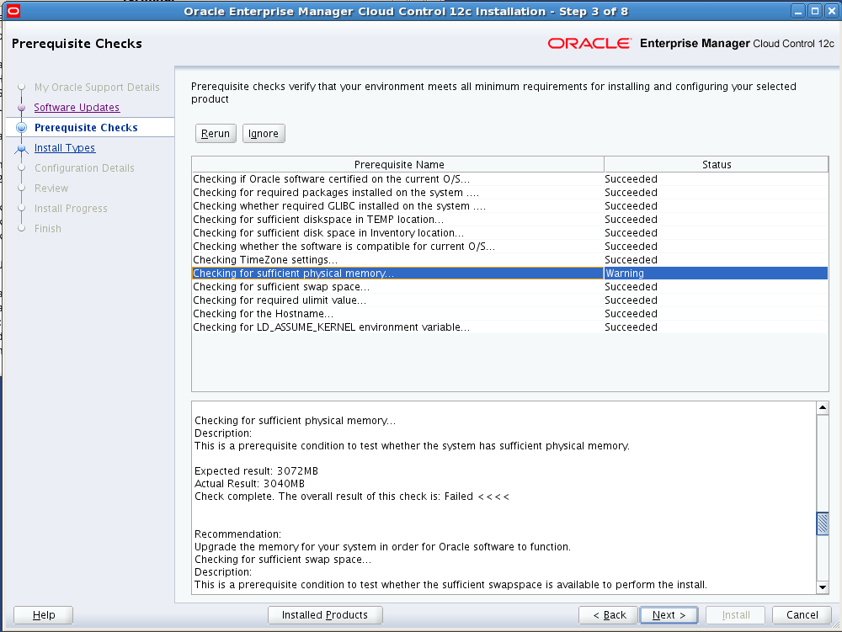
OUI – Prerequisite Checks

Slide 35
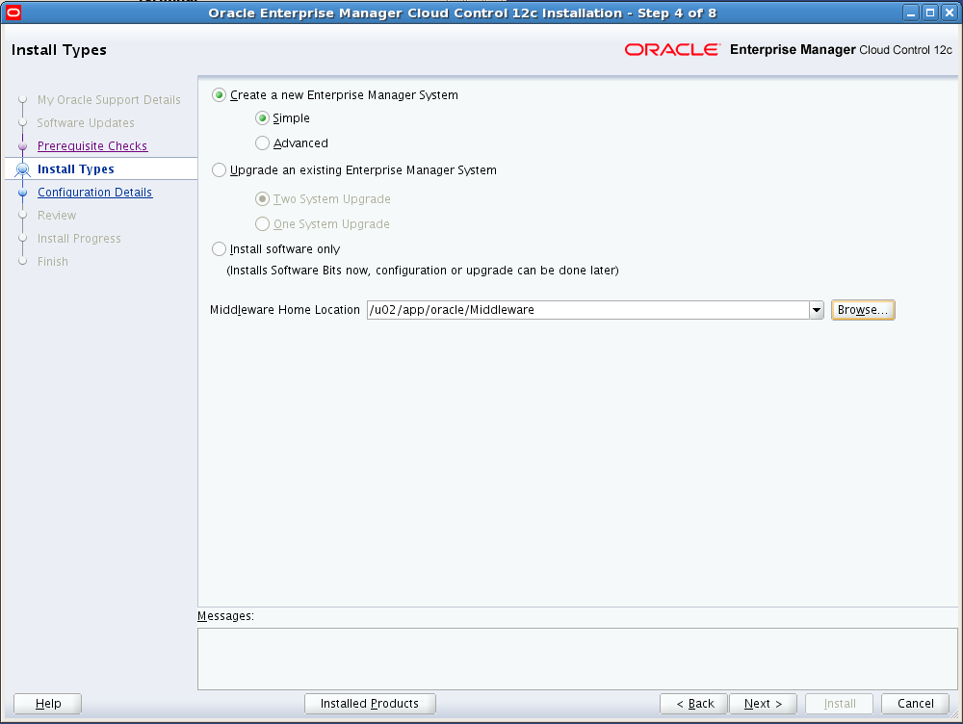
OUI – Install Types
Advanced… Customize ports, datafile locations, tablespace storage, Weblogic Server Details

Slide 36
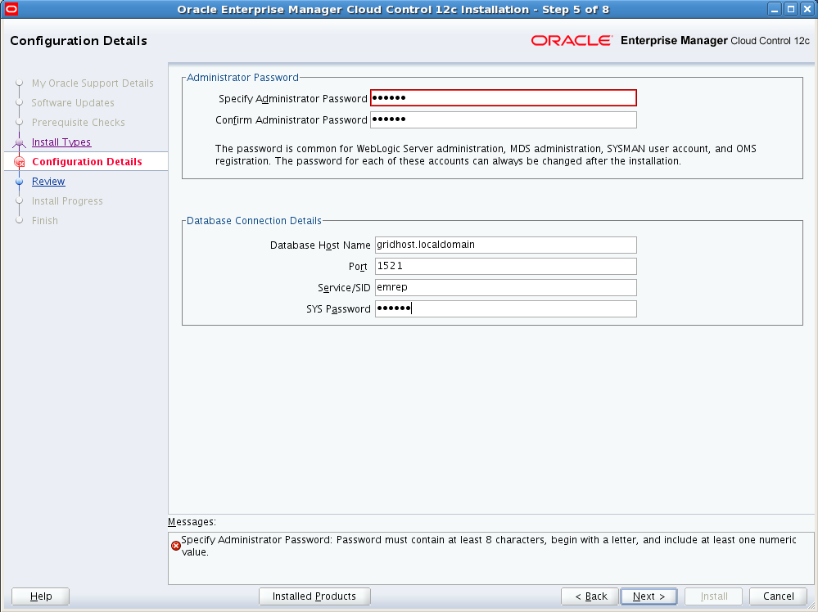
OUI – SYSMAN and Repository

Slide 37
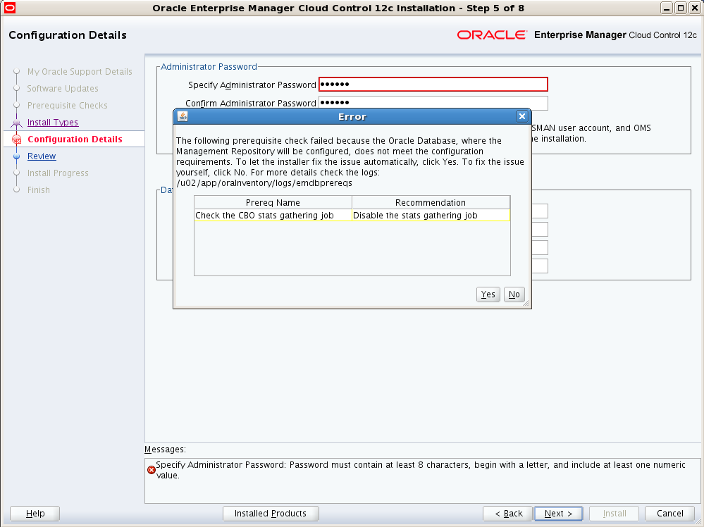
OUI – Final Checks

Slide 38
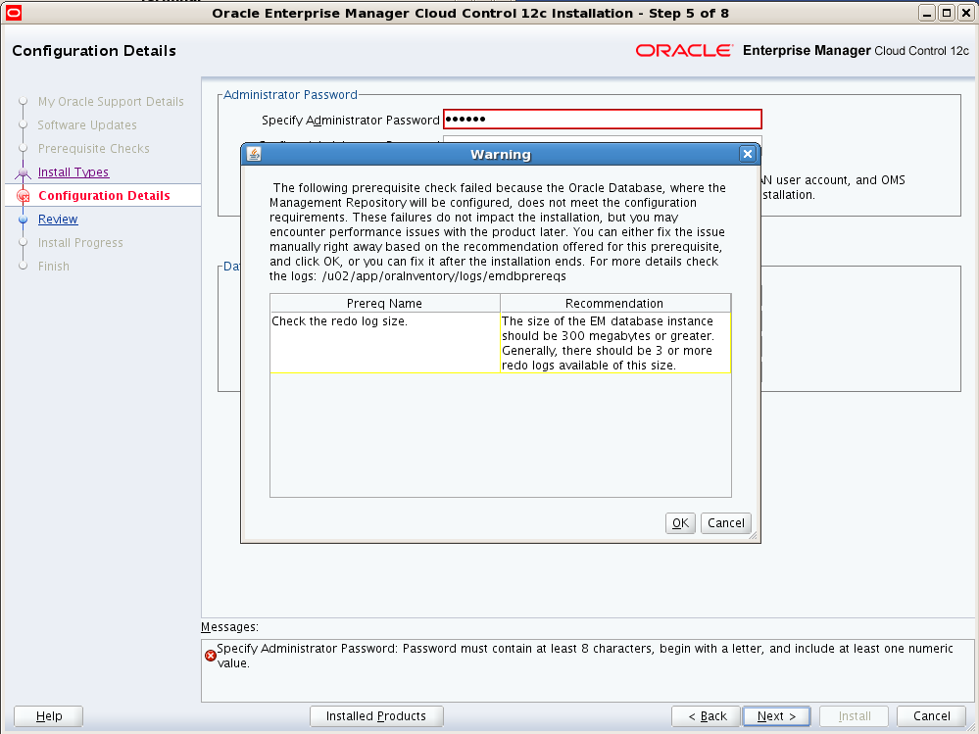
OUI – Final Checks

Slide 39
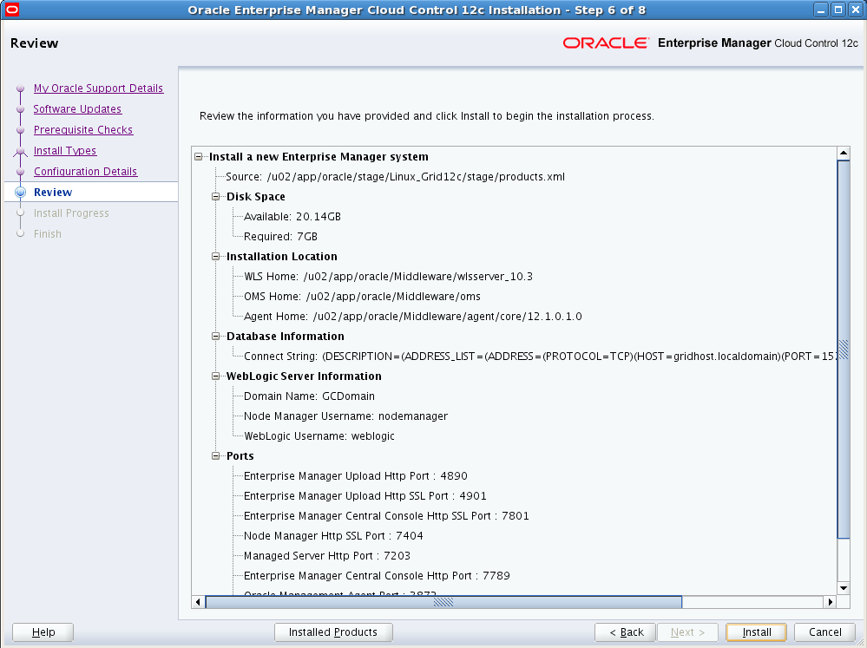
OUI - Review

Slide 40
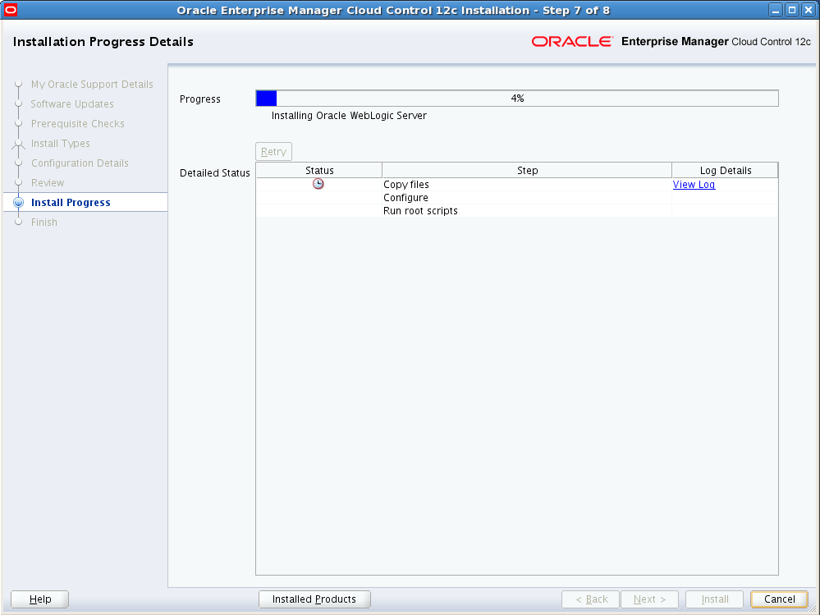
OUI - Progress

Slide 41
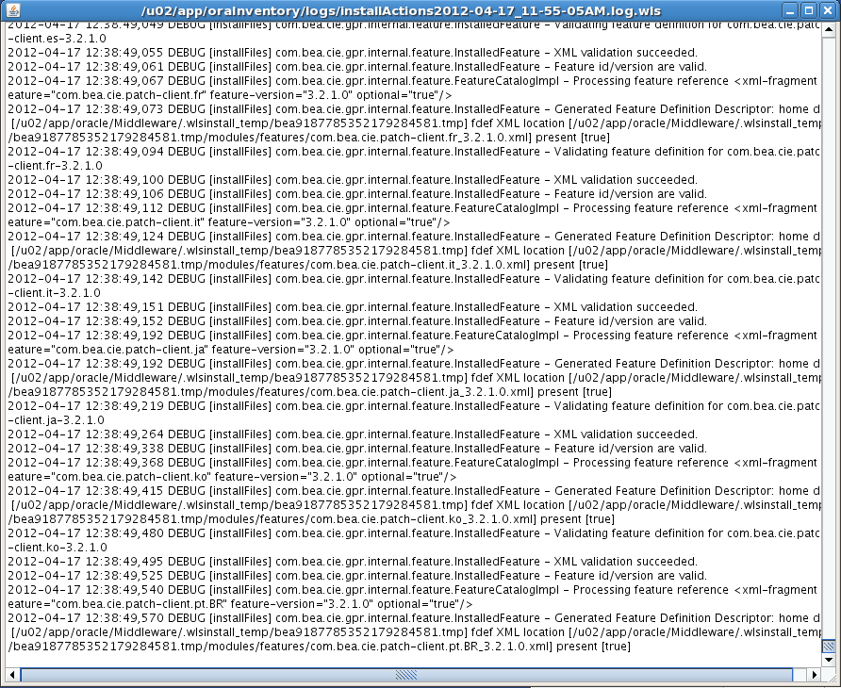
View Log

Slide 42
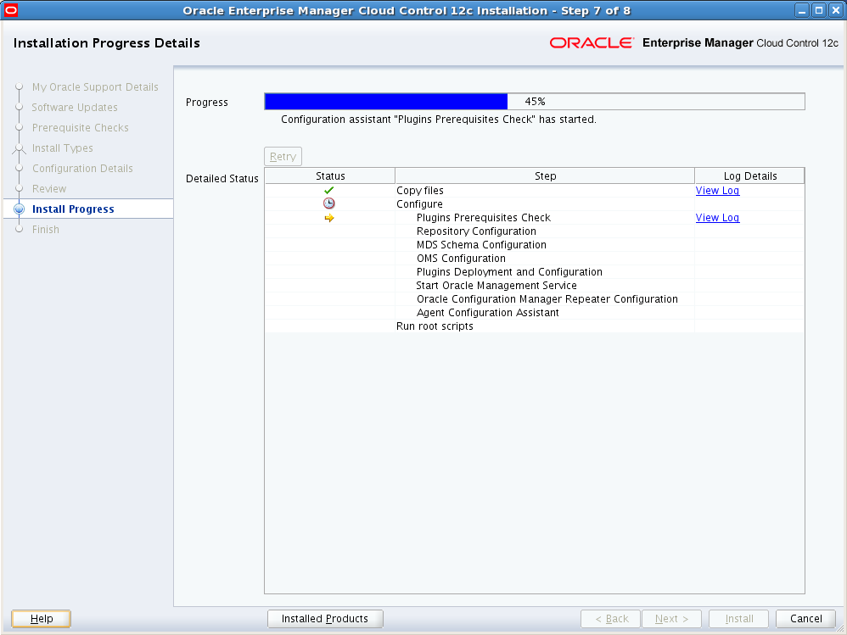
OUI - Progress

Slide 43
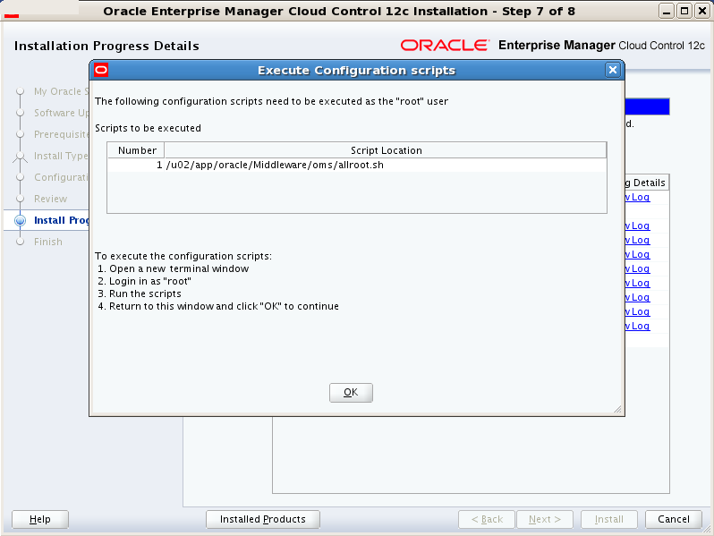
OUI – Run root scripts

Slide 44
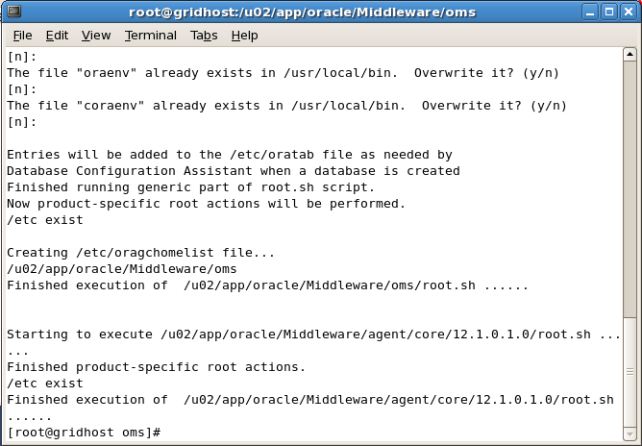
Run root scripts

Slide 45
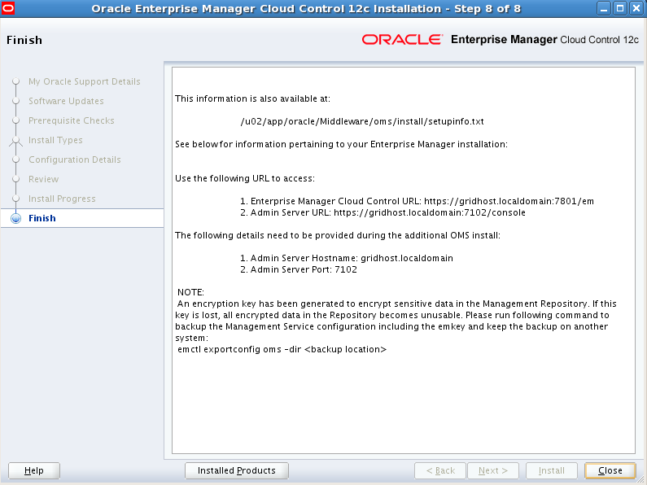
Install Complete

Slide 46
Verify Installation
Navigate to your OMS_HOME and check the status of the OMS
$ pwd
/u02/app/oracle/Middleware/oms/bin
$ ./emctl status oms
Navigate to your AGENT_HOME and check the status of the agent
$ pwd
/u02/app/oracle/Middleware/agent/core/12.1.0.1.0
$ ./emctl status agent

Slide 47

Accessing Cloud Control
Using the urls provided at the completion of installation:
Enterprise Console
Weblogic Server administration

Slide 48
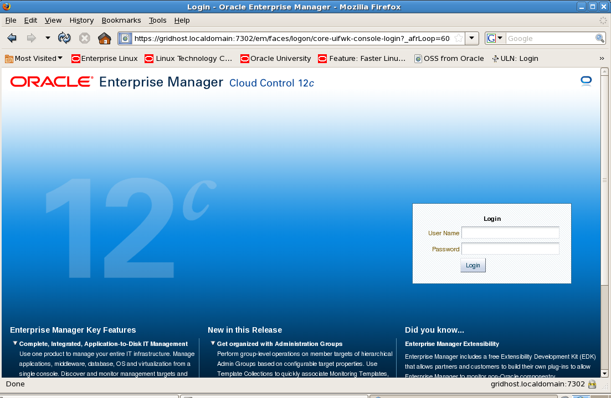
Console Login

Slide 49
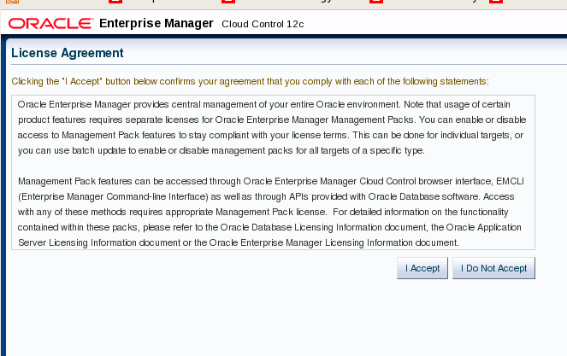
License Agreement

Slide 50
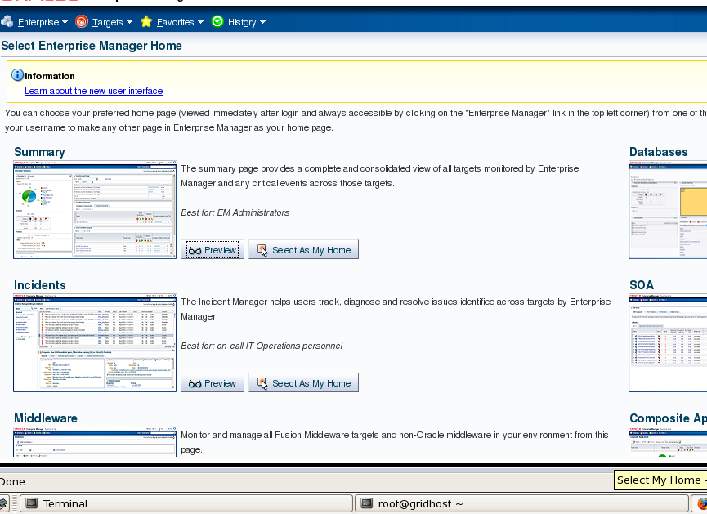
Home Page Template Selection

Slide 51
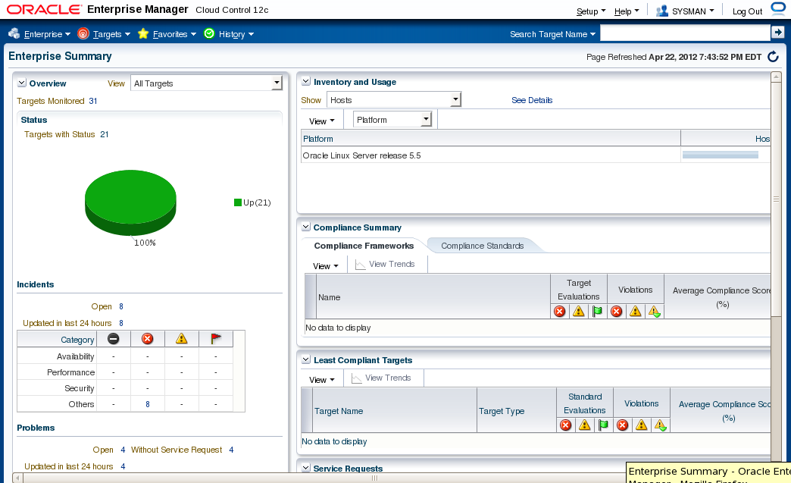
Console

Slide 52
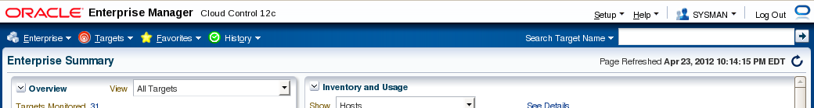
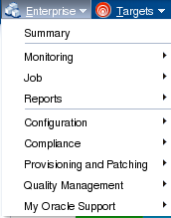
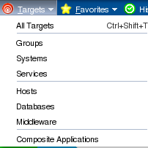
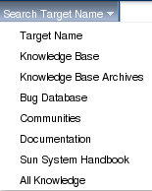
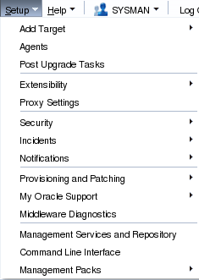
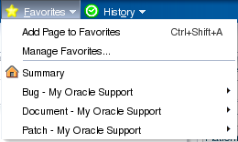
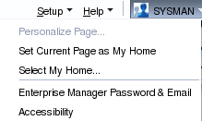
Menus

Slide 53
Files System Layout
Key directories:
$OMS_HOME=
$ORACLE_BASE/Middleware/oms
--OMS binaries
$OMS_INSTANCE_HOME=
$ORACLE_BASE/Middleware/gc_inst
$OMS_INSTANCE_HOME/em/EMGC_OMS1/sysman/log
--oms logfiles
$AGENT_BASE=
$ORACLE_BASE/Middleware/agent
$AGENT_HOME=
$AGENT_BASE/Middleware/agent/core/12.1.0.1.0
--agent binaries on oms host
$AGENT_INSTANCE_HOME=
$AGENT_BASE/agent_inst
$AGENT_INSTANCE_HOME/sysman
--agent configuration and log files
/etc/oragchomelist
$OMS_HOME
$AGENT_INST_HOME
$ORACLE_BASE
|________Middleware
|_____wlserver_10.3
|_____jdk16
|_____oms
|_____plugins
|_____oracle.sysman.db.oms.plugin_12.1.0.1.0
|_____oracle.sysman.emas.oms.plugin_12.1.0.1.0
|_____oracle.sysman.mos.oms.plugin_12.1.0.1.0
|_____agent
|_____plugins
|_____oracle.sysman.db.agent.plugin_12.1.0.1.0
|_____oracle.sysman.db.discovery.plugin_12.1.0.1.0
|_____oracle.sysman.emas.agent.plugin_12.1.0.1.0
|_____oracle.sysman.emas.discovery.plugin_12.1.0.1.0
|_____core
|_____12.1.0.1.0
|____agent_inst
|_____sbin
|_____agentimage.properties
|____sysman
|_____gc_inst
|_____Oracle_WT
|_____oracle_common
|_____utils
|_____logs
|_____modules
|_____user_project
|_____ocm.rsp
|_____registry.dat
|_____domain-registry.xml
|_____registry.xml

Slide 54
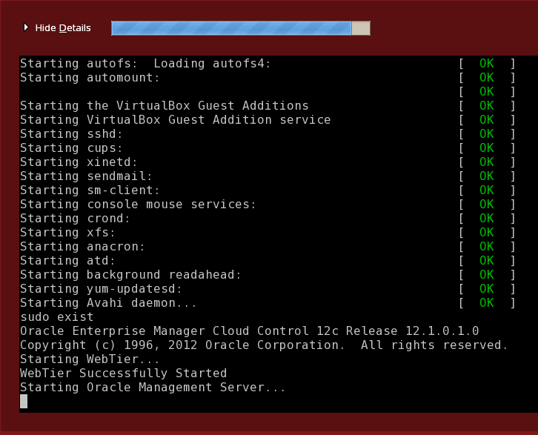
Starting Up Cloud Control

Slide 55
Disable Autostart
Additional configuration is necessary to enable proper autostart functionality – not covered in this presentation
As root:
# vi /etc/init.d
mv gcstartup gcstartup_old
mv unlockgcstartup unlockgcstartup_old
mv lockgcstartup lockgcstartup_old

Slide 56
Manual Start and Stop
Start the repository database and listener
As oracle:
$ more /etc/oratab
…
. oraenv
<emrep>
$ lsnrctl start
$ sqlplus / as sysdba
SQL> startup
SQL> exit

Slide 57
Manual Start and Stop
Start the OMS and Agent
As oracle:
$ $OMS_HOME/bin/emctl start oms
$ $AGENT_HOME/emctl start agent
Stop the agent then oms
$ $AGENT_HOME/emctl stop agent
$ $OMS_HOME/bin/emctl stop oms -all

Slide 58
Part 2 – Agent Deployment

Slide 59
Agent Push Method
Uses the Cloud Control Console
Great for mass deployment to numerous hosts
Host pre-requisites (target host)
Sudoer file must allow oracle to run /bin/sh as root. Example only:
oracle ALL=(ALL) ALL
Ensure that you have the following line in the /etc/sudoers file:
Defaults visiblepw
Ensure that you comment out the following line in the /etc/sudoers file:
Defaults requiretty
You do not require the following entry in the /etc/sudoers file. If you have this entry, comment it out.
(root)/oracle/product/oms12c/agent/agent_inst/bin/nmosudo

Slide 60
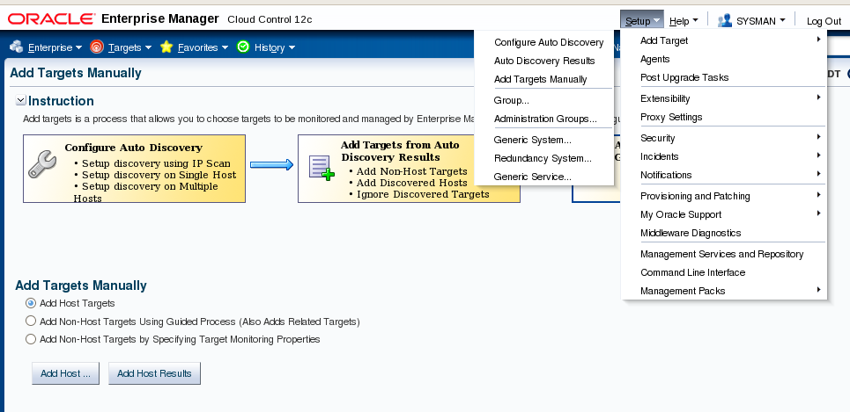
Add Target Manually

Slide 61
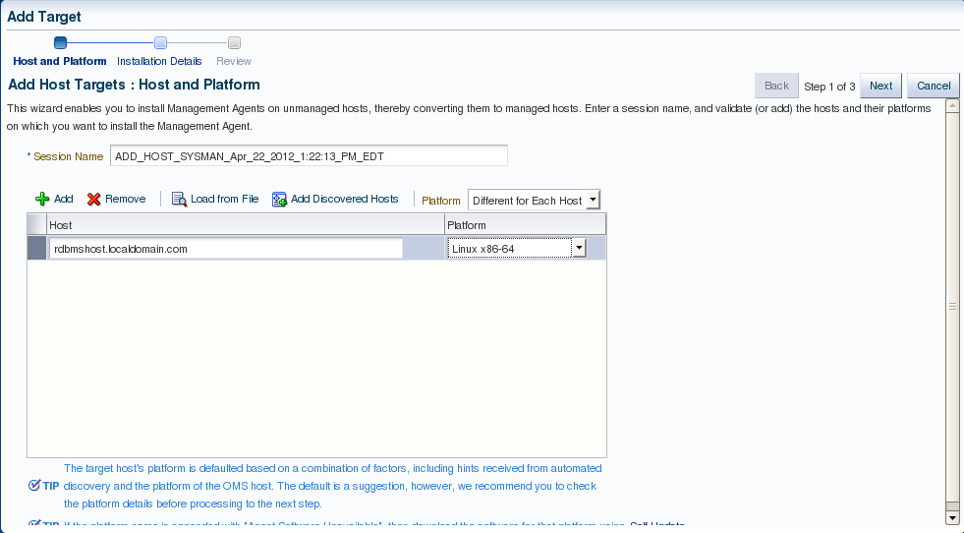
Add Target Wizard – Add Host

Slide 62
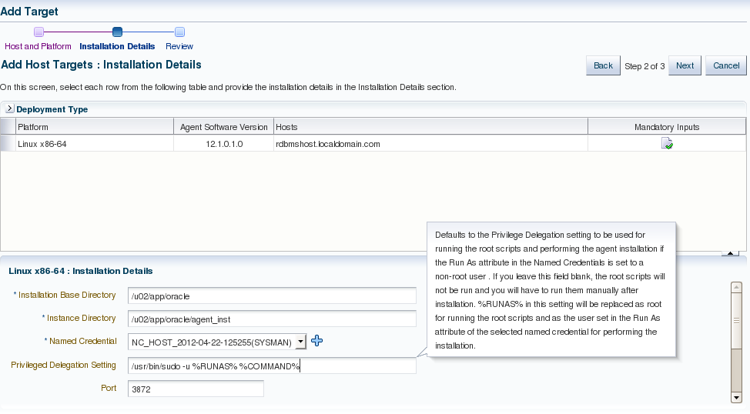
Add Host - Mandatory Inputs
Do NOT leave port null despite the wizard popup that says it will choose automatically.

Slide 63
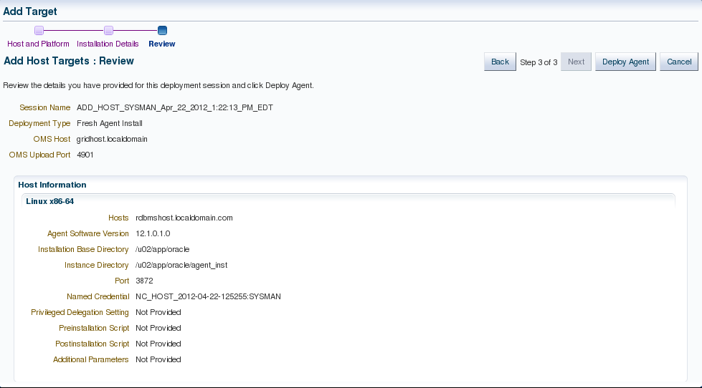
Add Host - Review

Slide 64
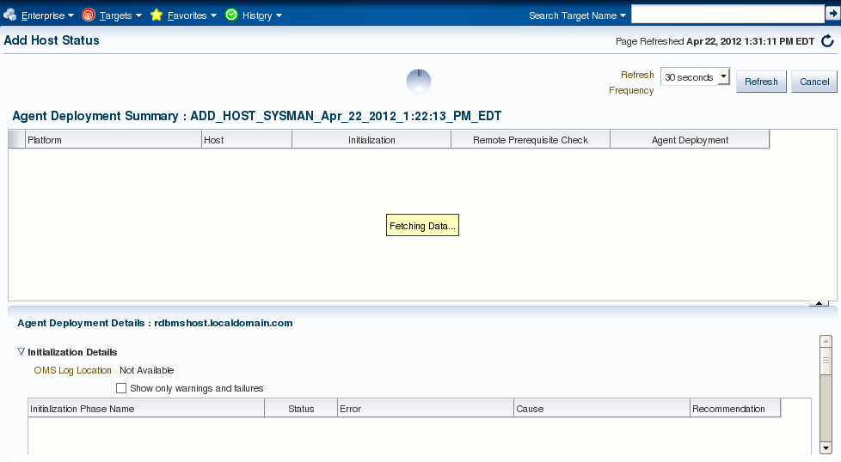
Deploy Agent - Processing

Slide 65
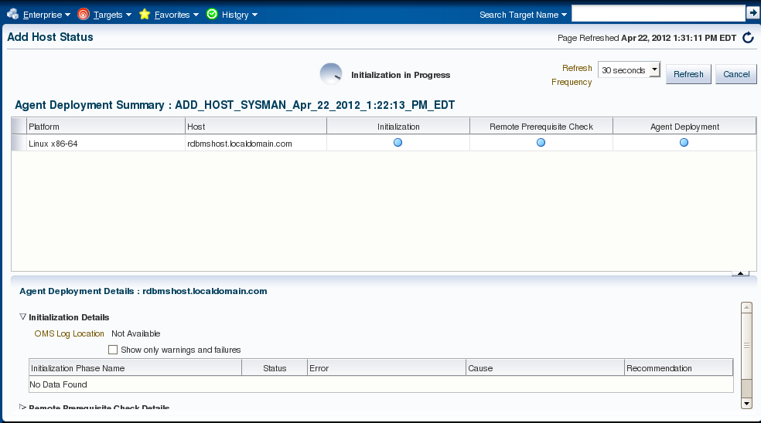
Agent Initialization

Slide 66

Transferring Agent Software

Slide 67
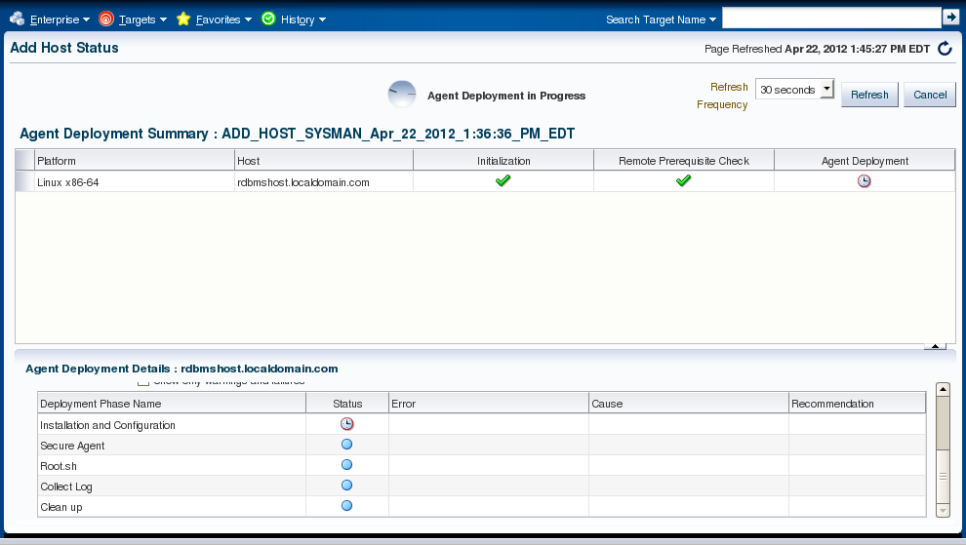
Installation and Configuration

Slide 68
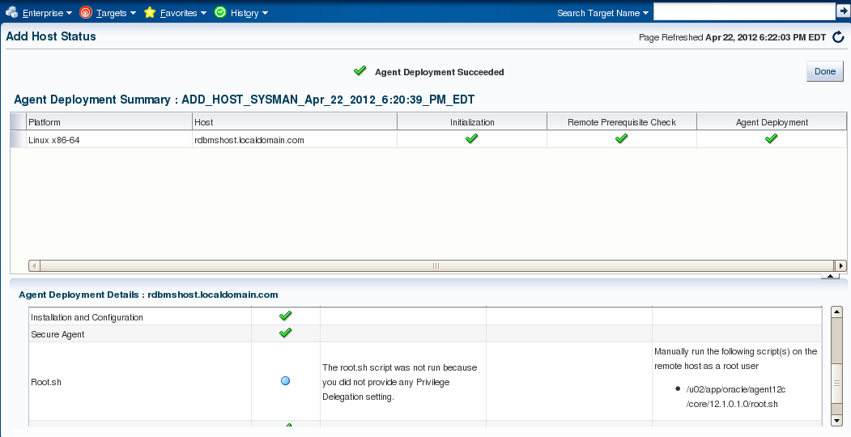
Deployment Succeeded

Slide 69
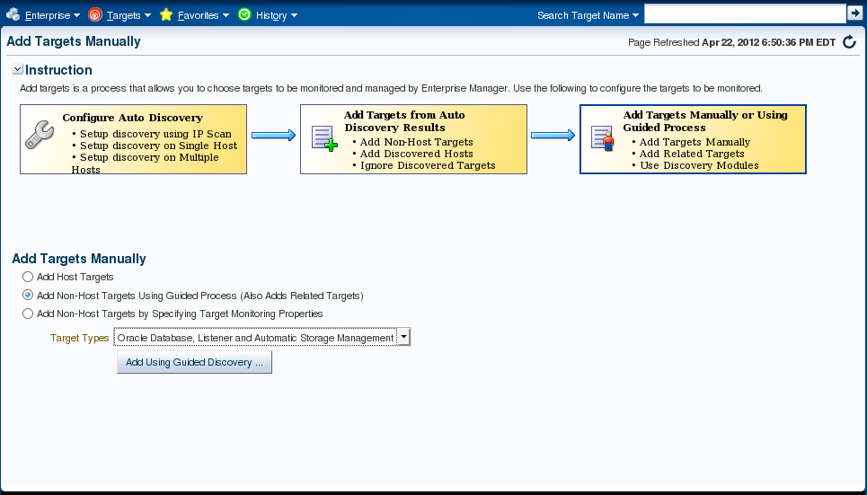
Add a Non-Host Target

Slide 70
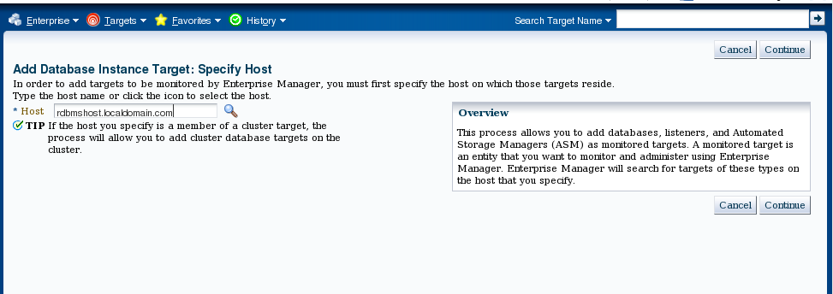
Add Non-Host Target (cont)

Slide 71
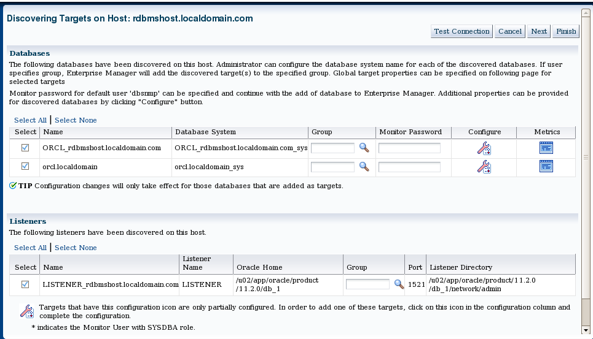
Target Discovery

Slide 72
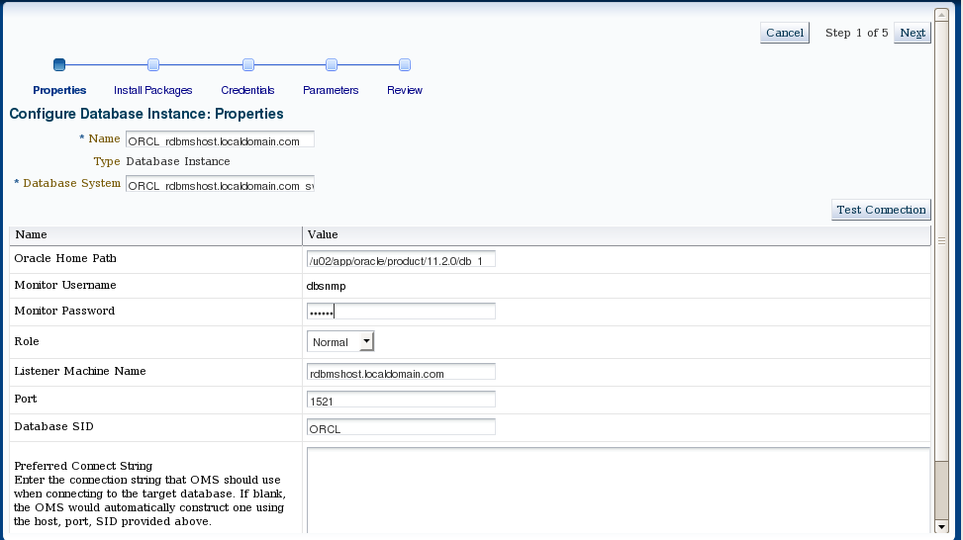
Configure Database Instance

Slide 73
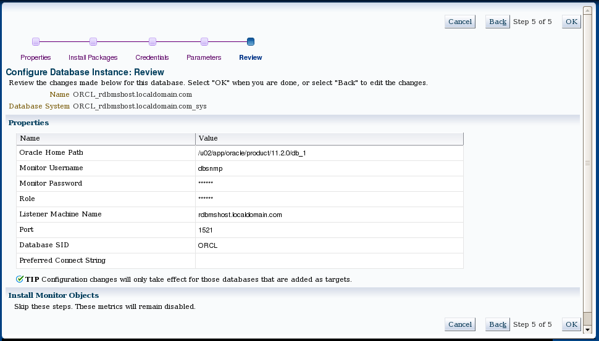
Configure Database - Review

Slide 74
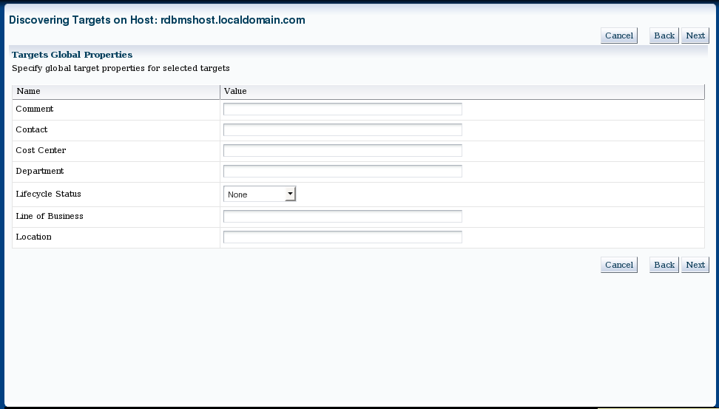
Target Global Properties

Slide 75
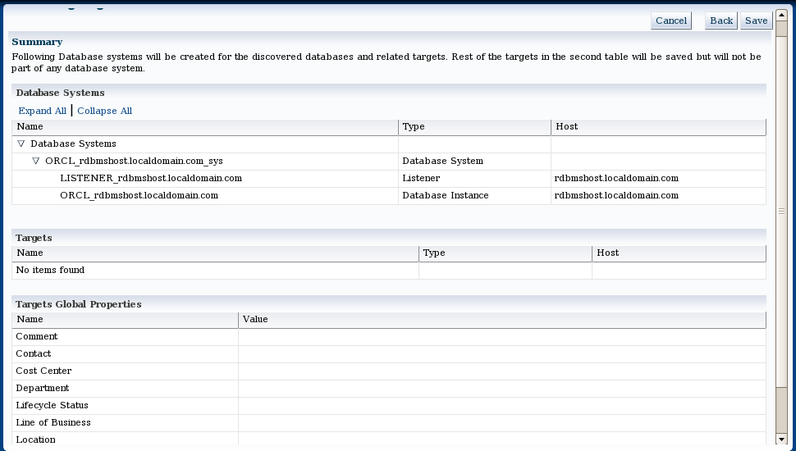
Add Target Summary

Slide 76
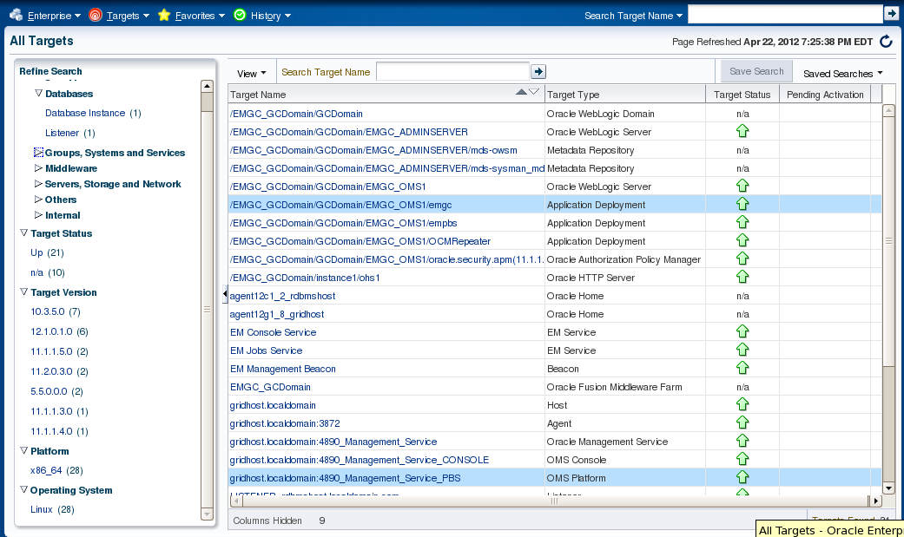
All Targets

Slide 77
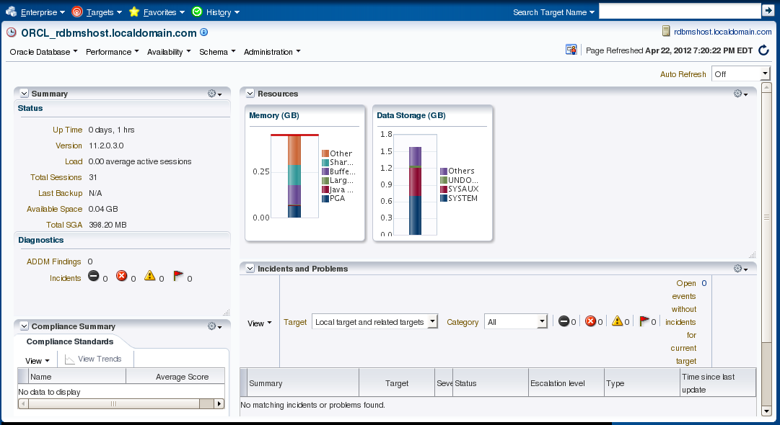
Database Home Page

Slide 78
Agent Installation – Silent
Refer to Metalink Document: ID 1360083.1
Obtain the appropriate agent software using the following method:
On the OMS host
$ cd $OMS_HOME/bin
$ ./emcli login -username=sysman -password=oracle01
Login successful
$ ./emcli sync
Synchronized successfully
$ ./emcli get_supported_platforms
Getting list of platforms ...
Check the logs at /u02/app/oracle/Middleware/oms/bin/agent.log
About to access self-update code path to retrieve the platforms list..
Getting Platforms list ...
-----------------------------------------------
Version = 12.1.0.1.0
Platform = Linux x86-64
-----------------------------------------------
Platforms list displayed successfully.

Slide 79
Agent Installation – Silent (continued)
On the OMS host (continued)
$ ./emcli get_agentimage -destination=/u02/app/oracle/stage/agent -platform="Linux x86-64" -version="12.1.0.1.0“
Platform:Linux x86-64
Destination:/u02/app/oracle/stage/agent
=== Partition Detail ===
Space free : 6 GB
Space required : 1 GB
Check the logs at /u02/app/oracle/stage/agent/get_agentimage_2012-04-22_16-59-56-PM.log
Setting property ORACLE_HOME to:/u02/app/oracle/Middleware/oms
calling pulloneoffs with arguments:/u02/app/oracle/Middleware/oms/u02/app/oracle/Middleware/oms/sysman/agent/12.1.0.1.0_AgentCore_226.zip12.1.0.1.0linux_x64
Check this logs for more information: /u02/app/oracle/Middleware/oms/sysman/prov/agentpush/logs

Slide 80
Agent Installation – Silent (continued)
When download completes:
Transfer .zip file to target host
$ scp -r 12.1.0.1.0_AgentCore_226.zip rdbmshost:/u02/app/oracle/stage/agent/12.1.0.1.0_AgentCore_226.zip
Unzip the installation files and create a response file
$ cd /u02/app/oracle/stage/agent
$ vi agent.rsp

Slide 81
Agent Installation – Response File
Uncomment required params:
OMS_HOST=gridhost.localdomain
EM_UPLOAD_PORT=<Value Unspecified>
AGENT_REGISTRATION_PASSWORD=oracle01
AGENT_INSTANCE_HOME=/u02/app/oracle/agent
AGENT_PORT=3872
b_startAgent=true
ORACLE_HOSTNAME=rdbmshost.localdomain.com
#s_agentHomeName=<Value Unspecified>
To obtain needed information about OMS:
$ ./emctl status oms -details
Oracle Enterprise Manager Cloud Control 12c Release 12.1.0.1.0
Copyright (c) 1996, 2012 Oracle Corporation. All rights reserved.
SYSMAN password:

Slide 82
OMS Status Details
$ ./emctl status oms -details
Oracle Enterprise Manager Cloud Control 12c Release 12.1.0.1.0
Copyright (c) 1996, 2012 Oracle Corporation. All rights reserved.
Enter Enterprise Manager Root (SYSMAN) Password :
Console Server Host : gridhost.localdomain
HTTP Console Port : 7789
HTTPS Console Port : 7801
HTTP Upload Port : 4890
HTTPS Upload Port : 4901
OMS is not configured with SLB or virtual hostname
Agent Upload is locked.
OMS Console is locked.
Active CA ID: 1
Console URL: https://gridhost.localdomain:7801/em
Upload URL: https://gridhost.localdomain:4901/empbs/upload
WLS Domain Information
Domain Name : GCDomain
Admin Server Host: gridhost.localdomain
Managed Server Information
Managed Server Instance Name: EMGC_OMS1
Managed Server Instance Host: gridhost.localdomain

Slide 83
Launch Silent Install
$ ./agentDeploy.sh AGENT_BASE_DIR=/u02/app/oracle/agent RESPONSE_FILE=/u02/app/oracle/stage/agent/agent.rsp
AGENT_BASE_DIR=/u02/app/oracle/agent
Validating the OMS_HOST & EM_UPLOAD_PORT
...
Completed successfully.

Slide 84
Tune in…
Next month’s webinar…
Getting to know
Oracle Enterprise Manager Cloud Control 12c

Slide 85
Resources
Introduction to Oracle Cloud Control 12c
http://docs.oracle.com/cd/E24628_01/doc.121/e25353/overview.htm
Install Cloud Control 12c
http://docs.oracle.com/cd/E24628_01/install.121/e22624/toc.htm#BEGIN
Full Enterprise Manager Cloud Control Documentation Portal
http://docs.oracle.com/cd/E24628_01/index.htm

Slide 86
Questions
(800) 538-0453
Or email…
Anna.RUEL@pTI.NET
Visit my blog….
Foobla.blogspot.com

