Slide 1
HDF Project Update
Mike Folk, Kent Yang, Elena Pourmal
The HDF Group
April 1, 2010

Slide 2
Outline
HDF Project Update
Helpdesk
HDF Releases
Library release highlights
Quality Assurance
Java Product Highlights
Other Tools Activities
Outreach
Related projects and activities
EOS Support
OPeNDAP
netCDF Support
Other projects of interest
Platform support issues

Slide 3
Helpdesk Statistics

Slide 4
HDF4 and HDF5 issues by years
HDF5 1.6.0
HDF5 1.8.0
Number of issues opened
Years

Slide 5
HDF4 issues by categories
Number of issues
Categories

Slide 6
HDF5 issues by categories
Number of issues
Categories

Slide 7
HDF issues resolution time
Percentage of all issues
Resolution time

Slide 8
Questions?

Slide 9
HDF Releases

Slide 10
Maintenance Releases 2009 - 2010
Product
May 2009
Sep 2009
H4toH5
2.1.1
Java Products
March 2010
Feb 2010
Jan 2010
Nov 2009
2.6.1
2.6
HDF5 1.8
HDF5 1.6
HDF
4.2.5
1.6.9
1.6.10
1.8.3
1.8.4-patch1
2.5 patch
Time Frame and versions of the products
1.8.4
Scheduled release time

Slide 11
HDF Libraries Releases Highlights

Slide 12
HDF 4.2.5
Changed versioning from HDFX.YrZ from to HDF X.Y.Z, e.g., HDF4.2r5 became HDF 4.2.5
SDgetchunkinfo now contains compression type and compression information.
A vgroup name and class name can now be more than the previous limit of 64 characters. Added two public functions Vgetnamelen, Vgetclassnamelen.
SDreset_maxopenfiles was added to allow users to reset the number of files that can be open at the same time to the system limit minus 3.

Slide 13
HDF 4.2.5
Added examples from the User’s Guide to the source
"make installcheck" was added to build and test examples using h4cc and h4fc.
The -k flag was added to "hdp dumpsds" to display SDSs in the order they are specified on the command line.
The -V option to print the library version string was added to many tools.
Support was added for 64-bit Mac Intel; provided universal binaries for tools
Removed old code

Slide 14
HDF5 1.6.9 and 1.6.10
Mostly bug fixes and improvements to tools
h5dump
Better handling of binary output
h5diff
Avoiding NaN detection
Reporting of non-comparable objects
Comparing INF
Using system epsilon
h5repack
Improved performance for chunked datasets

Slide 15
HDF5 1.8.3 and 1.8.4
Mostly minor bug fixes and improvements to tools as for 1.6
New functions to set chunk cache per dataset
New functions for greater flexibility when traversing external links
libhdf5.settings information is embedded in executables (configurable option)
h5dump can display data pointed by region references (-R flag)
The library no longer modifies a file opened for R/W (by re-writing the superblock) when no changes were made to the file.

Slide 16
HDF5 1.8.4-patch1
Correct a corruption problem that was present in releases HDF5 1.8.0 through HDF5 1.8.4.
Files that have this corruption problem meet all of the following circumstances (always read the small print ☺):
The version of HDF5 was before the HDF5 1.8.4 Patch 1 release (which includes the 1.8.4 release).
The file was created on a big-endian platform (SPARC/Solaris, POWER/AIX, etc).
NetCDF-4 was used to create the file, OR the H5Pset_libver_bounds(fapl, H5F_LIBVER_LATEST, H5F_LIBVER_LATEST) call was made, OR shared object header messages were enabled with H5Pset_shared_mesg_nindexes() when creating the file.
More than 8 attributes were added to an object in the file (in the case of using netCDF-4 or calling H5Pset_libver_bounds), OR if messages of the type specified to be shared were stored in the file (in the case of calling H5Pset_shared_mesg_nindexes).

Slide 17
H4toH5 tools and library
Based on HDF4r2.4 and HDF5-1.8.2
h4toh5 utility
Recognizes HDF-EOS2 files (--with-hdfeos2 configuration option)
Can generate HDF5 files that can be read by netCDF-4
h4toh5 library
Bug fixes
Performance improvements

Slide 18
Platforms support issues

Slide 19
HDF4 Platforms Supported
Systems
AIX 5.3 and 6.1
Linux 2.6 (CentOS-5)
Linux 2.6 x86_64
Linux (Fedora 12, Ubuntu 9.10, Open Suse 11.2)
Solaris 5.10
Linux on SGI Altix ia64
Windows 32/64-bit XP and Vista, Cygwin
Mac OS Intel 10.6.2 32/64-bit
FreeBSD 6.3-stable 32/64-bit
Compilers
IBM C and Fortran cmp
GNU C and Fortran 4.1.2, g95 (4.0.3)
GNU C and gfortran 4.4.1 and 4.4.2
Intel C and Fortran v11
PGI C and Fortran v9
Sun C 5.9 and Fortran 95 8.3
VS 2005 Intel Fortran 9.1
VS 2008 Intel Fortran 10
GNU C 3.4.6 and 4.4.4, gfortran 4.4.4

Slide 20
HDF5 Platforms Supported
Systems
As for HDF4
CrayXT3
Linux 2.6-Lustre
Open VMS 8.3
Compilers
As for HDF4
PGI C and Fortran v7.1-4
HP C, Fortran and C++ compilers

Slide 21
HDF4 and 5 Platforms to drop
Systems
?
Compilers
VS2005 with Intel 11

Slide 22
HDF4 and 5 Platforms to add
Systems
Windows 7 32/64-bit
?
Compilers
VS2010, Intel Fortran 11
?

Slide 23
HDF Binaries Distribution Issues

Slide 24
HDF4 and HDF5 Binaries
Current binaries
Generated semi-automatically
Require SZIP installed on the users’ system
Include shared and static libraries built with SZIP with encoder
Include statically built utilities with SZIP with encoder for the following platforms:
Linux 32 and 64-bit
Solaris 32 and 64-bit
Windows 32/64 bit XP, Cygwin
Mac OSX Intel 32 and 64-bit
FreeBSD 32 and 64-bit (HDF4 only)

Slide 25
HDF4 and HDF5 Binaries
Problems:
Users have to know which SZIP (encoder vs. decoder) to use and install the proper library
Users have to modify compiler scripts to point to the external libraries on the user’s system
Static binaries come with SZIP with encoder; while OK for reading tools, may be a violation for tools like hrepack, h5repack and h5copy
Windows binaries require proper MS RTLs on top of external SZIP, ZLIB and JPEG DLLs
Download statistics shows that some platforms are not used at all

Slide 26
HDF4 and HDF5 Binaries
Download statistics for HDF5 (similar for HDF4)
Other platforms are on the order of 1 - 10 downloads
Platform | Number of downloads
Linux (32/64, shared/static) | 2,038
Windows (XP, Vista, 32/64) | 2, 471
Mac Intel (32/64) | 216

Slide 27
HDF4 and HDF5 Binaries
Proposal to distribute binaries only for
Linux 32 and 64-bit
Windows 32 and 64-bit
Mac OSX 32 and 64-bit with universal binaries when possible
Improve packaging by including appropriate SZIP library
Improve compiler scripts and installation procedure
RFC is coming

Slide 28
HDF5 Backward/Forward Compatibility and Interoperability with other Libraries Issues

Slide 29
Backward/Forward Compatibility
Continued testing files from FTP sites with command line utilities for backward and forward file format compatibility
OMI Level 2 files
ftp://aurapar2u.ecs.nasa.gov
OMI Level2G, MLS and HIRDL files
ftp://acdisc.gsfc.nasa.gov
TOM files
ftp://acdisc.sci.gsfc.nasa.gov
TES files
ftp://l4ftl01.larc.nasa.gov
NPOESS MiniIDPS
ftp://nppsds.nascom.nasa.gov/MiniIDPS_1.5.00.48/

Slide 30
Backward/Forward Compatibility
Daily testing of HDF-EOS5 and netCDF-4 with the HDF5 code under development to assure API backward compatibility
Problem discovered:
To fix a performance bug in HDF5, we need to make hid_t to be 8 bytes
Both HDF-EOS5 and netCDF-4 become broken since they rely in hid_t to be an integer (4 bytes)
Solution????

Slide 31
HDF5 and HDF-EOS5 interoperability
Problem discovered:
Fortran HDF-EOS5 applications are not portable between 32-bit and 64-bit platforms
Some parameters have to be INTEGER or INTEGER*8 depending on the platform and on the parameter!
HDF-EOS5 (both C and Fortran) may have problems with files bigger than 2GB
For developers who need to work with the HDF-EOS5 and NPOESS files (e.g., OMI/Aura and OMPS/NPOESS), code development is challenging and may require a lot of code duplication

Slide 32
HDF5 and HDF-EOS5 interoperability
Proposed solution:
The HDF Group will add testing for HDF-EOS5 Fortran testing to assure code robustness
We will work with Abe on the solution for the HDF-EOS5 Fortran portability problem and will help to integrate it with the current HDF-EOS5 source code

Slide 33
“Bugs” statistics

Slide 34
HDF4 opened and closed issues
Number of issues

Slide 35
HDF5 opened and closed issues
Number of issues

Slide 36
Static Code Analysis

Slide 37
Bug Prevention or Static Code Analysis

Slide 38
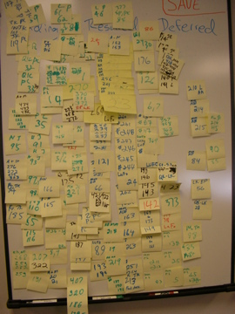
Static Code Analysis: Coverity

Slide 39
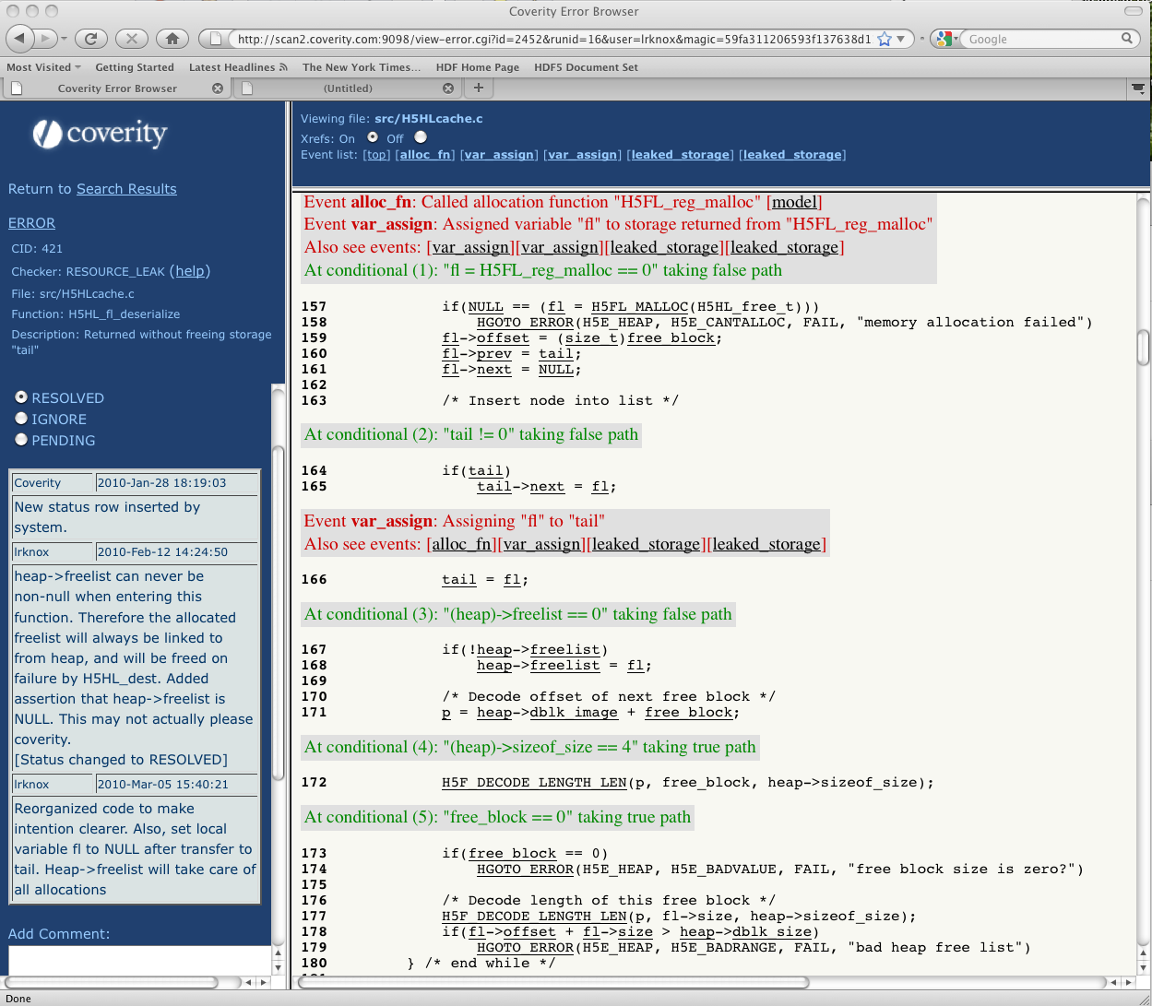
Static Code Analysis: Coverity

Slide 40
Static Code Analysis: Coverity
Coverity Prevent – commercial static code analysis tool for C, C++ and Java
Free for Open Source projects
Examples of errors:
Usage of pointers after freeing them
Memory leaks
Dead code
Out of bounds array accesses
Used on HDF5 1.8 and HDF 4.2.5

Slide 41
Static Code Analysis: Coverity
HDF5 had 358 issues at the beginning; down to 17 pending
Resource leak – 141 issues
Dereferencing possible NULL – 50 issues
Variables are used without initialization – 45 issues

Slide 42
Static Code Analysis: Coverity
HDF4 has 189 issues; will work as time and resources permit
Resource leak – 72 issues
Use after free – 20 issues
Dereferencing possible NULL – 17 issues
Misc.: negative checks, uninitialized variables, dereferencing pointers without checking for NULL, etc. - 80 issues

Slide 43
Questions?

Slide 44
Java Product Highlights 2009-2010
Notes:
44

Slide 45
HDF Java Products
Tools improvements
Support for external links
Support for a simplified way to produce binary output by h5dump (ESDIS)
Better support for user block with h5repack
Improved performance for free space tracking in a file
Fixed bugs with file mounting
Many improvements in configuration, installation and testing
Better support for shared C, Fortran and C++ libraries
http://www.hdfgroup.org/HDF5/release/obtain5.html

Slide 46

HDF Java Products Highlights
V2.6 released in February 2010
V2.6.1 (minor) released in March 2010
29 bug fixes and 12 enhancements
Support for HDF5 1.8 with 1.6 compatibility
Notes:
46
46
Need clarification from Peter.

Slide 47
Major Improvements in HDF-Java
Fix memory leak in the HDF-Java native.
Add functions to track any open IDs.
Add features to show data pointed to by object references or region references.
Search dataset by name from HDFView.
Show unsigned 64-bit integer.
Support netcdf3 files for the NetCDF module.
Notes:
47
47
Need clarification from Peter.

Slide 48
New Development in HDF-Java
HDF5 1.8 functions in HDF5 Java wrapper.
Unit test for HDF5 Java wrapper.
Standalone utility to convert Geo Tiff images to HDF5 files.

Slide 49
Future work for HDF-Java
hdf-java 2.7 release
Include HDF5 1.8 functions in HDF5 Java wrapper
Fix bugs and add new enhancements
Support HDF5 1.8 features in HDF-Java object layer and HDFView
Import/export Geo Tiff images in HDFView
Implement buffering in HDFView to handle large datasets and images
Notes:
49
49

Slide 50
Tools Activities
Notes:
50

Slide 51
Improvements in HDF4 tools
Display compression information for gzip and szip in hdp.
Fix a problem that hdp never terminates for some specific HDF4 files.
Fix a problem that hdp fails on NULL strings.

Slide 52
HDF5 tools highlights
21 bug fixes and 9 enhancements in HDF5 tools.
All bug fixes/enhancements are applied to both HDF5 trunk and 1.8 branch, also 1.6 branch if necessary.
Quality improvement (better code and testing) in HDF5 tools.

Slide 53
HDF5 tools highlights
h5watch (new tool in development)
h5watch allows the user to monitor the growth of a dataset.
It prints out new elements appended to the dataset whenever the user extends the size of that dataset.

Slide 54
Future work
Quality improvement
Better design (use common tools functions)
Better user interface (consistent flags/options among tools)
Better testing
Support HDF5 1.8 features
Replace deprecated functions with new enhanced functions.
Add capability to set version bounds.
Add capability to handle new features (e.g. compact groups).
Add capability to handle new objects (e.g. external links)
Handle file format compatibility issues
Retrieve version information for files and objects in a file.
Upgrade a file from an older format to a newer format.
Downgrade a file from a newer format to an older format.

Slide 55
Outreach

Slide 56
Earth Science Related Outreach
ESIP Federation Summer meeting, July 2009
Gave a presentation about HDF5
Space Mission Challenges for Information Technology, July 2009
Gave a presentation about HDF-OPeNDAP work at a mini-workshop
Visit JPL Earth Science Division, July 2009
Gave a presentation about HDF and HDF-EOS support from the HDF Group
Talked with AIRS,TES and SMAP team members
8th NASA ESDSWG conference, Oct. 2009
Reported on the OPeNDAP project, participate in several working groups
Helped Decadal Survey teams: SMAP and CLARREO
American Geophysical Union Fall meeting, Dec. 2009
Presented two posters regarding the HDF OPeNDAP work

Slide 57
HDF-EOS Workshop XIII
Tutorials
Introduction to HDF5 Data and Programming Models
Advanced HDF5 Features
Overview of HDF5 tools
Using visualization tools to access HDF data via OPeNDAP
The New HDF-EOS Website – How it can help you
Status
HDF Status and Developments
Update on HDF-Java Products
HDF Group Support for NPP/NPOESS in the coming year
Applications and Posters
HDF OPeNDAP Project Update and Demo
Independent HDF4 mapping project update
Transforming the Geocomputational Battlespace Framework With HDF5
New HDF-EOS Website

Slide 58
HDF Community and HDF support and developement

Slide 59
hdf-forum@hdfgroup.org
Started in Summer 2007
Monitored by the members of the group
As of March 29, 745 topics were discussed with more than 3000 messages
Several projects initiated/code contributed:
Cmake
Core driver for metadata
Problems solved
Building HDF5 binaries on Windows
Some bugs reported

Slide 60
Support for the third party filters in HDF5
http://wiki.hdfgroup.org/ Go to “Community support for HDF5” and “HFD5 Filters” to see
Policy to register a filter with The HDF Group
Current registered third-party filters
Filter identifier | Name | Description
305 | LZO | LZO lossless compression used by PyTables
307 | BZIP2 | BZIP2 lossless compression used by PyTables
32000 | LZF | LZF lossless compression used by H5Py project
32001 | BLOSC | Blosc lossless compression used by PyTables

Slide 61
Cmake and HDF
Problem: configuring, building and packaging on Windows
Cmake – Cross Platform Make
Open Source, supported by KitWare
Available for most of the platforms
Generates native makefiles and workspaces
Comes with packaging and testing capabilities including testing server Cdash

Slide 62
Cmake and HDF
FORUM users ported some parts of HDF5 1.8.4 to use Cmake
Further development is in SVN branch https://svn.hdfgroup.uiuc.edu/hdf5_1_8_cmake
Synced with the current 1-8 branch under development
External developers have write access to it
When development is finished, we will merge changes back to 1-8 branch before the release of HDF5 1.8.5
Target Windows first other platforms will work too for some limited configuration features

Slide 63
EOS Support

Slide 64
EOS Support
EOS2 and EOS5 are tested daily with HDF4 and HDF5 development code
HDF-EOS website
Add many tool and programming examples
Evaluate all the listed software packages
Add new software packages
Add detailed description for each software package
Add HDF-EOS User Forum
More information in a separate talk

Slide 65
OPeNDAP

Slide 66
OPeNDAP – current status
HDF5-OPeNDAP handler
Served OMI and MLS data
HDF4-OPeNDAP handler
Re-engineered the whole HDF-EOS2 module
A customized version has been provided to GES DISC
More information in a separate talk

Slide 67
netCDF Support

Slide 68
NetCDF4 support
Help Unidata NetCDF4 developers
Frequent communications with NetCDF4 developers
Test NetCDF4 daily with the HDF5 development code
Add more features to the HDF-EOS5 augmentation tool
The HDF-EOS5 files can be read by netCDF4
Provide a customized version for HIRDLS team

Slide 69
HDF4 Layout Maps
Discussed later

Slide 70
ERDC

Slide 71
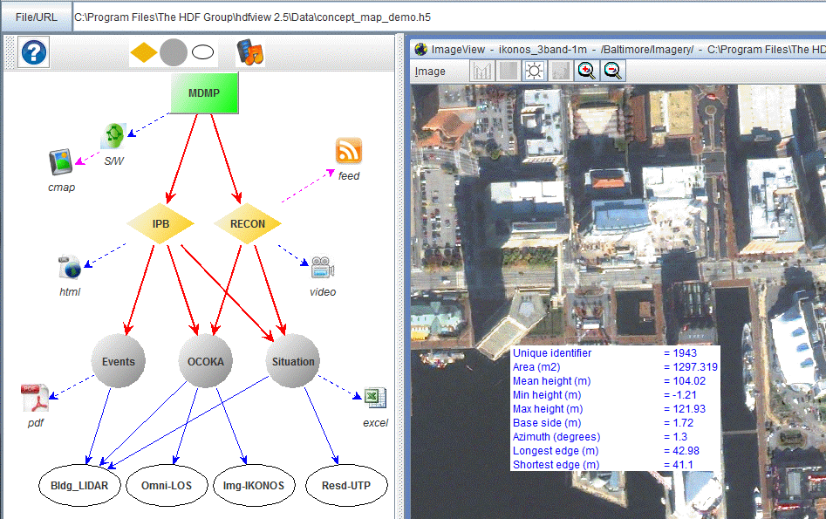
ERDC-HDF BAA Phase 1 completed
(Paper) Transforming the Computational BattleSpace Framework with HDF5
HDFView Concept Map Plugin

Slide 72
ERDC-HDF BAA Phase 2 in progress
Mission -- develop concepts and technologies that give Warfighters a deeper understanding of the operational environment and the local population so they can make more effective decisions.
A common HDF5 data model for handling spatial-temporal data and other civil information.
Tools to input military and civil information data to HDF5 file.
Capabilities of data fusion and analysis using the HDF5 data model.
A visualization tool/plug-in and central data server for demonstrating the concept and technology.

Slide 73
Thank You!

Slide 74
Acknowledgements
This work was supported by cooperative agreement number NNX08AO77A from the National Aeronautics and Space Administration (NASA).
Any opinions, findings, conclusions, or recommendations expressed in this material are those of the author[s] and do not necessarily reflect the views of the National Aeronautics and Space Administration.

