Slide 1
Science Fiction, Philosophy, and the Future Nanoethics Lecture IX
Roderick T. Long
Auburn Dept. of Philosophy

Slide 2
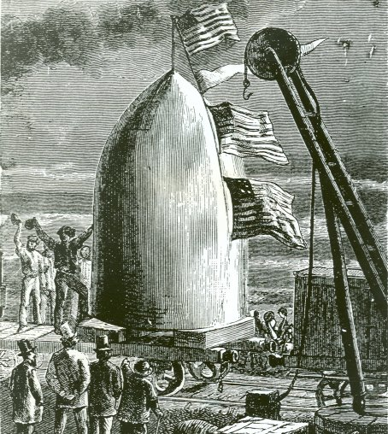
Origin of Science Fiction
As a distinctive literary genre, science fiction originates in the 19th century
Why?

Slide 3
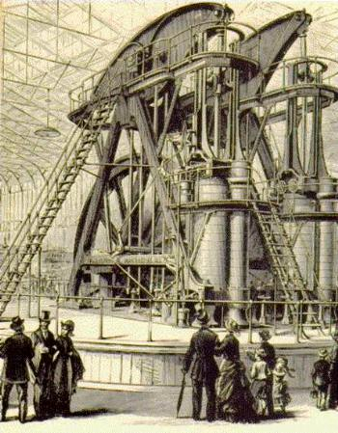
Origin of Science Fiction
The Industrial Revolution showed that technology could dramatically alter our lives – for better, or worse, or some of each

Slide 4

Origin of Science Fiction
The French and American Revolutions showed that political and sociological changes could do likewise

Slide 5
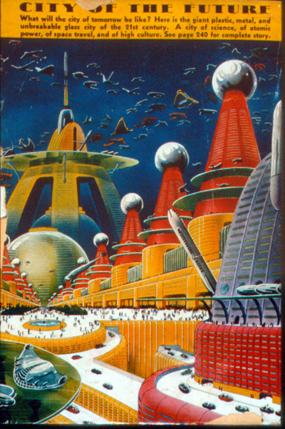
Origin of Science Fiction
Result: the expectation that the future can and will be different from the past – that current forms of technology and social organisation may give way to new and very different ones
This is a new outlook, and demands a new genre to explore it

Slide 6

Cautionary Note
If you know science fiction only through movies and tv shows rather than through novels and short stories, then you know it in what is (usually – there are honourable exceptions!) its least sophisticated, least thoughtful form

Slide 7
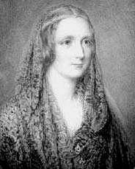
Mary Shelley
Mary Shelley (1797-1851), a pioneer of science fiction, was the daughter of Mary Wollstonecraft, pioneer of feminism, and of William Godwin, pioneer of anarchism; her husband was Percy Shelley, romantic poet and political radical
In short, she was deeply immersed in the futurist thought of her day

Slide 8
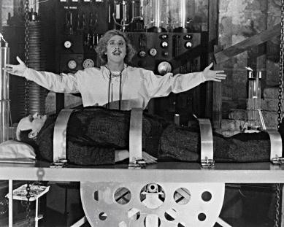
Mary Shelley
Her novel Frankenstein: or The Modern Prometheus (1818) dramatizes a scientist’s inability to control, and unwillingness to accept responsibility for, the destructive forces he unleashes

Slide 9
Mary Shelley
Her lesser-known novel The Last Man (1826) depicts a 21st-century world of airship travel, an America divided into independent northern and southern confederacies, and a plague that wipes out the entire human race except for the narrator

Slide 10
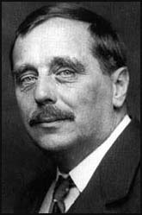
Two Prolific Pioneers of Science Fiction
Jules Verne (1828-1905) H. G. Wells (1866-1946)

Slide 11
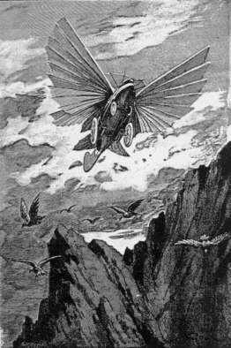
Verne and Wells
Verne’s characters travel by balloon (Five Weeks in a Balloon, 1863), by submarine (20,000 Leagues Under the Sea, 1870) and by airplane/helicopter (Robur the Conqueror, 1886)

Slide 12
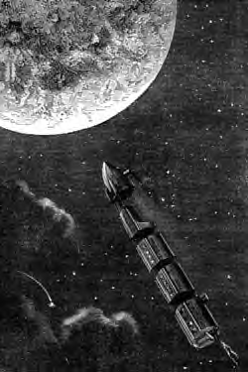
Verne and Wells
In Verne’s first two Gun Club novels, From the Earth to the Moon (1865) and Around the Moon (1870), Verne depicts a moon launch from Florida and splashdown return

Slide 13
Verne and Wells
In Verne’s third Gun Club novel, Topsy-Turvy (1890), engineers buy up land in the arctic and then attempt to knock the earth off its axis to make their land warmer and so raise property values
Anthropogenic global climate change, including melting icecaps!

Slide 14
Verne and Wells
While Verne got his astronauts to the moon by shooting them out of giant cannons, Wells had his First Men in the Moon (1901) use a special alloy that shielded against gravity
Interestingly, neither author used rockets ….

Slide 15
Verne and Wells
Wells’ Island of Dr. Moreau (1896) and Food of the Gods (1904) portray the results of biological experimentation (animal-human hybrids and giant animals, respectively) gone wrong

Slide 16
Verne and Wells
Verne’s Paris in the 20th Century (1863) depicts a future of technological marvels – but also of social regimentation by all-powerful government-sponsored corporations, a world in which science and engineering are prized but art and literature are scorned
It ends with the hero, a poet, collapsing in despair in Père Lachaise cemetery
Verne’s publisher refused to publish it

Slide 17

Verne and Wells
Wells’ The Time Machine (1895) depicts a future in which divisions between socioeconomic classes have advanced to the point where humanity is divided between the childlike, surface-dwelling Eloi and the bestial, subterranean, technology-using Morlocks
His The Sleeper Awakes and Story of the Days to Come (both 1899) explore similar themes

Slide 18
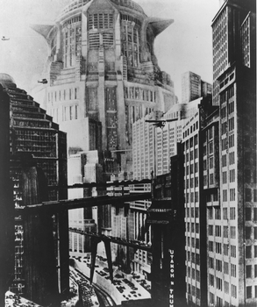
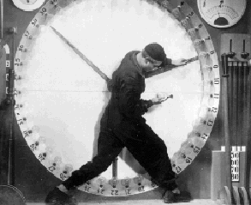
Verne and Wells
Wells’ concern
with the future
of the class
struggle is also
reflected in
Fritz Lang’s
classic 1927 film
Metropolis, featuring a conflict between wealthy, idle surface-dwellers and dehumanised
subterranean workers

Slide 19

Verne and Wells
Wells’ War of the
Worlds (1898)
depicts first contact
between humans
and intelligent
extraterrestrials
The results are not encouraging

Slide 20
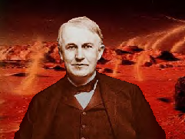
Verne and Wells
American writer Garrett
Serviss was dissatisfied
enough with Wells’ gloomy
War of the Worlds to write an
unauthorised (and surprisingly
scientifically accurate) sequel,
Edison’s Conquest of Mars (1898), in which real-life
inventor Thomas Edison builds a fleet of spaceships and
rayguns so humans can retaliate and kick Martian butt

Slide 21
Verne and Wells
In the 1870s, Verne’s mentor Victor Hugo had predicted that air travel would make war obsolete
Verne, by contrast, predicted military use of airplanes (Master of the World, 1904) as well as long-range missiles (The Begum’s Millions, 1879)

Slide 22

Verne and Wells
Gloomier still, Wells predicted tanks (The Land Ironclads, 1904), aerial bombardment of cities (War in the Air, 1908), atomic bombs (World Set Free, 1914), and submarine-launched missiles (Shape of Things to Come, 1933)

Slide 23
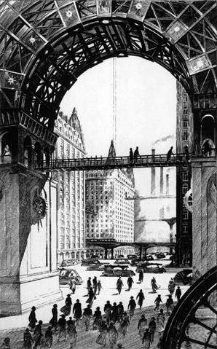
Verne and Wells
But not all their predictions were negative
Verne’s In the Year 2889 (1889), co-authored with his son Michel, depicts all the technological wonders of his Paris in the 20th Century without the negative social accompaniments

Slide 24
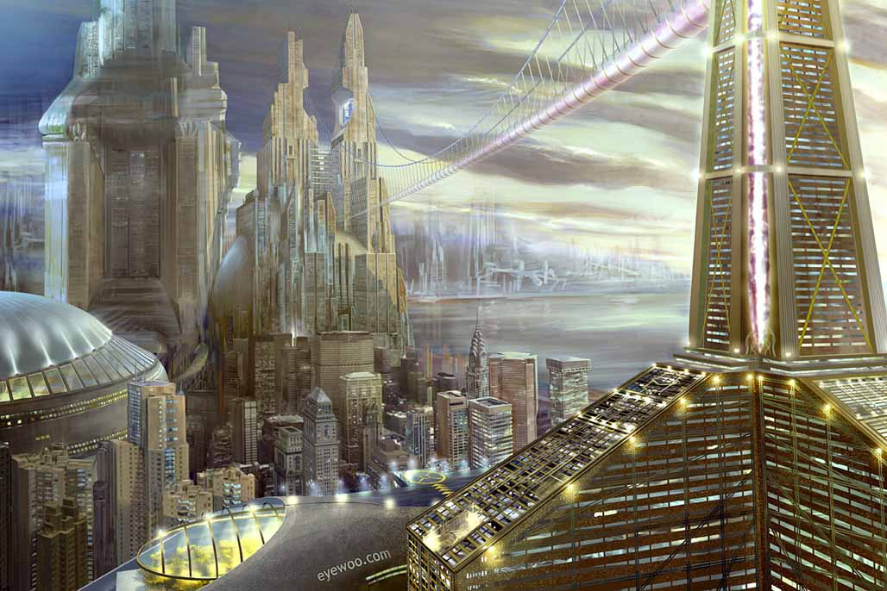
Verne and Wells
In Well’s Modern
Utopia (1905) and
Men Like Gods
(1923), advances
in technology and
social science create a paradise on earth,
free of poverty and crime

Slide 25

Verne and Wells
“Wells imagined both dark and bright futures because his creed allowed both while promising neither, and because the eighty years of his life were years of immense intellectual and technological accomplishment and appalling violence and destruction.”
– science fiction author Ursula Le Guin

