Slide 1

Quantitative Methods: Conducting a User Survey and Interpreting Data Midwest Archives Conference Fall Symposium October 22, 2010 Dayton, Ohio
Christopher J. Prom, PhD
Assistant University Archivist and Associate Professor
University of Illinois at Urbana-Champaign
prom@illinois.edu

Slide 2
My Quantitative Background
"The EAD Cookbook: a Survey and Usability Study". American Archivist 65, no. 2 (2002): 257-275. Survey
“User Interactions with Electronic Finding Aids in a Controlled Setting." American Archivist 67, no. 2 (2004): 234-68. Observational research w/stats
“Optimum Access? A Survey of Processing in College and University Archives.” CU Reader, 2007. Survey
w/ Ellen D. Swain "From College Democrats to the Falling Illini: Identifying, Appraising, and Capturing Student Organization Web Sites." American Archivist 70/2 (2007): 344-363. Descriptive statistics, sample of websites, Survey.
“Using Web Analytics to Improve Online Access to Archival Resources.” Forthcoming Spring 2011. The American Archivist. Weblog statistics.
Archon/AT User Survey (current). Survey
Big Proviso

Slide 3
Session Goals
You will be able to:
List the steps to be taken when designing a research study than includes a survey
Identify problems/issues when reading literature that uses surveys
Describe some elements affecting survey reliability
Find resources to help develop user surveys
Describe Excel tools for analyzing data
Avoid some common survey design, implementation and interpretation errors

Slide 4
Session Structure
Overview of Survey Planning/Design Methodology (70 min)
Planning
Formulating an effective survey instrument and survey process
Dos and Don’ts
Using Excel to Analyze Data 15 min)
Basic statistical concepts
Feature overview
Examples
Discussion/Your Questions (5 min)

Slide 5
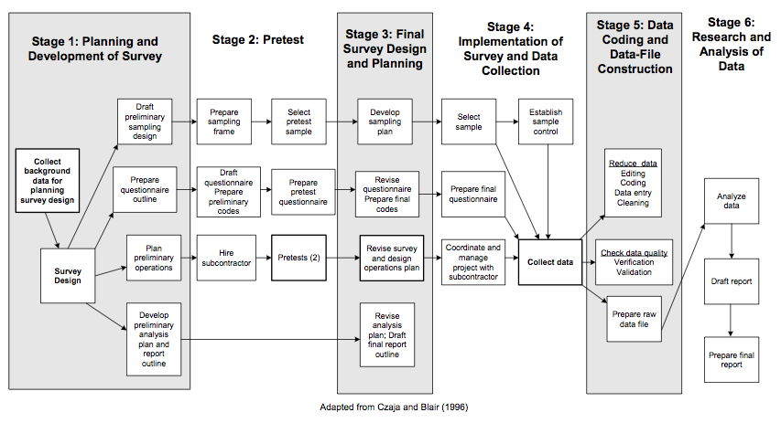
I: Overview of Survey Planning

Slide 6
Critical Steps
Determine purpose/plan
Identify population and sample that represents it
Formulate effective survey instrument
Pre-test and revise
Follow up with non-respondents
Analyze and report

Slide 7
Step 1: Determine Purpose
Do | Don’t
Set aside a month (or more) for planning | Go right to question writing
Know what you are trying to measure. | Survey just for ‘reporting’ or ‘statistical’ purposes
Limit your self to one major research question (Do you need a survey?) | Conflate disparate issues in one survey
Formulate specific hypotheses to prove or disprove | Have a vague, general purpose
Think about measurable data points that speak to each hypothesis (correlation) | Ask only open-ended questions
Notes:
How usable is our website? How satsified are its users? -leads to my GA study,

Slide 8
Example 1
Doris Malkmus, Teaching History to Undergraduates with Primary Sources: Survey of Current Practices, Archival Issues Vol 31:1.
How do faculty use primary sources in classroom?
12 straightforward questions—
10 clearly quantitative
One coded to categories
One simple comment field

Slide 9
Example 2: My processing survey
“What factors correlate with low processing speed?”
Demographic | Practices/Tools | Results
Repos. Size/type | Use of techniques | Total holdings
Staffing | Descriptive tools | Processed holdings
 | Access tools | Holdings online
 | Use of metadata standards

Slide 10
Exercise 1
Select a partner
Working together, formulate:
An research question relevant to one of both of your repositories
Three data points that potentially speak to it.

Slide 11
Step 2: Develop Sampling Plan
Sampling is useful for non-survey (e.g. descriptive statistics) and survey work
Population: The total group of things (e.g. people) who you want to measure)
Sample: A selected part of the population
Population
sample

Slide 12
Step 2: Develop Sampling Plan
Do | Don’t
Carefully identify the largest possible population | Inadvertently limit the population
Aim for 95% confidence-level sample OR Consider ‘sampling’ entire population | Inadvertently introduce bias
Consider stratified sampling | Over or under represent ‘statistically-significant’ groups in the population

Slide 13
If you Sample: Gold Standard
Random: Every member has equal chance of being chosen
Complete: Every member in sample responds
Representative: Sample represents characteristics of population as a whole
All sampling involves inferential statistics
Notes:
This is impossible to achieve!

Slide 14
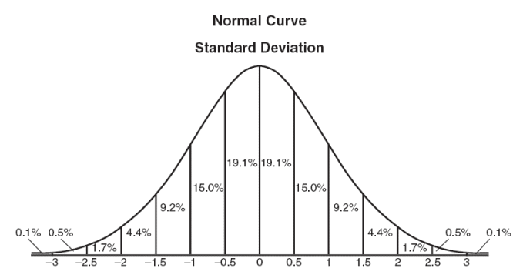
Population and Sample Means
Population mean
Sample B mean
Sample A mean
Sample C mean

Slide 15
Scary Sampling Terminology
Central Limit Theorem
For any distribution of a population, the distribution of the means of all random samples is itself approximately normal
Confidence Level
A range of numbers within with the population mean will lie, with the stated probability (e.g. 95%, 99%)
Standard Error
How much variability to expect, for a given sample.

Slide 16
Bottom Line
There are easy methods to increase confidence that your sample’s characteristics matches those of the population
When selecting sample, you need to
A: reduce bias; best way to do this is to select a truly random sample
B: Ensure sufficient sample size; must be measured against confidence level and standard error (aka ‘margin of error’

Slide 17
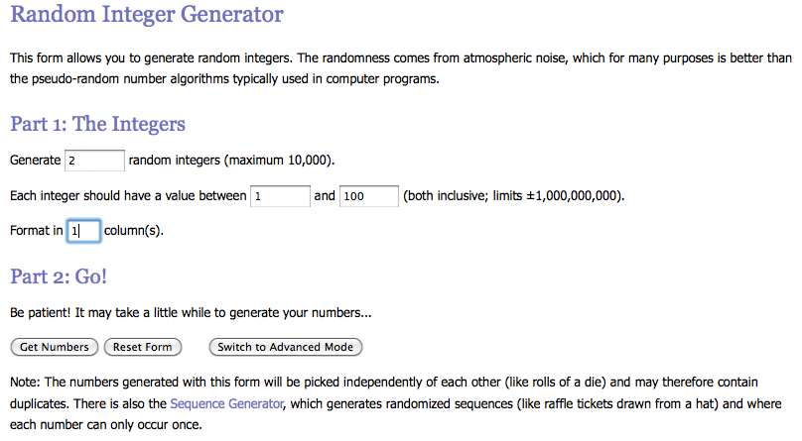
Random Number Generators
In Excel (must install Analysis Tools)
http://www.random.org/integers/

Slide 18
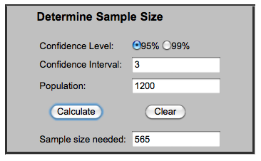
Sample Size Calculator
http://www.surveysystem.com/sscalc.htm

Slide 19
How to Sample Badly
Abraham Brookstein, Library Quarterly 44:2 (1974): 124-32
http://www.jstor.org/stable/4306378
Sample is not truly random (each one does not have equal chance of being picked)
Sample does not represent differences in population
Population itself is not correctly identified
Surveys: Special problems
Aim to get 95% confidence level, 3% interval
If you can’t, retrospectively calculate them (don’t just say, we had a response rate of 13%) and report variable ‘n’ for each question
Take active steps to ensure that respondents represent population

Slide 20
Exercise 2: Sampling
Work with your Partner
Identify a group that you think serves as a representative population that can answer your research question.
List three factors you will need to keep in mind to limit bias among respondents to a survey regarding your research question.
My Example: Student Orgs project
Websites; Carnegie list, stratified
Every x number, random start

Slide 21
Other Sampling Resources
http://www.davidmlane.com/hyperstat/
Ian Johnson, “I’ll give you a definite maybe,” https://records.viu.ca/~johnstoi/maybe/title.htm (Section 6)
Random Samples and Statistical Accuracy, http://www.custominsight.com/articles/random-sampling.asp (good for stratified sampling)

Slide 22
Step 3: Formulate Survey
Do | Don’t
Set aside two months or more for this step | Rush ahead without pre-testing
Use appropriate technologies | Use complex features or question types unless you understand them fully
Write “correlate-able” questions | Ask all open-ended questions
Ensure questions are not leading | Make the survey overly complex
Carefully weigh meaning of each word in a question | Ask too many questions
Notes:
How usable is our website? How satsified are its users? -leads to my GA study,

Slide 23
Types of Surveys
Interview Based |  | Web Based
Pro | Con | Pro | Con
High response rate for small population | Time consuming to do interviews | Sufficient response rate for large population | Time consuming to set up
Flexible questioning | Easy to introduce bias | Ability to easily correlate data | need attention to question design
Low/not tech requirements | Post processing time consuming | Less analysis/post processing | Higher initial tech requirements

Slide 24
Some Technical Options
Survey Monkey (free, $200 year to remove limits)
10 question limit
100 response limit
SurveyGizmo (higher limits to free account, lower cost, branching, etc.)
LimeSurvey (free, need PHP and mysql; install on own site, many webhosts support it)

Slide 25
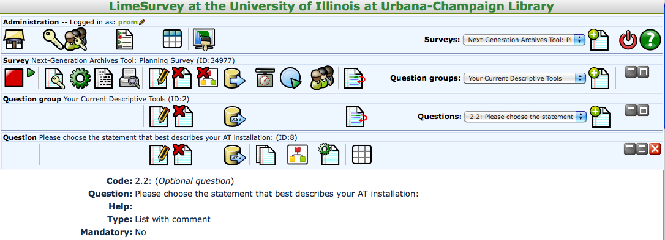
LiveSurvey Interface

Slide 26
Rule 1: Use Appropriate Question Types
Easy to compare/correlate
Yes/No
Numerical Value
List of Options (multiple choice, select one)
Numerical ranges
Or with weighted values
Arrays (be careful in how you implement)

Slide 27
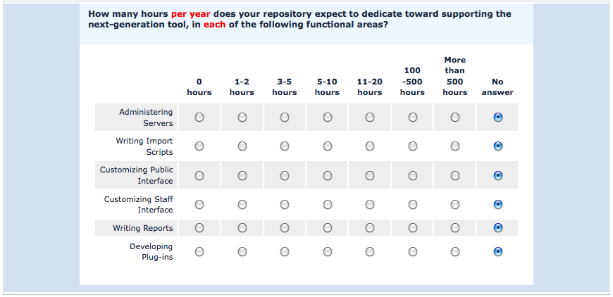
Array Question

Slide 28
Rule 1: Use Appropriate Question Types
Difficult to compare/correlate
List of Options (checkbox, select multiple)
Any open-ended question
Good list of question types
http://docs.limesurvey.org/tiki-index.php?page=question+types
Use existing models (Archival Metrics)
Other bad questions
Any that do not speak to your research question or gather essential demographic information

Slide 29
Rule 2: Use Appropriate Pacing
Simple consent process (IRB review probably necessary)
Most important/interesting questions first
Not too many questions per page or total
Use software that can be ‘left off’ and picked up
Demographic questions at end

Slide 30
Rule 3: Group Questions
Demographics
Nature of those responding (type of user, age, archival experience, etc)
Subject of study
experiences with website
Service satifaction
Etc.

Slide 31
Rule 4: Word Questions Carefully
Simple but precise language
Terms unambiguous or defined
Pre-test every question among target audience.

Slide 32
Exercise 3
Working with your partner, look back to the list of potential data points that you might wish to measure to help answer your research question.
Write a multiple choice question that you might present to the population.
Exchange questions with another group and provide each other feedback.
Then, rewrite your original question

Slide 33
Step 4: Data Analysis and Reporting
Do | Don’t
Read about basic statistical concepts | Use concepts you don’t understand
Install Excel’s “analysis tools” | Use them without understanding what they are doing
Clean data | Massage data in the process of cleaning it
Report provisos to your data | Attempt to whitewash or ignore problems with the sample
Think carefully about what your results really mean | Just report the data with minimal analysis
Notes:
How usable is our website? How satsified are its users? -leads to my GA study,

Slide 34
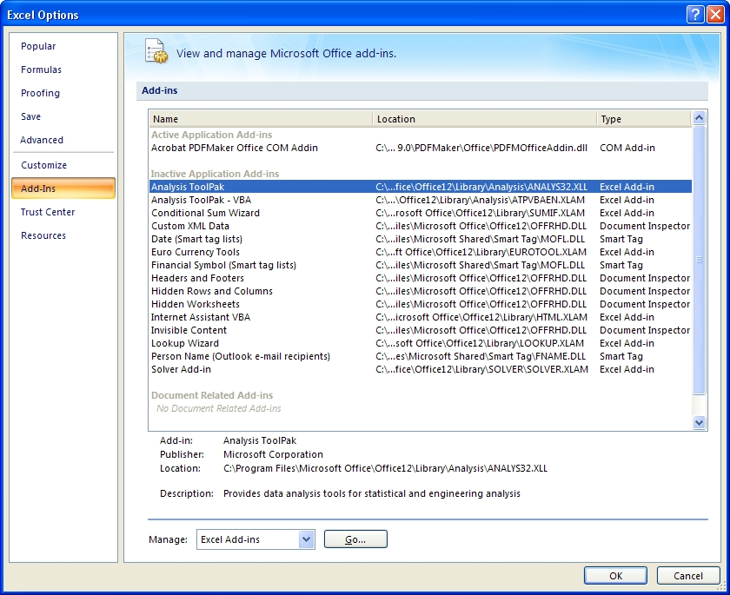
Using Excel Descriptive Statistics Tools

Slide 35
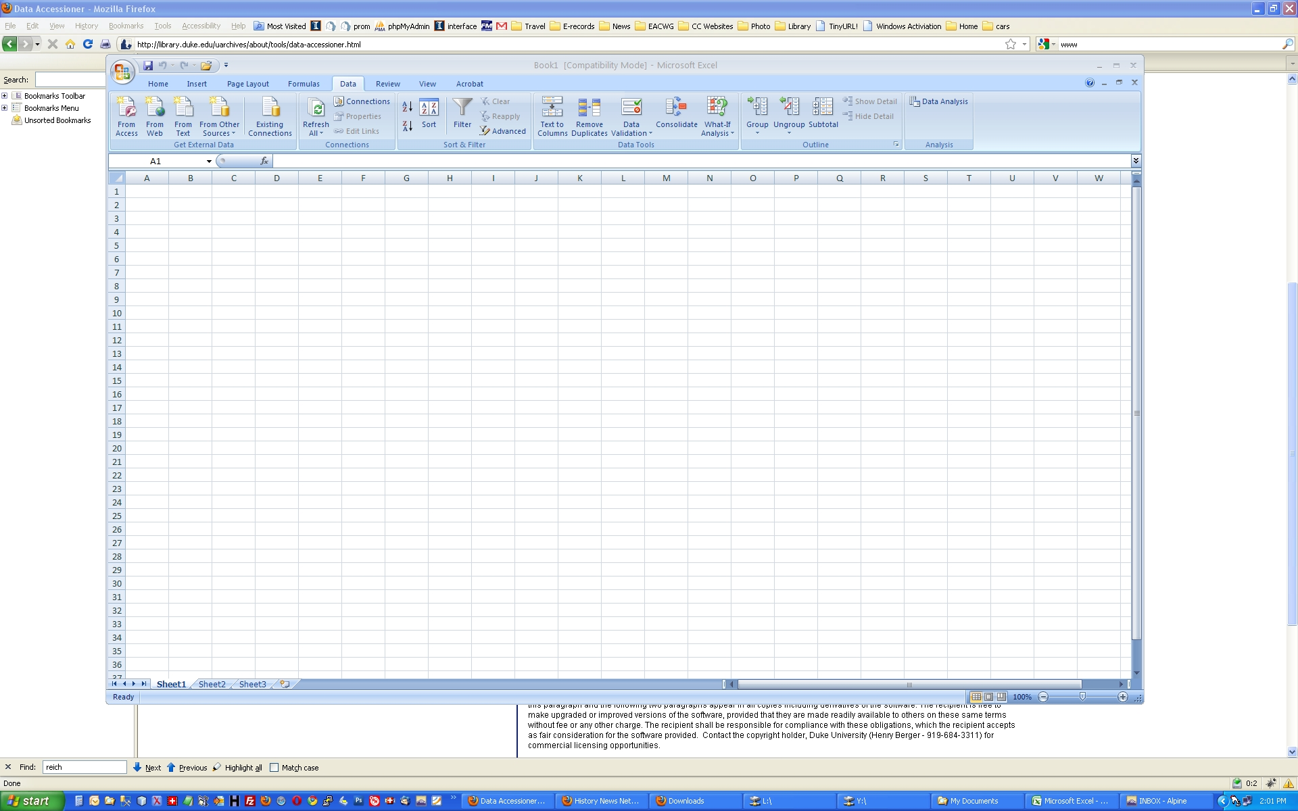
Using Excel Descriptive Statistics Tools

Slide 36
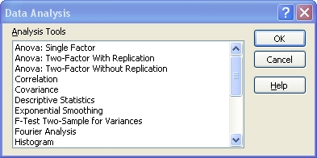
Using Excel Descriptive Statistics Tools

Slide 37
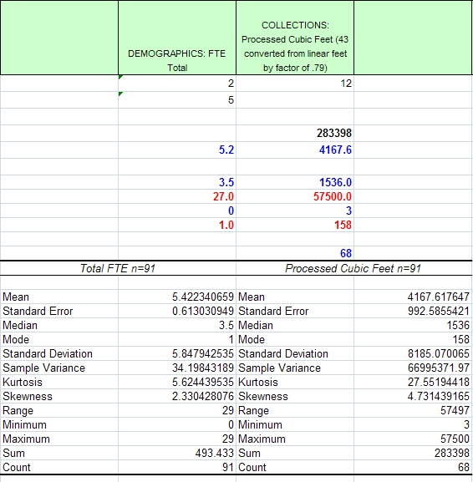
Using Excel Descriptive Statistics Tools

Slide 38
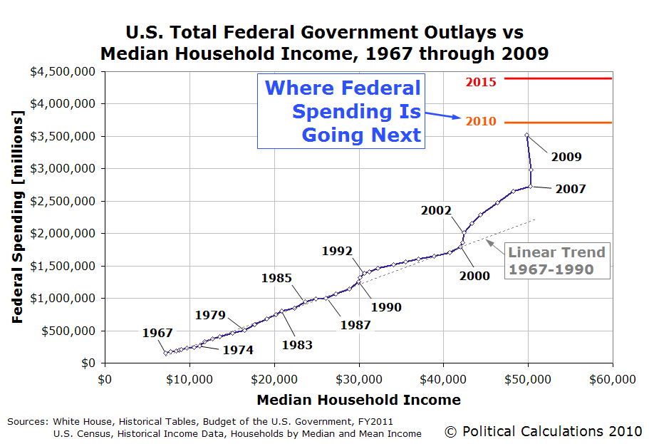
Rule 1: Don’t Compare Apples to Oranges

Slide 39
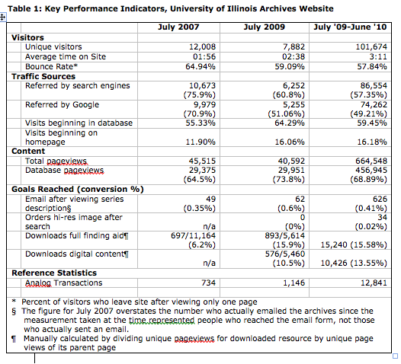
Rule 2: Use Tables and Charts Sparingly

Slide 40
Rule 3: Report What’s Meaningful
Common methods to show statistical significance
Limitations of Descriptive Stats
Correlation (CAUTION)
Variation from mean (in terms of standard deviations)
T-test (is difference between two means significant)
Use qualitative information to support the ‘why’ questions
Persuasive analysis should comprise heart of your report

Slide 41
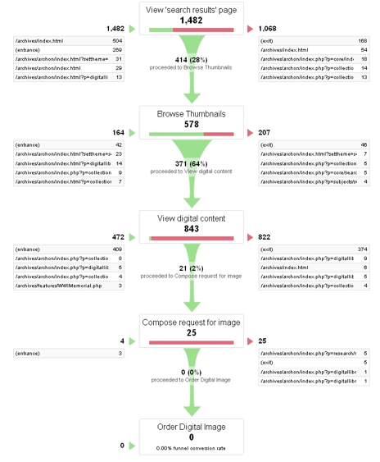
Rule 4: Use Figures to Tell the Story

Slide 42
Quantitative Methods: Conducting a User Survey and Interpreting Data Midwest Archives Conference Fall Symposium October 22, 2010 Dayton, Ohio
Christopher J. Prom, PhD
Assistant University Archivist and Associate Professor
University of Illinois at Urbana-Champaign
prom@illinois.edu

