Slide 1
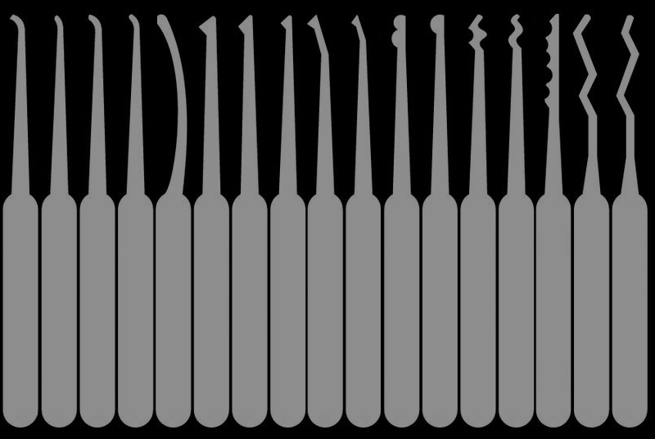
Distinguishing Picks
Deviant Ollam

Slide 2

Lockpicking Tools Can Be Confusing

Slide 3
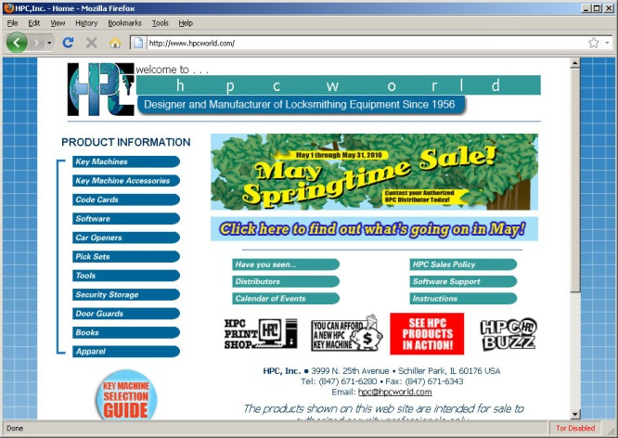
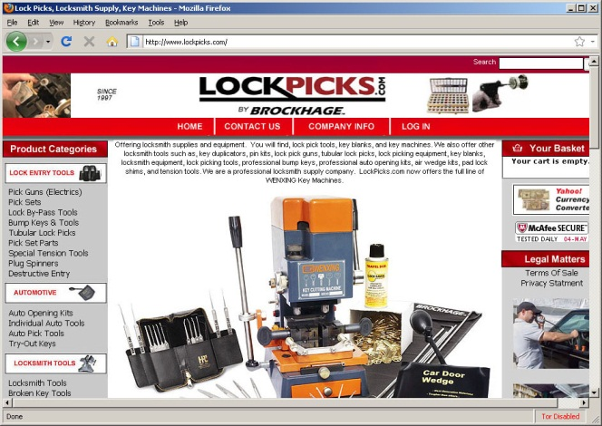

There are many lockpick vendors…

Slide 4
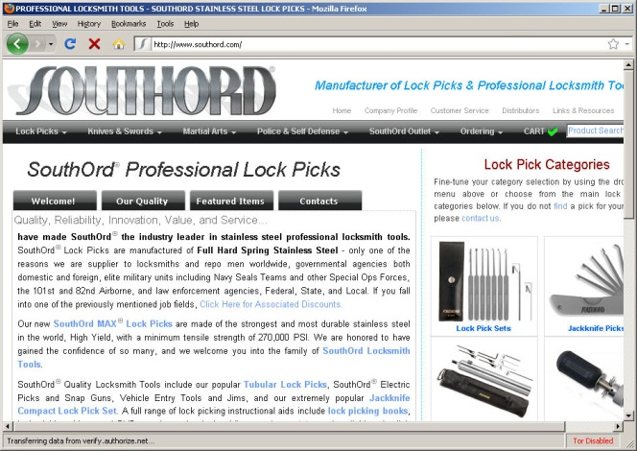
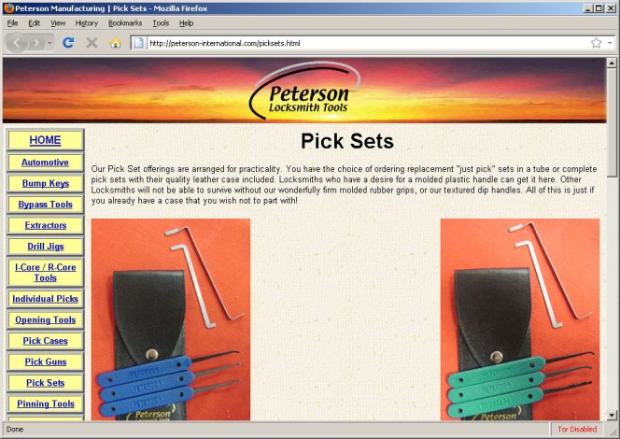
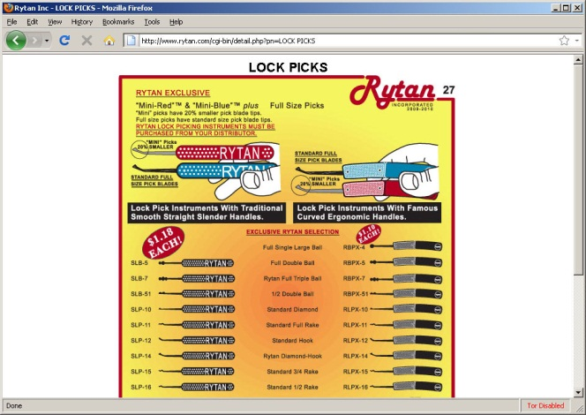
There are many lockpick vendors…

Slide 5
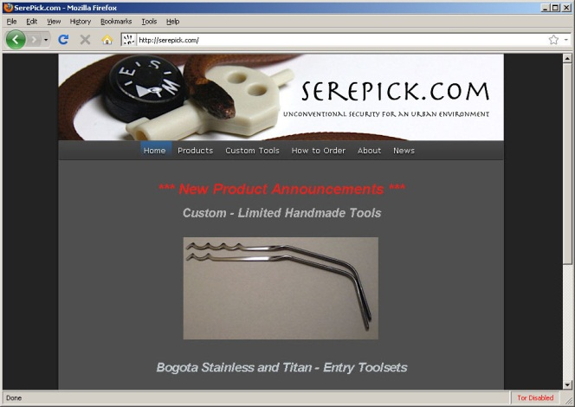
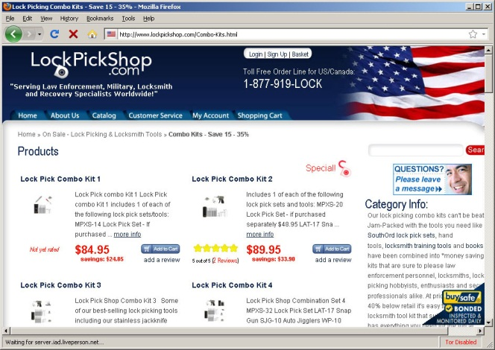
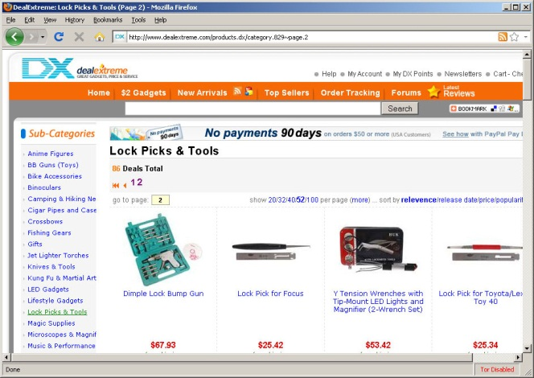
There are many lockpick vendors…

Slide 6
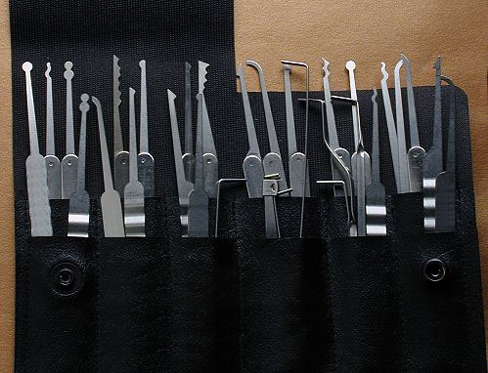
Selling many lockpicking tools

Slide 7

First, let’s talk about metal…

Slide 8

Spring Steel

Slide 9
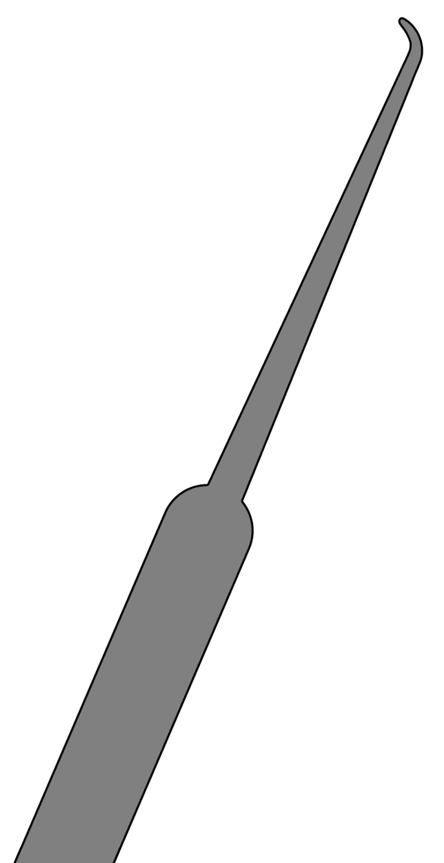
Stainless Steel

Slide 10
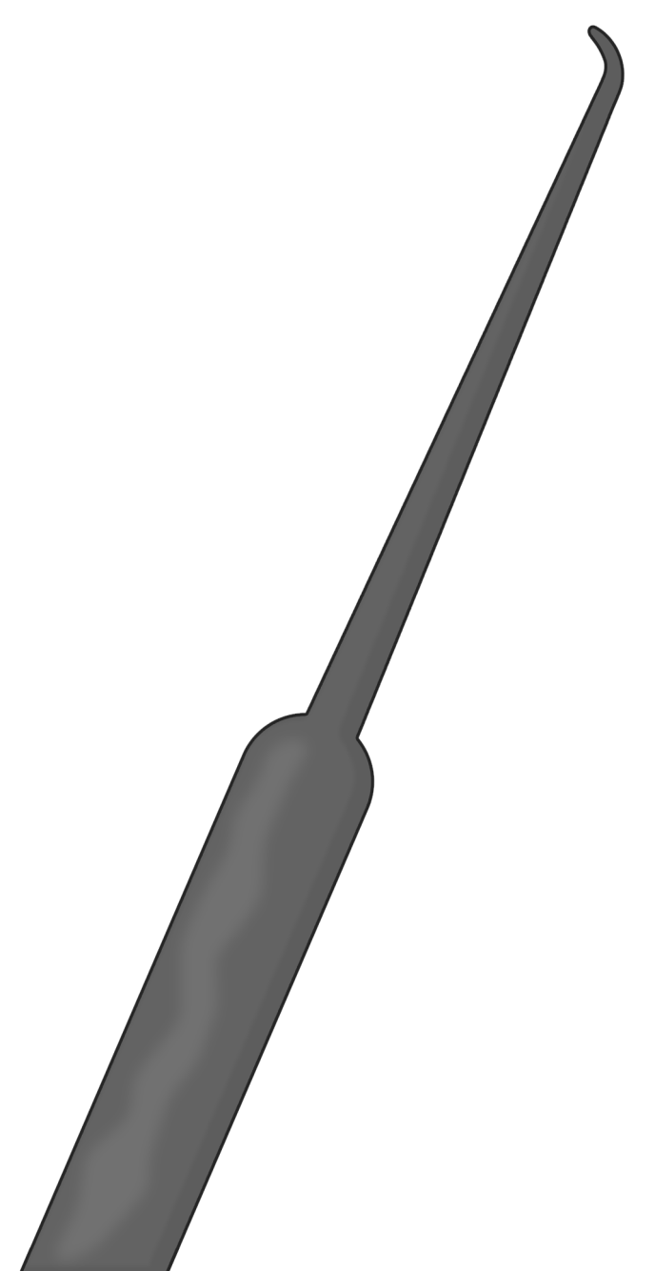
Titanium

Slide 11
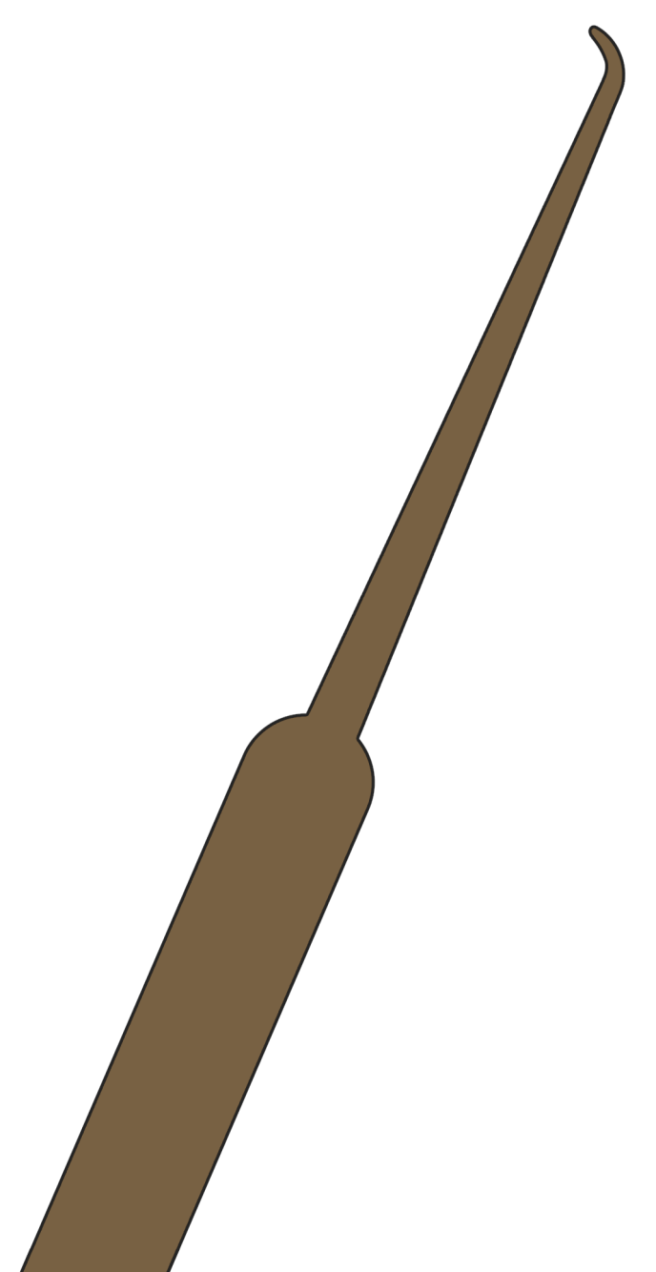
Other Metals ?

Slide 12
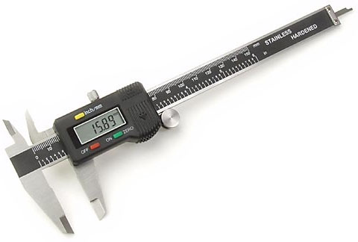
Thickness
0.0 1 5” – Peterson “Government Steel”
0.020” – SouthOrd, Rytan, Southern Specialties, TOOOL
0.022” – HPC Stainless
0.025” – original TOOOL kits
0.028” – HPC Spring Steel

Slide 13

“Standard” vs. “Euro”

Slide 14


“Standard” vs. “Euro”

Slide 15
“Standard” vs. “Euro”

Slide 16

“Standard” vs. “Euro”

Slide 17
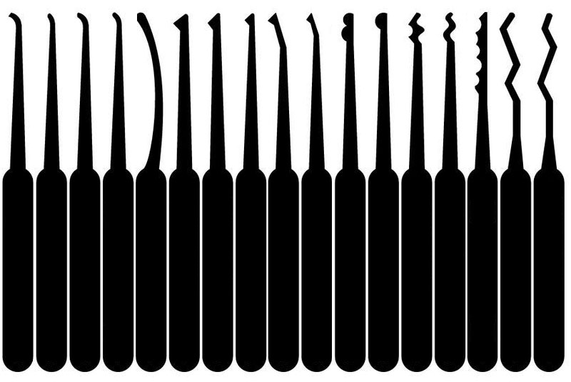
The real confusing mess… Categories & Names

Slide 18
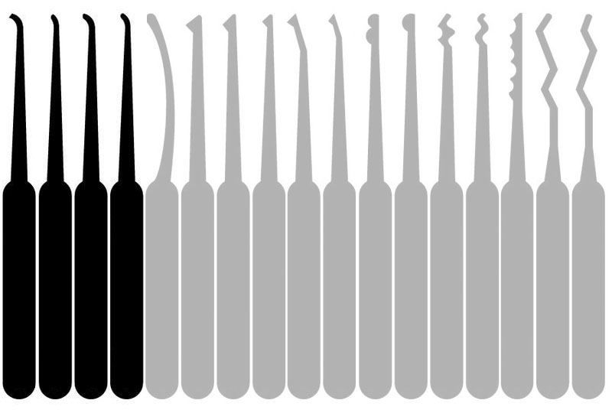
What would you call these ?

Slide 19





Hooks (a.k.a. Lifters)

Slide 20



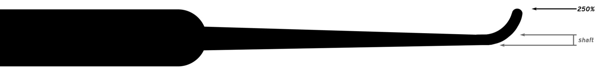
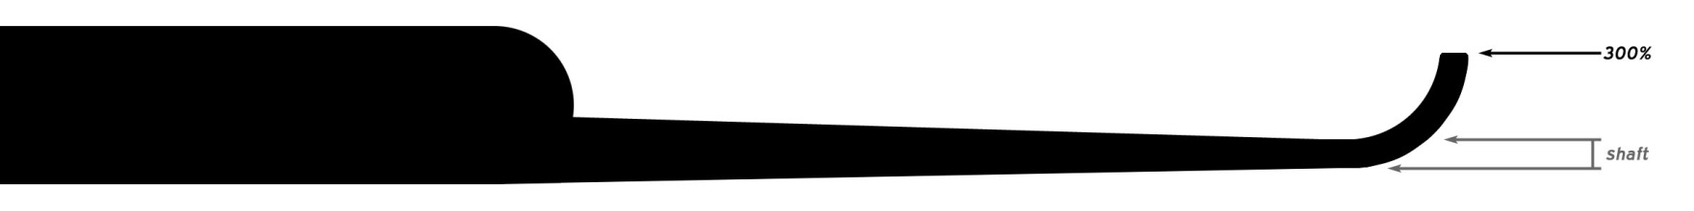
Hooks (a.k.a. Lifters)

Slide 21
Hooks (a.k.a. Lifters)
Short Hook (flat)
Short Hook (round)
Medium Hook
Gonzo Hook
Long Hook

Slide 22
Hooks (a.k.a. Lifters)
Typical
Useful
Meh
Awesome
FAIL

Slide 23
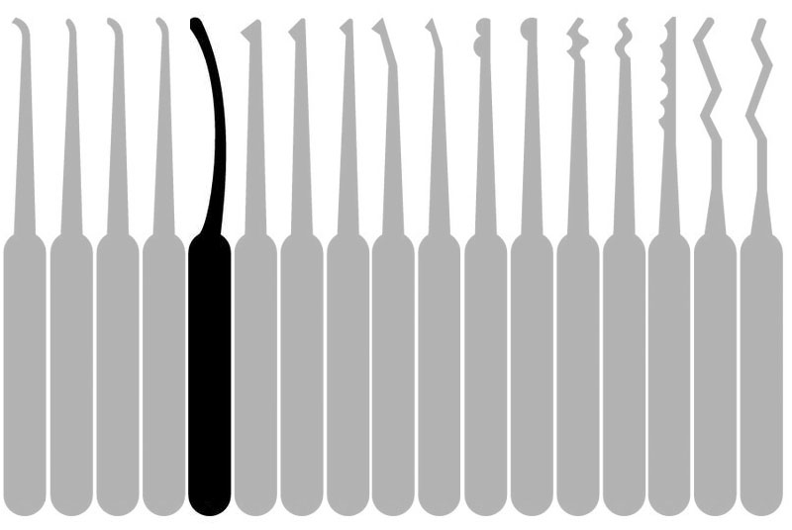
What would you call these ?

Slide 24


Reach Tools
Deep Curve
Hybrid

Slide 25
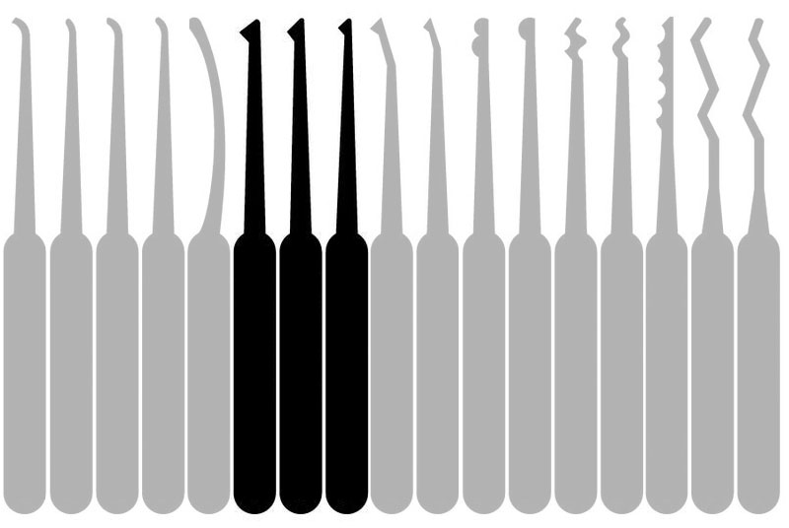
You’ve all seen these…

Slide 26




Diamonds

Slide 27



Diamonds

Slide 28
Diamonds
Small Diamond
Medium Diamond
Large Diamond
Diamond Head

Slide 29
Diamonds
Maybe
Yes
No
Dear God, Why ??

Slide 30
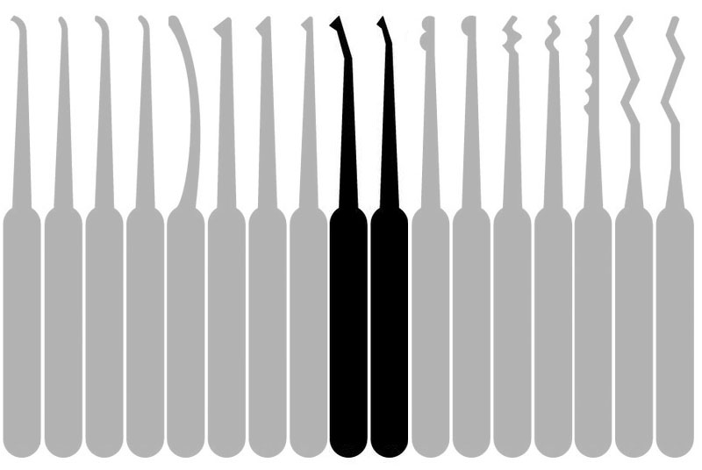
How would you categorize these…?

Slide 31



Offset Tools

Slide 32
Offset Tools
Offset Diamond
Offset Ball
Offset Snake

Slide 33
Offset Tools
Yeah, sure.
Meh, why not ?
Really ?

Slide 34
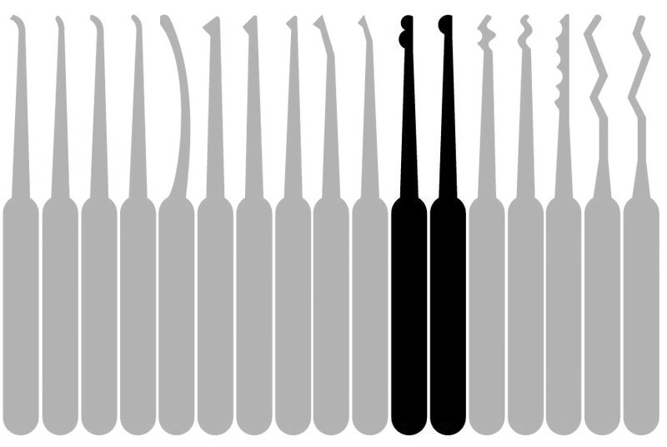
Balls, balls, balls…

Slide 35




Balls, balls, balls…

Slide 36
Balls, balls, balls…
Single Ball
Snowman
Half Snowman
Half Ball

Slide 37
Balls, balls, balls…
Pretty Useless
Can Be Useful
Tight Spaces ?
We Will Mock You

Slide 38
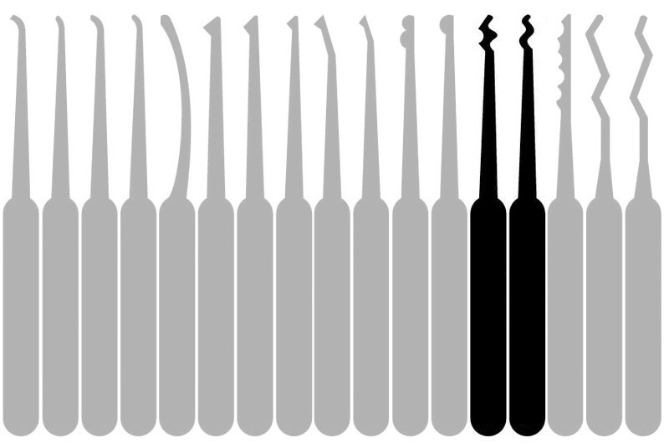
What would you call these ?

Slide 39

Raking tools… Welcome to Crazy Land

Slide 40






Raking Tools
Snake
a.k.a. C Rake, Double Rake
Three Quarter Snake
a.k.a. Rake-and-a-Half
Half Snake
a.k.a. Single Rake
Double Snake
a.k.a. Quad Rake
Stretched Snake
a.k.a. S Rake
Batarang
a.k.a. S Rake, Camel Back

Slide 41
Raking Tools
Snake
a.k.a. C Rake, Double Rake
Three Quarter Snake
a.k.a. Rake-and-a-Half
Half Snake
a.k.a. Single Rake
Double Snake
a.k.a. Quad Rake
Stretched Snake
a.k.a. S Rake
Batarang
a.k.a. S Rake, Camel Back
Dangerous Weakness

Slide 42
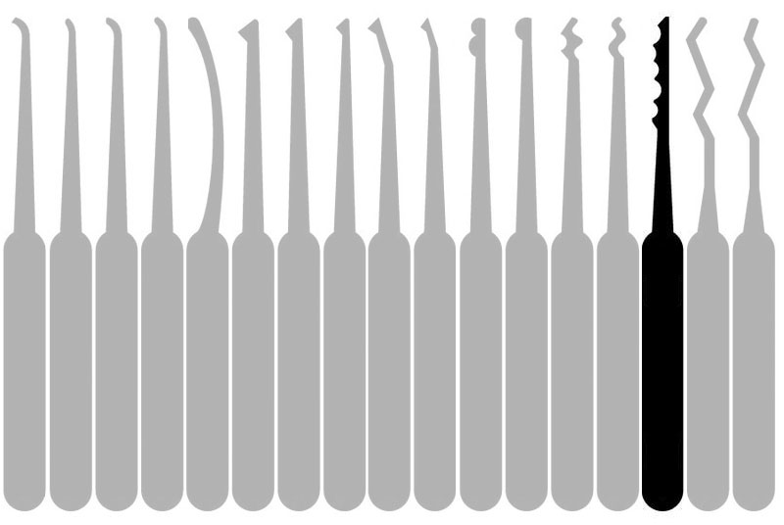
What about something like this…

Slide 43
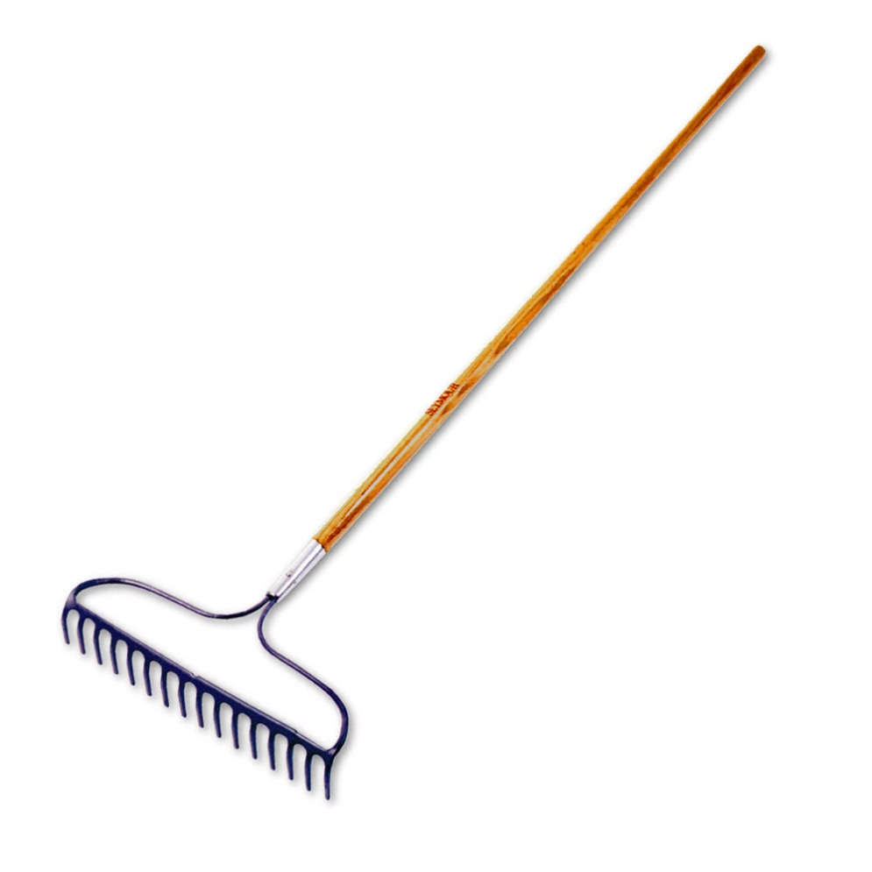
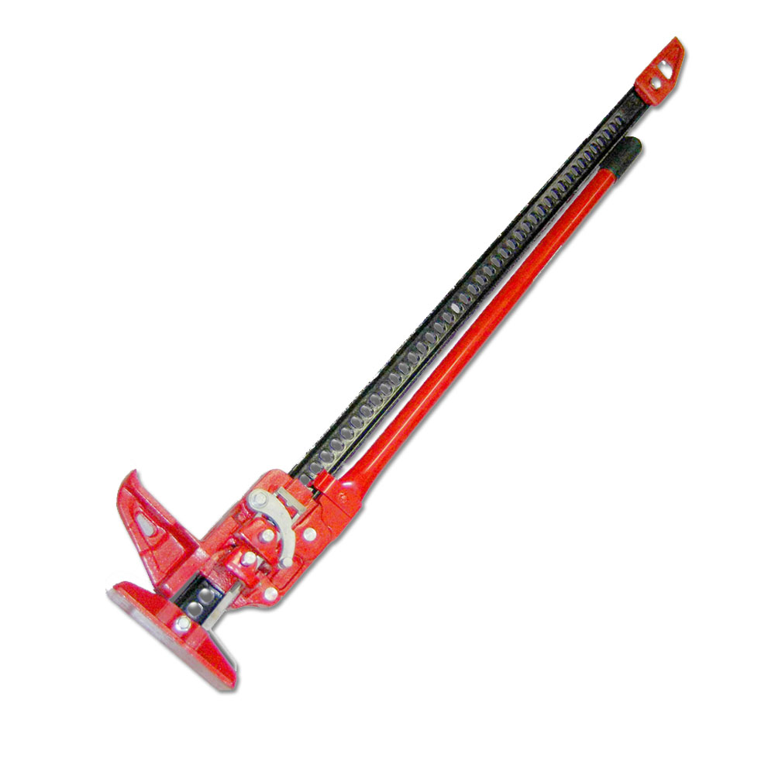
“Raking” vs. “Lifting”

Slide 44

Raking

Slide 45

Raking

Slide 46
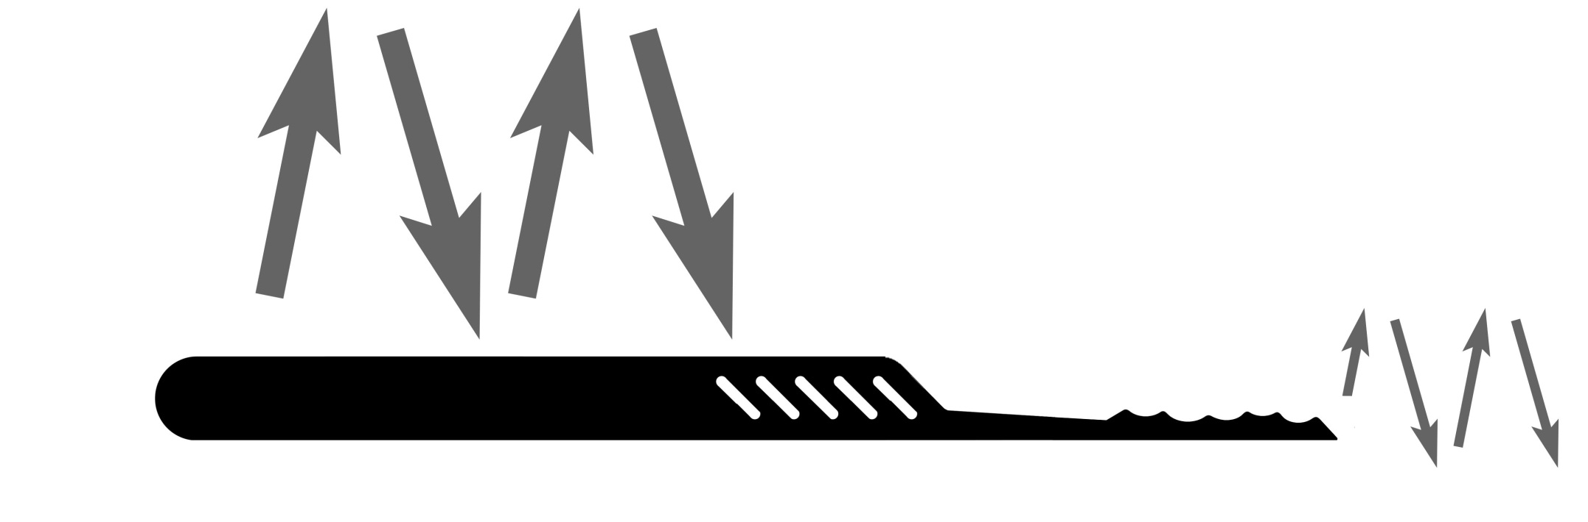
Lifting

Slide 47





Jagged Lifters
Wedge Rake
a.k.a. W Rake, Short Jag, Ramped Tool, & Stupid
Long Rake
a.k.a. L Rake, Long Jag,
Ripple, & Saw Tooth
Falle Slope
Falle Valley
Falle Hump
a.k.a. Long Rimple

Slide 48
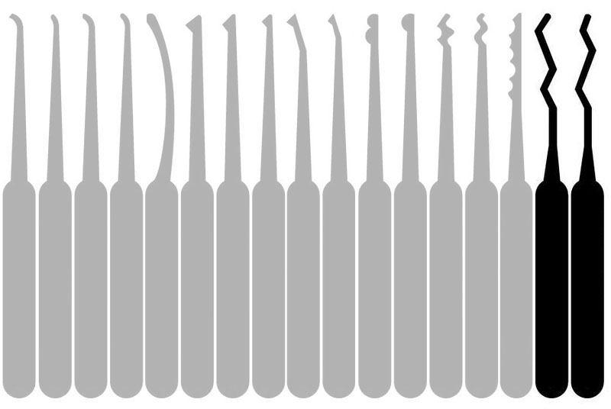
So, what on earth are these ?

Slide 49


King & Queen
King Pick
Queen Pick

Slide 50


A major innovation in pick tools
Thanks to Minnesota…
… with a nod to Columbia

Slide 51
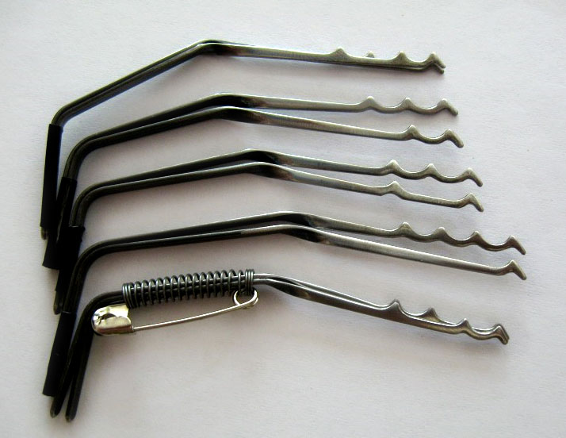
Raimundo’s Family of Tools

Slide 52
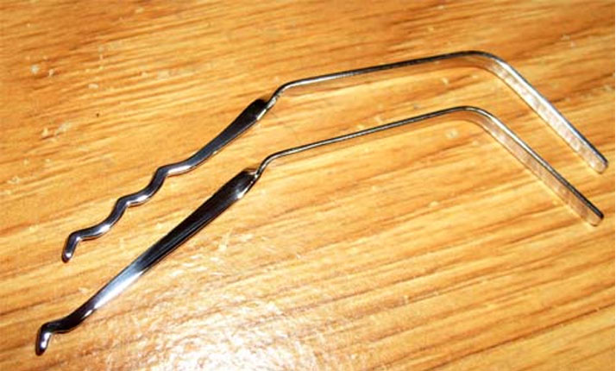
It Started with Two Tools…
“Jiggler” Tools

Slide 53
What is Jiggling ?
In Between Raking & Lifting …

Slide 54

What is Jiggling ?
… There is “Jiggling”

Slide 55


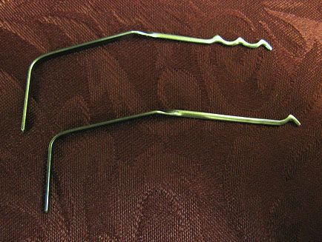
Bogota Family
´
Bogota
´
Single Hump a.k.a. Hollow Half Diamond

Slide 56



Bogota Family
´
Bogota
´
Single Hump a.k.a. Hollow Half Diamond
Two Hump a.k.a. Camel
Quad Hump
Sabana
http://theamazingking.com/bogota.html

Slide 57

Bogota Family
´
Bogota
´
Single Hump a.k.a. Hollow Half Diamond
Two Hump a.k.a. Camel
Quad Hump
Sabana
Wave Jiggler a.k.a. Faux-gota

Slide 58


Bogota Family
´
Bogota
´
Single Hump a.k.a. Hollow Half Diamond
Two Hump a.k.a. Camel
Quad Hump
Sabana
Wave Jiggler a.k.a. Faux-gota
Monserate (fore)
Monserate (aft)

Slide 59
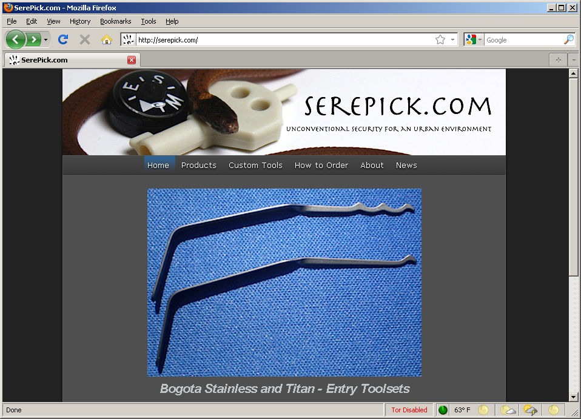
Bogota Picks for Operators
http://serepick.com
Titanium Alloy… almost zero Magnetic Footprint

Slide 60

When is a Diamond Not a Diamond ?

Slide 61

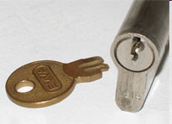
When It’s an Extractor Tool

Slide 62
This Tool May Look At Home Here…

Slide 63




… But Its Closest Relatives are Here

Slide 64
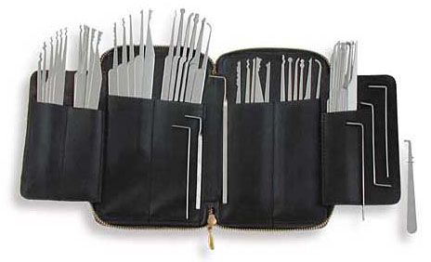
What Do You Really Need In Your Kit ?

Slide 65
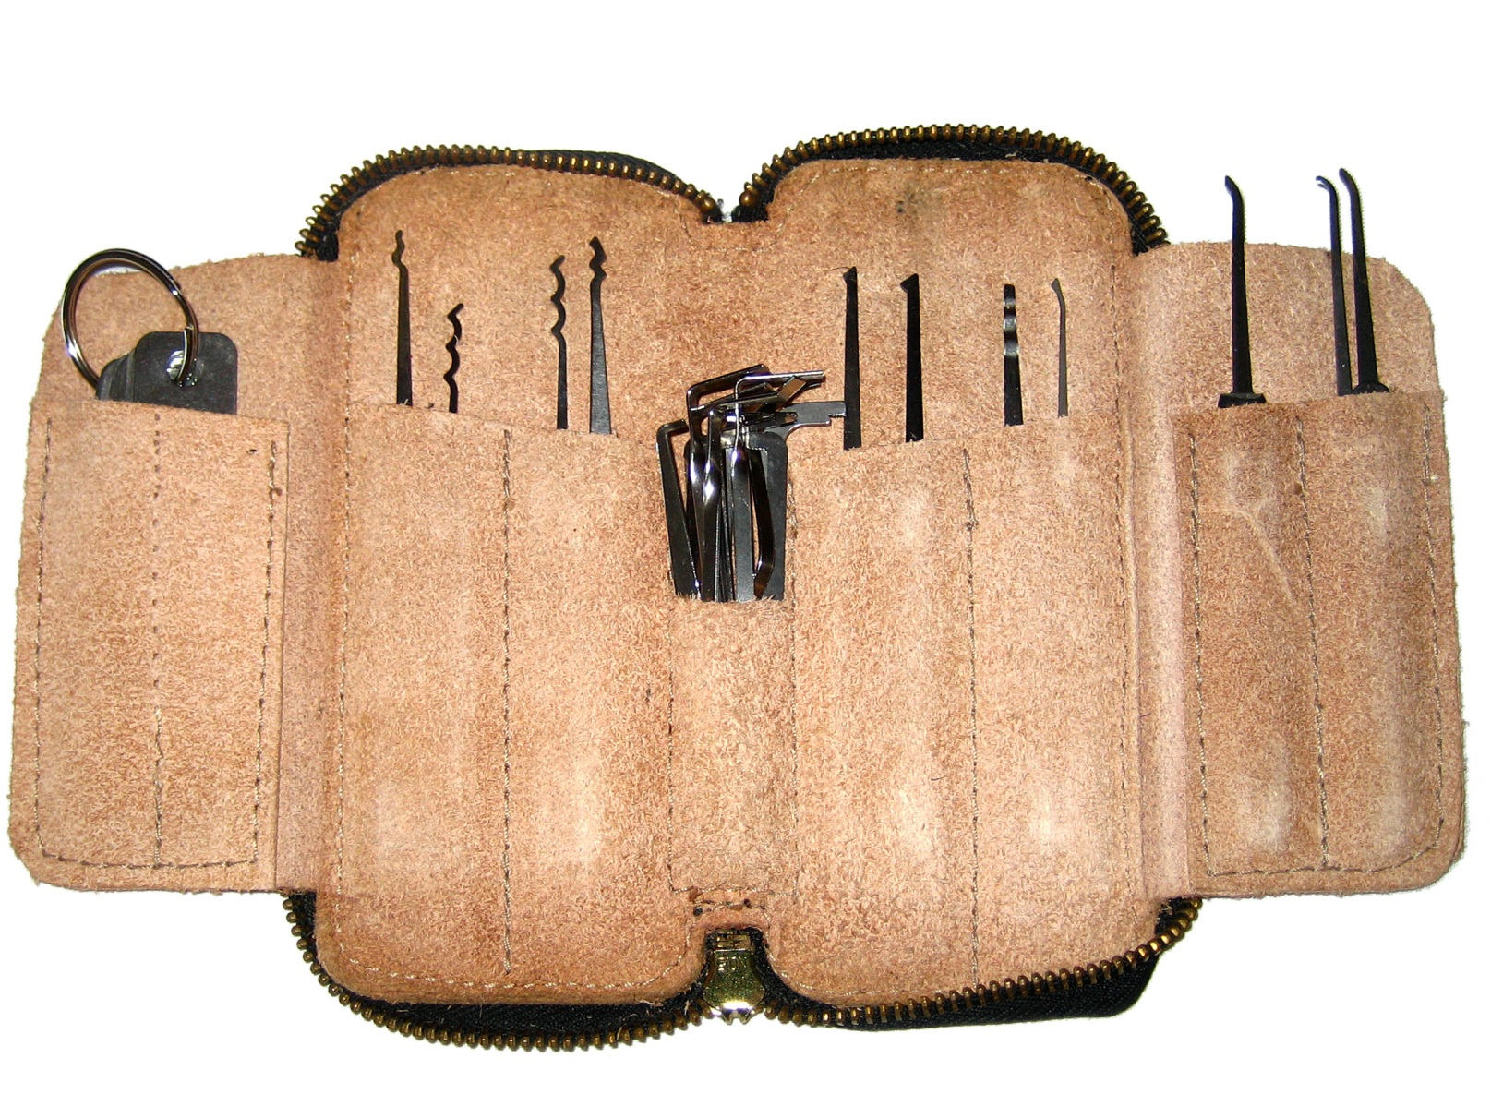
Typical Pick Kit

Slide 66
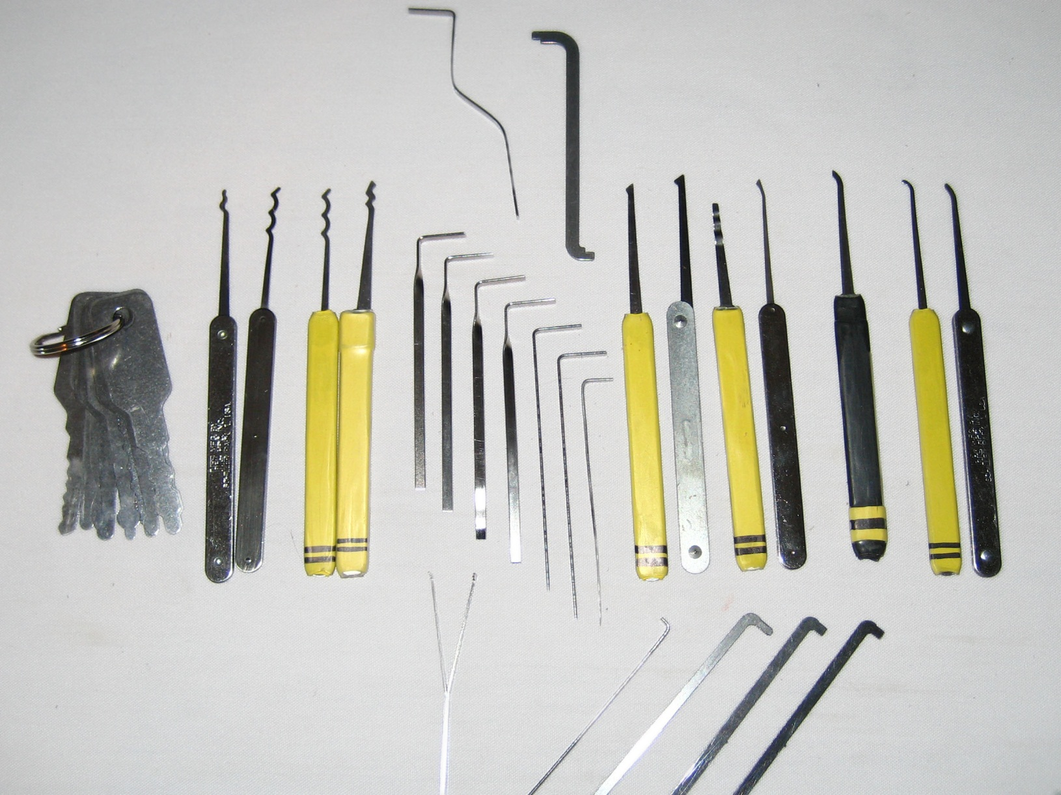
Typical Pick Assortment

Slide 67
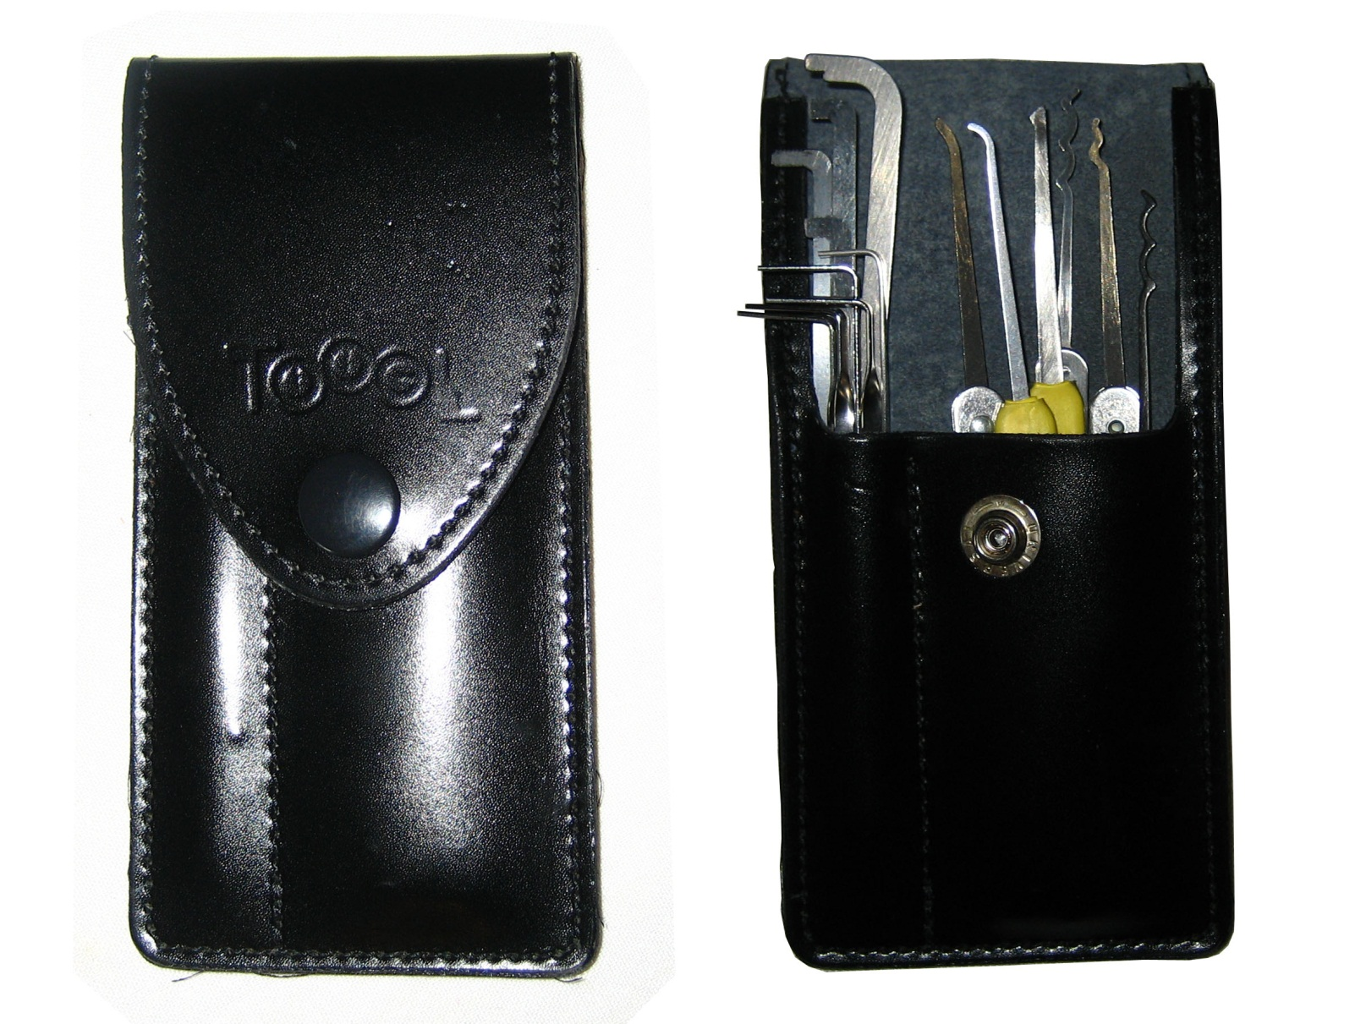
Getting More Efficient

Slide 68
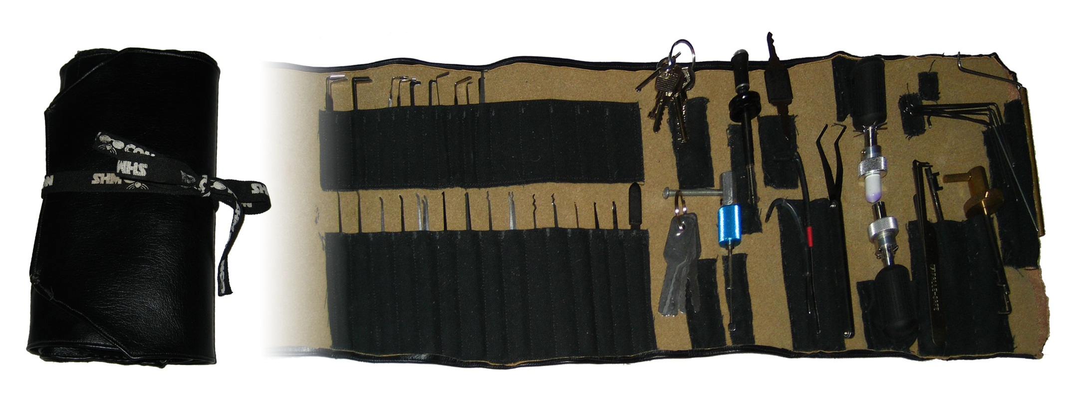
Having a Place for Everything

Slide 69
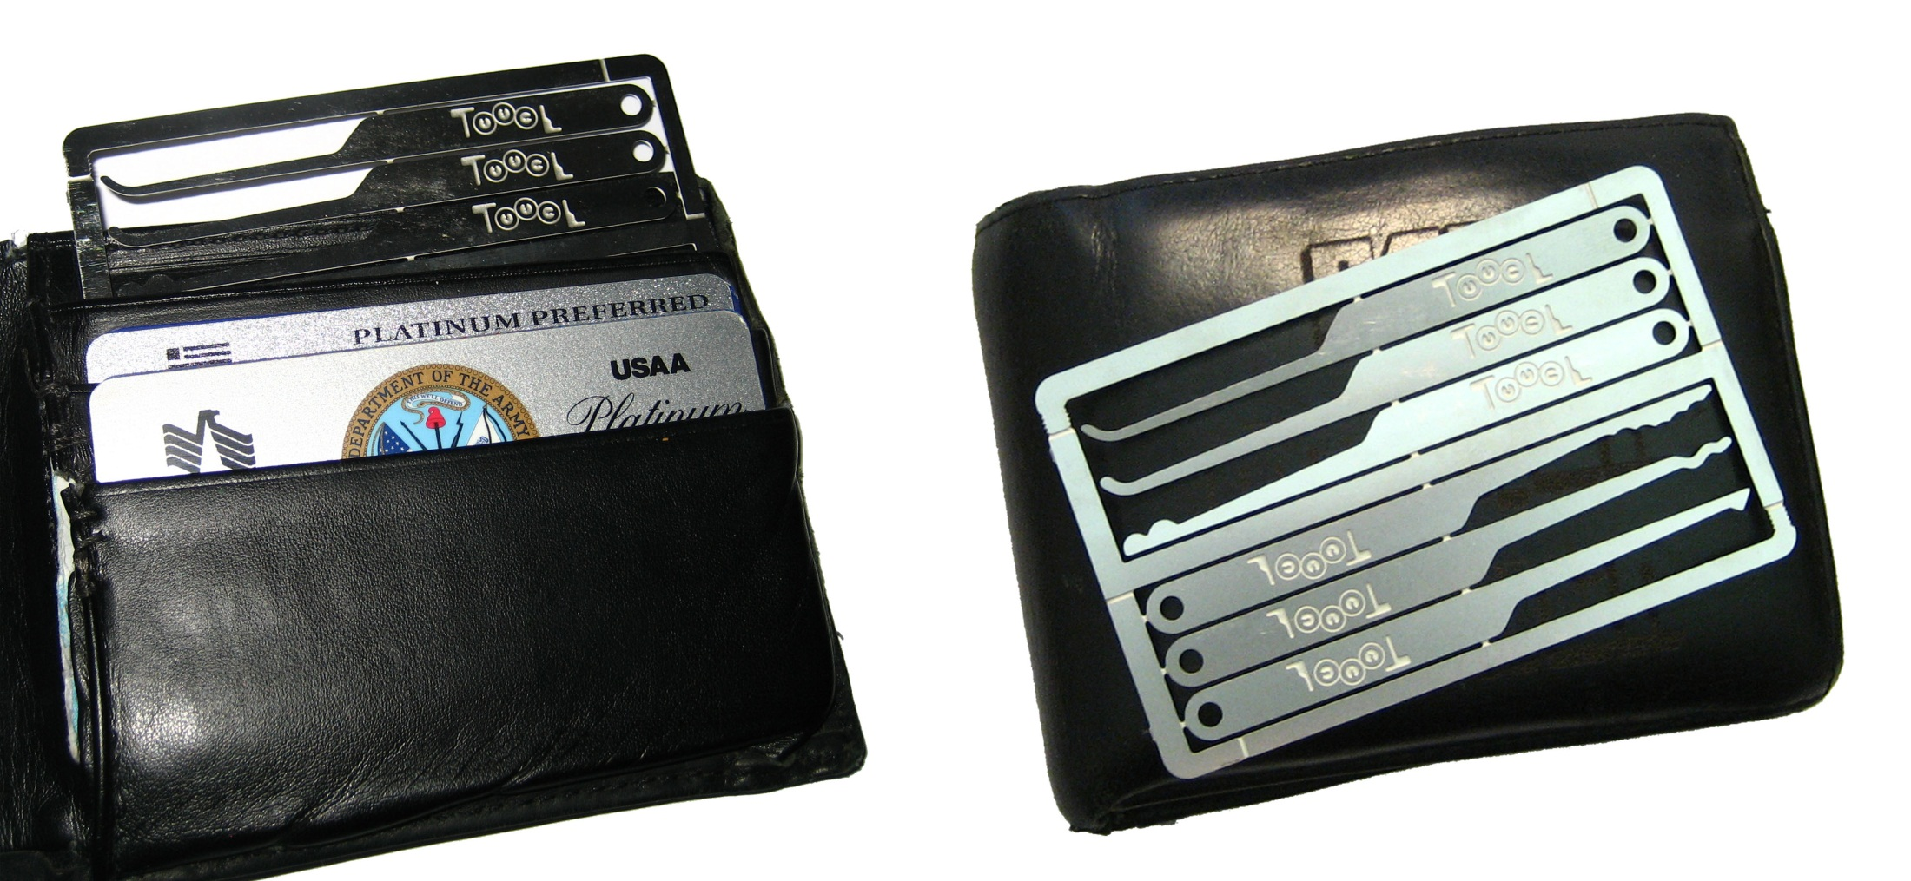
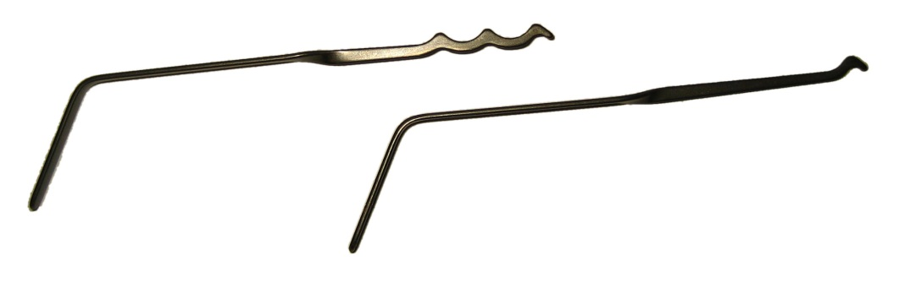
Everyday Carry

Slide 70

I’m Not This Guy…

Slide 71
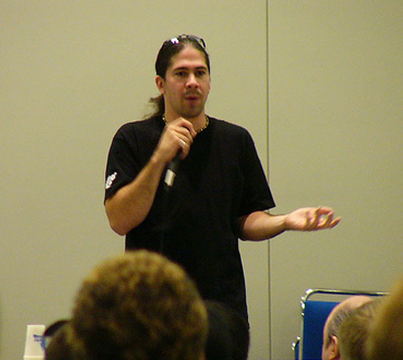
Don’t Take What I Say as Gospel

Slide 72
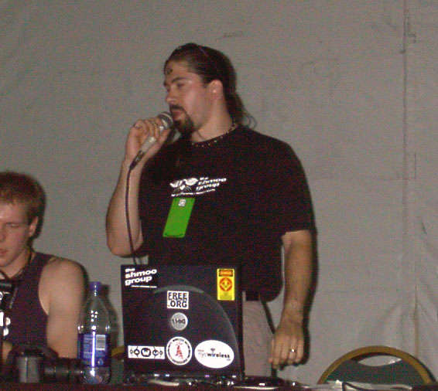
“Don’t Believe Everything I Say”

Slide 73

It’s All About You…

Slide 74
It’s All About You… … and It’s All Good

Slide 75
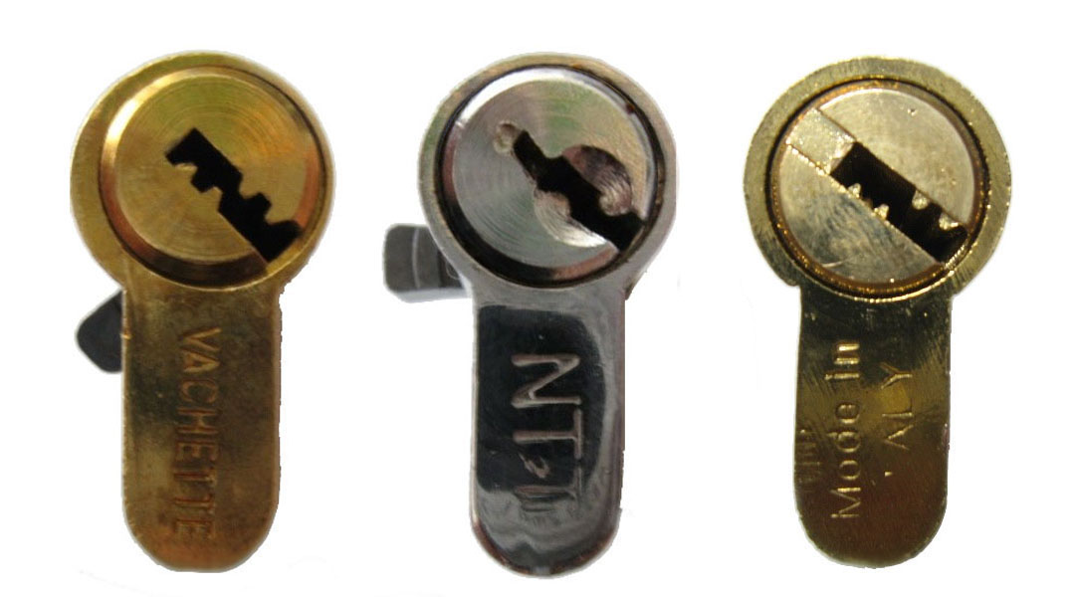
It All Comes Down To “Open!”
http://deviating.net http://enterthecore.net http://toool.us
thank you to TOOOL, John King, Schuyler, Matt Fiddler, Raimundo, & the sport picking community
this presentation is CopyLeft by Deviant Ollam. you are free to reuse any or all of this material as long as it is attributed and freedom for other s to do the same is maintained

