Slide 1
Further Social Implications: Conclusion Nanoethics Lecture VIII
Roderick T. Long
Auburn Dept. of Philosophy

Slide 2
Who Benefits?
Advances in nanotechnology will bring wealth and power – but to whom?
Military/governmental applications:
surveillance
weapons
bullet-proof clothing
Ethical obligations of scientists?

Slide 3
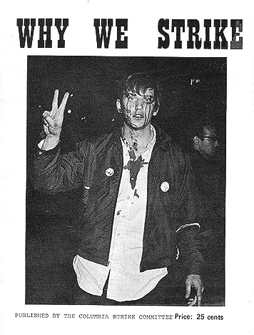
Who Benefits?
Columbia University, 1968:
Students protesting the university’s involvement in military research

Slide 4
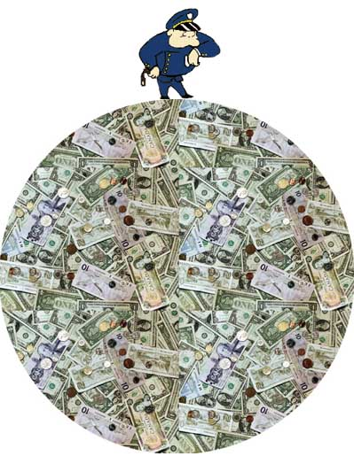
Who Benefits?
Wealth from advances in nanotechnology –
Who receives it?
Who controls it?
Corporations?
Governments?
Ordinary people?

Slide 5

Corporations and the Market
Corporations gain their wealth by providing customers with the best goods and services at the lowest price
Don’t interfere with corporations or the free market
Milton Friedman (1912-2006)

Slide 6
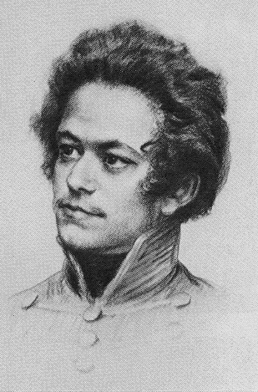
Corporations and the Market
Corporations gain their wealth by exploiting workers and by monopolising for themselves what really belongs to everybody
Abolish both corporations and the free market
Karl Marx (1818-1883)

Slide 7
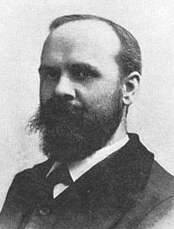
Corporations and the Market
Corporations gain their wealth thanks to systematic government intervention that skews the marketplace overwhelmingly in their favour and against ordinary people
Disempower corporations by establishing a free market
Benjamin Tucker (1854-1939)

Slide 8
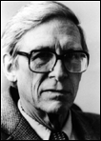
Corporations and the Market
Corporate wealth is fine so long as the resulting economic inequality works out to the benefit of the least advantaged
When that’s not the case, redistribution is called for
Regulate corporations and the market
John Rawls (1921-2002)

Slide 9
The Ethics of Patents
Nanotechnology patents represent a potentially lucrative source of income:
Who should rightfully own them?
How do rights to “intellectual property” (IP) differ from other kinds of property rights?

Slide 10

Intellectual Property
Rise of electronic media and the internet has raised controversy over IP to an all-time high

Slide 11
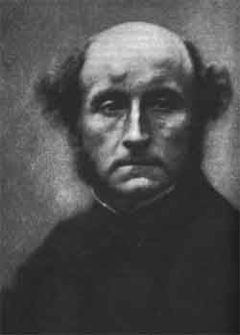
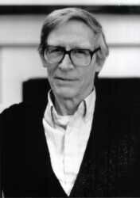
Property Rights: Consequentialist Approaches
Utilitarian view: the right system of property rights is whichever one maximizes the general happiness
Rawlsian view: the right system of property rights is whichever one most benefits the worst-off
(Rawls isn’t a consequentialist in general, but his Second Principle makes him a consequentialist about property rights)
In either case, it’s the job of economics to tell us which one that is

Slide 12
Implications for Intellectual Property
So what does economics tell us about the social effects of IP?
One consequentialist case for private property: to deal with scarcity and prevent tragedy of the commons

Slide 13
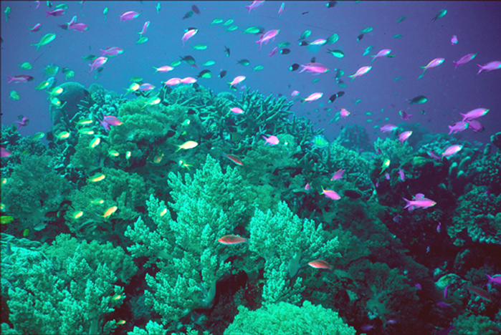
Tragedy of the Commons
Coral reefs are a popular place to fish, since they attract fish

Slide 14
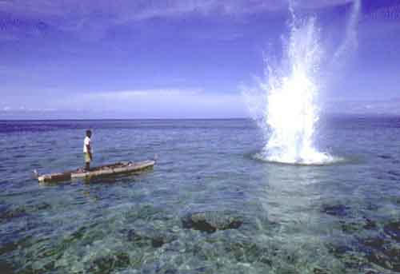
Tragedy of the Commons
One popular form of fishing near coral reefs is blast fishing, setting off explosions that stun the fish and make them float to the surface: high quantity yield for low effort

Slide 15


Tragedy of the Commons
But blast fishing destroys the coral reefs, thus yielding high returns in the short run but lower returns in the long run
Does this mean blast fishers are short-sighted?

Slide 16
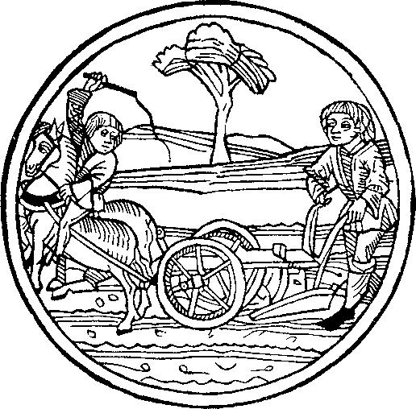
Tragedy of the Commons
Not necessarily:
My incentive to conserve resources for the future depends on my being the person who will benefit
For example, I take the effort to plant only because I believe I’m going to get to be the one who gets to reap

Slide 17
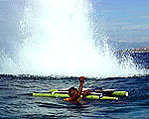
Tragedy of the Commons
But fishing sites aren’t private
property – I can’t exclude other
fishers from any given site
So if I refrain from blast fishing
today, I don’t thereby ensure
more fish for me in the future
I just let another blast fisher be the
one who reaps today’s yield
And if the future benefit is going to be sacrificed to a short-run gain no matter what I do, I figure I might as well be the one who makes that gain
So it’s in my self-interest to keep blast-fishing

Slide 18
Tragedy of the Commons
Hence a commons – a resource to which everyone has free access – becomes a tragedy – none of the users has an incentive to conserve it, even though they’d all be better off if it were conserved
Private property may not be the only solution to the tragedy of the commons (others include legislation and peer pressure) – but it’s one frequently recommended solution

Slide 19
Implications for Intellectual Property
Does the tragedy of the commons apply to IP?
Maybe not: abstract ideas aren’t “scarce” in the sense that their supply can’t be depleted through overuse
No matter how much I use an idea, there’s still just as much of that idea around for others
But there’s a broader consequentialist concern with giving producers incentive to produce
How apply to IP?

Slide 20
Implications for Intellectual Property
Supports IP?
Without exclusive rights to the ideas they produce, creators/inventors won’t have the incentive to produce them

Slide 21

Implications for Intellectual Property
Opposes IP?
Owners of IP are usually big corporations, not the actual producers
Historical studies suggest lack of IP doesn’t impede production
IP may stifle production and innovation by restricting the free flow of information
(Michele Boldrin & David Levine,
Against Intellectual Monopoly)

Slide 22
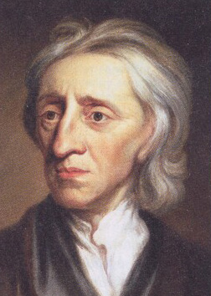
Property Rights: Non-Consequentialist Approaches
Locke: An individual creates value through homesteading previously unowned resources, which become rightfully his or hers
Kropotkin: A resource’s value derives from the entire social context, to which everybody contributes, so it becomes rightfully everybody’s

Slide 23
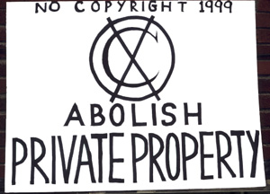
Implications for Intellectual Property
On a Kropotkinite view,
private intellectual
property (copyrights
and patents) will
obviously be illegitimate,
like all other property
What about on a Lockean view?
Here Lockeans disagree ….

Slide 24
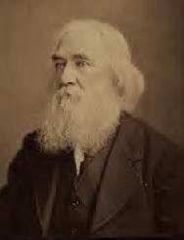
Lockeans For Intellectual Property
“All wealth … whether material or intellectual, which men produce, or create, by their labor, is, in reality, produced or created by the labor of their minds …. A man’s rights, therefore, to the intellectual products of his labor, necessarily stand on the same basis with his rights to the material products of his labor. If he have the right to the latter, on the ground of production, he has the same right to the former, for the same reason; since both kinds of wealth are alike the productions of his intellectual or spiritual powers.”
– Lysander Spooner (1808-1887)

Slide 25
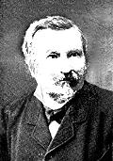
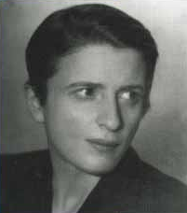
Lockeans For Intellectual Property
Ideas are the property of those who create them, just like any other product of human labor
Defend IP!
Gustave de Molinari Ayn Rand

Slide 26
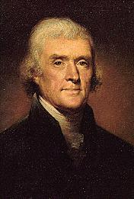
Lockeans Against Intellectual Property
“If nature has made any one thing less susceptible than all others of exclusive property, it is the action of the thinking power called an idea … Its peculiar character, too, is that no one possesses the less, because every other possesses the whole of it. … He who receives an idea from me, receives instruction himself without lessening mine; as he who lights his taper at mine, receives light without darkening me. … Inventions then cannot, in nature, be a subject of property.”
– Thomas Jefferson (1743-1826)

Slide 27

Lockeans Against Intellectual Property
You can own an idea in your head, but not the copy of your idea existing in other people’s heads or embodied in their property
Also you can’t homestead eternal laws/facts of nature
IP = protectionism, monopoly, and censorship: Abolish IP!
Benjamin Tucker
Stephan Kinsella

Slide 28
THE END

