Slide 1

WHAT PREVENTS ANYONE TO CONNECT TO AN IXP ? (Honestly ? I don´t know!)
Warning: after reading this you´re going to connect to an IXP !
LACNIC XV Cancun

Slide 2
Summary
Who am I ?
Lack of technical knowledge
Lack of vision
“It´s the economy, Stupid !”
ALOG experience as PIX of PTT-Metro Brazil
Commercial IXP – EQUINIX IBX

Slide 3
Who am I ?
27 years working with IT (assembly programming, embedded systems, linux, windows, network, databases, you name it)
Formerly owner of small ISP (I know the pain !)
Formerly Operations Director and nowadays CTO since 2008 @ ALOG Datacenters do Brasil, leader in Managed Hosting services (Recently acquired by Equinix)
ALOG is connected to PTT-Metro, the main IXP in Brazil and Equinix, how acquired ALOG, owns a commercial IXP called IBX.

Slide 4
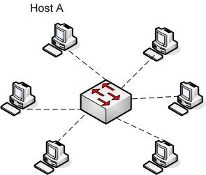

Lack of technical knowledge (What is an IXP ? How does an IXP work ? Is it safe ?)
Quick explanation: It´s like a “big switch” – Each customer is connected to a port and exchange the traffic with other participants. The routing decision can be made by BGP.
It´s perfectly safe, because you send to the IXP only the traffic that belongs to other participants and you receive in return only the traffic that belongs to you (you´re allowed to create your own filters)
It brings performance! Since everybody is connected together, you won´t suffer from Internet latency issues. It is almost like a local network.
It´s collaborative! When they grow, you grow.
It´s easy ! Lots of information available, docs and you can ask other participants

Slide 5
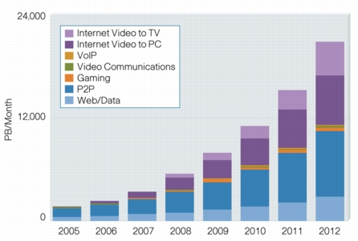

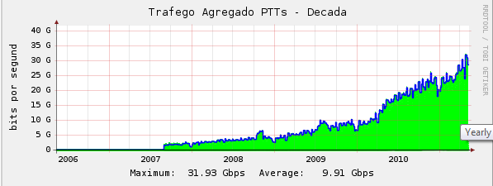


Lack of vision (I don´t need this!)
HUGE MISTAKE – Why ? Because Internet grows EVEN if you don´t sell more !
More users, Video, Video HD, Video SUPER HD, Video 3D ?
And so the IXP, with Internet growth and new
participants
Aggregated traffic PTT-Metro Brazil

Slide 6
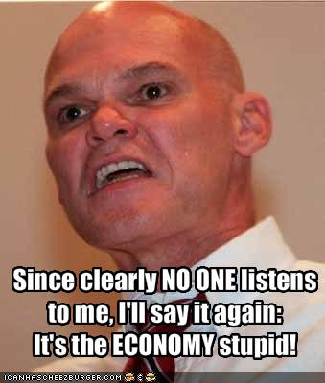
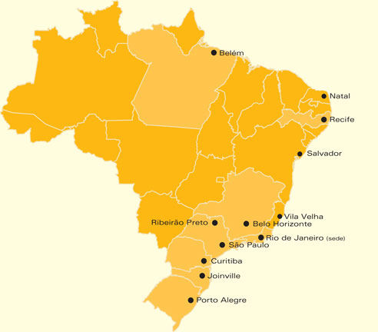
“It´s the economy, Stupid”
Almost impossible to grow an Internet (“global”) business in this scenario !
Only 1 Carrier Available!
BW =~ US$ 700/Mb/s/Mo
PTT-Metro (IXP) Several Carriers Available
BW =~ US$ 88/Mb/s/Mo

Slide 7
“It´s the economy, Stupid”
Total price for 100Mb/s:
Was =~ US$ 70,000/Mo
Now =~ US$ 12,800/Mo
Lan2Lan Connection 100Mb/s
BW =~ US$ 40/Mb/Mo
PTT-Metro (IXP) Several Carriers Available
BW =~ US$ 88/Mb/s/Mo

Slide 8

“It´s the economy, Stupid”
Total price for 100Mb/s:
Was =~ US$ 70,000/Mo
Now =~ US$ 12,800/Mo
Lan2Lan Connection 100Mb/s
BW =~ US$ 40/Mb/Mo
PTT-Metro (IXP) Several Carriers Available
BW =~ US$ 88/Mb/s/Mo

Slide 9

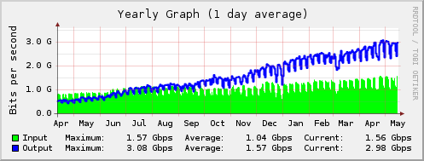
ALOG DATACENTERS´s EXPERIENCE
2 facilities (Rio de Janeiro and São Paulo), building the third in Tamboré (SP)
Connected to PTT-Metro São Paulo as PIX and hosts a remote PTT-Metro in Rio de Janeiro
Invited “everyone” to connect/peer
Very flexible in allowing customers to connect to PTT
GREAT results in traffic savings and great quality to our customers:

Slide 10

ALOG DATACENTERS´s EXPERIENCE
It’s easy to invite some participant to a well-known and very populated IXP, but how to convince anyone to connect to a newly created IXP ?

Slide 11


ALOG DATACENTERS´s EXPERIENCE
RIO DE JANEIRO SÃO PAULO
IX
Customers hosted in Rio de Janeiro’s facility DEMAND to connect to PTT-Metro São Paulo
We connect customers from Rio de Janeiro in PTT-Metro São Paulo, AND...
Any customer from Rio de Janeiro who wants to connect to PTT-Metro São Paulo MUST ALSO connect to PTT-Metro Rio de Janeiro (he won’t be charged for that).

Slide 12
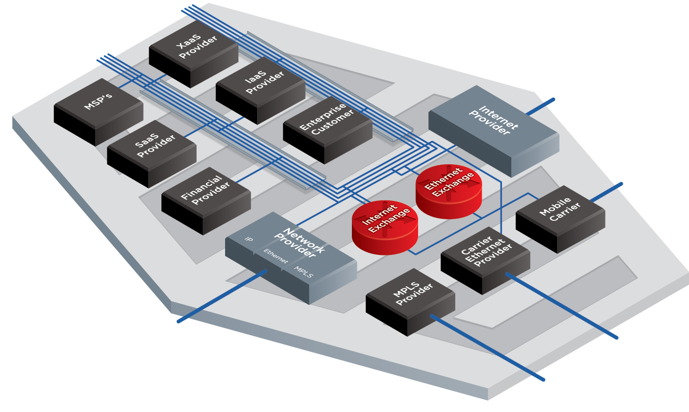
IBX – Equinix Ecosystem
Extend and Accelerate Access to Your Services
440+ Financial Service Providers
130+ Cloud Infrastructure and SaaS Service Providers
14 of the Top 21 Managed Security Service Providers
12 of the Top 16 Web Hosting
9 of the Top 10 Web Properties
9 of the Top 10 CDNs
5 of the Top 7 Streaming Video Sites
3 of the Top Global System Integrators
All 3 of the GSMA’s Data Exchanges for Mobile Carriers
Access a Wide Choice of Service Providers, Partners, and Customers
Customize networking, services, and interconnection needs within our rich ecosystem.

Slide 13
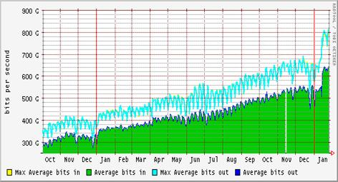
IBX – Equinix Ecosystem
Extend and Accelerate Access to Your Services
440+ Financial Service Providers
130+ Cloud Infrastructure and SaaS Service Providers
14 of the Top 21 Managed Security Service Providers
12 of the Top 16 Web Hosting
9 of the Top 10 Web Properties
9 of the Top 10 CDNs
5 of the Top 7 Streaming Video Sites
3 of the Top Global System Integrators
All 3 of the GSMA’s Data Exchanges for Mobile Carriers

Slide 14

SO, WHAT ARE YOU WAITING FOR ?
WHAT PREVENTS ANYONE TO CONNECT TO AN IXP ?
It’s cheaper
It’s better (low latency, better quallity)
It’s safer
It grows naturally with the Internet

Slide 15
Thank you ! Gracias ! Obrigado !
Antonio Carlos Pina
antonio.pina@alog.com.br May 2011

