Slide 1
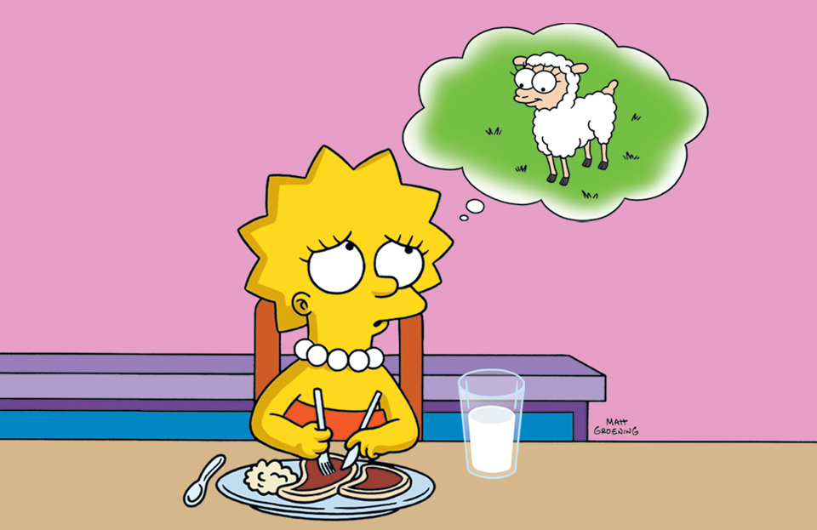
Veggie’s Facts vs. Myth
Submitted by Kyle Brett
Lock Haven University

Slide 2
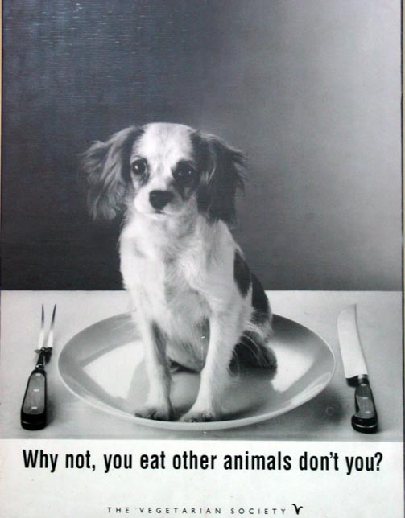
Myth #1
Humans were designed/evolved to eat meat.
FALSE:
We're designed to be able to eat meat occasionally, as a survival mechanism, but our digestive systems are very similar to those of the other plant-eaters and totally unlike those of carnivores. Also, the less meat someone eats, the less their risk of just about every major disease. Finally, people who don't eat meat have better physical performance, whether they're athletes or not. The argument that humans are carnivores because we possess "canine" teeth ignores the facts that other plant-eaters have these same so-called canine teeth, and that only plant-eaters have molar teeth.

Slide 3
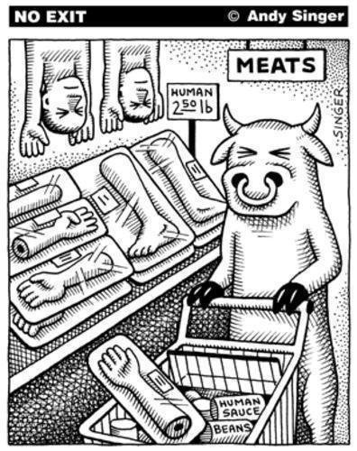
Myth #2
Vegetarians get little protein.
False:
Vegetables are around 23% protein on average, beans 28%, grains 13%, and even fruit has 5.5%. For comparison, human breast milk is only 6% (designed for the time in our lives when our protein needs are as high as they'll ever be). Professional recommendations for adults range from 2.5% to 10%, and plant foods supply that easily.

Slide 4
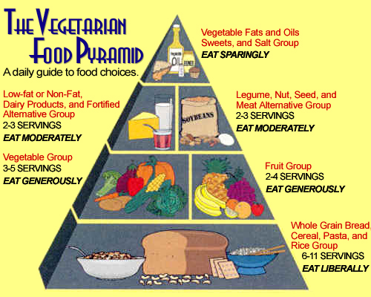
Myth #3
Beans are a good source of protein.
False:
You might as well say "Food is a good source of protein". In any event, beans (28%) don't average much more protein per calorie than common vegetables (23%).

Slide 5
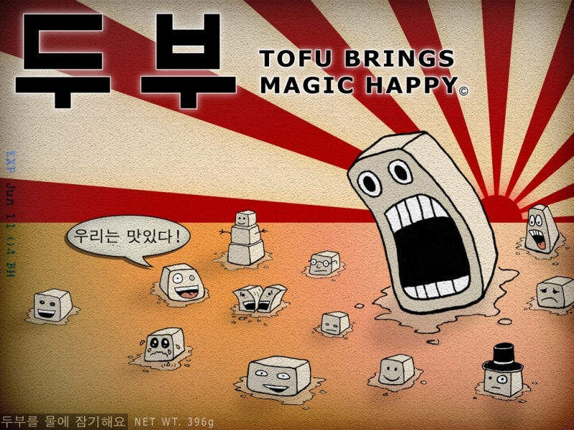
Myth #4
Tofu is a low-fat.
False:
Tofu contains far too much fat for regular use by most people… Tofu…is even a little worse… Obviously, tofu is a rich, high-fat, low-fiber food that should be used sparingly.

Slide 6
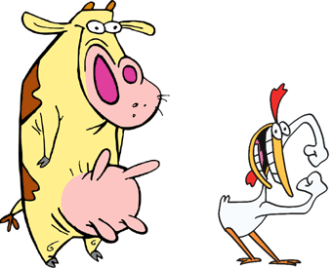
Myth #5
Meat protein is better than plant protein.
False:
This myth was popularized in the 1971 book Diet for a Small Planet and has no basis in fact. The author of the book admitted nearly thirty years ago that she made a mistake (in the 1982 edition of the same book).

Slide 7
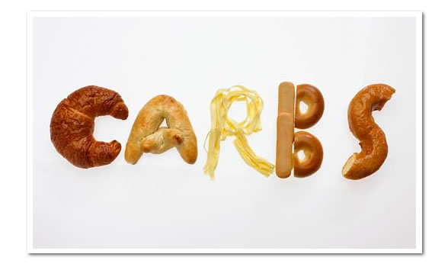
Myth #6
Carbohydrates make you fat.
False:
Refined carbs, like sugar and flour, can make you fat, because they're calorically dense. Fruits and veggies don't have that problem. You can lose weight even while eating copious amounts of potatoes.

Slide 8
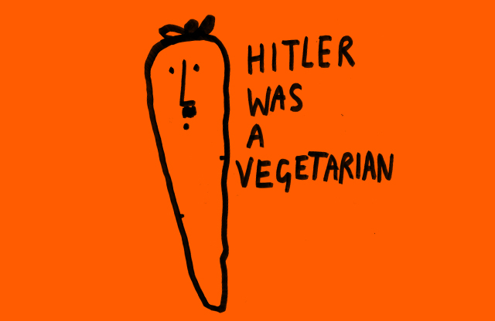
Myth #7
Hitler was a vegetarian.
False:
Hitler occasionally reduced his meat consumption on doctor's orders because of digestive problems, but he frequently cheated. If you want to call that vegetarianism, you might as well say that all meat-eaters are vegetarian for the eight hours they're asleep each not and not eating meat. Of course, educated people will understand that it's irrelevant that Hitler was vegetarian, but some non-vegetarians delight in repeating this myth as though they've made some sort of point .

Slide 9
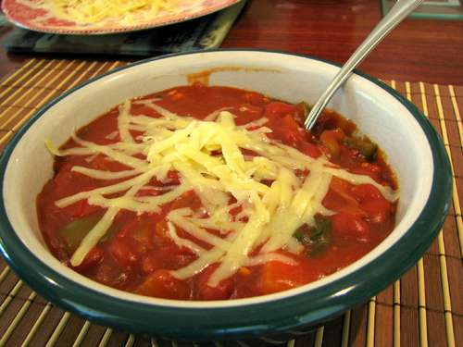
Easy Vegetarian Recipes!
Insanely Easy Vegetarian Chili
Ingredients:
1 tablespoon vegetable oil. 1 cup chopped onions. 3/4 cup chopped carrots. 3 cloves garlic, minced. 1 cup chopped green bell pepper. 1 cup chopped red bell pepper. 3/4 cup chopped celery. 1 tablespoon chili powder. 1 1/2 cups chopped fresh mushrooms. 1 (28 ounce) can whole peeled tomatoes with liquid, chopped. 1 (19 ounce) can kidney beans with liquid. 1 (11 ounce) can whole kernel corn, undrained. 1 tablespoon ground cumin. 1 1/2 teaspoons dried oregano. 1 1/2 teaspoons dried basil.
Directions: Heat oil in a large saucepan over medium heat. Sauté onions, carrots, and garlic until tender. Stir in green pepper, red pepper, celery, and chili powder. Cook until vegetables are tender, about 6 minutes. Stir in mushrooms, and cook 4 minutes. Stir in tomatoes, kidney beans, and corn. Season with cumin, oregano, and basil. Bring to a boil, and reduce heat to medium. Cover, and simmer for 20 minutes, stirring occasionally.

Slide 10
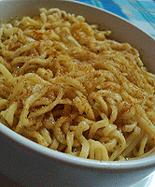
Veggie Ramen?!
Ingredients:
1 package ramen
3/4 cup water
1 tsp curry powder
1/2 tsp cumin
dash red pepper flakes
Directions:
Cook the ramen in the water for a minute or two, then add curry and cumin and cook for another 3 to 5 minutes, or until noodles are done. Add a dash of red pepper flakes and enjoy!

Slide 11
Sources!!!
http://michaelbluejay.com/veg/myths.html
http://vegetarian.about.com/od/maindishentreerecipes/r/ramencurry.htm
http://allrecipes.com//Recipe/insanely-easy-vegetarian-chili/Detail.aspx
Google images

