Slide 1

A Virtual File System for the PubChem Chemical Structure and Bioassay Database
Wolf-D. Ihlenfeldt Xemistry GmbH
Königstein, Germany

Slide 2
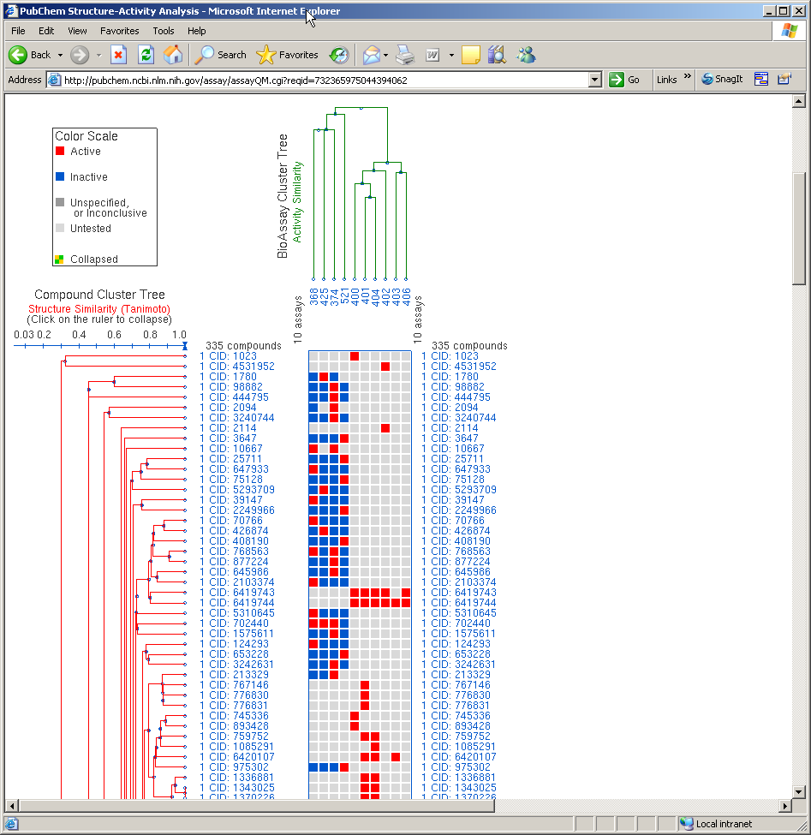
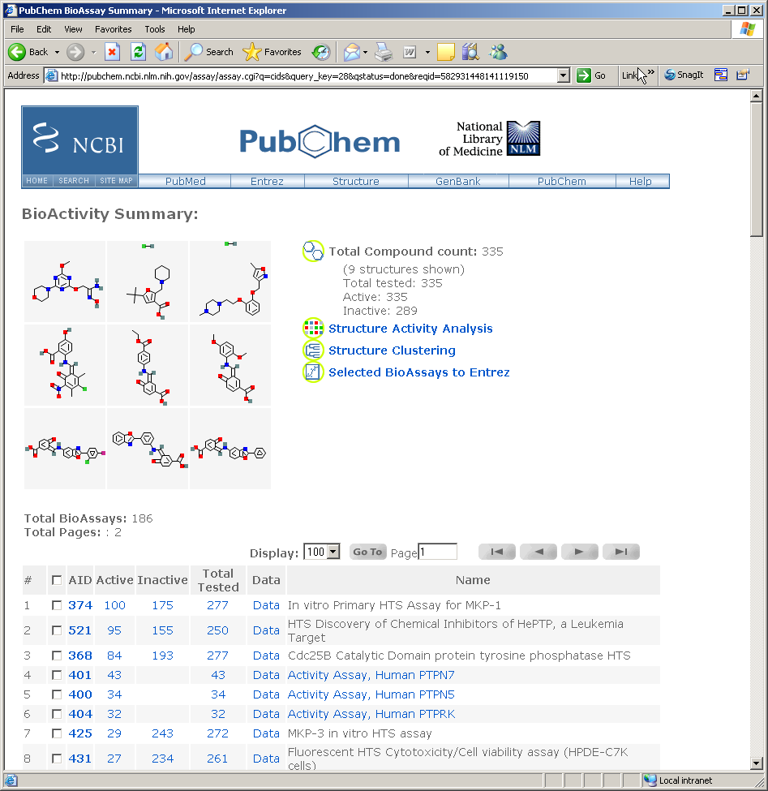
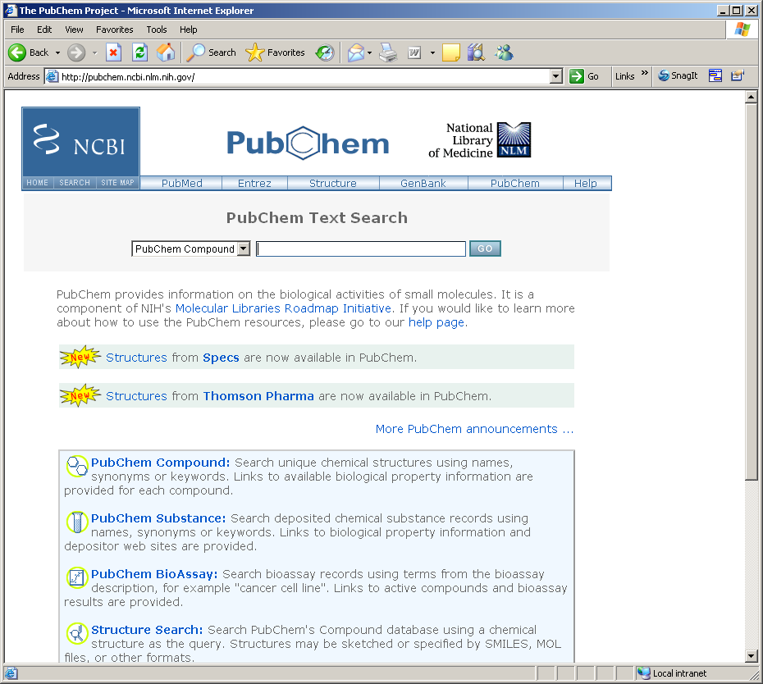
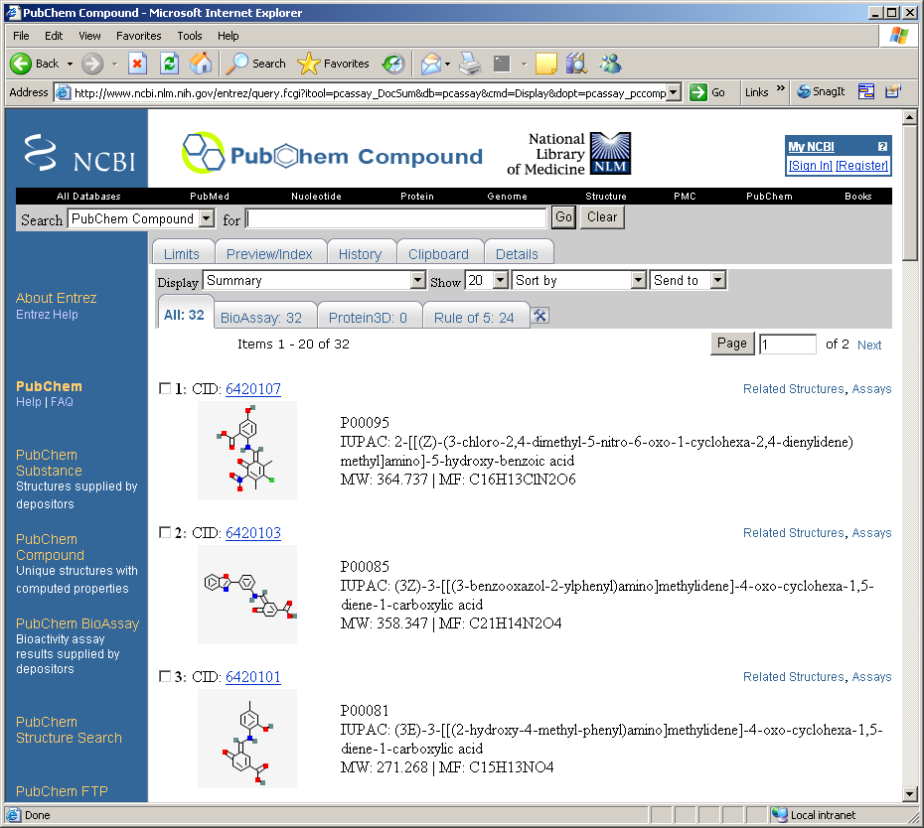
PubChem on the Web

Slide 3
PubChem Project Mission
Provide comprehensive public access to screening data generated by NIH Roadmap Initiative and other public research projects
Link assay results, structures screened, literature references, basic computed properties, external information sources
Convenient and free queries and download of filtered structure and assay data for further research
Wait a moment - they call that convenient ?!?

Slide 4
Problems with Interactive Data Retrieval in PubChem
Separation between text/data (Entrez) and structure query systems with inconsistent interfaces
Dumbed-down structure query interface, but overengineered text query tools
Obscure Entrez syntax for combining multiple subqueries
Quirky Entrez approaches regarding numerical queries, quoting, field names, output formats, history titles, auto query expansion…
History of history problems

Slide 5
Interactive Data Retrieval in PubChem
Very limited customization of downloadable data content
Full structure data record only as ASN.1 blob, optionally with gratutious homebrew XML wrapper
SD-file is incomplete, a structure approximation and still not compatible with exact interpretation of MDL standards
Nevertheless, well done system for browsing, but not for serious data collection

Slide 6
Routes to Programmatic Data Retrieval from PubChem
Some disconnected components exist:
Entrez e-utils Basic access to Entrez text databases, get status, retrieve ID sets, some record data or set history via simple text-based queries
PubChem structure display pages Can be abused for direct download of single records in ASN.1 format, bypassing the FTP wait queue
PubChem Power User Gateway (PUG) XML/ASN.1 specification for executing simple structure queries and getting ID sets, history handle from PubChem servers
No direct SQL server db access ever, that‘s policy!

Slide 7

The Cactvs Toolkit
Universal scripting environment for chemical data processing
Framework of chemical objects (ensembles, reactions, tables, …), dynamically defined object properties with associated computation methods, and extension modules (I/O modules for different types of files, database access, data type handlers, command extensions,…)
Lazy computation – request some data on an object, and a way will be found to get it if possible

Slide 8
Cactvs and PubChem
Cactvs Toolkit licensed by NCBI as integral component of the PubChem software suite
Used for file I/O, syntax verification, property computation, structure depiction, structure identification via hashcodes, interface to NIST InChI suite, fingerprints, sub/superstructure & formula search system, WWW structure sketching
Only externally available toolkit that understands PubChem data structures (ASN.1 specs for substances, compounds, assays, and PUG) – including literature references, conformer data, etc.

Slide 9
Basic PubChem Integration
Ensemble object creation via CID: set eh [ens create $cid] Direct download and parsing of binary ASN.1 record via display page. Also supported as file I/O module.
Computation of CID and SIDs from structure: set cid [ens get $eh E_CID] set sidlist [ens get $eh E_SIDSET] Parsing of Entrez E-utils output from submission of InChI string as text search

Slide 10
Basic PubChem Integration
Compound name lookup set iupacname [ens get $eh E_IUPAC_NAME] Direct download and parsing of XML CID display record, extracting OpenEye computed name
CAS number lookup set casno [ens get $eh E_CAS]
Direct download and parsing of XML SID set display records which contain depositor-supplied names, using pattern recognition

Slide 11
Initial PubChem Integration
CAS number I/O module set eh [molfile read $casfile] Look up CID as generic term via E-utils, download ASN.1 record via CID. Also supported as object creation command set eh [ens create $cas]

Slide 12
The PubChem Virtual File Project
Improved access to PubChem database make it indistinguishable from a local, read-only structure file in Cactvs scripting environment
Input functions transparently read structures and all their data from PubChem
Query functions convenient development and archival of queries exceeding the capabilites of Web interfaces and PUG, maintaining standard Cactvs query and retrieval syntax

Slide 13
General Approach
Implement a Cactvs I/O module I/O modules incorporate function tables with rich set of functions that are automatically called in specific situations, capability flags, documentation fields, etc.
Hidden, automatic use of Entrez E-utils and PUG Run as many tasks as possible on Entrez/PubChem structure search, data download and local processing only as last resort
Optimize for sake of efficiency and just being nice Use caching techniques to reduce network and server load, observe NCBI script access rules

Slide 14
PubChem Virtual File I/O
Code sample:
filex load pubchem 19
molfile open <pubchem> molfile0
molfile count molfile0 12002343
molfile read molfile0 ens0
ens props ens0 …E_INCHI E_IUPAC_NAME E_NCBI_COMPOUND_ID E_EXACT_MASS E_TPSA E_SMILES E_SMILES/2….
ens get ens0 E_CID 1
molfile read molfile0 ens1
molfile set molfile0 record 999999
Contact Entrez e-utils, get database status
E-utils, get 5K sector of record-CID map, then single-record ASN.1 download via display page
Single-record ASN.1 download via display page
Try to load compressed CID use bit vector from xemistry.com, fallback are more e-utils queries for record/CID map sectors

Slide 15
Simple PubChem Queries
Code sample:
set fh [molfile open <pubchem>]
set cidlist [molfile scan $fh „structure >= $smarts“ \
{proplist E_CID}]
Operations behind the scenes:
Set-up of PUG record
Post PUG, monitor return status
Cache CID result data
Direct access to result set, no structure download

Slide 16
Intermediate PubChem Queries
Code sample:
set fh [molfile open <pubchem>]
set enslist [molfile scan $fh \ „or {structure = $smiles1} {structure = $smiles2}\ {structure = $smiles3}“ enslist]
Operations behind the scenes:
Create and post PUG records, get history keys
Perform server-side e-utils result merge via history keys
Retrieve CID set
Download structures as ASN.1 blobs via CID

Slide 17
Power PubChem Queries
Code sample:
set stfh [molfile open $mysdfile]
set fh [molfile open <pubchem>]
set th [molfile scan $fh \ „and {structure ~>= $stfh 95} {formula >= \[M\]0} \ {E_NMOLECULES = 1} {E_STEREO_COUNT(1) >= 1}“ \ {table E_CID score E_SMILES E_FORMULA record image} \
{} 1000]
table write $th similar_in_pubchem.xls
Bioassay access is unfortunately not yet part of PUG.

Slide 18
Summary
Goal: Make PubChem finally conveniently accessible as data source for local work
Feature: Read all data from PubChem records, and further manipulate it to your heart‘s content
Feature: Write and conserve complex queries beyond what you can do with the Web interface
Feature: Export data in many more formats than possible via the Web interface
Future: Sort out remaining problems with caching and field access in complex queries, use parallel PUG submissions, integrate assay data access

Slide 19
Availability
Is a standard component of 3.353 and later CACTVS toolkit releases
Free academic downloads from www.xemistry.com for multiple platforms (Linux, MS Windows, MacOSX, Solaris, BSD)
Also part of basic commercial toolkit, to be distributed with regular customer updates

