Slide 1
Scaling Up Machine Learning
Parallel and Distributed Approaches
Ron Bekkerman, LinkedIn
Misha Bilenko, MSR
John Langford, Y!R
http://hunch.net/~large_scale_survey

Slide 2
Outline
Introduction | Ron
Tree Induction | Misha
Break
Graphical Models | Misha
Learning on GPUs | John
Linear Learning | John
Conclusion | John

Slide 3
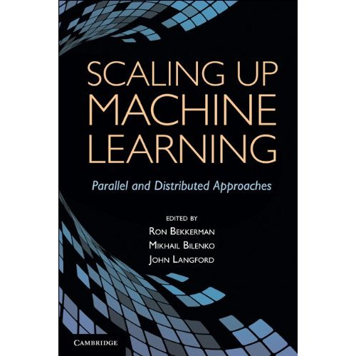
The book
Cambridge Uni Press
Due in November 2011
21 chapters
Covering
Platforms
Algorithms
Learning setups
Applications

Slide 4





















Chapter contributors
2
12
3
13
4
14
5
15
6
16
7
17
8
18
9
19
10
20
11
21

Slide 5
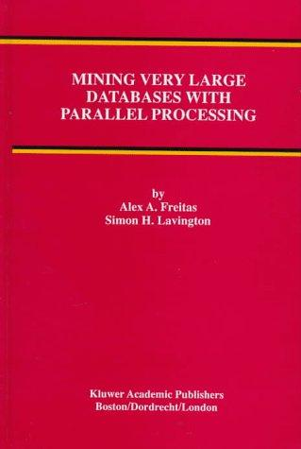

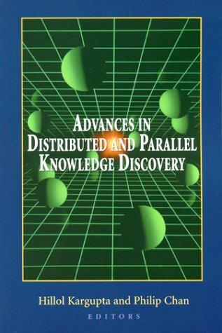
Previous books
1998
2000
2000

Slide 6
Data hypergrowth: an example
Reuters-21578: about 10K docs (ModApte)
RCV1: about 807K docs
LinkedIn job title data: about 100M docs
Bekkerman et al, SIGIR 2001
Bekkerman & Scholz, CIKM 2008
Bekkerman & Gavish, KDD 2011

Slide 7
New age of big data
The world has gone mobile
5 billion cellphones produce daily data
Social networks have gone online
Twitter produces 200M tweets a day
Crowdsourcing is the reality
Labeling of 100,000+ data instances is doable
Within a week ☺

Slide 8
Size matters
One thousand data instances
One million data instances
One billion data instances
One trillion data instances
Those are not different numbers, those are different mindsets ☺

Slide 9
One thousand data instances
Will process it manually within a day (a week?)
No need in an automatic approach
We shouldn’t publish main results on datasets of such size ☺

Slide 10
One million data instances
Currently, the most active zone
Can be crowdsourced
Can be processed by a quadratic algorithm
Once parallelized
1M data collection cannot be too diverse
But can be too homogenous
Preprocessing / data probing is crucial

Slide 11
Big dataset cannot be too sparse
1M data instances cannot belong to 1M classes
Simply because it’s not practical to have 1M classes ☺
Here’s a statistical experiment, in text domain:
1M documents
Each document is 100 words long
Randomly sampled from a unigram language model
No stopwords
245M pairs have word overlap of 10% or more
Real-world datasets are denser than random

Slide 12



Can big datasets be too dense?
3746554337.jpg
7264545727.jpg
8374565642.jpg
6255434389.jpg
2648697083.jpg
5039287651.jpg
3045938173.jpg
8871536482.jpg
4596867462.jpg
2037582194.jpg

Slide 13
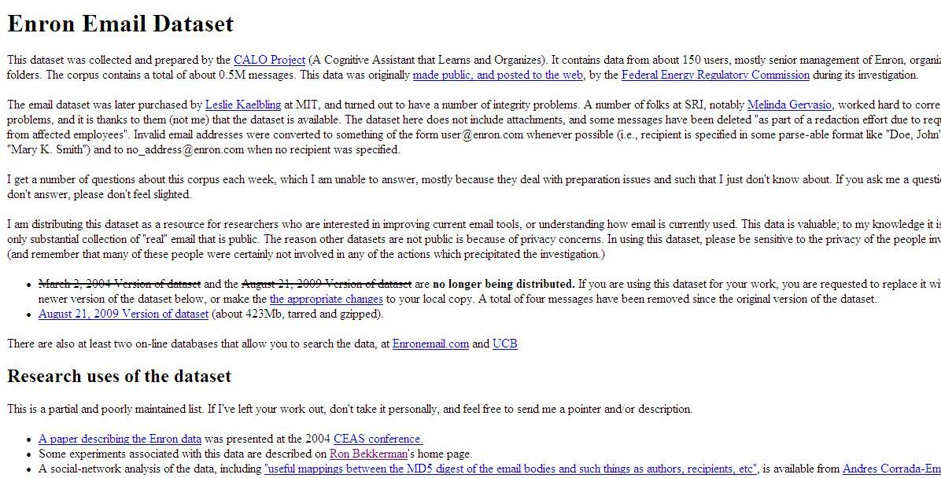
Real-world example

Slide 14
(Near) duplicate detection
Bekkerman et al, KDD 2009

Slide 15
One billion data instances
Web-scale
Guaranteed to contain data in different formats
ASCII text, pictures, javascript code, PDF documents…
Guaranteed to contain (near) duplicates
Likely to be badly preprocessed ☺
Storage is an issue

Slide 16
One trillion data instances
Beyond the reach of the modern technology
Peer-to-peer paradigm is (arguably) the only way to process the data
Data privacy / inconsistency / skewness issues
Can’t be kept in one location
Is intrinsically hard to sample

Slide 17
A solution to data privacy problem
n machines with n private datasets
All datasets intersect
The intersection is shared
Each machine learns a separate model
Models get consistent over the data intersection
Xiang et al, Chapter 16
D₁
D₂
D₆
D₃
D₅
D₄
Check out Chapter 16 to see this approach applied in a recommender system!

Slide 18
So what model will we learn?
Supervised model?
Unsupervised model?
Semi-supervised model?
Obviously, depending on the application ☺
But also on availability of labeled data
And its trustworthiness!

Slide 19
Size of training data
Say you have 1K labeled and 1M unlabeled examples
Labeled/unlabeled ratio: 0.1%
Is 1K enough to train a supervised model?
Now you have 1M labeled and 1B unlabeled examples
Labeled/unlabeled ratio: 0.1%
Is 1M enough to train a supervised model?

Slide 20
Skewness of training data
Usually, training data comes from users
Explicit user feedback might be misleading
Feedback providers may have various incentives
Learning from implicit feedback is a better idea
E.g. clicking on Web search results
In large-scale setups, skewness of training data is hard to detect

Slide 21

Real-world example
Goal: find high-quality professionals on LinkedIn
Idea: use recommendation data to train a model
Whoever has recommendations is a positive example
Is it a good idea? ☺

Slide 22
Not enough (clean) training data?
Use existing labels as a guidance rather than a directive
In a semi-supervised clustering framework
Or label more data! ☺
With a little help from the crowd

Slide 23
Semi-supervised clustering
Bekkerman et al, ECML 2006
Cluster unlabeled data D while taking labeled data D* into account
Construct clustering while maximizing Mutual Information
And keeping the number of clusters k constant
is defined naturally over classes in D*
Results better than those of classification

Slide 24
Semi-supervised clustering (details)
Define an empirical joint distribution P(D, D*)
P(d, d*) is a normalized similarity between d and d*
Define the joint between clusterings
Where
and are marginals

Slide 25
Crowdsourcing labeled data
Crowdsourcing is a tough business ☺
People are not machines
Any worker who can game the system will game the system
Validation framework + qualification tests are a must
Labeling a lot of data can be fairly expensive

Slide 26
How to label 1M instances
Budget a month of work + about $50,000

Slide 27
How to label 1M instances
Hire a data annotation contractor in your town
Presumably someone you know well enough

Slide 28
How to label 1M instances
Offer the guy $10,000 for one month of work

Slide 29
How to label 1M instances
Construct a qualification test for your job
Hire 100 workers who pass it
Keep their worker IDs

Slide 30

How to label 1M instances
Explain to them the task, make sure they get it

Slide 31
How to label 1M instances
Offer them 4¢ per data instance if they do it right

Slide 32
How to label 1M instances
500
Your contractor will label 500 data instances a day
This data will be used to validate worker results

Slide 33
How to label 1M instances
You’ll need to spot-check the results

Slide 34
How to label 1M instances
You’ll need to spot-check the results

Slide 35
How to label 1M instances
Each worker gets a daily task of 1000 data instances
1000
1000
1000
1000
1000
1000
1000
1000

Slide 36
How to label 1M instances
Some of which are already labeled by the contractor
1000
1000
1000
1000
1000
1000
1000
1000

Slide 37
How to label 1M instances
Check every worker’s result on that validation set

Slide 38
How to label 1M instances
Check every worker’s result on that validation set

Slide 39
How to label 1M instances
Fire the worst 50 workers
Disregard their results

Slide 40
How to label 1M instances
Hire 50 new ones

Slide 41
How to label 1M instances
Repeat for a month (20 working days)
50 workers × 20 days × 1000 data points a day × 4¢

Slide 42
Got 1M labeled instances, now what?
Now go train your model ☺
Rule of the thumb: heavier algorithms produce better results
Rule of the other thumb: forget about super-quadratic algorithms
Parallelization looks unavoidable

Slide 43
Parallelization: platform choices
Platform | Communication Scheme | Data size
Peer-to-Peer | TCP/IP | Petabytes
Virtual Clusters | MapReduce / MPI | Terabytes
HPC Clusters | MPI / MapReduce | Terabytes
Multicore | Multithreading | Gigabytes
GPU | CUDA | Gigabytes
FPGA | HDL | Gigabytes

Slide 44
Example: k-means clustering
An EM-like algorithm:
Initialize k cluster centroids
E-step: associate each data instance with the closest centroid
Find expected values of cluster assignments given the data and centroids
M-step: recalculate centroids as an average of the associated data instances
Find new centroids that maximize that expectation

Slide 45
Parallelizing k-means

Slide 46
Parallelizing k-means

Slide 47
Parallelizing k-means

Slide 48
Parallelization: platform choices
Platform | Communication Scheme | Data size
Peer-to-Peer | TCP/IP | Petabytes
Virtual Clusters | MapReduce / MPI | Terabytes
HPC Clusters | MPI / MapReduce | Terabytes
Multicore | Multithreading | Gigabytes
GPU | CUDA | Gigabytes
FPGA | HDL | Gigabytes

Slide 49
Peer-to-peer (P2P) systems
Millions of machines connected in a network
Each machine can only contact its neighbors
Each machine storing millions of data instances
Practically unlimited scale ☺
Communication is the bottleneck
Aggregation is costly, broadcast is cheaper
Messages are sent over a spanning tree
With an arbitrary node being the root

Slide 50
k-means in P2P
Datta et al, TKDE 2009
Uniformly sample k centroids over P2P
Using a random walk method
Broadcast the centroids
Run local k-means on each machine
Sample n nodes
Aggregate local centroids of those n nodes

Slide 51
Parallelization: platform choices
Platform | Communication Scheme | Data size
Peer-to-Peer | TCP/IP | Petabytes
Virtual Clusters | MapReduce / MPI | Terabytes
HPC Clusters | MPI / MapReduce | Terabytes
Multicore | Multithreading | Gigabytes
GPU | CUDA | Gigabytes
FPGA | HDL | Gigabytes

Slide 52
Virtual clusters
Datacenter-scale clusters
Hundreds of thousands of machines
Distributed file system
Data redundancy
Cloud computing paradigm
Virtualization, full fault tolerance, pay-as-you-go
MapReduce is #1 data processing scheme

Slide 53
MapReduce
Mappers
Reducers
Process in parallel → shuffle → process in parallel
Mappers output (key, value) records
Records with the same key are sent to the same reducer

Slide 54
k-means on MapReduce
Panda et al, Chapter 2
Mappers read data portions and centroids
Mappers assign data instances to clusters
Mappers compute new local centroids and local cluster sizes
Reducers aggregate local centroids (weighted by local cluster sizes) into new global centroids
Reducers write the new centroids

Slide 55
Discussion on MapReduce
MapReduce is not designed for iterative processing
Mappers read the same data again and again
MapReduce looks too low-level to some people
Data analysts are traditionally SQL folks ☺
MapReduce looks too high-level to others
A lot of MapReduce logic is hard to adapt
Example: grouping documents by words

Slide 56
MapReduce wrappers
Many of them are available
At different levels of stability ☺
Apache Pig is an SQL-like environment
Group, Join, Filter rows, Filter columns (Foreach)
Developed at Yahoo! Research
DryadLINQ is a C#-like environment
Developed at Microsoft Research
Olston et al, SIGMOD 2008
Yu et al, OSDI 2008

Slide 57
k-means in Apache Pig: input data
Assume we need to cluster documents
Stored in a 3-column table D:
Initial centroids are k randomly chosen docs
Stored in table C in the same format as above
Document | Word | Count
doc1 | new | 2
doc1 | york | 2

Slide 58
k-means in Apache Pig: E-step
D_C = JOIN C BY w, D BY w;
PROD = FOREACH D_C GENERATE d, c, i_{d} * i_{c} AS i_{d}i_{c} ;
PROD_{g} = GROUP PROD BY (d, c);
DOT_PROD = FOREACH PROD_{g} GENERATE d, c, SUM(i_{d}i_{c}) AS dXc;
SQR = FOREACH C GENERATE c, i_{c} * i_{c} AS i_{c}²;
SQR_{g} = GROUP SQR BY c;
LEN_C = FOREACH SQR_{g} GENERATE c, SQRT(SUM(i_{c}²)) AS len_{c};
DOT_LEN = JOIN LEN_C BY c, DOT_PROD BY c;
SIM = FOREACH DOT_LEN GENERATE d, c, dXc / len_{c};
SIM_{g} = GROUP SIM BY d;
CLUSTERS = FOREACH SIM_{g} GENERATE TOP(1, 2, SIM);

Slide 59
k-means in Apache Pig: E-step
D_C = JOIN C BY w, D BY w;
PROD = FOREACH D_C GENERATE d, c, i_{d} * i_{c} AS i_{d}i_{c} ;
PROD_{g} = GROUP PROD BY (d, c);
DOT_PROD = FOREACH PROD_{g} GENERATE d, c, SUM(i_{d}i_{c}) AS dXc;
SQR = FOREACH C GENERATE c, i_{c} * i_{c} AS i_{c}²;
SQR_{g} = GROUP SQR BY c;
LEN_C = FOREACH SQR_{g} GENERATE c, SQRT(SUM(i_{c}²)) AS len_{c};
DOT_LEN = JOIN LEN_C BY c, DOT_PROD BY c;
SIM = FOREACH DOT_LEN GENERATE d, c, dXc / len_{c};
SIM_{g} = GROUP SIM BY d;
CLUSTERS = FOREACH SIM_{g} GENERATE TOP(1, 2, SIM);

Slide 60
k-means in Apache Pig: E-step
D_C = JOIN C BY w, D BY w;
PROD = FOREACH D_C GENERATE d, c, i_{d} * i_{c} AS i_{d}i_{c} ;
PROD_{g} = GROUP PROD BY (d, c);
DOT_PROD = FOREACH PROD_{g} GENERATE d, c, SUM(i_{d}i_{c}) AS dXc;
SQR = FOREACH C GENERATE c, i_{c} * i_{c} AS i_{c}²;
SQR_{g} = GROUP SQR BY c;
LEN_C = FOREACH SQR_{g} GENERATE c, SQRT(SUM(i_{c}²)) AS len_{c};
DOT_LEN = JOIN LEN_C BY c, DOT_PROD BY c;
SIM = FOREACH DOT_LEN GENERATE d, c, dXc / len_{c};
SIM_{g} = GROUP SIM BY d;
CLUSTERS = FOREACH SIM_{g} GENERATE TOP(1, 2, SIM);

Slide 61
k-means in Apache Pig: E-step
D_C = JOIN C BY w, D BY w;
PROD = FOREACH D_C GENERATE d, c, i_{d} * i_{c} AS i_{d}i_{c} ;
PROD_{g} = GROUP PROD BY (d, c);
DOT_PROD = FOREACH PROD_{g} GENERATE d, c, SUM(i_{d}i_{c}) AS dXc;
SQR = FOREACH C GENERATE c, i_{c} * i_{c} AS i_{c}²;
SQR_{g} = GROUP SQR BY c;
LEN_C = FOREACH SQR_{g} GENERATE c, SQRT(SUM(i_{c}²)) AS len_{c};
DOT_LEN = JOIN LEN_C BY c, DOT_PROD BY c;
SIM = FOREACH DOT_LEN GENERATE d, c, dXc / len_{c};
SIM_{g} = GROUP SIM BY d;
CLUSTERS = FOREACH SIM_{g} GENERATE TOP(1, 2, SIM);

Slide 62
k-means in Apache Pig: E-step
D_C = JOIN C BY w, D BY w;
PROD = FOREACH D_C GENERATE d, c, i_{d} * i_{c} AS i_{d}i_{c} ;
PROD_{g} = GROUP PROD BY (d, c);
DOT_PROD = FOREACH PROD_{g} GENERATE d, c, SUM(i_{d}i_{c}) AS dXc;
SQR = FOREACH C GENERATE c, i_{c} * i_{c} AS i_{c}²;
SQR_{g} = GROUP SQR BY c;
LEN_C = FOREACH SQR_{g} GENERATE c, SQRT(SUM(i_{c}²)) AS len_{c};
DOT_LEN = JOIN LEN_C BY c, DOT_PROD BY c;
SIM = FOREACH DOT_LEN GENERATE d, c, dXc / len_{c};
SIM_{g} = GROUP SIM BY d;
CLUSTERS = FOREACH SIM_{g} GENERATE TOP(1, 2, SIM);

Slide 63
k-means in Apache Pig: E-step
D_C = JOIN C BY w, D BY w;
PROD = FOREACH D_C GENERATE d, c, i_{d} * i_{c} AS i_{d}i_{c} ;
PROD_{g} = GROUP PROD BY (d, c);
DOT_PROD = FOREACH PROD_{g} GENERATE d, c, SUM(i_{d}i_{c}) AS dXc;
SQR = FOREACH C GENERATE c, i_{c} * i_{c} AS i_{c}²;
SQR_{g} = GROUP SQUA BY c;
LEN_C = FOREACH SQR_{g} GENERATE c, SQRT(SUM(i_{c}²)) AS len_{c};
DOT_LEN = JOIN LEN_C BY c, DOT_PROD BY c;
SIM = FOREACH DOT_LEN GENERATE d, c, dXc / len_{c};
SIM_{g} = GROUP SIM BY d;
CLUSTERS = FOREACH SIM_{g} GENERATE TOP(1, 2, SIM);

Slide 64
k-means in Apache Pig: M-step
D_C_W = JOIN CLUSTERS BY d, D BY d;
D_C_W_{g} = GROUP D_C_W BY (c, w);
SUMS = FOREACH D_C_W_{g} GENERATE c, w, SUM(i_{d}) AS sum;
D_C_W_{gg} = GROUP D_C_W BY c;
SIZES = FOREACH D_C_W_{gg} GENERATE c, COUNT(D_C_W) AS size;
SUMS_SIZES = JOIN SIZES BY c, SUMS BY c;
C = FOREACH SUMS_SIZES GENERATE c, w, sum / size AS i_{c} ;

Slide 65
MapReduce job setup time
Panda et al, Chapter 2
In an iterative process, setting up a MapReduce job at each iteration is costly
Solution: forward scheduling
Setup the next job before the previous completed
Setup
Process
Tear down
Data
Data
Setup
Process
Tear down
Data
Data
Setup
Process
Tear down

Slide 66
k-means in DryadLINQ
Budiu et al, Chapter 3
Vector NearestCenter(Vector point, IQueryable<Vector> centers)
{
var nearest = centers.First();
foreach (var center in centers)
if ((point - center).Norm() < (point - nearest).Norm())
nearest = center;
return nearest;
}
IQueryable<Vector> KMeansStep(IQueryable<Vector> vectors,
IQueryable<Vector> centers)
{
return vectors.GroupBy(vector => NearestCenter(vector, centers))
.Select(g => g.Aggregate((x,y) => x+y) / g.Count());
}

Slide 67
DryadLINQ: k-means execution plan

Slide 68
Takeaways on MapReduce wrappers
Machine learning in SQL is fairly awkward ☺
DryadLINQ looks much more suitable
Beta available at http://blogs.technet.com/b/windowshpc/archive/2011/07/07/announcing-linq-to-hpc-beta-2.aspx
Check out Chapter 3 for a Kinect application!!!
Writing high-level code requires deep understanding of low-level processes

Slide 69
Parallelization: platform choices
Platform | Communication Scheme | Data size
Peer-to-Peer | TCP/IP | Petabytes
Virtual Clusters | MapReduce / MPI | Terabytes
HPC Clusters | MPI / MapReduce | Terabytes
Multicore | Multithreading | Gigabytes
GPU | CUDA | Gigabytes
FPGA | HDL | Gigabytes

Slide 70
HPC clusters
High Performance Computing clusters / blades / supercomputers
Thousands of cores
Great variety of architectural choices
Disk organization, cache, communication etc.
Fault tolerance mechanisms are not crucial
Hardware failures are rare
Most typical communication protocol: MPI
Message Passing Interface
Gropp et al, MIT Press 1994

Slide 71
Message Passing Interface (MPI)
Runtime communication library
Available for many programming languages
MPI_Bsend(void* buffer, int size, int destID)
Serialization is on you ☺
MPI_Recv(void* buffer, int size, int sourceID)
Will wait until receives it
MPI_Bcast – broadcasts a message
MPI_Barrier – synchronizes all processes

Slide 72
MapReduce vs. MPI
MPI is a generic framework
Processes send messages to other processes
Any computation graph can be built
Most suitable for the master/slave model

Slide 73
k-means using MPI
Pednault et al, Chapter 4
Slaves read data portions
Master broadcasts centroids to slaves
Slaves assign data instances to clusters
Slaves compute new local centroids and local cluster sizes
Then send them to the master
Master aggregates local centroids weighted by local cluster sizes into new global centroids

Slide 74
Two features of MPI parallelization
Pednault et al, Chapter 4
State-preserving processes
Processes can live as long as the system runs
No need to read the same data again and again
All necessary parameters can be preserved locally
Hierarchical master/slave paradigm
A slave can be a master of other processes
Could be very useful in dynamic resource allocation
When a slave recognizes it has too much stuff to process

Slide 75
Takeaways on MPI
Old, well established, well debugged
Very flexible
Perfectly suitable for iterative processing
Fault intolerant
Not that widely available anymore ☹
An open source implementation: OpenMPI
MPI can be deployed on Hadoop
Ye et al, CIKM 2009

Slide 76
Parallelization: platform choices
Platform | Communication Scheme | Data size
Peer-to-Peer | TCP/IP | Petabytes
Virtual Clusters | MapReduce / MPI | Terabytes
HPC Clusters | MPI / MapReduce | Terabytes
Multicore | Multithreading | Gigabytes
GPU | CUDA | Gigabytes
FPGA | HDL | Gigabytes

Slide 77
Multicore
One machine, up to dozens of cores
Shared memory, one disk
Multithreading as a parallelization scheme
Data might not fit the RAM
Use streaming to process the data in portions
Disk access may be the bottleneck
If it does fit, RAM access is the bottleneck
Use uniform, small size memory requests
Tatikonda & Parthasarathy, Chapter 20

Slide 78
Parallelization: platform choices
Platform | Communication Scheme | Data size
Peer-to-Peer | TCP/IP | Petabytes
Virtual Clusters | MapReduce / MPI | Terabytes
HPC Clusters | MPI / MapReduce | Terabytes
Multicore | Multithreading | Gigabytes
GPU | CUDA | Gigabytes
FPGA | HDL | Gigabytes

Slide 79
Graphics Processing Unit (GPU)
GPU has become General-Purpose (GP-GPU)
CUDA is a GP-GPU programming framework
Powered by NVIDIA
Each GPU consists of hundreds of multiprocessors
Each multiprocessor consists of a few ALUs
ALUs execute the same line of code synchronously
When code branches, some multiprocessors stall
Avoid branching as much as possible

Slide 80
Machine learning with GPUs
To fully utilize a GPU, the data needs to fit in RAM
This limits the maximal size of the data
GPUs are optimized for speed
A good choice for real-time tasks
A typical usecase: a model is trained offline and then applied in real-time (inference)
Machine vision / speech recognition are example domains
Coates et al, Chapter 18
Chong et al, Chapter 21

Slide 81
k-means clustering on a GPU
Hsu et al, Chapter 5
Cluster membership assignment done on GPU:
Centroids are uploaded to every multiprocessor
A multiprocessor works on one data vector at a time
Each ALU works on one data dimension
Centroid recalculation is then done on CPU
Most appropriate for processing dense data
Scattered memory access should be avoided
A multiprocessor reads a data vector while its ALUs process a previous vector

Slide 82
Performance results
4 millions 8-dimensional vectors
400 clusters
50 k-means iterations
9 seconds!!!

Slide 83
Parallelization: platform choices
Platform | Communication Scheme | Data size
Peer-to-Peer | TCP/IP | Petabytes
Virtual Clusters | MapReduce / MPI | Terabytes
HPC Clusters | MPI / MapReduce | Terabytes
Multicore | Multithreading | Gigabytes
GPU | CUDA | Gigabytes
FPGA | HDL | Gigabytes

Slide 84
Field-programmable gate array (FPGA)
Highly specialized hardware units
Programmable in Hardware Description Language (HDL)
Applicable to training and inference
Check out Chapter 7 for a hybrid parallelization: multicore (coarse-grained) + FPGA (fine-grained)
Durdanovic et al, Chapter 7
Farabet et al, Chapter 19

Slide 85
How to choose a platform
Obviously depending on the size of the data
A cluster is a better option if data doesn’t fit in RAM
Optimizing for speed or for throughput
GPUs and FPGAs can reach enormous speeds
Training a model / applying a model
Training is usually offline

Slide 86
Thank You!
http://hunch.net/~large_scale_survey

Slide 87
Parallel Information-Theoretic Co-Clustering
Bekkerman & Scholz, Chapter 13

Slide 88
Illustration of Distributional Co-Clustering
Y
Σ
1 0 1 0 0 0 0 1 0
3
3
3
3
4
5
2
4
3
1 0 0 0 1 0 0 0 1
0 0 0 0 0 1 0 1 1
0 0 0 0 1 0 1 1 0
X
0 1 1 0 0 0 1 1 0
1 0 1 0 0 0 1 1 1
0 0 0 1 0 0 1 0 0
0 0 1 0 1 0 1 0 1
0 0 1 0 1 0 0 1 0
Σ
3 1 5 1 4 1 5 6 4
30

Slide 89
Illustration of Distributional Co-Clustering
Y
Σ
1 0 1 0 0 0 0 1 0
3
3
3
3
4
5
2
4
3
1 0 0 0 1 0 0 0 1
0 0 0 0 0 1 0 1 1
0 0 0 0 1 0 1 1 0
X
0 1 1 0 0 0 1 1 0
1 0 1 0 0 0 1 1 1
0 0 0 1 0 0 1 0 0
0 0 1 0 1 0 1 0 1
0 0 1 0 1 0 0 1 0
Σ
3 1 5 1 4 1 5 6 4
30

Slide 90
Illustration of Distributional Co-Clustering
Σ
1 0 1 0 0 0 0 1 0
3
3
3
3
4
5
2
4
3
1 0 0 0 1 0 0 0 1
0 0 0 0 0 1 0 1 1
0 0 0 0 1 0 1 1 0
0 1 1 0 0 0 1 1 0
1 0 1 0 0 0 1 1 1
0 0 0 1 0 0 1 0 0
0 0 1 0 1 0 1 0 1
0 0 1 0 1 0 0 1 0
Σ
3 1 5 1 4 1 5 6 4
30

Slide 91
Illustration of Distributional Co-Clustering
Σ
1 1 1
3
3
3
3
4
5
2
4
3
1 1 1
0 0 3
0 1 2
1 1 2
1 1 3
0 1 1
0 2 2
0 2 1
Σ
4 10 15
30

Slide 92
Illustration of Distributional Co-Clustering
Σ
8
12
9
2
2
4
Mutual Information
2
3
7
0
5
4
Σ
4 10 15
30

Slide 93
Information-Theoretic Co-Clustering
Construct clusterings of X and Y by optimizing Mutual Information

Slide 94
Two optimization strategies
Both strategies:
Randomly initialize clusterings of X and Y
Alternate reclustering wrt and wrt
Strategy 1: Centroid-based
At iteration t, assign each x to cluster x with
Compute for each new cluster x
Dhillon et al, KDD 2003
~
“centroid”
~

Slide 95
Sequential Co-Clustering
For each x:
Remove x from its original cluster
For each cluster x:
Compute the delta in the Mutual Information if x is assigned to x
Assign x to the cluster such that the delta is maximal
~
~

Slide 96
Sequential vs. centroid-based updates

Slide 97
Sequential vs. centroid-based updates

Slide 98
Theoretical results in a nutshell
The centroid-based algorithm misses updates
Sequential CC updates more aggressively & faster
Theorem: Sequential CC has a true subset of local optima compared to centroid-based IT-CC

Slide 99
Results on small data sets
Dataset centroid sequential
acheyer 39.0 ± .6 46.1 ± .3
mgondek 61.3 ±1.5 63.4 ± 1.1
sanders-r 56.1 ± .7 60.2 ± .4
20NG 54.2 ± .7 57.7 ± .2
Does the sequential strategy
work better on large sets?

Slide 100
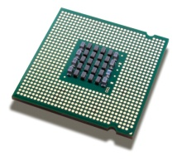
From inherently sequential to parallel
Objective function:

Slide 101
Parallel sequential co-clustering
Initialize clusters at random
Split clusters to pairs
Assign each pair to one machine
“Shuffle” clusters in parallel
Try moving each instance from one cluster to another
Assign a different pair of clusters to each machine
Repeat to cover all cluster pairs

Slide 102
How can we make sure that each cluster pair is generated exactly once?
With minimal communication costs?

Slide 103
Tournament
0
1
2
3
7
6
5
4
0 7
1 6
2 5
3 4
0 7
1 6
2 5
3 4
3 7
0 6
1 5
2 4

Slide 104
Tournament
3
0
1
2
7
6
5
4
0 7
1 6
2 5
3 4
3 7
0 6
1 5
2 4
6 7
0 5
1 4
2 3

Slide 105
Tournament
6
0
1
2
7
5
4
3
0 7
1 6
2 5
3 4
3 7
0 6
1 5
2 4
6 7
0 5
1 4
2 3

Slide 106
Tournament
2
6
0
1
7
5
4
3
0 7
1 6
2 5
3 4
3 7
0 6
1 5
2 4
6 7
0 5
1 4
2 3
2 7
6 5
0 4
1 3

Slide 107
Tournament
5
6
0
1
7
4
3
2
0 7
1 6
2 5
3 4
3 7
0 6
1 5
2 4
6 7
0 5
1 4
2 3
2 7
6 5
0 4
1 3
5 7
6 4
0 3
1 2

Slide 108
Tournament
1
5
6
0
7
4
3
2
0 7
1 6
2 5
3 4
3 7
0 6
1 5
2 4
6 7
0 5
1 4
2 3
2 7
6 5
0 4
1 3
5 7
6 4
0 3
1 2
1 7
5 4
6 3
0 2

Slide 109
Tournament
4
5
6
0
7
3
2
1
0 7
1 6
2 5
3 4
3 7
0 6
1 5
2 4
6 7
0 5
1 4
2 3
2 7
6 5
0 4
1 3
5 7
6 4
0 3
1 2
1 7
5 4
6 3
0 2
4 7
5 3
6 2
0 1

Slide 110
Experimental Setup
DataLoom:
Parallelization of sequential co-clustering
MPI-based implementation
Centroid-based IT-CC:
Implementation in MapReduce
Double k-means:
Co-clustering in Euclidean space

Slide 111
Overall costs per full iteration
~
k : #clusters, m : #machines, v : #values in P(Y | X)
Communication:
centroid-based O(2m ⋅ k ⋅ |Y|) = O(m ⋅ k²)
DataLoom O((k-1) ⋅ (v/2)) = O(k ⋅ v)
In our experiments (many machines, sparse data): (sending centroids) 2m|Y| ≈ v/2 (sending cluster)
CPU cycles: O(k ⋅ v) for both centroid-based & DataLoom
~
~

Slide 112
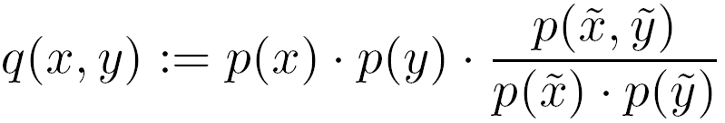
Experimental results
RCV1 dataset
800,000 docs
150,000 words
Netflix (KDD Cup ‘07)
18,000 movies
480,000 users
55 2nd-level Reuters categories
800 document / 800 term clusters
clustering without label information
choose the mode of each cluster
Clustering binary rating matrix
800 movie / 800 user clusters
for hold-out users: rank movies
cluster-induced distribution:
112

Slide 113
Conclusion
DataLoom: parallelization of sequential co-clustering
Theoretical result:
Sequential updates superior for cluster updates
Experimental results:
Excellent clustering results on two large benchmarks

