Slide 1
What is your sign baby? Door decorations & bulletin board idea
Submitted by Alisha Wauters
Resident Assistant, University of Iowa

Slide 2
What’s your sign, baby?

Slide 3
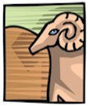
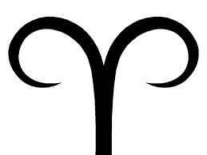
Aries
Aries is the first of the zodiac signs. Aries is the sign of the self, people born under this sign strongly project their personalities onto others and can be very self-oriented. Aries tend to venture out into the world and leave impressions on others that they are exciting, vibrant and talkative. Aries tend to live adventurous lives and like to be the center of attention, but rightly so since they are natural, confident leaders. Aries are enthusiastic about their goals and enjoy the thrill of the hunt, “wanting is always better than getting” is a good way to sum it up. Aries are very impulsive and usually do not think before they act – or speak. Too often Aries will say whatever pops into their head and usually end up regretting it later!
Season: Spring
Color: Red
Stone: Diamond
Keywords: active, initiating, leading, independent, aggressive, impatient, combative, energetic, pioneering, naïve, assertive
March 21-April 19

Slide 4
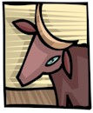
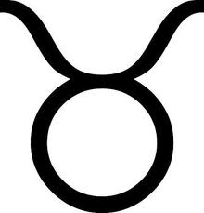
Taurus
Taurus is the one who has immense perseverance, even when others have given up. Taurus's have a well known reputation for being stubborn, which is not necessarily a bad thing. The stubborn streak can cause Taurus to butt heads and conflict with other strong character types. Taurus are not fond of change. They like the familiar and routine comfort of life. Taurus is easy going and not one to pick a fight but should some poor souls attempt to provoke Taurus, the wrath will be known, for they have a temper underneath the calm surface. Taurus likes security, in every aspect of their lives from home, to love, to career. Taurus can be secretive, opinionated and stingy. Taurus tend to be self-indulgent and lazy, Taurus are master procrastinators of the astrology zodiac! They do however have a strong, persistent drive that comes to life when they chose, and no one would ever know that they are lazy. The secret to this is that their laziness is pushed aside when it comes to themselves.
Season: Spring
Stone: Emerald
Color: Green
Keywords: persevering, down-to-earth, stable, stubborn, possessive, prosperous, dependable, physical, sensual
April 20- May 20

Slide 5

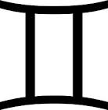
Gemini
Gemini are many sided, quick in the mind and physically. They are brimming with energy and vitality, they are clever with words. They are intelligent and very adaptable to every situation and every person. Gemini are very curious, they want to be involved. They do not mind their own business! This is because they really enjoy communicating, they are the ultimate social butterfly. They have interesting opinions and thoughts and are not afraid to speak their mind. Lacking perseverance, Gemini easily goes off topic to explore another thought or idea. Gemini are superficial, they will form opinions on matter without diving into them and exploring them fully. Routine and boredom are Gemini’s biggest fears. Gemini would rather be naïve then know the depressing truth, they do not want anything putting a damper on their freedom or positive energy.
Season: Spring
Stone: Agate
Color: Yellow
Keywords: talkative, mental, adaptable, flexible, changeable, responsive, sociable, superficial
May 21 – June 20

Slide 6
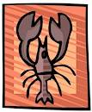

Cancer
Cancer is a mysterious sign filled with contradictions. They want security and comfort yet seek new adventure. They are very helpful to others yet sometimes can be cranky and indifferent. Cancer has a driving, forceful personality that can be easily hidden beneath a calm, cool exterior. They have a deep psyche and intuitive mind that is hidden from the world. Cancer is deeply sensitive and easily hurt by others. They are complex, fragile, unpredictable and temperamental and need constant support and encouragement. When it gets the support needed, it has a tremendous amount to offer in return. Cancer will always want to stay in touch with old friends. They have unconditional love and caring more so then any other astrology sign. They are very observant and can read people very well. Cancer has a lot of emotional issues but once they overcome their shyness, there is anything they can’t do.
Season: Summer
Stone: Pearl
Color: White
Keywords: gentle, conservative, feeling, nurturing, defensive, contemplative
June 21 – July 22

Slide 7
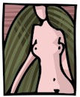
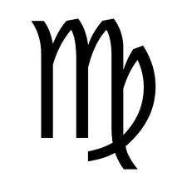
Virgo
The Virgo is often considered a shy, “lady in waiting” personality that is a little naïve. Though Virgos are seldom celibate, they often keep their personal identity intact throughout their lives. This composure is virginal in nature. Virgo exists in the mind, everything is inside. To the world, Virgo presents a calm and collected exterior but on the inside, nervous uncontrolled intensity in the mind, trying to figure things out, how to improve everything, analyzing and thinking. Virgo can tire itself out without even moving! Virgo has a constant drive to improve and perfect, this can lead to extreme pickiness and finickiest. They are pure, their motives are honest and never malicious and they want to accomplish something.
Season: Summer
Stone: Sapphire
Color: Blue
Keywords: analytical, intelligent, reserved, critical, helpful, conscientious
August 23 – September 22

Slide 8


Leo
Leos are high esteemed, honorable and very devoted to themselves in particular! Leo is always center stage and full of flair. Leos are full of energy and others are attracted to the Leo’s wit and charm. A Leo will never settle for second best. Public image is very important and they will do whatever it takes to protect their own reputation. Leos are very generous, kind and openhearted people. They are not one to hold a grudge, they easily forgive, forget and move on. Leos are always trying to make things right in the world, they have larger than life emotions. They react to situations with action but are not impulsive. They look at the future and consider the consequences of their actions.
Season: Summer
Stone: Ruby
Color: Orange
Keywords: magnanimous, generous, hospitable, caring, warm, authoratative, active, open
July 23 – August 22

Slide 9
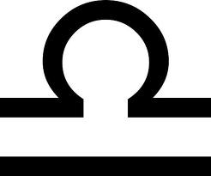
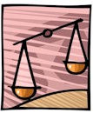
Libra
Libras are diplomatic. They put themselves in other’s shoes. They are the ones that want to make things right and have balance and harmony. They have captivating charm, elegant taste and they are easy to like due to their eager-to-please, easy going nature. They are amazing listeners and are able to sooth and calm people. Libras like attention and admiration for people they have brought together. Libras are very intelligent but often hide this. They express their intelligence through creativity. Libras love variety and different situations. They welcome change. They love luxury and seem to be constantly fussing over their appearance. They love anything upscale and classy. Libras work hard to please others and others find them incredibly captivating.
Season: Fall
Stone: Marble
Color: Pastel Green
Keywords: just, sociable, refined, accommodating, kind, fair, diplomatic, likable, indecisive, respectful, artistic
September 23 – October 22

Slide 10
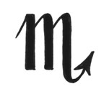
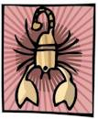
Scorpio
Scorpio is the astrology sign of extremes and intensity. Scorpios are very deep, intense people. They present a cool, detached, and unemotional air to the world yet lying underneath is a tremendous power, extreme strength, intense passion and a strong will and a persistent drive. Scorpios have a very penetrative mind, do not be surprised if they ask questions, they are trying to delve deeper and figure things out and survey the situation. Scorpio’s are very weary of the games that other people try to play and they are very aware of it. Scorpios tend to dominate and control anyone that lets them or anyone they find weak. The persons a Scorpio respects is treated with kindness, loyalty and generosity. On the outside, a Scorpio has great secretiveness and mystery. This magnetically draws people to them.
Season: Fall
Stone: Topaz
Color: Purple
Keywords: passionate, perceptive, resourceful, possessive, psychological, prowling, determined, probing, fixed, focused
October 23 – November 21

Slide 11
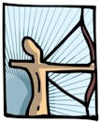

Sagittarius
Sagittarius seem to be guided by luck, good things happen to Sagittarius and this is usually because of their optimistic outlook and positive disposition which attracts good fortune. Despite hardships, Sagittarius is always optimistic. Sagittarius have a vibrant, expansive personality that is free like a bird. They are full of curiosity and always look forward to the future. Sagittarius are detached from emotions because emotions hold a person back , they do not like to talk about their feelings. They simply experience them and move on. Sagittarius can be reckless and irresponsible because they will at a suggestion of something new before they weigh the advantages and disadvantages.
Season: Fall
Stone: Topaz
Color: Turquoise
Keywords: optimistic, restless, enthusiastic, adventurous, honest, irresponsible, outspoken, independent
November 22 – December 21

Slide 12
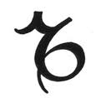
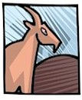
Capricorn
Capricorns are very ambitious people, they always have something they are pursuing and they want their lives to be fulfilled. Capricorns are extremely patient and will wait for a long time for something they want. They know that there is only one chance to succeed and they are taking the proper steps to ensure they accomplish their goals with flying colors. Capricorns have very active minds and strong powers of concentration. Capricorns like being in control. They are very cautious. They accept change but introduce it slowly. Capricorns tend to see life in black or white. There are no gray areas for these are areas not understood and this is uncomfortable. They tend to be in control in a romantic relationship that way they are never vulnerable to another person.
Season: Winter
Stone: Amber
Color: Brown
Keywords: tenacious, conservative, resourceful, disciplined, wise, ambitious, prudent, constant
December 22 – January 19

Slide 13
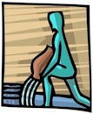

Aquarius
Aquarius are the people who deviate from the crowd and go their own way. They are always after intellectual stimulation and traveling their way regardless of what people think. They like to experience both sides sand see both opinions as they formulate new opinions. They have a “live and let live” policy where everyone is free to be themselves. An Aquarius never judges others. They learn how to interact with others through observation. They can be masters of manipulation justifying anything they do or think. Anything new is an opportunity. Their eccentricity makes them unique. Deep inside, Aquarius would never intentionally hurt anyone, they have respect for every human, even though this might not seem apparent to the more emotional types.
Season: Winter
Stone: Amethyst
Color: Sky Blue
Keywords: individualistic, assertive, independent, humanitarian, inventive, original, eccentric, opinionated, intellectual, idealistic, cool, friendly, detached
January 20 – February 18

Slide 14


Pisces
Pisces is the sign of mysticism, mystery and the spiritual unknown. Pisces live in two worlds, the real world and the spiritual word. They do this to avoid the realities of pain and suffering in the world. They have extreme emotions and feel intensively. Pisces have formidable intuitive ability. Pisces are very good at understanding people for they have the ability to delve into the psyche and see behind a person’s motives. Pisces are prone to drug addiction and indulging lifestyles because of their eternal search for themselves a. Pisces have a strength of character and will stand up for what they believe in. They can be lazy in matters they do not care about. Pisces is the most sensitive of all zodiac signs.
Season: Winter
Stone: Jade
Color: Sea Green
Keywords: intuitive, dreamy, artistic, humane, sympathetic, sensitive, compassionate, perceptive, tender, impressionable
February 19 – March 20

Slide 15
Note from the Author
I made matching door decs with each of my resident’s zodiac sign!
This can also be used to create an interactive bulletin board. Residents can be asked to add their names to their signs.

