Slide 1
An ounce of prevention is worth a pound of cure (and millions of dollars in savings): Balancing our investment in the Chesapeake by maintaining healthy watersheds September 6, 2012 Mark Bryer The Nature Conservancy Chair, Healthy Watershed Goal Team

Slide 2
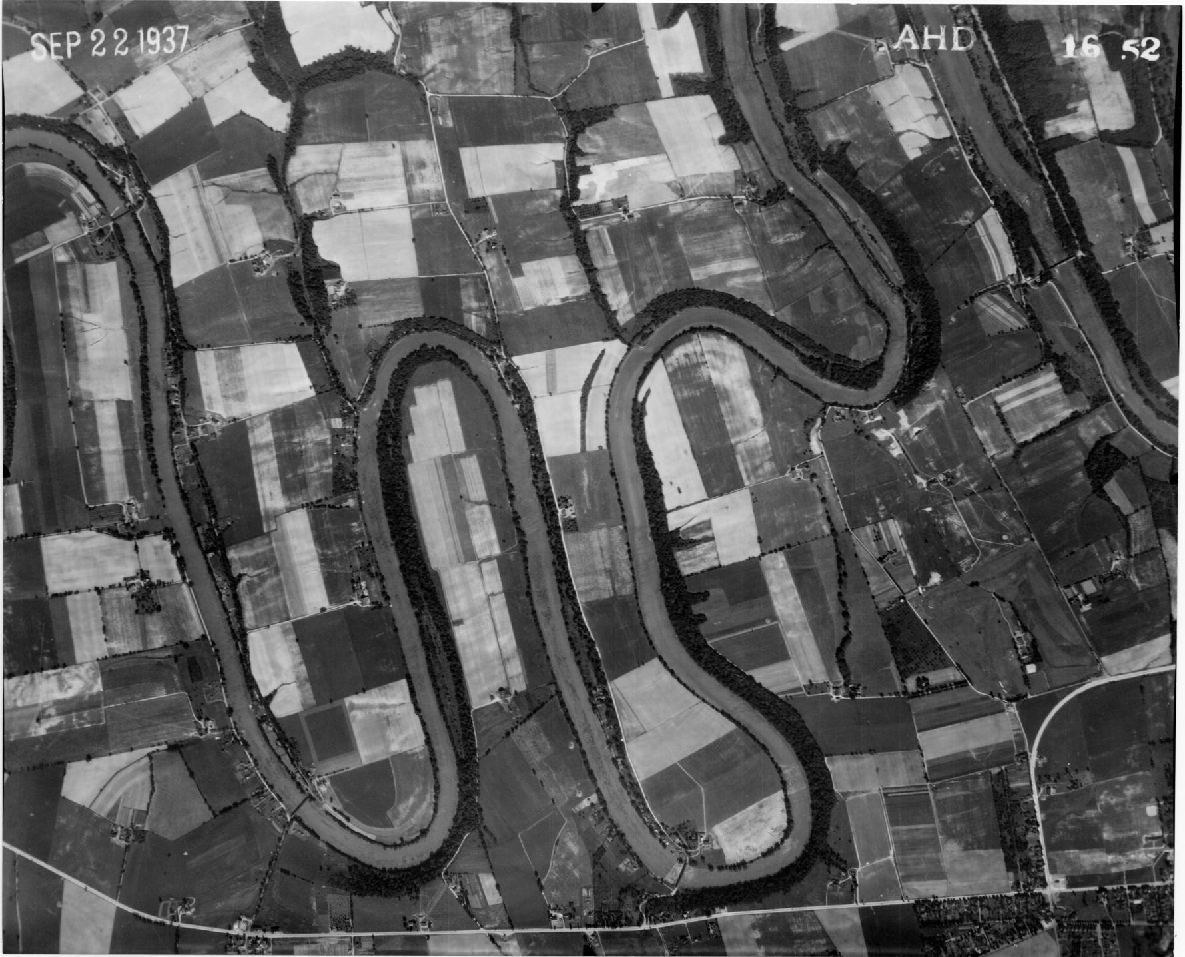

Slide 3
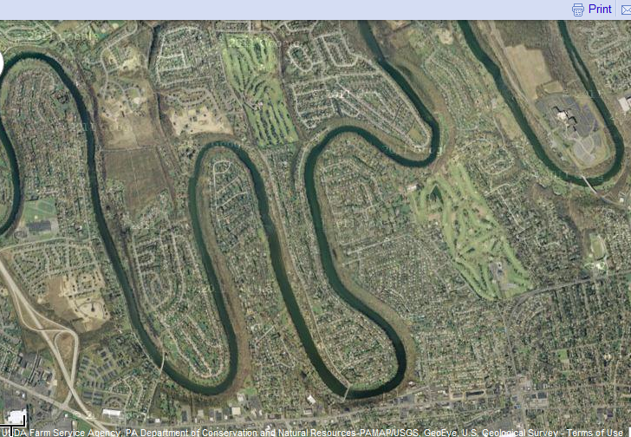

Slide 4
CBP Organization Chart
Chesapeake Executive Council
Principals’ Staff Committee
Independent
Evaluator
Citizens’ Advisory
Committee
Local Government
Advisory Committee
Scientific & Technical
Advisory Committee
Management Board
Action Teams
Technical
Support & Services
Chesapeake Action Plan Goal Implementation Teams
Protect &
Restore
Fisheries
Protect & Restore
Vital Aquatic
Habitats
Protect &
Restore Water
Quality
Maintain
Healthy
Watersheds
Foster
Chesapeake
Stewardship
Enhance Partnering,
Leadership
& Management
Notes:
4
As you look at this option, you may ask yourself, where are the local governments and citizens in this structure?
At the October 5th meeting, we had a lot of discussion about the importance of local level involvement in the Chesapeake Bay Program. Participants recognized that local government and community level actions are extremely important . The majority of participants felt that the Program needs to directly hear local perspectives as it develops policies and actions. The question is where and how can the CBP best solicit the community level participation (knowledge, expertise, and information) in its policy debate and decision making. There were three basic positions regarding community level involvement: 1) A number of participants argued that the local governments, citizens, and watershed groups would be most effective if they were represented on the Policy Board and other standing committees or task forces as appropriate. This argument focused on the idea that they could shape the actions and policies as decision-makers by participating on decision making bodies much more effectively than as members of advisory committees. 2) Other participants argued that the local governments, citizens and watershed groups operate best in an advisory capacity. People felt that the time commitment required by sitting on regular meetings of the Policy Board or any of the other committees was too great for the average citizen or local government official. They also believed that the role of advisory committees provides more strength (in numbers) than having a few representatives on the Policy Board or other committees spread throughout the organization. 3) Both the states of Virginia and Pennsylvania asserted that contact with local governments and community groups could best come through the state structures for implementation. The rationale was that the states are much more closely connected to the local level than the overall Bay Program. At the end of the meeting, we agreed to solicit the opinions of LGAC and CAC on numbers 1 and 2.

Slide 5

Committee membership
State agencies
MD Department of Planning (Vice Chair) and DNR, MDE, PA DEP and DCNR, VA DEQ and DCR, Chesapeake Bay Commission, DC DOE, NY DEC
Federal agencies
EPA, USGS, USFWS, USFS, NRCS, NPS, DOD
Academic
VCU, VA Tech
Non-profits
The Conservation Fund, Chesapeake Bay Foundation, American Farmland Trust, Trust for Public Land, The Nature Conservancy

Slide 6
Maintain Healthy Watersheds Goal Implementation Team
Goal: Maintain local watershed health across a range of landscape contexts

Slide 7
What is a Healthy Watershed?
There are many ways to define a healthy watershed, here are a few examples:
EPA Healthy Watershed Initiative Definition
Natural land cover
Sufficient habitat
Aquatic/riparian connectivity
Natural, dynamic hydrologic and geomorphic processes
State Classifications
Water quality
Good benthic index of biotic integrity score (BIBI)
Antidegradation designations

Slide 8
Why focus on healthy watersheds?
Balanced investment strategy - Restoration of the Bay depends on the protection of resource lands that maintain watershed health.
Cheaper than restoration - protecting what’s still good is far more cost effective than trying to restoring it.
Meaningful “up-watershed” - majority of people in the watershed connect to the health of their local streams, not the Bay.

Slide 9
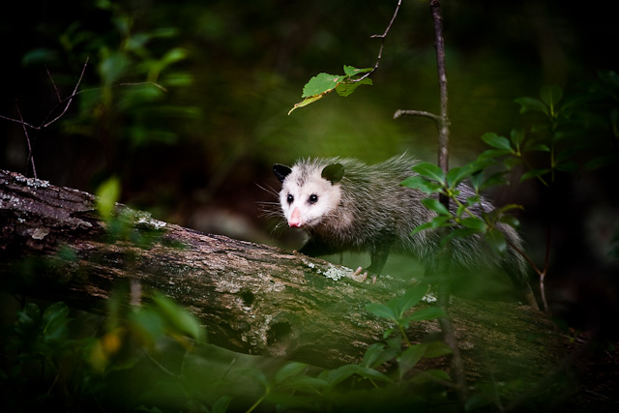
Benefits of Healthy Watersheds
Healthy watersheds provide:
Clean water for healthy ecosystems and human use
Habitat for fish and wildlife
Recreation opportunities
Increased quality of life
Better adaptation to climate change and land use change
Nutrient cycling
Carbon sequestration
Economic benefits

Slide 10
An ounce of protection…
Economic benefits of protecting Healthy Watersheds
Lower water treatment costs
Flood mitigation
Fishing, boating, eco-tourism
Increased property values
The challenges and costs of restoring these services are often much greater than the costs of protecting them.

Slide 11
Economics of protection
For every 10% increase in forest cover of source drinking water area, treatment costs decreased by 20% (Earnst, C., 2004)
In PA, homes near green space are worth 30% more ($16.3 billion)
Existing wetlands surrounding Boston have been valued at $72,000 per hectare pre year based on the cost avoidance they provide by preventing flood damage (Myers 1996)
Notes:
New York protected its drinking water source watershed and saved $5 billion in infrastructure costs and $300 million annually

Slide 12
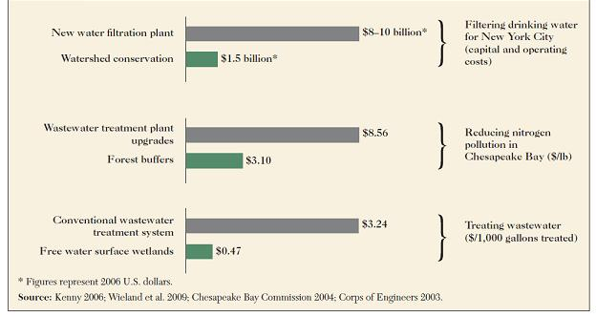
Economics of protection
Notes:
New York protected its drinking water source watershed and saved $5 billion in infrastructure costs and $300 million annually

Slide 13
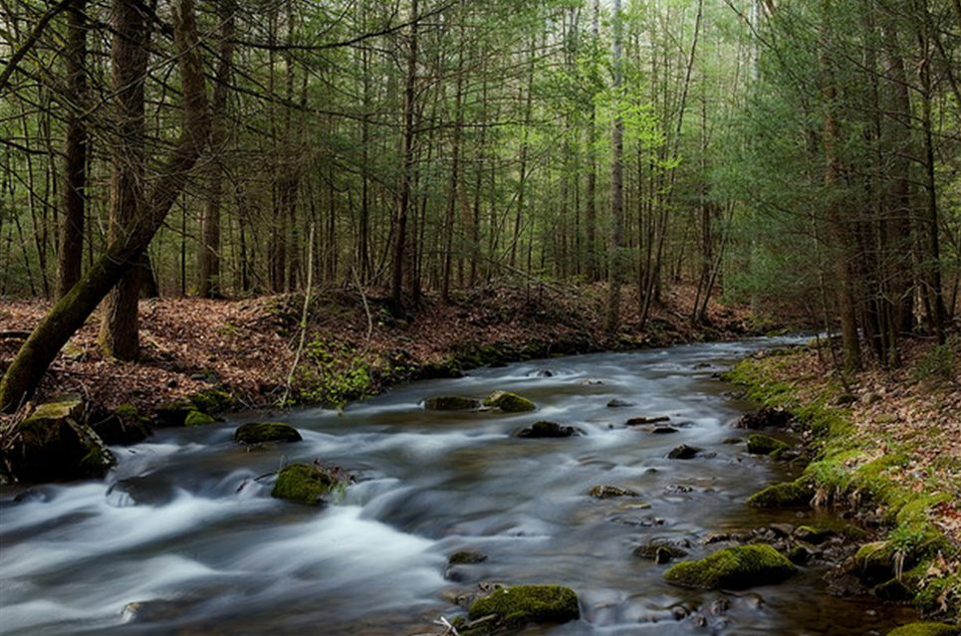
Maintaining HW: How are we doing?
We don’t exactly know…but we do know:
We have a snapshot of current health based on bugs in our streams
The number of impaired streams is increasing
We don’t know how effective management interventions are at keeping our streams healthy
Notes:
Our knowledge (especially of trends) is not adequate
Currently use Benthic Index of Biotic Integrity (BIBI) map which is a snap shot of 10 years worth of data
http://www.chesapeakebay.net/indicators/indicator/health_of_freshwater_streams_in_the_chesapeake_bay_watershed
don’t have a bay-wide picture
often don’t have a state or local picture to prioritize management/ protection, support resource allocation, and facilitate cross border management

Slide 14
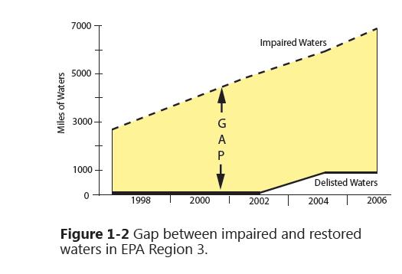
Restoration is not an easy answer
The cost of repairing damaged ecosystems is high and has a low success rate

Slide 15
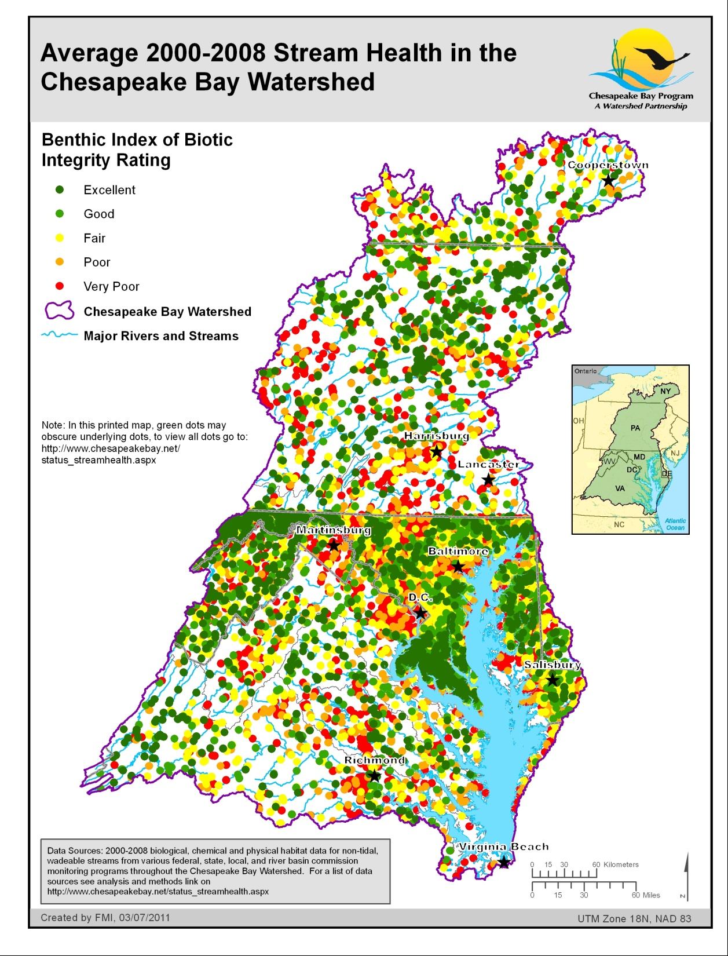
Notes:
But missing information on trends and protection status

Slide 16
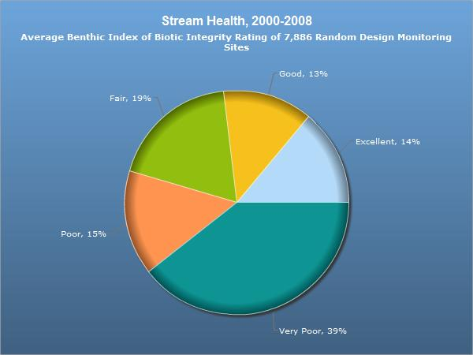

Slide 17
Presidential Executive Order:
Improve the health of streams so that 70% of the streams throughout the Chesapeake watershed have quality that is fair or better by 2025.
Current condition: 45% are fair, good or excellent.
So, in other words, in the next 13 years:
Restore 25%
and
Don’t lose any of the current 45%!!

Slide 18
An essential role for Maintaining Healthy Watersheds
Why do we need a balanced strategy of protection and restoration?
Ecosystem services provided by healthy watersheds are expensive or even impossible to replace
Restoration is expensive and not always effective, although necessary
Ultimately, if healthy watersheds are degraded or lost, the price tag for Bay recovery goes up and the “reasonable assurance” of success goes down

Slide 19
What’s GIT4 doing?
Develop tracking system for Healthy watersheds
Identify healthy watersheds and threatened areas
Determine current protection efforts
Help target resources and conservation efforts
Notes:
(w/ reference to relevant actions for audience members)
Audience can: Call for HW examples and engagement with the GIT
Audience can: Understand and advocate for HW

Slide 20
Where are the healthy watersheds?
Which healthy watersheds are at the greatest risk of being degraded?
What management actions are we taking to protect healthy watersheds, and are they working?
Notes:
But missing information on trends and protection status

Slide 21
What’s GIT4 doing?
Develop tracking system for Healthy watersheds
Identify healthy watersheds and threatened areas
Determine current protection efforts
Help target resources and conservation efforts
Advocacy communications
Create forum for discussion and information sharing about what works
Compile and publish case studies, existing state programs, including anti-degradation
Track at the 2012 Watershed Forum
Notes:
(w/ reference to relevant actions for audience members)
Audience can: Call for HW examples and engagement with the GIT
Audience can: Understand and advocate for HW

Slide 22
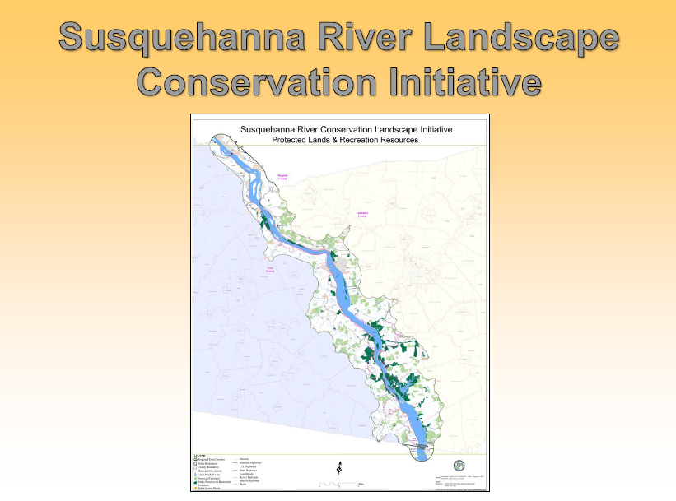
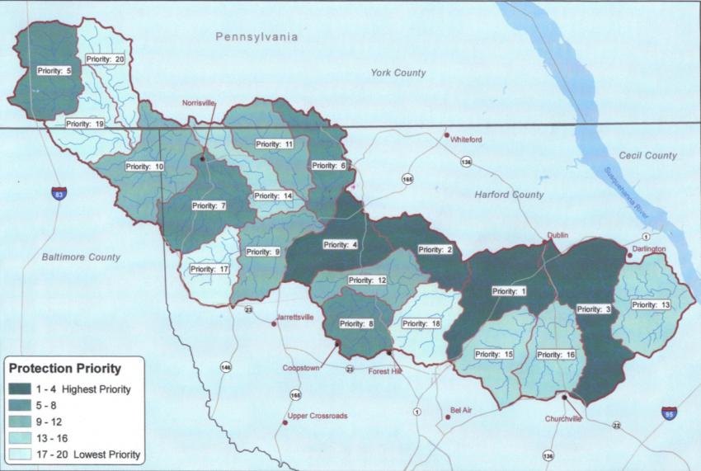
Sharing knowledge
Deer Creek – PA/MD
Notes:
And anti-degradation programs

Slide 23
What’s GIT4 doing?
Develop tracking system for Healthy watersheds
Identify healthy watersheds and threatened areas
Determine current protection efforts
Help target resources and conservation efforts
Advocacy communications
Create forum for discussion and information sharing about what works
Compile and publish case studies, existing state programs, including anti-degradation
Track at the 2012 Watershed Forum
Improve science and policy
Pilot a fish community indicator of watershed health
Convene workshops to explore linkage between healthy watershed protection and the Bay TMDL
Notes:
(w/ reference to relevant actions for audience members)
Audience can: Call for HW examples and engagement with the GIT
Audience can: Understand and advocate for HW

Slide 24
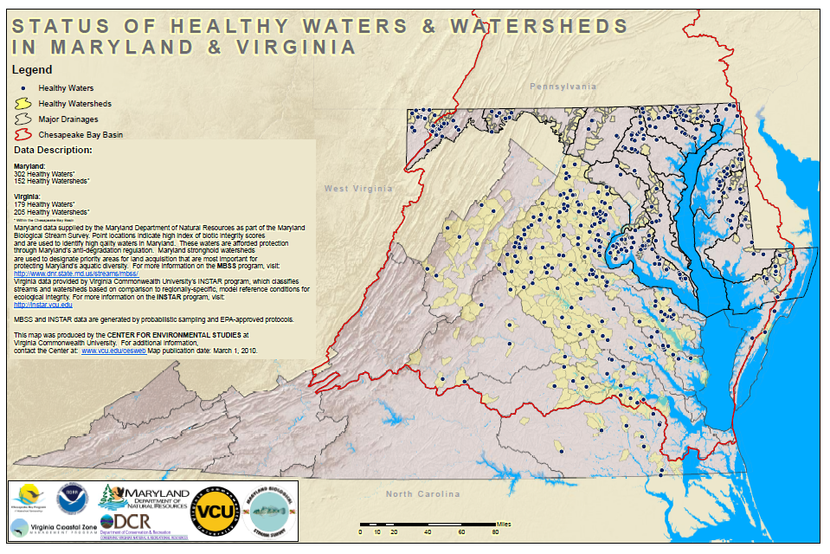
Improving science

Slide 25
“New development is increasing nutrient and sediment loads at rates faster than restoration efforts are reducing them…a 16% increase over the past two decades”
“Developed lands contribute less than one-third of the Bay loads but would require about two-thirds of the overall estimated restoration costs”

Slide 26
Crediting conservation
Sponsoring a series of workshops to explore how to “count” protective actions that avoid conversion of forests and other critical resource lands
Science – STAC
Policy – Chesapeake Bay Commission
Potential applications include:
Credit in-stream processing by healthy streams
Credit permanent BMPs by applying high efficiencies
Increase assurance that load caps will be maintained

Slide 27
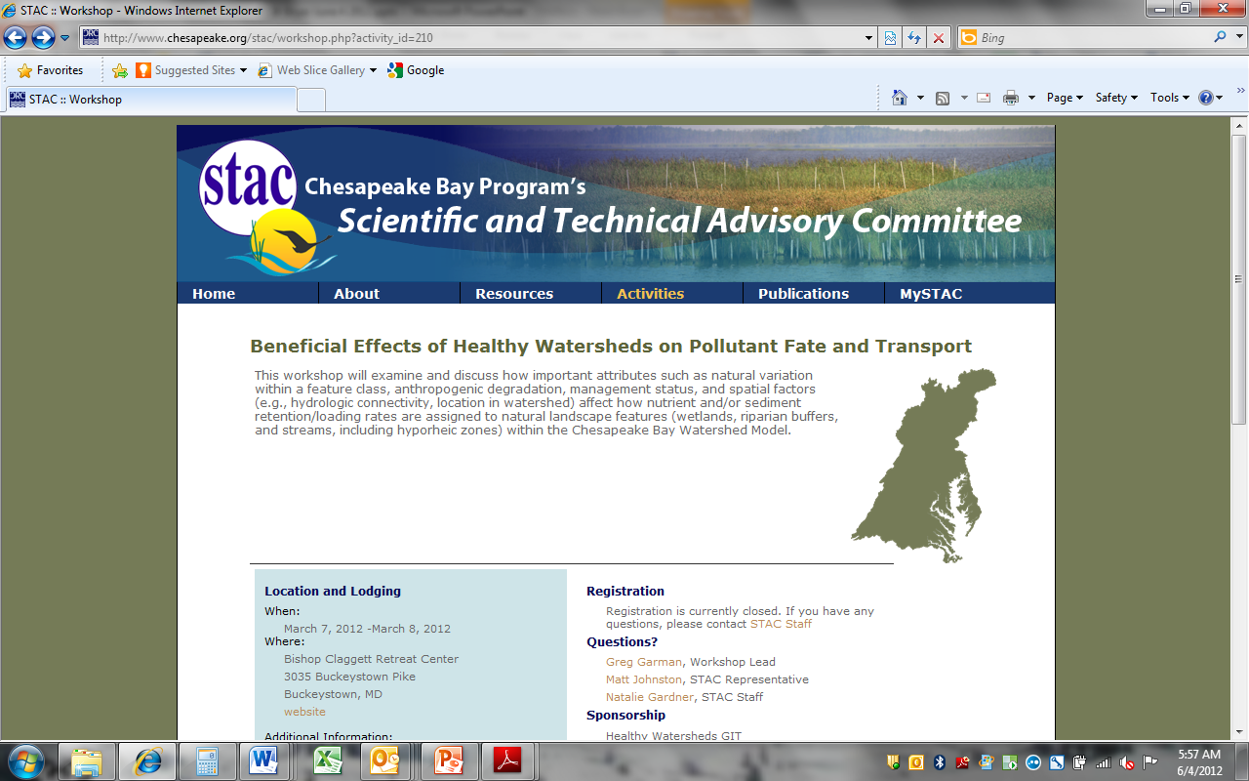

Slide 28
Bern Sweeney,
Stroud Center

Slide 29
(Luc Claessens, Univ of DE)

Slide 30
What the scientists said:
There’s a lot of uncertainty and future research needs
But, we all agree that some really things matter when quantifying benefits of healthy watersheds:
Forest amount and spatial arrangement
Stream width
Flow paths (surface and subsurface)
Retention time and connectivity (e.g., floodplains!)
Location, location, location!
And we can quantify benefits of features to better represent the values of natural features
→ Pursue upgrades to our pollution accounting framework that more accurately reflect these benefits and create incentives to keep them intact!

Slide 31
Chesapeake Bay Commission policy project
Focused on identifying and recommending policy options that credit protective actions through our existing water quality policy framework
Project slated to be completed by the end of 2012
Steps:
Develop scientific basis (GIT 4/STAC)
Legal analysis of existing federal/state policy framework
Workgroup development of policy options
Recommendations to EPA/States

Slide 32
So, what do we know?
Land conversion increases nutrient and sediment loads
The number of impaired streams in the mid-Atlantic region has increased dramatically
More than 3 million people are projected to move into the watershed in the next three decades
Energy development in the upper watershed has increased significantly
Natural areas provide pollution reduction benefits through in-stream processing, denitrification, as well as supporting local, “up-watershed” communities and economies
Investing today in pollution prevention through land protection and other proactive means is more cost-effective and successful than allowing streams to be degraded and then attempting to restore them
The accounting framework for the current TMDL is based on reductions from a 2010 baseline and does not account for or directly promote actions that avoid future loads
Prevention of land conversion will be essential to meet pollution reduction and maintenance goals for the Bay

Slide 33
What we need to do…
Track where healthy watersheds are and how good we are at protecting them
Update watershed models to better reflect the values that healthy watersheds provide
→ 2017 update
Develop new policy approaches that create additional incentives for protection of healthy watersheds
Advocate for protection as an essential complement to restoration in meeting our water quality and habitat goals

Slide 34
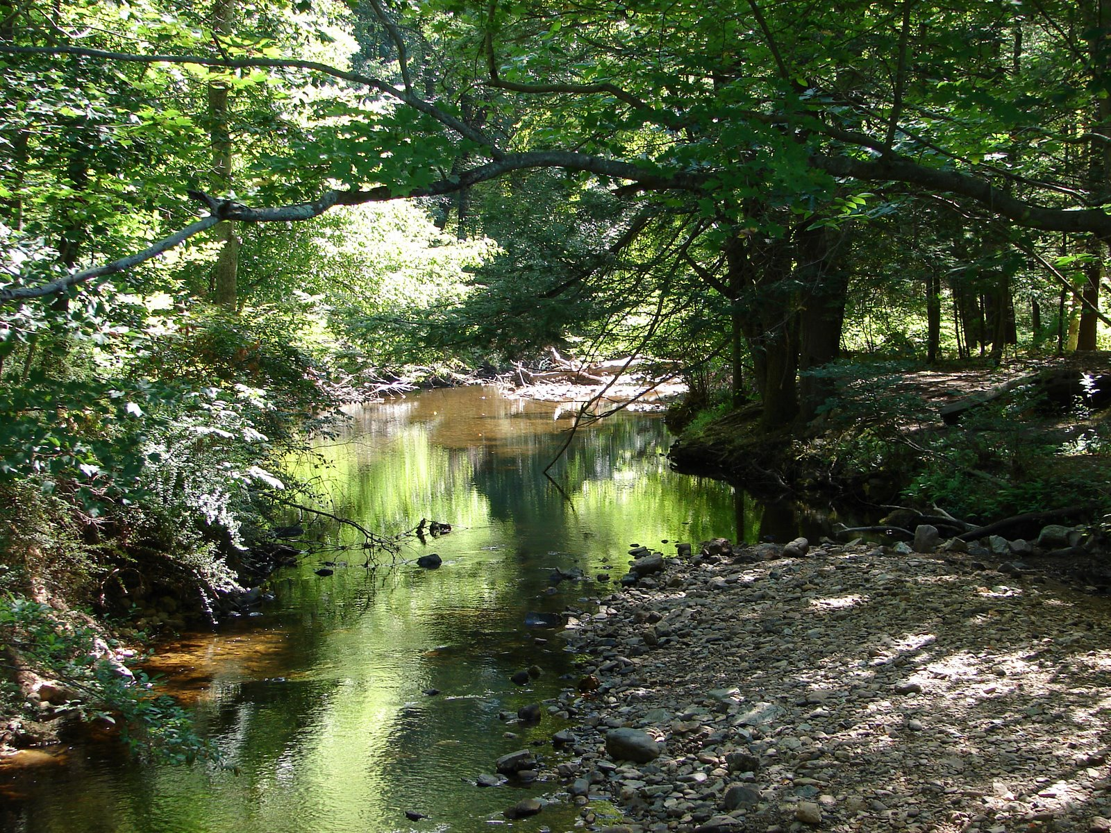
© Doug Cook

Slide 35
