Slide 1
Practicing Civility, Promoting Respect
Compiled by Justine Moral
Resident Assistant

Slide 2
Needing Each Other
` We need each other, whether we realize it or not, whether we are willing to acknowledge it or not. Arrogance and pride pretend we don’t. The “lie” of rugged individualism that is so prevalent in this country creates an illusion that we are not and should not be dependent upon other people. What a joke! Another set of hands pulled you from your mother’s womb at birth; another set of hands changed your diapers, fed you, nourished you; another set of hands taught you how to read and write. Now another set of hands grows your food, delivers your mail, collects your garbage, provides your electricity, protects your city, defends your nation; another set of hands will comfort and care for you when you become sick and old; in the end, another set of hands will lower you into the ground when you die.
Adapted from The Servant: A Simple Story About the True Essence of Leadership by James C. Hunter

Slide 3
Social Capital
Social capital consists of the stock of active connections among people: the trust, mutual understanding, and shared values and behaviors that bind the members of human networks and communities and make cooperative action possible. Social capital makes an organization, or any cooperative group, more than a collection of individuals intent on achieving their own private purposes. Social capital bridges the space between people. Its characteristic elements and indicators include high levels of trust, robust personal networks and vibrant communities, shared understandings, and a sense of equitable participation in a joint enterprise – all things that draw individuals together into a group.
Taken from In Good Company: How Social Capital Makes Organizations Work by Don Cohen and Laurence Prusak

Slide 4
Social Capital
This kind of connection supports collaboration, commitment, ready access to knowledge and talent, and coherent organizational behavior. This description of social capital suggests appropriate organizational investments – namely, giving people space and time to connect, demonstrating trust, effectively communicating aims and beliefs, and offering equitable opportunities and rewards that invite genuine participation, not mere presence.
Taken from In Good Company: How Social Capital Makes Organizations Work by Don Cohen and Laurence Prusak

Slide 5
Maintaining Relational Accounts
Maintaining Relational Accounts is the relational account metaphor that teaches us the importance of keeping healthy relationship balances with the significant people in our lives, including those with whom we work. Simply put, when we meet a person for the first time, we basically (should) have a neutral relationship account balance because we don’t know one another, we’re still testing the waters. As the relationship matures, however, we make deposits and withdrawals in these imaginary accounts based on how we behave. Adapted from The Servant: A Simple Story About the True Essence of Leadership by James C. Hunt

Slide 6
Maintaining Relational Accounts
For example, we make deposits into these accounts by being trustworthy and honest, giving people appreciation and recognition, keeping our word, being good listeners, not talking behind other people’s backs, using the simple courtesies of hello, please, thank you, I’m sorry, and so on. We make withdrawals by being unkind, discourteous, breaking our promises and commitments, backstabbing others, being poor listeners, being puffed up and arrogant, and so on.
Adapted from The Servant: A Simple Story About the True Essence of Leadership by James C. Hunt

Slide 7
Civility
Civility...is the sum of the many sacrifices we are called to make for the sake of living together. When we pretend that we travel alone, we can also pretend that these sacrifices are unnecessary. Yielding to this very human instinct for self-seeking... is often immoral, and certainly should not be done without forethought. We should make sacrifices for others not simply because doing so makes social life easier (although it does), but as a signal of respect for our fellow citizens, marking them as full equals, both before law and before God. Rules of civility are thus also rules of morality; it is morally proper to treat our fellow citizens with respect, and morally improper not to. Our crisis of civility, then is part of a larger crisis of morality. And because morality is what distinguishes humans from other animals, the crisis is ultimately one of humanity. Taken from Civility: Manners, Morals, and the Etiquette of Democracy by Stephen L. Carter

Slide 8
Duties Civility Imposes
1. Our duty to be civil toward others does not depend on whether we like them or not.
2. Civility creates not merely a negative duty not to do harm, but an affirmative duty to do good.
3. We must come to the presence of our fellow human beings with a sense of awe and gratitude.
4. Civility assumes that we will disagree; it requires us not to mask our differences but to resolve them respectfully.
5. Civility requires that we listen to others with the knowledge of the possibility that they are right and we are wrong.
6. Civility requires that we express ourselves in ways that demonstrate our respect for others.
7. Civility allows criticism of others, and sometimes even requires it, but the criticism should always be civil.
8. Civility discourages the use of legislation rather than conversation to settle disputes, except as a last, carefully considered resort.
Taken from Civility: Manners, Morals, and the Etiquette of Democracy by Stephen L. Carter

Slide 9
Rules of Civility and Decent Behavior
1. Every action done in company ought to be with some sign of respect to those that are present.
2. Shake not the head, feet, or legs; role not the eyes nor lift one eyebrow higher than the other; wry not the mouth; and bedew no man’s face with your spittle by approaching too near him when you speak.
3. Turn not your back to others, especially in speaking; jog not the table or desk on which another reads or writes; lean not upon anyone.
4. Wherein you reprove another, be unblamable yourself, for example is more prevalent than precepts.
5. Use no reproachful language against anyone, neither curse nor revile.
6. Let your conversation be without malice or envy, for ‘tis a sign of a tractable and commendable nature; in all causes of passion admit reason to govern.
7. Speak not injurious words, neither in jest nor earnest; scoff not at none although they give occasion.
8. Think before you speak; pronounce not imperfectly, nor bring out your words too hastily, but orderly and distinctly.
9. While you are speaking, point not your finger at whom you discourse, nor approach too near to whom you talk, especially to his face.
10. Speak not evil of the absent for it is unjust.
George Washington, first President of the United States of America

Slide 10
Thoughts on Respect
Some Things to Remember
• Each one of you has a story. You don’t have to know what each other’s story entails. All you have to do is acknowledge that each one has one: that there are probably lots of things each of you doesn’t understand about the other’s perspective, and that one of the reasons for you to talk with each other is that you learn more about each others’ views.
• The single most important rule about managing an interaction is this: You cannot move the conversation in a more positive direction until the other person feels heard and understood. And they won’t feel heard and understood until you’ve listened.
• As you do so, however, it is imperative that you remember this fact: Each of you is the ultimate authority on you and only on you. You are the expert on what you think, how you feel, and why you have come to this place. If you think it or feel it, you are entitled to say it, and no one can legitimately contradict you. You only get in trouble if you try to assert what you are not the final authority on – who is right, who intended what, what happened.
Adapted from Difficult Conversations: How to Discuss What Matters Most by Douglas Stone, Bruce Patton, and Sheila Heen

Slide 11
The Respectful Workplace
Acknowledge all individuals in a respectful manner.
Listen to a person’s concerns as you think that s/he would like them to be listened to.
Don’t try to impose your way of doing things, or your values, on others.
Paraphrase and reflect on statements that are confusing to you or which you don’t understand.
Acknowledge your own feelings honestly.
Verbalize your concerns and let the other person know your boundaries.
Don’t get involved in abusive situations. Step away
Don’t tolerate “put downs” of others for whatever reason. State how inappropriate and unprofessional they are.
Get help when you don’t know what to do.
Adapted from Program I – Opening the Right Doors – of the video, The Respectful Workplace

Slide 12
Signs of a Civil and Respectful Environment
1. People receive credit for the good work that is done.
2. Individuals take responsibility for their actions/behavior rather than making excuses or blaming others.
3. Individuals are committed to keeping each other informed and trust each other to pass along information appropriately.
4. People collaborate on important issues by seeking out each others opinions and expertise.
5. People talk in terms of “we” instead of creating “us and them” distinctions.
6. Individuals focus on the main issue or mission and don’t get sidetracked by differences in detail.
7. Individuals respect organizational structures and roles and don’t use them as weapons.
8. Individuals value each other’s background and experience rather than discrediting each other’s competence.
9. Concerns, criticisms, and conflicts are openly raised, are focused on methods for accomplishing the work, and are discussed in a respectful manner.
10. People speak positively about their work, the organization, and the future rather than negatively or expressing cynicism.
Taken from Driving Fear From the Workplace by K. Ryan and D. Oestreich

Slide 13
Promoting RESPECT
Recognize the inherent worth of all with whom you work.
Eliminate derogatory words and phrases from your vocabulary.
Speak with people – not at them – or about them.
Practice empathy. Walk a while in others’ shoes.
Earn the respect of colleagues and co-workers through your behaviors.
Consider your impact on others before speaking and acting.
Treat everyone with dignity and courtesy.

Slide 14
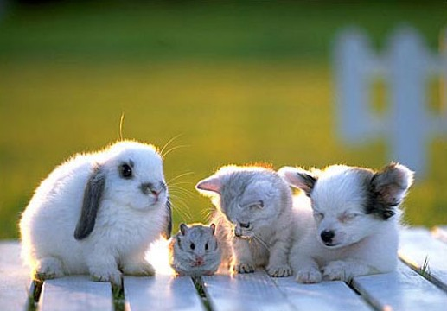

Slide 15
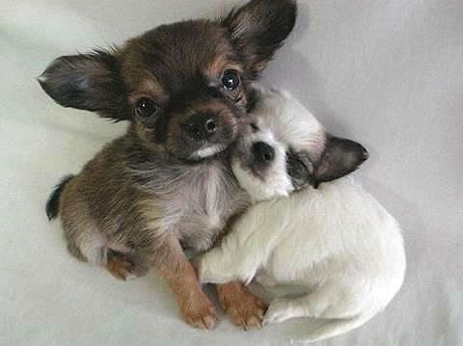

Slide 16
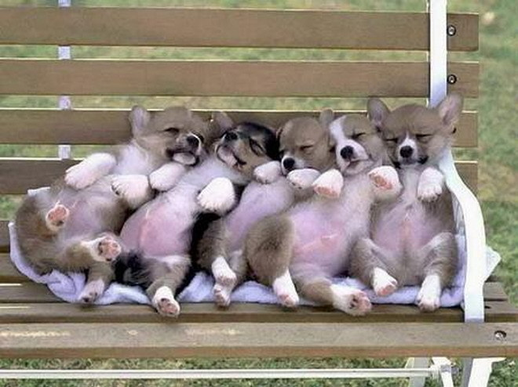

Slide 17
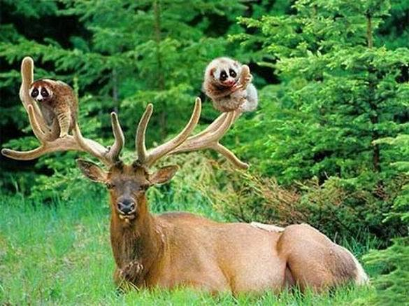

Slide 18
