Slide 1

Clemson university
PRESIDENT JAMES F. BARKER, FAIA
SOUTH CAROLINA COMMISSION ON HIGHER EDUCATION
August 8, 2012

Slide 2

CLEMSON 2020 ROAD MAP
The Clemson 2020 Road Map
Four Strategic Priorities
Enhance student quality and performance
Provide engagement opportunities for all students
Recruit and retain top faculty and staff
Build to compete
Facilities
Technology
Infrastructure

Slide 3
CLEMSON 2020 ROAD MAP
The Clemson 2020 Road Map
Build to Compete
Lee Hall
Academic Success Center
Center for Emerging Technologies at CU-ICAR
Zucker Graduate Education Center announced at CURI
Life Sciences building scheduled for completion in October

Slide 4
CLEMSON 2020 ROAD MAP
The Clemson 2020 Road Map
Student Quality – 2012 Freshman Class
SAT average is 1245
52 % were in the top 10 % of their high school class
Record number of undergraduate applications – 18,500+
4 % increase in yield
Yield of Palmetto Fellows with 1350+ SATs increased from 42 % in fall 2011 to 50 % this year
Yield of in-state students in top 10 percent increased from 49 % last fall to 56 % this year
10 % increase in the number of minority students
Calhoun Honors College freshman enrollment up 16 %
Bridge to Clemson filled in less than 3 weeks (fastest ever)

Slide 5
CLEMSON 2020 ROAD MAP
The Clemson 2020 Road Map
Student Engagement
Creative Inquiry participation increased ~ 30 percent (students)
3,100 students (vs. 2,361 in 2010-11)
330 teams (vs. 289 in 2010-11)
Living/Learning Communities continued to grow
Two new communities added in 2011-12; two planned for 12-13
Reached 1,405 students in 2011-2012 (vs. 938 in 2010-11)
On-campus student participation rate is 23% (vs. 15% in 2010-11)
University Professional Internship program launched
17 students in spring pilot program
33 working this summer
On target to reach 100 this academic year
Recognized by Chronicle of Higher Education

Slide 6
CLEMSON 2020 ROAD MAP
The Clemson 2020 Road Map
Faculty and Staff Excellence
24 active NSF career awardees
5 professors named to Princeton Review’s Best 300 Professors list
Jim Bottum (Chief Information Officer) - Inaugural Presidential Fellow with Internet2
Dr. Julie Martin (Assistant Professor) – American Association for the Advancement of Science - Technology and Science Policy Fellowship awardee
Travis Pruitt (Research Staffer) – Southeastern Branch of the American Association for Laboratory Animal Science Technician of the Year Award recipient

Slide 7
GREENVILLE ONE
Clemson in Greenville
The College of Business and Behavioral Science plans to consolidate graduate, professional and continuing education programs in downtown Greenville when Greenville One project is completed.
There are no immediate plans to move programs from the University Center of Greenville.

Slide 8
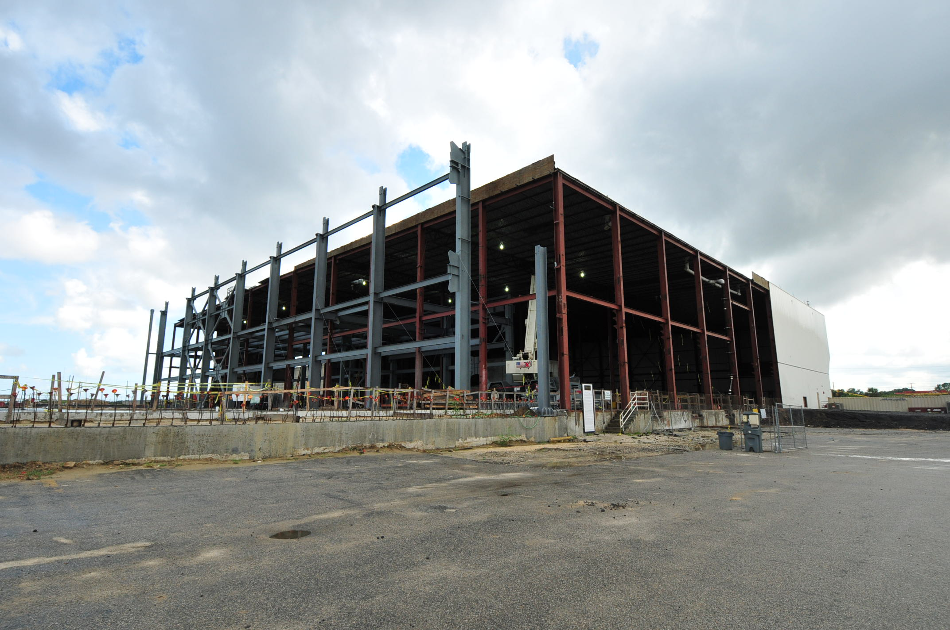
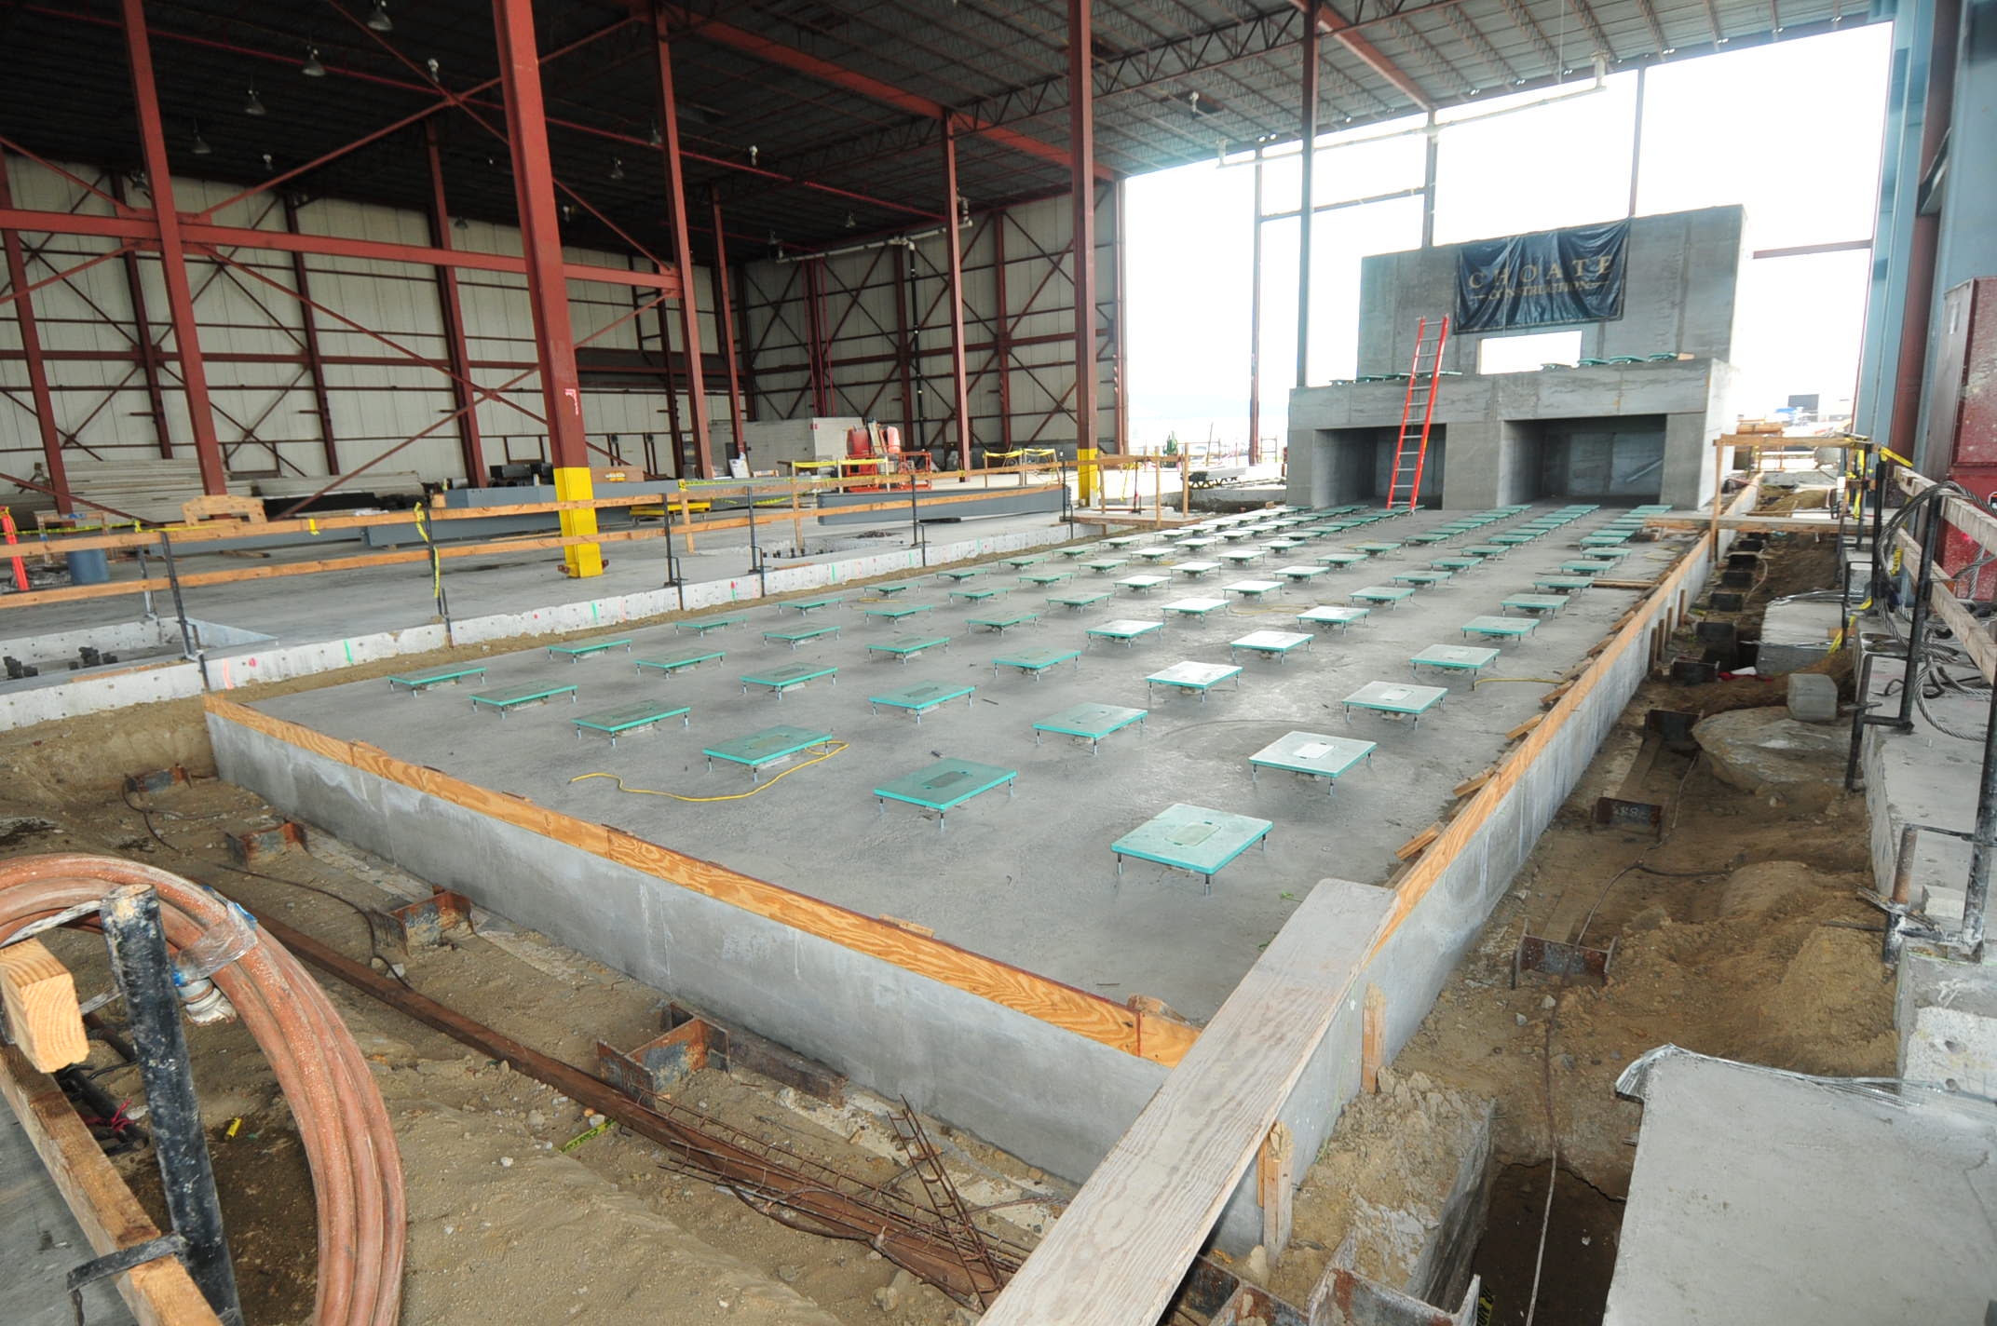
Wind Turbine Drive Train Testing Facility at the Clemson University Restoration Institute

Slide 9
CHARLESTON ARCHITECTURE CENTER
Clemson in Charleston
Charleston Architecture Center
A presence in downtown Charleston for 25 years.
Designs for permanent facility on Clemson’s Meeting Street location are in final stages.
Ideal location for students and College of Charleston partners.

Slide 10
2012-13 LEGISLATIVE PRIORITIES
2012 Legislative Session
3% cost of living salary increase for faculty and staff
$3 million (nonrecurring) for the Grid Simulator at the Clemson University Restoration Institute (CURI)
Nearly $4.5 million (nonrecurring) for deferred maintenance
$2 million (nonrecurring) for Clemson’s research partnership with the Greenwood Genetics Center

Slide 11
2012-13 LEGISLATIVE PRIORITIES
2013 Legislative Priorities
Continue research and economic development initiatives at the Clemson University Restoration Institute (CURI), related to advanced materials and energy
Expand upon our current Workforce Development initiatives through partnerships with technical colleges across the state
Enhance Student Engagement

Slide 12
2012-13 LEGISLATIVE PRIORITIES
2013 Capital Priorities
Support a bond bill for higher education
Support continued efforts by the General Assembly to fund deferred maintenance

Slide 13
2012-13 LEGISLATIVE PRIORITIES
Higher Education
Continued funding for SmartState
Expand Regulatory Relief

Slide 14
2012-13 LEGISLATIVE PRIORITIES
Questions?

Slide 15
