Slide 1
1. Taoism (Daoism)
Be like water:
flow smoothly around obstacles rather than bumping up against them
adapt yourself to the shape of the channel and you won’t get stuck
The natural rather than the humanmade world is offered as a model

Slide 2
1. Taoism (Daoism)
Grass is flexible and bends before the wind – so it survives

Slide 3
1. Taoism (Daoism)
The tree is rigid and
doesn’t bend before
the wind – so it
breaks!
Flexibility looks like
weakness but is
really strength
Rigidity looks like strength but is really weakness

Slide 4
1. Taoism (Daoism)
Don’t meddle with spontaneous processes; let them evolve unhindered – don’t micromanage!

Slide 5
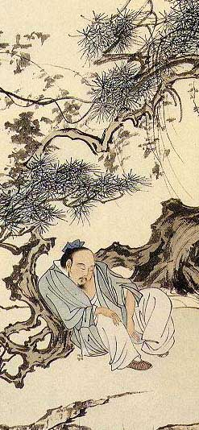
1. Taoism (Daoism)
Don’t spend too much time trying to get ahead, trying to change or improve yourself or the world
Don’t worry too much about learning or culture
Think intuitively – language and abstract thought lead us astray by imposing artificial categories on reality
Relax – choose simplicity – be an “uncarved block”

Slide 6
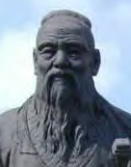
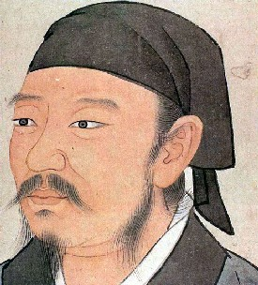
2. Confucianism
Confucius (K’ung-fu-tzu, Mencius (Meng-tzu, Hsün-tzu (Xunzi:
Kongfuzi: 551-479 BCE) Mengzi: 372-289 BCE) 310-220 BCE)

Slide 7
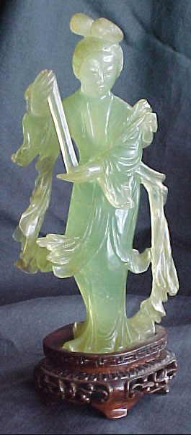
2. Confucianism
The Taoists are wrong!
Don’t be an uncarved block – instead you should constantly be seeking to improve yourself, “like carving and polishing jade”
Promote education, culture, commerce, civilisation
Cultivate relationships of reciprocity and mutual respect

Slide 8
2. Confucianism
Embrace traditional norms and social roles as the defining framework of your life
The framework may be revised piecemeal from within, but never simply rebuilt from scratch

Slide 9
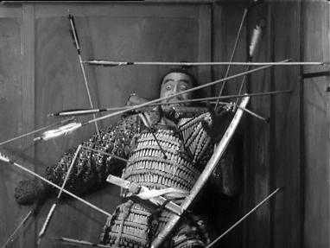
2. Confucianism
Deference to established
social roles can mean
deference to authority –
but not always
If the ruler doesn’t live up
to his “job description,”
he’s no longer a true ruler, and may be disposed of as a common criminal

Slide 10
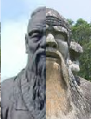
Implications for Nanoethics?
Confucian attitudes seem more favourable toward technological progress and self-transformation than Taoist attitudes do
On the other hand, Confucians’ reverence for tradition might make them more cautious about radical change than the Taoists’ laissez faire attitude

Slide 11
A Disagreement Among Confucians
Hsün-tzu:
Contrary to the Taoists, our natural inclinations are corrupt and untrustworthy
Therefore moral education is like making bowls out of wood – imposing an alien form, shaping and molding us against nature
The virtuous person is an artificial product of a good teacher

Slide 12
A Disagreement Among Confucians
Mencius:
Yes, we need moral education – but such education works with our nature and helps it reach its fulfillment, rather than working against it
It’s more like watering a plant than like carving wood into bowls
Don’t tug on your plants to help them grow!

Slide 13
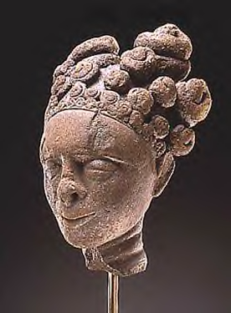
3. Akan Teachings
An example of traditional African thought: the Akan peoples of West Africa
“Humans have value”
“Humans need help.”
Humans as dependent beings

Slide 14
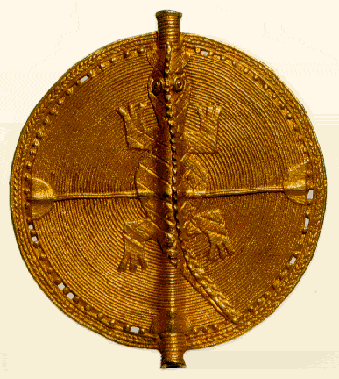
3. Akan Teachings
“When you ask for help, your belongings won’t hear you – people will.”
“Whatever threatens another will one day threaten you.”
Humans as mutually dependent beings

Slide 15
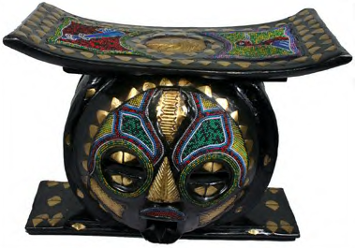
3. Akan Teachings
But concern for others isn’t
purely strategic:
“Every person is a child
of God – none is a child
of the earth.”
Humans as beings with sacred value

Slide 16
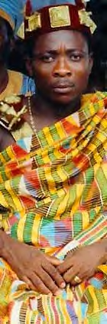
3. Akan Teachings
“Whoever lands on earth lands in a town.”
No human existence outside the context of a community
Akan regard Kinship as essential to human identity
(Akan teachings not sympathetic to Rawls’ Veil of Ignorance?)
But not a rejection of individual identity:
“Nobody else was present when God gave me my destiny.”

