Slide 1


Combining Global and Local Virtual Lights for Detailed Glossy Illumination
Tomáš Davidovič
Jaroslav Křivánek
Miloš Hašan
Philipp Slusallek
Kavita Bala
Saarland University / DFKI
Cornell University
Charles University, Prague

Slide 2
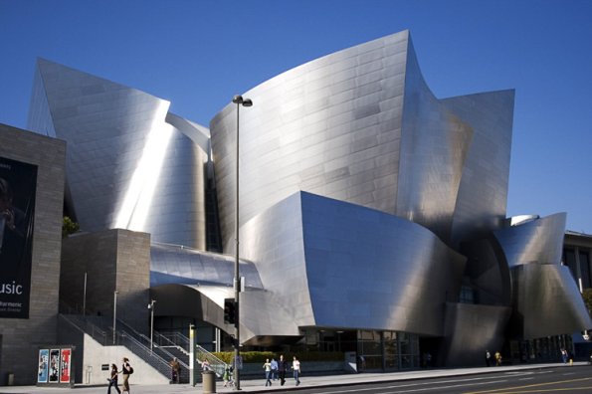
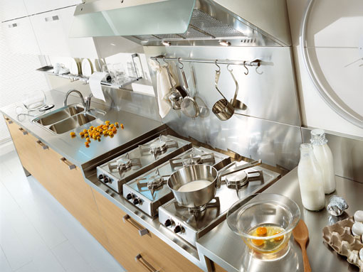
Goal: Glossy inter-reflections
Notes:
Our goal is to efficiently compute global illumination effects due to glossy inter-reflections, some examples of which are shown here. This is an important problem with applications in virtual prototyping, e-commerce, or architectural pre-visualization.

Slide 3
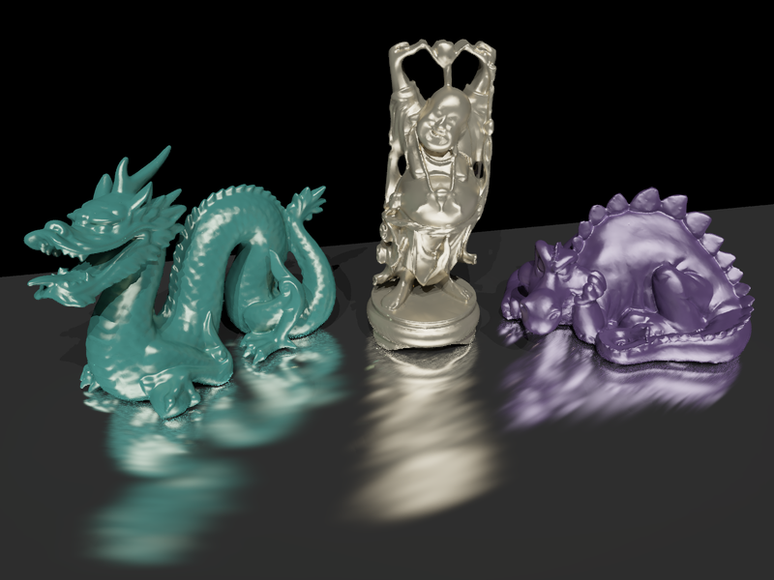

Our new approach
Indirect glossy highlights from complex geometry
our approach: 6 minutes
reference: 244 minutes
Notes:
Our approach renders scenes featuring sharp glossy inter-reflection including indirect highlights in minutes as opposed to a path tracer that takes hours to converge in such scenes.

Slide 4
Previous work
Unbiased methods
(Bidirectional) path tracing [Kajiya 86, Lafortune el al. 93]
Metropolis light transport [Veach and Guibas 97]
Biased methods
(Progressive) photon mapping [Jensen 2001, Hachisuka et al. 08/09]
Radiance caching [Křivánek 05]
Scalable virtual light methods
Lightcuts [Walter et al. 05/06]
Matrix row-column sampling [Hašan et al. 07/09]
Notes:
Let me start by review some of the related work.
The unbiased and biased Monte Carlo methods listed here can take extremely long time to converge.
The scalable methods based on virtual lights, such as lightcuts or matrix row-column sampling, are more efficient but cannot capture the sharp glossy inter-reflections effects that we’re interested in.

Slide 5
Previous work – VPL rendering
Instant radiosity [Keller 1997]
Approximate indirect illumination by
Virtual Point Lights (VPLs)
Generate VPLs
Render with VPLs
Notes:
Due to its efficiency, we choose virtual light-based rendering as the basis of our approach. These methods originate from instant radiosity proposed by Keller et al. and the idea is to approximate indirect illumination by a number so called Virtual Point Lights, or VPLs.
A basic VPL rendering algorithm works as follows: <click> In the first step, the VPLs are distributed on scene surfaces by tracing particles from light sources. <click> In the second step, the image is rendered by summing contributions from all the VPLs.

Slide 6
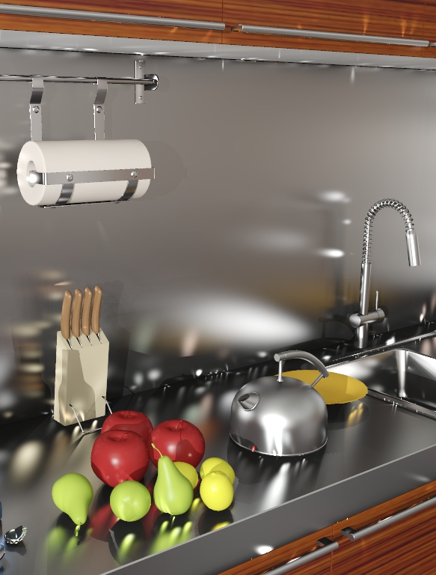
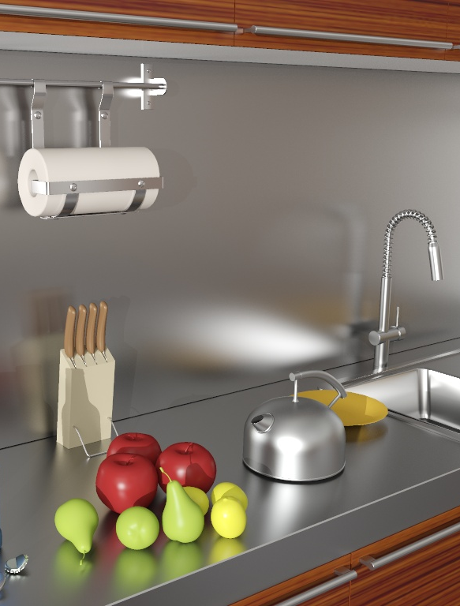
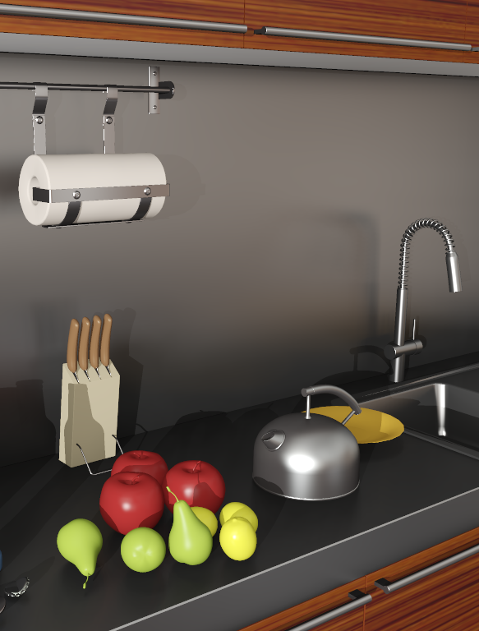
Previous work – VPL energy loss
VPL
GI reference
VPLs w/ clamping
artifacts
energy loss →
material change
[Křivánek et al. 10]
Notes:
It has been a common knowledge that VPL rendering does not work well in glossy scenes.
The problem is that the VPL methods can produce noise that manifests itself as light splotches, especially visible on glossy surfaces.
The usual way of dealing with these artifacts is so called clamping, where we clamp away the offending energy by limiting the contribution of a single VPL to a prescribed maximum value. But as we’ve shown in our previous work, this selective energy removal can severely change material appearance, as you can see in the image on the right, where the countertop looks dark and diffuse instead of having the more metallic appearance seen in the reference.

Slide 7
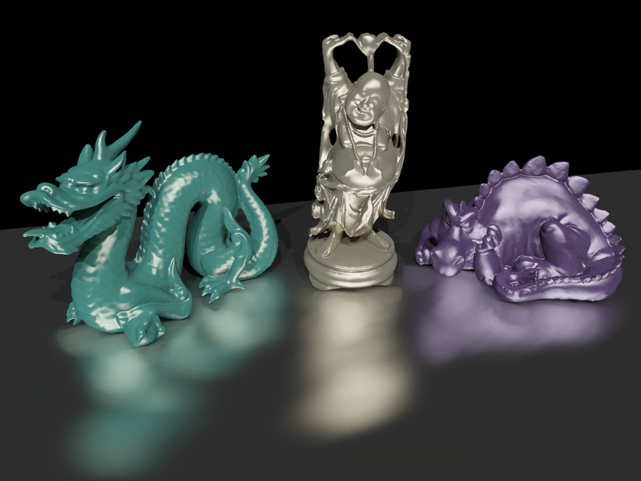
Previous work – VSLs
Replace point lights by spheres [Hašan et al. 2009]
Alleviates the energy loss but blurs illumination
virtual spherical lights (VSLs)
reference
blur
Notes:
Last year at Siggraph Asia, we proposed the Virtual Spherical Lights that deal with the energy loss of classic VPLs by spreading the energy of each light over a finite domain. But the VSLs can severely blur the illumination, as shown in the reflections on the floor in the image on the left.

Slide 8
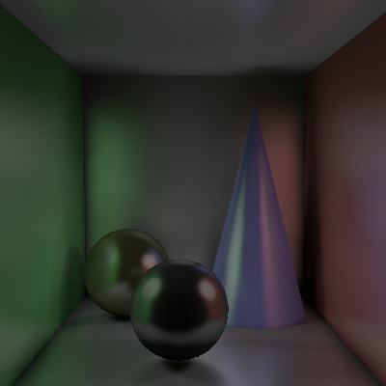
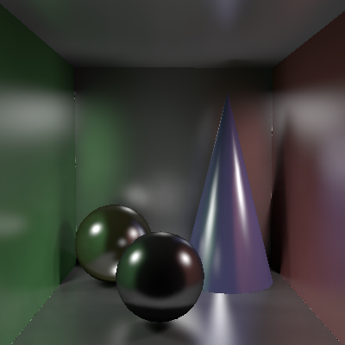
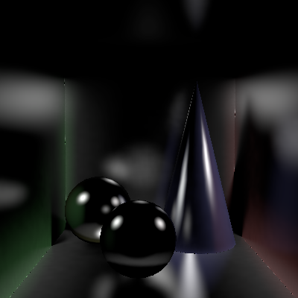
Previous work – Compensation
Compute the missing energy by path tracing [Kollig and Keller 2004]
As slow as path-tracing everything (for glossy)
Clamping
Instant radiosity (VPLs)
Compensation
Path tracing
indirect illumination
Notes:
Another approach to deal with the energy loss was proposed by Kollig and Keller. They compute the clamped energy by path tracing.
So their method can be viewed as separation of light transport into two components, each of which is solved by a different technique.
The problem of this approach is that their compensation method is nearly as expensive as path tracing the entire image and represents a bottleneck of the entire algorithm.

Slide 9
Our approach
Specific fast solution for each component
Clamping
Global component
Visibility clust.
Compensation
Local component
Local VPLs
indirect illumination
Notes:
* This finally brings me to our algorithm.
* We stick with the idea of separating the light transport into the clamped, global component, and the local component.
* The <click> global component accounts for the long-distance light transfer, while the <click> local component corresponds to the short-range inter-reflections, and indirect glossy highlights.
* The key contribution of our paper is that we take advantage of the specific structure of each of the two components to design a solutions for each of them that is substantially more efficient than a general GI solution.
* Specifically, we handle as much energy as possible in the global component, which we do by means of a novel visibility clustering algorithm.
* This leaves only a fraction of the energy for the local component, which we handle by so called local VPLs with aggressive visibility approximation.
* As a result, the compensation is no longer a bottleneck and the overall algorithm yields high quality images in minutes.

Slide 10
Outline
Solution of the global component
Solution of the local component
Results
Notes:
In the rest of the talk, I will first describe our solution for the global component, after that Tomas will take over and describe the local component solution and show our results.

Slide 11
Solving the global component

Slide 12
Global (clamped) component
Light transport over long distances
Handled by classic “global” VPLs
Scalable solution: visibility clustering
global
local
Notes:
As I mentioned, the global component captures light transport over longer distances.
We handle the global component by the classic VPLs with clamping, that we refer to as “global” VPLs.
We need as many VPLs as possible in the global method, so there isn’t much energy left for the compensation. Therefore, we need a solution that scales with many VPLs.
We propose a “visibility clustering” method that build on Matrix Row Column Sampling, but it’s better suited for handling glossy scenes.

Slide 13
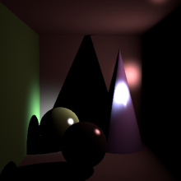
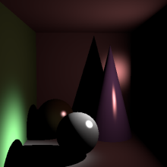
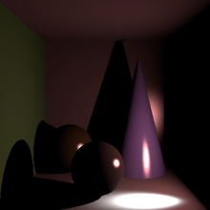
Review of MRCS
Matrix interpretation
Lights
Pixels
indirect illumination
Notes:
Before going into the detail of our visibility clustering, I will explain how MRCS works.
First, in MRCS, the problem is viewed as a large matrix of light-pixel interactions – that I will refer to as the interaction matrix.
This means that each element of the matrix is the contribution of a single light to a single pixel.
So, the columns of the matrix are really images rendered with a single light.
The rows represent contributions of the lights to a particular pixel.

Slide 14
Review of MRCS
Problem statement
Lights
= Σ (
)
Pixels
indirect illumination
Notes:
In this setting, the image we want to render is equal to the sum of the columns of the matrix.

Slide 15
Review of MRCS
Solution
Lights
≈ Σ (
)
Pixels
indirect illumination
shadow maps
for visibility
Notes:
But evaluating all the lights (including their visibility) is too expensive, so MRCS chooses a couple of columns – or lights – to approximate the sum. This is possible because in diffuse scenes, the matrix is close to low-rank.
The information necessary to pick good columns, is obtained by evaluating a number of rows of the matrix.
Part of the efficiency of the method stems from the fact that GPU-based shadow mapping can be used to evaluate visibility for both the columns and the rows of the matrix.

Slide 16
Visibility Clustering – Motivation
Many VPLs needed for shading
Shading is cheap → shade from all VPLs
Cannot afford visibility for every VPL
Key idea:
Separate shading from visibility
Lights
shading (all VPLs)
visibility (representatives)
Notes:
The design of our visibility clustering approach is motivated by several observation on shading and visibility in glossy scenes.
First, we observe that in glossy scenes we cannot easily pick a small subset lights to approximate the solution, because shading from the individual lights is quite different. In other words, we want to compute the shading from all the global VPLs. And that’s actually doable because the GPU is extremely efficient at computing the shading.
But we just cannot afford to evaluate a SM for each of those 200k lights! So the key insight is to separate shading from visibility, use ALL the light for shading, and only a small number of representative lights for visibility.

Slide 17
Global solution overview
Global VPL tracing
Row sampling
Reduced matrix
shading
visibility
Visibility clustering
Render lights with reps’ visibility
Global solution
(clamped)
Notes:
Here’s the overview of the of the complete solution for the global component. We start by distributing the global VPLs in the scene by tracing particles form light sources. After that, we sample a number of rows of the interaction matrix, which means that we pick a number of pixels and for each of them, we evaluate the shading and visibility for all the lights. That gives us the reduced shading and visibility matrices. The visibility clustering then analyzes these matrices and yields clusters of lights that will share the same shadow map. After that, we render all the VPLs with the shadow map of the representative light for each cluster. This yields the complete global solution.
There’s only one bit that remains to be explained here, and that’s the visibility clustering algorithm.

Slide 18
Visibility clustering
Clustering algorithm
Hierarchical splitting
Minimize the clustering cost
L2 error of reduced matrix due to visibility approximation
clusters
shading
visibility
representatives
Notes:
The goal of the visibility clustering algorithm is to group VPLs into clusters that will share the shadow map of its representative VPL. We use a data-driven approach where we analyze the row samples from the light interaction matrix.
The clustering algorithms proceeds in a top-down fashion, splitting clusters with highest cost, which is defined as the L2 error of the matrix incurred by the visibility approximation.

Slide 19




Visibility clustering result
Matrix row-column sampling
Our visibility clustering
10k shadow maps
10k shading lights
5k shadow maps 200k shading lights
Notes:
Here’s a comparison of the result of our visibility clustering with MRCS in the same time for a simple scene of the happy Buddha statue reflected in a glossy plane. The MRCS result uses 10k representative lights (i.e. 10k shadow maps and 10k lights for shading), which leaves visible splotches in the image. The visibility clustering, in the other hand, uses only 5k shadow maps for visibility but all the 200k lights for shading, substantially improving the smoothness of the reflections.

Slide 20
Solving the local component

Slide 21
Local (compensating) component
Localized light transport
Less energy
Solution: Local VPLs
global
local
Notes:
Hello everyone, I will now present our method for dealing with the local light component.
As the name suggests, the local component takes care of the localized light transport, which means either short distance or indirect highlight.
Also, it represents only fraction of the energy in the image, albeit a critical one.
Our solution for this problem is called Local VPLs.

Slide 22
Review of compensation
Kollig & Keller compensation
global
2) Connect
Clamped energy
1) Shoot path
3) Contribute
Notes:
Lets first start with the overview of the standard Kollig & Keller compensation<click>
They first trace a ray from the hit point, and for glossy scenes we need hundreds or thousands of paths per pixel <click>
Connect the target to global light, to obtain the intensity <click>
This path tracing result is then used in place of the clamped away energy. <click>
Now, that this is a lot of effort on compensating a single pixel, and we can surely improve on that <next slide>

Slide 23
Local lights – idea
Our approach
global
Create
local light
local
Contribute
to a tile
Notes:
So the idea is that we create a VPL here, and to amortize the cost of tracing the path, we have it contribute not just to the pixel that generated the light, but also to its neighbor pixels.
So, with this basic idea, lets take a look at what’s necessary to actually make it work.

Slide 24
Local lights – technical solution
Our approach
global
local
local
Probability
density
from
tile pixels
Jitter
tiles
Notes:
The first important thing we have to compute is the probability density of the generated local VPL.
We cannot simply use the probability with which it has been generated, but we have to sum the probabilities over all the pixels in the tile it contributes to.
The second important thing is, that if we used a fixed tile grid, the boundaries would be fairly visible. So to break this coherence, we jitter the tiles for each VPLs.

Slide 25
Local lights – technical solution
Our approach
global
local
Reject
50-75%
2-4x speedup
One-sample
visibility
Clamped
energy = 0
Key idea: Tile visibility approximation
Notes:
So now we come to the part that simply would not be possible without the light transport split we do.
To compute the full probability density for our light, we would normally need to compute visibility to all pixels, which would be prohibitively expensive.
However, we do have the global component that contains most of the energy and handles most of the shadows.
The local lights, with the only fraction of the total energy and localized contribution, can then have their visibility approximated.
We approximate it by just one visibility sample, which is actually the ray that generated the light in the first place.
So the key insight here, the light transport split made tile visibility approximation possible.
The second thing the split allows us to do is rejecting lights. Not all local lights actually have contribution to the tile they belong to, and we can flat out reject these, giving us another 2-4x speedup.

Slide 26
The complete local solution
Generate local
lights
Reject
zero contrib
Connect to
global lights
Contribute
to a tile
Local solution
(compensation)
Notes:
So, for the overview of the whole process.
We generate local lights <click>
Reject lights with zero contribution <click>
Connect the surviving local lights to global lights <click>
Have them contribute to a tile <click>
And after repeating this about 20 million times, we get the final local solution. <next slide>

Slide 27
The complete local solution
Global solution
(clamped)
Long distance transport
Most of the energy
Visibility clustering
Indirect illumination
solution
Local solution
(compensation)
Localized transport
Less energy
Reuse on tiles
Notes:
So we introduced the local solution, which handles localized light transport, contains a fraction of the energy and works by reusing local lights over tiles.
We also introduced the global solution, which handles the longer distance transport, contains most of the energy and is solved by visibility clustering.
Now we simply combine the two to obtain the final indirect illumination solution.

Slide 28
CPU/GPU cooperation
Render global VPLs
Render local VPLs
GPU
CPU
Generate & cluster global
VPL
Generate local VPLs
Notes:
There is one important implementation aspect left.
To get the most out of the modern computers, we want to have tight CPU/GPU cooperation.
So our algorithm starts on the CPU, generating and clustering global VPLs.
This is then sent to GPU for rendering and CPU starts generating local VPLs.
Once the GPU is done with the global VPLs, the local VPLs are sent for rendering, and more are generated until the whole image is finished.

Slide 29
Results
Notes:
Ok, now for some results

Slide 30
Tableau
VSL: 6 min 16 sec
Our: 5 min 43 sec
reference: 244 min
shadow maps:
global lights:
local lights:
5,000
200,000
55,600,000
Notes:
So this is the already introduced scene with glossy statues on glossy table.
We compare our methods on the left, with the reference path tracing solution on the right.
Our method here takes just under 6 minutes, while the reference solution took about 4 hours to converge.
The scene has low occlusion so we need only about 5000 shadow maps, but we shade from all the 200k VPLs. We use over 55 million Local VPLs, but our method can handle even such staggering amount very fast.
We are also comparing with the only other virtual lights method capable of handling such scenes, which is VSLs. However, the VSLs on these scenes cannot capture the sharp reflections and the result is blurry.

Slide 31
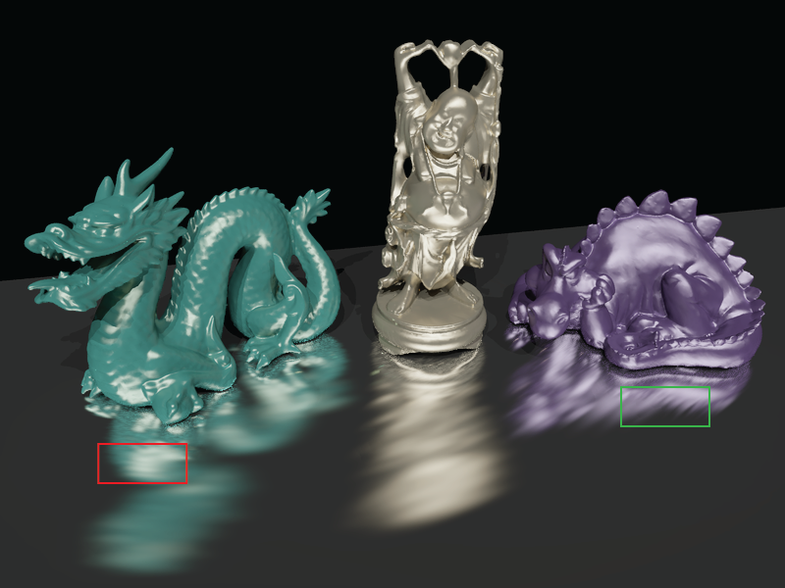





Tableau
VSL: 6 min 16 sec
Our: 5 min 43 sec
reference: 244 min
shadow maps:
global lights:
local lights:
5,000
200,000
55,600,000
Notes:
While our method matches the reference solution very well.

Slide 32
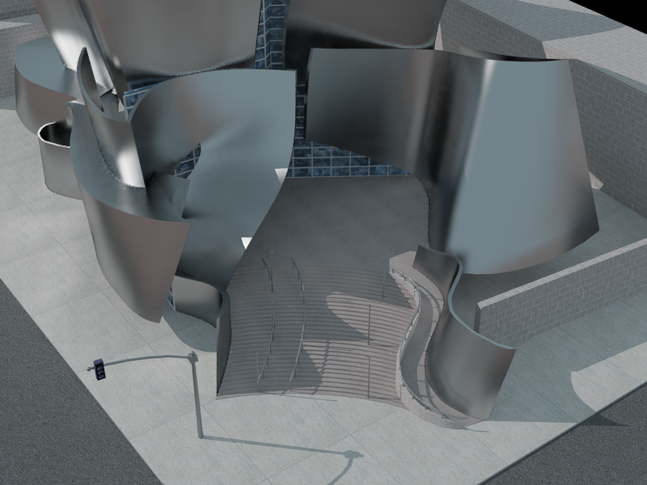

Disney Concert Hall
Our: 2 min 44 sec
reference: 127 min
shadow maps:
global lights:
local lights:
15,000
200,000
13,500,000
Notes:
The next scene is the metallic Disney Concert Hall, so again a lot of glossy inter-reflections.

Slide 33
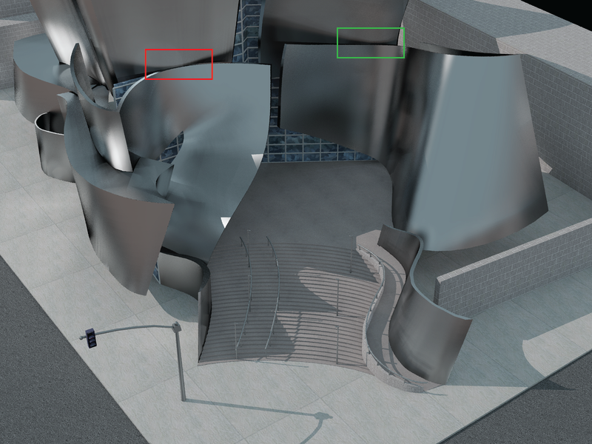
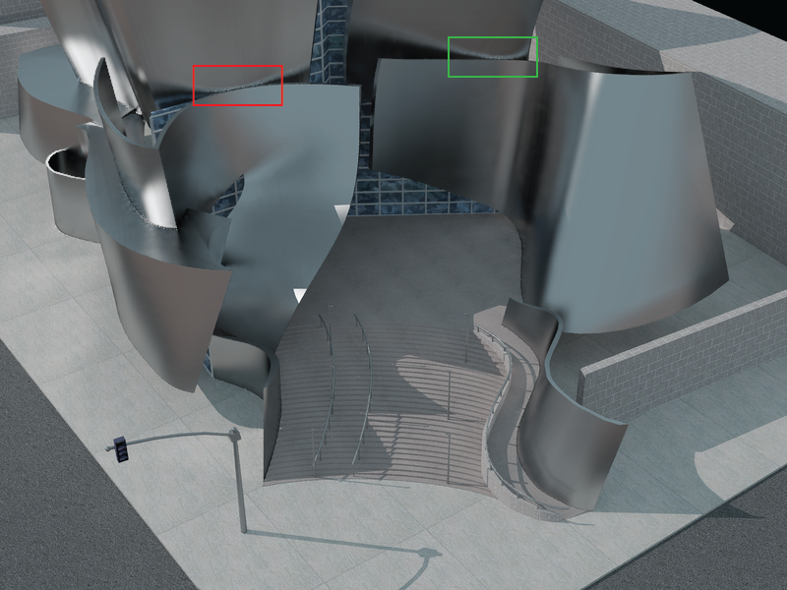







Disney Concert Hall
VSL: 1 min 47 sec
Our: 2 min 44 sec
reference: 127 min
shadow maps:
global lights:
local lights:
15,000
200,000
13,500,000
Notes:
Here I would like to draw your attention to this particular caustic, cast by top of the front metal wall on the wall behind it.
Here the VSLs come out actually faster, but unfortunately fail to capture these finer details. Our method can capture this in just under three minutes.

Slide 34
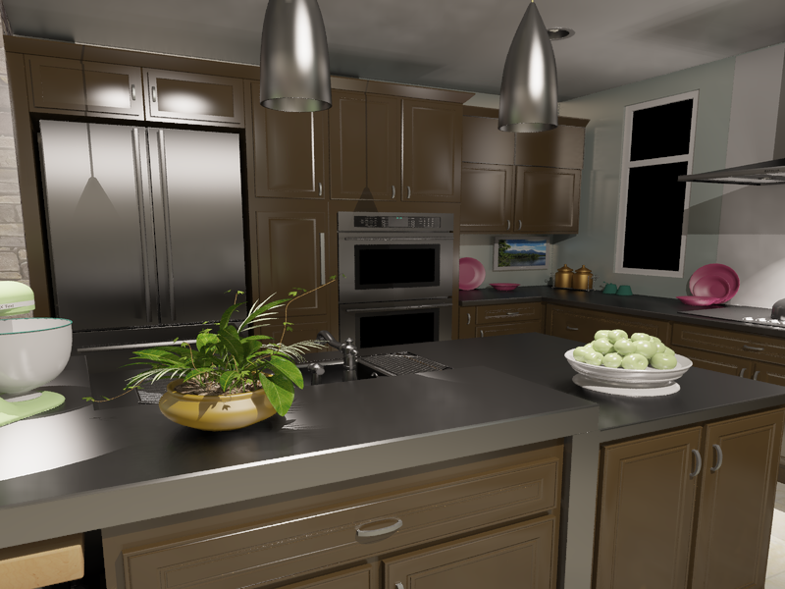
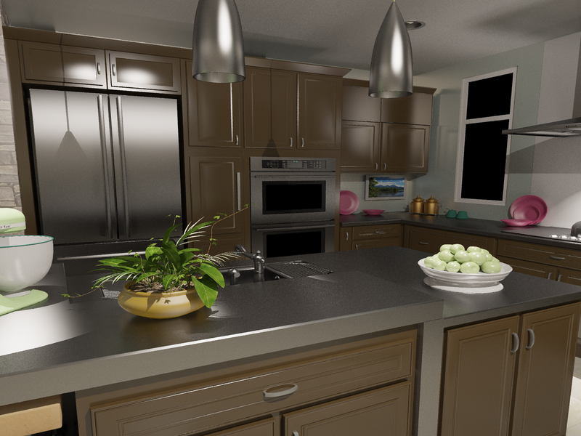
Kitchen #1
Our: 4 min 16 sec
reference: 3343 min
shadow maps:
global lights:
local lights:
10,000
200,000
25,100,000
Notes:
The next scene we have is a kitchen with a lot of glossy finish.
This scene is much harder for the path tracer than the previous scenes, as it took over 50 hours to converge.
However, our approach still works in very reasonable four minutes.

Slide 35
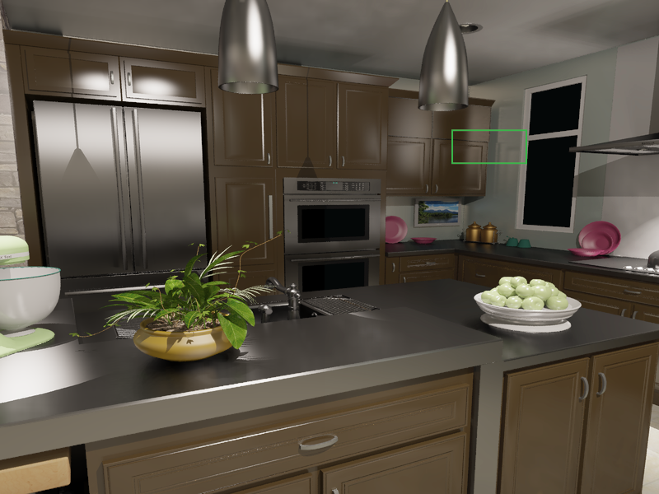



Kitchen #1
Our: 4 min 16 sec
reference: 3343 min
shadow maps:
global lights:
local lights:
10,000
200,000
25,100,000
Notes:
The glossy cupboard casts detailed caustics on the wall next to it, and again our method matches the path traced solution very well.

Slide 36
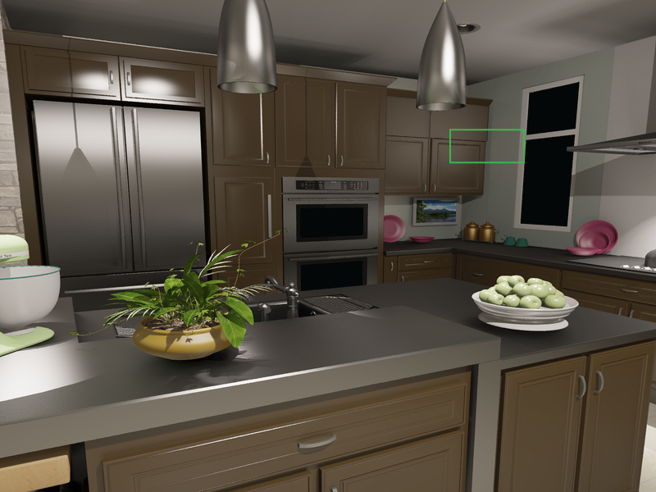

Kitchen #1
VSL: 4 min 24 sec
Our: 4 min 16 sec
reference: 3343 min
shadow maps:
global lights:
local lights:
10,000
200,000
25,100,000
Notes:
This caustic is again blurred away in the VSLs.

Slide 37
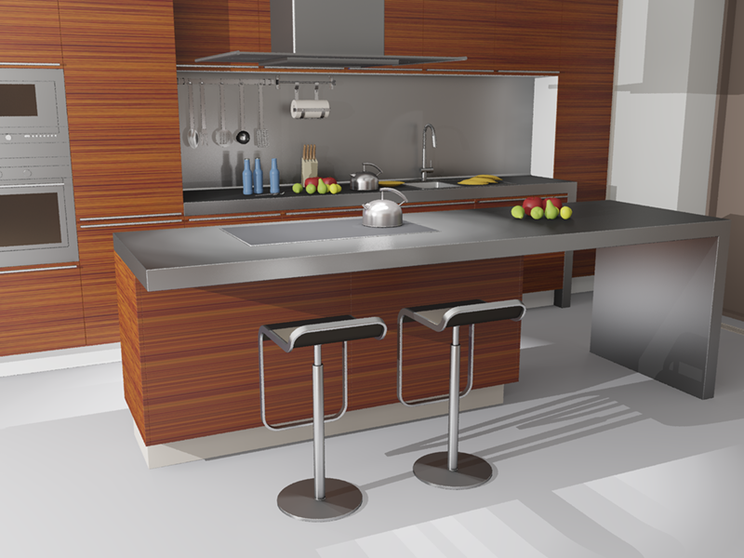
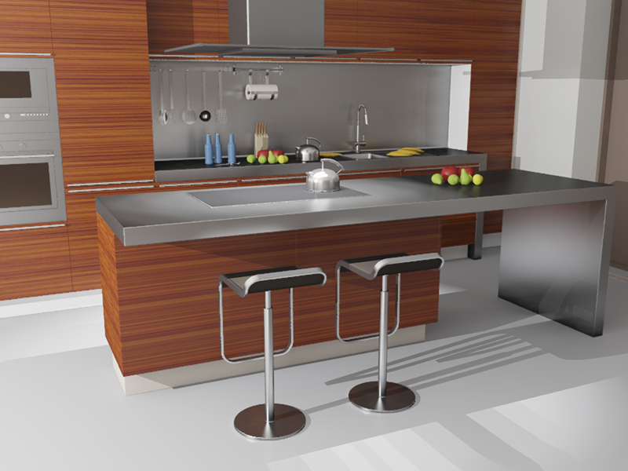

Kitchen #2
VSL: 6 min 25 sec
Our: 5 min 28 sec
reference: 6360 min
shadow maps:
global lights:
local lights:
10,000
300,000
17,100,000
Notes:
The last scene I have is another kitchen, this time a more glossy one.

Slide 38






Kitchen #2
VSL: 6 min 25 sec
Our: 5 min 28 sec
reference: 6360 min
shadow maps:
global lights:
local lights:
10,000
300,000
17,100,000
Notes:
Here we see that our method nicely captures this highlight from metal stool leg, which is vital for the proper perception of materials.
Also, the back wall is metallic, so the paper towels should be reflecting and, indeed, in our method they do.

Slide 39




Kitchen #2 – limitations
Our: 5 min 28 sec
reference: 6360 min
Loss of shadow definition
Small loss of energy
Notes:
However, this scene also shows some of the limitations the method has.
There is a loss of definition of the shadows behind the bottles.
This is caused by the fact that the local lights on the kettle in the front contain too much energy, so we are looking into ways to push even more energy into the global method.
One detail we did not mention is that in some of the scenes we still need slight clamping even on the Local VPLs, causing some darkening here. This can be solved by interpreting the Local VPLs as Local VSLs.

Slide 40
Conclusions & Future Work
Highly glossy materials with GI
Split light transport
Global component
Local component
Specialized methods for each
Future work
Explore other solutions for global component
Revisit split criteria (MIS instead of clamping?)
Notes:
To conclude, we presented a method for handling highly glossy materials with global illumination.
This is achieved by splitting light transport into two components.
The global ones, represented as a dense matrix, and the local one which is sparse, and using specialized methods for each.
For the future work would like to explore other solutions for the global component, for example light cuts.
Also, all VPL methods currently use clamping as means to split what we call global and local components. But there are some cases where this is obviously not optimal, so we will be looking into different split criteria, like multiple importance sampling.
Also, generally, all the VPL methods use clamping. But we have observed that in some cases the clamping makes clearly suboptimal splits, so we think that maybe using some kind of multiple importance sampling instead of clamping could provide better results.

Slide 41


Acknowledgements
Marie Curie Fellowship PIOF-GA-2008-221716
NSF CAREER 0644175, NSF CPA 0811680
Intel and Intel VCI
Microsoft
Autodesk
German Research Foundation (Excellence Cluster 'Multimodal Computing and Interaction‘)
Notes:
We would like to thank all the funding agencies that made this project possible.

Slide 42
Thank you
Notes:
And we thank you for your attention.

Slide 43
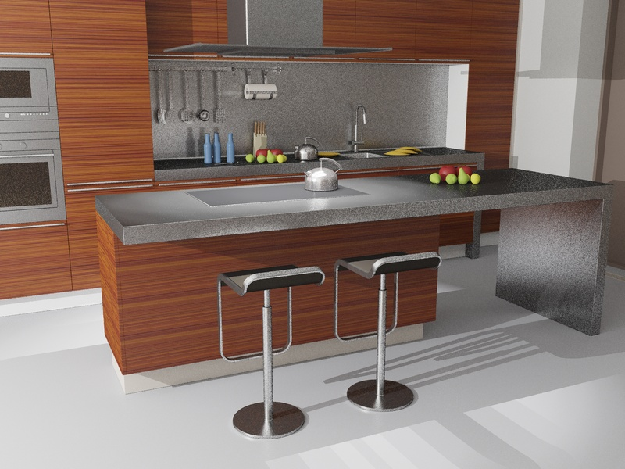

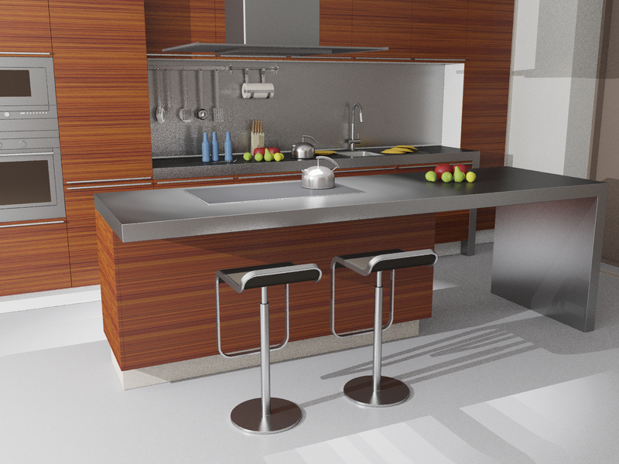

Kitchen #2 – PPM and SPPM
(Stochastic) Progressive Photon Mapping
PPM: 26 min 40 sec
Our: 5 min 28 sec
SPPM: 27 min 49 sec
Notes:
We did not limit ourselves to comparing only with the VSLs <click to vanish>, and here we show comparison with progressive photon mapping <click to appear>.
The PPM here run for approximately five times longer than our method and, as you can see, is still quite noisy. We actually let it run even after this point, but the convergence rate became very slow and the image did not improve much.

