Slide 1
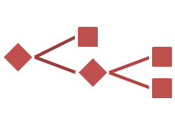

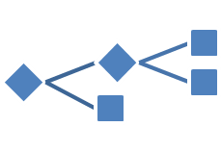
Scaling Up Decision Tree Ensembles
Misha Bilenko (Microsoft)
with Ron Bekkerman (LinkedIn) and John Langford (Yahoo!)
http://hunch.net/~large_scale_survey

Slide 2
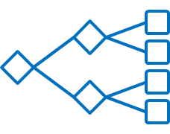






































Tree Ensembles: Basics
Rule-based prediction is natural and powerful (non-linear)
Play outside: if no rain and not hot, or if snowing but not windy.
Trees hierarchically encode rule-based prediction
Nodes test features to branch
Leaves produce predictions
Regression trees: numeric outputs
Ensembles combine tree predictions
$$Precipitation$$
$$false$$
$$true$$
$$Temp≤90$$
$$Wind<10$$
$$f$$
$$t$$
$$f$$
$$t$$
=
$$Temp<32$$
$$−$$
$$+$$
$$−$$
$$f$$
$$t$$
$0$.1
$$0.6$$
$$0.2$$
$$Precipitation$$
$$−$$
$$+$$
$$false$$
$$true$$
$$0.05$$
$$0.6$$
$$Wind<10$$
$$IsWeekend$$
$$Temp≤90$$
$$f$$
$$t$$
$$f$$
$$t$$
+
$$f$$
$$t$$
+
+…
$$DaysToKDD$$
$$Deadline>14$$
=
$$Temp<32$$
$0$.1
$$0.6$$
$$0.2$$
$$f$$
$$t$$
=
$$0.2$$
$$f$$
$$t$$
0.05
$$0.6$$
$$−3$$
$$1.8$$

Slide 3
Tree Ensemble Zoo
Different models can define different types of:
Combiner function: voting vs. weighting
Leaf prediction models: constant vs. regression
Split conditions: single vs. multiple features
Examples (small biased sample, some are not tree-specific)
Boosting: AdaBoost [FS97], LogitBoost [F+00], GBM/MART [F01b], BrownBoost [F01a], Transform Regression [SUML11-Ch9]
Random Forests [B01]: Random Subspaces [H98], Bagging [B98], Additive Groves [S+07], BagBoo [P+10]
Beyond regression and binary classification: RankBoost [F+03], abc-mart [L09], GBRank [Z+08], LambdaMART [SUML11-Ch8]

Slide 4
Tree Ensembles Are Rightfully Popular
State-of-the-art accuracy: web, vision, CRM, bio, …
Efficient at prediction time
Multithread evaluation of individual trees; optimize/short-circuit
Principled: extensively studied in statistics and learning theory
Practical
Naturally handle mixed, missing, (un)transformed data
Feature selection embedded in algorithm
Well-understood parameter sweeps
Scalable to extremely large datasets: rest of this section

Slide 5










Naturally Parallel Tree Ensembles
No interaction when learning individual trees
Bagging: each tree trained on a bootstrap sample of data
Random forests: bootstrap plus subsample features at each split
For large datasets, local data replaces bootstrap -> embarrassingly parallel
$$=Split( )$$
$$=Train\left( \right)$$
$$=Split( )$$
Bagging tree construction
Random forest tree construction

Slide 6
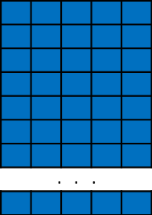
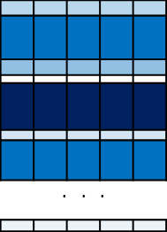




Boosting: Iterative Tree Construction “Best off-the-shelf classifier in the world” – Breiman
Reweight examples for each subsequent tree to focus on errors
 | . | . | .
$$=Train\left( \right)$$
$$=Train\left( \right)$$
$$=Train\left( \right)$$
Numerically: gradient descent in function space
Each subsequent tree approximates a step in $−\frac{∂L}{∂f}$ direction
Recompute target labels $y^{(m)}=−{\left[\frac{∂L\left(y, f\left(x\right)\right)}{∂f\left(x\right)}\right]}_{f\left(x\right)=f^{(m−1)}(x)}$
Logistic loss: $L(y,f\left(x\right))=\log{(1+exp⁡(−yf\left(x\right))}$ $y^{(m)}=\frac{y}{1+\exp{(yf\left(x\right))}}$
Squared loss: $L\left(y,f\left(x\right)\right)= \frac{1}{2}{\left(y−f\left(x\right)\right)}^{2}$ $y^{(m)}=y−f(x)$

Slide 7


Efficient Tree Construction
Boosting is iterative: scaling up = parallelizing tree construction
For every node: pick best feature to split
For every feature: pick best split-point
For every potential split-point: compute gain
For every example in current node, add its gain contribution for given split
Key efficiency: limiting+ordering the set of considered split points
Continuous features: discretize into bins, splits = bin boundaries
Allows computing split values in a single pass over data
$$?$$
$$?$$

Slide 8
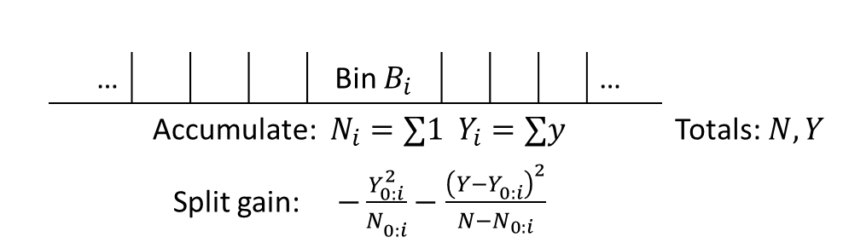
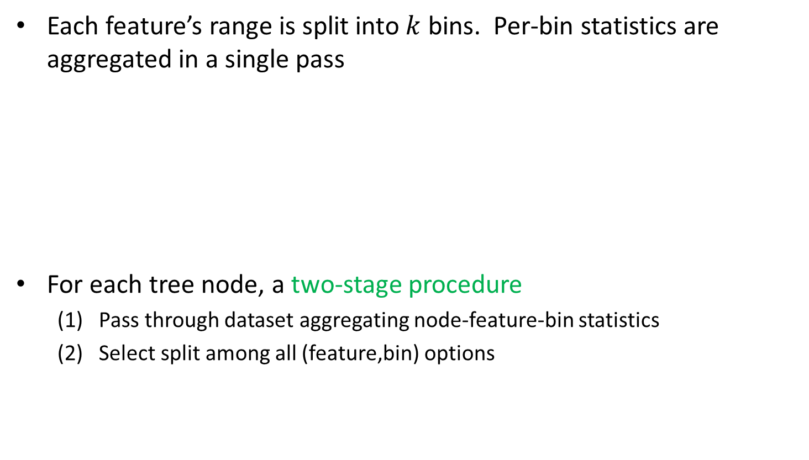
Binned Split Evaluation
Each feature’s range is split into $k$ bins. Per-bin statistics are aggregated in a single pass
For each tree node, a two-stage procedure
Pass through dataset aggregating node-feature-bin statistics
Select split among all (feature,bin) options
 |  | … |  |  |  | Bin $B_{i}$ |  |  |  | …
 |  |  | Accumulate: $N_{i}=∑1$ $Y_{i}=∑y$ |  |  |  |  |  |  |  |  | Totals:$N, Y$
 |  |  | Split gain: $−\frac{Y_{0:i}^{2}}{N_{0:i}^{}}−\frac{{\left(Y−Y_{0:i}^{}\right)}^{2}}{N−N_{0:i}}$
Features
Bins

Slide 9
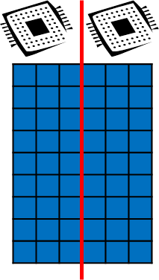
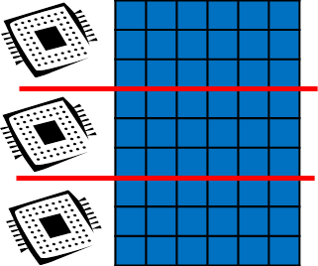
Tree Construction Visualized
Features
Features
Features
Bins
Bins
. | . | . | .
A
B
B
A
 | . | . | .
Instances
Bins
Features
Bins
Features
Observation 1: a single pass is sufficient per tree level
Observation 2: data pass can iterate by-instance or by-feature
Supports horizontally or vertically partitioned data

Slide 10





Data-Distributed Tree Construction
Master
Worker
Master
Send workers current model and set of nodes to expand
Wait to receive local split histograms from workers
Aggregate local split histograms, select best split for every node
Worker
2a. Pass through local data, aggregating split histograms
2b. Send completed local histograms to master

Slide 11

Feature-Distributed Tree Construction
Master
Worker
Workers maintain per-instance index of current residuals and previous splits
Master
Request workers to expand a set of nodes
Wait to receive best per-feature splits from workers
Select best feature-split for every node
Request best splits’ workers to broadcast per-instance assignments and residuals
Worker
2a. Pass through all instances for local features, aggregating split histograms for each node
2b. Select local features’ best splits for each node, send to master

Slide 12
PLANET [SUML11-Ch2] (Parallel Learner for Assembling Numerous Ensemble Trees)
Platform: MapReduce (Google), RPC (!)
Data Partitioning: Horizontal (by-instance)
Binning: during initialization
Single-pass approximate quantiles via [Manku et al. ’98]
Modulate between distributed and single-machine tree construction
MapReduceQueue: distributed tree construction
InMemoryQueue: single-worker tree construction (when node small enough)

Slide 13
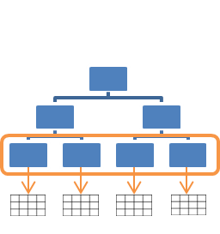
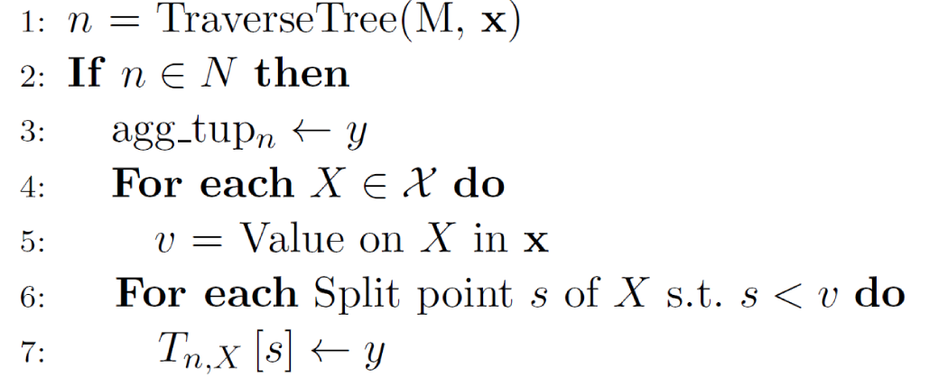
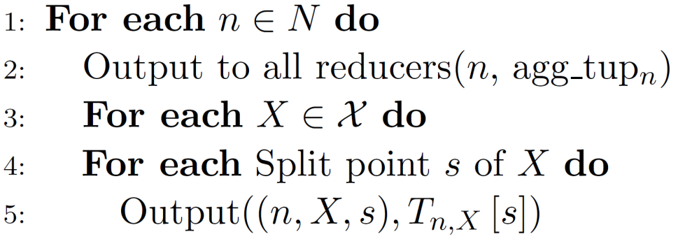

PLANET: ExpandNodes Mapper
Go through examples, aggregating summaries ($∑y$, $∑1$) for every:
Node: total statistics for the node (applies for all features)
Split: for every feature-bin
$Mapper.Map(\left\langle x,y\right\rangle , model M, nodes N)$ $Mapper.Finalize()$

Slide 14
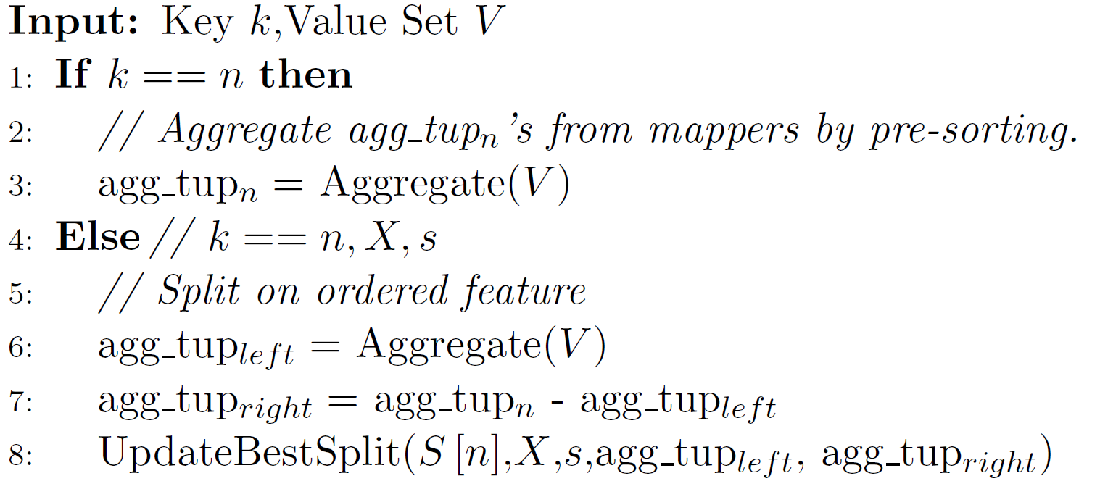
PLANET: ExpandNodes Reducer
Receives (presorted)
(a) Totals for every node
(b) Feature-split histogram for every node
Adds up histograms, finds best split among all possible ones.
Emits best split found for given node

Slide 15
PLANET: Master (Controller)
Master (Controller)
Creates and sends jobs to MRQueue or InMemoryQueue
Aggregates best splits for each node, updates model
Engineering is non-trivial, impactful
MapReduce per-worker setup and tear-down costs are high
Forward-schedule: pre-allocate Mappers and Reducers, standby
Controller uses RPC to send jobs
Categorical attributes
Specially handled (different MR keys; still linear using the “Breiman trick”)
Evaluation speedup: fingerprint, store signature with each node

Slide 16
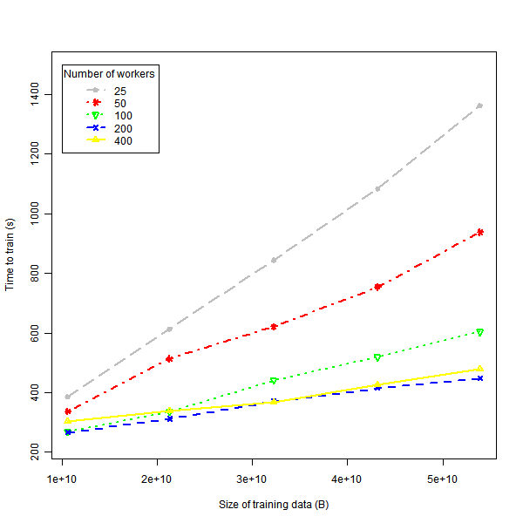
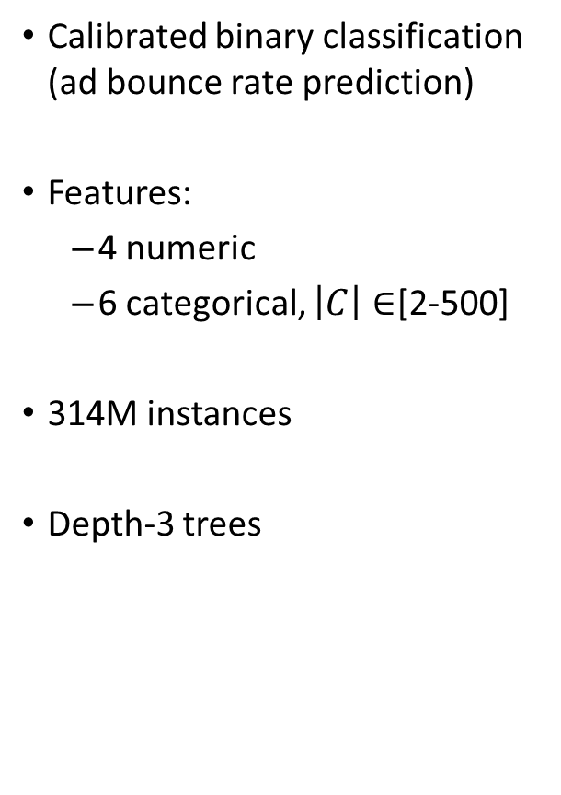
PLANET: Experiments
Calibrated binary classification (ad bounce rate prediction)
Features:
4 numeric
6 categorical, $\left|C\right|∈$[2-500]
314M instances
Depth-3 trees

Slide 17
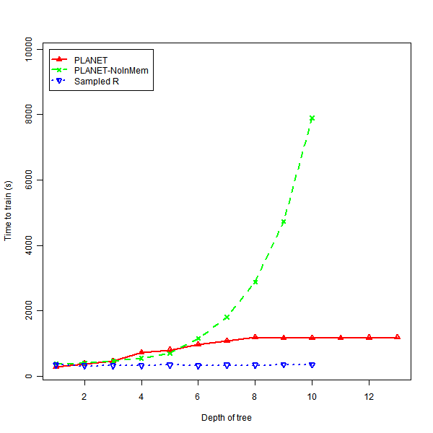
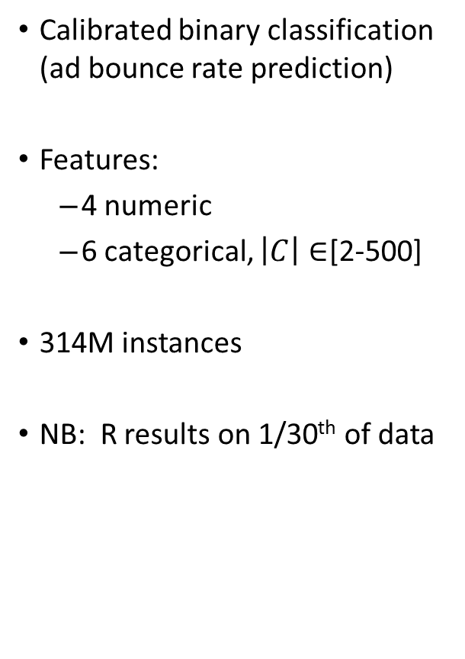
PLANET: Experiments
Calibrated binary classification (ad bounce rate prediction)
Features:
4 numeric
6 categorical, $\left|C\right|∈$[2-500]
314M instances
NB: R results on 1/30th of data

Slide 18
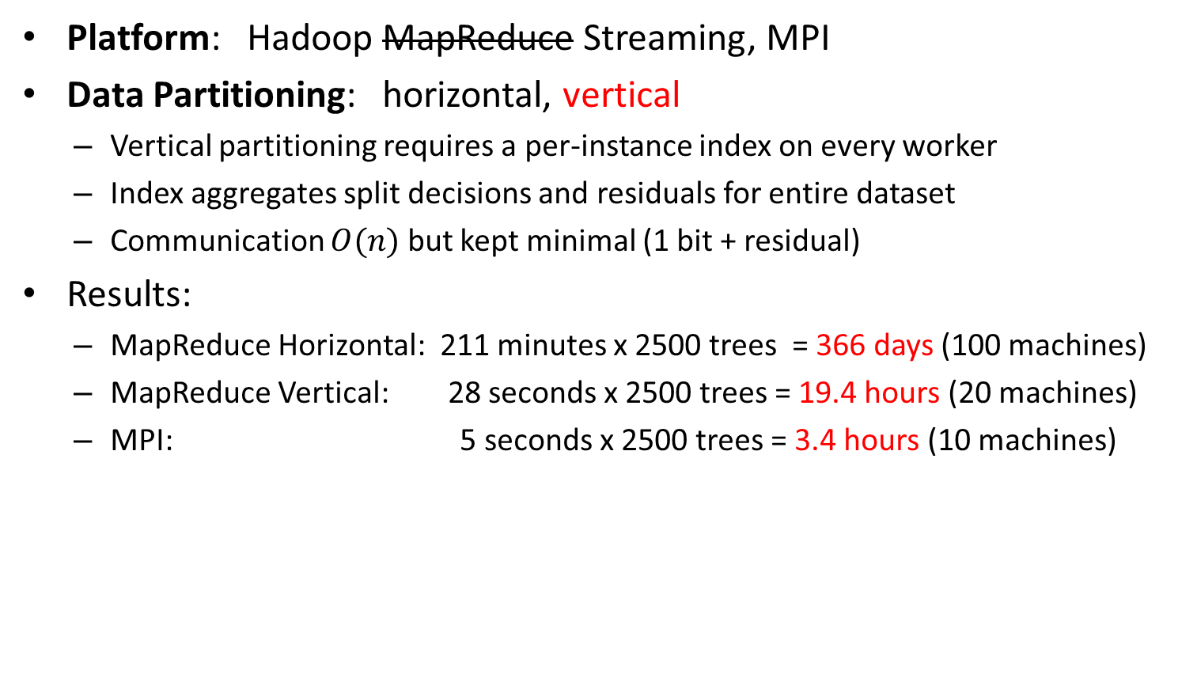
Yahoo! GBDT [Y+09]
Platform: Hadoop MapReduce Streaming, MPI
Data Partitioning: horizontal, vertical
Vertical partitioning requires a per-instance index on every worker
Index aggregates split decisions and residuals for entire dataset
Communication $O(n)$ but kept minimal (1 bit + residual)
Results:
MapReduce Horizontal: 211 minutes x 2500 trees = 366 days (100 machines)
MapReduce Vertical: 28 seconds x 2500 trees = 19.4 hours (20 machines)
MPI: 5 seconds x 2500 trees = 3.4 hours (10 machines)

Slide 19
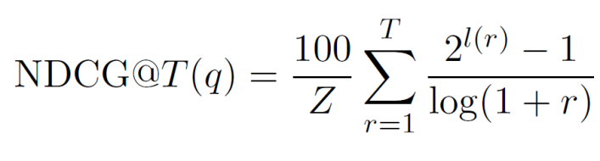
Distributed LambdaMART [SUML11-Ch8]
Boosting for Learning to Rank
Loss function:
Boosting residuals defined via NDCG-based pseudogradient
Platform: MPI on HPC Cluster
Binning: during initialization
Data Partitioning: horizontal and vertical schemes considered

Slide 20
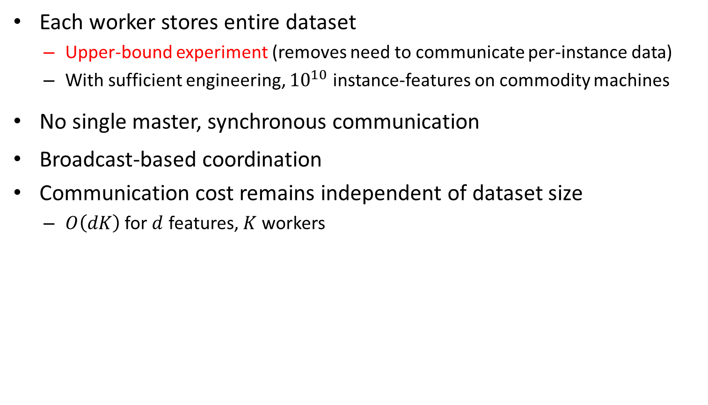
Feature-distributed LambdaMART
Each worker stores entire dataset
Upper-bound experiment (removes need to communicate per-instance data)
With sufficient engineering, ${10}^{10}$ instance-features on commodity machines
No single master, synchronous communication
Broadcast-based coordination
Communication cost remains independent of dataset size
$O\left(dK\right)$ for $d$ features, $K$ workers

Slide 21
Data-distributed LambdaMART
Evaluate the potential for boosting trees built with sampled data
Coordinated by master
Each worker
Trains full tree on its partition and broadcasts to all other workers
Evaluates other worker’s trees on its partition
Sends evaluation results to master
Master selects best tree based on combined evaluation
Randomized variant: sample worker’s hypotheses for evaluation

Slide 22
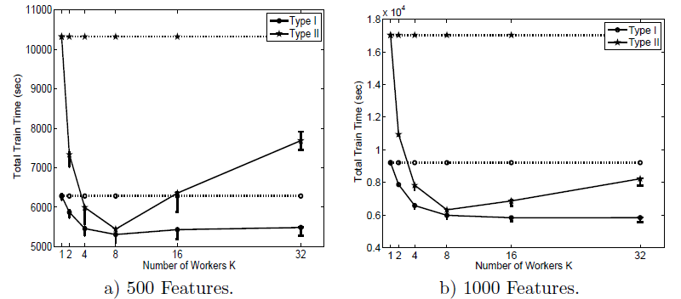
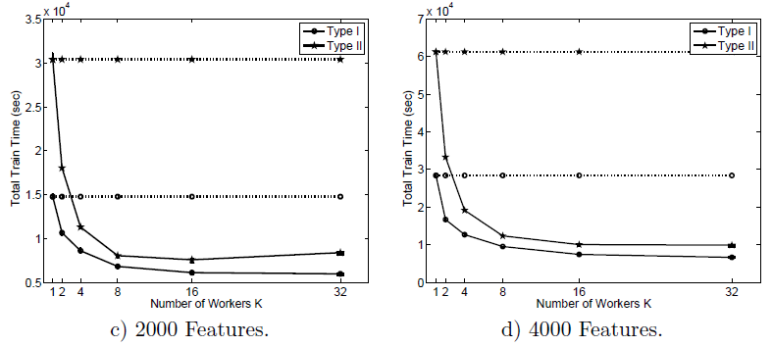
Feature-Distributed LambdaMART: Results
Ranking (web search)
14M query-url pairs
140K queries
500-2000 features
200-leaf trees
Communication costs limits gains
Notes:
6x speedup

Slide 23
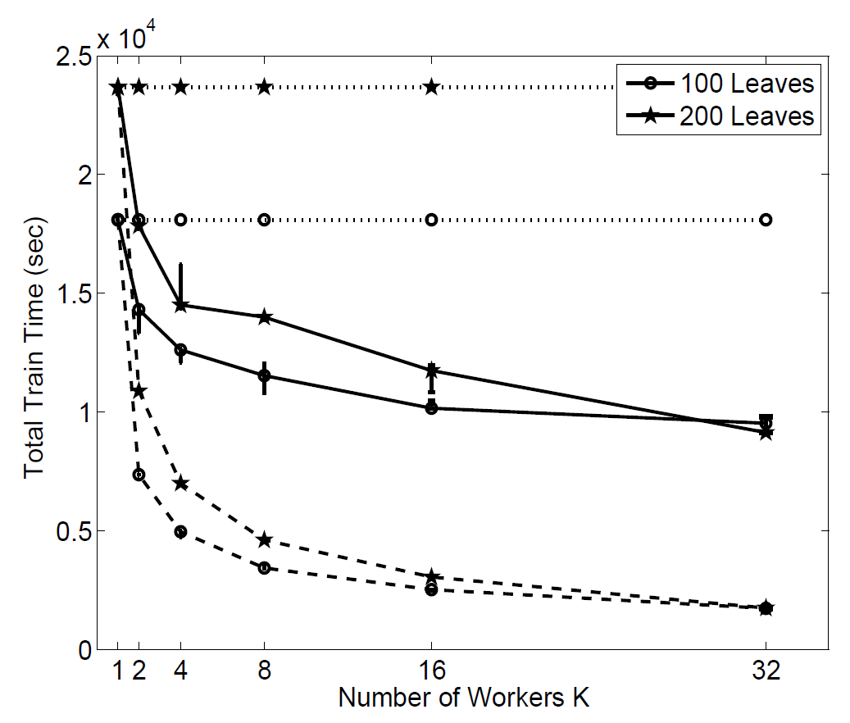
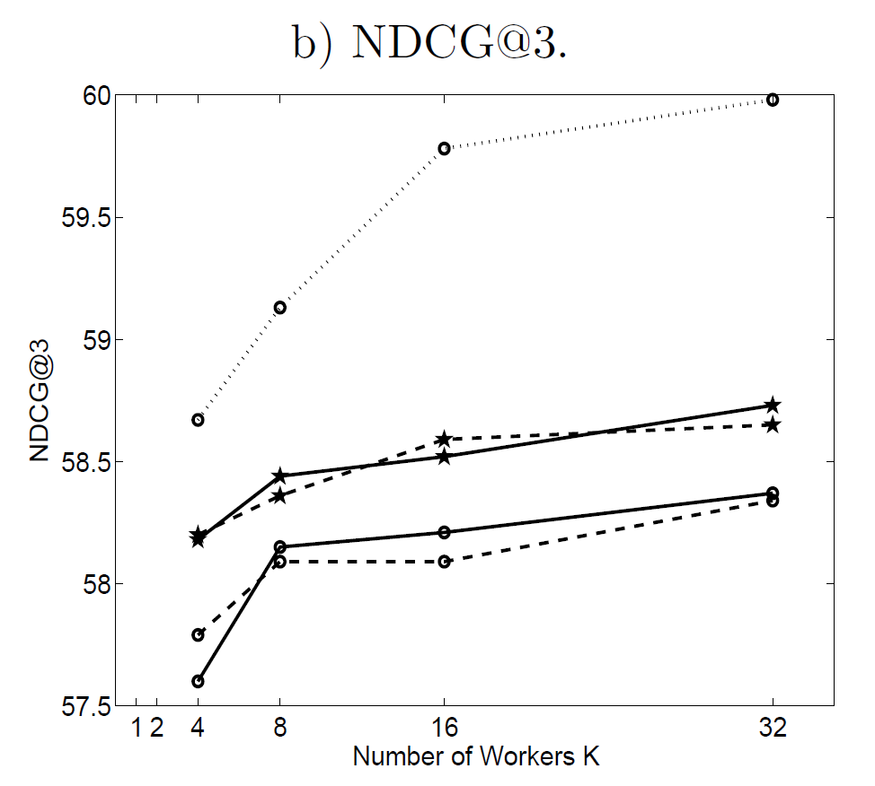
Distributed LambdaMART: Results
Ranking (web search)
14M query-url pairs,
140K queries
500-2000 features
200-leaf trees
Data-distributed:
Speedup from sampling comes at accuracy cost

Slide 24
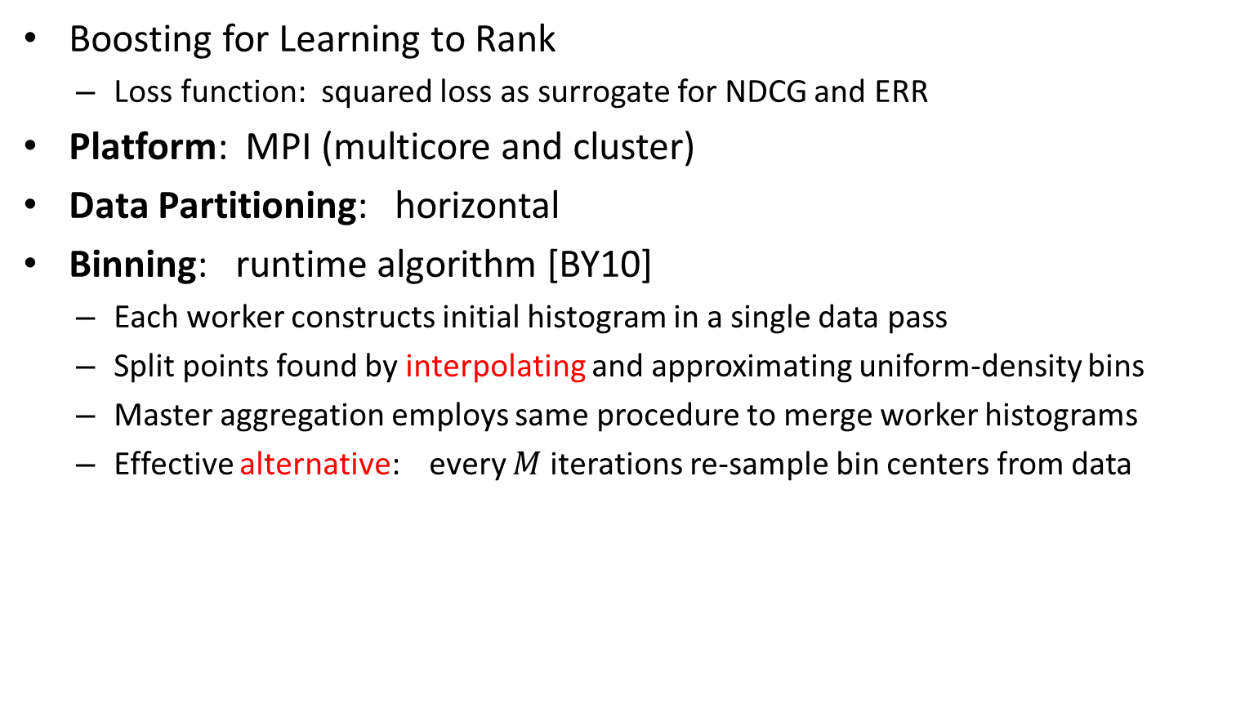
Parallel Boosted Regression Trees [T+11]
Boosting for Learning to Rank
Loss function: squared loss as surrogate for NDCG and ERR
Platform: MPI (multicore and cluster)
Data Partitioning: horizontal
Binning: runtime algorithm [BY10]
Each worker constructs initial histogram in a single data pass
Split points found by interpolating and approximating uniform-density bins
Master aggregation employs same procedure to merge worker histograms
Effective alternative: every $M$ iterations re-sample bin centers from data

Slide 25
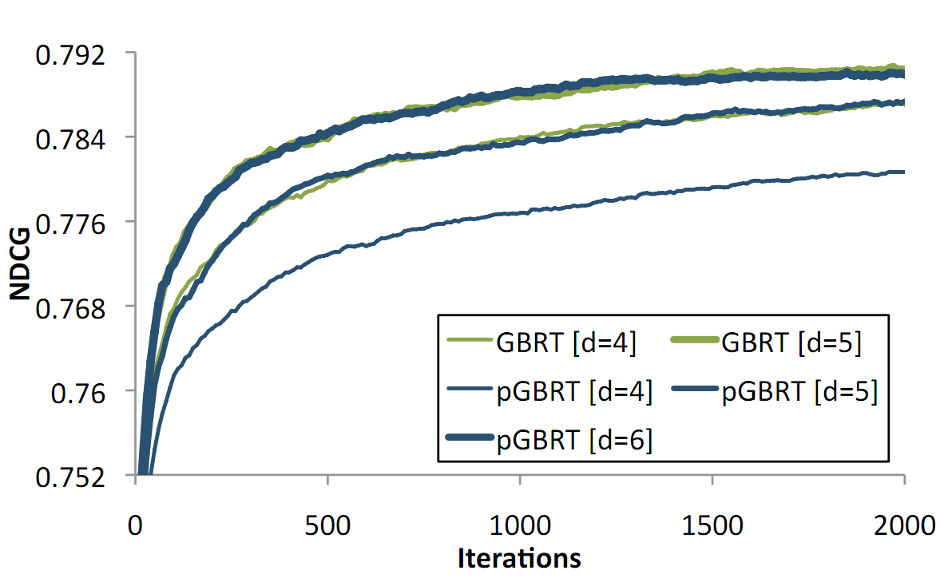
pGBRT Experiments: Accuracy
Yahoo! Learning to Rank Challenge Task I
475K documents (20K queries)
700 features

Slide 26
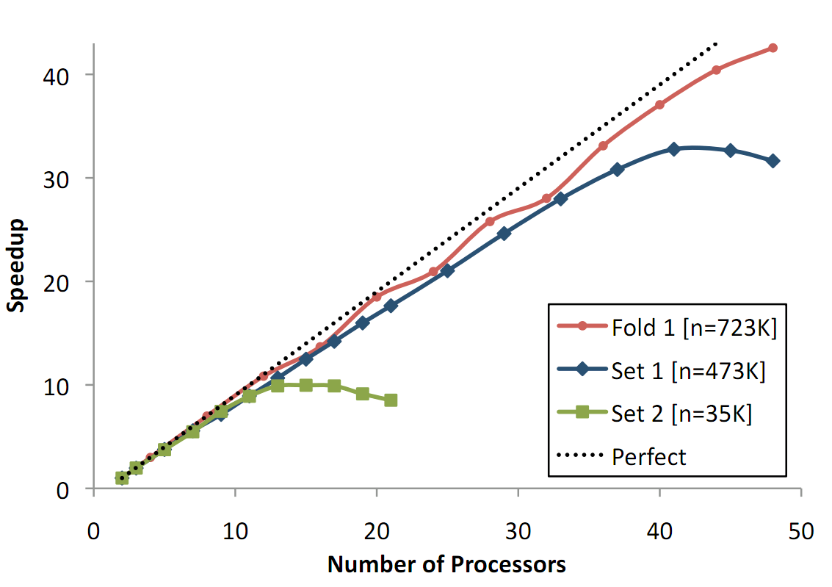
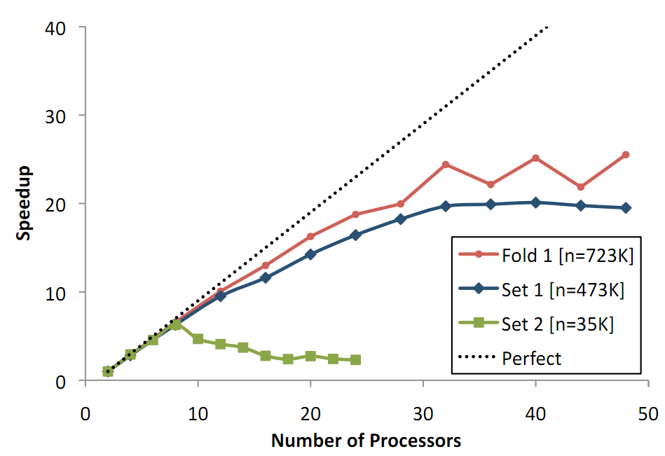
pGBRT Experiments: Speedup
48-core SMP
Yahoo! Learning to Rank Challenge dataset
Network communication limits speedups earlier
6-node DMP

Slide 27
Distributed Tree Ensembles: Conclusions
Boosting can be sped up very effectively on cores and clusters
MapReduce dataflow is not ideal, overhead is significant
Direct communication (MPI/RPC) is required for efficiency
Feature binning is essential
Pre-binning and run-time randomized binning are both effective
Vertical partitioning is promising but requires delicate engineering
Open problem: cluster-scale parallelization of deeper trees

Slide 28
References
[BY10] Y. Ben-Haim and E. Yom-Tov. A streaming parallel decision tree algorithm. J. of Machine Learning Research, 11:849–872, 2010.
[B96] L. Breiman. Bagging predictors. Machine Learning, 24(2):123–140, 1996.
[B01] L. Breiman. Random forests. Machine Learning, 45(1):5–32, 2001.
[FS97] Yoav Freund and Robert E. Schapire. A decision-theoretic generalization of on-line learning and an application to boosting. Journal of Computer and System Sciences, 55(1):119-139, 1997.
[F01a] Yoav Freund. An adaptive version of the boost by majority algorithm. Machine Learning, 43(3):293--318, 2001.
[F+03] Yoav Freund, Raj Iyer, Robert Schapire, and Yoram Singer. An Efﬁcient Boosting Algorithm for Combining Preferences. Journal of Machine Learning Research 4: 933-969, 2003.
[F01b] Friedman, J. Greedy function approximation: a gradient boosting machine. Annals of Statistics, 25(5):1189-1232, 2001.
[F+00] Jerome Friedman, Trevor Hastie and Robert Tibshirani. Additive logistic regression: a statistical view of boosting. Annals of Statistics 28(2):337-407, 2000.
[H98] Ho, T. K. The random subspace method for constructing decision forests. IEEE PAMI, 20(8):832–844, 1998.
[P+10] D. Y. Pavlov, A. Gorodilov, and C. A. Brunk. BagBoo: a scalable hybrid bagging-the-boosting model. CIKM-2010.
[S+07] Daria Sorokina, Rich Caruana, Mirek Riedewald. Additive Groves of Regression Trees. ECML-2007.
[SUML11-Ch2] Biswanath Panda, Joshua S. Herbach, Sugato Basu, and Roberto J. Bayardo. MapReduce and its Application to Massively Parallel Learning of Decision Tree Ensembles. In “Scaling Up Machine Learning”, Cambridge U. Press, 2011.
[SUML11-Ch8] Krysta M. Svore and Christopher J.C. Burges. Large-scale Learning to Rank using Boosted Decision Trees. In “Scaling Up Machine Learning”, Cambridge U. Press, 2011.
[SUML11-Ch9] Ramesh Natarajan and Edwin Pednault. The Transform Regression Algorithm. In “Scaling Up Machine Learning”, Cambridge U. Press, 2011.
[T+11] Stephen Tyree, Kilian Q. Weinberger, Kunal Agrawal. Parallel Boosted Regression Trees for Web Search Ranking. WWW-2011.
[Y+09] Jerry Ye, Jyh-Herng Chow, Jiang Chen, Zhaohui Zheng. Stochastic Gradient Boosted Distributed Decision Trees. CIKM-2009.
[Z+08] Z. Zheng, H. Zha, T. Zhang, O. Chapelle, K. Chen, and G. Sun. A general boosting method and its application to learning ranking functions for web search. NIPS 2008.

