Slide 1
Building curriculum for flexibility and retention
Dr Craig Bellamy BA (Hons) MA Ph.D
3 May 2012, La Trobe University

Slide 2
Landscape (the daunting tasks)
Retention (transform practice)
Teaching /Flexibility (responding)
Notes:
General issues around retention and flexibility in the present landscape and suggest some professional development practices to address the issues within an overall program of activities (and I’ll show u some of the professional development activities I have tried towards the end of the presentation)

Slide 3
Landscape: government policies
Deregulation
1995 age group; 45% enter HE (sometime in their life)
Government equity plans (focus upon success and retention of poorly represented groups. Ie. rural)
Notes:
Waves of deregulation (and re-regulation) of the Australian higher education system.
Bradley Review (2008), there is an aspiration to get 40% of 25-34 year olds to hold a Bachelor degree by 2020
And indeed, it is estimated that those born around 1995, about 45% will enter HE sometime in their life (completing or otherwise)
This year we also have uncapped domestic student numbers and also the decline of international students (that has his some universities more than others, particularly Monash)
And also, there are government equity plans that not only require Universities to target and enrol underrepresented groups, but also to focus upon their success and retention .

Slide 4
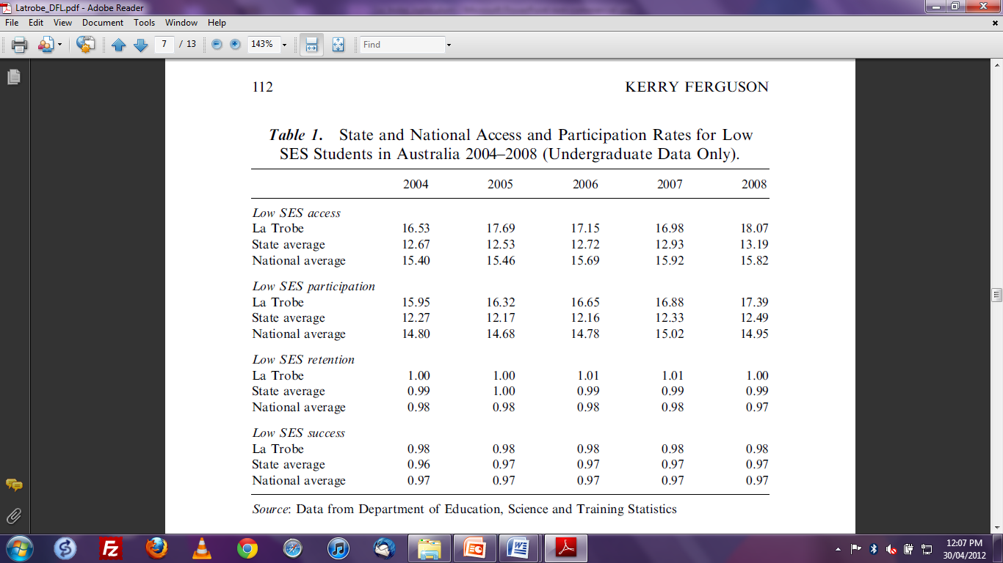
Notes:
This is the present situation at La Trobe (and I can only rely on articles and data that is already in the public sphere).
40% of students the first to attend university (recent survey at La Trobe)
La Trobe has always enrolled a large number of students from Low Socio-Economic Status and indeed there is an upward trend here.
And a success rate of less than 1.0 indicates that they are withdrawing at a greater rate than the general student population...
National average of 70% completion (McInnis, James, 2004) (and I am not sure how La Trobe benchmarks against this figure or how the faculty benchmarks itself)

Slide 5
Landscape: Low Socio-Economic Student background
Lower socio-economic groups believe vocational training of more benefit (McInnis, James, 2004)
Weaker personal interest in their subjects (more interested in an income)
Less confident in their ability to succeed
Gap in the research on ‘trigger points’ of withdrawal: most work done on first year experience
Notes:
These are some of the problems of students from Low Socio-Economic backgrounds that may effect their retention rates.
Not necessarily a straight forward causality and therefore, not a straightforward fix.
Isolation a big factor in withdrawal
Transfer to another institution? (Australian system quite flexible). And other external factors...

Slide 6
Landscape: Attrition, impact upon institution
Adverse publicity for an institution with poor record of completing students
Waste of resources into recruiting students
Institutions that seek to enrol students from disadvantaged backgrounds must back up efforts to encourage sustained success (York, Longden, 2004) (La Trobe’s services particularly good!)
Notes:
Some of the reasons why retention is a particular concern for a University such as La Trobe...

Slide 7
Why students leave their programs (Yorke, Longden, 2004)
Flawed decision-making about entering their program
Students’ experience of the program and the institution generally
Failure to cope with the demands of the program
Events that impact upon the students lives outside the institution
Notes:
And these are some of the reasons why students leave their programs. And again some of the external factors are difficult to address, but there are a number of strategies that a university can undertake to address student retention and success in their programs.

Slide 8
Retention: Key institutional strategies
Marketing and recruitment
Transition management (student orientation)
Teaching and learning
Student support programs
Development of learning communities
Notes:
These strategies include better marking and recruitment that facilitates better choices in program by the students (such as open days)
Transition management (ie. programs for special entry students)
Student support programs,
Development of learning communities (that promote retention and interdisciplary work)
And teaching and learning

Slide 9
Retention: Key institutional strategies
Teaching and learning
Student support programs
Development of learning communities
Transition management (student orientation)
Marketing and recruitment
Notes:
And Ill concentrate on teaching on learning because (as follows)...

Slide 10
Teaching and learning (and retention)
“ A policy focus on student success in higher education through teaching, learning and assessment, and through institutional support services, is likely to lead to better retention than a focus on retention itself” Yorke, Longden, 2004.
(ie. it is better to look at the entire program rather than one aspect of it in isolation)
Notes:
Thus it worth looking at the entire program, rather than just addressing one aspect of the program in isolation from the program...

Slide 11
Teaching and learning (and retention)
It must be important; it must have some value to the learner
The learner needs to expect success when engaging the learning tasks (Biggs, Tang, 2007)
Notes:
And to really understand retention, we need as much information as possible as to how subjects are taught: course content, methods of assessment, success rates of past students, perhaps employment after the degree.
But the literature points to some key concepts in terms of teaching and learning and retention in that a) It must be important; it must have some value to the learner and, b)The learner needs to expect success when engaging the learning tasks (Biggs, Tang, 2007)

Slide 12
Designing Quality Teaching and Learning (Biggs, Tang)
Teaching in such a way to bring out the structure of the topic or subject
Teaching to elicit an active response from students (ie. presenting problems, questions)
Build on what students already know (ie. the ‘public sphere’)
Depth of subject (important in internet age where there is too much broad information!)
Explicit aims and intended outcomes for assessment
Notes:
How do the less academically focussed students see value and personal success in the tasks? (ie. what’s in it for them? Are there examples that resonate with their experience?) (the public sphere example and teaching overseas students)
Also, teaching through problems and scenarios (as in teaching through scenarios and ethics in information systems. Use the example of the auto-pilot system
Link between cohesion and focus of the course and student retention (especially for the weaker students that require greater direction) Clarifying goals and objectives aligns with much of the literature on ‘constructive alignment’...Lack of goals exacerbates negative views from weaker starters...

Slide 13
Teaching and learning (and retention)
What is the teaching/learning climate? (ie. negative reinforcement is worse than positive)
Applauding undergraduate success! (partly through assessment)
Teacher feedback has a powerful effect on students expectation of success (Biggs, Tang)
Peer assessment (grading with rubrics) through a ‘flexible learning’ approach.
Notes:
Other teaching and learning strategies, particularly at the level of the classroom include the teaching climate through the positive reinforcement of student success, and the alignment of learning outcomes with assessment. And there has been a lot of work done on assessment through rubrics which is part of what is termed a ‘flexible learning’ approach. It is like a marking sheet that breaks assessment down into certain learning outcomes...

Slide 14
Flexible learning: methods of teaching and learning (mixed teaching methods/activities)
Flexible Learning
Online Delivery
Part-time study
Intensive Study (summer schools)
Mixed mode attendance (online etc.)
Notes:
A particular emphasis on what the student does; both inside and outside the classroom...(and a particular good method of understanding this is called ‘cultural probes’ developed by William Gaver. A Kit of diaries, cameras etc. are used to record situations. And I know that both Kay Souter and Matthew Riddle here at La Trobe have used this approach in deterring learning spaces here at the university.
What learning activities need to take place to achieve the desired learning outcomes (how is flexibility a part of this?).
A set of learning activities, so flexible, to broker certain learning outcomes...

Slide 15
Flexible study (advantages)
cater for a broader range of student learning styles
develop independent and self-directed learning approaches in our students
improve access to university study for students who live some distance from the University campuses
cater for students who have family and work commitments
broaden options for students on each of our campuses as well as nationally and offshore
open up our courses to a wider market (from Utas)

Slide 16
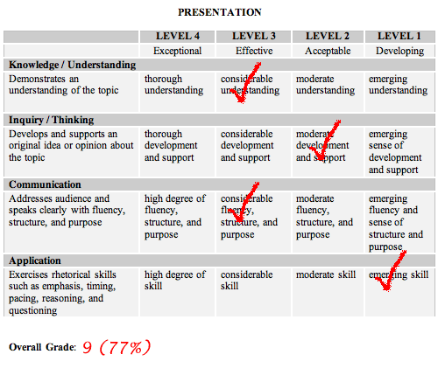
Different modes of delivery (online)
Notes:
A Learning tool...
Rubrics: timing and quality of feedback and self-directed learning...
Identifying students at risk (through moodle plug-ins and other methods)
Rubrics have become popular with teachers as a means of communicating expectations for an assignment, providing focused feedback on works in progress, and grading final products. Although educators tend to define the word “rubric” in slightly different ways, Heidi Andrade’s commonly accepted definition is a document that articulates the expectations for an assignment by listing the criteria, or what counts, and describing levels of quality from excellent to poor.
Rubrics are often used to grade student work but they can serve another, more important, role as well: Rubrics can teach as well as evaluate. When used as part of a formative, student-centered approach to assessment, rubrics have the potential to help students develop understanding and skill, as well as make dependable judgments about the quality of their own work. Students should be able to use rubrics in many of the same ways that teachers use them—to clarify the standards for a quality performance, and to guide ongoing feedback about progress toward those standards

Slide 17
How can retention/ flexibility be promoted at a program/faculty level?
Assemble relevant information to support targeted reform through a program of activities (ie. what PD activities are needed? And evaluated?)
Reforms must be adapted to each teacher and teaching strengths (ie. distributed models; and abundance of research on SoLT), Committees, early adopters, champions etc.
Why didn’t that work? What can I do to make my students more active...
THATCamp (A ‘learning community’ for the Digital Humanities)
Teachers@work (RMIT) (transformative reflection)

Slide 18
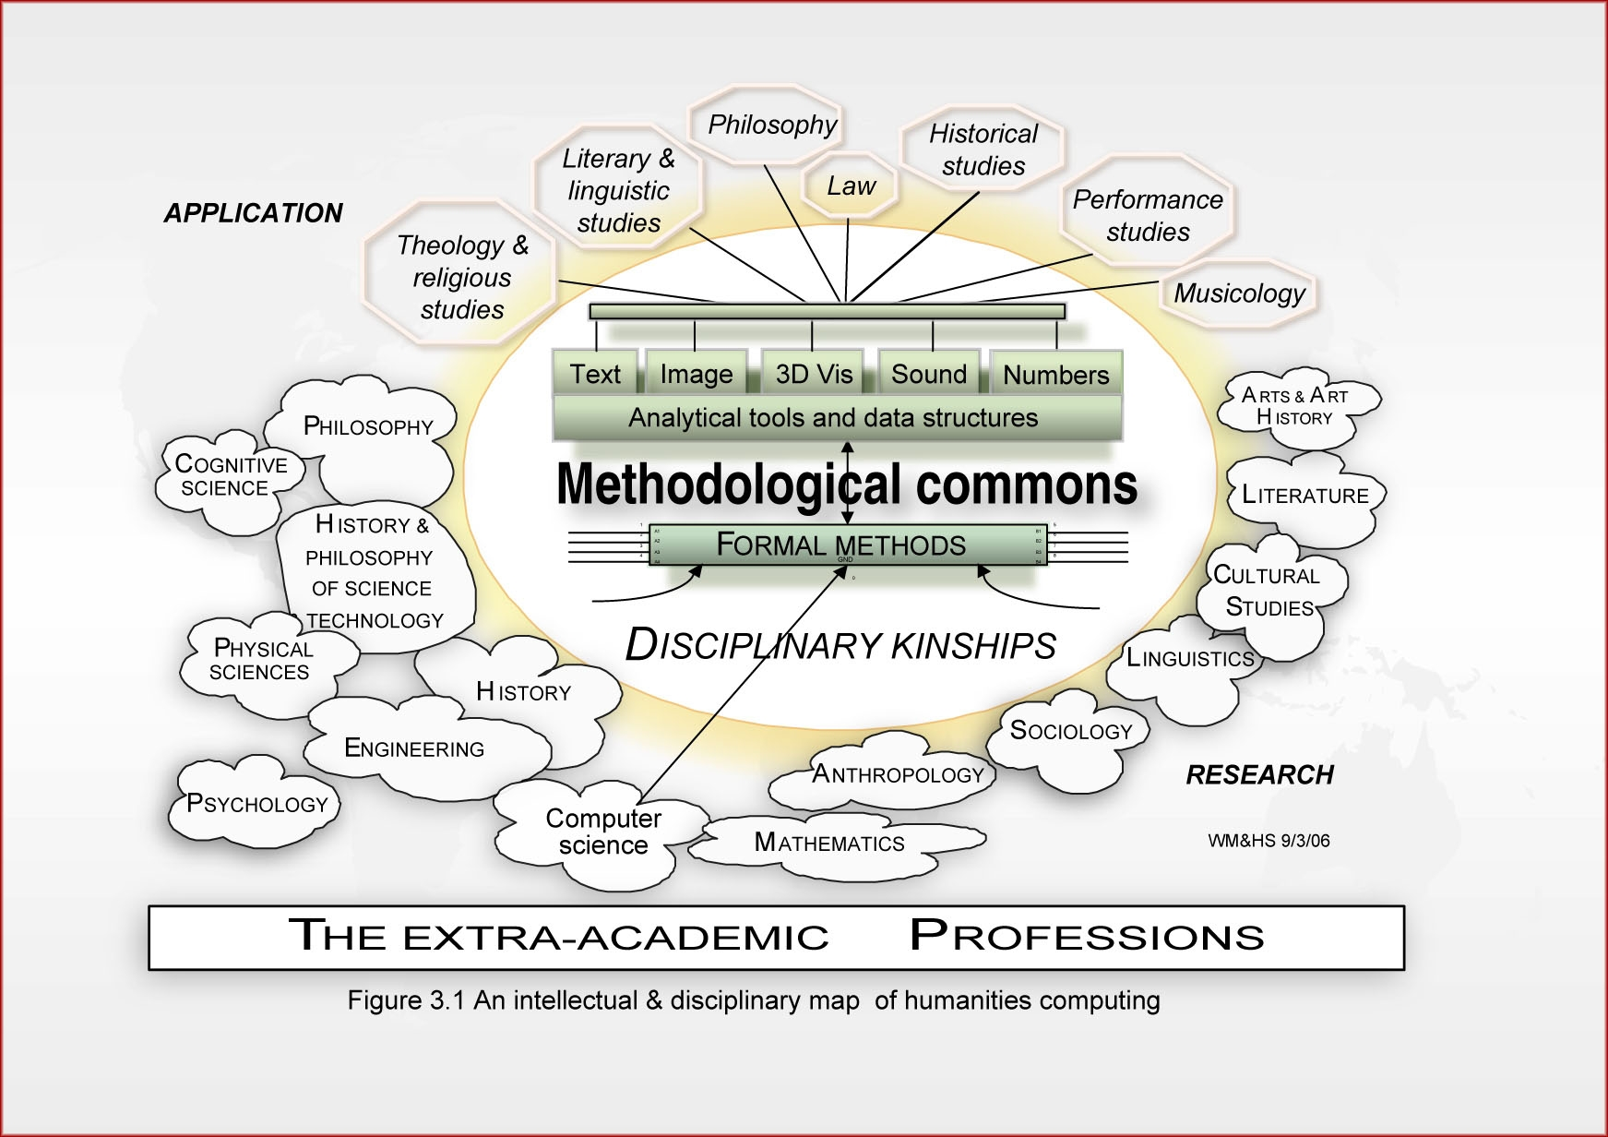
Notes:
This is a learner community model. This was partly developed by Professor Harold Short of King’s College London, who I invited to speak in Melbourne last week particularly in terms of issues around developing curriculum in digital humanities.
And a program that Professor Short developed (and I later helped assess and wrote a report about) was called ‘the methods’ network that was partly based upon this ‘methodological commons’ idea.
Basically it was a series of 50 or so workshops at a national level around key methods developed in certain disciplines (like text analysis in linguistics and text mining for historians). And individuals from other disciplines would be invited to the workshops in the hope of building communities of practice and synergies around the methods.
And this ‘methodological commons’ has been used in a number of ‘professional development’ type activities, like the ‘teachers at work’ program at RMIT (say where a popular media teacher will talk about his issues with teaching with blogs etc.)

Slide 19
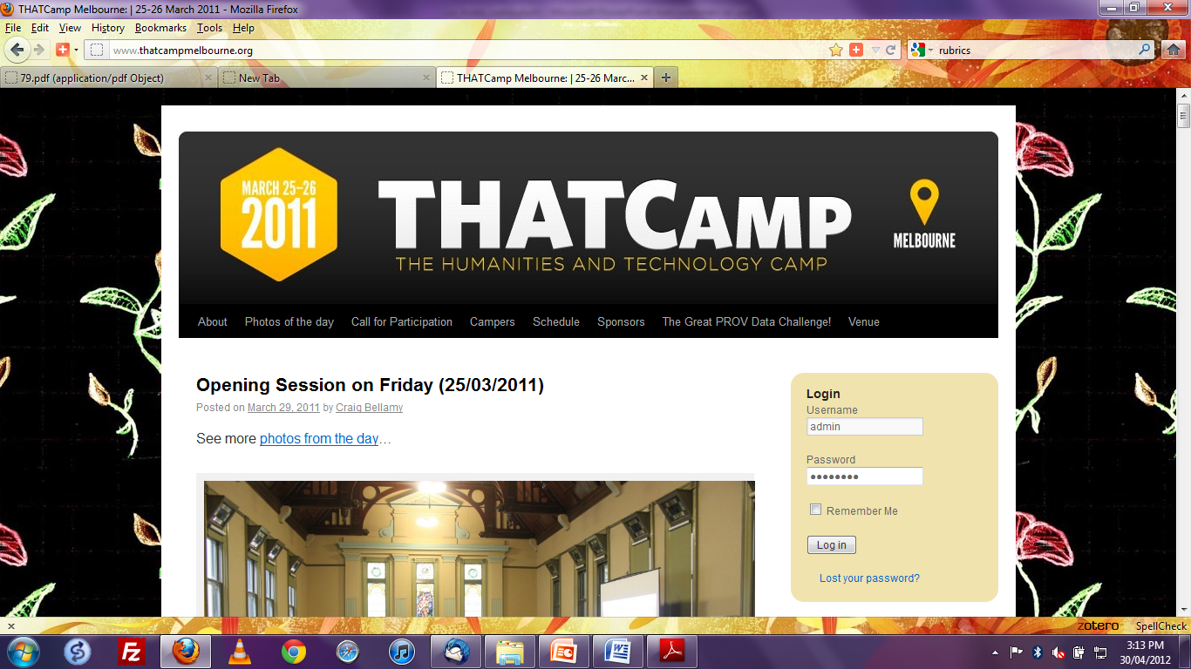
Notes:
And another approach that I have tried is THATCamp (Technology and humanities camp) which is an ‘unconference’ model.
THATCamp as a ‘professional development’ activity and a ‘bottom up’ approach to exchanging ideas about computing in the humanities.

Slide 20
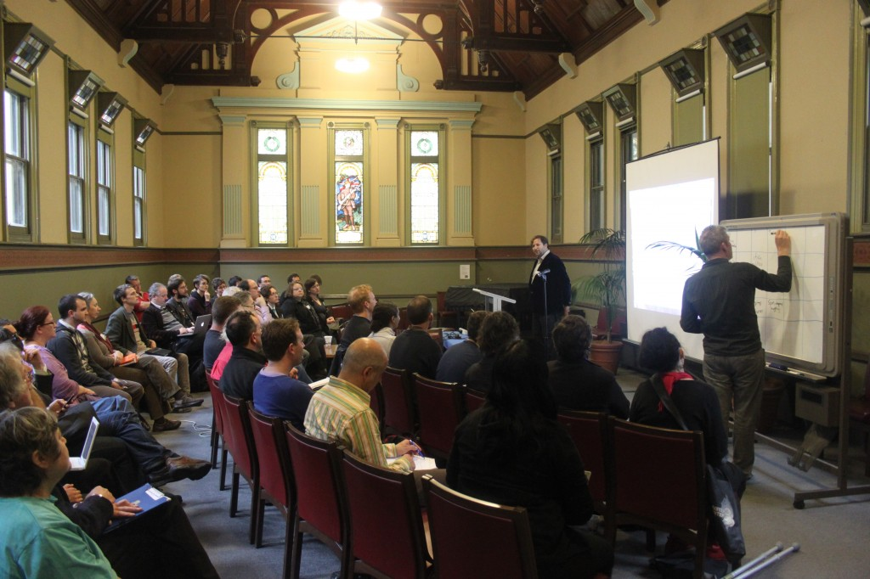
Notes:
This is the opening morning session of THATcamp. Participants bring along there own session ideas and they are written on a board and then the participants vote on those sessions and they become part of the days itinerary. And they go to break-out rooms to discuss the particular theme...

Slide 21
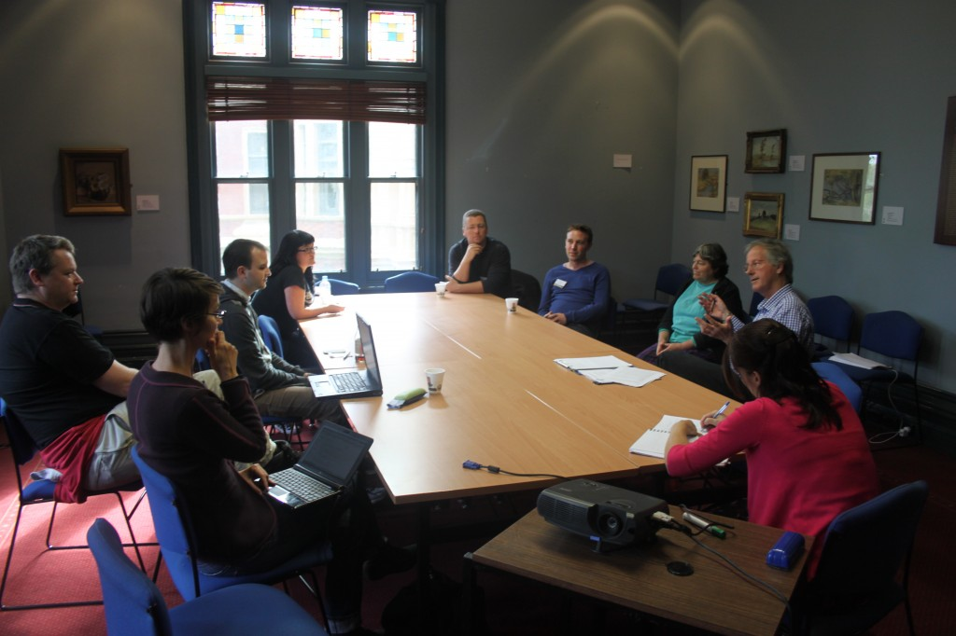
Notes:
And this is one of the break-out sessions on ‘pedagogy’. And of particular note, is that out of THATCamp Melbourne we proposed the recently successful HuNI project (or the Humanities united Network Infrastructure). Led by Professor Den Verhoeven of Deakin University.

Slide 22
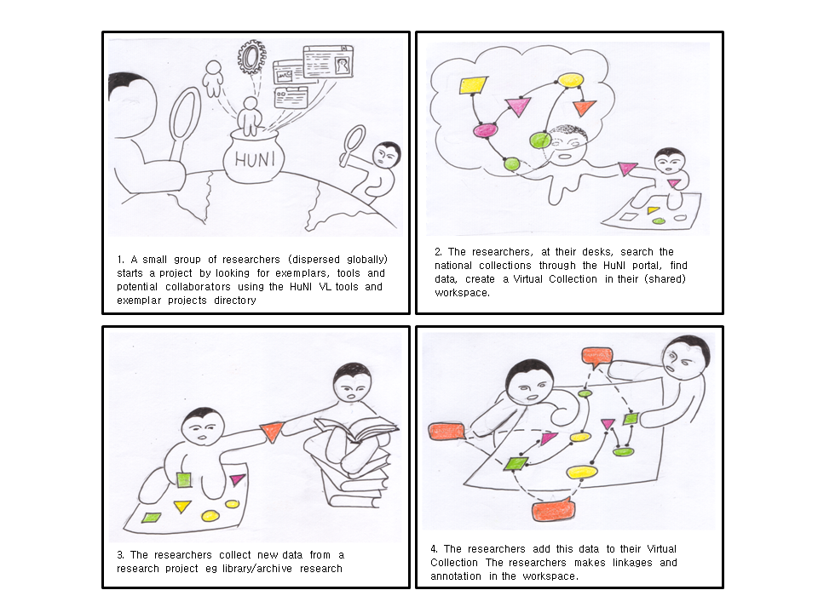
Notes:
So what we will build is a Virtual Laboratory (this has been a focus of some of my research over recent years). It is a $1.3 Million dollar project to link some of Australia’s key data sources. It will not only link them but also provide a learning space where students and researchers can query them and form learning communities and do innovative analysis on them.

Slide 23
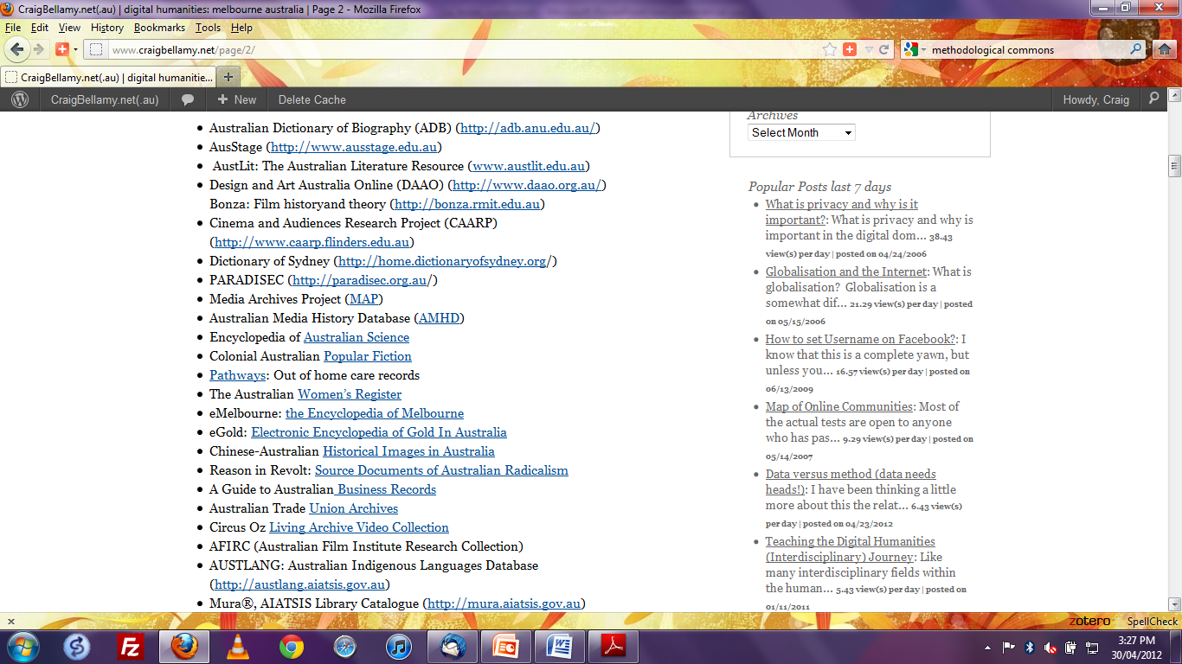
Notes:
And this is a list of the partners that I have listed on my blog.
So the point is that flexible learning isn’t just about Moodle and other Learner Management Systems; there are a bunch of other resources and tools out there that can be used in teaching and learning in the classroom and other places where learning happen.

Slide 24
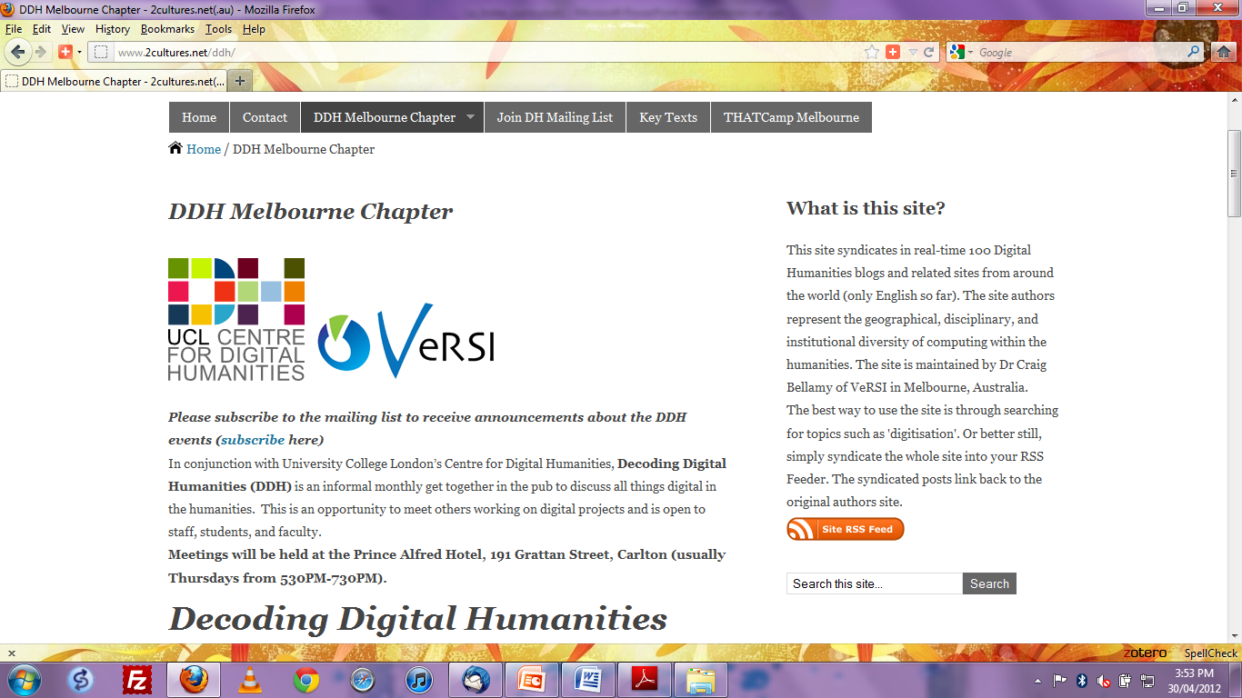
Notes:
Another thing I tried along the line of a more informal approach to community building is a pub night called ‘decoding digital humanities’. And we did this in conjunction with UCL’s Centre for Digital Humanities in the UK and we discussed papers and software etc.

Slide 25
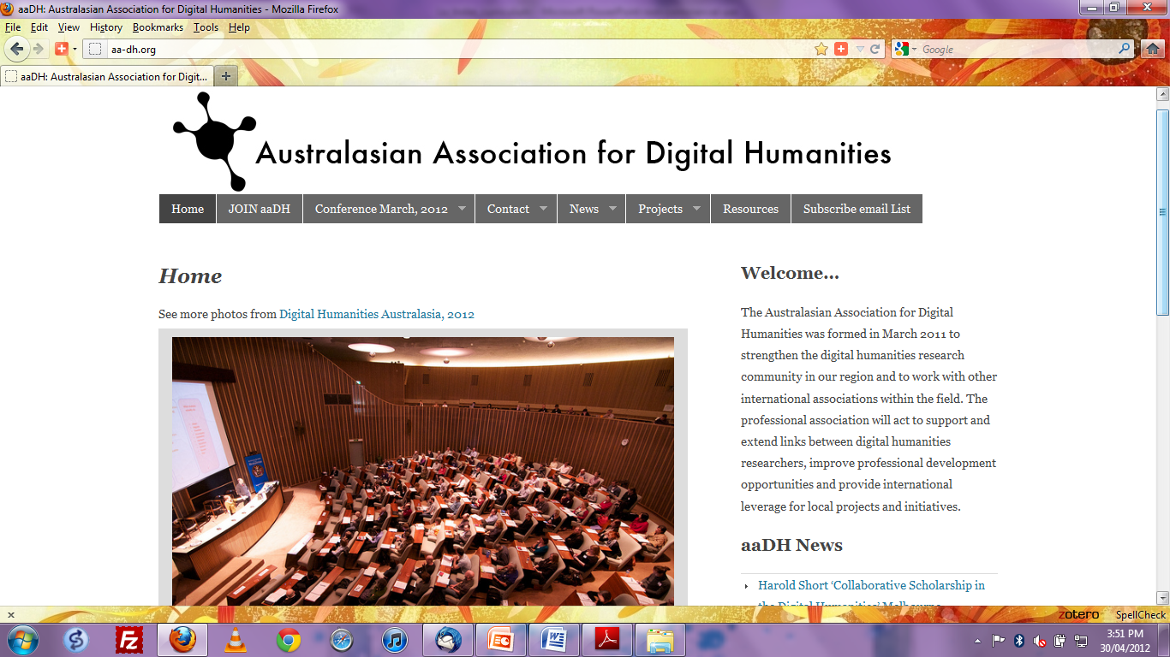
Notes:
And one of the major contributions that the digital humanities makes to teaching is that it provides technical architectures that open-up critical interpretations of digital objects (within assessable tasks) to broader audiences of students
And this is important because Information retrieval and analysis skills become more important through the increase of social/cultural data and the increasing use of the internet as a learning tool in all sorts of learning contexts.
Provide technical architectures that open-up critical interpretations of digital objects (within assessable tasks) to broader audiences of students
Information retrieval and analysis skills become more important through the increase of social/cultural data

Slide 26
Flexibility
Retention
Teaching
Notes:
So to conclude, we can’t look at questions of retention and flexibility is an isolated way, they must be seen within a larger and interrelated framework of the promotion of excellence teaching (through models such as constructive alignment that i believe has informed much of the curriculum renewal plans here at La Trobe.

Slide 27
Summary/questions?
Issues are complex in making students successful!
‘Flexibility’ doesn’t always impact in a positive way upon retention (need to be considered within good teaching). Teaching is a social process
Synergetic approach to evidence gathering, retention, flexibility, teaching and learning, and policy making and implementation (as in Faculty Graduate Capabilities project)
No grand theory or one size fits all to effective teachers; teachers understands what works and what doesn’t work with their own content and context (but good approaches can be shared...a need to be flexible and willing to experiment)
Notes:
good teaching a must for retention...but more research needed on the link between quality of teaching and retention
Growing diversity of the student body requires some experimentation with new ways to promote and assess learning (RMIT Chancellor)
Look for ways to take advantage of this diversity.
Important to stick to educational goals and outcomes...
An important part of the student experience is access to resources outside the classroom...
Look to the OTL to support innovation in teaching and learning
And in terms of these issues of Retention and flexibility: it is always important to remember at its heart education is a social process!

