Slide 1
Cultural Datasets Consortium Meeting
The ‘infrastructure turn’: Virtual Research Environments (VREs) in the humanities
Dr Craig Bellamy
Analyst Digital Humanities
Secretary: Australasian Association for Digital Humanities

Slide 2

Surf Foundation (Netherlands)

Slide 3
JISC - Study of Documents and Manuscripts

Slide 4
The Landscape...
The Digital Humanities (growing energy in the field; Australia and Internationally)
eResearch (‘eScience’, ‘Cyberinfrastructure’)
Virtual Research Environments (VREs) in the humanities (examples)

Slide 5
Digital Humanities
DH (…a focus on methods). Long relationship with Computer Science
Interdisciplary and largely research driven (computational)
Led by US, UK, Germany, Italy, Japan
Long history (dating back to the 1940s)
DH largely exists within existing humanities ‘infrastructures’ (journals, centres, departments, conferences, associations etc.) And within cultural institutions…

Slide 6
eResearch and the Humanities
Infrastructure movement (eScience, Cyberinfrastruture)
Infrastructure movement has a healthy relationship with the humanities in UK, Canada through various programmes and tools
Largely scientific paradigm (and we must avoid the ‘nothing there in the first place’ notions of ‘infrastructure’ and ‘collaboration’ in the humanities and other external pressures from science and technology (ie. empiricism, positivist)
It needs to address more than one specific research need to qualify as infrastructure

Slide 7
VREs Examples
“...the humanities need to consider the multiple opportunities associated with cyberinfrastucture, whilst maintaining epistemic integrity and avoiding modelling new infrastructure uncritically after existing models” (Patrik Svensson, DHQ, Winter 2011)

Slide 8
Virtual Research Environments (VREs)
Term ‘VRE’ largely coined by JISC in the UK through their VRE programme
US uses the term ‘Collaboratory’
Fairly new territory for the digital humanities and broader humanities (past 5-10 years in humanities, 20 years in Science)

Slide 9
VREs (examples)
TextGrid (Germany)
TAPoR (Canada)
NINES (USA)
DARIAH (EU)
Holocaust (EU)

Slide 10
1: TextGrid
Large German government funded project (2006+) (Open-grid architecture)
Part of the larger D-Grid project
Phase 2: 2009: Virtual Research Environment released June 2011
2 components (Repository and Laboratory)
Core humanities disciplines (phase 2) German language and literature, musicology, (corpus‐ and computer‐) linguistics, medieval Latin, editing glosses, history of arts

Slide 11
TextGrid Generic tools
TextGridLab(oratory) – generic tools
• Toolbox for collaborative research
‐ authentication
‐ project and user management
‐ navigator
‐ data import and export
‐ versioning
‐ search tools
‐ webservice interface (REST and SOAP)

Slide 12
TextGrid Specific Tools
• TextGridLab
‐ interactive tools ‐ (eclipse based)
• XML editor
• text image linking tool
• aggregation tool (building corpora)
• metadata editor
‐ streaming tools (web service based)
• collating tool (together with EU interedition group)
• lemmatizer
• sorting tool
• dictionary search tool, dictionary grid

Slide 13
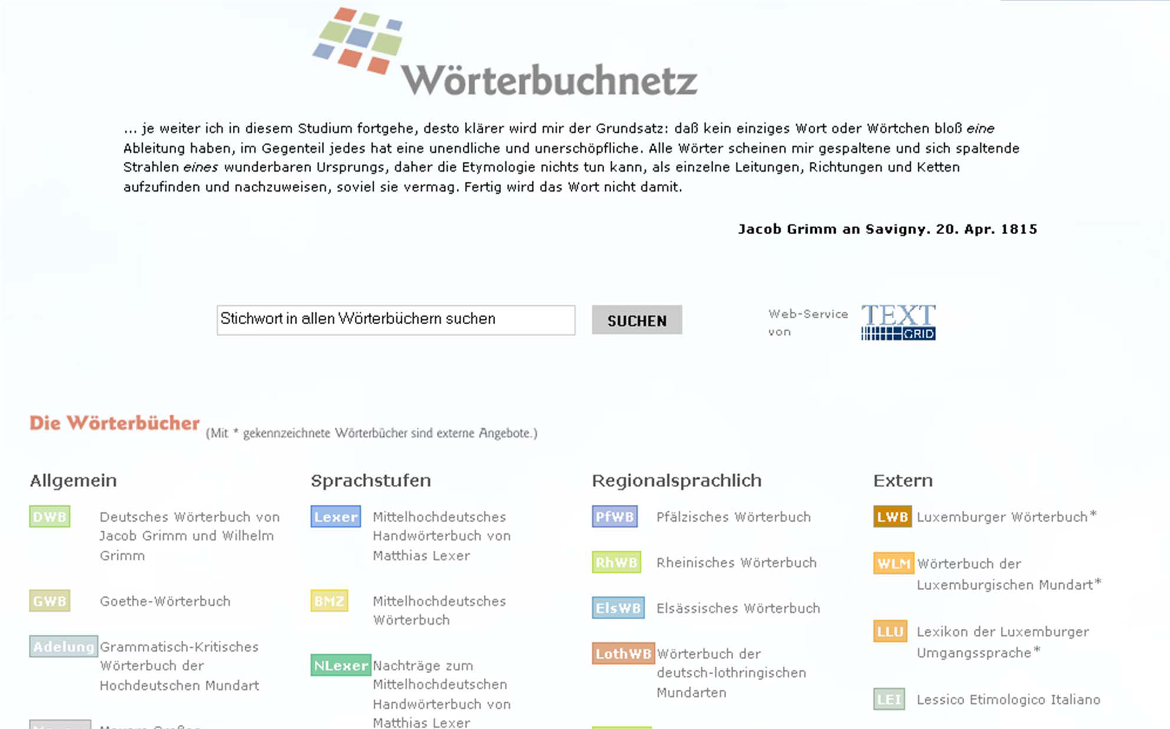

Slide 14
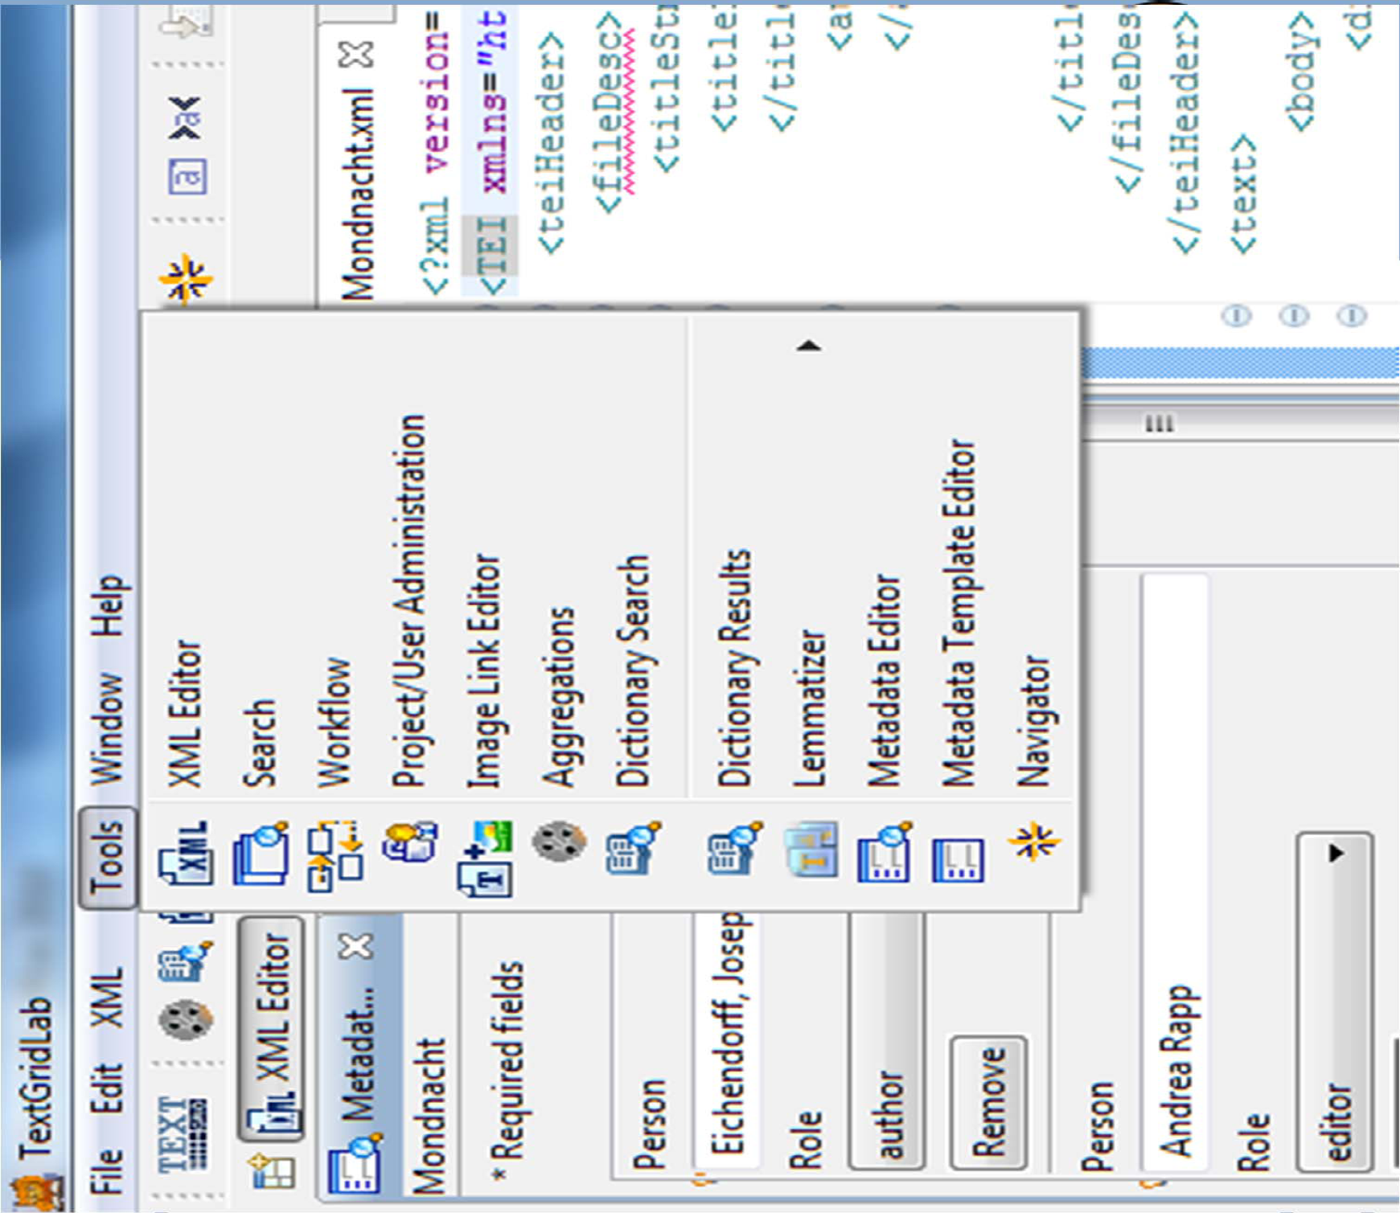

Slide 15
2: TAPoR
Launched in 2003
Text Analysis Portal for Research
Network of six leading humanities computing centres in Canada
TAPoR is a portal for:
Collecting texts - TAPoR lets you keep a library of references with links to original documents on the web or elsewhere
Analyzing texts - You can then pass these texts to tools that analyze the text and then store the results
Tools on TAPoR are web services not on the TAPoR server
TAPoR provides a common interface for tools

Slide 16
3: NINES
Networked Infrastructure for Nineteenth-Century Electronic Scholarship
Goals:
to serve as a peer-reviewing body for digital work in the long 19th-century (1770-1920), British and American;
peer-reviewing and legitimating digital literary editing, to support scholars’ priorities and best practices in the creation of digital research materials;
to develop software tools for new and traditional forms of research and critical analysis.
It provides scholars with access to a federated digital environment and a suite of computerised analytic and interpretive tools.
NINES is currently aggregating 670,373 peer‑reviewed digital objects from 96 federated sites.

Slide 17
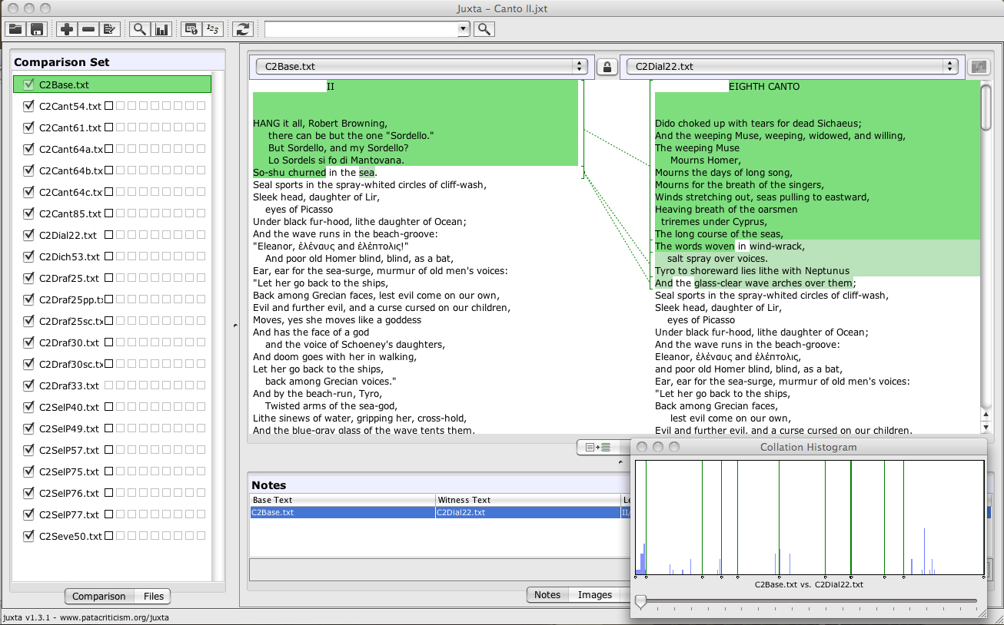
NINES Juxta tool

Slide 18
4: DARIAH
EU 7th Framework Programme funded large scale project
Preparations started in 2008, construction in 2011 and operational in 2016
Aimed to be as decentralised as possible
Outputs:
Technological services and tutorials to link data archives into the DARIAH network
Software and consultancy for emerging data centres
An interoperability layer (links data centres)
Means of linking into DARIAH for countries/disciplines that don’t yet have a Digital Humanities infrastructure
Best practices and guidelines for individual researchers to foster data interoperability and preservation across the DARIAH network

Slide 19
5: European Holocaust research Infrastructure
EU Funded 7th Framework
20 organisations
VRE developed at CeRCH, Kings College London
4 year project, 7 million Euros
1200 collections (so far)
Strong stand of unknown material...
http://www.ehri-project.eu/ehri-the-project

Slide 20
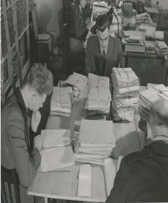
The Human VRE?

Slide 21
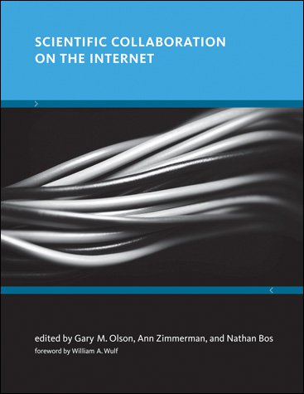
Research needs shape the VRE...

Slide 22
(Scientific) Collaboration on the Internet
...‘five factors—the nature of the work, common ground, collaboration readiness, management, technical readiness all contribute to the success of a ‘collaboratory’ (VRE).
(Olson, Zimmerman, Boss, p89)

Slide 23
Key tensions..
“...two key tensions in achieving these goals have been identified: the greater the diversity, the less common ground and trust, which together impede the understanding of each other and the production of new ideas; and the larger the scale, the greater the coordination overhead, increasing exponentially rather that linearly”
(Olson, Zimmerman, Boss, p89)

Slide 24
Final thoughts: finding common ground…
Humanities research the starting point!
What epistemic communities and computational paradigms does it support (existing models versus a new model?) What is being shared? (standards etc.)
What collaborative activities may it support?
What new research questions may be asked (scenarios, compelling research stories, outputs)?
What may scale mean in this project (ie. are there questions beyond the work of one individual researcher?
What are the risks (risks to humanities academic practice, ‘two cultures’ risks? And finding common ground between the technology-led issues and humanities questions is not trivial)

