Slide 1
Idaho’s Native American Tribes
By Sydney Penner
Resident Assistant
University of Idaho

Slide 2
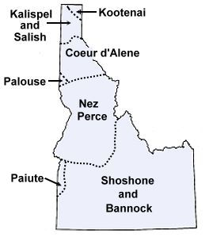
The original inhabitants of what is now Idaho.

Slide 3
The Kootenai Tribe
The Kootenai Tribe of Idaho was once part of a larger Kootenai Tribe situated in what is now Montana and Canada. Although the "Kootenay" tribe was party to the Treaty of Hellgate in Montana on July 16, 1855, the Idaho Kootenai were apparently not represented, although the treaty ceded lands of the Idaho Kootenai. Thereafter tribal members received a few allotments but there was no reservation established for the Kootenai Tribe of Idaho. It was not until October 18, 1974, that lands were set aside in trust for the Kootenai Tribe by the United States.
Act of October 18, 1974, Pub. L. No. 93-458, 88 Stat. 1383.

Slide 4
The Coeur d’Alene Tribe
The Homeland is still home. The place "where the old ones walked" includes almost 5,000,000 acres of what is now north Idaho, eastern Washington and western Montana. The "old ones" were extremely wealthy from an Indian perspective, with everything they needed close at hand. Unlike the tribes of the plains, the Coeur d'Alene's and their neighbors, the Spokane's, the Kootenai, the Kalispel, the bands of the Colville Confederated Tribes and the Kootenai-Salish, or Flatheads, were not nomadic. Coeur d'Alene Indian villages were established along the Coeur d'Alene, St. Joe, Clark Fork and Spokane Rivers. The homeland included numerous and permanent sites on the shores of Lake Coeur d'Alene, Lake Pend Orielle and Hayden Lake.

Slide 5
The Coeur d’Alene Tribe
These tribes traded among themselves an with dozens of tribes far away on the Pacific coast. Ancient trade routes connected the Coeur d'Alene's with the Nez Perce, the Shoshones and the Bannocks to the south and southeast. To the east were the tribes of the Great Plains and the vast herds of buffalo. With the coming of horses, young Coeur d'Alene men journeyed east to hunt buffalo. These journeys, however, were not necessary for survival. They were viewed as adventures, and even rites of passage, for youth who would emerge into manhood and into leadership roles.
All ancient tribal trade routes and paths remain today. In fact, those very same routes are still used all across the country. Today, however, we call those tribal routes "Interstate highways."
The first white people to encounter the Coeur d'Alene's were French trappers and traders. It was one of these Frenchmen who found the tribe to be vastly experienced and skilled at trading, thus the name "Coeur d'Alene,"meaning "heart of the awl." The nickname stuck. One Frenchman described the tribe as "the greatest traders in the world."

Slide 6
Shoshone-Bannock Tribes
The Shoshone-Bannock Tribes are located in Southeastern Idaho. The tribal government offices and most tribal business enterprises are located eight miles north of Pocatello in Fort Hall. The Fort Hall Reservation was established by the Fort Bridger Treaty of 1868 as a 1.8 million acre homeland for the four distinct bands of Shoshone and one Northern Paiute band, the Bannock, that once inhabited this region.
Between 1868 and 1932, the reservation land-base was reduced by more than two-thirds due to non-Indian encroachment on the land. Today, the reservation consists of 544,000 acres, nestled between the cites of Pocatello, American Falls and Blackfoot, and is divided into five districts: Fort Hall, Lincoln Creek, Ross Fork, Gibson and Bannock Creek. The tribes are proud to say that 96% of that land still remains in tribal and individual Indian ownership.

Slide 7
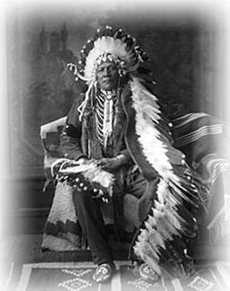
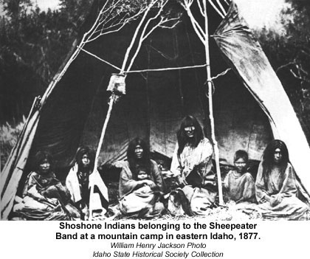
Photos of Idaho’s Native American Tribes
Pat Tyhee, credit: Idaho Museum of Natural History

Slide 8
The Nez Perce Tribe
The river region of the Nimi'ipuu, Nez Perce, people allowed them to live a much more secure life than the arid desert allowed to the Bannock & Shoshoni. Because the Nimi'ipuu founded their villages along the banks of the Clearwater, Salmon and Snake River drainage the resources available to them were somewhat easier to gather and hunt. This mountainous region of Idaho has outstanding changes in elevation which causes a diversity of animals and plants to thrive. The Nez Perce had to migrate seasonally to gather and hunt food, but the relative plenitude of the resources encouraged these people to live and associate with settled villages during much of the year.

Slide 9
The Nez Perce Tribe
Local villages usually had populations from 30 to 200 individuals, which permitted the Nimi'ipuu to develop into the largest population in Idaho before settlement by land hungry pioneers.
This living area, based on a riverine system, allowed the Nimi'ipuu a diversity of resources not easily had by the Shoshoni & Bannock to the south. The men hunted large game animals which lived in the mountains bordering the rivers and small game such as rabbit, squirrel and marmot which lived in the neighboring valleys. Game birds were also common in this area of river drainage. Ducks, geese and grouse would have been available as food.

Slide 10
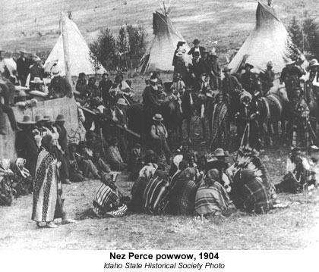
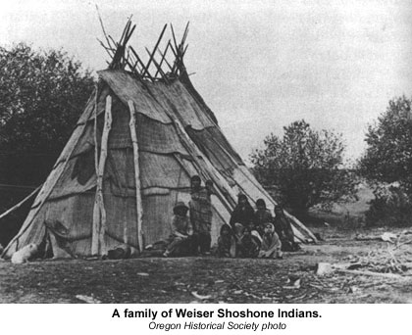
Photos of Idaho’s Native American Tribes

Slide 11
Information is from:
http://www.native-languages.org/idaho.htm
http://www.isc.idaho.gov/kootenai.htm
http://www.cdatribe-nsn.gov/cultural/ancestral.aspx
http://www.shoshonebannocktribes.com/
http://imnh.isu.edu/digitalatlas/geog/native/natvfr.htm
http://imnh.isu.edu/digitalatlas/geog/native/natvfr.htm

