Slide 1
Top 10 Boxing Matches of all time
By: Phillip Sterling, RA, Eastern Illinois University
(with help from Time Mag.)

Slide 2
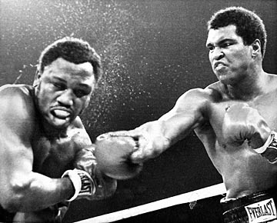
The thrilla in manila
Heavyweight Boxing Championship of the World
Fought at the Araneta Coliseum in Quezon City, Metro Manila, Philippines
October 1, 1975
Ali wins with 14th Round TKO
“The Greatest” Muhammad Ali (Cassius Clay) vs. “Smokin” Joe Frazier III

Slide 3
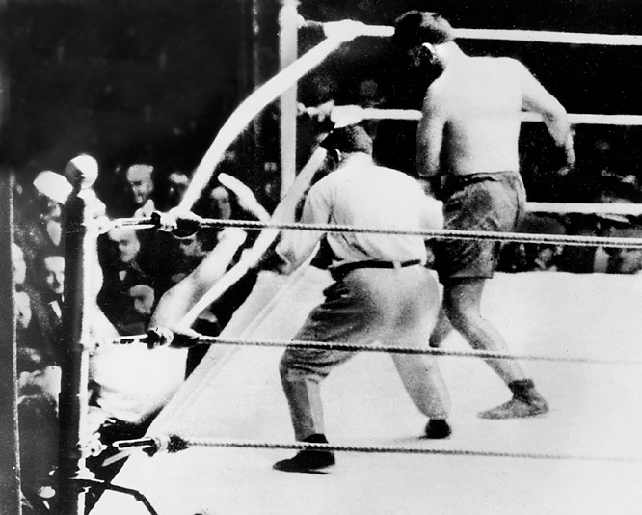
Jack Dempsey vs. Luis Angel Firpo
Heavyweight Boxing Championship of the World
Fought at the Polo Grounds in NYC
September 14, 1923
Dempsey wins with 2nd Round KO
“The Manassa Mauler” Jack Dempsey vs. “El Toro de las Pampas” Luis Angel Firpo

Slide 4
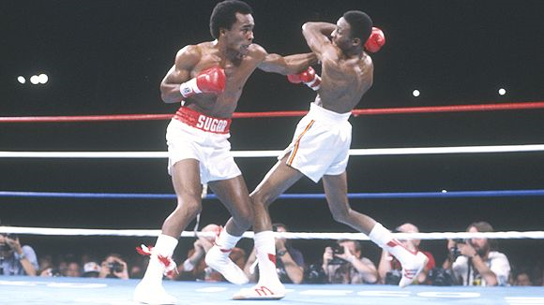
The Showdown
Welterweight Boxing Championship of the World
Fought at Caesars Palace in Las Vegas
September 16, 1981
Sugar Ray wins with 14th Round TKO
“Sugar” Ray Leonard vs. “The Hitman” Thomas Hearns

Slide 5
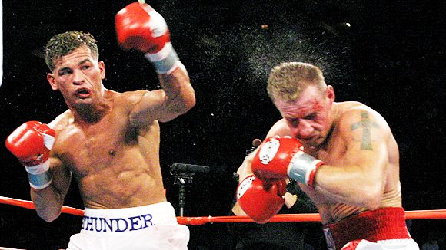
Micky Ward vs Arturo Gatti I
Welterweight Matchup
Fought at Mohegan Sun Casino in Uncasville, Connecticut
May 18, 2002
Ward wins with majority decision
9th Round dubbed “The Round of the Century”
“Irish” Micky Ward vs. “Thunder” Arturo Gatti

Slide 6
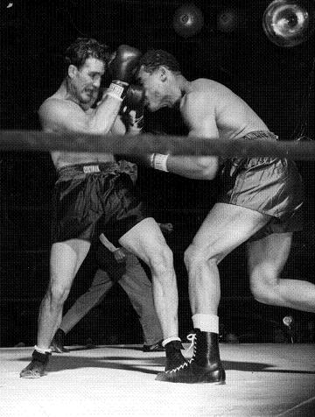
Joe Louis vs. Billy Conn
Heavyweight Boxing Championship of the World
Fought at the Polo Grounds in NYC
June 18, 1941
Louis wins with 13th Round KO (by extreme luck)
“Brown Bomber” Joe Louis vs. “The Pittsburg Kid” Billy Conn

Slide 7
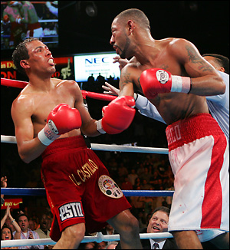
Diego Corrales vs. Jose Luis Castillo
Lightweight Boxing Championship of the World
Fought at Mandalay Bay in Las Vegas
May 7, 2005
Corrales wins with 10th Round TKO
“Chico” Diego Corrales vs. “El Terrible” Jose Luis Castillo

Slide 8
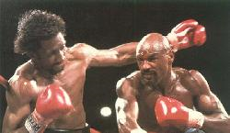
The WAR
Middleweight Boxing Championship of the World
Fought at Caesars Palace in Las Vegas
May 15, 1985
Hagler wins with 3rd Round TKO
“Marvelous” Marvin Hagler vs. “The Hitman” Thomas Hearns

Slide 9
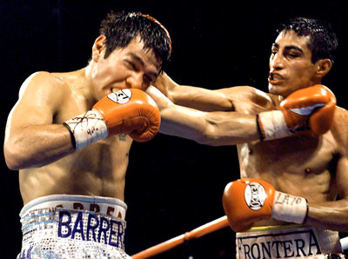
Erik Morales vs. Marco Antonio Barrera I
Super Bantamweight Boxing Championship of the World
Fought at Mandalay Bay in Las Vegas
February 19, 2000
Morales wins with a split decision
“El Terrible” Erik Morales vs. “Baby Faced Assassin” Marco Antonio Barrera

Slide 10
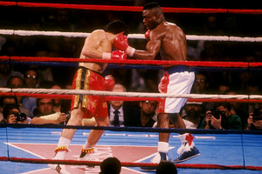
Thunder meets lightning
Junior Welterweight Boxing Championship of the World
Fought at Las Vegas Hilton
March 17, 1990
Chavez wins with 12th Round TKO
“The Great Mexican Champion” Julio Cesar Chavez vs. “TNT” Meldrick Taylor

Slide 11
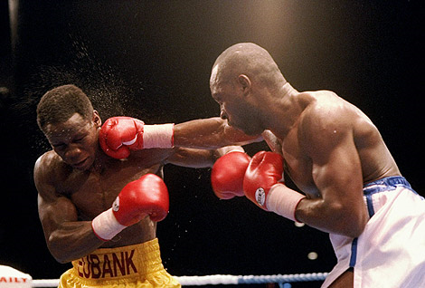
Who’s fooling who
Middleweight Boxing Championship of the World
Fought at Old Trafford in London
November 18, 1990
Eubank wins with 9th Round KO
“Dark Destroyer” Nigel Benn vs. “Simply the Best” Chris Eubank

Slide 12
Boxing Knowledge
KO – Knockout (Occurs when a person is knocked down and cannot stand back up before the count of 10)
TKO – Technical Knockout - (Occurs when the Ref calls the match because of excessive cuts, blood, or when the fighter cannot continue

Slide 13
Boxing Knowledge
Unanimous Decision – All three judges select the same winner
Majority Decision – Two of the three judges agree on a winner and the third judge scores a draw
Split Decision – Two of the Three Judges agree on a winner and the third judge chooses the other contestant

Slide 14
Weight Limit | Class
Unlimited | Heavyweight
200 | Cruiserweight
175 | Light Heavyweight
168 | Super Middleweight
160 | Middleweight
154 | Super Welterweight
147 | Welterweight
140 | Super Lightweight
135 | Lightweight
130 | Super Featherweight
126 | Featherweight
122 | Super Bantamweight
118 | Bantamweight
115 | Super Flyweight
112 | Flyweight
108 | Light Flyweight
105 | Minimumweight

